Slide 1

Bridging Tiers:
How Special Populations Partner with Tier 1 to Drive Student Success

Slide 2
Guiding Principles
All skills align to standards
Shared objective: student success
Balance, high quality strategies, efficiency

Slide 3
Guiding Principle One
We recognize that every skill aligns with a specific standard.
Year One: 2022-2023

Slide 4
YEAR ONE GOALS
Collaborate with Tier 1
Vertically align standards K-5
Incorporate standards into instruction
Year One: 2022-2023

Slide 5
Collaboration: 2022-2023
Quarterly Collaboration Meetings with Tier 1 Data Team Meetings
Year One: 2022-2023

Slide 6
STE Collaboration Meetings
Tier 1 planning time
All stakeholders meet
Struggles, Strategies, Successes
Year One: 2022-2023

Slide 7
STE Data Team Meetings
Submit Student Names
  SLA or ESL data
  Data Points
Person submitting student
speaks first
Team Decision

Slide 8


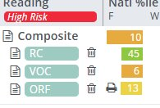


Name:
Grade: 2nd (Teacher's Name)
Subject: ELA​
Current Services: ILPD (Teacher's Name)
Proposed Movement: Continue Services in ILPD, PM Monthly
ELA Data
October 2025
ELA Data ​
August 2025 ​
​

Slide 9
Name: Student A
Grade: 1st Grade (Teacher's Name) ​
Subject: ELA​
Current Services: ESL​
Proposed Movement: Continued Support ​
Summary of Concerns:
ESL Students struggle to blend and include the correct ending when combining word parts.
Notes:
If you are working with three sounds, try switching to two
Model continuous blending (use a visual to show holding out the sound)
Do they have trouble articulating any of the sounds in the word? (use mirror)
Scaffolded approach, I do, we do, you do and if they aren’t able to “you do” yet, continue we do., we do, we do.
Manipulatives (square titles) and push them together.
Backwards blending

Slide 10
PLC Work- Vertical Alignment

Slide 11
Grade 3 Reading
3.RL.KID.1 Ask and answer questions to demonstrate understanding of a text, referring explicitly to the text as a basis for the answers
Year One: 2022-2023

Slide 12
4 | 4.RL.KID.1 Refer to details and examples in a text when explaining what the text says explicitly; refer to details and examples in a text when drawing inferences from the text.
3 | 3.RL.KID.1 Ask and answer questions to demonstrate understanding of a text, referring explicitly to the text as a basis for the answers.
2 | 2.RL.KID.1 Ask and answer such questions as who, what, where, when, why, and how to demonstrate understanding of key details in a text.
1 | 1.RL.KID.1 Ask and answer questions about key details in a text.
K | K.RL.KID.1 With prompting and support, ask and answer questions about key details in a text.
from TN ELA Standards (p. 28)

Slide 13
Vertical Alignment by Standard Standard 3.RL.KID.1
4.RL.KID.1 | Drawing inferences from the text
3.RL.KID.1 | Refer explicitly to the text as a basis for answers
2.RL.KID.1 | Answer the five W questions
1.RL.KID.1 | Ask and answer questions
Year One: 2022-2023

Slide 14
Grade 3 Math
3.OA.A.1 Interpret the factors and products in whole number multiplication equations (e.g., 4 x 7 is 4 groups of 7 objects with a total of 28 objects or 4 strings measuring 7 inches each with a total length of 28 inches).
Year One: 2022-2023

Slide 15
4 | 4.OA.A.1 Interpret a multiplication equation as a comparison (e.g., interpret 35 = 5 x 7 as a statement that 35 is 5 times as many as 7 and 7 times as much as 5).
3 | 3.OA.A.1 Interpret the factors and products in whole number multiplication equations (e.g., 4 x 7 is 4 groups of 7 objects with a total of 28 objects or 4 strings measuring 7 inches each with a total length of 28 inches).
2 | 2.OA.A.1 Add and subtract within 100 to solve one- and two-step contextual problems, with unknowns in all positions, involving situations of add to, take from, put together/take apart, and compare. Use objects, drawings, and equations with a symbol for the unknown number to represent the problem.
1 | 1.OA.A.1 Add and subtract within 20 to solve contextual problems, with unknowns in all positions, involving situations of add to, take from, put together/take apart, and compare.
K | K.OA.A.1 Represent addition and subtraction with objects, fingers, drawings, acting out situations, verbal explanations, expressions, or equations.
from TN Math Standards

Slide 16
Vertical Alignment by Skill Standard 3.0A.A.1
4.OA.A.1 | Multiplicative Comparison
3.OA.A.1 | Whole number multiplication
2.OA.C.4 | Repeated addition with arrays
1.NBT.A.1 | Skip counting to 120 by ones, twos, and fives
Year One: 2022-2023

Slide 17
Guiding Principle Two
We will work together toward a shared objective: student success.
Year Two: 2023-2024

Slide 18
Year TWO Goals
Include Sped team in PLC
Give Form B CFA assessments
Year Two: 2023-2024

Slide 19
Collaboration: 2023-2024
Quarterly Collaboration Meetings with Tier Data Team Meetings
Common PLC Time (Sped/Intervention)
Year Two: 2023-2024

Slide 20
STE PLC Discussions
Monthly Meetings
Intervention & Sped
  Grade Level Standards
  Instructional Strategies
  Common Data Discussions
Year Two: 2023-2024

Slide 21
A note about Form B assessments…
Year Two: 2023-2024

Slide 22
2023 – 2024 Qualitative Data
Year Two: 2023-2024

Slide 23
Year THREE Goals
Include ESL team in PLC
Give Form B CFA assessments
Use Tier 1 as an alignment resource
Year Three: 2024-2025

Slide 24
Collaboration: 2024-2025
Quarterly Collaboration Meetings with Tier 1 Data Team Meetings
Common PLC Time (Sped/Intervention/ESL)
Quarterly Alignment Meetings
Year Three: 2024-2025

Slide 25
Alignment Meetings
Quarterly Meetings
  Grade level shares information
    Essential Standards
    Preferred Strategies
    Common Misconceptions
Year Three: 2024-2025

Slide 26
Guiding Principle 3
We prioritize high-impact strategies to address learning gaps while maintaining balanced, standards-based instruction and making efficient use of our limited time.

Slide 27
Year FOUR Goals
Modify data collection/analysis
Make collaboration more efficient
Further align tiered instruction
Year Four: 2025-2026

Slide 28
Collaboration: 2025-2026
Collaboration Request Form
Data Team Meetings
Common PLC Time (Sped/Intervention/ESL)
Quarterly Alignment Meetings
Year Four: 2025-2026

Slide 29
Collaboration Meetings
Grade level teachers submit
STE Collaboration Request Form
Special pops attends PLC to discuss students
Year Four: 2025-2026

Slide 30
Alignment Meetings
Quarterly Meetings
  Grade level teachers
    Standards, Strategies, Misconceptions
  Special populations teachers
    Implementation Plan
Year Four: 2025-2026

Slide 31
How can special populations maximize limited teaching time to incorporate skills, standards, AND student needs?
Year Four: 2025-2026

Slide 32
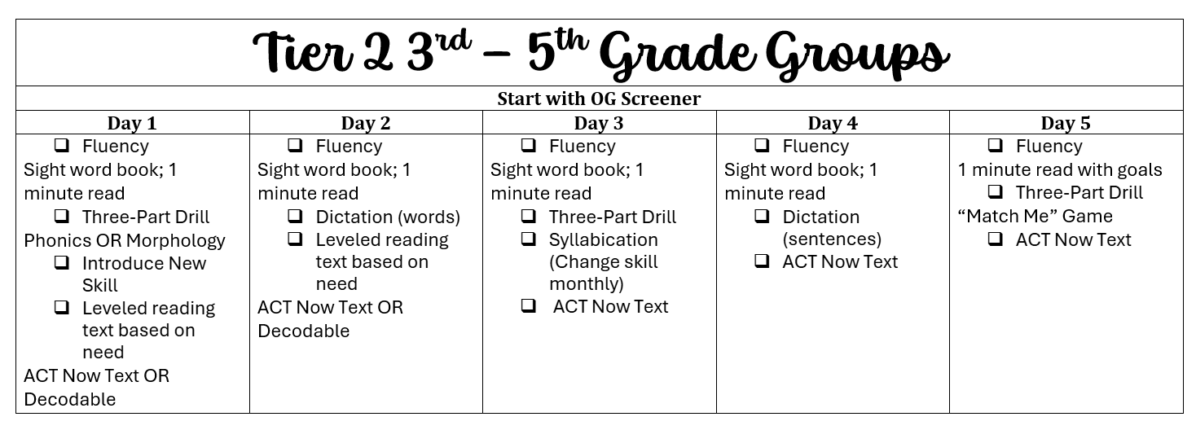
STE RTI Guides
Year Four: 2025-2026

Slide 33
Deciding Factors
More important → daily components
Less important → a few times per week
Most important → balance
Year Four: 2025-2026

Slide 34
Grade Level Lesson Plans for RTI
    Common plans
    Divide responsibilities
    Alignment meeting notes drive instruction
Year Four: 2025-2026

Slide 35
Common Assessments
    Semester One
      Continue form b
      Positives and negatives
    Semester Two- Shift
      Universal Screeners
      Benchmarks
Year Four: 2025-2026

Slide 36
Bridging Tiers Timeline
Year One
  Special Population 1
  Vertical Alignment
  Collaboration Plan
Year Two
  Add Special Population 2
  Common Assessment/Analysis
Year Three
  Add Special Population 3

Slide 37
Reminders
Find the catalyst
Collaborate with Tier 1
Flexibility is key

Slide 38

Contact Information
Dr. Lisa Snider
sniderl@rcschools.net
Ms. McKinsie Rutherford
rutherfordm@rcschools.net

