Slide 1

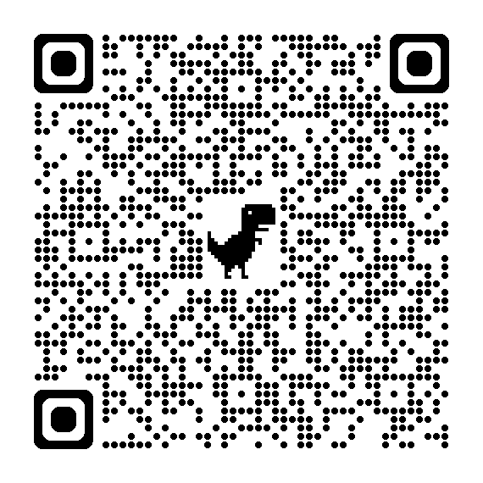
Putnam County’s Approach to AI:
Empowering Classrooms, Safeguarding Privacy, and Preparing Future-Ready Students
Navigating the digital landscape with confidence and creativity.
gavel
Legal Framework 2026
https://go.pcsstn.org/ai-approach

Slide 2


Slide 3
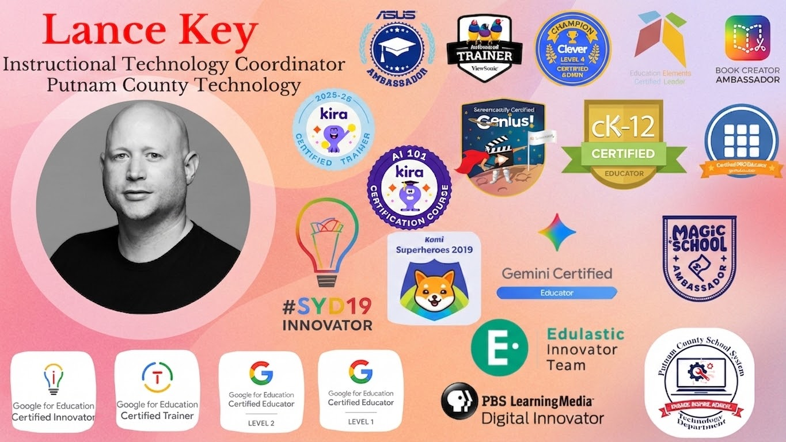

Slide 4


Slide 5
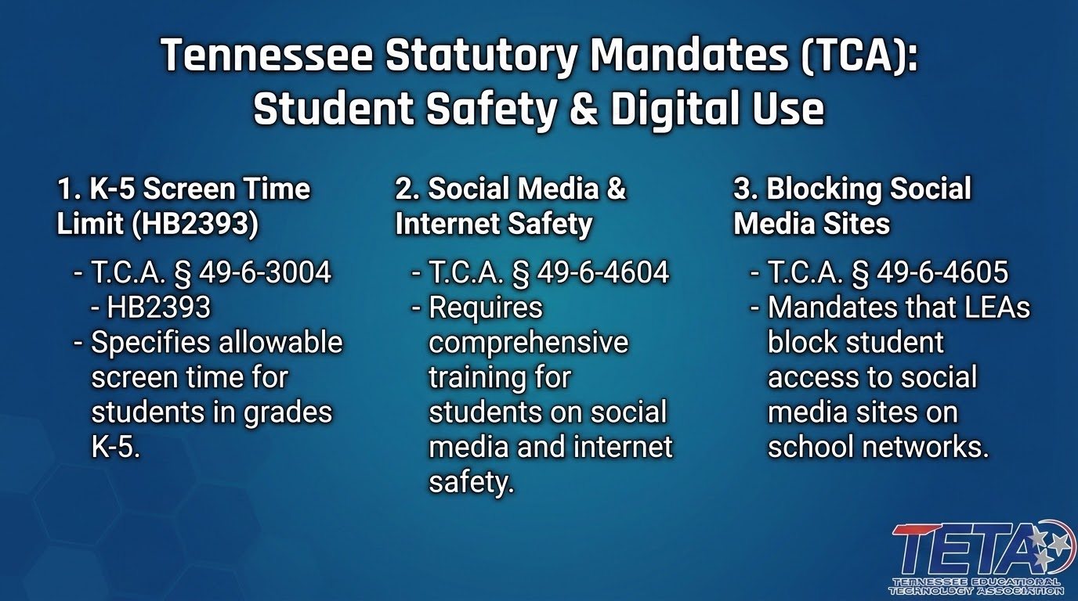
TCA § 49-6-3004 - HB2393
  Screen Time (K-5)
TCA § 49-6-4604
  Social Media & Internet Safety Training
TCA § 49-6-4605
  Block students on school networks from accessing Social Media Sites.

Slide 6

What’s Your Plan for TN’s New Law?
TEEN
INTERNET
SAFETY
SOCIAL
MEDIA
TRAINING

Slide 7


OUR DISTRICT’S PLAN
WHITE COUNTY
PUTNAM COUNTY
Grades 6-8
Homeroom Video/Discussion Questions
(Every student, every year)
In-depth Kira Course
(Students take at least once per MS career in CS)
Grades 9-12
Homeroom Video/Discussion Questions
(Every student, every year)
In-depth Kira Course
(All Freshmen in CS)

Slide 8
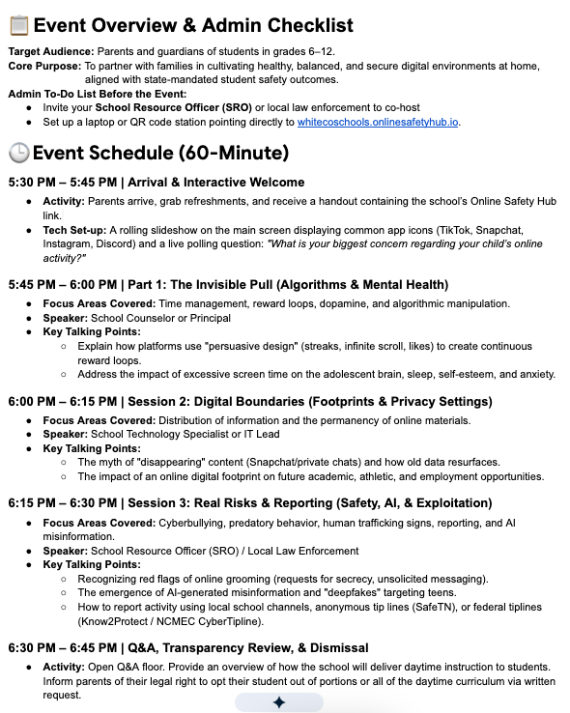

Parent Night Resources
We Used Gemini to Help Us Create A Parent Night
Feel free to make copies and make it yours

Slide 9
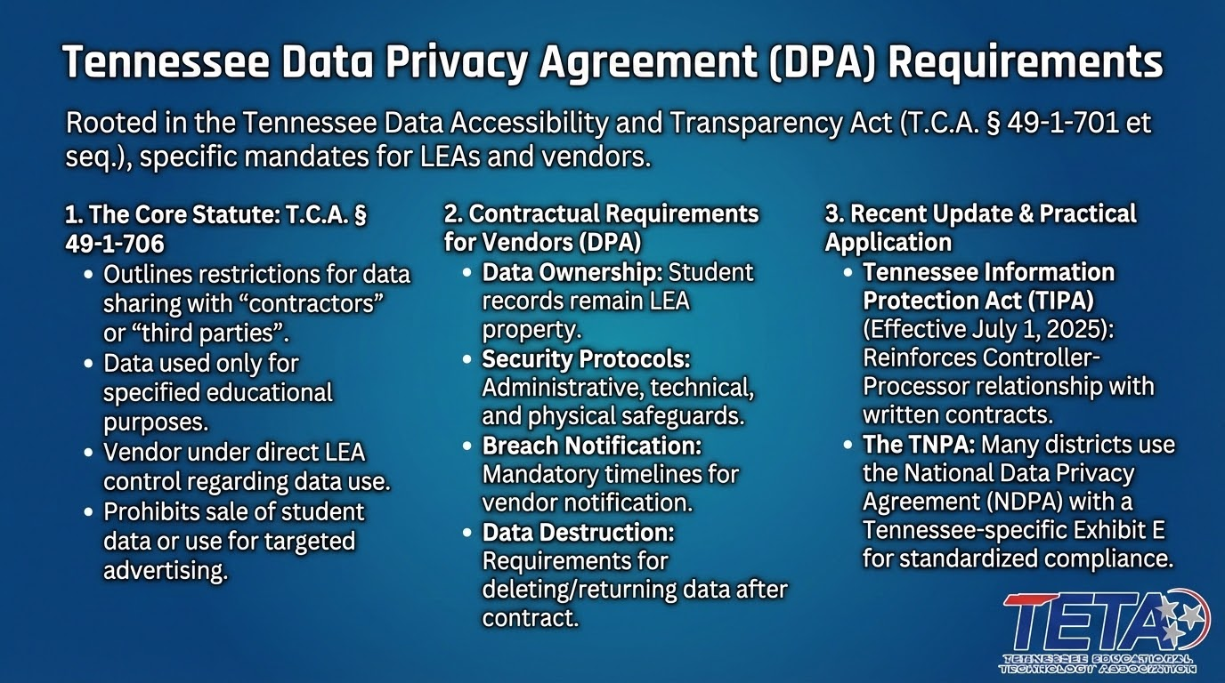

Slide 10

Putnam County’s Approval Process
assignment
1. Teacher Request
Teacher requests digital tool via Google Form.
security
2. Privacy Check
Technology checks if the vendor will sign a Data Privacy Agreement (DPA).
fact_check
3. Supervision Review
Curriculum Supervisor approve or deny based on HQIM support, district goals, and budget constraints.
verified_user
4. Final Process
If approved, Tech Dept starts securing a DPA through the SDPC.

Slide 11
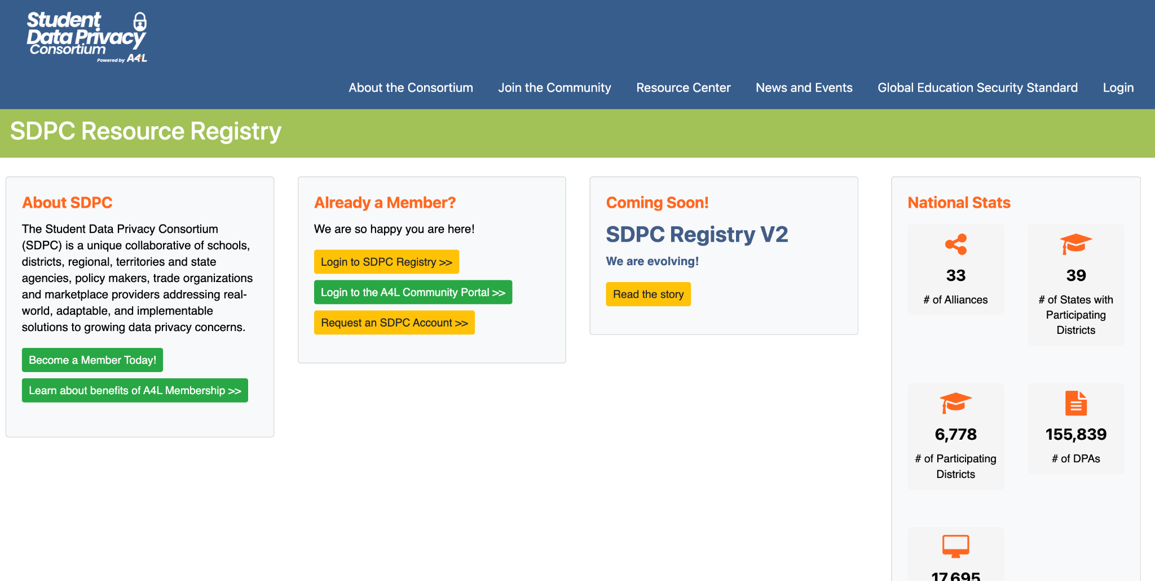
https://sdpc.a4l.org/
PCSS Approved Digital Resources on Website

Slide 12

The Tennessee Educational Technology Association (TETA) is a non-profit organization comprised of professionals committed to promoting the use of educational technology in classrooms throughout the state.
It’s Free to Join

Slide 13


PUTNAM COUNTY SCHOOLS
Building a
Tennessee IPG
Walkthrough
with Google Apps Script

Slide 14

Why Build an IPG Web App?
tablet_android
Digital Walkthroughs
Replace paper forms with a fast, mobile-friendly web interface.
rule
Standardized Data
Ensure consistent rubrics and observation standards across schools.
bolt
Instant Feedback
Share walkthrough insights instantly with teachers to support growth.
dashboard
Live Dashboards
Monitor school and district performance in real-time.
timeline
Historical Trends
Track growth and instructional shifts over weeks, months, or years.
assessment
District Reporting
Easily export and share compliance and progress reports.

Slide 15
Why Google Apps Script?
apps
Google Workspace
Included at no extra cost with your existing Google Workspace account.
storage
Sheets Database
Turn Google Sheets into a powerful, familiar, and accessible database.
mail
Gmail Integration
Automate email notifications and messaging workflows seamlessly.
picture_as_pdf
PDF Generation
Automatically generate documents and export PDFs directly to Drive.
security
Secure Login
Protect data using native, enterprise-grade district credentials.
web
Web Deployment
Build and deploy interactive web applications in minutes.

Slide 16
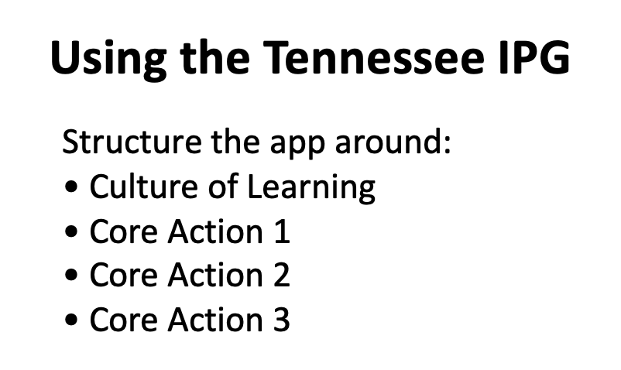
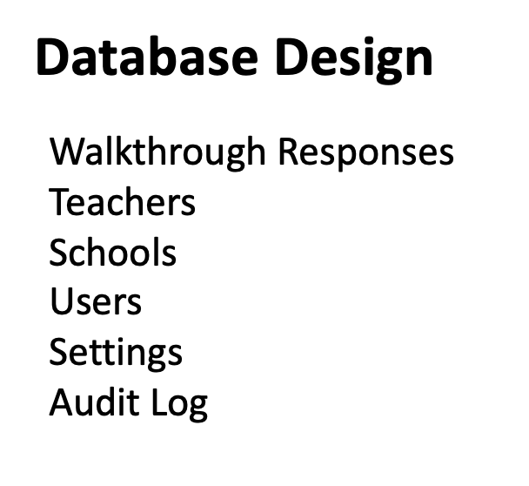
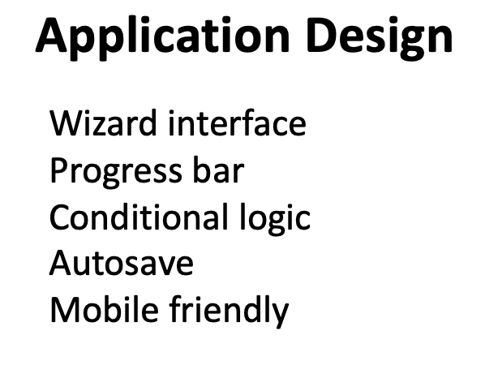
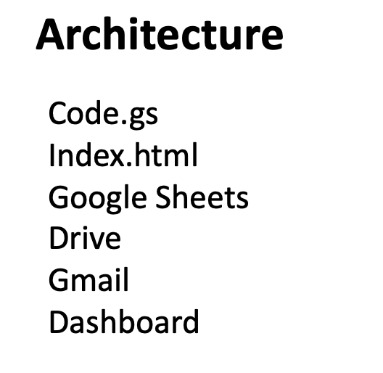

Slide 17
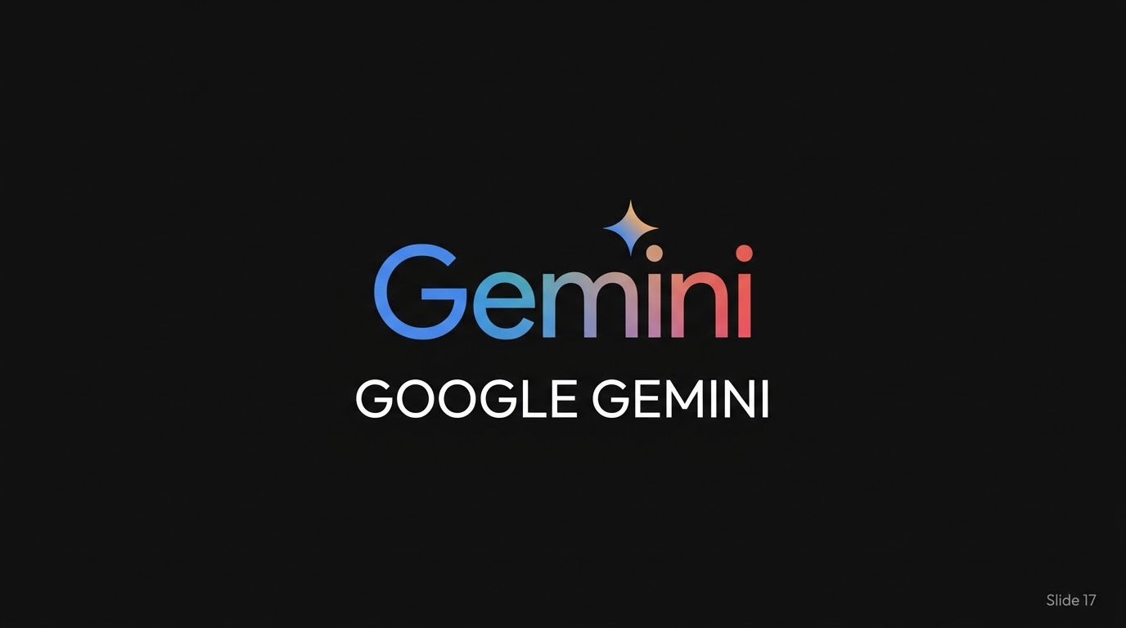

Slide 18
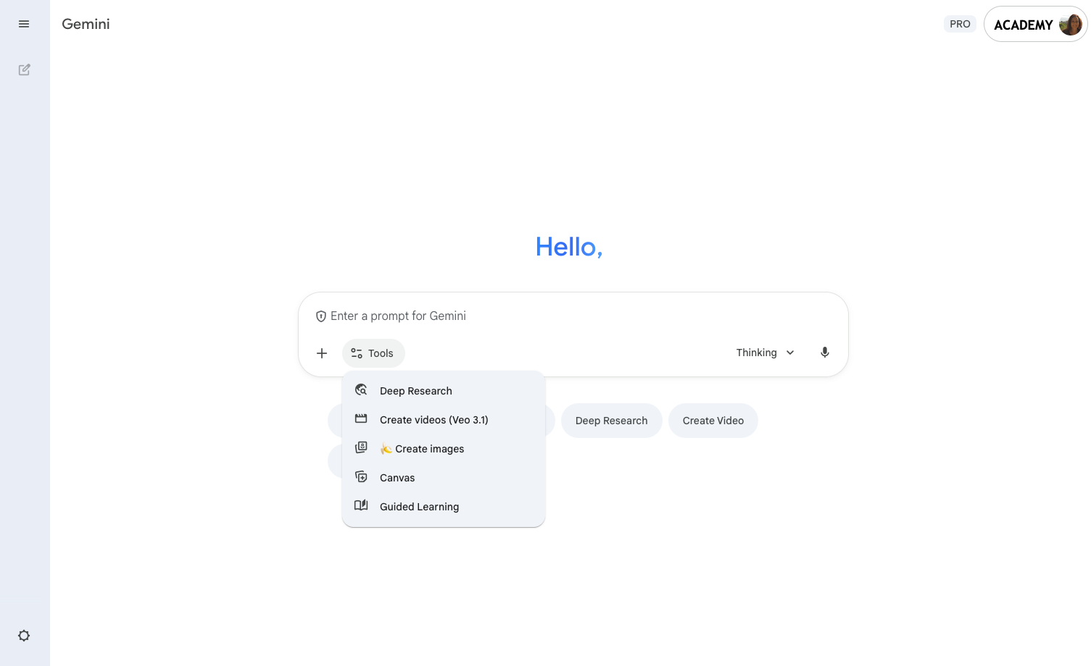
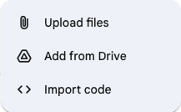
Anatomy of the Gemini app
Start a new chat
Add files to your prompt
Prompt input area
Access Gemini tools
Instead of typing your prompt, speak it!
Note: Google AI Pro accounts get higher access to new and powerful features, including unlocking access to video generation (Veo 3.1).

Slide 19
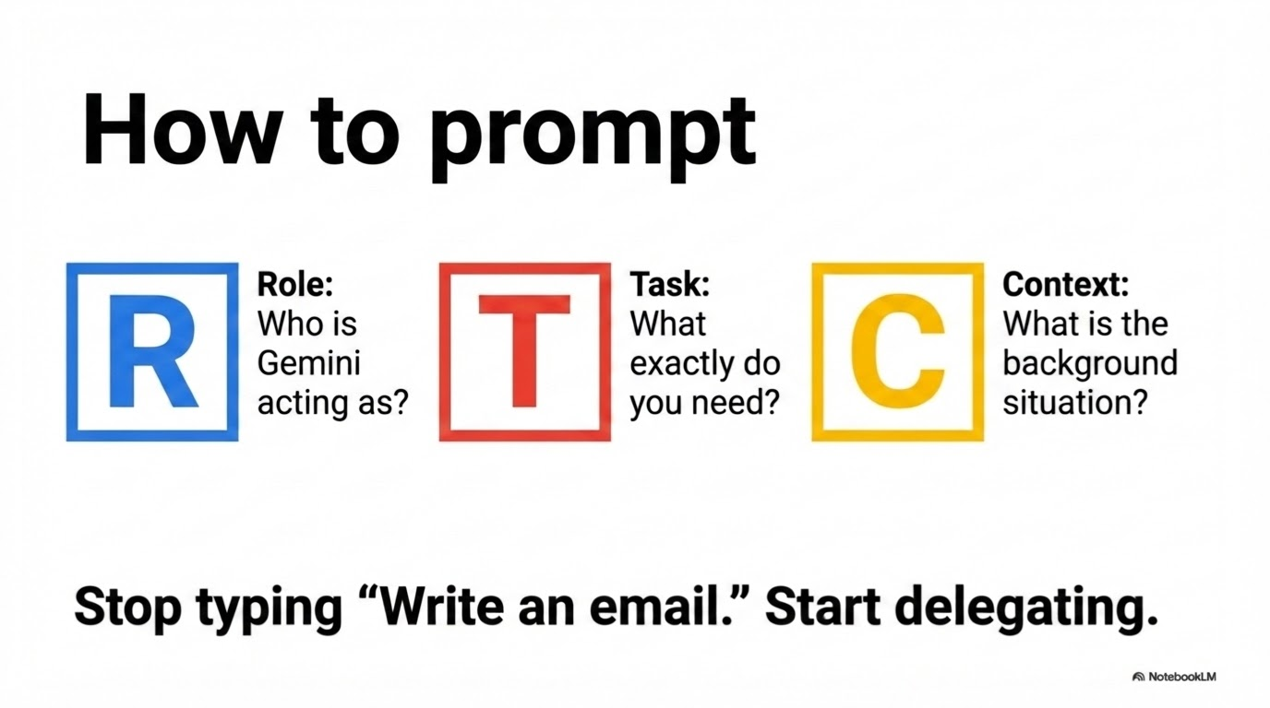

Slide 20

Prompting Framework
Who should it act as? What role will it play? | Act as a 5th grade English teacher
What steps should it take? | Review the document for creative writing prompts to encourage descriptive writing
What tone or format should it have? | Respond in a helpful and encouraging manner
What context or constraints do you need it to know? | Keep responses to a 5th grade reading level
Proprietary + Confidential

Slide 21
Gemini can help your education community achieve more
Who might use Gemini
Instructional leader
IT director
Superintendent
Educator
University student
Get help creating resources and brainstorming ideas to empower educators. | Get help providing secure and innovative technology for students and staff. | Get help streamlining administrative work so you can focus on supporting students and educators. | Get help creating captivating learning experiences, grant writing, and more. | Get always-on academic support to help students on their learning journeys.
Quickly create content, like lesson plan templates, to share across your institution Easily differentiate content that’s tailored to student interests or skill levels Summarize research and share it faster | Get ideas for new security settings to implement Create how-to documentation for a variety of tech and tools Develop schedules for rolling out new policies | Draft job descriptions in seconds Summarize emails and draft responses Create newsletters with custom images Analyze student data quicker | Brainstorm grant ideas and get help writing Create differentiated class exercises and assessments Create personalized feedback faster Bring concepts to life with unique imagery | Deepen understanding with customized practice materials Get initial feedback on work Develop essential career-readiness AI skills
Notes:
So who is Gemini really for within your institution?
Gemini can empower a broad range of people within your [school/district/university], from helping instructional leaders create resources that can scale across your institution, to helping superintendents streamline administrative work so they can focus more on supporting students and educators.
One of the amazing things about Gemini is it’s versatility and breadth of use cases.

Slide 22
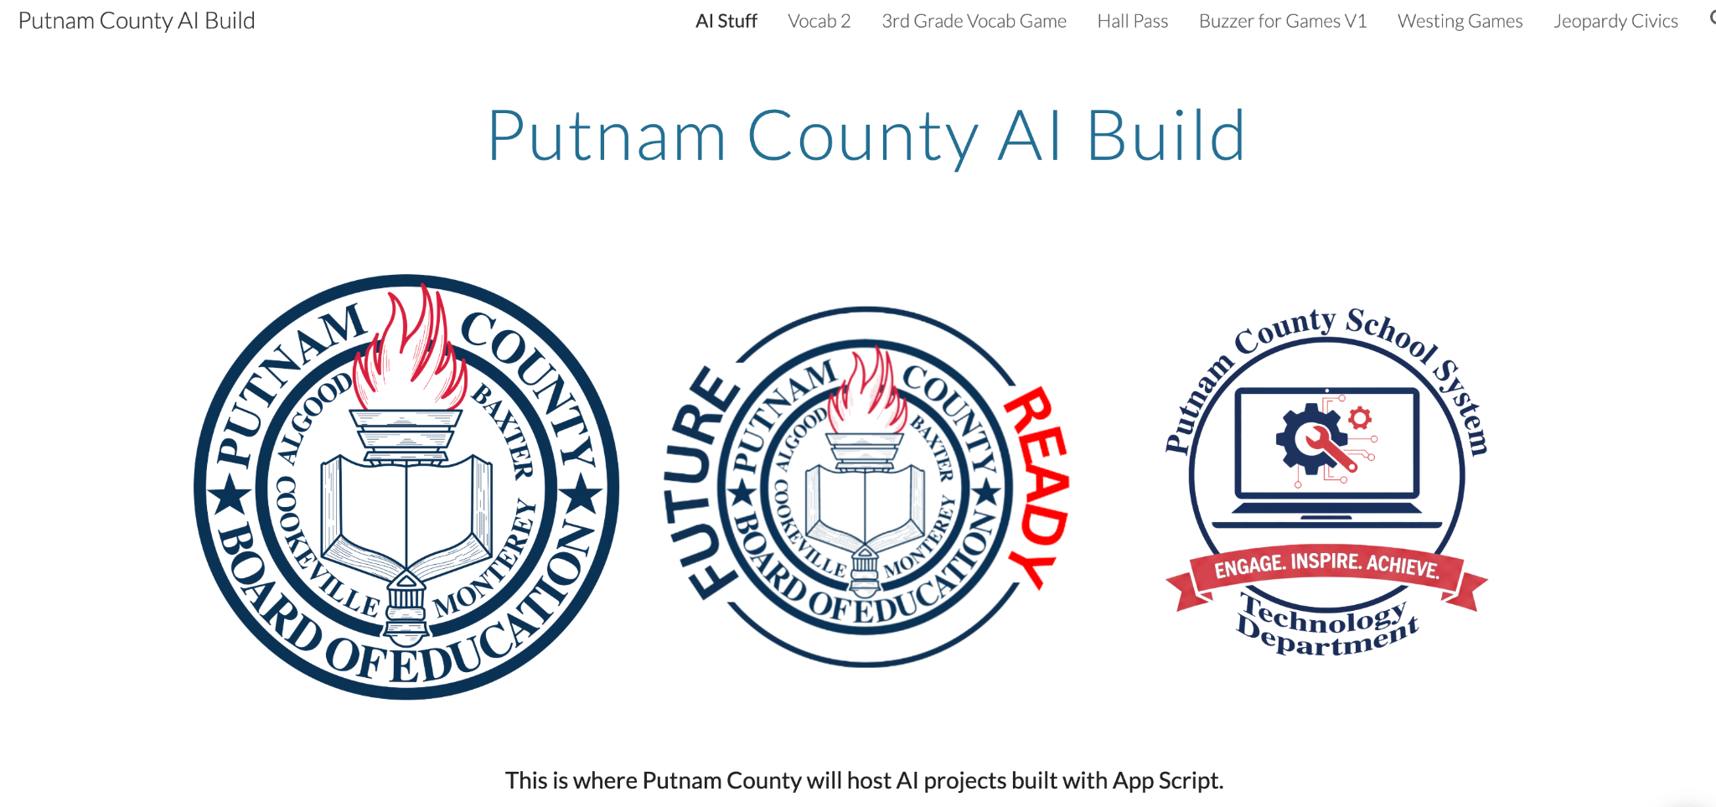
https://sites.google.com/pcsstn.com/aistuff

Slide 23
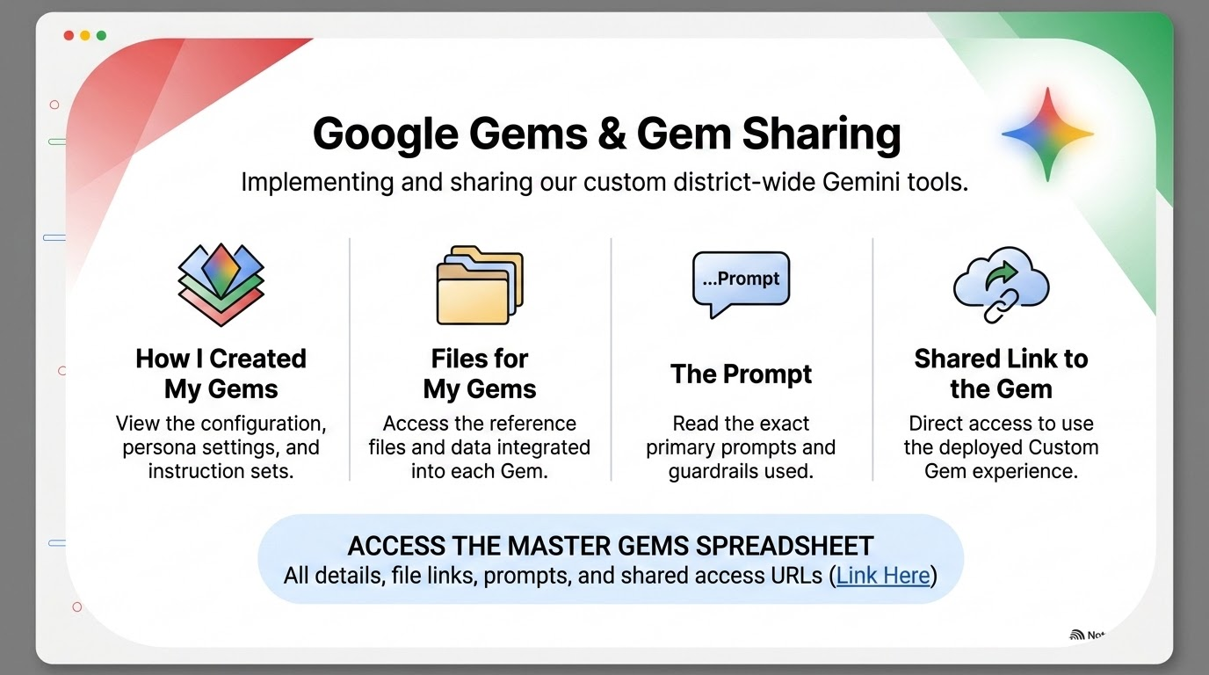

Slide 24
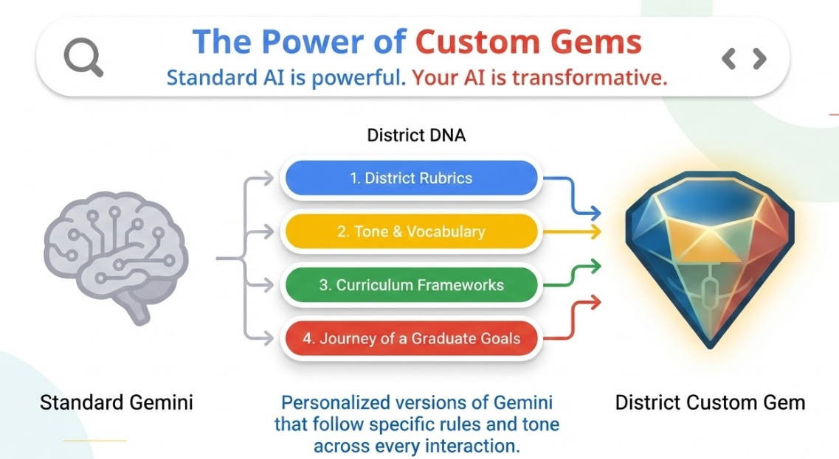

Slide 25
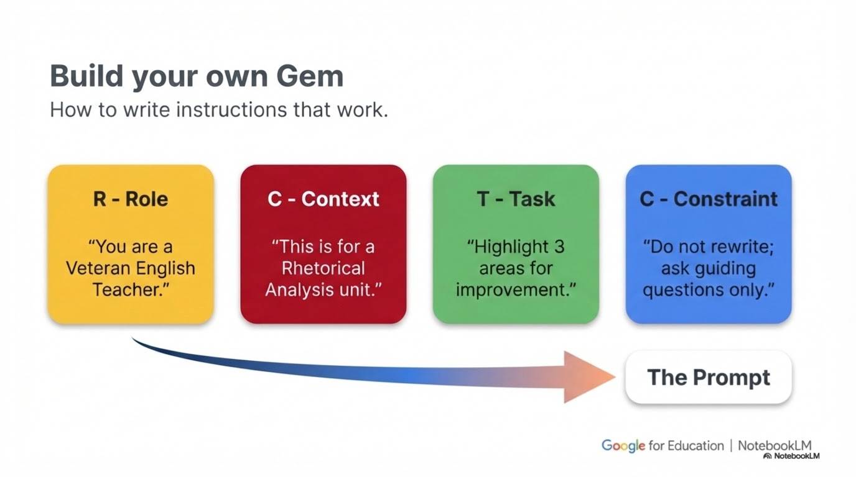

Slide 26
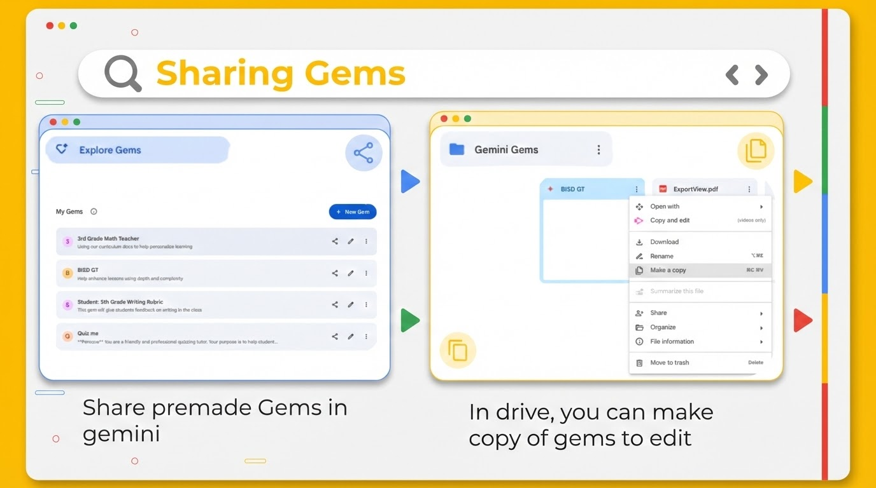

Slide 27
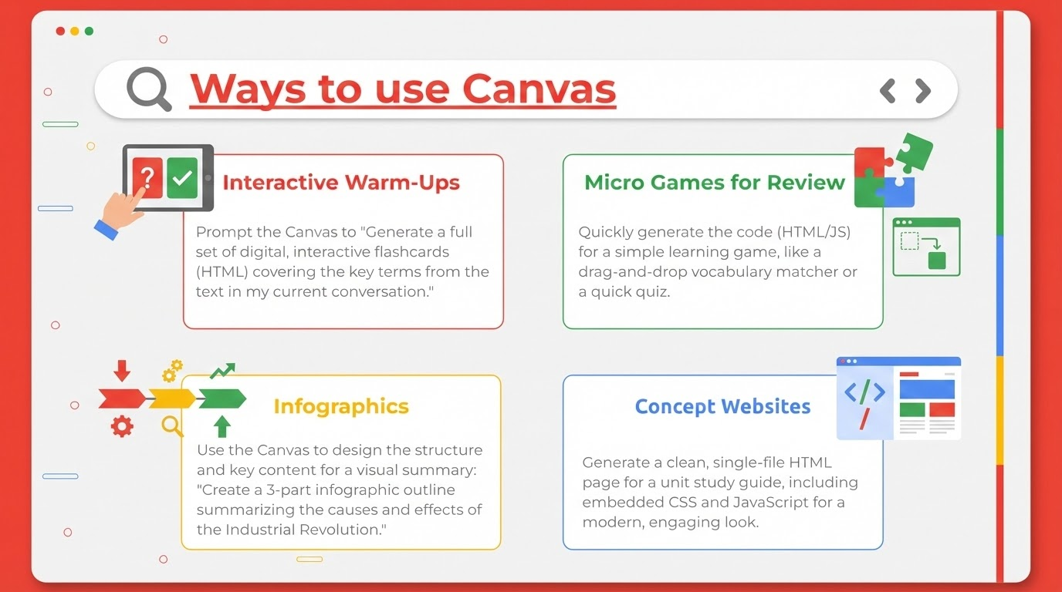

Slide 28
Resources
Lance’s Gems Document
Eric’s Gems Document
https://www.edugems.ai/home

Slide 29

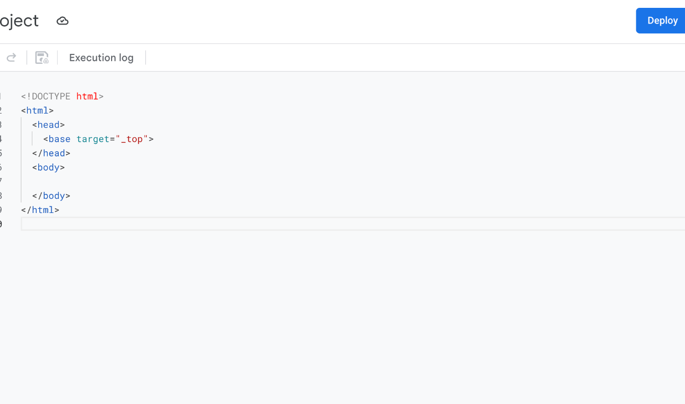

Introduction to Apps Script
script.google.com
Access via Google Sheets
1
Open your Spreadsheet
2
Click Extensions in the top menu
3
Select Apps Script
Proprietary + Confidential

Slide 30
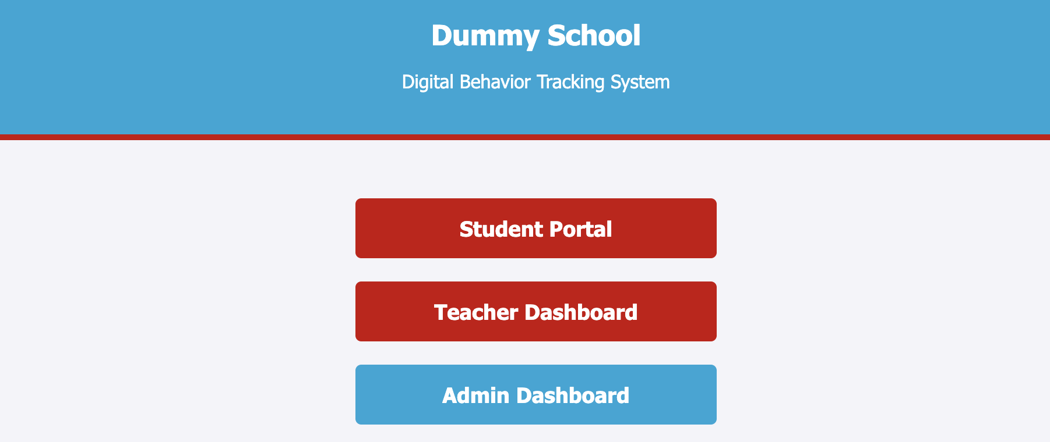
https://go.pcsstn.org/dummy-behavior

Slide 31
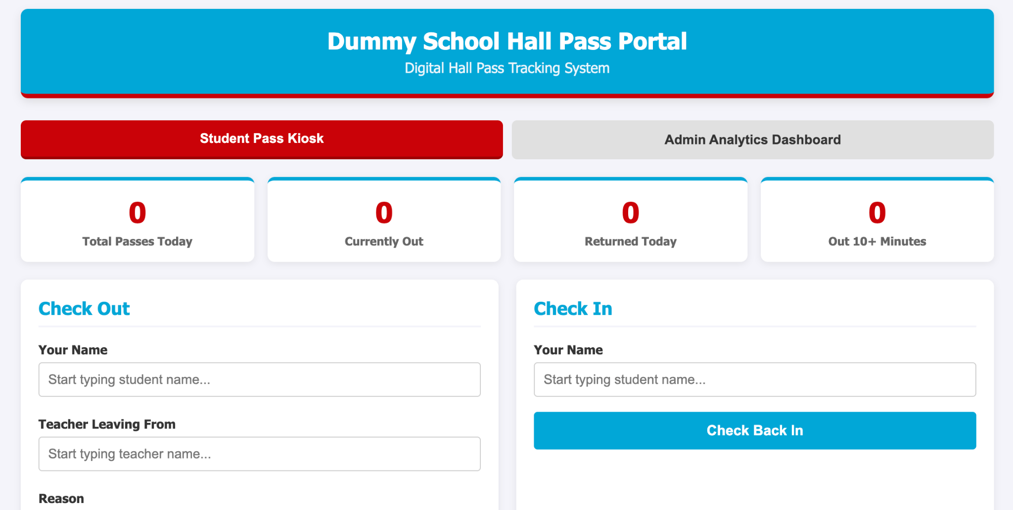
https://go.pcsstn.org/dummy-hallpass

Slide 32

NotebookLM
Overview

Slide 33
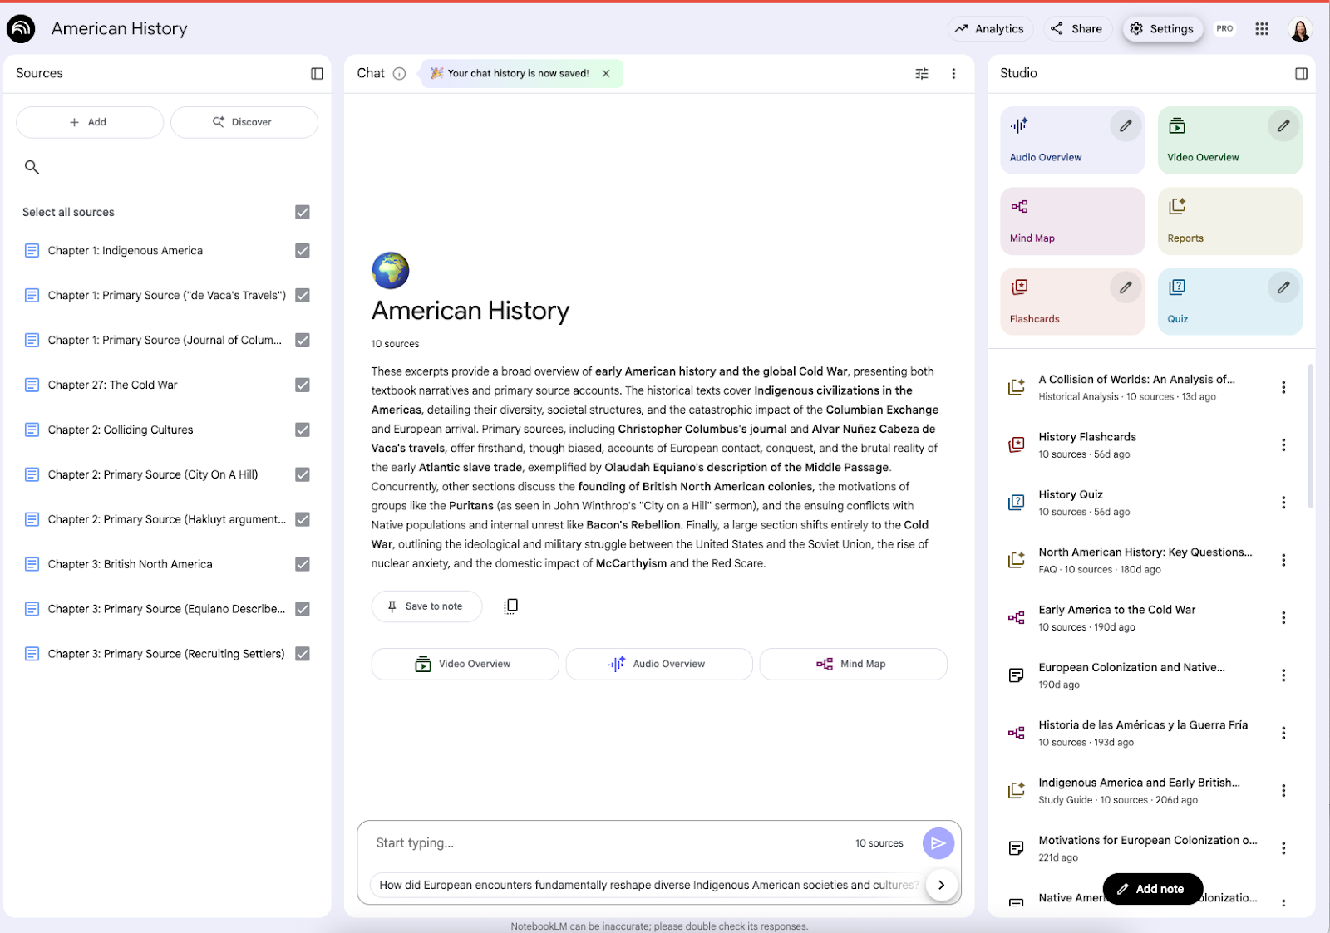
NotebookLM: Your research and thinking partner, grounded in the information you trust
Upload sources (education standards, lecture notes, and course readings) or Discover sources based on a topic of interest
Chat with your sources and NotebookLM will give you grounded information. Grounding helps reduce hallucination and incorrect information
Transform your material into different artifacts, an Audio Overview, a Video Overview, Flashcards, Quizzes and more
NotebookLM is now available to Google Workspace for Education users of all ages
Core Services with enterprise-grade data protection: data isn’t reviewed or used to train AI models

Slide 34
Anatomy of NotebookLM
(Optional) Share your notebook with colleagues or students
Give your notebook a name
Upload your sources
In the Studio panel, generate a podcast-style audio overview, video overview, flashcards and more
Discover new sources (optional)
Check and uncheck sources
Ask questions of your sources

Slide 35
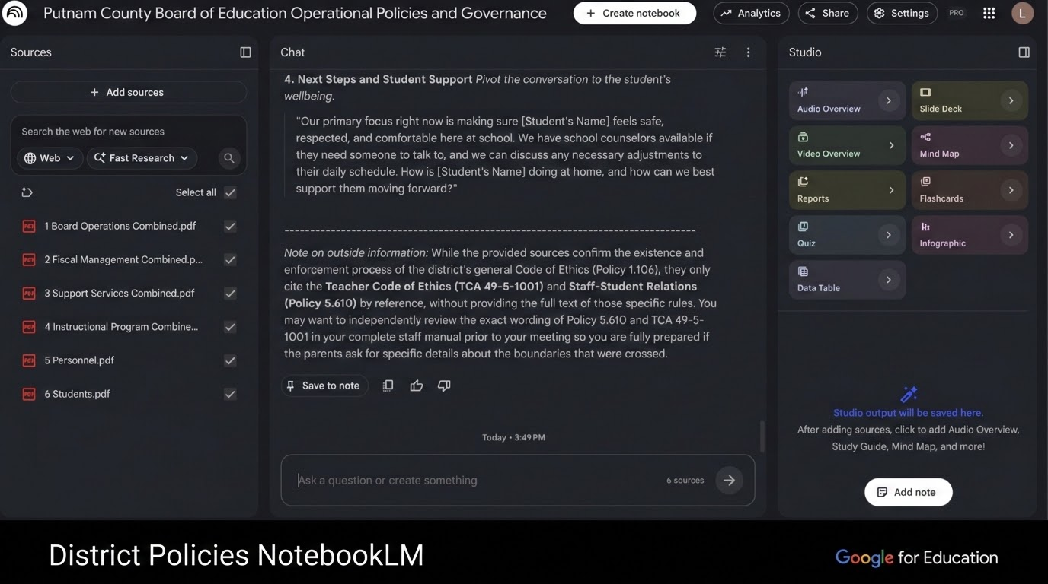

Slide 36
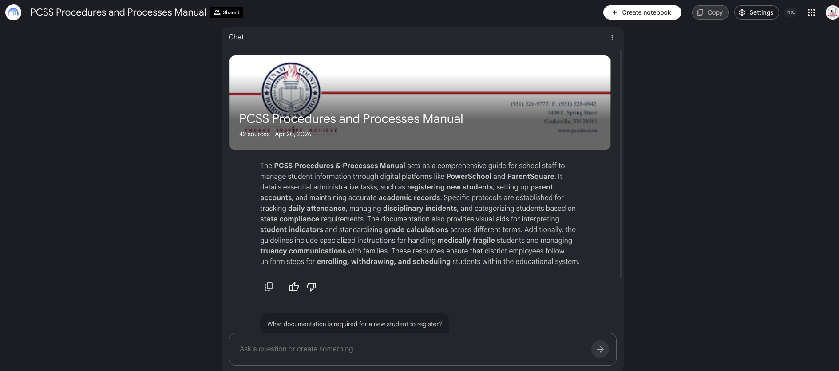

Slide 37
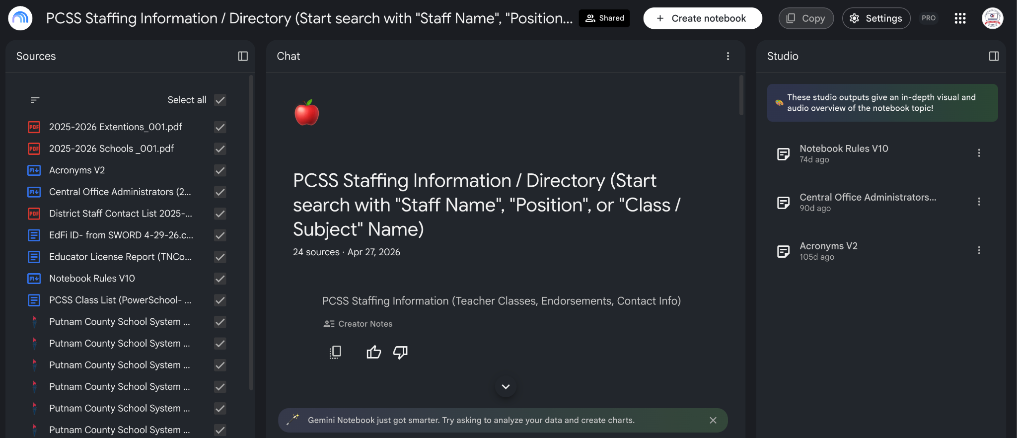

Slide 38
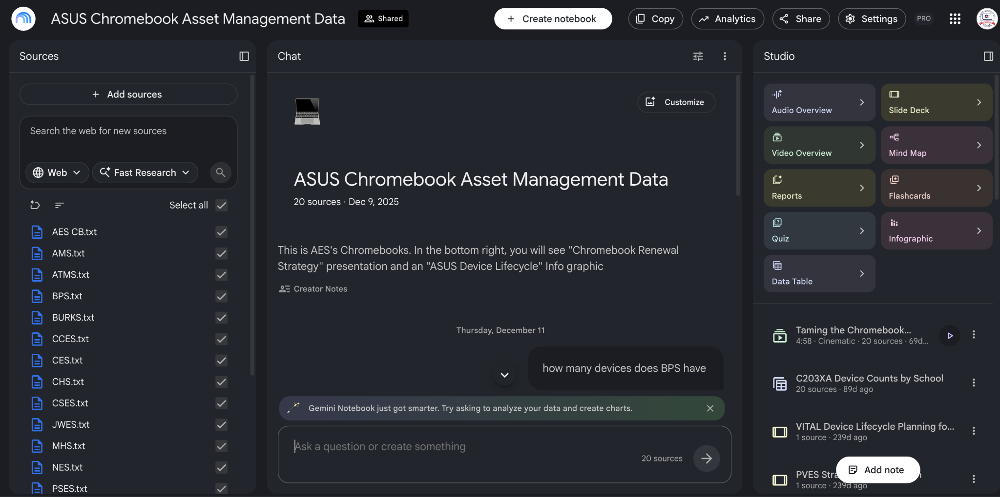

Slide 39
Multimodal Feature: Video Overviews

Slide 40
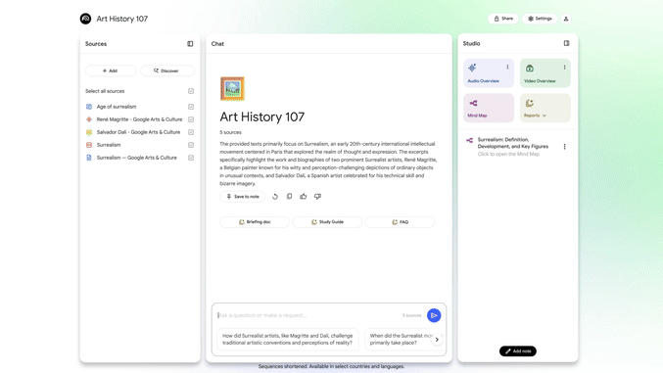

Visual learning through Video Overviews
NotebookLM's Video Overviews transforms your sources into an AI-narrated video, pulling key images, diagrams, quotes, and numbers directly from your documents.
And with the Customize feature, you can guide the hosts to focus on what’s most important to you.
All editions
Available globally (multiple languages)
All ages for EDU

Slide 41
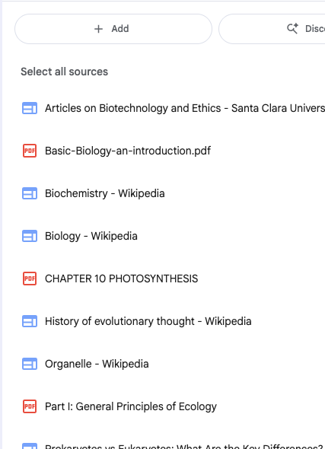
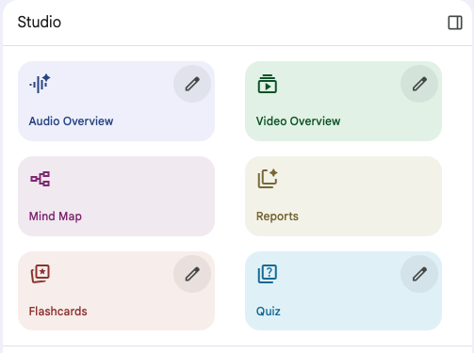
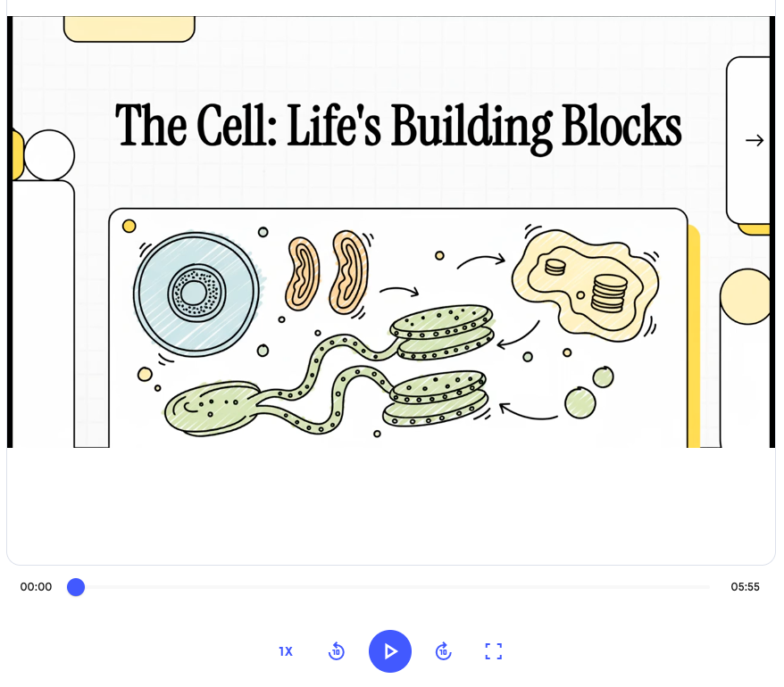
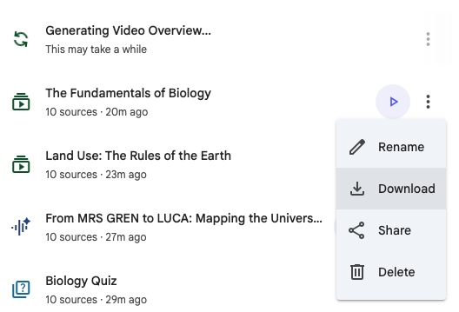
How to generate a Video Overview in NotebookLM
B
D
A
Click on “Video Overview”
You’ll find this option in the Studio panel. When you click the chip, NotebookLM will generate an AI narrated video of your sources.
View, download, or share
Play the video in NotebookLM, download it for later, or share it with students or colleagues.
E
Select your sources
Choose one or more files in your notebook (e.g., lesson plans, student notes, research articles).
View the Video Overview
Watch the video, increase the video speed or the window size.
C
Use “Customize” to guide the focus
Want the video to highlight specific topics or tailor it to a student audience? Use the Customize option to steer tone, audience, or content area.

Slide 42
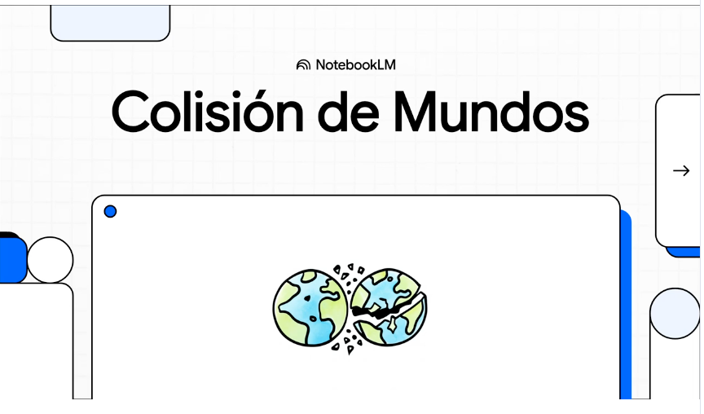

Use Cases
Pro tip
Summary of this week’s class material
Create Video Overviews for the material covered during the week as a review for your students
Video Overviews in different languages
Use the ‘customize’ button to create videos in up to 50+ different languages! Great for multilingual students
Load multiple Video Overviews in your notebook, including multiple ones for different languages

Slide 43
Interactive Features: Quizzes, Flashcards

Slide 44
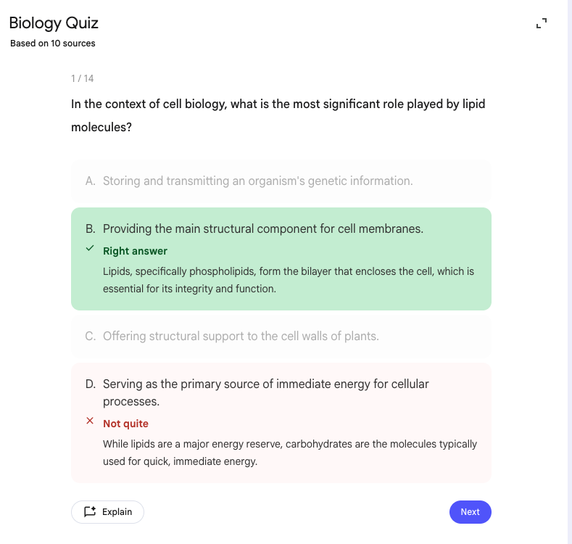
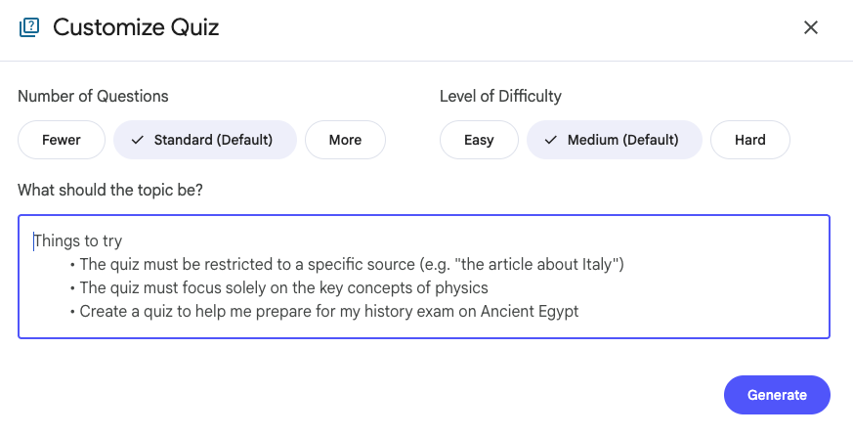
Interactive learning through Quizzes
NotebookLM now turns your documents into interactive quizzes generated in seconds and grounded entirely in your source materials. Ace that test, master a new skill, and share it with anyone with a simple link.
Customize the focus, number of questions and level of difficulty.
All editions
Available globally (multiple languages)
All ages (EDU)

Slide 45
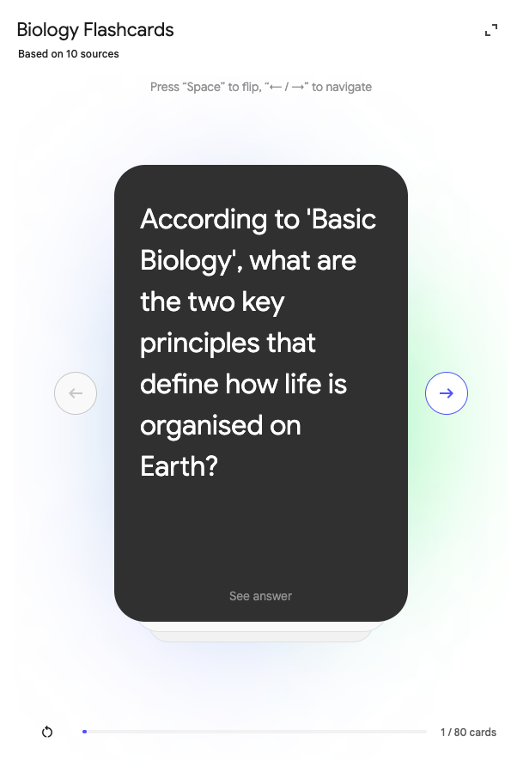
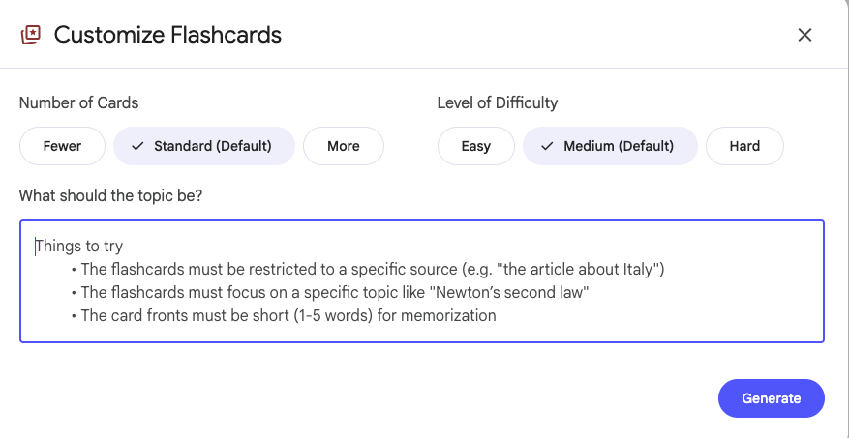
Interactive learning through Flashcards
Turn your sources into interactive flashcards. Encourage power studying for your students.
Customize the focus, number of flashcards and level of difficulty.
All editions
Available globally (multiple languages)
All ages (EDU)

Slide 46
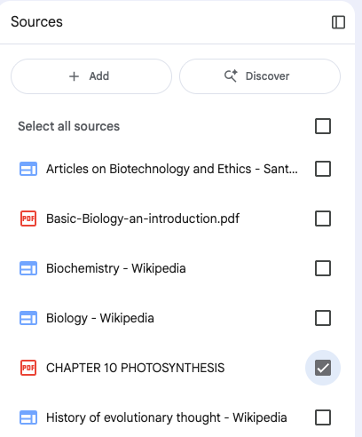
Use Cases
Pro tip
Quizzes & Flashcards for the week’s assignment
Help your students prepare for an upcoming test or assignment by creating Quizzes & Flashcards and sharing it with them
Create Quizzes with different difficulty levels
Use the customization button to create multiple levels of quizzes so students can master the topics gradually
Create different notebooks with resources for the week to create the Quizzes & Flashcards (instead of creating a notebook with the entire semester’s curriculum)
To focus the Quizzes & Flashcards on very specific topics, select the specific source you are interested in (like below)

Slide 47
Learning Guide and Custom Personas

Slide 48
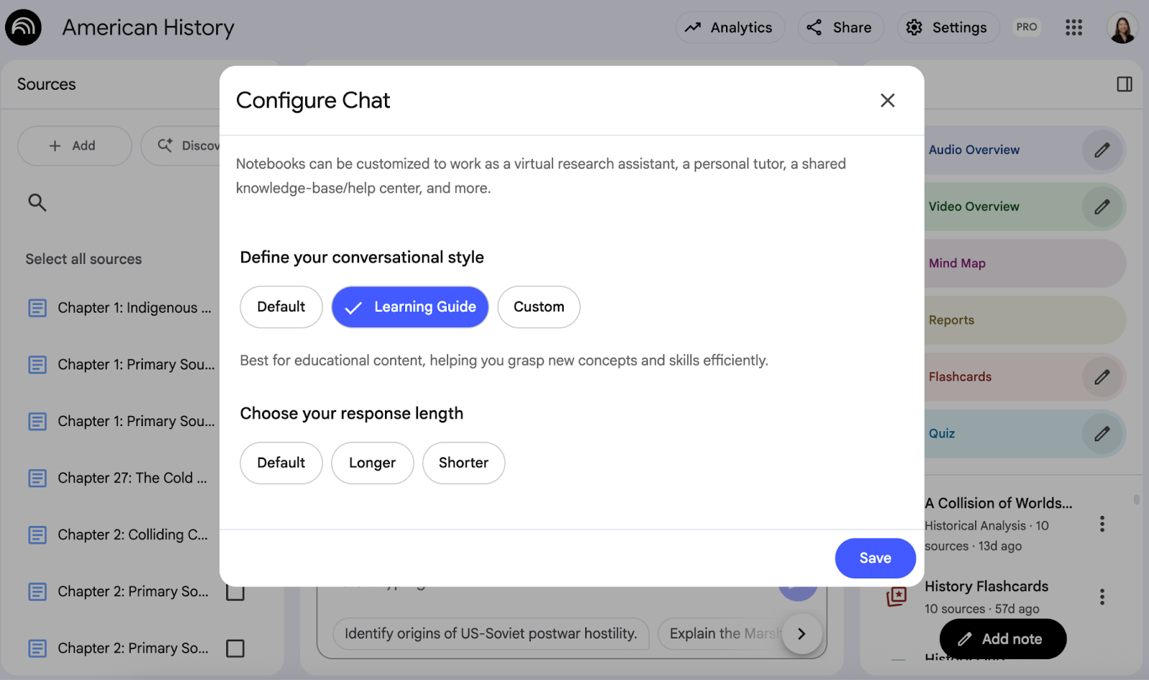
Learning Guide
Go beyond answers and build a deep understanding
✔
We introduced a new configuration: “Learning Guide”, which encourages participation with probing, open-ended questions.
Instead of just giving answers, it helps you break down problems step-by-step and adapts explanations to your needs, building a deeper understanding of the subject.

Slide 49
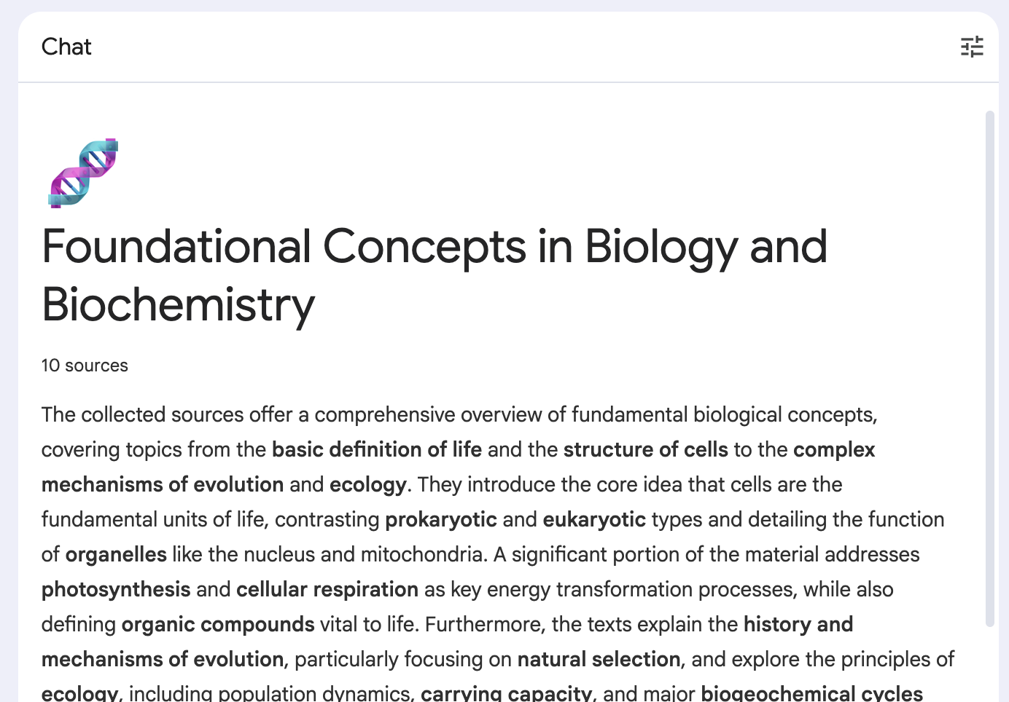
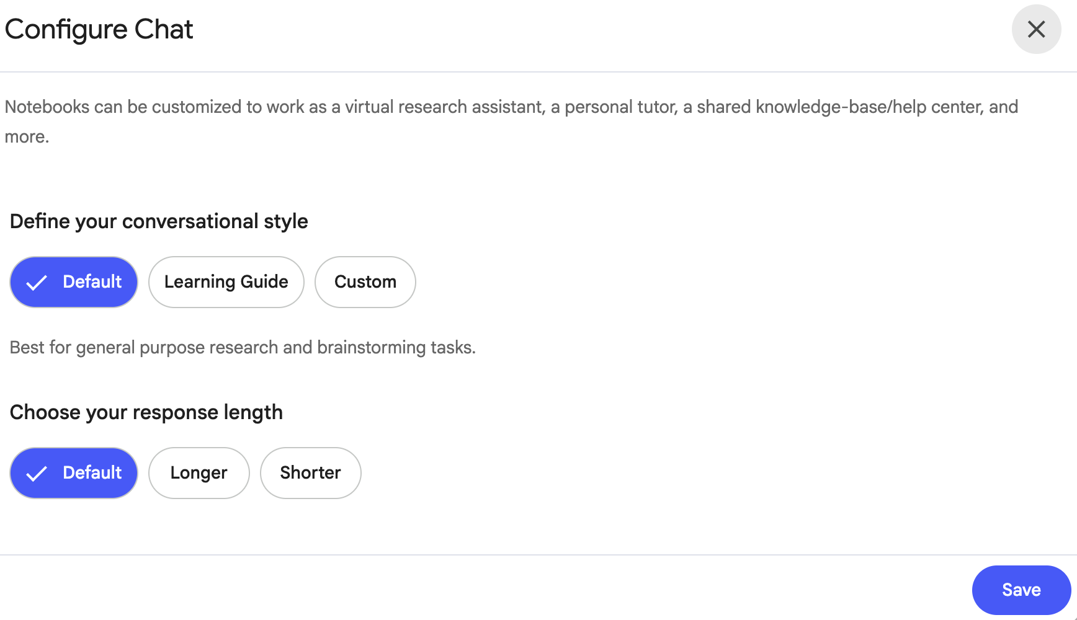
How to use ‘Learning Guide’ in NotebookLM
B
A
B
Click on configure chat button
On the top right of the chat panel, you will find a customization button
Customize the chat
Click on the desired conversational style between: Default, Learning Guide or Custom.
Select the desired response length.

Slide 50
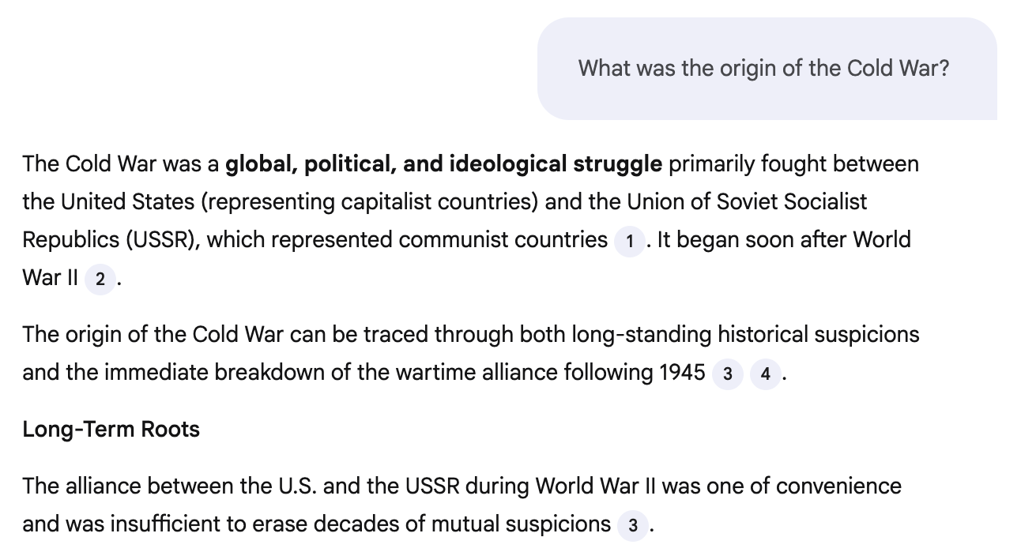
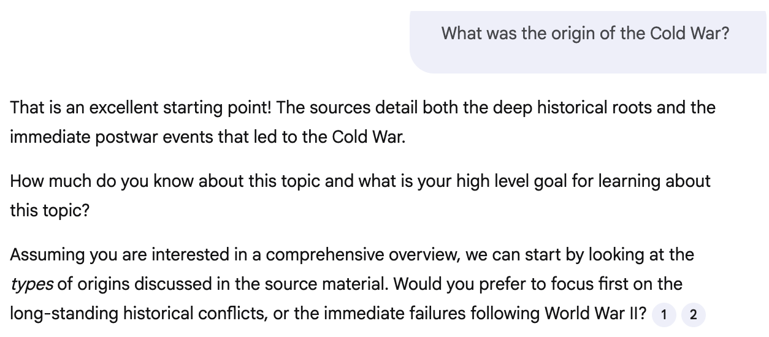
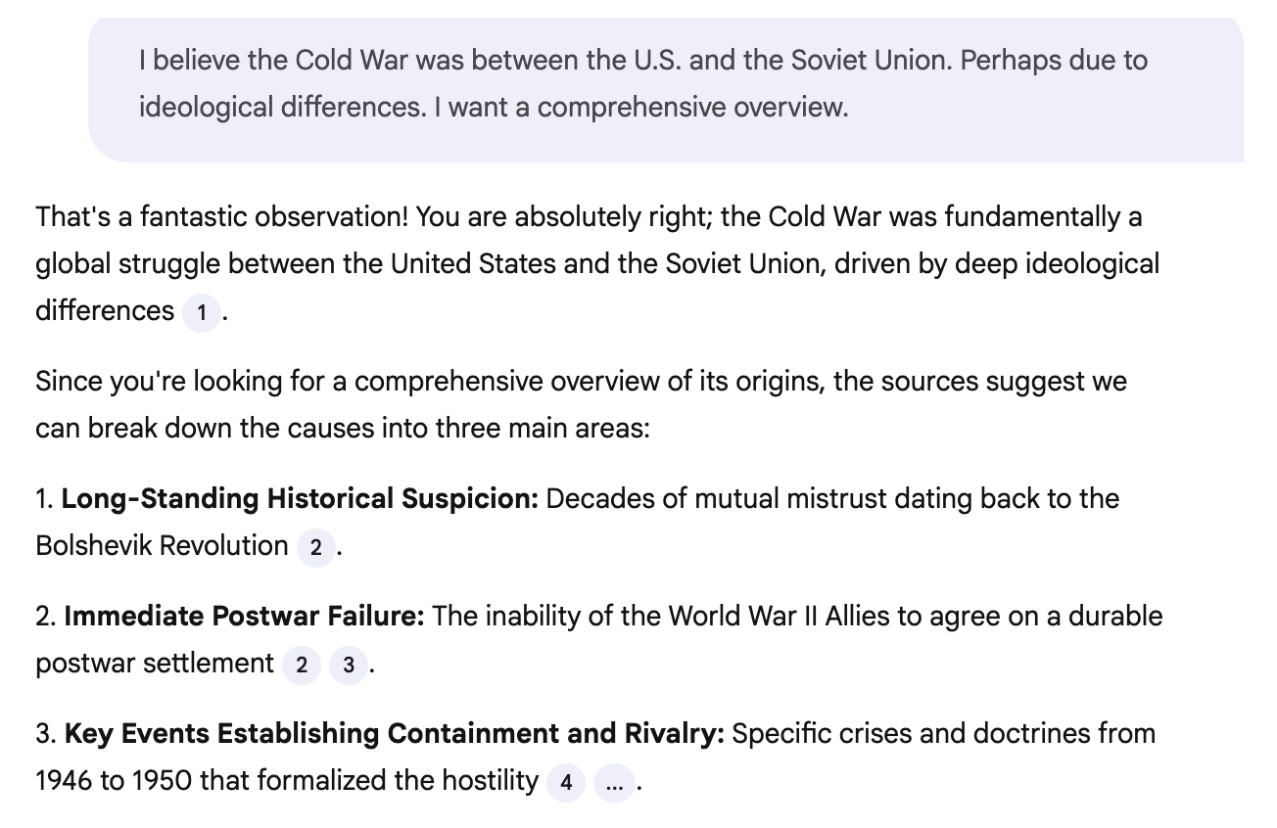
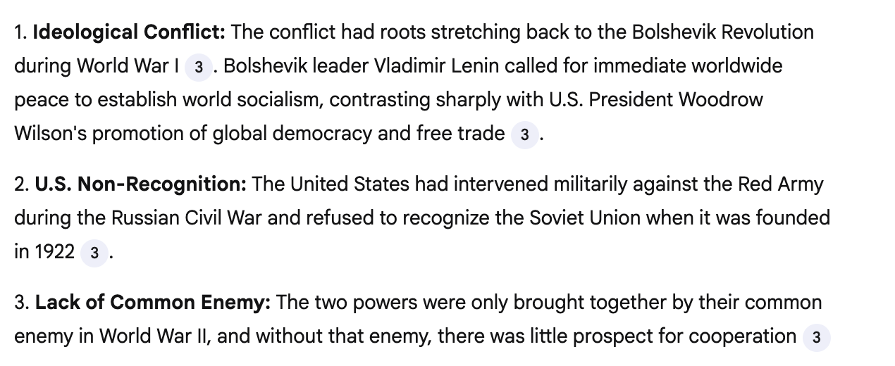
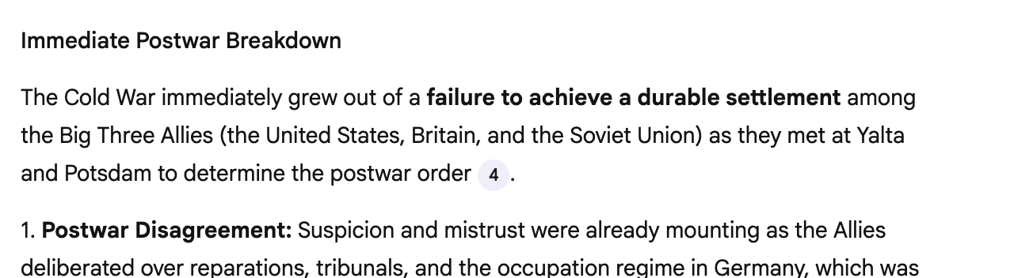
Default Mode
Learning Guide
Enter your prompt in the Gemini chat box

Slide 51
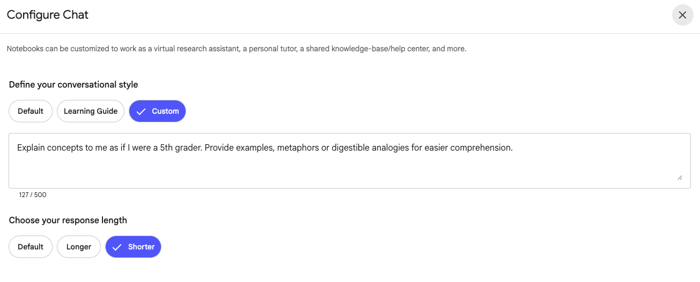
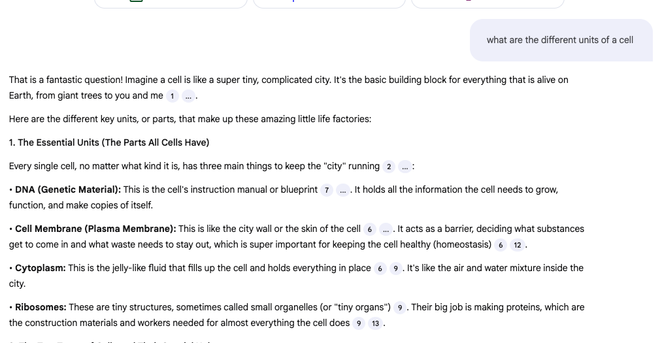
Create custom styles based on your learning or teaching goals
All editions
Available globally
All ages (EDU)

Slide 52
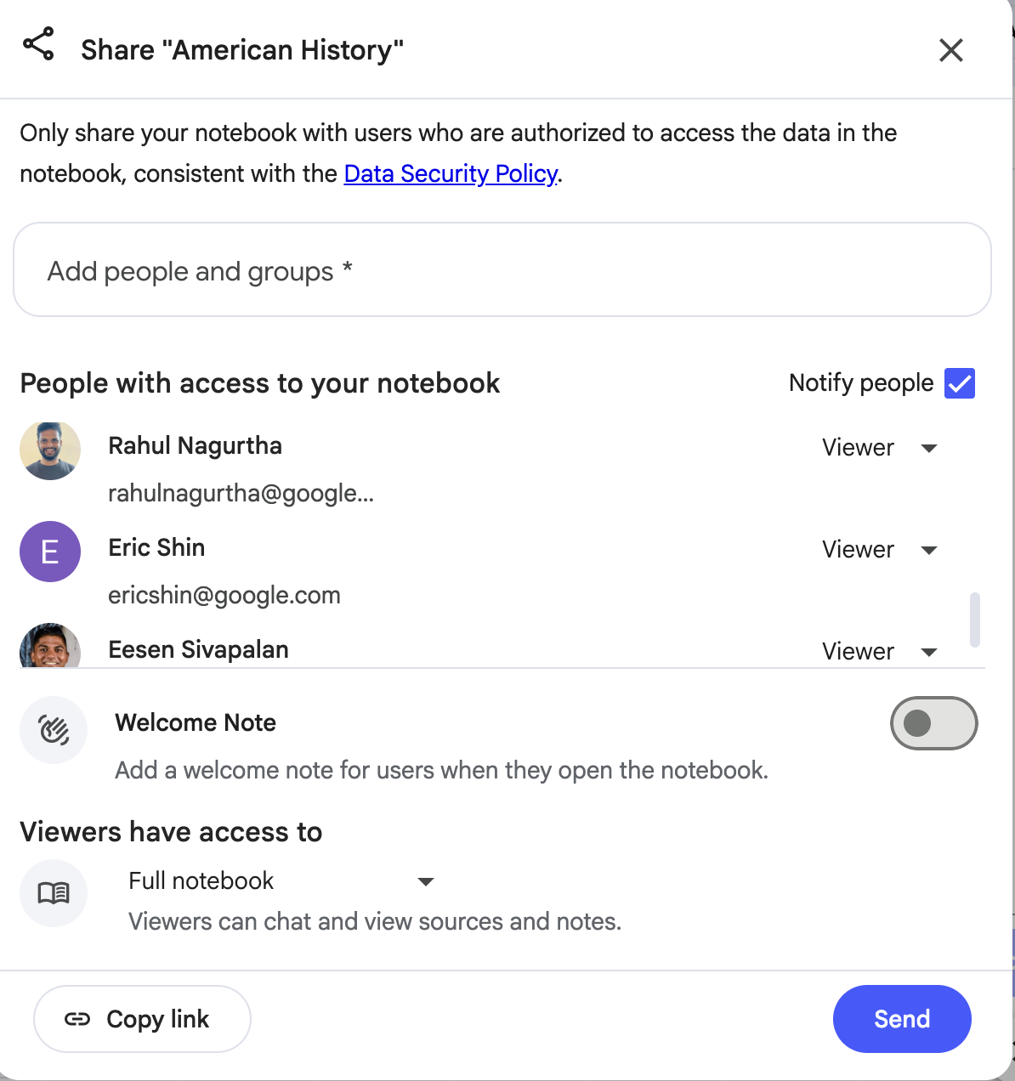
Use Cases
Pro tip
Create and share notebooks in ‘Learning Guide’ mode
Help your students truly understand the material by changing the notebook to ‘Learning Guide’ mode
Personalized learning styles for students
Configure the chat to create a style that will engage your students based on their interests, learning style and level
Sharing a notebook in ‘view only’ will enable students to interact with the notebook and sources but not change the chat configurations

Slide 53


Putnam County, TN
Lance Key
Instructional Technology Coordinator
@Lancerkey
LKey2@pcsstn.com

Slide 54

Putnam County, TN
Johnny Sloan
Technology Supervisor
sloanj2@pcsstn.com

Slide 55


Putnam County, TN
Adam West
Future Ready Coordinator
westa@pcsstn.com

