Slide 1


Slide 2

The Question

Slide 3
Our Guiding Question
🔍 "What if the biggest barrier facing English Learners... isn't language?"
⏸️ Don't answer it yet!
💭 Keep this question in mind throughout
today's journey.

Slide 4
Leadership Conversation #1
🤔 Think • 👥 Pair • 💬 Share
💭 Think of a thriving EL student.
⭐ What made the difference?
❓ A program—or something else?
🤝 Share with a partner. (2–3 minutes)
Tennessee Instructional Standards: B5, C7

Slide 5
My Story

Slide 6
Growing up Between Two Languages
🇦🇷 First-Gen Argentine American
    📺 Parents learned English through television, cartoons, and work.
    🏫 Former English Learner
    👨‍🏫 28 years in education
    🎯 Why this work is personal

Slide 7
The East Ridge Story

Slide 8
Our School Context
East Ridge Middle School
🏫 Enrollment: 556 students, Grades 6–8
🌎 Diverse, multilingual community
🗣️ 24.3% English Learners
📊 TSI/ATSI identified school
🎯 Leadership Challenge: How do we create a school where every student thrives?
Tennessee Instructional Standards: A1, A3, A4

Slide 9
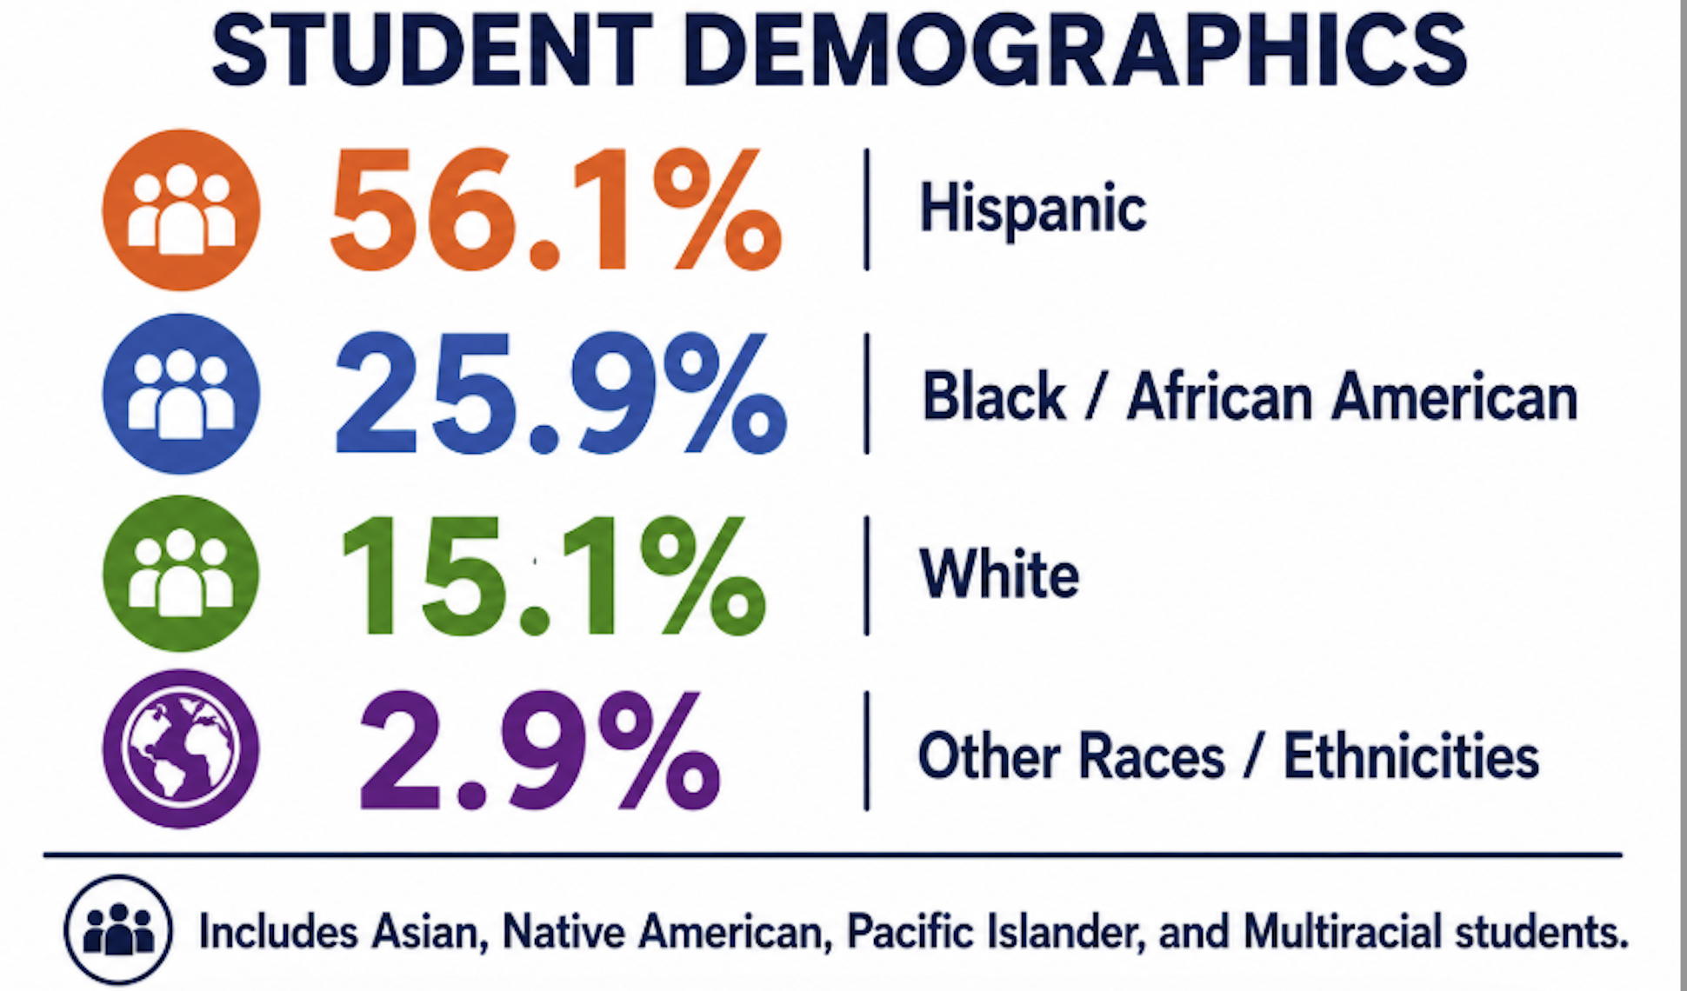
Our School Context

Slide 10
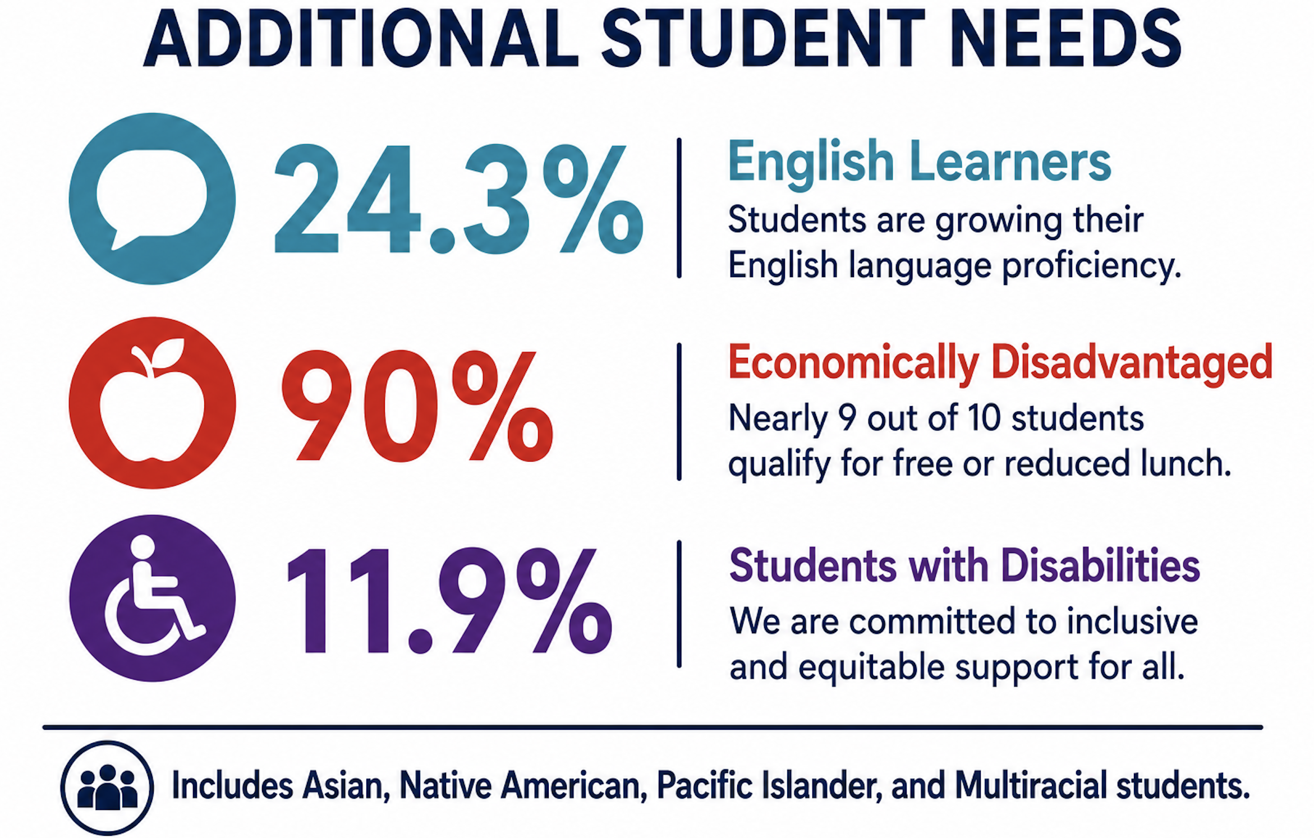
Our School Context

Slide 11
Leadership Belief #1

Slide 12
Culture is the Intervention
🏫 Building Belonging
🌱 Culture Before Programs
🤝 Relationships Before Compliance
🏔️ "Every day is a GREAT day
East of the RIDGE!" 🏔️
Tennessee Instructional Standards: B1, B3, B5

Slide 13
Culture is the Intervention
Building Belonging Means:
🎯 High Expectations
🗣️ Student Voice
👥 Family Partnerships
⭐ Shared Ownership
Tennessee Instructional Standards: B1, B3, B5

Slide 14
House System
🏠 Creates Belonging
🏆 Positive Competition
🌟 Student Leadership
🎉 Celebrations & Recognitions
🤝 Family Connections
Tennessee Instructional Standards: B1, B4, B5, B6

Slide 15
Leadership Conversation #2
🤔 Think • 👥 Pair • 💬 Share
❓ What tells a new student: “You belong here”?
🏫 Identify 3 practices from your
school.
🗣️ Be ready to share one idea (2–3 min)
Tennessee Instructional Standards: B1, B5

Slide 16
Leadership Belief #2

Slide 17
Every Teacher is a Language Teacher
👥 Co-teaching
📝 Collaborative planning
🤝 Shared ownership
🎓 Professional learning
👀 Administrator look-fors
Tennessee Instructional Standards: A2, C4, C5

Slide 18
Professional Development
🍎 SIOP: One Bite at a Time
💬 Kagan Cooperative Learning
🧭 Instructional Coaching
👥 Co-Teaching
📝 PLC Collaboration & Co-Planning
📊 Walkthrough Feedback
Tennessee Instructional Standards: C1, C2, C3, C4, C5

Slide 19
Leadership Belief #3

Slide 20
Beyond Decoding
🧠 Language ≠ Intelligence
📖 Reading English ≠ Learning
💡 Students can think before they
speak fluently
🗣️ Academic discourse matters
Tennessee Instructional Standards: A2, A4

Slide 21
Kagan Cooperative Learning
🌱 Year 1: Teacher implementation
🚀 Year 2: Student ownership
🎤 Every student has a VOICE
⚖️ Equitable participation
Tennessee Instructional Standards: A2, C4

Slide 22
Leadership Conversation #3
🎯 Experience a Kagan structure.
  💬 Debrief: How does structured talk support ELs?
Tennessee Instructional Standards: C4

Slide 23
Leadership Belief #4

Slide 24
Belonging Drives Attendance
📅 Chronic absenteeism/Attendance
🤝 Relationships
👨‍👩‍👧‍👦 Family engagement
🌟 Student ownership
🏫 Positive school culture
Tennessee Instructional Standards: B1, B3, B4, B5

Slide 25
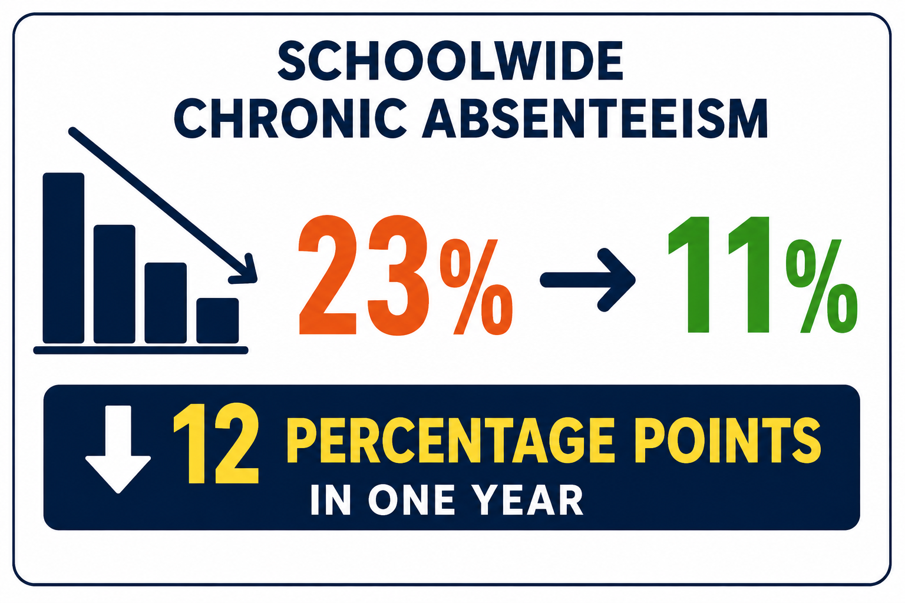
Belonging Drives Attendance
Tennessee Instructional Standards: B1, B3, B4, B5

Slide 26
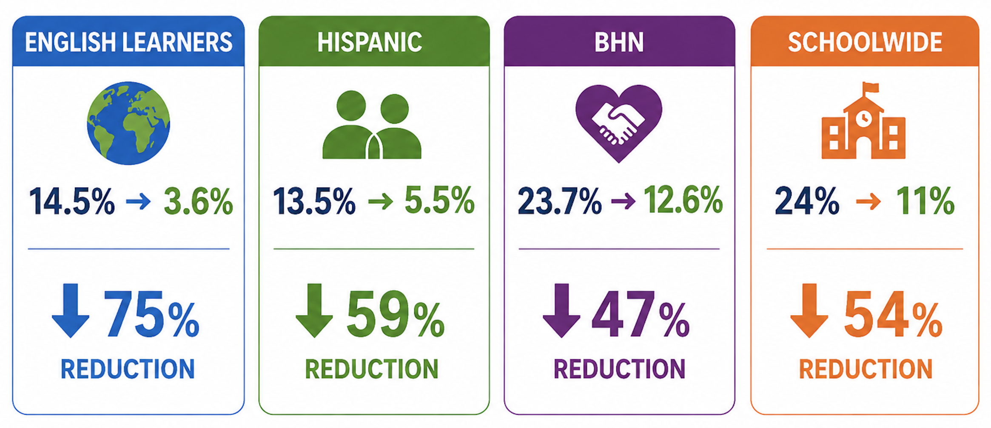
Belonging Drives Attendance
Tennessee Instructional Standards: B1, B3, B4, B5

Slide 27
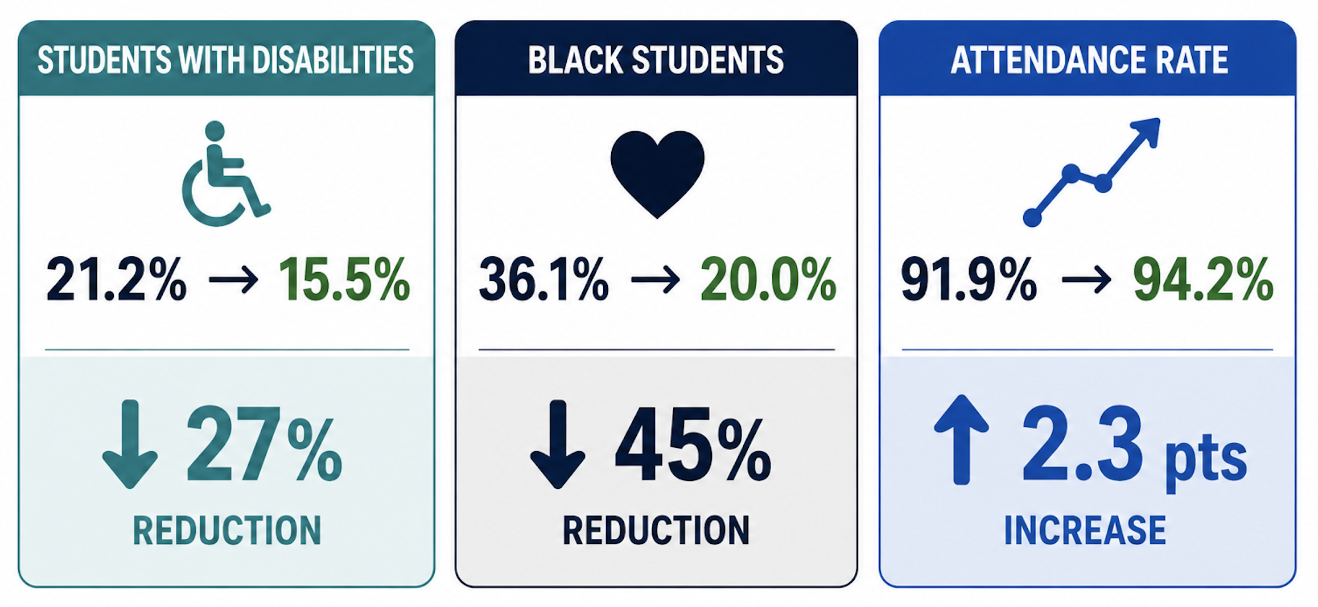
Belonging Drives Attendance
Tennessee Instructional Standards: B1, B3, B4, B5

Slide 28
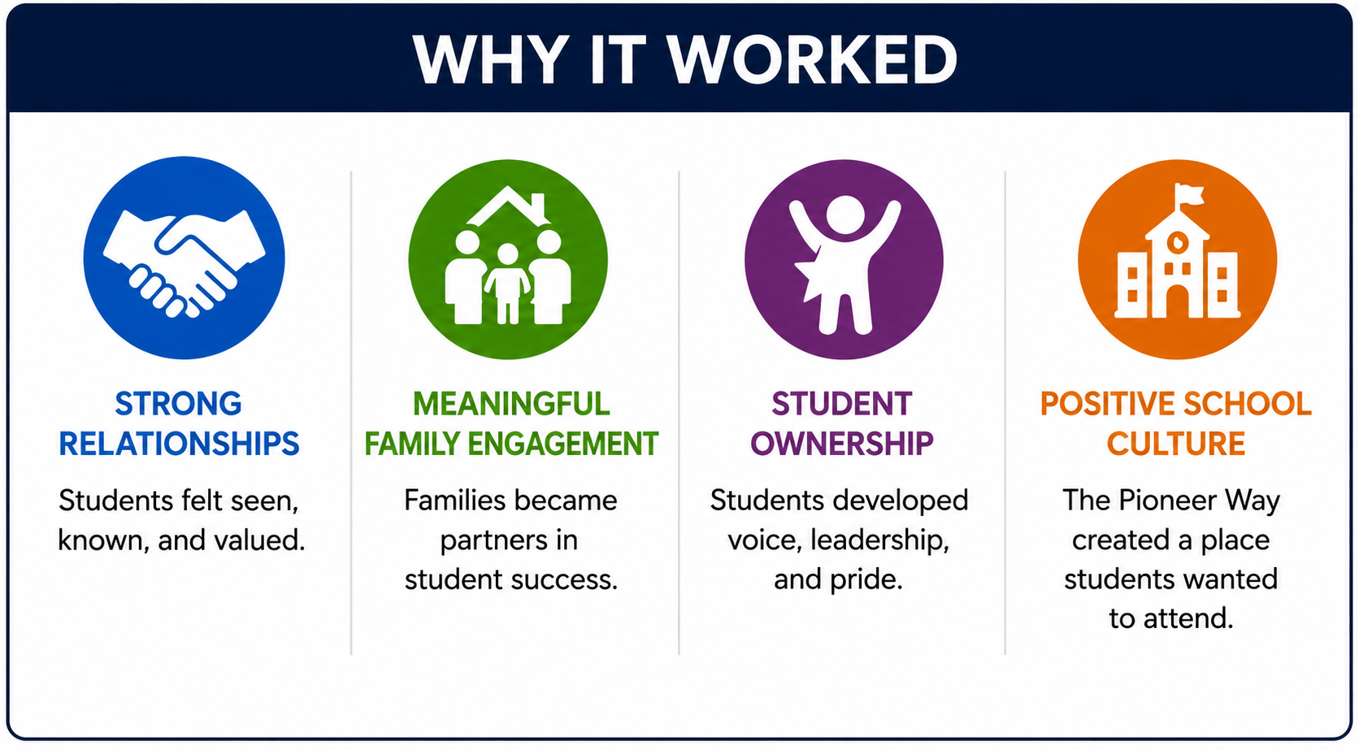
Belonging Drives Attendance
Tennessee Instructional Standards: B1, B3, B4, B5

Slide 29
Leadership Conversation #4
❓Students attend school because...
🤝 Table discussion (3 minutes)
🔗 Connect responses to culture.
Tennessee Instructional Standards: B5

Slide 30
Returning to the Question

Slide 31
Leadership Lessons
🌱 Culture Culture eats programs!
👩‍🏫 Every teacher is a language teacher.
🎤 Student voice accelerates language.
❤️ Belonging drives attendance.
⭐ Leadership shapes culture.
Tennessee Instructional Standards: A5, B5, C7

Slide 32
Reflection
💭 What if the biggest barrier facing
English Learners... isn't language!!!
Tennessee Instructional Standards: A1, B1, C7

Slide 33
Closing
📅 Monday Morning Commitment:
🎯 What is ONE thing you'll can focus on
in your school to support English
Learners?
Tennessee Instructional Standards: A1, B1, C7

Slide 34
Reminder
Every day is a GREAT day... whether you're north, south, east, or west; over the mountain, by the lake, by the river, through the valley, or around the hill.

Slide 35
Questions & Conversations
Questions
Thank you!

