Slide 1
DISCLAIMER – Generative AI Tools
The State of Tennessee does not currently permit the use of Generative
AI tools, such as Otter, in meetings hosted on state resources. Meetings with contractors, vendors, and subrecipients are not public meetings and may involve discussion of protected state data. Generative AI tools are not adequately regulated and are designed to train on data that is collected and may misrepresent data or release protected data to the general public. While the State supports your desire to maintain
documentation of the meeting and what you learn, please respect our decision to safeguard information and do not attempt to use tools such as these. If you choose to use a tool such as this, the State will block that tool from the meeting.

Slide 2

When a Student Makes a Threat of Mass Violence: From Threat Assessment to Manifestation Determination
Dr. April Ebbinger, NCSP
Director of Psychological and Behavioral Services
Julie Lane, Ed.S.
Senior Manager of Complex Behavior

Slide 3

Special Circumstances and Interim Alternative Educational Settings
Threats of Mass Violence​
General Process for Threats​
Compare and Contrast Threat Assessment and Manifestation Determination Review​
Other Considerations

Slide 4
Threats of Mass Violence

Slide 5
Mass Violence Statistics
86 percent of mass shooters aged 20 or under leaked their plans.
K-12 school shooters are more likely to leak their plans to classmates, social media, or online forums.
Leakage often equates to higher suicidality.
7 out of the recent 10 mass shootings have evidence of radicalization via online forums.

Slide 6
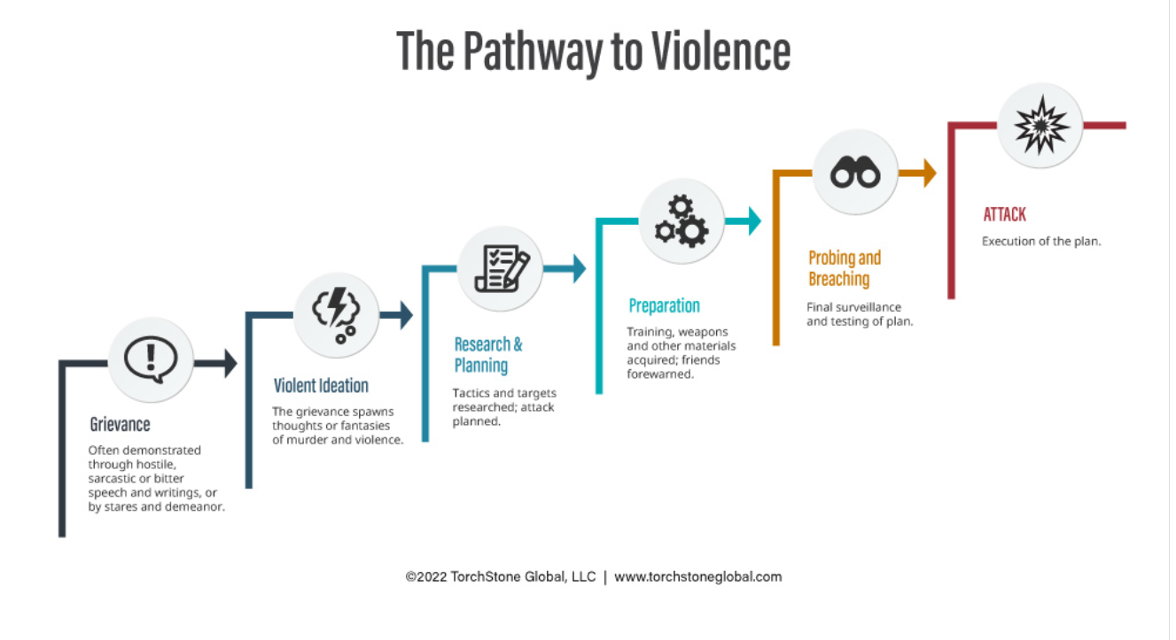

Slide 7

Threats of Mass Violence
A person commits a Class E felony if the person recklessly, by any means of communication, threatens to commit an act of mass violence on school property or at a school-related activity. See Tenn. Code Ann. § 39-16-517(b).
Means of communication means direct and indirect verbal, written, or electronic communications, including graffiti, pictures, diagrams, telephone calls, voice over internet protocol calls, video messages, voice mails, electronic mail, social media posts, instant messages, chat group posts, text messages, and any other recognized means of conveying information. See Tenn. Code Ann. § 39-16-517(a).

Slide 8

Threat of Mass Violence
A student has committed a zero-tolerance offense if the student “[t]hreatens mass violence on school property or at a school-related activity.” ​Tenn. Code Ann. § 49-6-3401(g)(2)
“Mass violence” means “any act which a reasonable person would conclude could lead to the serious bodily injury or death of two or more persons.” See Tenn. Code Ann. § 39-16-517.​

Slide 9

Threats of Mass Violence
Chapter 882 of the Public Acts of 2024 amended requirements related to threats of mass violence.​
  If a student threatens mass violence, the student must undergo a threat assessment to determine whether the threat was a valid threat.​
  The student may be suspended until the threat assessment is complete.​
  If the threat was not a valid threat, then the student must not be expelled for committing a zero-tolerance offense but may be suspended.
See Tenn. Code Ann. § 49-6-3401(g).

Slide 10
Discussion: What would you do?
Chloe is a ninth-grade student with an emotional disturbance. During math class, her teacher hands out grades from the latest math test. Chloe sees that she got an F on the test and mutters “I’m going to burn this school down so I never have to take another math test.”​​
What would you do next? ​
What are your obligations if Chloe is suspended for more than 10 days?

Slide 11
Process for Threats of Mass Violence: General Education Students
*Student may be suspended while threat assessment is completed.
Threat of Mass Violence
Complete Threat Assessment*
Expel or Suspend based on Outcome

Slide 12
Process for Threats of Mass Violence: Special Education Students
Provide special education services if 10 days has been exceeded
Threat of Mass Violence
Complete Threat Assessment*
Suspend, Expel, or Neither Pending Outcome
Hold Manifestation Determination within 10 Days of Decision to Change Placement
*Student may be suspended while threat assessment is completed.

Slide 13

Students’ Right to Free Appropriate Public Education (FAPE)
If a student with a disability is removed from school following a threat assessment, the district must ensure that the student continues to receive the services required for FAPE and that the student is afforded any applicable procedural rights.
See U.S. Dep’t of Educ., “Questions and Answers: Addressing the Needs of Children with Disabilities and IDEA's Discipline Provisions,” (July 19, 2022); U.S. Dep’t of Educ., ”Supporting Students with Disabilities and Avoiding the Discriminatory Use of Student Discipline under Section 504 of the Rehabilitation Act of 1973, (July 2022).

Slide 14
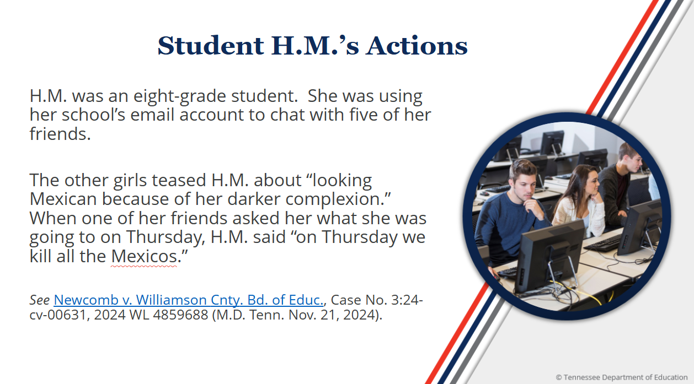

Slide 15
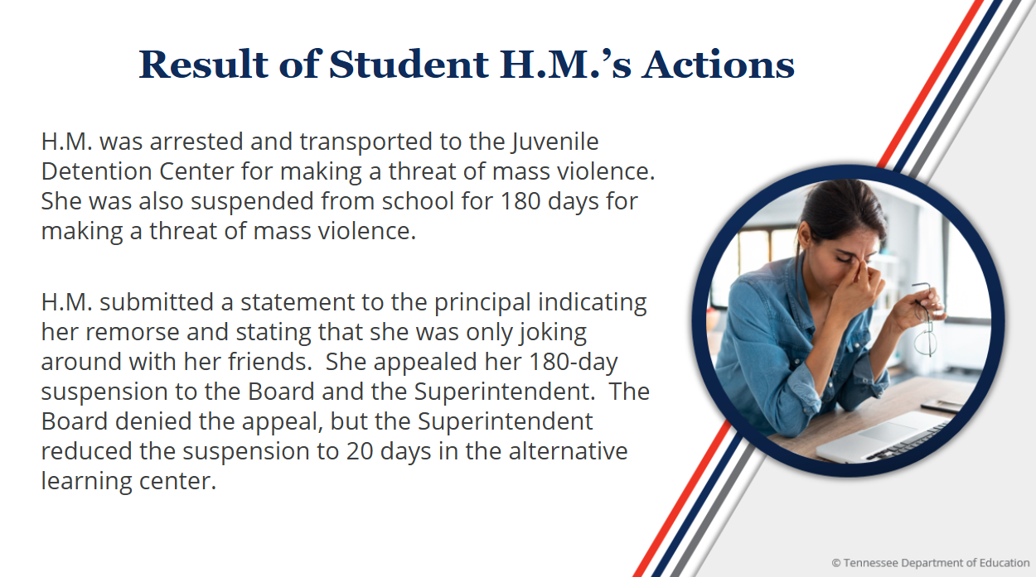

Slide 16


Slide 17

Legal Standard
“In cases involving school discipline, a substantive due process claim will only succeed in the rare case when there is no rational relationship between the punishment and the offense.”​
“[T]he Board may not expel students from school arbitrarily or irrationally.”

Slide 18
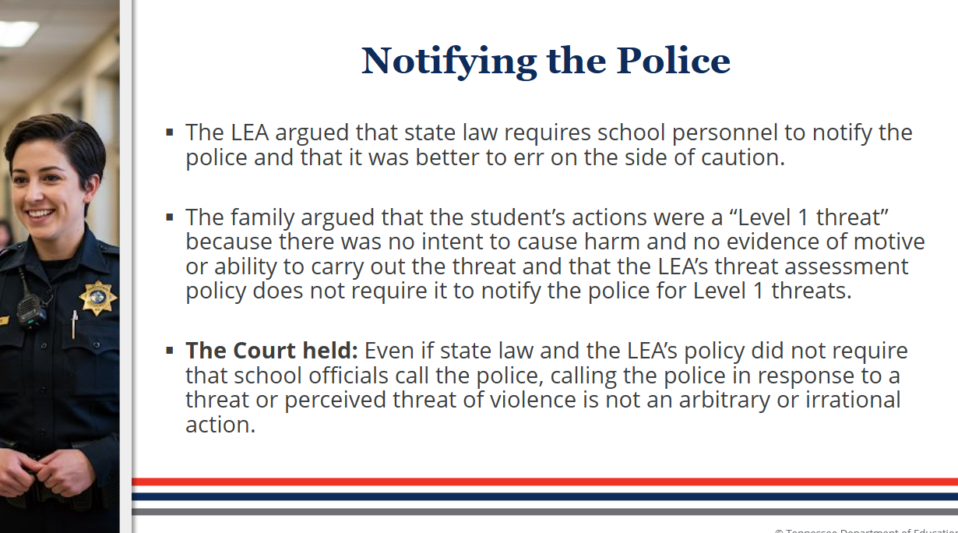

Slide 19
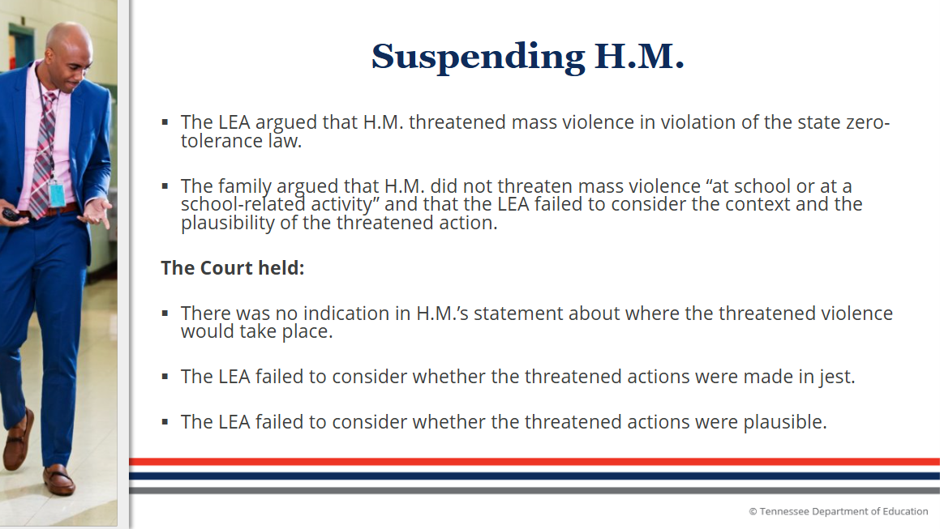

Slide 20
Commonalities and Differences between Threat Assessment and Manifestation Determination Review

Slide 21

Should MDR and Threat Assessment Occur Concurrently?
Districts should consider conducting an MDR concurrently with a threat assessment for a student with a disability.
If the student's behaviors are related to her disability, the district may not unilaterally suspend or expel the student for more than 10 days.
  West Virginia Dep’t of Educ., In re: Student with a Disability (Dec. 23, 2019) (noting a district could not expel a student whose remarks indicated he was "going to shoot up the school" because the student's conduct was a manifestation of his disability)
  U.S. Dep’t of Educ., St. Charles (MO) R-VI Sch. Dist. (Mar. 2, 2010) (finding that a Missouri district improperly expelled a student with an emotional disturbance without appropriately considering whether her threat to attack the school was a manifestation of her disability).

Slide 22

What is an MDR?
An MDR is an evaluation of a student’s misconduct to determine whether the misconduct is caused by or substantially related to the student’s disability.
An MDR must be performed when an LEA proposes disciplinary measures that will result in a “change of placement” for a student with a disability. 34 C.F.R. § 300.530(e).

Slide 23

What is a Threat Assessment?
Intent
Capability
Opportunity or Means
The primary purpose of a threat assessment is to prevent targeted violence.
A threat assessment identifies, assesses, and manages individuals who might pose a rick of violence to an identified or identifiable target.

Slide 24

Who is on the MDR team?
  The MDR team must include:
      The parent;
      A representative from the LEA;
      Relevant members of the student’s IEP team, as determined by the parent and the LEA.
  Parents have the right to invite additional participants to the MDR, but they do not have the right to “uninvite” participants invited to the MDR by the LEA.
  See 34 C.F.R. § 300.530(e)(1).

Slide 25

Who must be included on the threat assessment team?
Both law enforcement personnel and local education agency (LEA) personnel must be included. See Tenn. Code Ann. § 49-6-2701.
​
LEA personnel may include:​
  Mental health providers (school psychologist, school social worker, or school counselor)​
  Juvenile services personnel​
  Representatives of local district attorney’s office​
  Representatives of the Department of Children Services

Slide 26

MDR Determinations
The MDR team must answer the following questions:​
Was the student’s conduct caused by or did it have a substantial relationship to the student’s disability?​
Was the student’s conduct a direct result of the LEA’s failure to implement the student’s IEP?​
See 34 C.F.R. 300.530(e)(1).

Slide 27
Threat Assessment Guiding Questions
Did the student communicate a threat or engage in threatening behavior? Is there intent to harm?
Is the threat an expression of humor, rhetoric, anger, or frustration that can be easily resolved so that there is no intent to harm? Does the person retract the threat or offer an explanation and/or apology that indicates no future intent to harm anyone?
Is the threat legitimate and serious?

Slide 28

MDR: Determining the Relationship Between the Conduct and the Disability
Behavior prompting suspension/expulsion
  Description of the behavior
  Incident reports
  Statements from students, peers, or faculty
Ability to understand impact and consequences
  Has the student received information regarding school rules?
  Has the student expressed that similar conduct is wrong?
Ability to control behavior
  What is the nature and severity of the disability?
  Was the behavior premeditated or impulsive?
Appropriateness of the program
  Current eligibility
  Other relevant medical information and current evaluations
  Functional Behavior Assessment (FBA)/Behavior Intervention Plan (BIP)
  Current services/placement

Slide 29

Threat Assessment: Determining the Seriousness Given Disability
Prior threats
Discipline records
Outside agency reports
Faculty, staff, student interviews
Review of social media
Witness statements
Special education records
Other records

Slide 30
Possible Outcomes

Slide 31
MDR Determinations
  The MDR team must answer the following questions:
      Was the student’s threat of mass violence caused by or did it have a substantial relationship to the student’s disability?
      Was the student’s threat of mass violence a direct result of the LEA’s failure to implement the student’s IEP?
If the answer to either question is YES, then the behavior IS a manifestation of the student’s disability.
If the answer to both questions is NO, then the behavior IS NOT a manifestation of the student’s disability.

Slide 32
The Threat IS a Manifestation​ of the Student’s Disability
  If the LEA determines that it failed to implement the student’s IEP, then the LEA must take immediate steps to remedy those deficiencies. See 34 C.F.R. § 300.530(e)(3).
  The LEA must return the student to the placement from which the student was removed unless the parent and school agree to a change of placement as part of the modifications of the behavior intervention plan (BIP) and/or least restrictive environment. See 34 C.F.R. § 300.530(f)(2).
  The LEA must conduct a functional behavior assessment (FBA) and implement a BIP for the student. If the LEA has already developed a BIP, then the LEA must review and modify the BIP to address the behavior. See 34 C.F.R. § 300.530(f)(1).

Slide 33
The Threat is NOT a Manifestation​ of the Student’s Disability
  The LEA may apply disciplinary policies in the same manner and for the same duration that they would to a student without a disability. See 34 C.F.R. § 300.530(c).
  School personnel and at least one of the student’s teachers must determine the extent to which services are needed:
    To enable the student to continue to participate in the general education curriculum, and
    To progress toward meeting the goals set out in the student’s IEP.
  See 34 C.F.R. § 300.530(d)(4).

Slide 34

Appeals
  A student’s parents may appeal a determination that the student’s conduct was a manifestation of the student’s disability by filing an expedited due process. See 34 C.F.R. § 300.532(a).
  The hearing must be held within 20 school days of the date the complaint was filed and the judge must make a determination within 10 school days of the hearing. See 34 C.F.R. § 300.532(c).

Slide 35
Other Considerations

Slide 36
Child Find and Threat Assessments
Districts have an affirmative duty under the IDEA and Section 504 to locate, identify, and evaluate all students who need or may need special education and related services due to a disability. 34 C.F.R. § 300.111(a)(1) and 34 C.F.R. § 104.35(a).
If a district believes that a general education student presents dangerous behaviors warranting a threat assessment, it may need to evaluate the student's IDEA or Section 504 eligibility.
  The dangerous behaviors or conduct may put the district on notice that the student has a disability or potential disability.
  This is especially true if the district believes the student may need counseling or other mental health services to safely attend school or access his educational program.

Slide 37
Special Circumstances and Interim Alternative Educational Settings

Slide 38

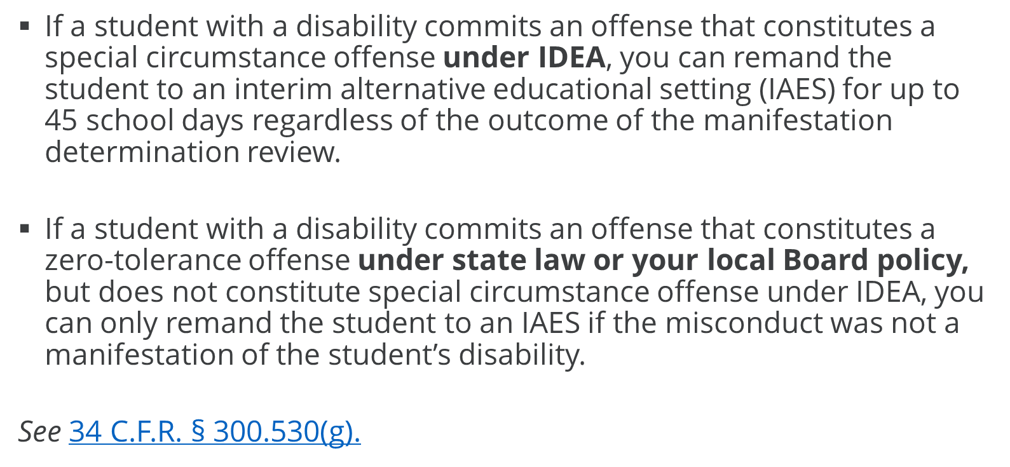
Special Circumstances & Zero-Tolerance Offenses

Slide 39
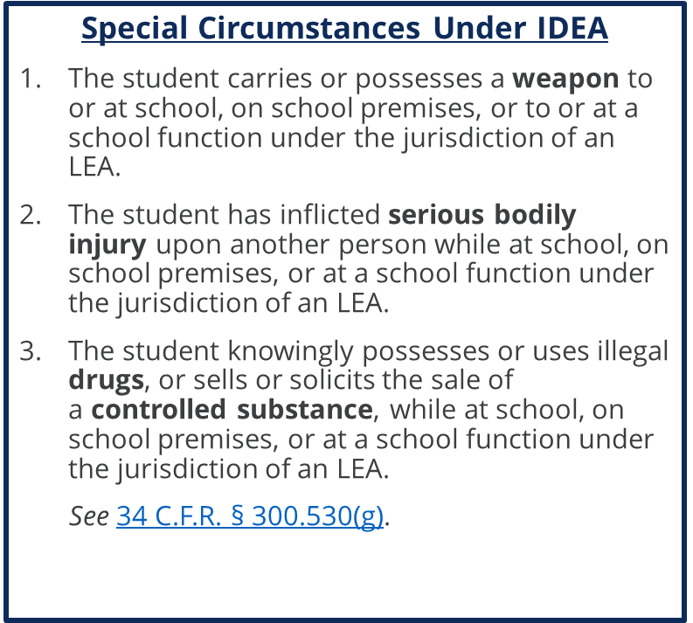
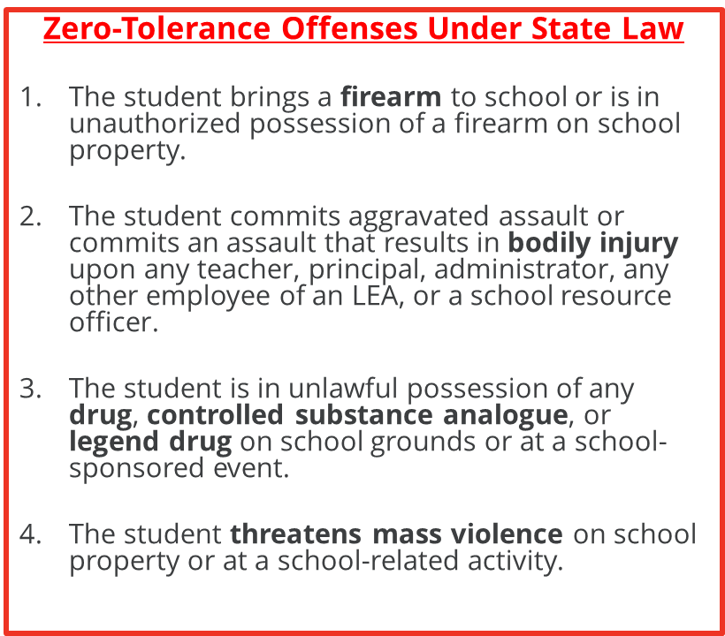
Comparing Special Circumstances and Zero-Tolerance Offenses
  See Tenn. Code Ann. § 49-6-3401(g)(2).

Slide 40

Interim Alternative Educational Settings (IAES)
Under the IDEA, a district may remove a student to an IAES for up to 45 days if the student: 1) carries a weapon to or possesses a weapon at school; 2) knowingly possesses or uses illegal drugs or sells or solicits the sale of a controlled substance while at school; or 3) has inflicted serious bodily injury upon another person while at school.
Even if a student has not inflicted serious bodily injury or brought a weapon to school, a threat assessment may indicate that the behaviors pose an imminent threat to others. If this occurs, a district may file an expedited due process hearing to seek the student's removal to an IAES for up to 45 days.
                34 C.F.R. § 300.532(a);34 C.F.R. § 300.532(c)

Slide 41
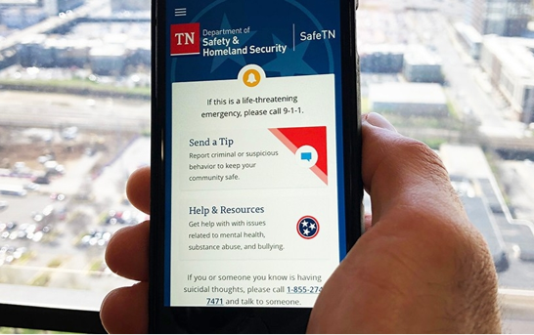
Resources
U.S. Dep’t of Educ., “Questions and Answers: Addressing the Needs of Children with Disabilities and IDEA’s Discipline Provisions,” (July 19, 2022). ​
Section 1 - School Threat Assessment Checklist​
Section 1 - Questions to Ask When Selecting a Training Program​
SafeTN

Slide 42

Thank You!
Dr. April Ebbinger
Director of Psychological and Behavioral Services
april.ebbinger@tn.gov
Taylor Jenkins
Assistant General Counsel for Special Education
taylor.jenkins@tn.gov

