Slide 1


The Power of
Collaboration
Building Partnerships That Improve Student Outcomes
Presented by:
Holly M. Harms and
Ashley Meadows

Slide 2


Holly M. Harms
  B.S. in Social Work
  M.A. in Special Education
  Teacher Leader
  Middle School Special Ed Teacher
  Elementary Special Ed Teacher
  PK Special Ed Teacher
Ashley Meadows
  B.A. in Elementary Education from MTSU
  M.A. in Educational Leadership
  Elementary General Education Teacher
  Elementary Special Education Teacher

Slide 3

Objectives
  Understand what collaboration is
  Explore student outcomes
  Identify the benefits of collaboration by building relationships, consistency, and shared responsibility
  Develop actionable strategies to build collaboration of SPED and Gen. Ed. teachers in your building.

Slide 4
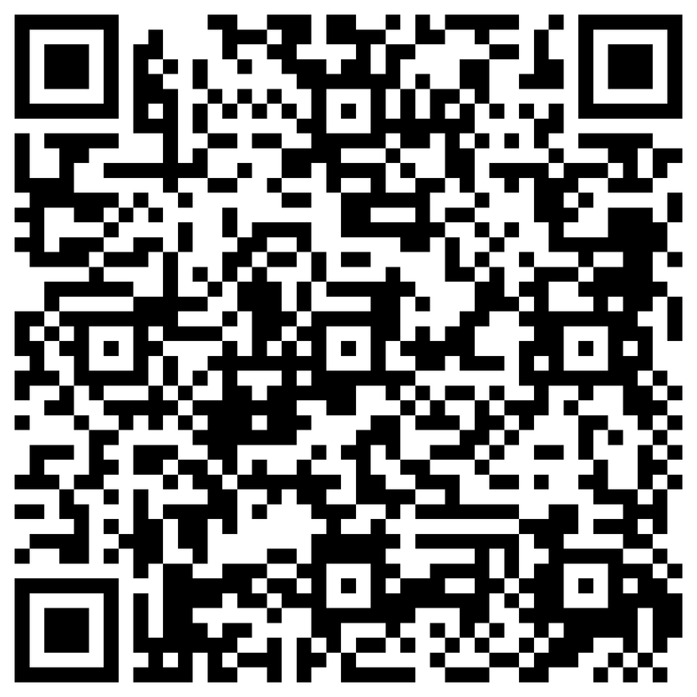
How often do your SPED and Gen. Ed. Teachers Collaborate?
Scan the QR code to rate your current school’s level of collaboration between departments 1-4.

Slide 5


What is Collaboration?
Collaboration is the process of two or more individuals or organizations working together to achieve a common goal, share knowledge, and pool resources. It involves active, shared effort to create, produce, or solve problems, often fostering trust and innovation.
COMMON GOALS
SHARE IDEAS & RESOURCES
ESTABLISHED RELATIONSHIP
PROBLEM SOLVING

Slide 6
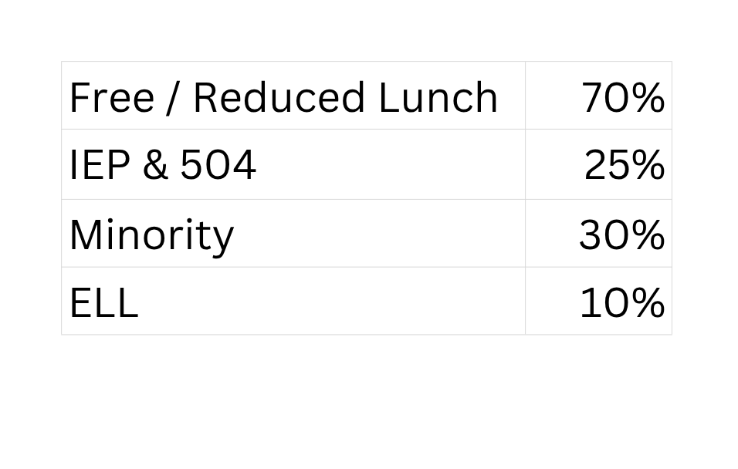
Portland East Middle School (PEMS) Demographics

Slide 7
Students with Disabilities (SWD)
Nearly half of students with an IEP have at least one incarcerated parent or are being raised by another family member (outside of biological parents).

Slide 8


Portland East Middle School
What is an ATSI School?
An ATSI school (Additional Targeted Support and Improvement) is a federal accountability designation under the Every Student Succeeds Act (ESSA). It refers to a school where at least one specific student group (e.g., English learners, students with disabilities, or a specific racial minority) performs as poorly as the lowest-performing 5% of Title I schools in the state.
PEMS was an ATSI school for 23-24 SY
Qualified for ATSI primarily due to lack of SWD growth.

Slide 9


Celebrations!
  Increased proficiency across grade levels
  Strong growth among SWD
  Evidence that instructional strategies are working
  Students making meaningful academic gains
"Growth is not about where students start—it's about how far they progress."

Slide 10
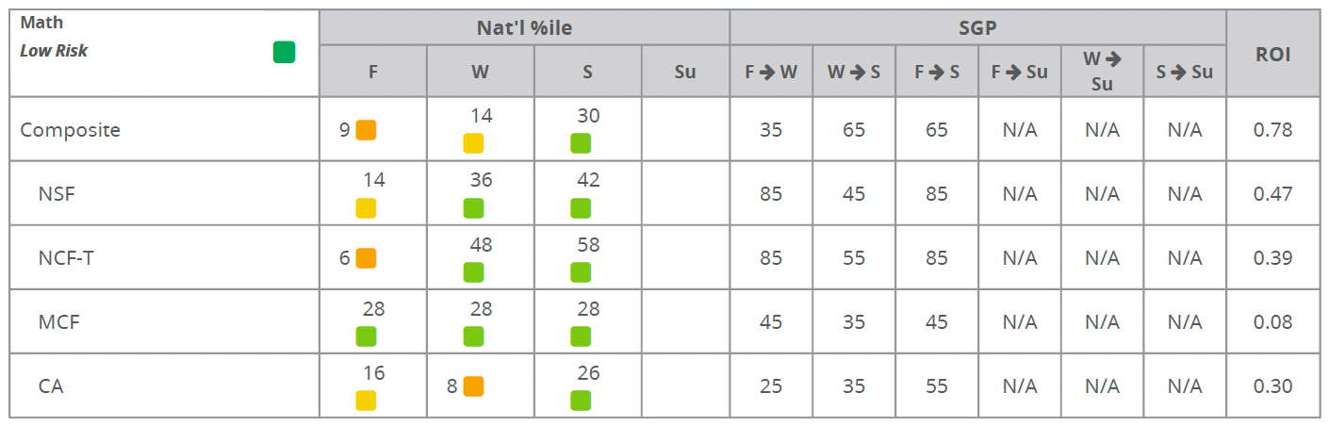
Benchmark Data
6th grade student
ELL & SpEd (Basic Reading and Math Problem Solving)
Low income

Slide 11

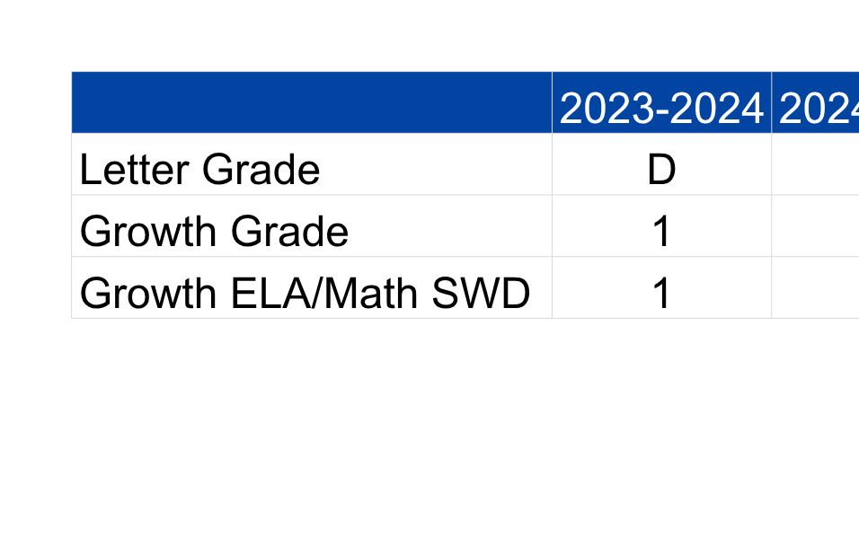
TCAP Scores

Slide 12
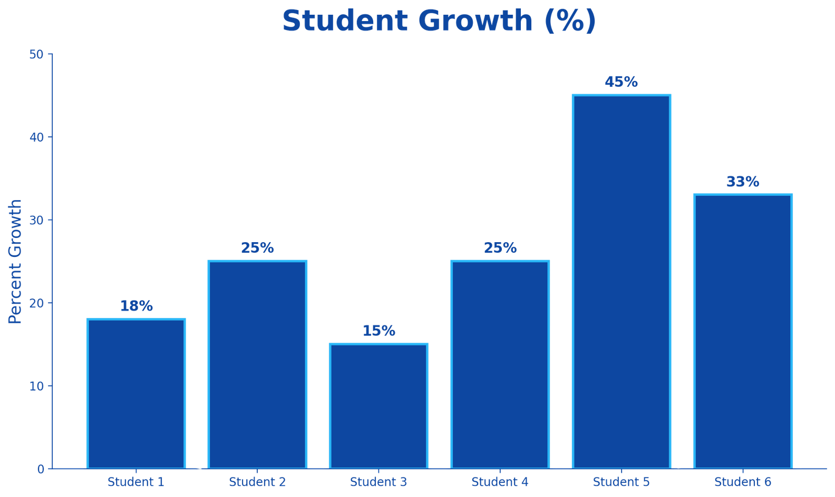
2024-2025 TCAP Math Growth

Slide 13


From Barriers to Bridges
Identifying Obstacles So We Can Build
Stronger Collaborative Partnerships

Slide 14






“Our planning times don’t align.”
Obstacles
“I have 19 other students to worry about.”
"I can't support kids with needs. I don't know how."
“There are too many
standards and not enough time.”
“I don’t know
anything about the general curriculum.”
“I feel uncomfortable co-teaching.”

Slide 15



Evidence Based Practices
“Research suggests that brief, structured collaboration meetings can significantly improve instructional consistency and implementation of accommodations.”
-Friend & Cook, 2017
“The nature of relationships among the adults within a school has a greater influence on the character and quality of that school and on student accomplishment than anything else.”
-Roland S. Barth
“Collaborative expertise requires educators to work together with precision, clarity, and shared responsibility for impact.”
— John Hattie

Slide 16
Benefits of Building Relationships
  Shared resources
  Shared data for IEP
  Gen. ed. expertise
  Different perspecitives
  Shared celebrations
  Increased academic outcomes

Slide 17
Strategies to Build Relationships
  Start by building personal connections
  Establish a shared vision for students: Our students, not yours or mine
  Communicate consistently: in person check-ins
  Focus on solutions not problems
  Build trust through reliability
  Recognize and value each other's expertise: Respect their opinion
  Take ownership when you make a mistake

Slide 18

Turn and Talk
Building Relationships
Share strategies that have been beneficial to you or strategies you could easily implement.

Slide 19
Benefits of Consistency
  Identify concerns early before they become major issues
  Adjust interventions quickly
  Monitor student progress more effectively
  Ensure accommodations are implemented regularly
  Greater willingness to problem solve together
  Increased trust and team cohesion
  Creates shared accountability

Slide 20
Strategies for Consistency
  Regularly asking for teacher input on IEP and goals
  Scheduled progress monitoring with shared access to data
  Request to attend grade-level data team meetings or PLC’s
  Schedule meetings in advance so teachers have time to prepare
  Communicate when plans change
  Regular quick check-ins with each teacher
  Work inclusion into SPED teacher’s schedule

Slide 21
Turn and Talk
Consistency
Share strategies that have been beneficial to you or strategies you could easily implement.

Slide 22
Benefits of Shared Responsibility
Moving from “My Students” to “Our Students”
  Student needs are addressed from multiple perspectives
  Instructional decisions become more informed
  Increases collective expertise
  Prevents teacher isolation

Slide 23
Strategies for
Shared Responsibility
  Utilize data from multiple resouces
  Request access to general education curriculum
  Observe/work inclusion into your schedule
  Clearly define roles and systems with teachers and principals
  Use joint planning templates
  Analyze student data together
  Analyze intervention outcomes
  Celebrate sucess together

Slide 24
Action Items
SPED Teacher
  Learn gen. ed. curriculum/standards
  Pre-teach standards in intervention
  Review gen. ed. benchmark data
  Alternate days for standards and IEP goals
  Observe/inclusion in gen. ed. class for consistency in how material is being taught
  Meet before IEP meetings to have a discussion of progress in gen.ed. and IEP goals (collaboration document).

Slide 25
Turn and Talk
Shared Responsibility
Share strategies that have been beneficial to you or strategies you could easily implement.

Slide 26
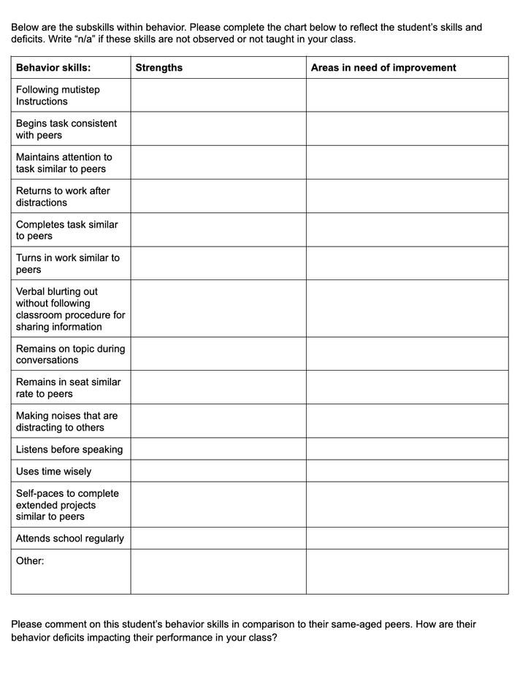
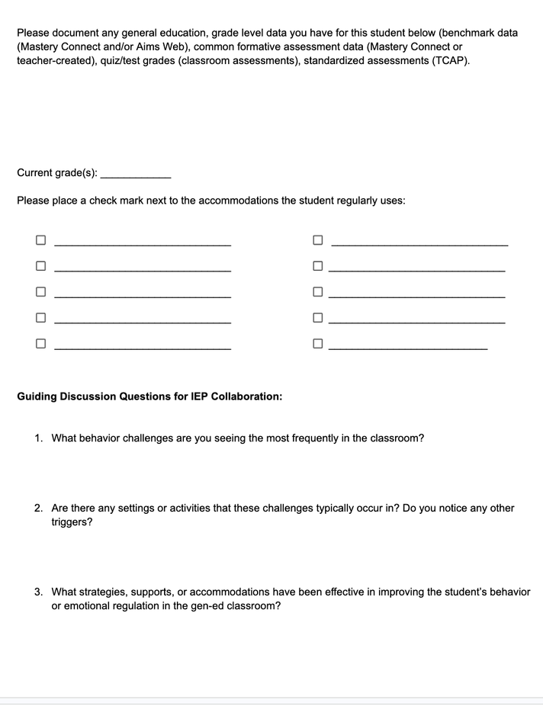
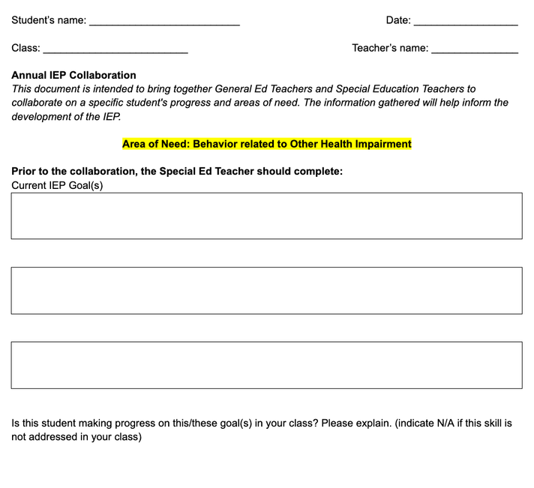
Collaboration Documents

Slide 27
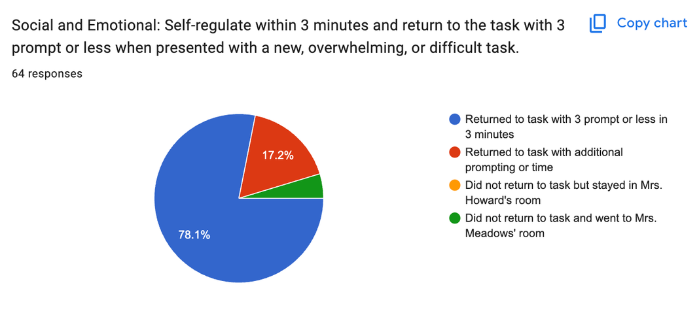
Shared Documents
QR codes and Google Forms for easily accessible data
Suggested Shared
Planning Documents
  Planbook
  Google Docs
  Google Sheets

Slide 28
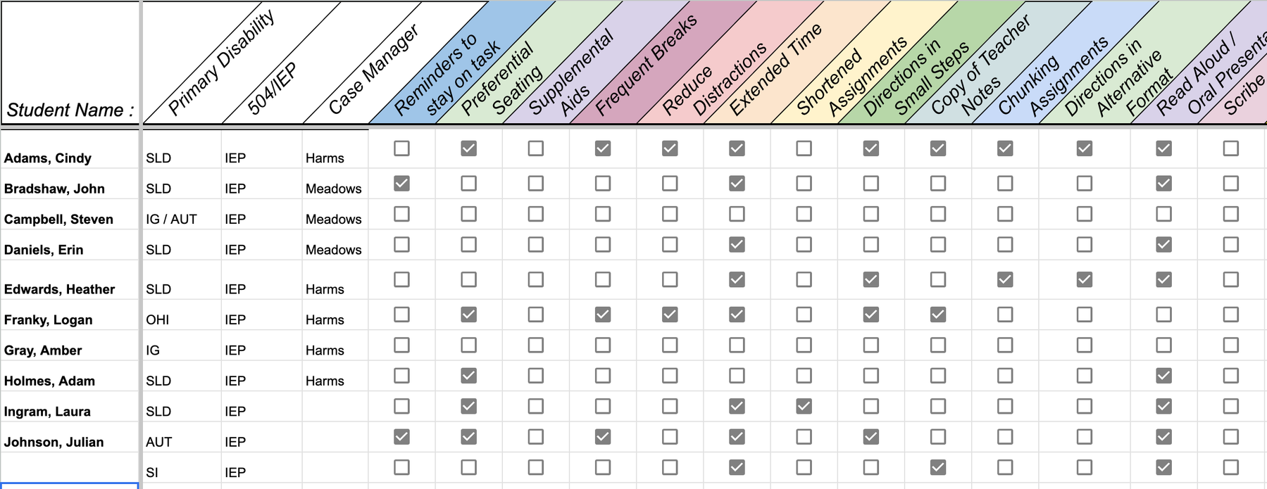
Accommodations
Checklist

Slide 29
Collaboration Creates Collective Impact
Intentional collaboration through building relationships, consistency, and shared responsibilities can increase students’ academic achievement.
Together We Can:
  Increase student achievement
  Improve growth outcomes for students with disabilities
  Strengthen inclusive practices
  Build a culture of collective efficacy
  Ensure success for all learners

Slide 30

Thank You!
The Power of Collaboration
Building Partnerships That Improve Student Outcomes
Questions and Discussion
holly.harms@sumnerschools.org
ashley.meadows@sumnerschools.org

