Slide 1
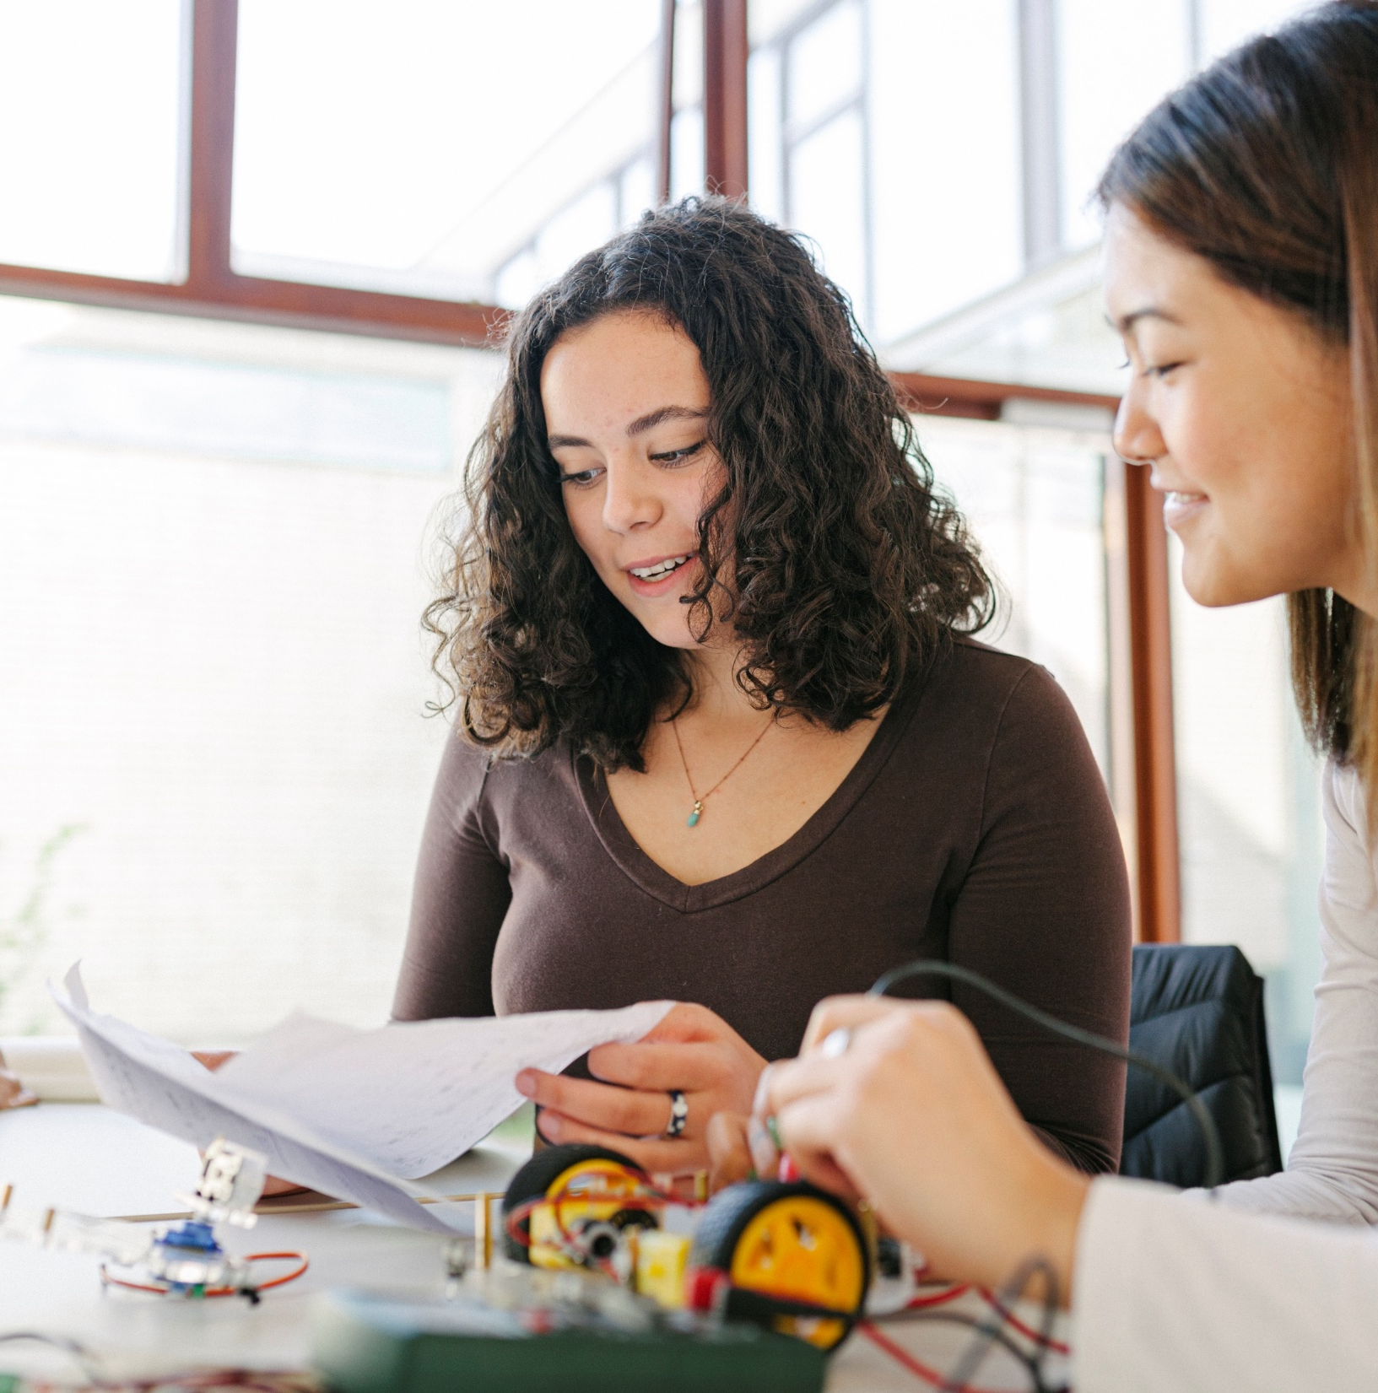
Paraeducators as Partners
Alison Gauld, Ed.D.
Senior Manager of Professional Development and Low Incidence Disabilities |Special Education and Student Support
© Tennessee Department of Education

Slide 2
Generative AI Tools
DISCLAIMER
The State of Tennessee does not currently permit the use of Generative AI tools, such as Otter, in meetings hosted on state resources. Meetings with contractors, vendors, and subrecipients are not public meetings and may involve discussion of protected state data.
Generative AI tools are not adequately regulated and are designed to train on data that is collected and may misrepresent data or release protected data to the general public.
While the State supports your desire to maintain documentation of
the meeting and what you learn, please respect our decision to safeguard information and do not attempt to use tools such as these. If you choose to use a tool such as this, the State will block that tool from the meeting.

Slide 3

Objectives
After this session, participants will be able to:
Define paraeducators and their role in supporting students with disabilities,
Explain the role of a paraeducator as an assistant who works under the supervision of licensed/endorsed educator, and
Use strategies that lead to successful partnerships between a special educator and paraeducator, ultimately increasing student outcomes.

Slide 4
Definitions
Paraprofessional: Paraprofessionals are individuals who assist and work under the supervision of a licensed professional.
  Examples: a paralegal assists an attorney, a paramedic assists a medical professional.
Paraeducator: A paraprofessional is an individual who is employed in a preschool, elementary school, or secondary school support staff under the supervision of a certified or licensed teacher. 20 U.S.C. § 7011(11).

Slide 5
Paraeducators
Paraeducators, working under the direct supervision of a teacher, may provide one or more of the following:
  one‐on‐one special education services,
  special education services to small groups of students with disabilities or within a general education setting,
  classroom management assistance,
  support with parental involvement activities,
  translation or interpreting to provide the student access to the instruction, and/or
  instructional support services.

Slide 6
“Under the Supervision”

Slide 7

“Under the Supervision” Defined
“Under the Supervision” is a short phrase designed to capture the legal requirements that a paraprofessional only provide services when trained, coached, supervised, and regularly collaborating with a properly endorsed/licensed professional.
Paraeducators must be supervised by an endorsed special educator. They may not “fill” a teaching position even when there are staffing shortages or missing personnel.

Slide 8
Special Educator and Paraeducator Roles Overview
Special Educator
  Collaboration with the general education teacher(s)
  Planning instruction and intervention
  Data-based decision-making to inform instruction and intervention
  Communication with parent(s)
  Developing the IEP
  Creating Progress Reports
  Ensuring accommodation(s) and/or modification(s) are implemented with fidelity
  Ensuring FAPE
Paraeducator
  Fully trained by and regular collaboration with the supervising special educator
  Delivering instruction and/or intervention as directed
  Collecting formal and informal data to inform decision-making
  Communicate with special educator
  Support implementation of the IEP
  Support use of accommodation(s) and/or modification(s)
Both
Engage with the student
Progress monitor
Collaborate regularly

Slide 9
Strategies to Increase Training and Collaboration

Slide 10

The Need for Paraeducators
The Bureau of Labor Statistics projected a 5.4% growth in jobs between 2021 and 2031.
1,235,000 paraeducators were employed in the K-12 public school setting in 2021.
It is projected that there will be on more than 153,700 openings each year for paraeducators in the United States.
(U.S. Bureau of Labor Statistics, 2022)
Notes:
https://www.bls.gov/emp/tables/emp-by-detailed-occupation.htm#top

Slide 11
The Need for Paraeducators in TN
As of 2022, there were 9,460 special education paraeducators employed in Tennessee.
(TN Department of Education, 2022)
Yet, the majority of special education teachers reported a lack of time for training and supervising paraeducators.
The majority of paraeducators report that they do not feel adequately trained to successfully support students.
(Barnes et al., 2016)
Notes:
TN Department of Education. (2022). 2022 Annual Statistical Report. TN Department of Education. https://www.tn.gov/education/districts/federal-programs-and-oversight/data/department-reports/2022-annual-statistical-report.html
U.S. Bureau of Labor Statistics. (2022, October 4). Occupational Outlook Handbook – Teacher Assistants. U.S. Bureau of Labor Statistics. https://www.bls.gov/ooh/education-training-and-library/teacher-assistants.htm

Slide 12

Working as Partners
Paraeducators are an important part of our team. Successful partnerships have:
  planned check-ins/meetings,
  clear roles,
  purposeful collaboration, and
  strategies for handling conflict, emergency situations, and the unexpected.
This requires time for training, coaching, mentoring, and meeting on a regular basis.

Slide 13
Establishing Time for Training and Collaboration
Time for training and collaboration needs to be built into the weekly schedule.
  Caution: Planning to meet while doing other tasks such as meeting the school buses, monitoring recess, or lunch is not typically effective nor sufficient to meet the needs of the students or the adults.
Setting time aside often requires school leadership buy-in or planning within the master schedule. Begin conversations now for this work.
This time together needs to be a priority, not “something extra.” Adding celebrations and successes to the beginning of the agenda will start the conversation positively and focused on student outcomes.

Slide 14
Strategies for “Finding” Time
Look for a common time that students can work independently or with a peer tutor.
Work with related services personnel to provide services to the class simultaneously once a week or at least every other week.
  This also encourages integrated services models.
One paraeducator is the “go-to” for student needs while the special educator and another paraeducator meet.
Plan a longer lunch break once a week and meet before lunch.

Slide 15
Strategies for “Finding” Time, cont.
Work with your district to leverage flexible start/end times for the workdays to meet before or after school.
  Make sure this is allowable in your district policy.
Examine the student’s LRE.
  Often, students have more time in special education or with paraeducator support than necessary because of adult schedules, not student needs. Ensuring the focus is on what is needed may result in more time to meet and collaborate, thus increasing student outcomes more efficiently.

Slide 16
Roles and Responsibilities
The paraeducator and special educator need clear roles and responsibilities. It is also important to share this information with:
  general education teachers,
  parents and families,
  related services professionals,
  outside providers, and
  other staff who work with the same students or in the same space(s).

Slide 17
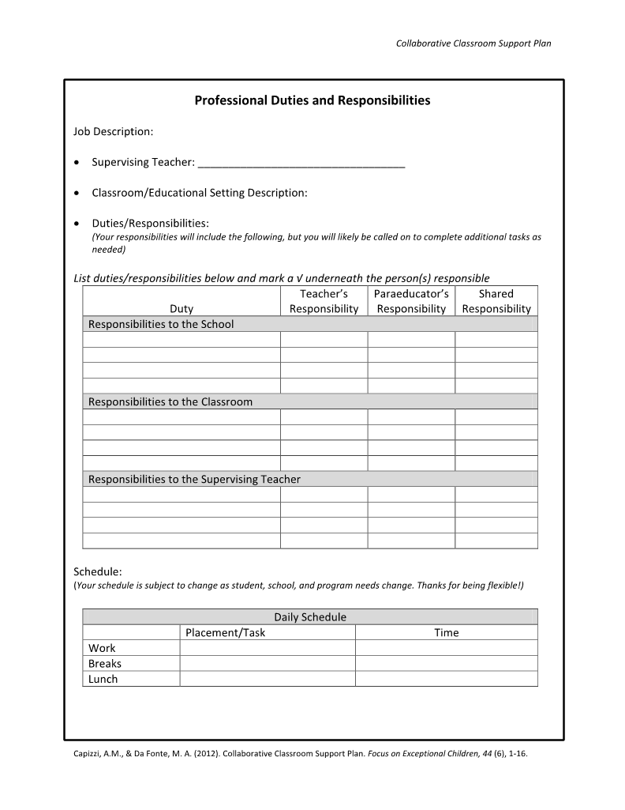
Roles and Responsibilities
When possible, before beginning a school year or on the paraeducators first day, collaboratively review and define the paraeducator’s role, including:
  responsibilities to the students,
  responsibilities to the special educator,
  responsibilities to the general education teacher(s), and
  explain shared responsibilities.
Capizzi & Da Fonte (2012) created a tool that you can use to guide this work. (See sample on left.)

Slide 18
Special Educator and Paraeducator Roles Overview (Reminder)
Special Educator
  Collaboration with the general education teacher(s)
  Planning instruction and intervention
  Data-based decision-making to inform instruction and intervention
  Communication with parent(s)
  Developing the IEP
  Creating Progress Reports
  Ensuring accommodation(s) and/or modification(s) are implemented with fidelity
  Ensuring FAPE
Paraeducator
  Fully trained by and regular collaboration with the supervising special educator
  Delivering instruction and/or intervention as directed
  Collecting formal and informal data to inform decision-making
  Communicate with special educator
  Support implementation of the IEP
  Support use of accommodation(s) and/or modification(s)
Both
Engage with the student
Progress monitor
Collaborate regularly

Slide 19

Purposeful Collaboration
Finding the time to meet is the first step. Planning how to spend the time is also important.
The meeting should focus on specific student needs, not a general check-in on the adult’s schedule.
Both the paraeducator and the special educator should come with data on the student’s progress to analyze.
The special educator should share the instructional plans with the paraeducator and check for understanding.
There should be time to discuss any concerns or questions.

Slide 20
Collaboration Documentation
Documenting the decisions and discussion at each meeting creates a reference for clarification after the meeting and also evidence of ongoing supervision by the special educator.
Documentation can be done using a variety of tools and should include:
  date of the meeting,
  people present,
  summary of the discussion,
  key decisions made, and
  a note of any pending questions or concerns.

Slide 21
Example Meeting Log
Council for Exceptional Children

Slide 22
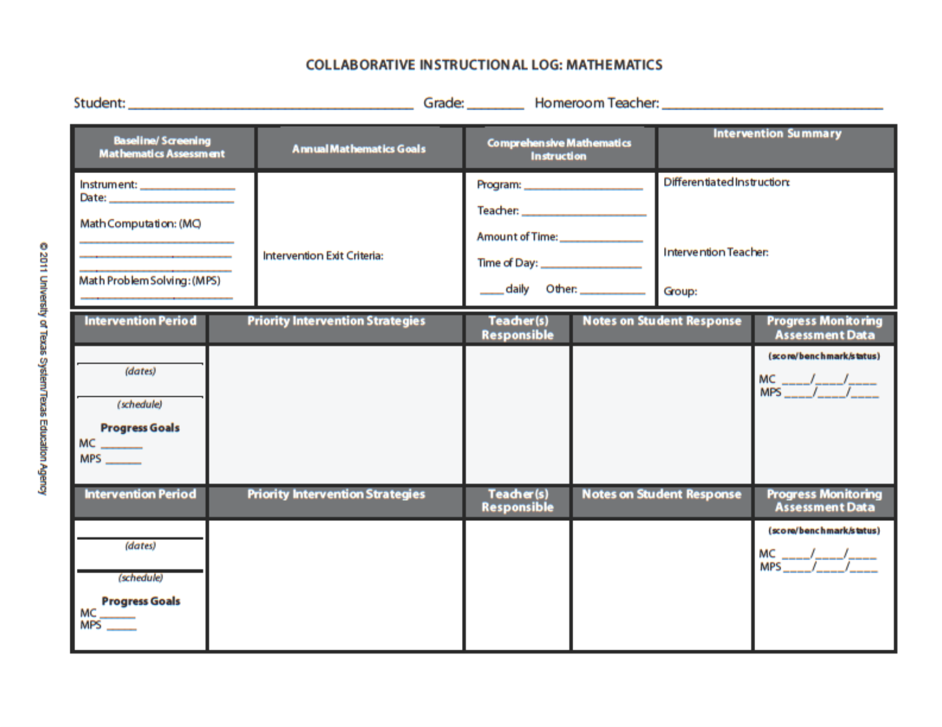
Example Meeting Log
The Meadows Center

Slide 23
Example Meeting Log Options
Create a Google Form
Use an Excel spreadsheet with a row for each student
Use a notebook for each student
Record the meeting
Create a Paraeducator Binder with policies, expectations, and a section for logging each meeting
What other tools have you used?

Slide 24

Conflict, Disagreements, and Misunderstandings
Even strong partnerships need to have a plan for dealing with conflict, disagreements, and misunderstandings.
It is best to choose a strategy when all team members are feeling valued and safe.
The strategy needs to meet the needs of all members of the team.
It is okay to seek a third neutral party as a facilitator, but you should be careful that they are not choosing sides or delivering a judgment.

Slide 25
Strategies for Conflict, Disagreements, and Misunderstandings
Establish clear communication expectations prior to a conflict.
Prior to a concern, learn about each other’s work style, communication styles, and strengths.
Recognize that some people want space to process, and others need to address the problem immediately. The plan needs to provide both time to process and a clear timeline for moving forward.
Identify a “safe word” or code for taking a break before emotions escalate.
Use a conversation protocol that requires active listening and thoughtful questioning.
Remember, you both want to do the best job possible. This is a chance to grow.

Slide 26
Communication and Work-Style Preference Tools
Capizzi & Da Fonte (2012)

Slide 27
Final Thoughts…

Slide 28

Summary
Paraeducators are important partners who work under the supervision of a licensed/endorsed special educator.
Providing training, coaching, and regular collaboration is key to paraeducator, and ultimately, student success. For example, the TRIAD ParaEducator Asynchronous Learning Course
Keeping a log of the decisions made during meetings will help everyone stay on track.
Everyone is a valuable team member, even when they do not all agree.

Slide 29
Bonus Idea: 10 Simple Ways to Appreciate Your Paraeducator
Introduce them
Treat them as equal
Say “thank you” at the end of the day
Get to know them
Ask for their feedback and value it
Use the term “paraeducator”
Buy them coffee
Write them a note
Give them a break
Include them in the school community

Slide 30

Questions or Comments?
Alison Gauld, Ed.D.
Alison.Gauld@tn.gov
615-854-9520
Permission is granted to use and copy these materials for non-commercial educational purposes with attribution credit to the “Tennessee Department of Education”.
If you wish to use the materials for reasons other than non-commercial educational purposes, please contact the office of general counsel at (615) 741-2921.​

