Slide 1
IT TAKES TWO:
Collaborating and
Co-Teaching for Special Populations
Presented By: Ginna Winstead, B.S., M.Ed.
Former Teacher with Clarksville-Montgomery County

Slide 2
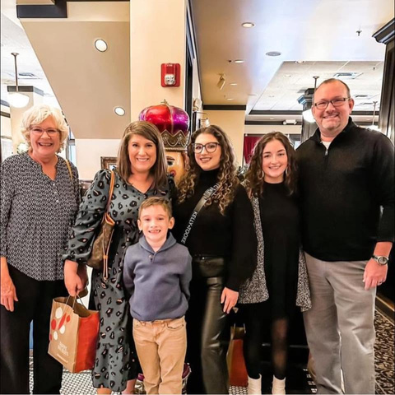
ABOUT ME
Wife, Mother, Daughter, Lifelong Learner, Activist
  Born in Nashville
  Identified as Gifted in 1st Grade
  Graduate of MLK Magnet
  Married to Scott
  Mom and Bonus Mom to Abbi, Sydney, and Oliver
  Graduate of Austin Peay
    Undergrad: B.S. Chemistry
    M.Ed. Educational Leadership
  Passionate About Shopping, Traveling, and Making Life Easier

Slide 3

Participation expected
Notes:
I am not an expert.
I am just like you.
We are better together.
For the next hour, we will work together.

Slide 4
Task #1
  What do you want to take away from this session?

Slide 5
Task #2
  Think about your experience in the classroom co-teaching.
  Identify THREE glows and THREE grows.

Slide 6
CO-TEACHING
6 Models Are Taught
One Teach,
One Observe
Station
Teaching
One Teach,
One Assist
Parallel
Teaching
Alternative
Teaching
Team
Teaching

Slide 7
CO-TEACHING
It’s not a one size fits all!
Co-teaching is the dependent variable in an inclusive classroom.

Slide 8
CO-TEACHING
Share with a friend:
  What is your ideal way to co-teach?
  What has been your default method of co-teaching?

Slide 9
CO-TEACHING
  “Read the Room”
  Understand Who is Responsible for What
  KNOW YOUR STUDENTS
  Utilize Eachother’s Strengths
  Adapt and Adjust

Slide 10
Task #3
  Think about what collaboration looks like to you.
  Write down ONE thing you want improve this year.

Slide 11
POP QUIZ
WHAT IS COLLABORATION?

Slide 12
ACCORDING TO GOOGLE:
Collaboration is the process of two or more people, organizations, or entities working together to complete a task to achieve a shared goal. It involves pooling different skill sets, sharing resources, and exchanging knowledge to create an outcome that is greater than what could be achieved individually.

Slide 13
MCREL INTERNATIONAL
Balanced Leadership
Classroom
Practices
Desired
Student
Outcome
School
Practices
Student
Supports

Slide 14
MCREL INTERNATIONAL
Balanced Leadership
Create a Purposeful Community
Establish a Clear Focus
Manage Change
Notes:
Focusing on right classroom and school practices gives a powerful positive effect on student performance.
Managing change to prevent misinterpretation.
Purposeful community sharing purposes leads to more sustainable and effective changes in student performance.

Slide 15
MCREL INTERNATIONAL
Balanced Leadership
Is your classroom a community?
Who is a member of that community?
Is it purposeful?

Slide 16
MCREL INTERNATIONAL
Balanced Leadership
Defining a Puposeful Community:
  Academic Optimism
  Moral Purpose
  Intentional Use of Assets
  Community Engagement

Slide 17
Task #4
  Can you have effective collaboration without a purposeful community?

Slide 18
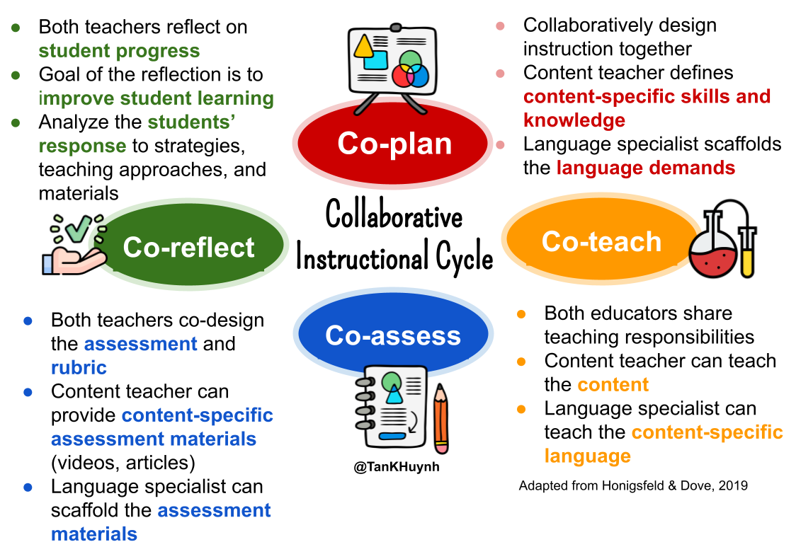

Slide 19
COLLABORATION
in real life....
We have a minimum of 150 minutes for individual duty-free planning time per week in Tennessee.
What changes can be made to make it easier to collaborate effectively?

Slide 20
Thank you!
What else can we solve?

