Slide 1

Strategies for Being a Meaningful High School Counselor
Dr. Tim Gott
School Counselor
Blackman High School

Slide 2

Focus of Today’s Session
Your Why
Student Connection
Working with Parents
Time Management
Self Care

Slide 3

Your Why
What is your compass?

Slide 4

Your Why
Why did you choose to be a counselor?
How do you do counseling?
What is the end result?

Slide 5

Student Connection
Let students know they are seen, heard, and valued
  Make quality time to connect
  Names (if possible)
  Celebrate your students

Slide 6

Student Connection
Use powerful questions
  Open Ended
  Not just Yes or No
  Based on what you observe
  How have you handled this in the past?
  What would you tell your friend if she was in this situation?

Slide 7
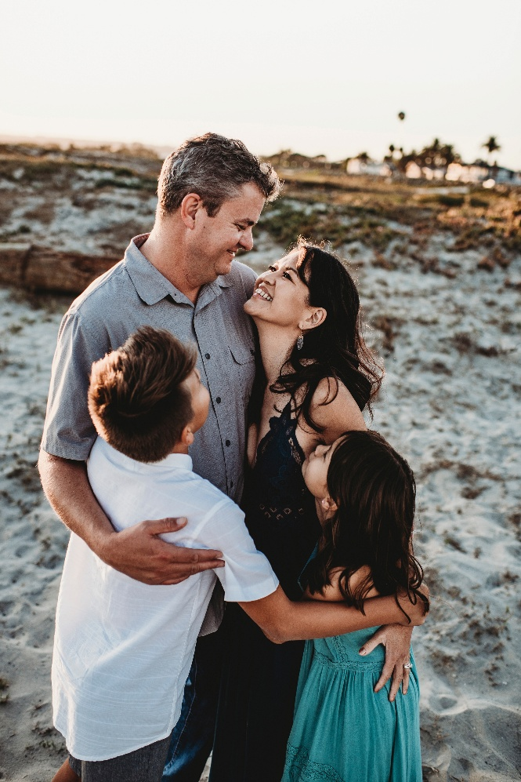
Working With Parents
See them as partners
Make connections by phone, email, social media, newsletters
Listen to their concerns before we respond

Slide 8

Time Management
Lean, Mean, and Meaningful

Slide 9

Time Management
Set your boundaries and then milk the minutes
Tight-fisted vs. Open-handed
Hours of availability
Timeframe to respond

Slide 10
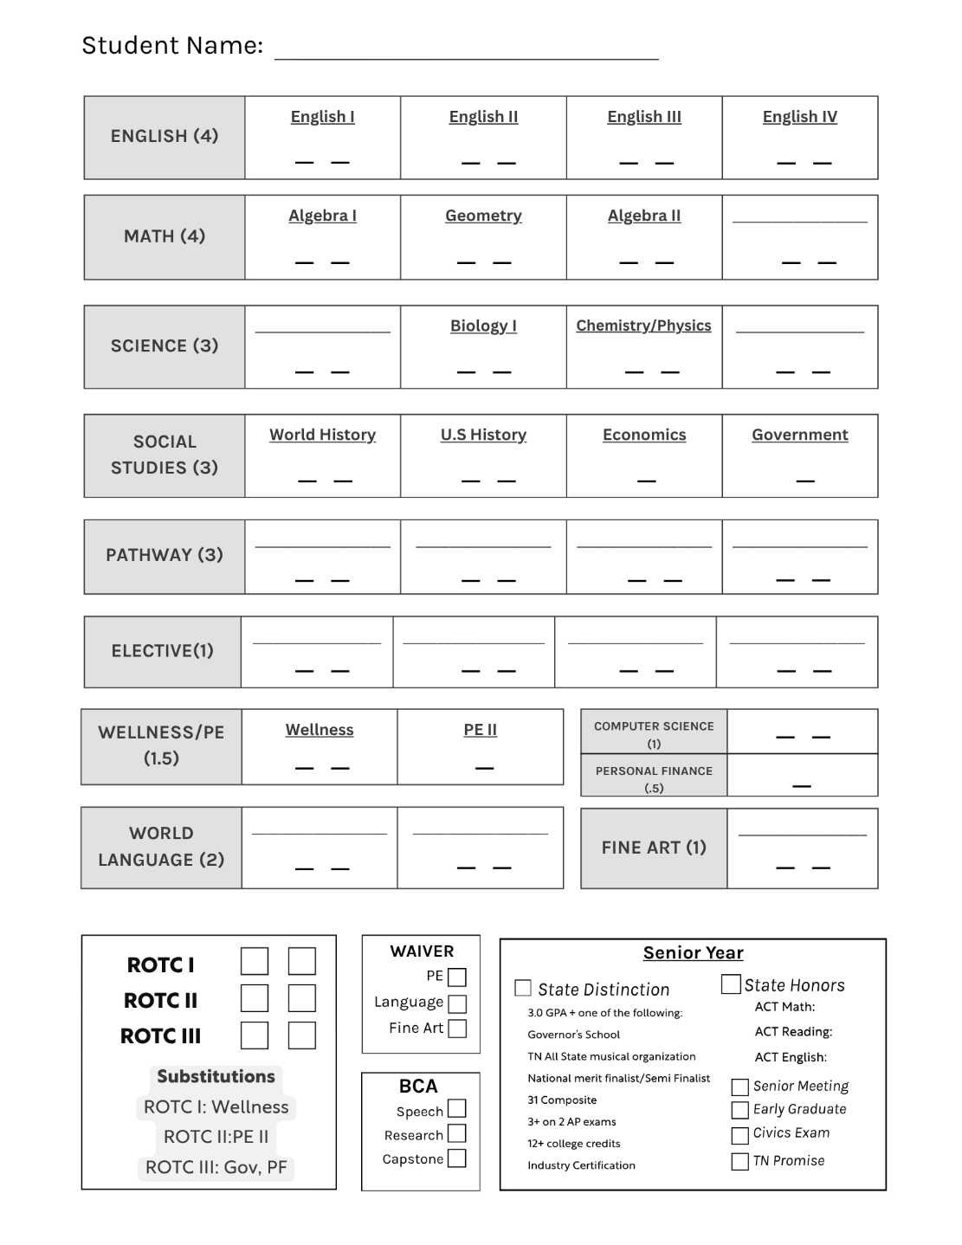
Time Management
Use your tools

Slide 11
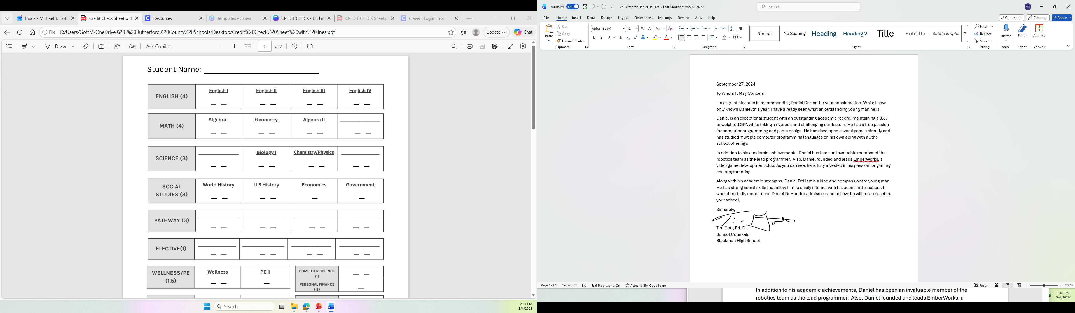
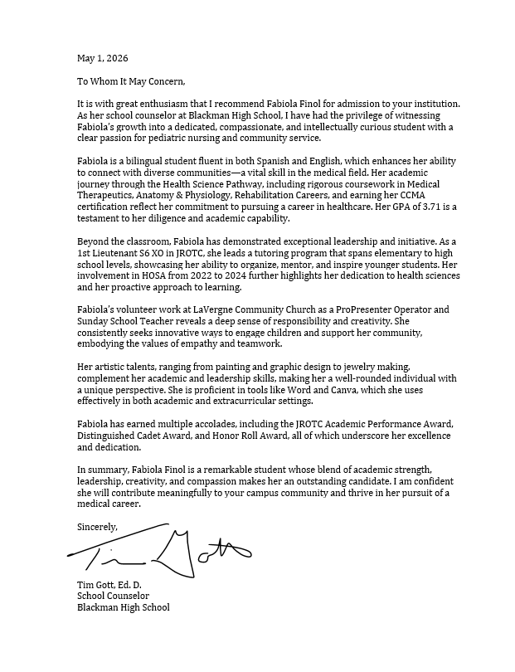
Time Management
Letters
of
Recommendation

Slide 12



Self Care
Put your oxygen mask on first

Slide 13
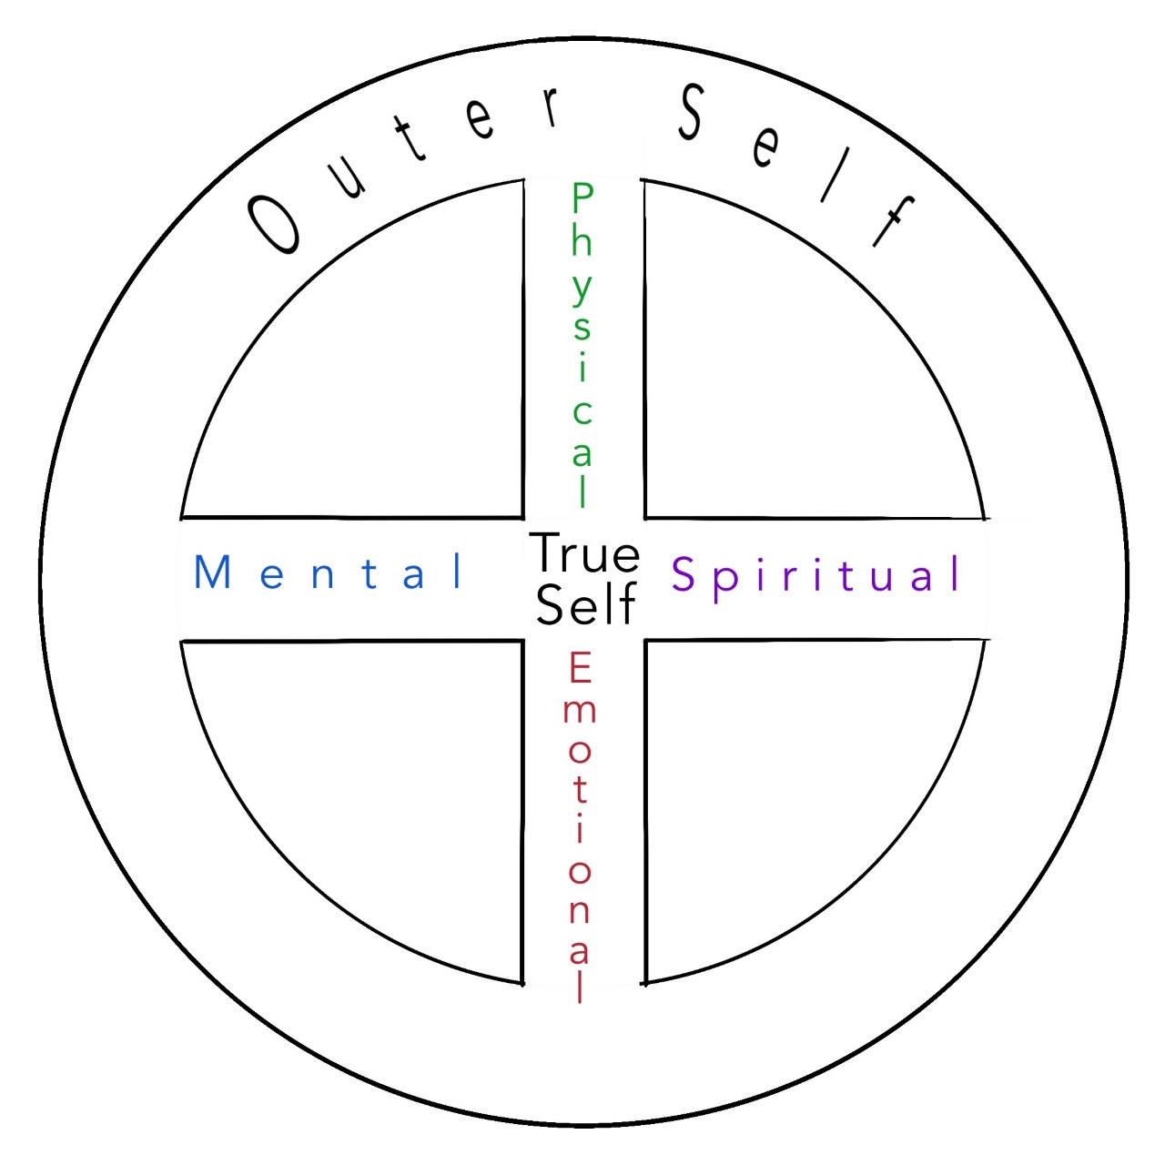
Self Care
Finding Your Balance

Slide 14
Self Care
Complete the stress cycle
Physical Activity
Breathing
Positive Social Interaction
Affection
Crying
Laughter
Creative Expression
From Burnout: The Secret to Solving the Stress Cycle by Amelia and Emily Nagoski

Slide 15
Contact Information
Tim Gott
gottm@rcschools.net
tim.gott@wku.edu
270-307-0135
www.gottcc.com

