Slide 1
Engineering Feelings
Connecting STEAM and Counseling
Emily Fain-Lynch- MA,LSC

Slide 2
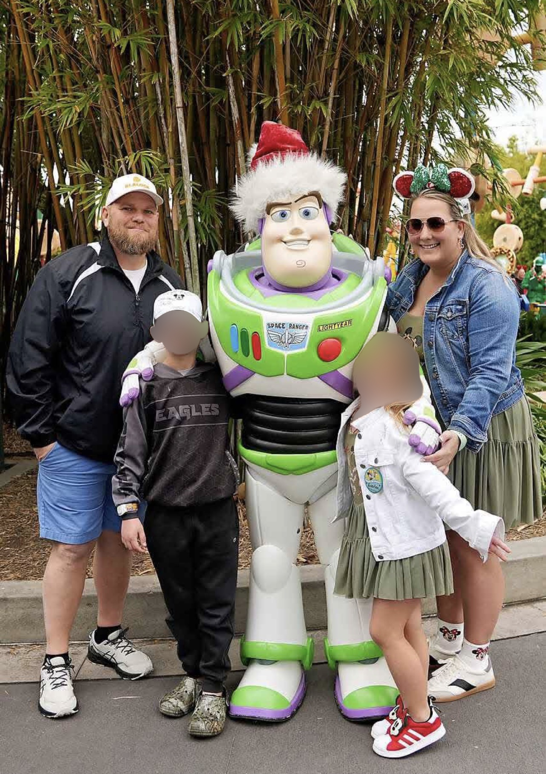

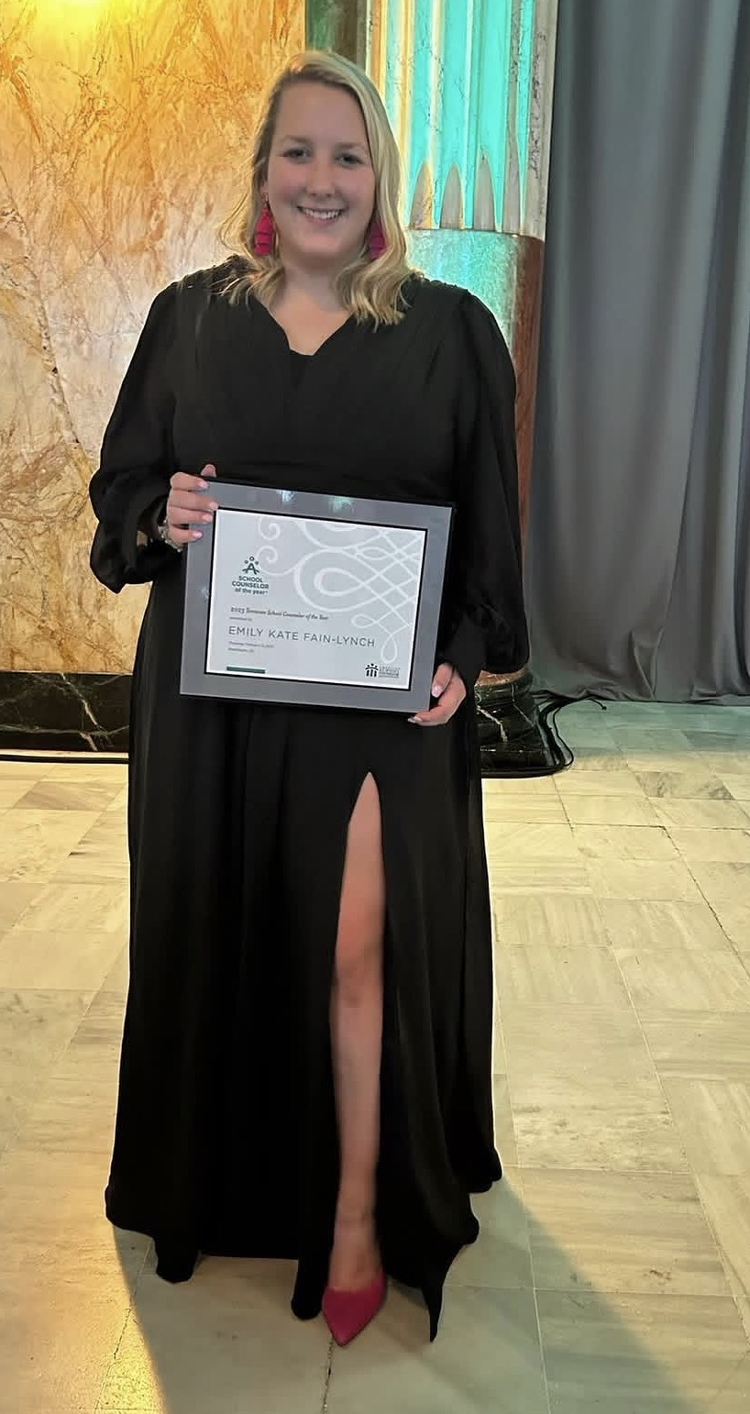
Emily Fain-Lynch
Going into year 9
TN School Counselor of the Year 2023

Slide 3
Green Magnet Academy
STEM Designated since
Title 1
360 students Kinder-5th

Slide 4
What is STEAM
SCIENCE
TECHNOLOGY
ENGINEERING
ART
MATH

Slide 5
Engineering Design Process
ASK
IMAGINE
PLAN
CREATE
IMPROVE

Slide 6
PBL
Project Based Learning
Problem Based Learning
Learning Intentions and Success Criteria

Slide 7
For Example
Today we are learning how STEAM and School Counseling can be connected to create meaningful learning for students.
We are successful when we have garnered new ideas for implementation of STEAM into our comprehensive school counseling programs.

Slide 8
Design Lab
Unique to my school
Full day instruction by design lab teacher while classroom teacher in room
Really got my start by collaborating with design lab teacher

Slide 9
My favorite things about STEAM- Creativity and Accessibility!
Great for students who struggle academically with reading, writing, etc.
Great opportunity to both practice teamwork and utilize team member strengths
Open-ended

Slide 10
Where to start?
Think about YOUR school- where can you begin? Certain teachers, grade levels, specialty areas?

Slide 11
Some things to consider when doing STEAM activities
What supplies? And money?
Time?
Display?
Cross curricular connection?

Slide 12
Questions about STEAM?

Slide 13
Classroom lesson examples…

Slide 14
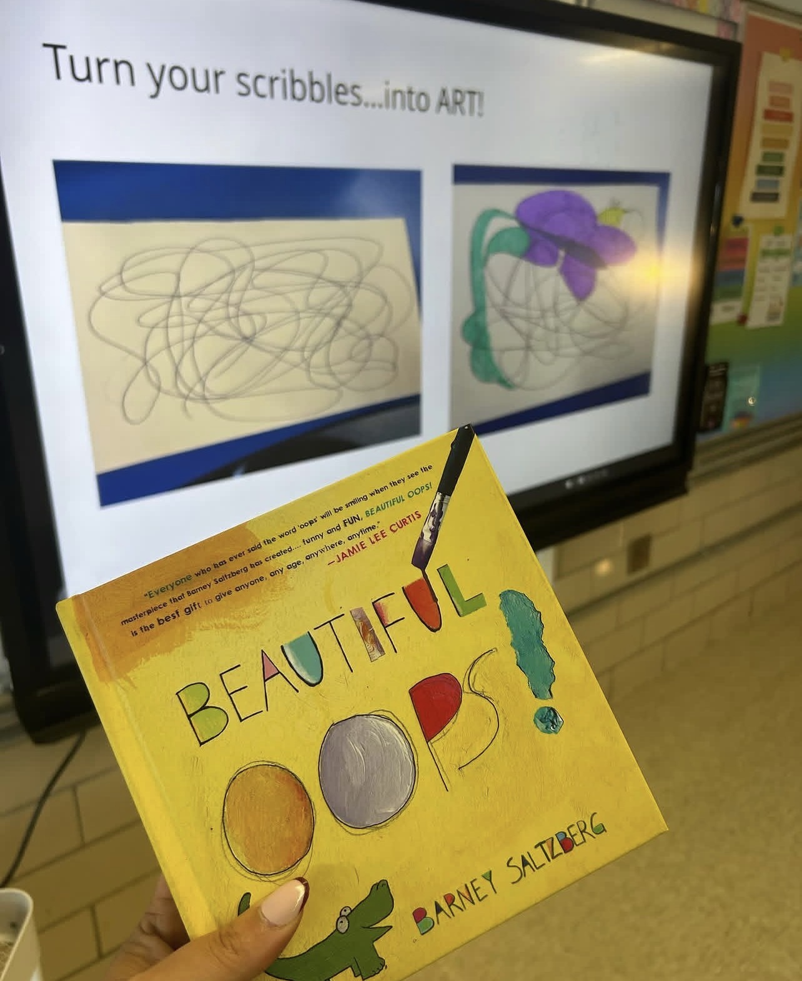
Growth mindset- doodle challenge

Slide 15
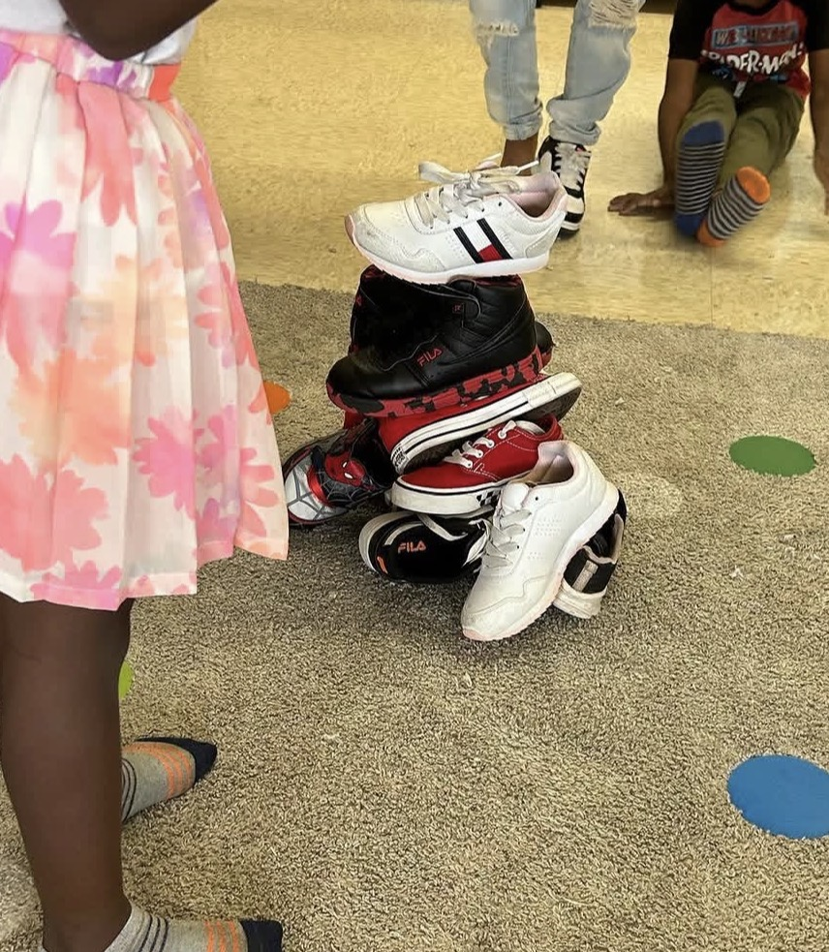
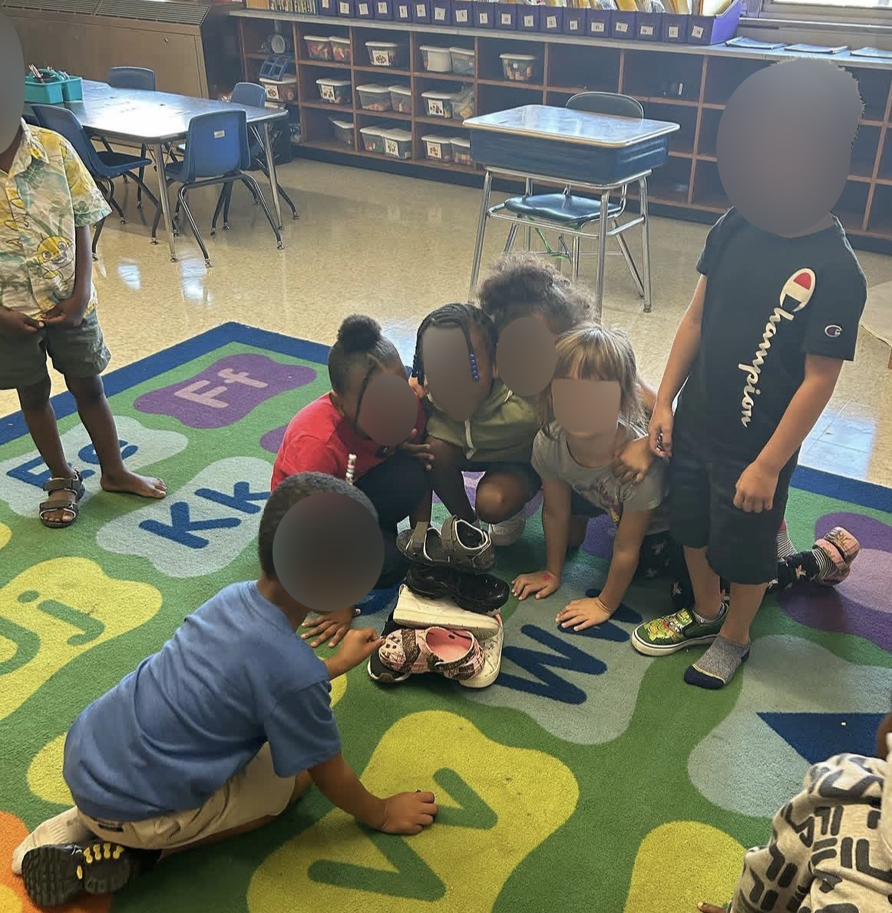
Teamwork- building challenges

Slide 16
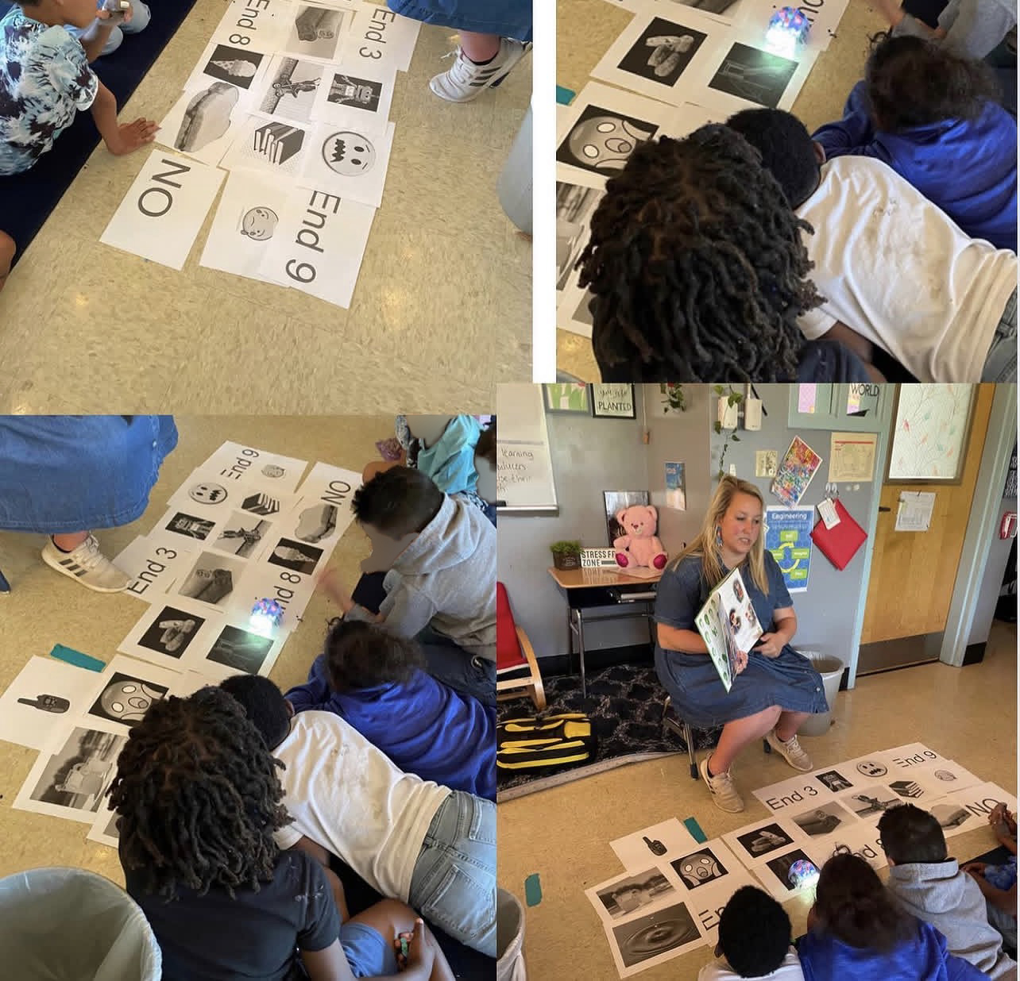
Choose your own adventure- with robots

Slide 17
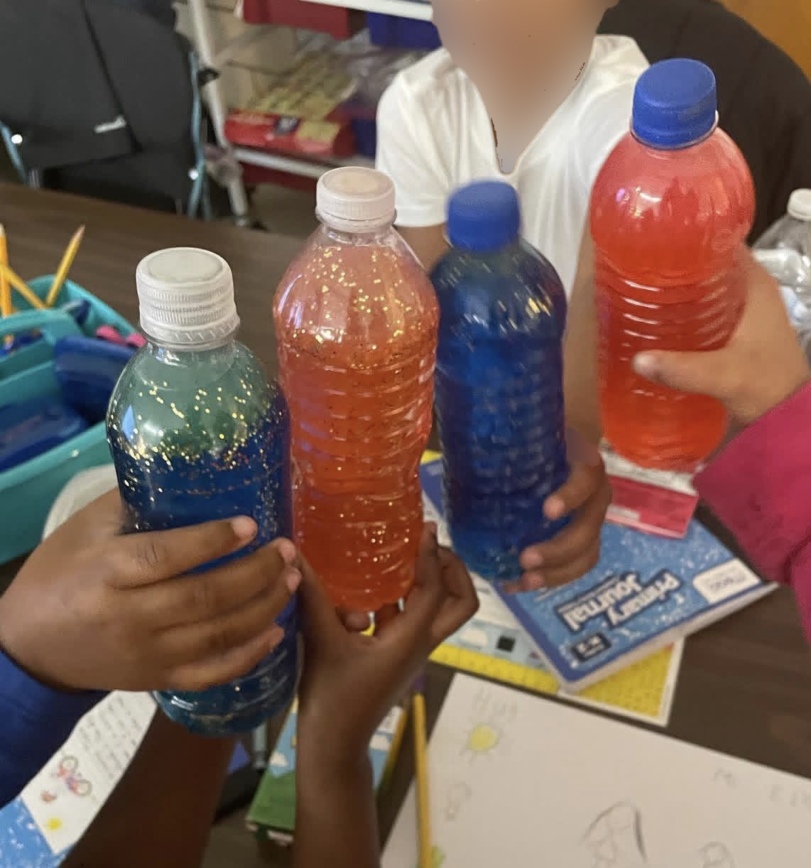
Calming tools creation

Slide 18
Anti-bullying
Story quilt
Stickers
Posters
Book

Slide 19
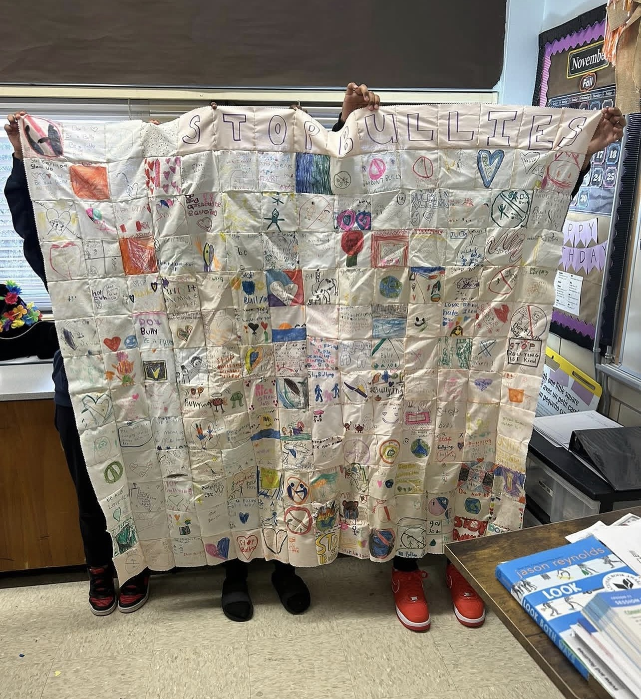
Story quilt

Slide 20
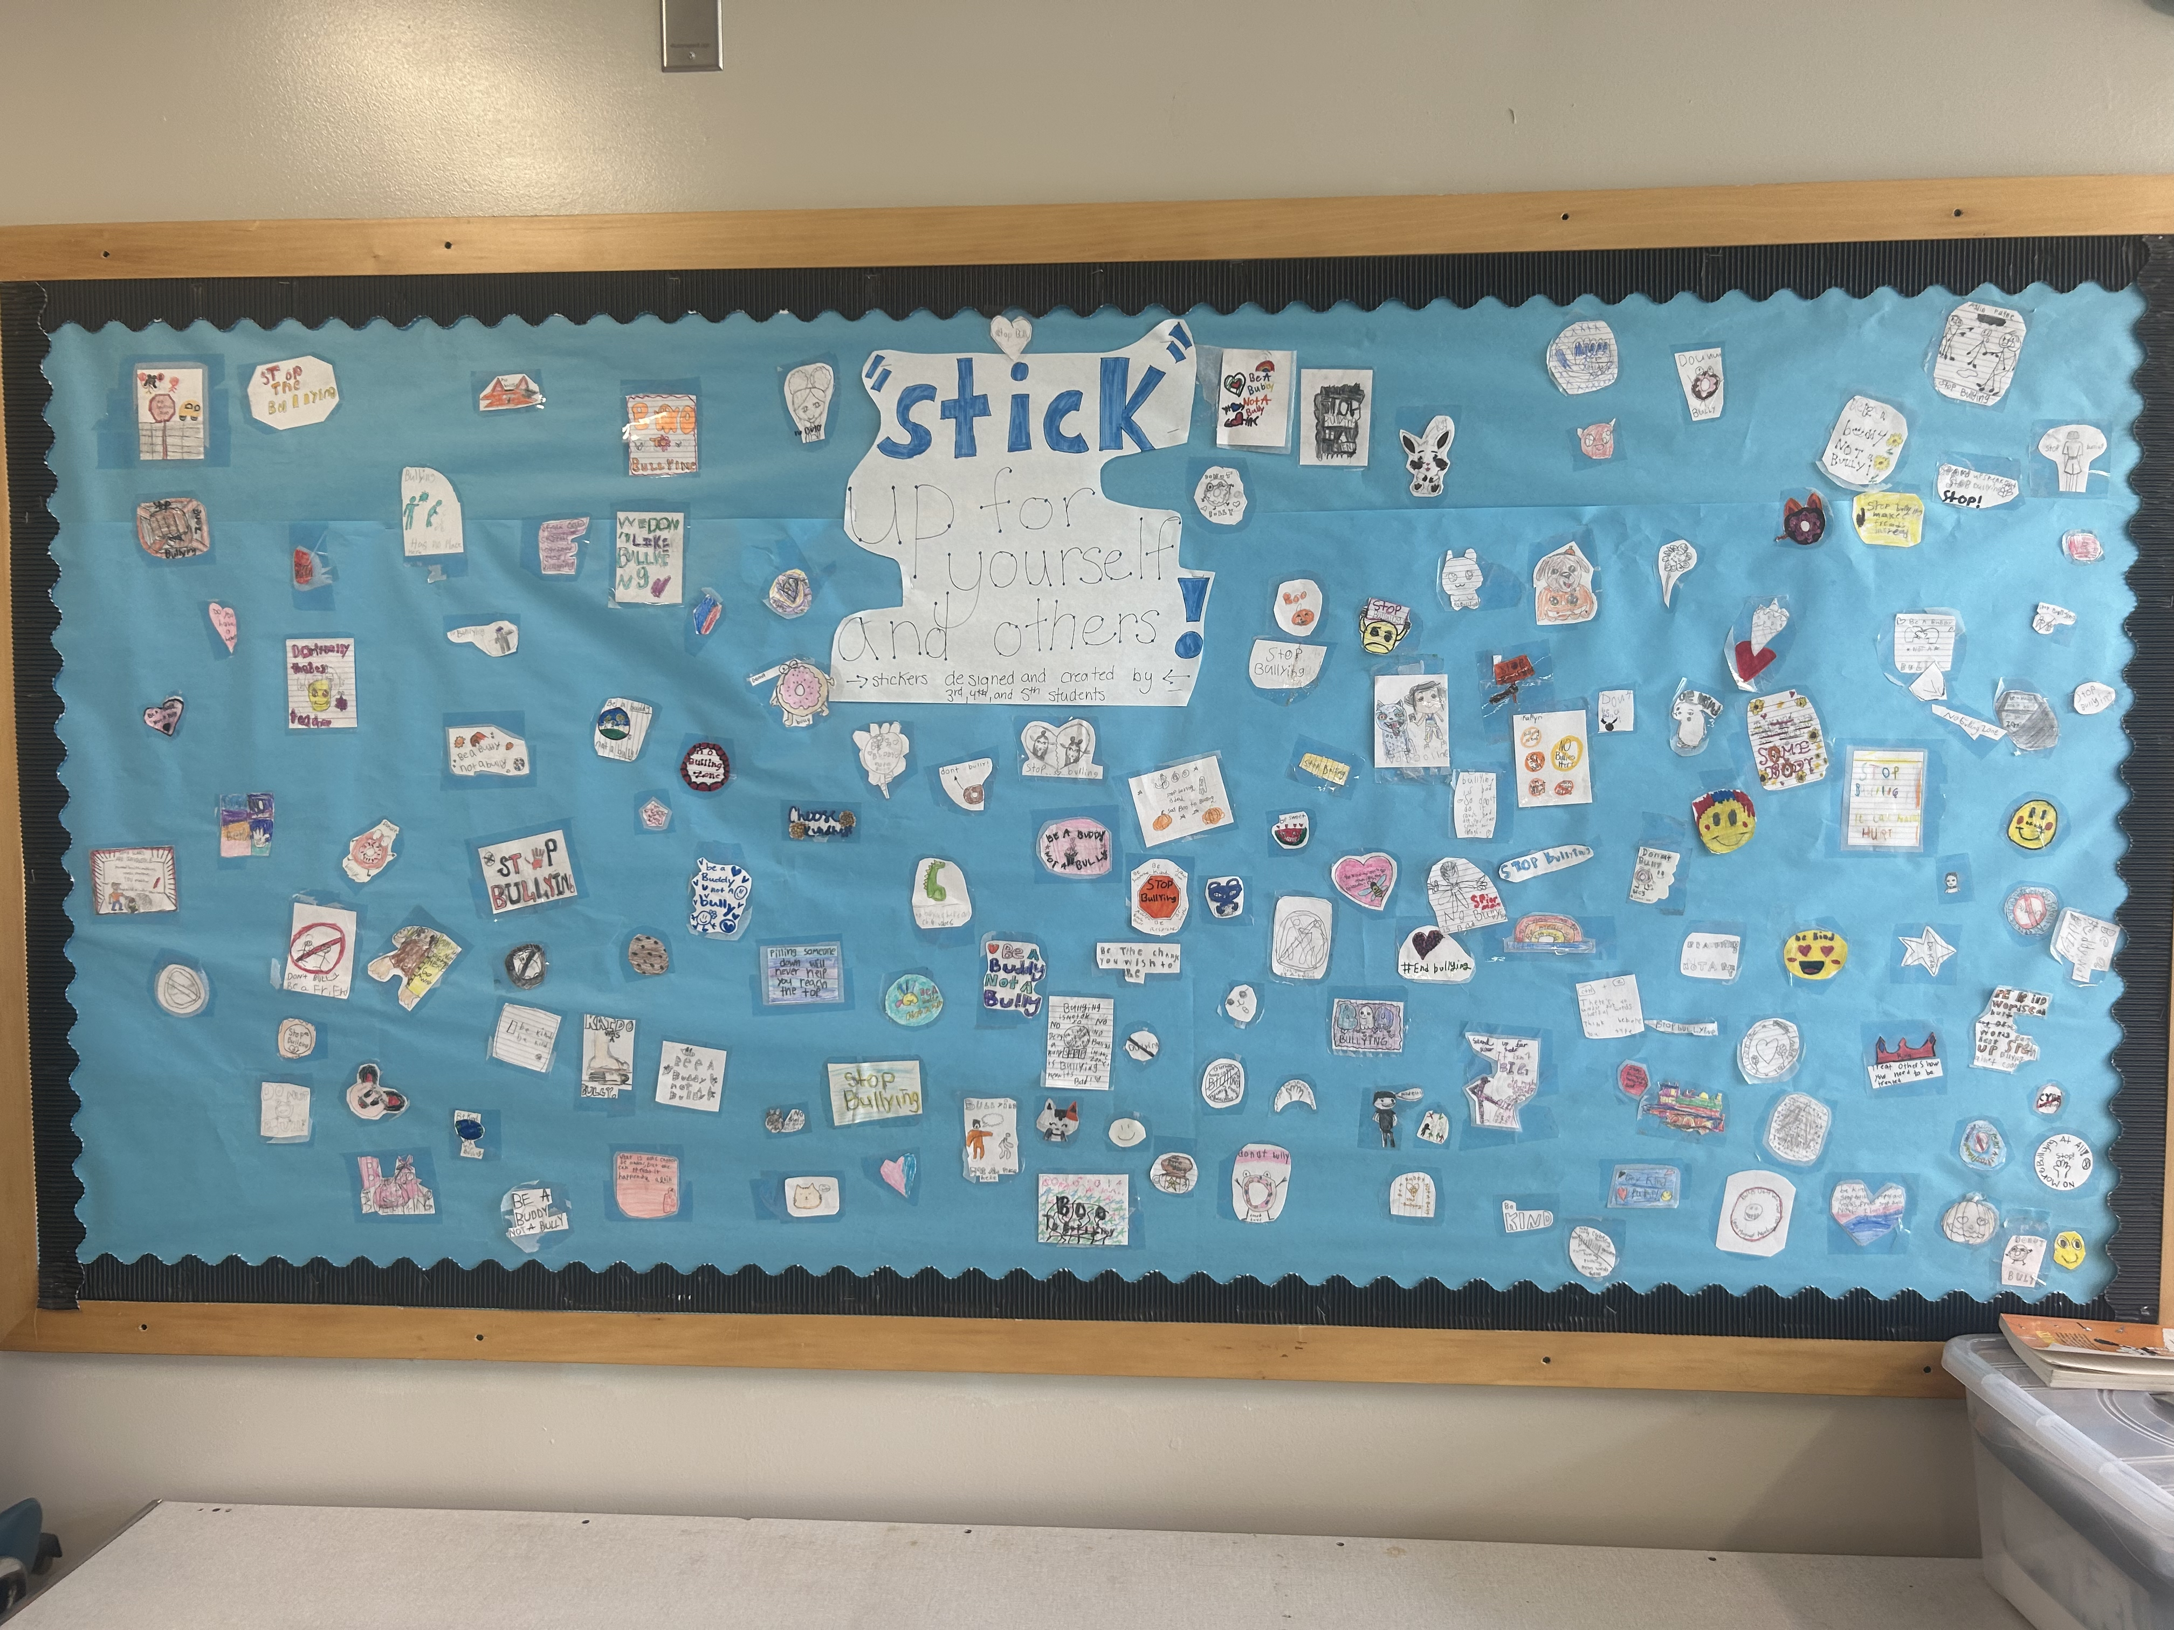
Stickers

Slide 21
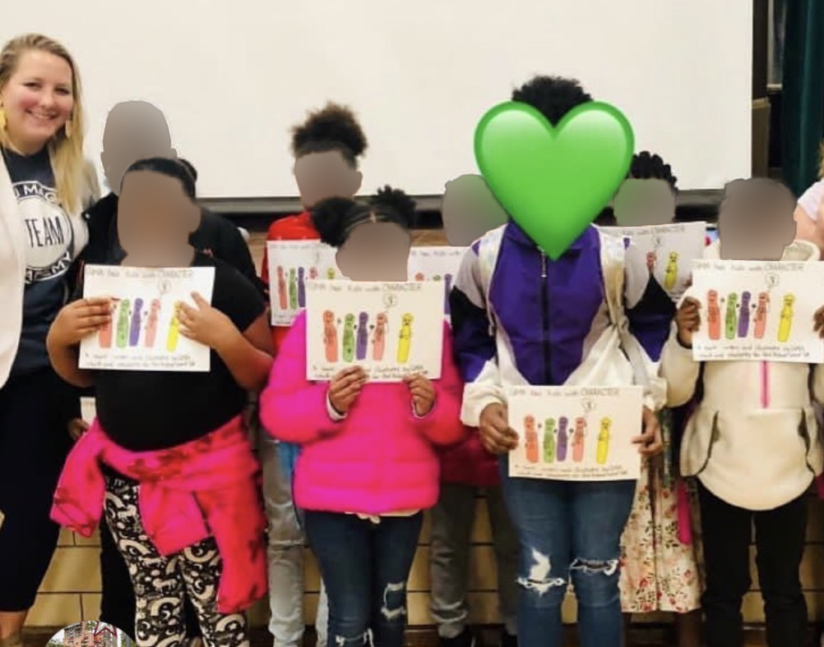
Book

Slide 22
Large Scale Projects
Logistics

Slide 23
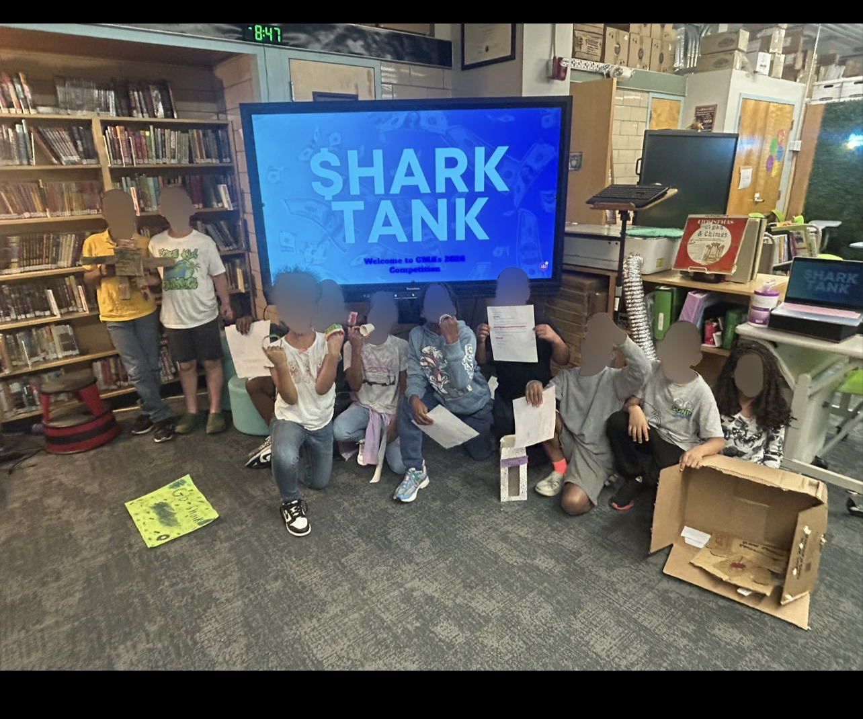
Shark Tank

Slide 24
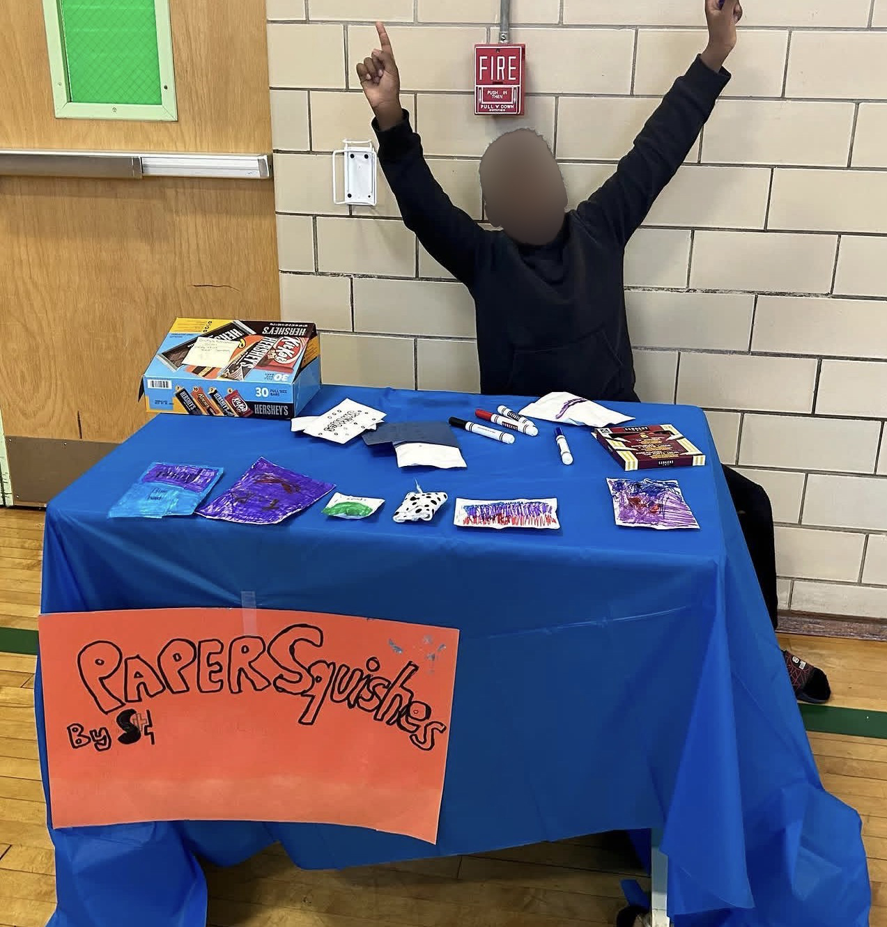
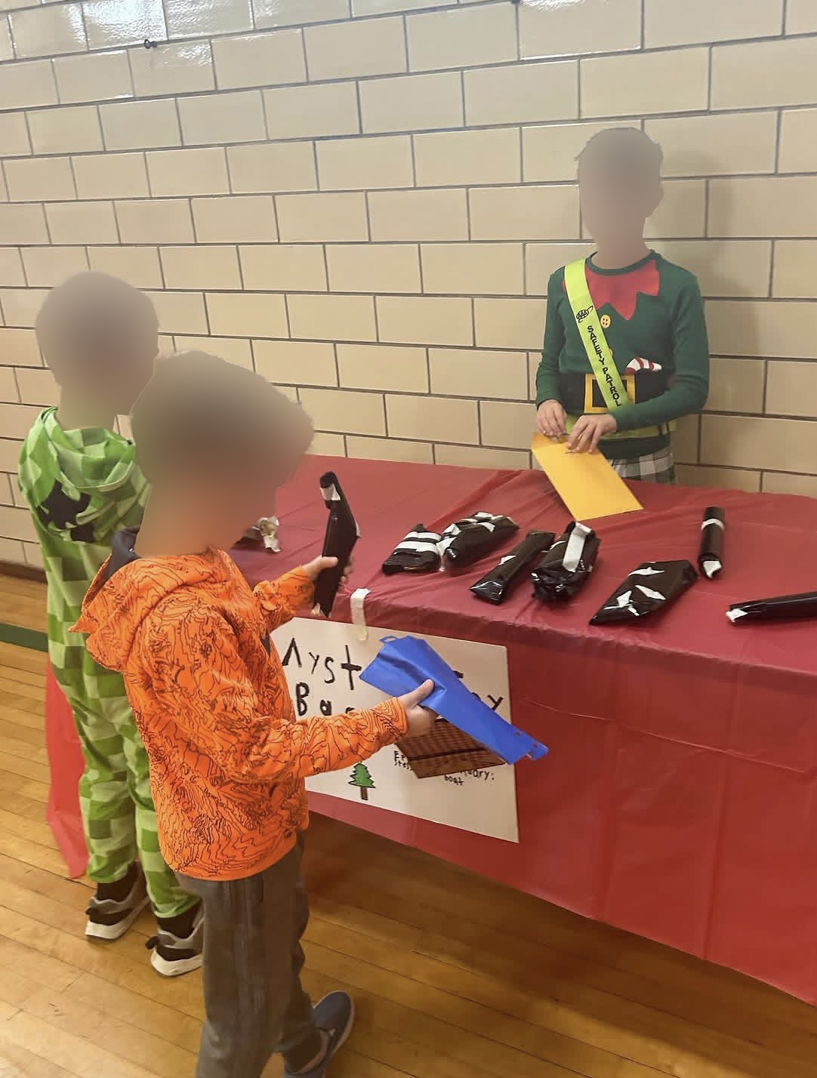
Christmas Market

Slide 25
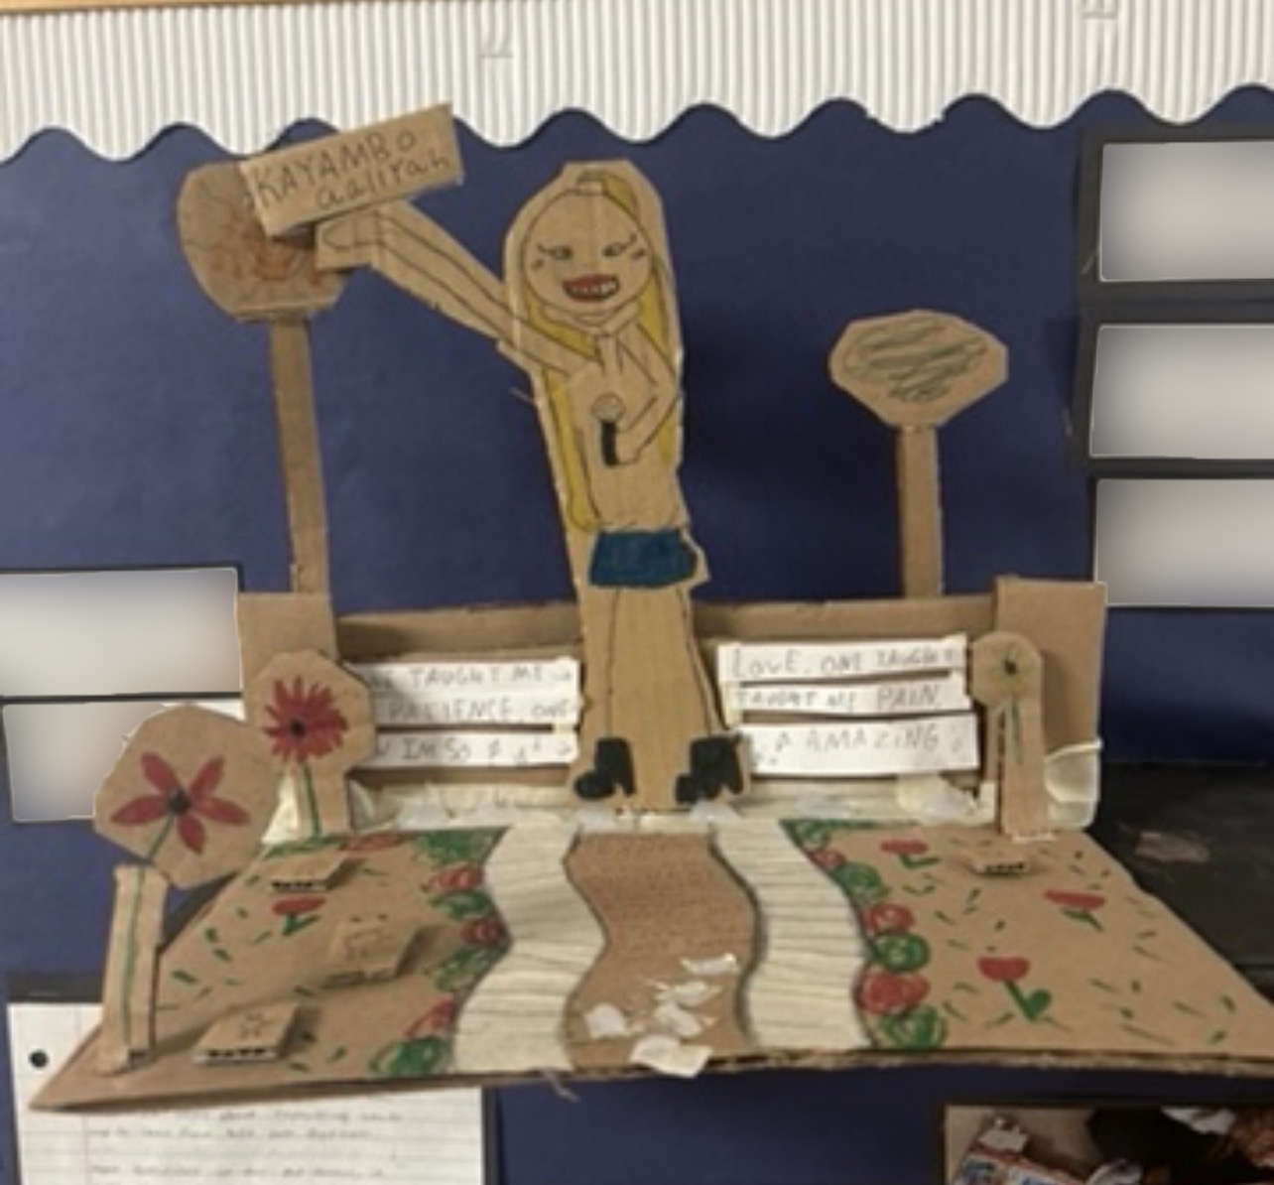
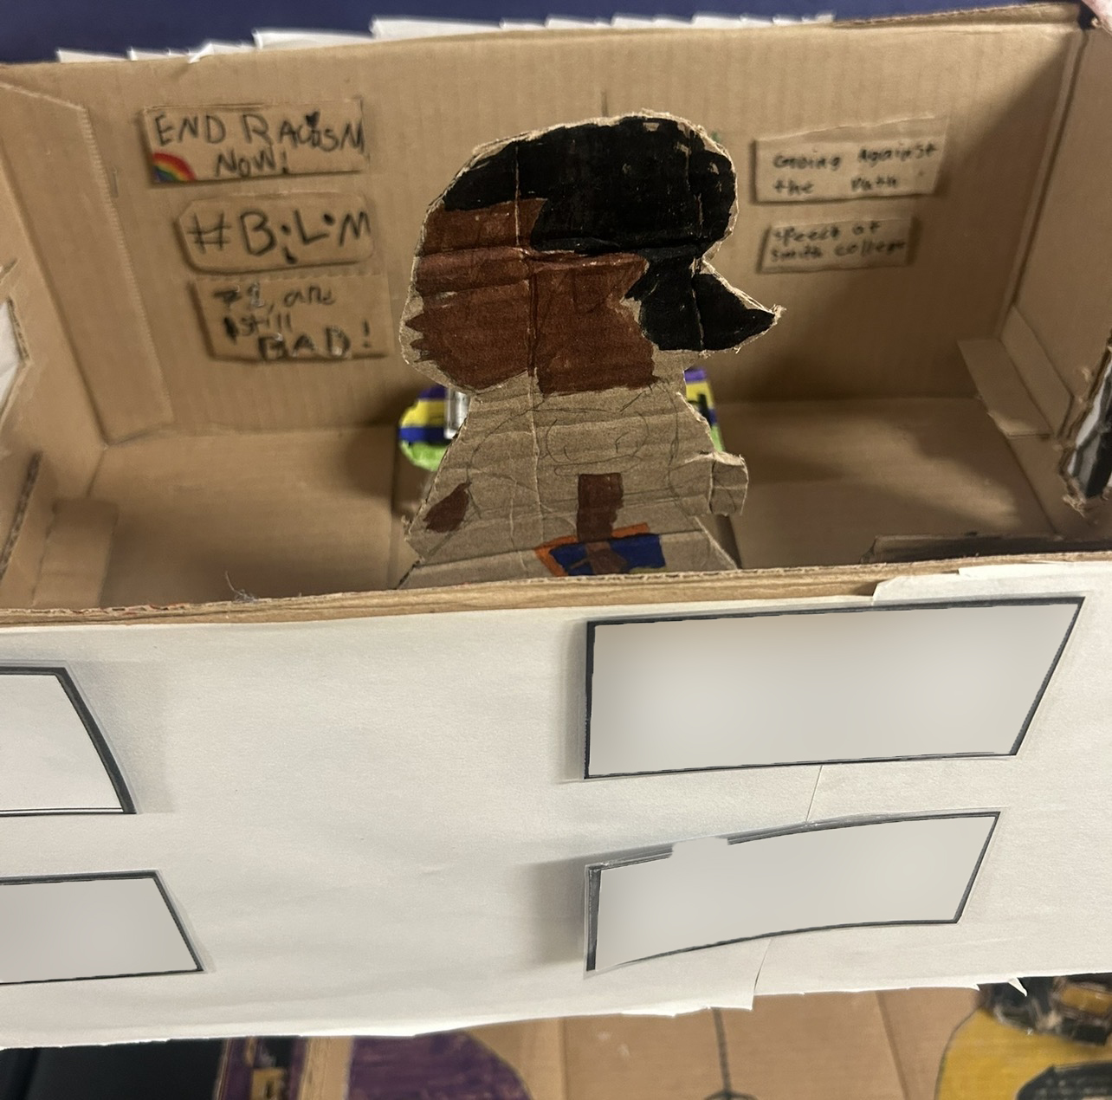
Memorializing Empathy

Slide 26
Idea Share- what ideas have sparked for you today?

Slide 27
Let’s try it! Boomerang Kidness Mini Lesson
Learning Intention: Today we are learning how kindness is like a boomerang!
Success Criteria: We are successful today we we have created a boomerang that promotes kindness!

