Slide 1






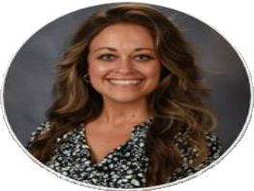
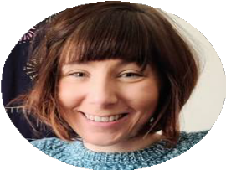
From to
Using ELPA PLDs with Purpose
Lauren Crutchfield
District High School ESL Instructional Coach Rutherford County Schools
Dr. Meghan Vigil
District Middle School ESL Instructional Coach
Rutherford County Schools

Slide 2

Reflection: Where I’m At
Defining Key Terms
Using Student Work to Set Language Goals
Managing Student Data
Reflection: Where I’m Going

Slide 3



p. 1

Slide 4




Reflection: Where I’m At

Slide 5


What does EL student goal-setting look like in your classroom, school, or district?

Slide 6


What do you want ELL student goal-setting to look like in your classroom, school, or district?

Slide 7

What does student goal-setting look like in your classroom, school, or district?
What do you want student goal-setting to look like in your classroom, school, or district?

Slide 8
Defining Key Terms

Slide 9





terms
Collecting Samples
recordings
written samples
typed samples
Student Work
Specifically productive artifacts (writing/speaking).

Slide 10

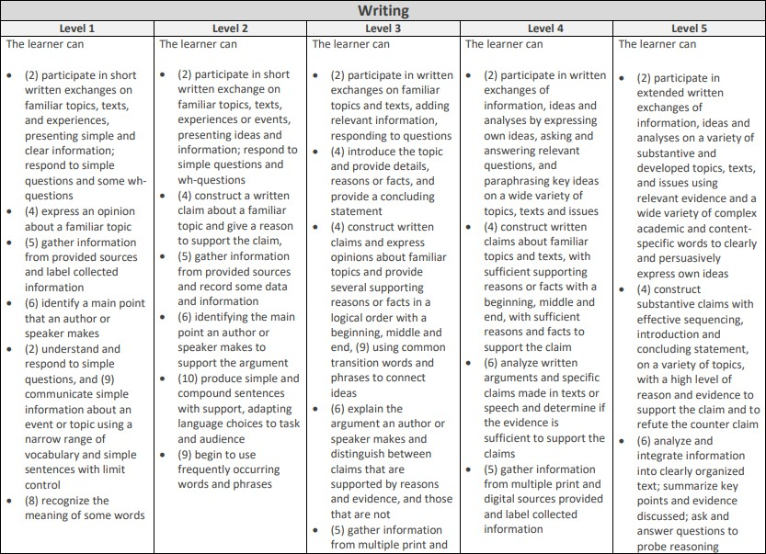
terms
PLDs
Proficiency Level Descriptors
PLDs are the "tool for assessing an English learner's degree of language proficiency," stated by ELPA21.

Slide 11

terms
PLDs
The domain Listening Reading Writing Speaking

Slide 12
terms
PLDs
The ELPA
Proficiency Level

Slide 13
terms
PLDs
The number beside the bullet
point is the standard it correlates to.

Slide 14
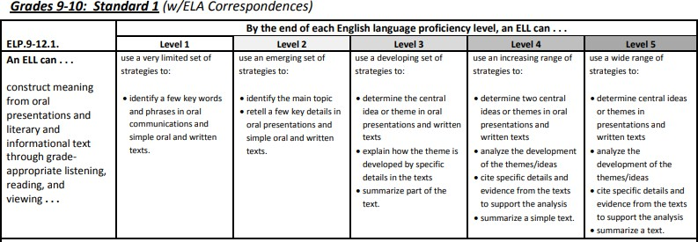
terms
Standards
“The 10 ELP Standards highlight a strategic set of language functions (what students do with language to accomplish content-specific tasks) and language forms (vocabulary, grammar, and discourse specific to a particular content area or discipline) which are needed by ELLs as they develop competence in the practices associated with English language arts (ELA) & literacy, mathematics, and science.”
https://elpa21.org/wp-content/uploads/2023/02/1.2.2-ELP-Standards-2014.pdf

Slide 15
terms
Standards
“The five ELP levels for each of the ELP Standards address the question, ‘What might an ELL’s language use look like at each ELP level as he or she progresses toward independent participation in grade-appropriate activities?’”
https://elpa21.org/wp-content/uploads/2023/02/1.2.2-ELP-Standards-2014.pdf

Slide 16

terms
PLC
A Professional Learning Community (PLC) is a team of educators who work together through continuous cycles of learning, collaboration, and reflection to enhance instruction and improve student success.

Slide 17

We will learn how to set targeted goals for ESL students using their writing and speaking work.
We will align goals with PLDs and ELPA21 standards and provide strategies to support students in reaching them.

Slide 18

Student Work Analysis
2024-25 PLC development
2025-26 PLC rollout
2026-27 PLC refinement
2027-28 PLC deepening

Slide 19

Student Work Analysis
We will use BOTH the PLDs and standards because PLDs are the "tool for assessing an English learner's degree of language proficiency," stated by ELPA21. PLDs are a summary, but when there are times we need more to go on to make a scoring decision, we will use the standards. These two documents support one another.

Slide 20

Frequent monitoring of student progress allows us to provide targeted feedback to individual students and identify patterns in learning that inform instructional adjustments.

Slide 21


Feedback is information given to a learner about their performance relative to learning goals or outcomes.
Hattie, J., & Zierer, K. (2018). Visible learning: The sequel—A synthesis of over 2,100 meta-analyses relating to achievement. Routledge.

Slide 22


Subjective Data
Definition: Based on thoughts, feelings, and opinions within the observer’s mind.
Flaw: How valid is it? Would others think the same? What do you have to show?
Sounds like: “My students are struggling.”

Slide 23

Objective Data
Subjective Data
Definition: Based on thoughts, feelings, and opinions within the observer’s mind.
Definition: Based on actual facts external to the mind. There is proof.
Power: Undeniable reality
Sounds like: “My students can identify the main idea but can’t explain their reasoning.” OR “40% of the students still can’t correctly write a complex sentence.”
Flaw: How valid is it? Would others think the same? What do you have to show?
Sounds like: “My students are struggling.”

Slide 24
Objective Data
Objective data protects you against bias, favoritism, and perceptual errors.
Subjective Data
Definition: Based on thoughts, feelings, and opinions within the observer’s mind.
Definition: Based on actual facts external to the mind. There is proof.
Power: Undeniable reality
Sounds like: “My students can identify the main idea but can’t explain their reasoning.” OR “40% of the students still can’t correctly write a complex sentence.”
Flaw: How valid is it? Would others think the same? What do you have to show?
Sounds like: “My students are struggling.”

Slide 25
Using Student Work to Set Language Goals

Slide 26




Language Check
Write a narrative about a typical day in your life. Start with your morning routine (waking up, eating breakfast, getting ready). Include any interactions with family or people you live with. Then describe your day activities, such as school, work, errands, or hobbies.
Mention places you go and people you
meet. End by sharing a memorable moment or how your day made you feel.
p.2

Slide 27


Using the Proficiency Level Descriptors (PLDs), where would I score this sample?
What did the student do to reach that level of proficiency, and which specific skills did they demonstrate?
What did the student not do to reach the next level of proficiency, and which specific skills prevented their advancement?

Slide 28
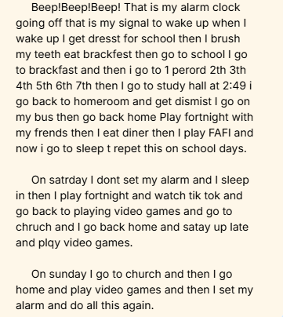
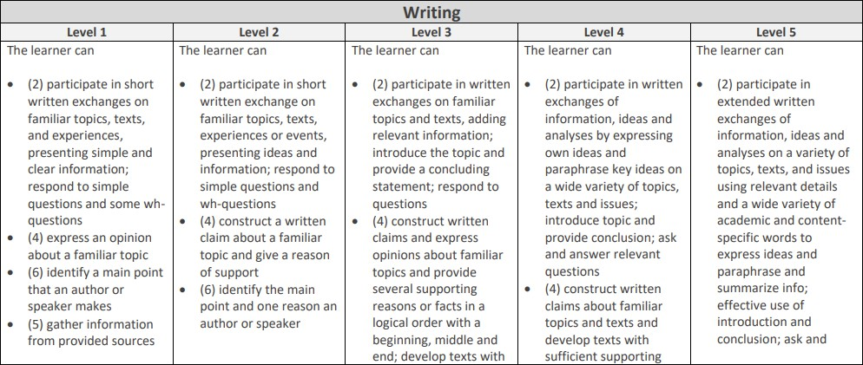
Using the Proficiency Level Descriptors (PLDs), where would I score this sample?
p.2

Slide 29
Using the Proficiency Level Descriptors (PLDs), where would I score this sample?
Writing
Level 2 | Level 3 | Level 4
The learner can (2) participate in short written exchange on familiar topics, texts, experiences or events, presenting ideas and information; respond to simple questions and wh-questions | The learner can (2) participate in written exchanges on familiar topics and texts, adding relevant information; introduce the topic and provide a concluding statement; respond to questions | The learner can (2) participate in written exchanges of information, ideas and analyses by expressing own ideas and paraphrase key ideas on a wide variety of topics, texts and issues; introduce topic and provide conclusion; ask and answer relevant questions

Slide 30
Using the Proficiency Level Descriptors (PLDs), where would I score this sample?
Writing
Level 2 | Level 3 | Level 4
The learner can | The learner can | The learner can
(2) participate in | (2) participate in | (2) participate in
short written | written exchanges | written
exchange on | on familiar topics | exchanges of
familiar topics, | and texts, adding | information,
texts, experiences | relevant | ideas and analyses
or | information; | by
events, presenting | introduce the | expressing own
ideas and | topic and provide a | ideas and
information; | concluding | paraphrase key
respond to simple | statement; respond | ideas on a wide
questions and wh- | to questions | variety of topics,
questions |  | texts and issues;
 |  | introduce topic and
 |  | provide conclusion;
 |  | ask and answer
 |  | relevant questions

Slide 31
Using the Proficiency Level Descriptors (PLDs), where would I score this sample?
Writing
Level 2 | Level 3 | Level 4
(4) construct a written claim about a familiar topic and give a reason of support | (4) construct written claims and express opinions about familiar topics and provide several supporting reasons or facts in a logical order with a beginning, middle and end; develop texts with some details using common transition words and phrases to connect ideas | (4) construct written claims about familiar topics and texts and develop texts with reasons or facts with a beginning, middle and end, with sufficient reasons and facts to support the claim

Slide 32
Using the Proficiency Level Descriptors (PLDs), where would I score this sample?
Writing
Level 2 | Level 3 | Level 4
(4) construct a written claim about a familiar topic and give a reason of support | (4) construct written claims and express opinions about familiar topics and provide several supporting reasons or facts in a logical order with a beginning, middle and end; develop texts with some details using common transition words and phrases to connect ideas | (4) construct written claims about familiar topics and texts and develop texts with reasons or facts with a beginning, middle and end, with sufficient reasons and facts to support the claim

Slide 33
Using the Proficiency Level Descriptors (PLDs), where would I score this sample?
Writing
Level 2 | Level 3 | Level 4
(10) produce simple and compound sentences with support, using frequently occurring words and phrases, adapting language choices to task and audience | (10) produce and expand simple, compound, and a few complex sentences using an increasing number of general academic and content specific words and phrases in short written texts that shows developing style and tone | (10) use standard English to accurately communicate using compound and complex sentences, including transitional words and phrases, adapting language to purpose, task and audience

Slide 34
Using the Proficiency Level Descriptors (PLDs), where would I score this sample?
Writing
Level 2 | Level 3 | Level 4
(10) produce simple and compound sentences with support, using frequently occurring words and phrases, adapting language choices to task and audience | (10) produce and expand simple, compound, and a few complex sentences using an increasing number of general academic and content specific words and phrases in short written texts that shows developing style and tone | (10) use standard English to accurately communicate using compound and complex sentences, including transitional words and phrases, adapting language to purpose, task and audience

Slide 35
Using the Proficiency Level Descriptors (PLDs), where would I score this sample?
Writing
Level 2 | Level 3 | Level 4
(10) produce simple and compound sentences with support, using frequently occurring words and phrases, adapting language choices to task and audience | (10) produce and expand simple, compound, and a few complex sentences using an increasing number of general academic and content specific words and phrases in short written texts that shows developing style and tone | (10) use standard English to accurately communicate using compound and complex sentences, including transitional words and phrases, adapting language to purpose, task and audience

Slide 36
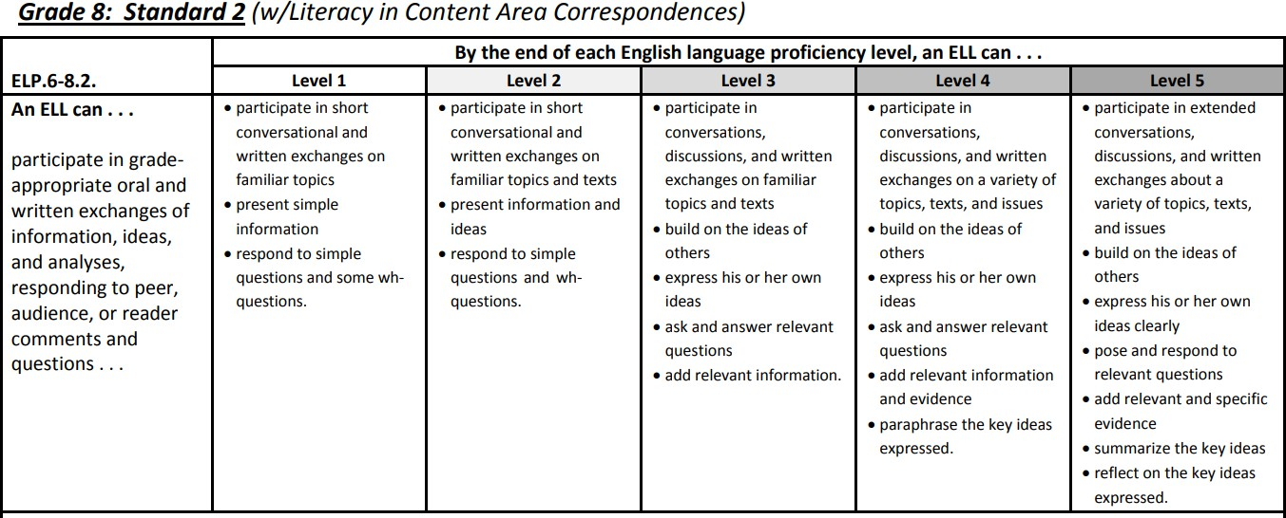

Slide 37
Dive Deeper Into the Standard
ELP.6-8.2 An ELL can participate in grade-appropriate oral and written exchanges of information, ideas, and analyses, responding to peer, audience, or reader comments and questions... | Level 2 | Level 3 | Level 4
 | participate in short conversational and written exchanges on familiar topics and texts present information and ideas respond to simple questions and whquestions. | participate in conversations, discussions, and written exchanges on familiar topics and texts build on the ideas of others express his or her own ideas ask and answer relevant questions add relevant information. | participate in conversations, discussions, and written exchanges on a variety of topics, texts, and issues build on the ideas of others express his or her own ideas ask and answer relevant questions add relevant information and evidence examples paraphrase the key ideas expressed.

Slide 38
Dive Deeper Into the Standard
ELP.6-8.10 An ELL can make accurate use of standard English to communicate in grade-appropriate speech and writing... | Level 2 | Level 3 | Level 4
 | with support (including visual aids and sentences), use nouns, pronouns, verbs, prepositions, adjectives, adverbs, conjunctions, and prepositional phrases produce simple and compound sentences. | with support (including modeled sentences), use relative pronouns (e.g., who whom which, that), relative adverbs (e.g. where, when, why), subordinating conjunctions, and prepositional phrases produce and expand simple, compound, and a few complex sentences | use an increasing number of intensive/reflexive pronouns (e.g., myself, ourselves) and verbs in the active and passive voices place phrases and clauses within a sentence recognize and correct most misplaced and dangling modifiers produce and expand simple, compound, and complex sentences.
 | all run-on sentences

Slide 39


Using the Proficiency Level Descriptors (PLDs), where would I score this sample?
Level 3
What did the student do to reach that level of proficiency, and which specific skills did they demonstrate?
Strong introduction
Beginning, middle, and end
Prepositional phrases (On saturday, on sunday...)
What did the student not do to reach the next level of proficiency, and which specific skills prevented their advancement?
Run-on sentences make it hard to identify compound/complex
sentences
Lack of details or examples

Slide 40



Turn what you learned from the analysis into a meaningful, actionable goal for the student.

Slide 41

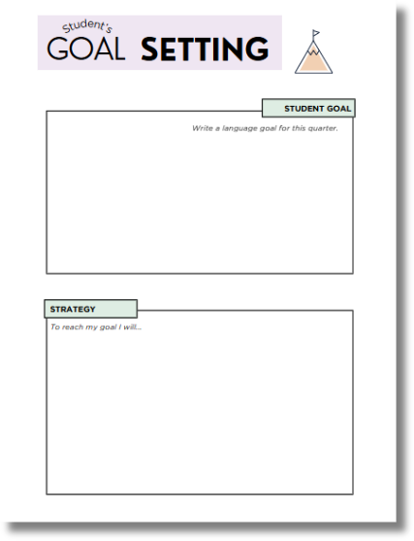

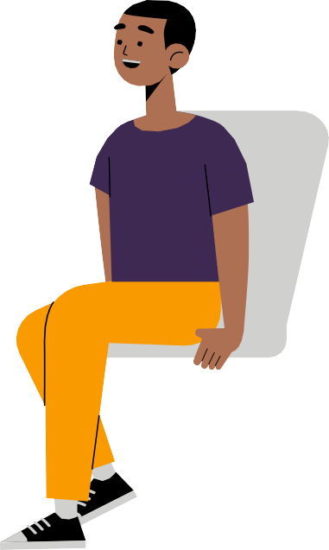
Co-create goals
Teacher-assigned goals
Student-selected goals
Group or class goals

Slide 42

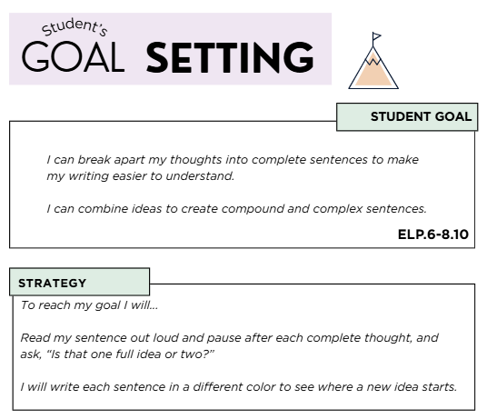
Student Goal
I can break apart my thoughts into complete sentences to make my writing easier to understand. I can combine ideas to create compound and complex sentences. ELP.6-8.10
Strategy
To reach my goal I will... Read my sentence out loud and pause after each complete thought, and ask, “Is that one full idea or two?” I will write each sentence in a different color to see where a new idea starts

Slide 43
INSTRUCTIONAL REFLECTION
When we identify patterns, we can adjust our instruction to maximize our impact on student growth.

Slide 44

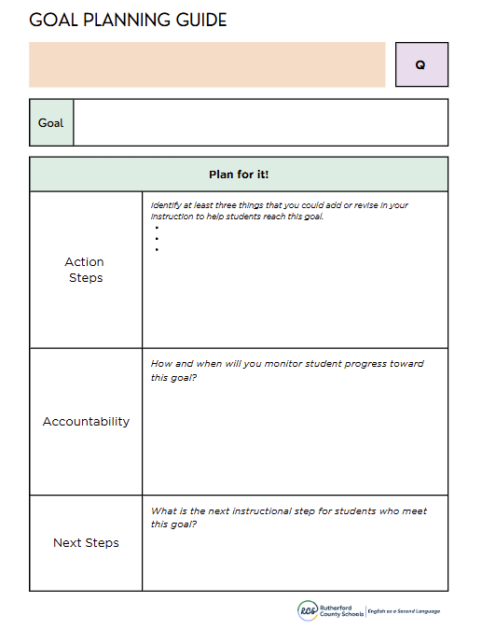
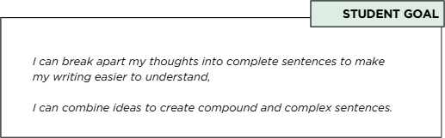
Instructional Reflection
When we identify patterns, we can adjust our instruction to maximize our impact on student growth.

Slide 45
Instructional Reflection
When we identify patterns, we can adjust our instruction to maximize our impact on student growth.

Slide 46

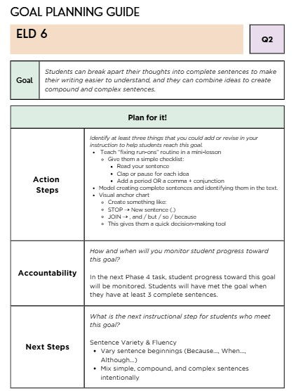
Goal | Students can break apart their thoughts into complete sentences to make their writing easier to understand, and they can combine ideas to create compound and complex sentences.
Plan for it!
Action Steps |  | Teach “fixing run-ons” routine in a mini-lesson Give them a simple checklist: Read your sentence Clap or pause for each idea Add a period OR a comma + conjunction Model creating complete sentences and identifying them in the text. Visual anchor chart Create something like: STOP → New sentence (.) JOIN → , and / but / so / because This gives them a quick decision-making tool
Accountability |  | In the next culminating writing task, student progress toward this goal will be monitored. Students will have met the goal when they have at least 3 complete sentences.

Slide 47



Slide 48

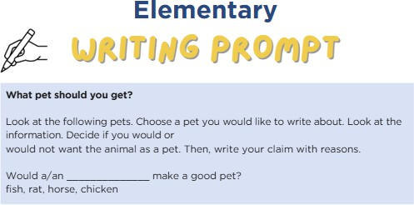
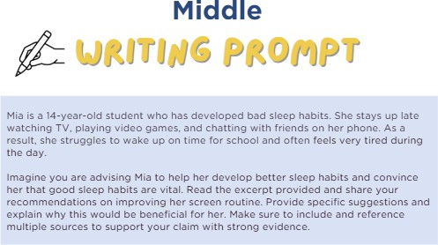
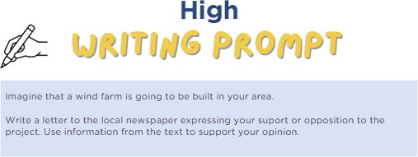
p.6-7
p.8-10
p.11-12
Standards: 2, 4, 5, 10

Slide 49

1. Using the Proficiency Level Descriptors (PLDs), where would I score this sample?
What did the student do to reach that level of proficiency, and which specific skills did they demonstrate?
What did the student not do to reach the next
level of proficiency, and which specific skills prevented their advancement?
Answer these questions on your own.
p.3

Slide 50

1. Using the Proficiency Level Descriptors (PLDs), where would I score this sample?
Turn and Talk

Slide 51

Turn and Talk
2. What did the student do to reach that level of proficiency, and which specific skills did they demonstrate?

Slide 52
Turn and Talk
3. What did the student not do to reach the next level of proficiency, and which specific skills prevented their advancement?

Slide 53
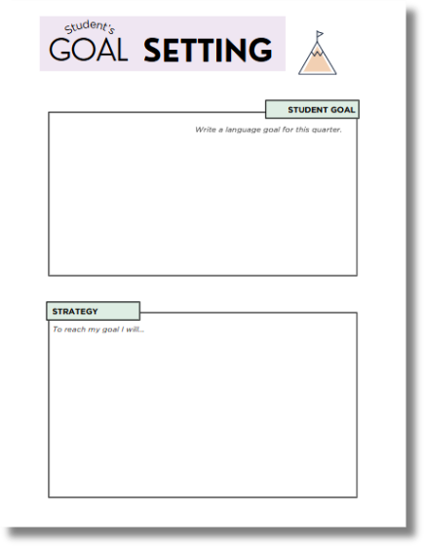
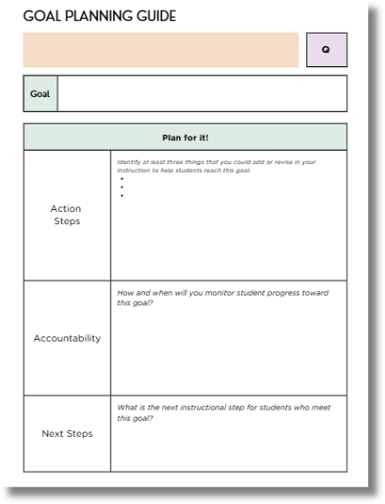
Create a student goal & an instructional goal
p.4-5

Slide 54

Turn and Talk
How might aligning your instructional goals to your students’ goals change the way you and your PLC plans instruction and responds to student needs?

Slide 55


Re-evaluate goals often based on new work samples

Slide 56
Managing Student Data

Slide 57


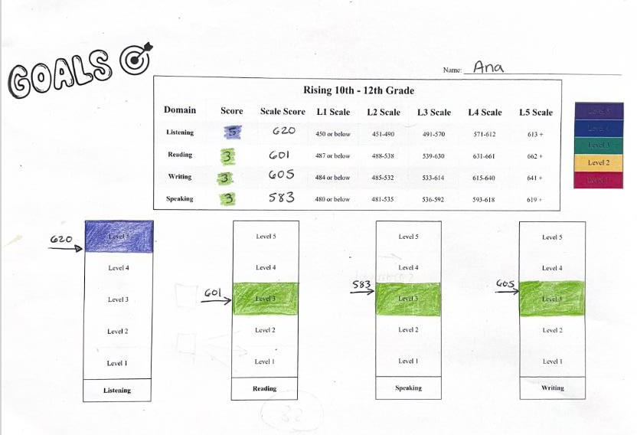

Encouraging Student Ownership

Slide 58
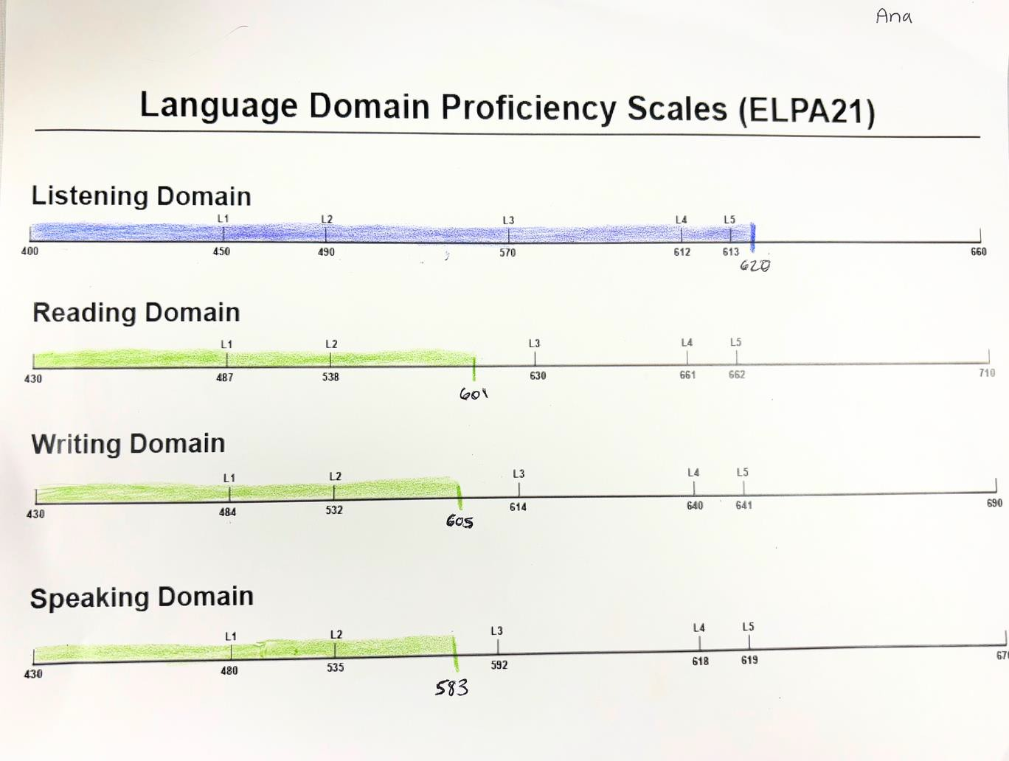
Encouraging Student Ownership

Slide 59
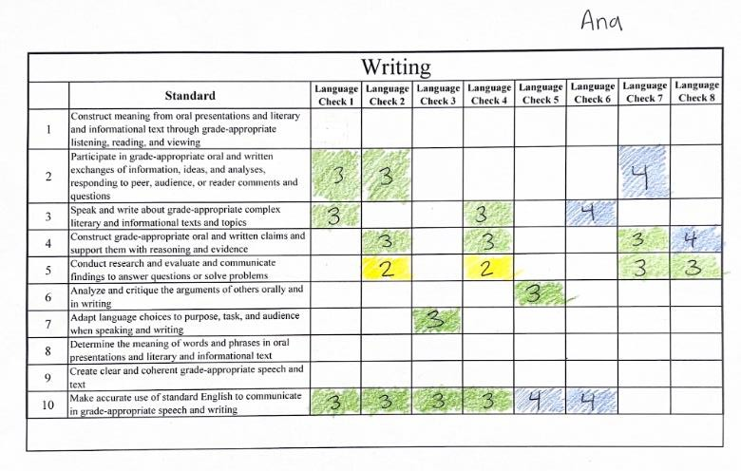
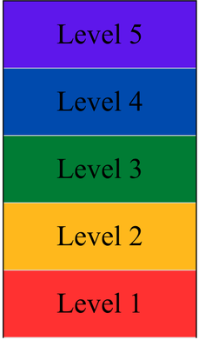

Encouraging Student Ownership

Slide 60

STUDENT PORTFOLIOS
a powerful motivator
“This collection of writing samples can provide a dramatic reminder of the progress a student has made—progress that otherwise might be overlooked.”
The Writing Revolution pp. 215

Slide 61
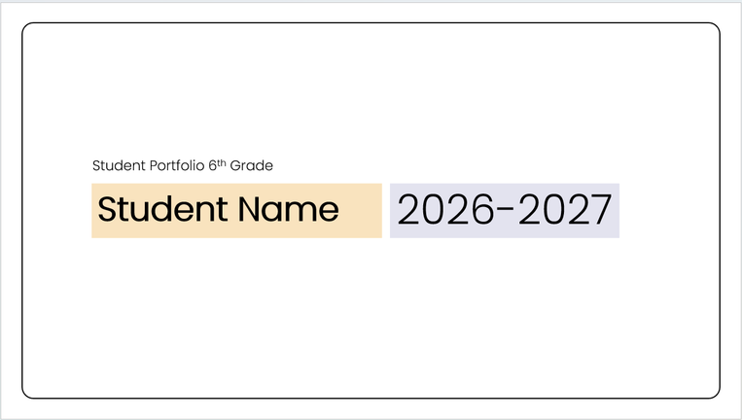
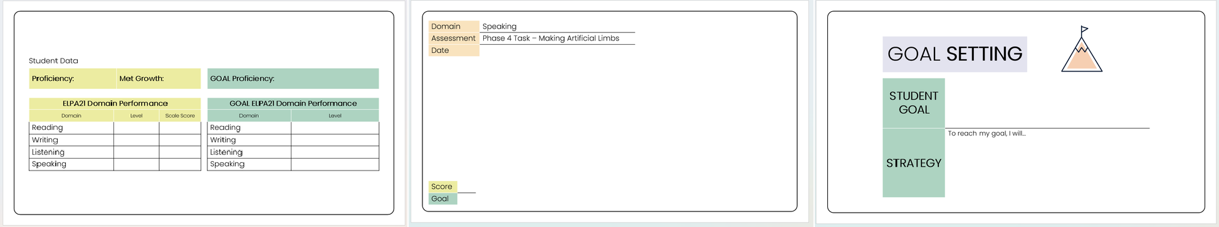
STUDENT PORTFOLIOS
a powerful motivator
Digital Portfolios
Great for capturing student speaking
Upload files to PowerPoint portfolios
Screenshot writing samples for easy inclusion

Slide 62



Where do I keep it?
“The best data system is the one you’ll actually use consistently.”
Excel Spreadsheet Ongoing.
Organized by class, student.
Binder
Ongoing.
Organized by class, student.

Slide 63



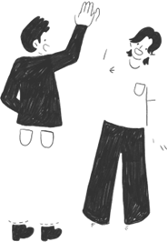



Collaborating with Others
Coach
Another teacher
PLC

Slide 64



Collaborating with Others
Improved Student
_{Strategy} Performance
Share
Accountability
Gain Deeper Understanding of the Standards
Shared Responsibility

Slide 65


Common complaints:
It’s too time consuming.
It’s overwhelming.
I don’t know where to start.
Introduce simple systems:
focus on 1-2 key data points at a time
use quick tracking tools

Slide 66
Reflection: Where I’m Going

Slide 67

initial ELPA21 data chat
scoring student work with PLDs
setting instructional goals based on student work
what you are already doing
Using Student Work to Set Language Goals
student language goal aligned to ELPA21 standard
what you want to start or refine
individual language check data tracker
student portfolios
p.13

Slide 68







Slide 69



Slide 70

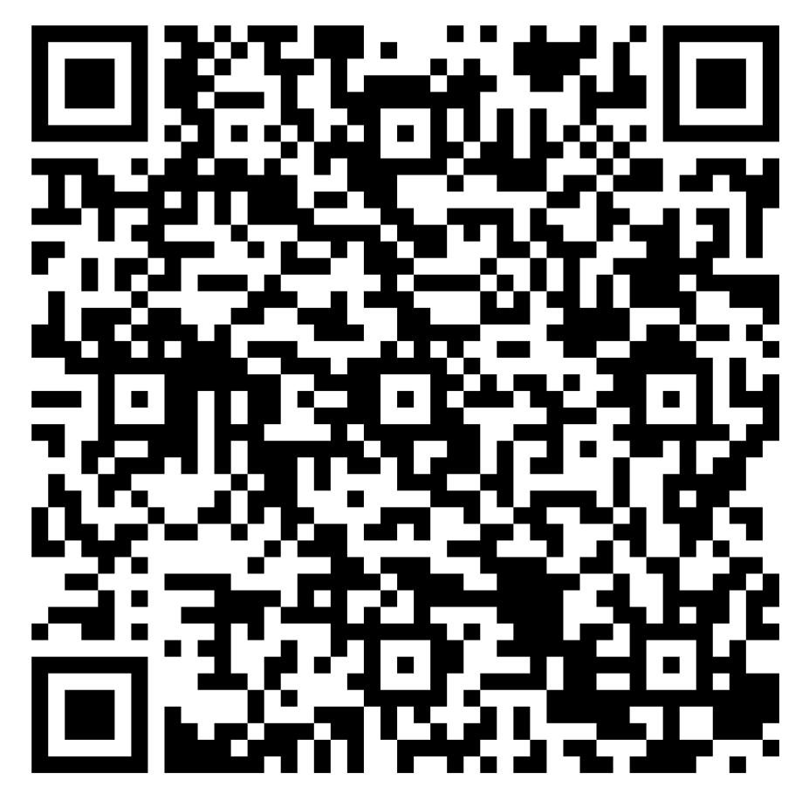


Middle School ESL Coach vigilm@rcschools.net
High School ESL Coach crutchfieldL@rcschools.net

