Slide 1

Amplifying Language and Learning Across Content Areas:
Practical Strategies for Supporting
Recently Arrived Multilingual Learners
Casey Minshall
Director of EL Teaching & Learning
Megan Trcka
EL Coordinator

Slide 2



Today we will...
  present supports and strategies for effectively serving Recently Arrived English Learner (RAEL) students.
  reflect on learning and make connections to current context and practice.
  engage in time for questions and answers.

Slide 3


Slide 4


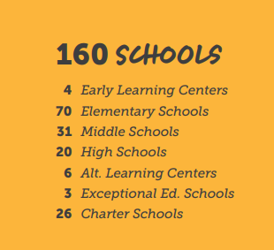

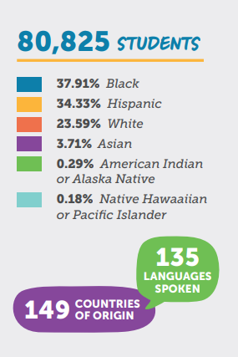
Notes:
What is special about MNPS is our mantra Every Student Known. Our Director of Schools, Dr. Adrienne Battle, and her dynamic team ensure our leaders at all levels are strategically focusing on the student at the center.

Slide 5
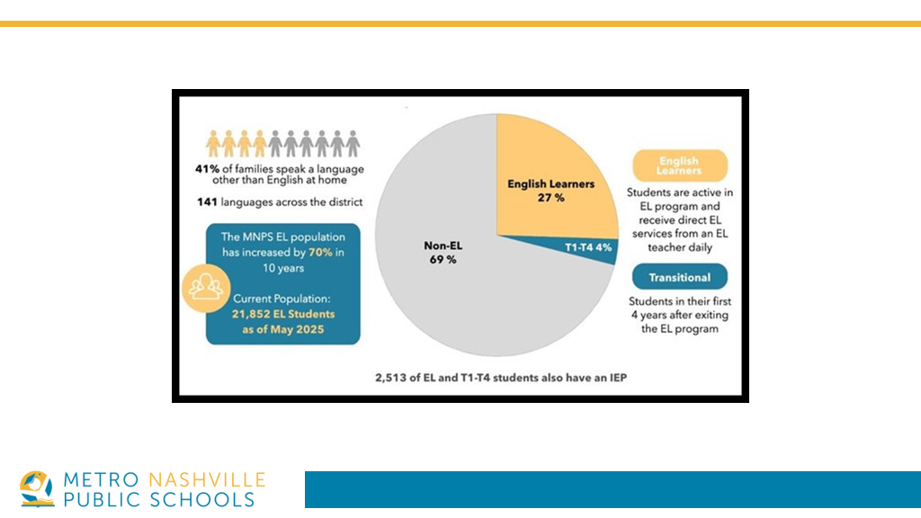

Slide 6
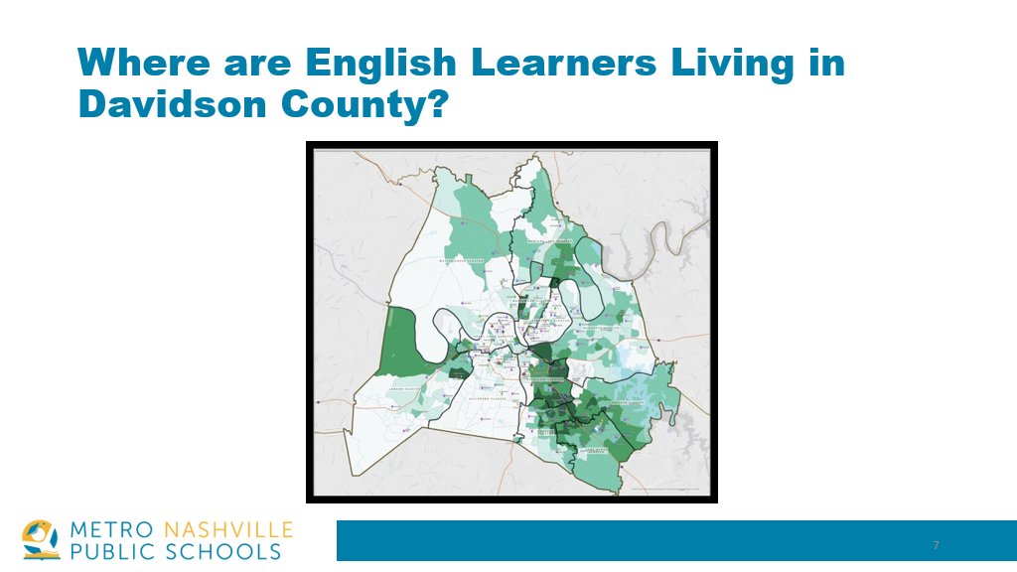
Where are English Learners living in Davidson County?
Notes:
Here is a map of Davidson Co which covers more than 500 square miles. Darker green represents higher density of English Learner families. ​
But, the map has not always looked this way. MNPS EL Population has increased by 70% over the last 10 years. ​
Some of the lighter green areas, are not as familiar with the work (instructional, yes, but as we know also includes SEL and so much more). ​
So, there’s a need for goals​

Slide 7
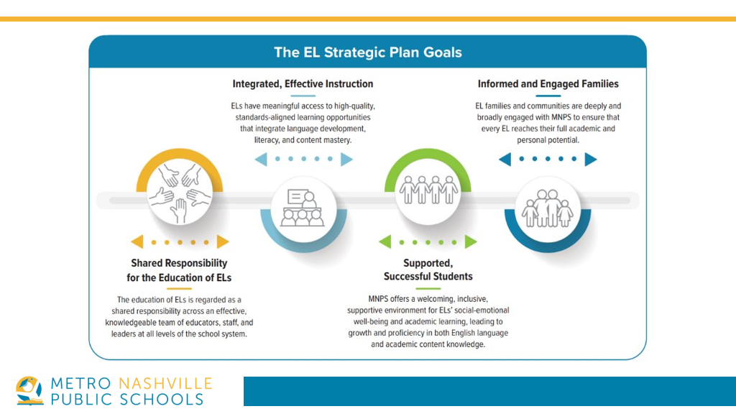
Notes:
We are focusing on 4 key goals to make this happen. With 41% report speaking a language other than English we’ve got to improve in all of these areas, of course, but certainly share that responsibility throughout our departments and school buildings. ​
​

Slide 8
Thinking about your current context, share about the Recently Arrived English Learners (RAEL) students you support:
  How many RAEL students do you serve?
  What kinds of support are they receiving?
  Do you feel you are meeting their needs? If not, what gaps or opportunities you notice?

Slide 9
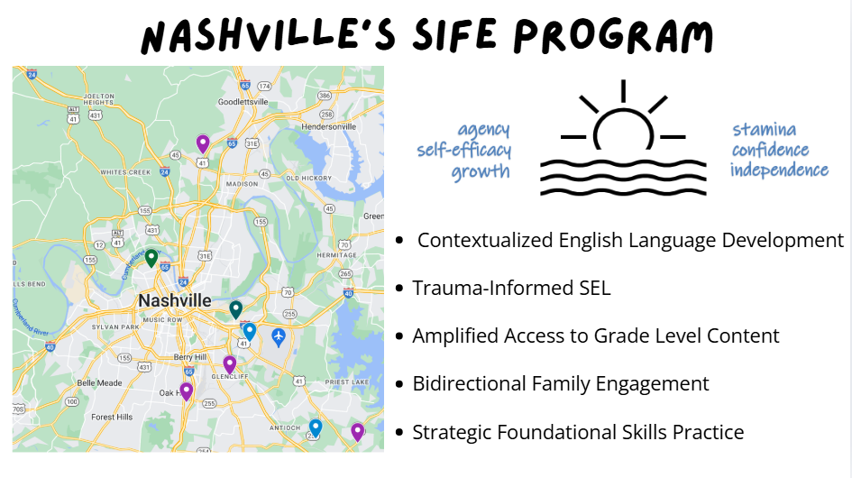
Students with Interrupted
Formal Education

Slide 10
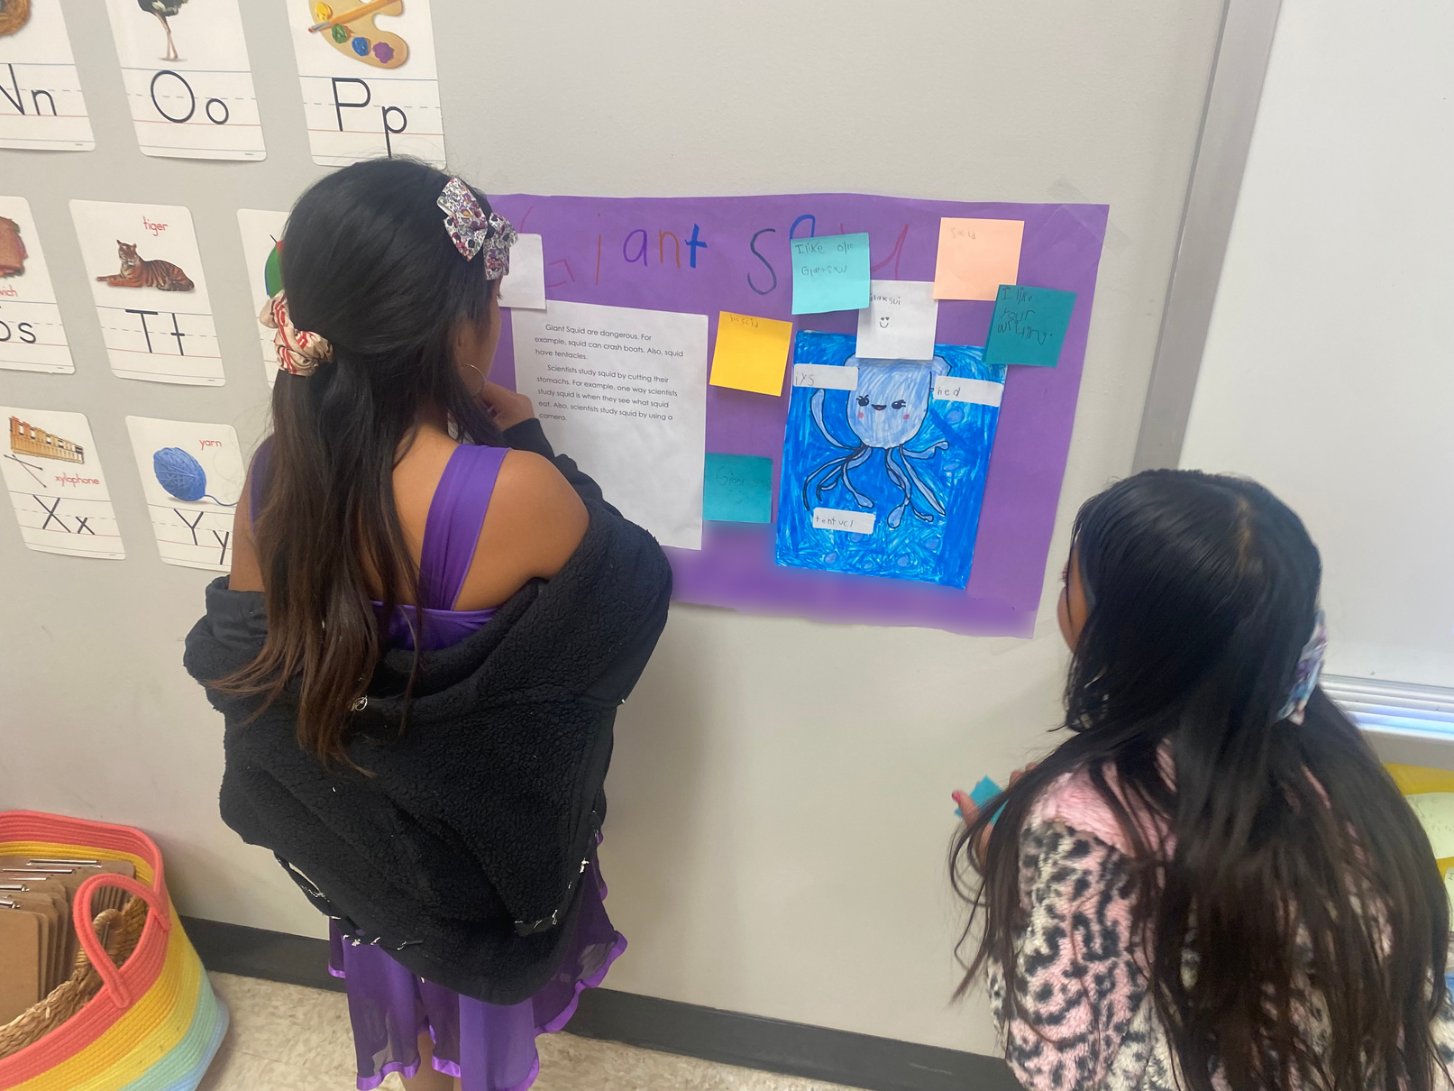
Amplifying Language and Learning Across Content Areas:
Practical Strategies for Supporting
Recently Arrived Multilingual Learners (RAEL)
Funds of Knowledge:
Know your students/families and their strengths
Social Emotional Learning:
Create a calm, safe,
engaging environment
Quality Instruction:
Intentional Instructional Supports

Slide 11
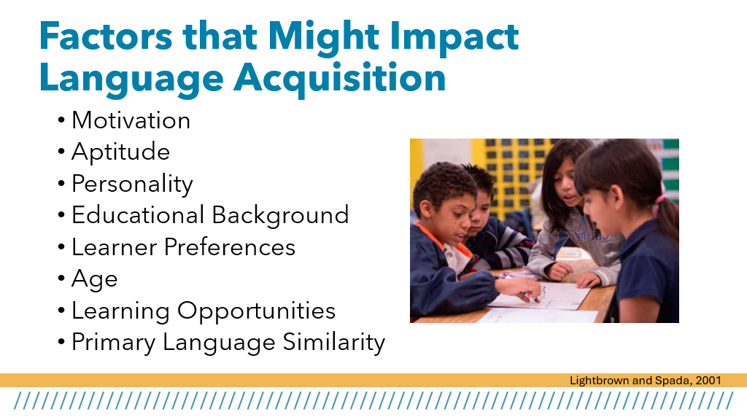

Slide 12
Amplifying Language and Learning Across Content Areas:
Practical Strategies for Supporting
Recently Arrived Multilingual Learners (RAEL)
Funds of Knowledge:
Know your students/families and their strengths
Social Emotional Learning:
Create a calm, safe,
engaging environment
Quality Instruction:
Intentional Instructional Supports

Slide 13
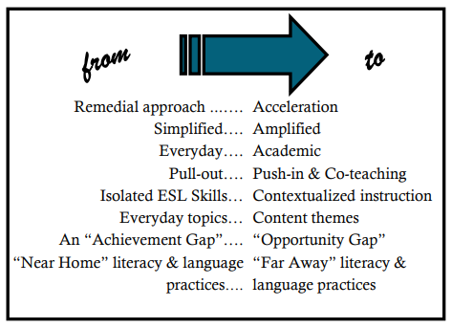
First things first
Council of the Great City Schools
Notes:
Add citation

Slide 14
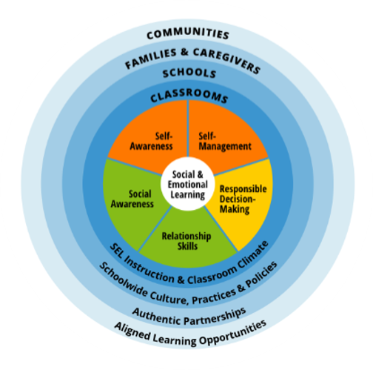
funds of Knowledge
Notes:
Social and Emotional Learning (SEL) is an integral part of education and human development. SEL is a process through which all young people and adults learn to recognize and manage emotions, demonstrate care and concern for others, develop positive relationships, make responsible decisions, and behave ethically, respectfully, and responsibly.
SEL advances education equity and excellence through authentic school-family-community partnerships to establish learning environments and experiences that feature trusting and collaborative relationships, rigorous and meaningful curriculum and instruction that is student-centered, and ongoing evaluation.

Slide 15
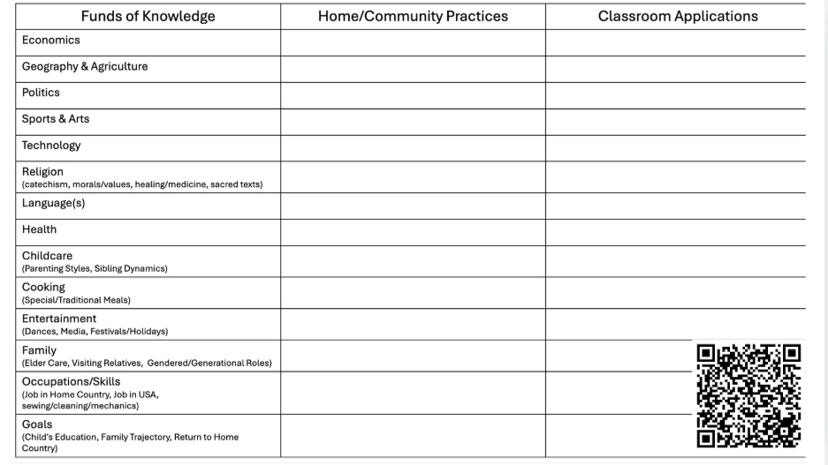

Slide 16
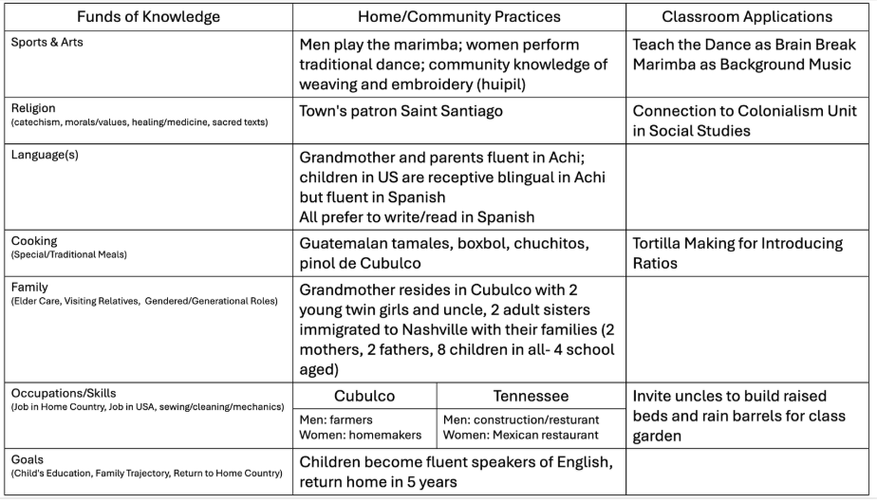

Slide 17
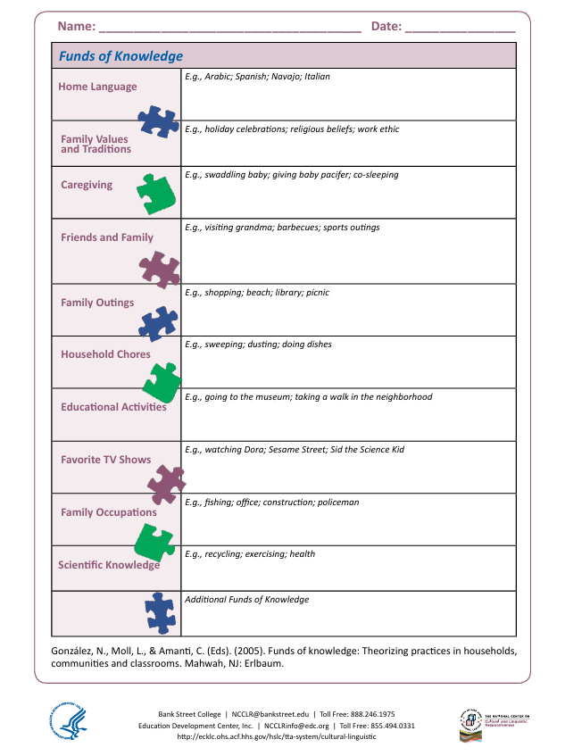

Slide 18
background or experiences & learning
  How have your life experiences shaped the way you approach learning or relationships?
  In what ways might RAEL students’ strengths go unrecognized in traditional school settings?
  What barriers might prevent you from using students’ funds of knowledge, and how could you address them?

Slide 19
Amplifying Language and Learning Across Content Areas:
Practical Strategies for Supporting
Recently Arrived Multilingual Learners (RAEL)
Funds of Knowledge:
Know your students/families and their strengths
Social Emotional Learning:
Create a calm, safe,
engaging environment
Quality Instruction:
Intentional Instructional Supports

Slide 20
Notes:
Consider the push pull factors:
Issues of Security: Violence; Gangs and Narcotrafficking​
Poverty, Chronic Malnutrition​
Climate Change​
Lack of Educational and Economic Opportunities
Social and Emotional Learning (SEL) is an integral part of education and human development. SEL is a process through which all young people and adults learn to recognize and manage emotions, demonstrate care and concern for others, develop positive relationships, make responsible decisions, and behave ethically, respectfully, and responsibly.
SEL advances education equity and excellence through authentic school-family-community partnerships to establish learning environments and experiences that feature trusting and collaborative relationships, rigorous and meaningful curriculum and instruction that is student-centered, and ongoing evaluation.

Slide 21
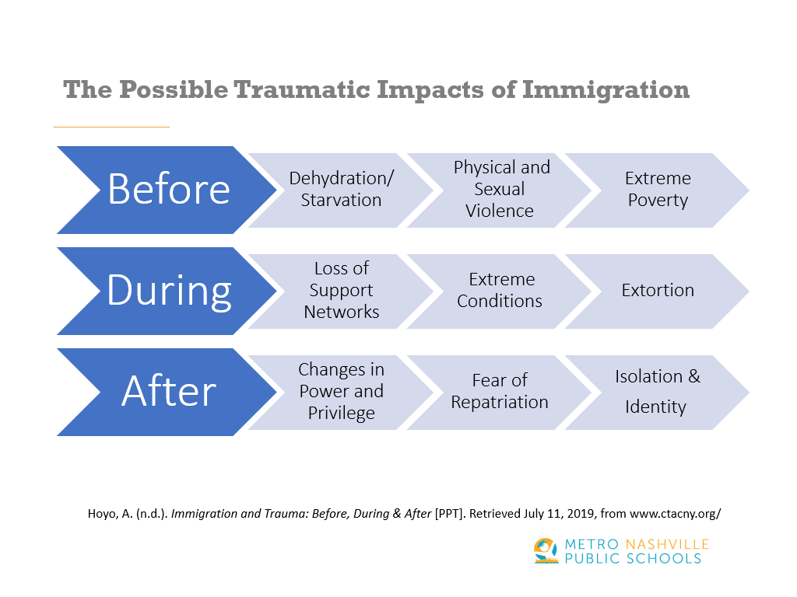
possible traumatic impacts of immigration

Slide 22
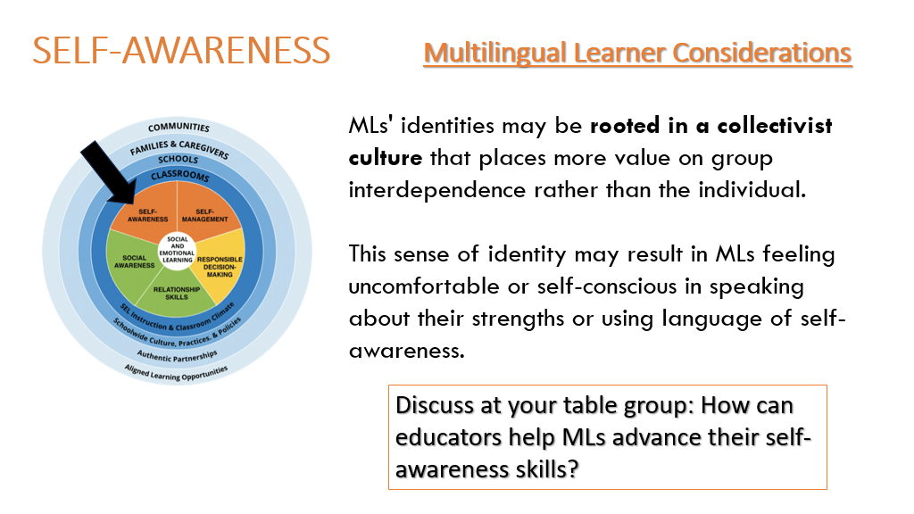

Slide 23
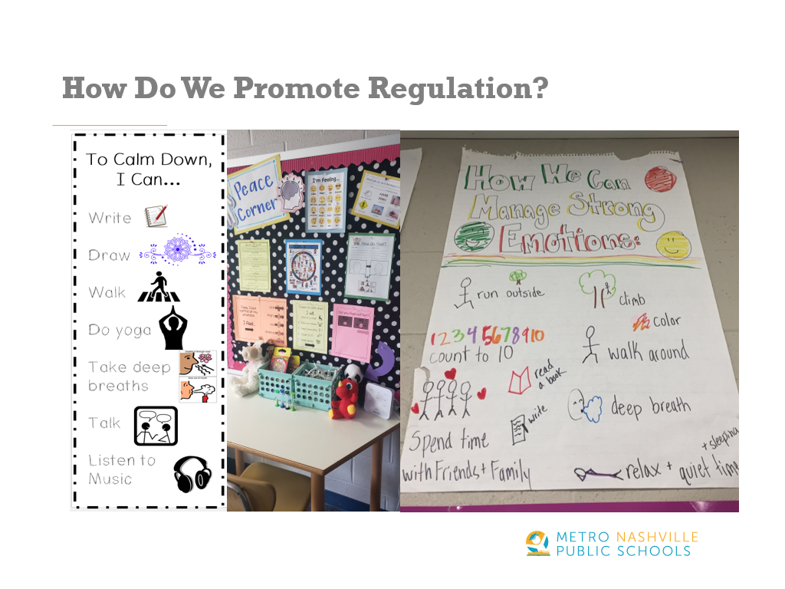
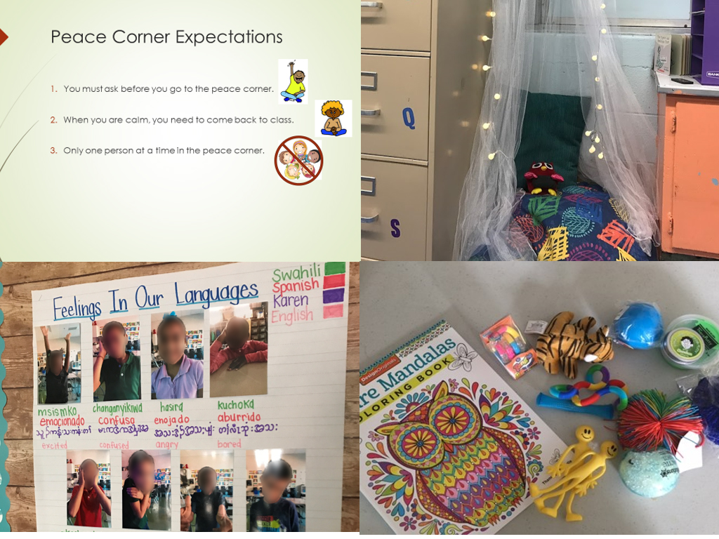
trauma informed
Classrooms

Slide 24
Amplifying Language and Learning Across Content Areas:
Practical Strategies for Supporting
Recently Arrived Multilingual Learners (RAEL)
Funds of Knowledge:
Know your students/families and their strengths
Social Emotional Learning:
Create a calm, safe,
engaging environment
Quality Instruction:
Intentional Instructional Supports

Slide 25

Notes:
We have this tool in MNPS and as you can see, the SEL/FoK focus lives on the instructional design checklist. For the sake of today's focus specifically on RAEL, we are going to look at another more condensed document that supports the approach you would like in ensuring RAEL students get what they need at a bare minimum.

Slide 26
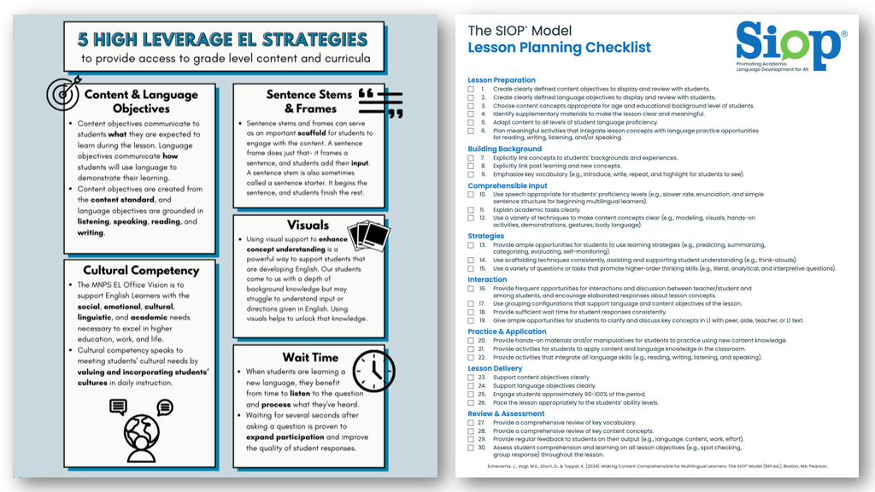

Notes:
This poster combines several of the checklist elements into an easy-to-digest "elevator speech" for ALL teacher

Slide 27
Funds of Knowledge
&
SEL
Notes:
This poster combines several of the checklist elements into an easy-to-digest "elevator speech" for ALL teacher

Slide 28
Notes:
This poster combines several of the checklist elements into an easy-to-digest "elevator speech" for ALL teacher

Slide 29

Content Objective: Students will make five detailed observations about sedimentary rocks.​
​
Language Objective: Students will write and orally share five important facts in their own words with a partner.

Slide 30
Notes:
This poster combines several of the checklist elements into an easy-to-digest "elevator speech" for ALL teacher

Slide 31
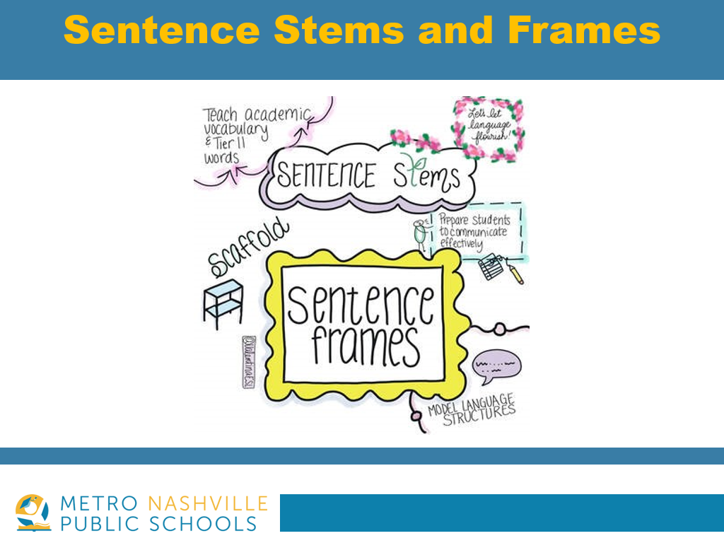
Based on the experiment, I can infer that the ____will increase and the ____will decrease. ​
​Human activities disrupt ecosystem services by ___________.

Slide 32
Content Language Objectives & Sentence Frames
  What do these two strategies have in common?
  What needs to be considered when preparing Content Language Objectives and/or Sentence Frames for RAEL students?

Slide 33
Notes:
This poster combines several of the checklist elements into an easy-to-digest "elevator speech" for ALL teacher

Slide 34

"Research at 3M Corporation concluded
that we process visuals 60,000
times faster than text"
(Williams College of Education, 2010).
  Make sure the vocabulary word is inferable based on the visual.​​
  Have students interact with the visual.​
.
Source: https://seidlitzblog.org/2019/04/03/mastering-vocabulary-with-visuals/

Slide 35
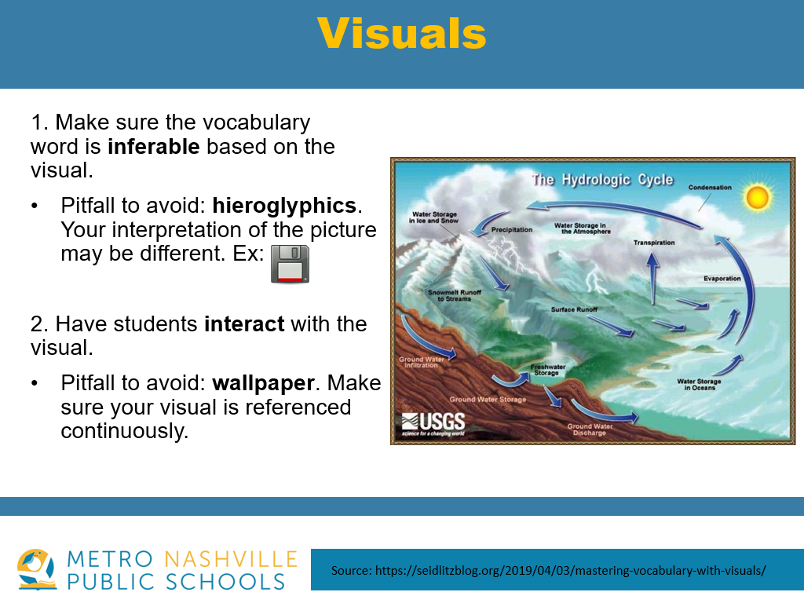

Slide 36
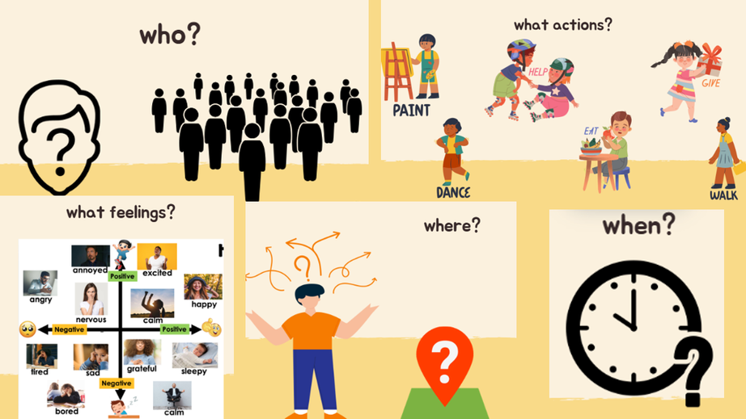
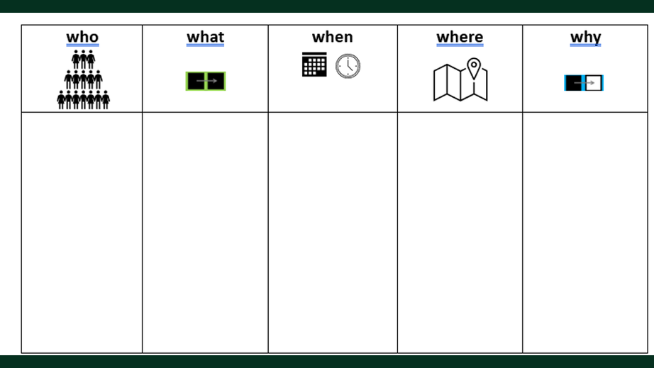

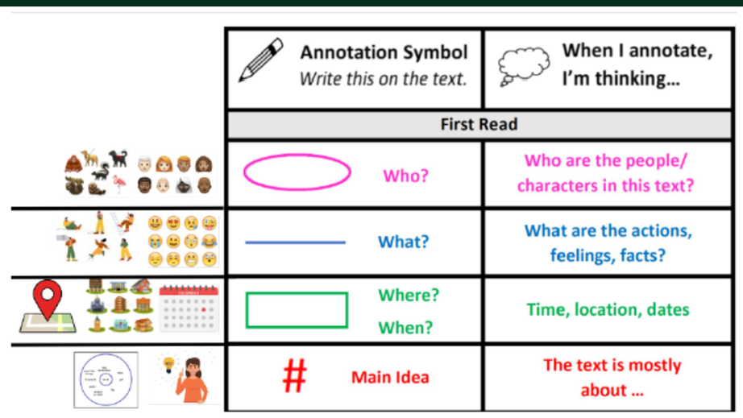

Slide 37
visual support
  What factors should you consider when choosing visuals?
  In what situations can visuals be ineffective or misleading?

Slide 38
Notes:
This poster combines several of the checklist elements into an easy-to-digest "elevator speech" for ALL teacher

Slide 39

"When students are learning a new language, they benefit from time to listen to the question and process what they've heard." -Valentina Gonzalez

Slide 40
Notes:
Discuss why we have both documents and how they work together.

Slide 41
Key reflections
  How might you apply these five high-leverage EL strategies in your specific context to support recently arrived English learners—whether in your classroom, on your team, or in your leadership role?
  What supports are needed in your current setting to implement these practices effectively and enhance both language development and learning?

Slide 42


Slide 43
Casey.Minshall@mnps.org
Director of EL Teaching & Learning
Megan.Trcka@mnps.org
EL Coordinator

