Slide 1

If You Can Dream It, We Can Build It:
AI Ideas for Teachers and Administrators
Putnam County

Slide 2
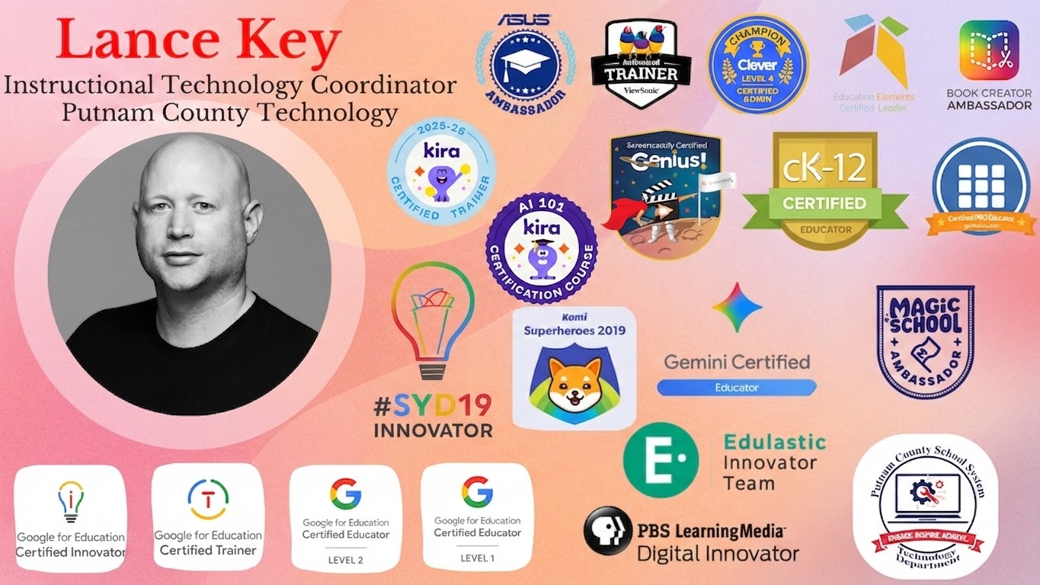

Slide 3


Slide 4
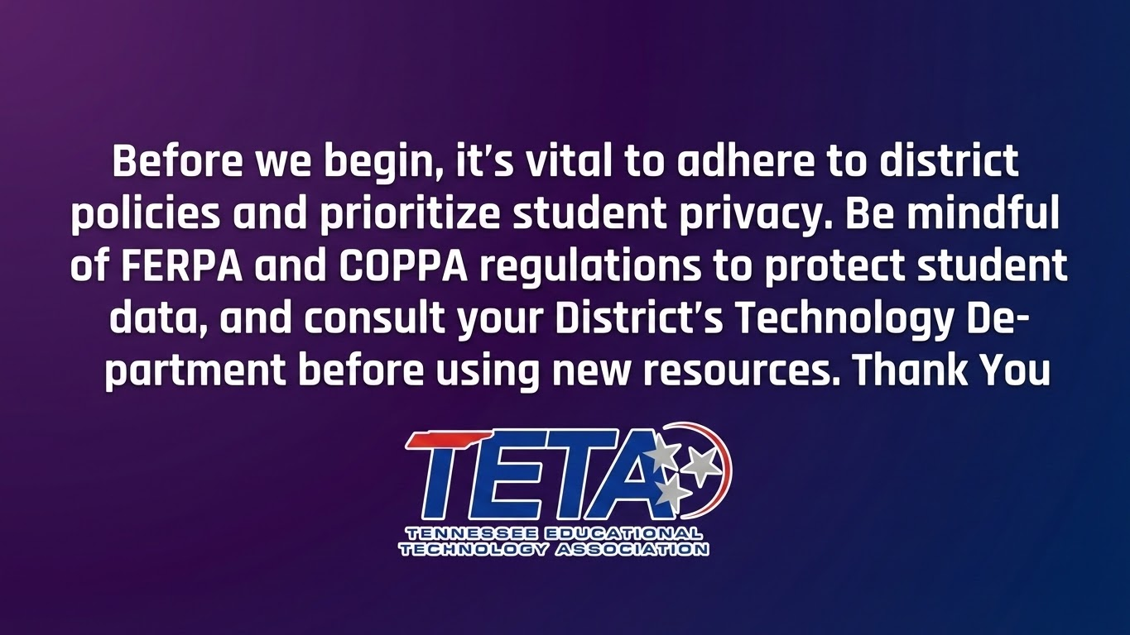

Slide 5
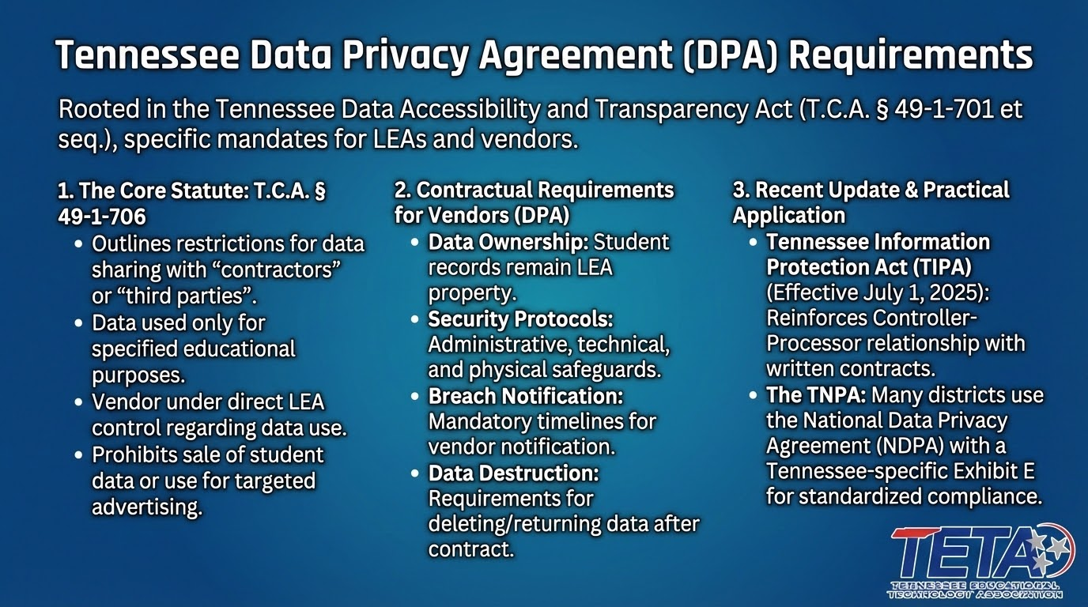

Slide 6


Slide 7
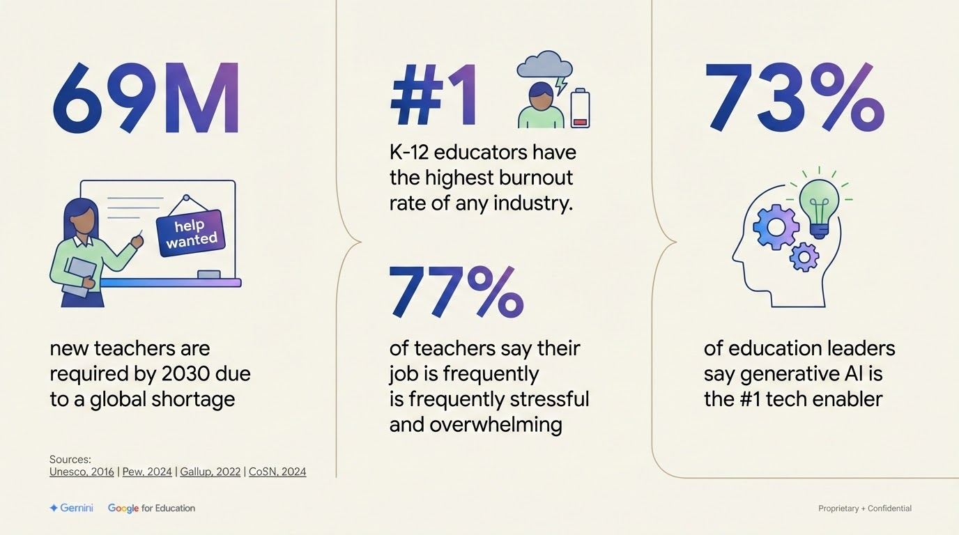

Slide 8
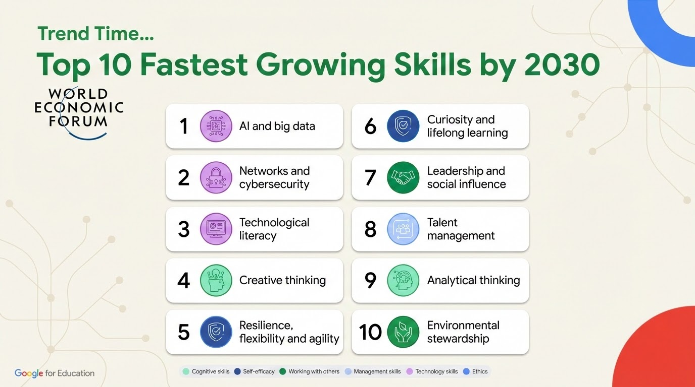

Slide 9
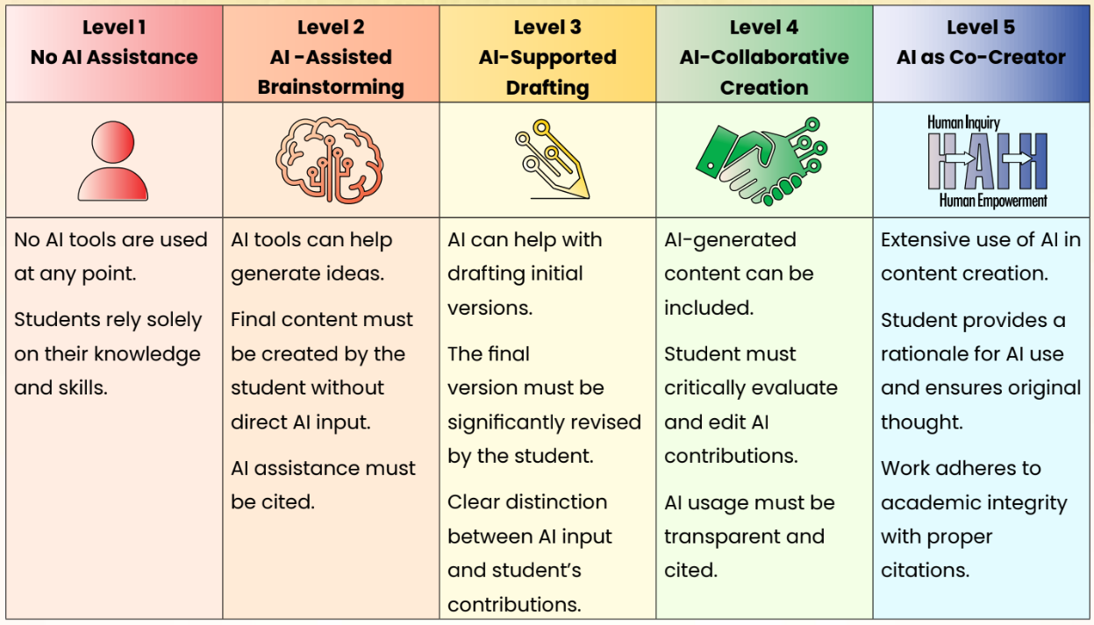

Slide 10

Prompting can help you…

Slide 11

Prompting Framework
Who should it act as? What role will it play? | Act as a 5th grade English teacher
What steps should it take? | Review the document for creative writing prompts to encourage descriptive writing
What tone or format should it have? | Respond in a helpful and encouraging manner
What context or constraints do you need it to know? | Keep responses to a 5th grade reading level
Proprietary + Confidential

Slide 12
Gemini can help your education community achieve more
Who might use Gemini
Instructional leader
IT director
Superintendent
Educator
University student
Get help creating resources and brainstorming ideas to empower educators. | Get help providing secure and innovative technology for students and staff. | Get help streamlining administrative work so you can focus on supporting students and educators. | Get help creating captivating learning experiences, grant writing, and more. | Get always-on academic support to help students on their learning journeys.
Quickly create content, like lesson plan templates, to share across your institution Easily differentiate content that’s tailored to student interests or skill levels Summarize research and share it faster | Get ideas for new security settings to implement Create how-to documentation for a variety of tech and tools Develop schedules for rolling out new policies | Draft job descriptions in seconds Summarize emails and draft responses Create newsletters with custom images Analyze student data quicker | Brainstorm grant ideas and get help writing Create differentiated class exercises and assessments Create personalized feedback faster Bring concepts to life with unique imagery | Deepen understanding with customized practice materials Get initial feedback on work Develop essential career-readiness AI skills
Notes:
So who is Gemini really for within your institution?
Gemini can empower a broad range of people within your [school/district/university], from helping instructional leaders create resources that can scale across your institution, to helping superintendents streamline administrative work so they can focus more on supporting students and educators.
One of the amazing things about Gemini is it’s versatility and breadth of use cases.

Slide 13


Slide 14
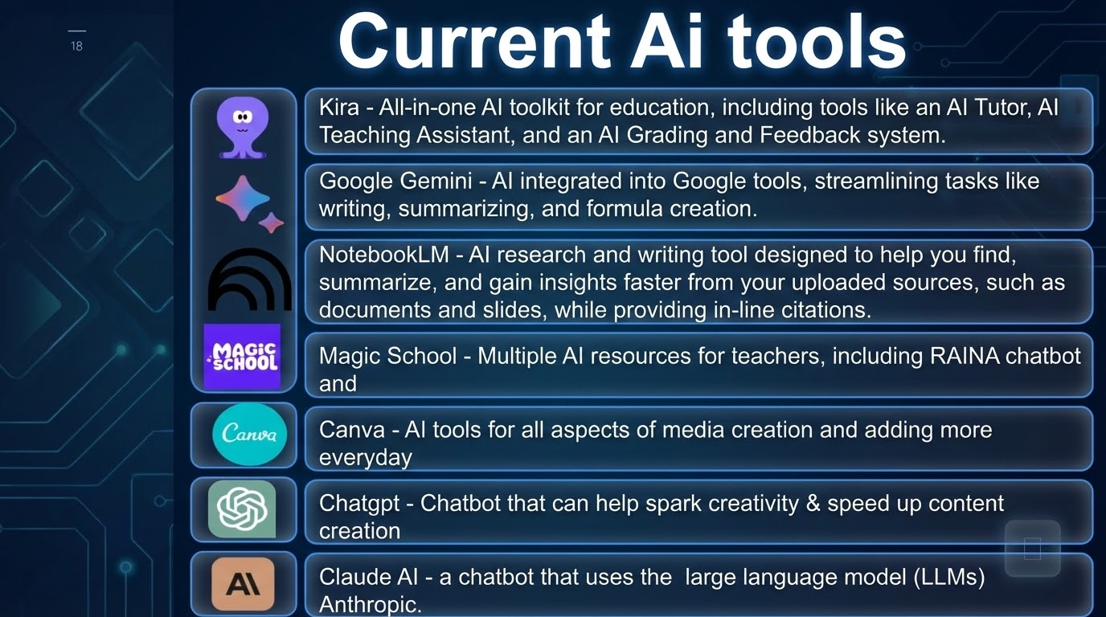

Slide 15
Other Ai tools
Perplexity
Class Companion
Brisk Teaching
Adobe Firefly
Dezgo
Conker
AI Quiz Creator
Gamma
Suno
HeyGen
Google NotebookLM
Sora | OpenAI
HP AI Teacher Academy

Slide 16

Putnam County, TN
Lance Key
Instructional Technology Coordinator
@Lancerkey
LKey2@pcsstn.com

