Slide 1


Teaching Writing
in an AI World
Presented By Lois Bennett

Slide 2


Teaching Background
  Total Teaching Experience - 23 years
  On-Level 10-12th grade – 21 years
  AP Literature - 14 years
  Dual Enrollment - 5 years
  Academic Integrity Committee – 2 years

Slide 3



Overview
1
5
My Philosophy
Feedback over Grades
2
6
Summative
Grades
Why Students Cheat
3
7
Teacher as Coach
Cheat-Proof Assignments
4
Process over Product
8
Establising
Mutual Trust

Slide 4



My Philosophy of Teaching
  Students want to learn and succeed.
  Students are worried about failure and being “wrong.”
  Developing a Growth Mindset is difficult, but essential.
  Establishing Mutual Trust with our students builds relationships and skills.
  Assume the Best - Prepare for the Worst.

Slide 5

Why Teach Writing?
  Writing is not the result of learning, but the learning itself.
  Writing teaches the essential skills of critical thinking, interpretation, analysis, and communication.
  Writing involves inquiry, argumentation, synthesis, and creativity - all of which are essential for decision-making.
  All disciplines require these skills - not just writing-based disciplines.

Slide 6


The Problem:
“As artificial intelligence becomes increasingly capable of generating polished, grammatically correct text that meets academic standards, educators face a critical challenge: How can we teach students to write authentically and effectively?”
(Steven Mintz, “Teaching Writing in the Age of AI”)
“We have a responsibility to our students to openly discuss the benefits and drawbacks of AI while keeping our instructional emphasis on the power of human thought.”
(Jennifer Gunn, “Real Writing in the AI World”)

Slide 7

Why do Students Cheat?
1
2
3
Fear of Failing
Grades
Procrastination
Panic
Laziness
Grades are more important than growth.
Afraid to be “wrong” and look “unintelligent”
When they put off an assignment too long, some will decide it is better to cheat than submit it late.
AI is the new “easy” way.

Slide 8


Extreme Solutions:
All Writing in Class!!
All Writing on Paper!!

Slide 9

A More Practical Approach
1
Process over Product
2
Feedback over Grades
3
Cheat-Proof Assignments
4
Establishing Mutual Trust

Slide 10

Teacher as Coach
“To develop writers, especially in a compacted time, we must value the process over and above the end product.
Our teaching energy must go to coaching the thinking that writing demands, not to catching the students in acts that shortcut the writing process.”
(Gunn)

Slide 11

Teacher as Coach
Teacher-Guided Process
Students need the most assistance at the beginning of an assignment.
Doing parts of the Planning, Drafting, and Revising in class gives them access to the teacher
This builds their confidence for independent work later in the process.

Slide 12
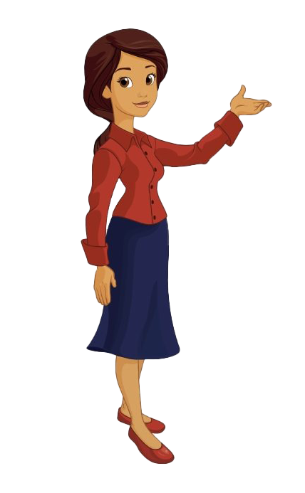
Teacher as Coach
Reassuring Language
  “This is a new skill, so you won’t feel fully confident.”
  “It is okay to struggle with this. Allow yourself the struggle."
  “This is your first attempt, so you might feel shaky about it.”
  “Your ____ skills are developing; keep working on _____.”
  “Trust me with your weaknesses, so we can build them into strengths.”
  Cheesy phrases: “fledgling attempt,” “maiden voyage,” etc.

Slide 13
Process over Product
Low-Stakes Writing Opportunities
Student need opportunities to write with impunity.
  Daily Journaling - no penalty for grammar, spelling, etc.
  Reading Responses - focus on ideas over composition
  Exit Slips - to assess understanding not writing skill
Starting the year with frequent low-stakes writing activities builds your students’ confidence in their own ideas, and it helps you learn each authentic voice.

Slide 14

Process over Product
Process Pieces in Class
Beginning in class guarantees the student does at least some authentic work on the necessary skill.
Teachers are present to assist, so students feel more confident when working independently.
Examples:
  Researching Databases
  Reading and Taking Notes
  Outlining and Evidence Collecting

Slide 15

Feedback over Grades
Gradeless Philosophy
Based on the book Pointless by Sarah Zerwin - students receive feedback rather than numerical grades.
This removes the fear of failing grades and gives students the freedom to take risks in their ideas and writing.
  Full credit is based on effort and following directions.
  Process Work receives ample feedback for improvement.
  Numerical grades reserved for Summative Assignments.

Slide 16

Feedback over Grades
Managing the Feedback
  Peer Feedback - ShortAnswer.com, passing journals, group composing, pair-share
  Immediate Feedback - Writing Conferences, Share in Class
  Focused Feedback - focus on one key skill for each small piece
  Feedback Bank - on Teams or a Google Doc to save frequent comments
  Mini-Lessons - based on frequent errors or common weaknesses

Slide 17

“Grading” the Process
Writing Conferences
Meeting with students individually can replace the rough draft process.
  Conferences can be required. Make time in class or outside of it.
  You do not have to read the whole paper!
  Require students to take notes on required revisions.

Slide 18

“Grading” the Process
Two-Paragraph Draft
Rough Drafts are overwhelming for students and teachers!
  Introduction + One-Two Body Paragraphs
  Feedback on Rubric Material - how will the Final be graded?
  Comment on an issue once or twice only
  Color-coded highlight feedback

Slide 19

“Grading” the Process
Trusting the Process
Students are responsible for applying the feedback to the full paper based on what was discussed or marked.
  Keep records of conferences
  Use “save as a pdf” or “safe with comments” on the draft
  Have students write a "revision reflection" that addresses how they revised the paper.

Slide 20

Summative Grading
Rubric Expectations
Final Drafts still need to be graded. Students deserve an ultimate reflection of their efforts and improvements.
  Grade according to the same criteria the feedback addressed.
  Points removed for not following directions or correcting feedback.
  Identify strengths and improvements as well as ongoing weaknesses.
  Less Feedback given on Final Drafts

Slide 21
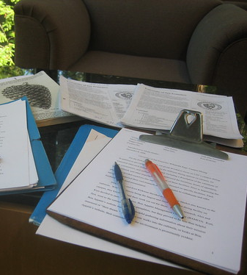
Summative Grading
Attention to Feedback
An element of the grade on the final draft should be related to whether or not the student implemented the feedback provided during the process.
  Require a percentage of revision.
  Place content improvements over mechanical improvements.
  Not having a numerical grade on the draft will prevent students from thinking they can submit that draft again and receive the same grade.

Slide 22



Establishing Mutual Trust
1
2
We Trust Students to produce Authentic Writing
Students Trust Us with their Authentic Writing
We see authentic thinking and writing in class.
We send students home to complete the work
We let go of the control over it.
Students believe that we want to see them grow and succeed
They apply the feedback we provide
They want to share their growth.

Slide 23
Other Important Considerations
1
Creating "Cheat-Proof" Assignments
2
Uses of AI in the Classroom
3
Addressing Academic Dishonesty
4
The Most Reluctant Students

Slide 24
“Cheat-Proof” Assignments
Process Pieces
Require students to submit digital copies of:
Outlines
Notes
Sources
When the final product does not match the process, it reveals that steps were skipped.

Slide 25

“Cheat-Proof” Assignments
Individual Connection
Require students to connect their writing to personal experience or opinion:
Memoirs
Editorials
Judging a "Contest"
Conclusions with Personal Response
They must interact authentically with the text and the writing.
Note: This may mean letting go of “never use I” policies."

Slide 26

“Cheat-Proof” Assignments
Specific to Class Materials
Teach texts or articles that are recent or lesser known rather than traditional texts.
Provide specific articles/texts that students must incorporate
Assign two specific texts to compare
Students are more confident with the material because it has been discussed in class.

Slide 27

AI Has Its Place
  AI Tools are useful for certain steps in the writing process. We must acknowledge and train students in those skills as well.
  “While useful for brainstorming and drafting, AI-generated text bypasses the deeper intellectual processes that writing is meant to cultivate—critical thinking, interpretation and original analysis” (Mintz).

Slide 28
Acceptable Use of AI
Clear Expectations
Make it clear what level of AI Assistance is acceptable for each assignment:
  Brainstorming and Outlining?
  Revisions - What level?
  If AI Assistance is not allowed, explain your reasoning:
  "It is important for you to practice the skill of..."
  "Your ability to ______ independently is what I am assessing today."

Slide 29

Acceptable Use of AI
Chat Prompt Examples
Use student-safe AI programs like:
Magic School
School AI
Provide specific prompts that you allow:
  “Make light revisions to the word choice and sentence structure.”
  “Correct any grammar, punctuation, or capitalization errors”
  Require students to submit or cite their prompts as part of responsible research and writing.

Slide 30
Acceptable Use of AI
Citing AI Sources
Students can acknowledge use of AI programs.
Parenthetical Citations – to denote when one sentence was written or revised
End Notes – MLA and APA have formats for citing generative AI
Writing Statement/Reflection
Have students write a brief statement about how they utilized AI during their writing process. This can be added to or replace a Works Cited page.
  What prompts did they use?
  What changes did they accept and what did they reject?
  How did AI assist their process and what extent is independent thought?

Slide 31

When they DO Cheat
Address It - Don’t Ignore It
Meet with students to discuss:
  What led to the decision to cheat?
  How can they build their confidence or time management to avoid that in the future?
  Focus on relationship building - look for the mutual trust.

Slide 32

When they DO Cheat
Consequences
(Note: Reference District Policies)
  Develop a strict due date for the make up assignment.
  Require new process materials, or a return to the process the student began.
  You can require more work done during class to re-establish trust with this student.

Slide 33



The Most Reluctant Students
Relationship Building
  Does the student have trust issues with teachers?
  Convince him/her that you will not fail them for effort.
Homework/Classwork Balance
  Students who cannot (or will not) do homework need more in-class opportunities.
  Provide additional time and assistance during the school day.

Slide 34
The Most Reluctant Students
Goal-Setting
  Passing the Class, Graduating High School
  Critical Thinking, Job-Based Skill Sets
Relevant Goals
  Scaffolding - allow them to connect and respond at their level.
  Creative Response - give choice in genre and method of response

Slide 35
Authentic Writing is
Still Possible!
“By making writing more purpose-driven and applicable to real-world contexts, instructors can help students see why developing their own authentic writing voice matters, even in an age of AI-generated text.” (Mintz)

Slide 36


References
  Columbia University Center for Teaching and Learning. “Learning Through Writing in the Age of AI.” 2024. https://ctl.columbia.edu/resources-and-technology/resources/writing-ai/
  Gunn, Jennifer. “Real Writing in the AI World.” English in Texas. 54:1, Spring/Summer 2024. https://files.eric.ed.gov/fulltext/EJ1440039.pdf
    Rubric Examples
    Assignment Scaffolding Examples
  Mintz, Steven. “Teaching Writing in the Age of AI.” Inside Higher Ed. 02 May 2025. https://www.insidehighered.com/opinion/blogs/higher-ed-gamma/2025/05/02/challenges-and-approaches-teaching-writing-age-ai
    Specific writing assignment ideas
    Strategies for teaching writing modes
  Zerwin, Sarah. Pointless: An English Teacher’s Guide to More Meaningful Grading. Heinemann, 2020.

