Slide 1


Slide 2
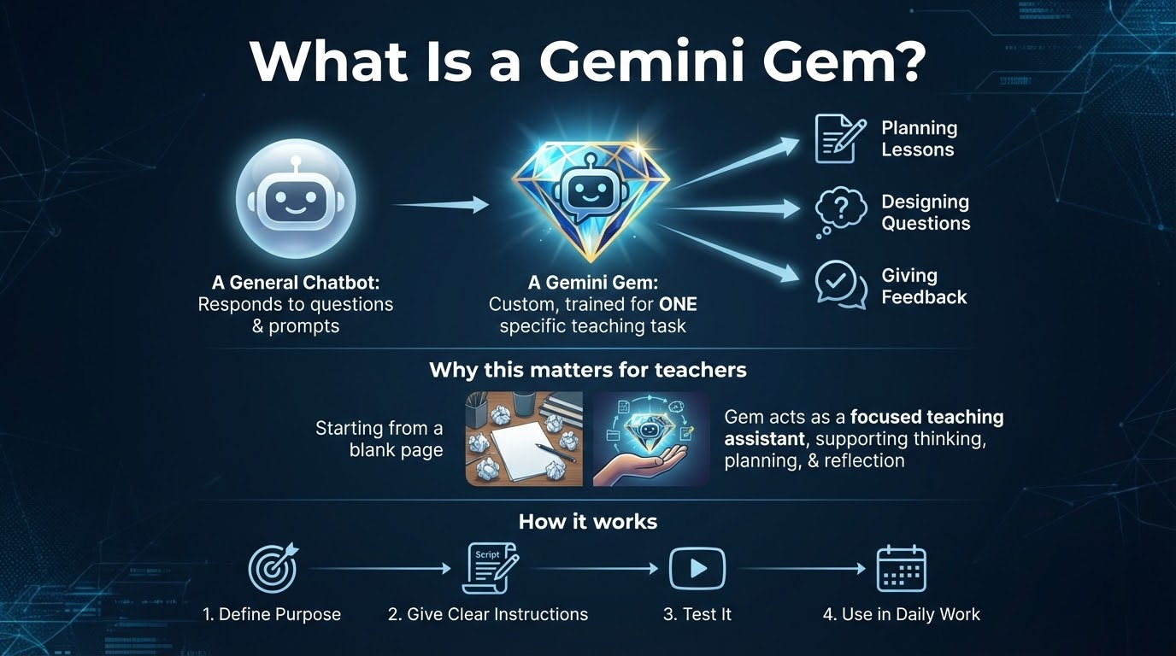

Slide 3


Slide 4
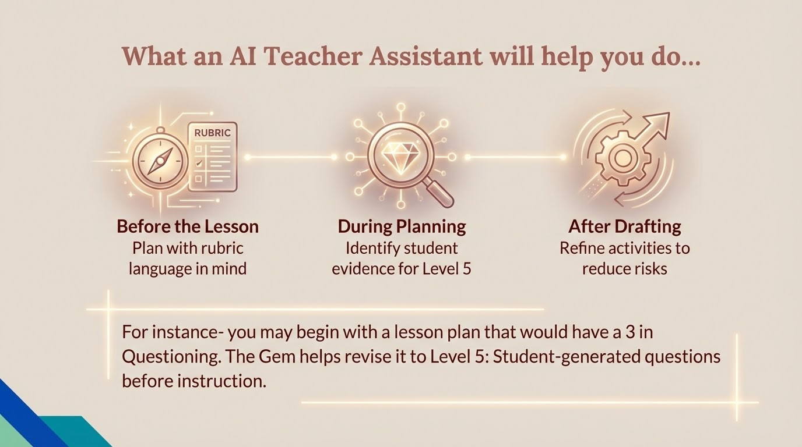

Slide 5
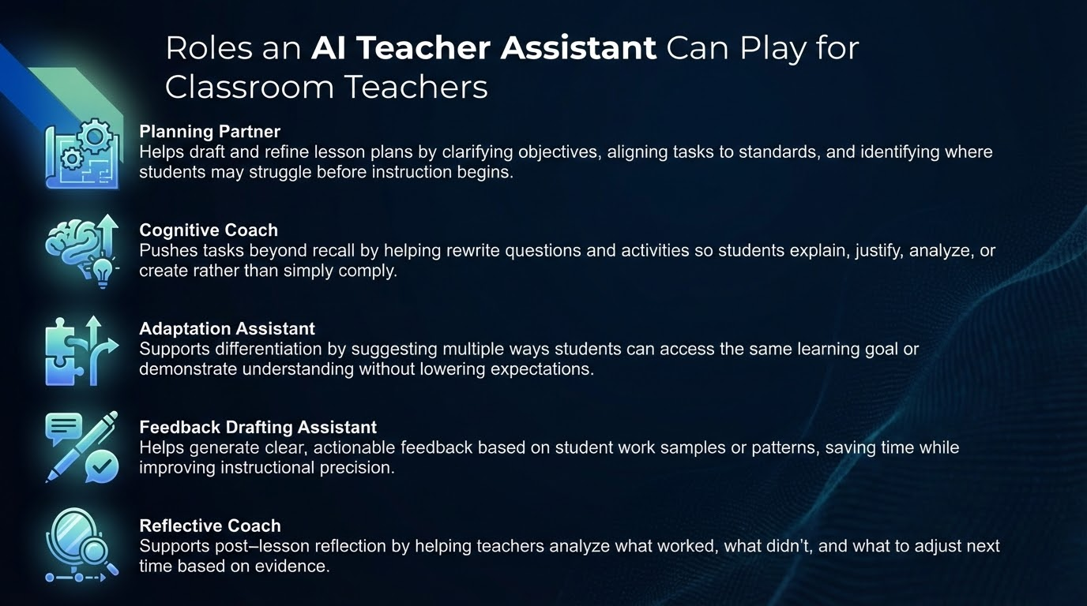

Slide 6
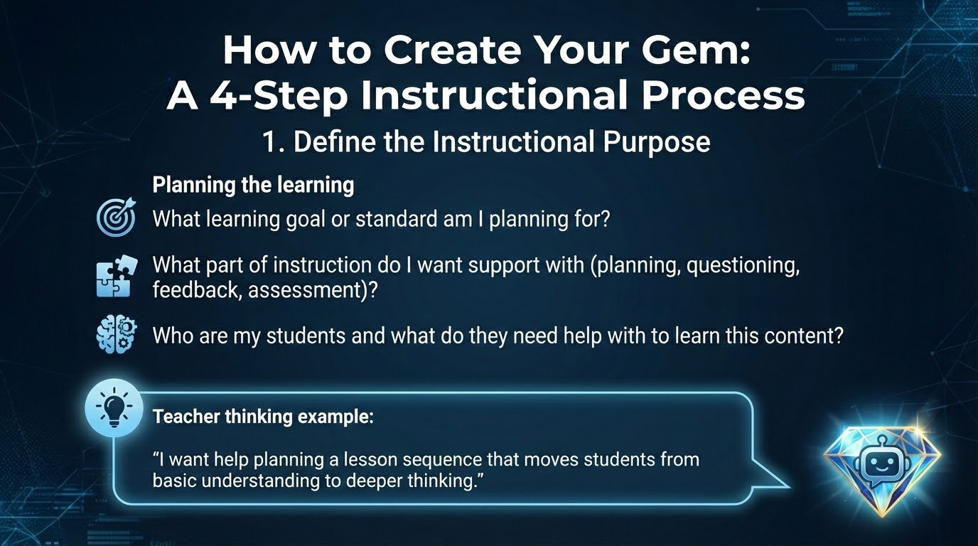

Slide 7
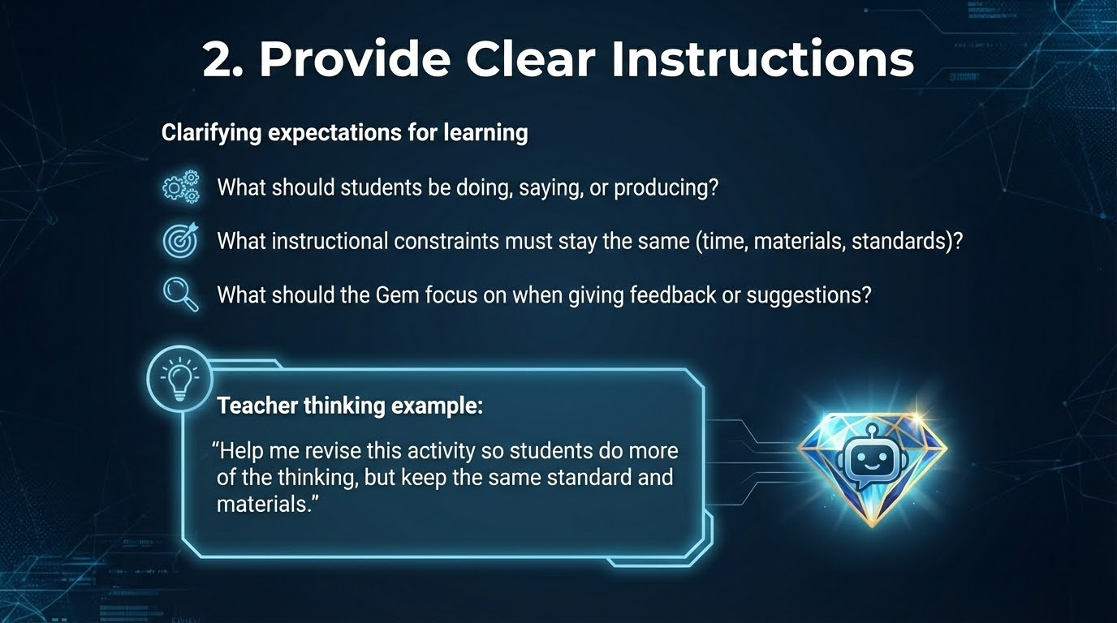

Slide 8
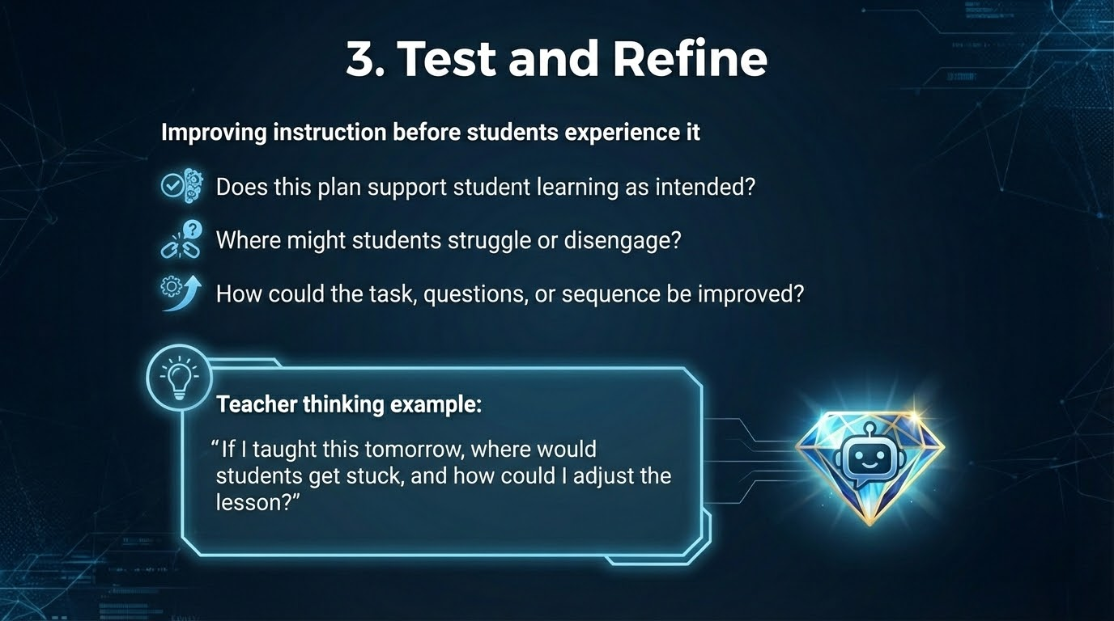

Slide 9
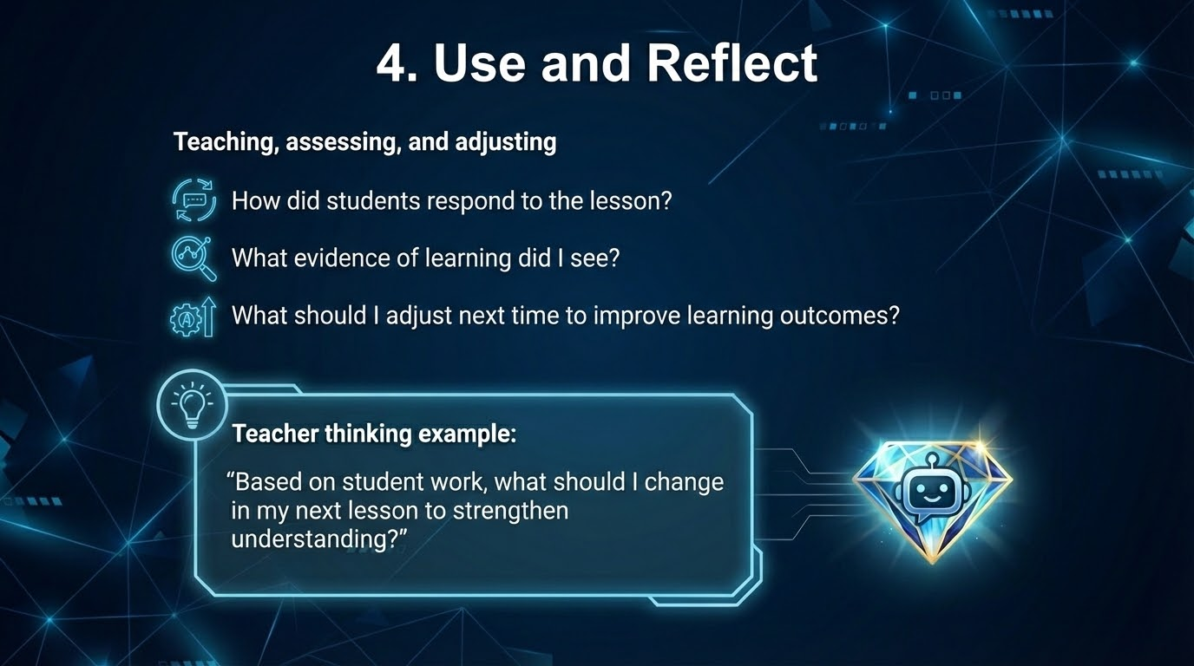

Slide 10
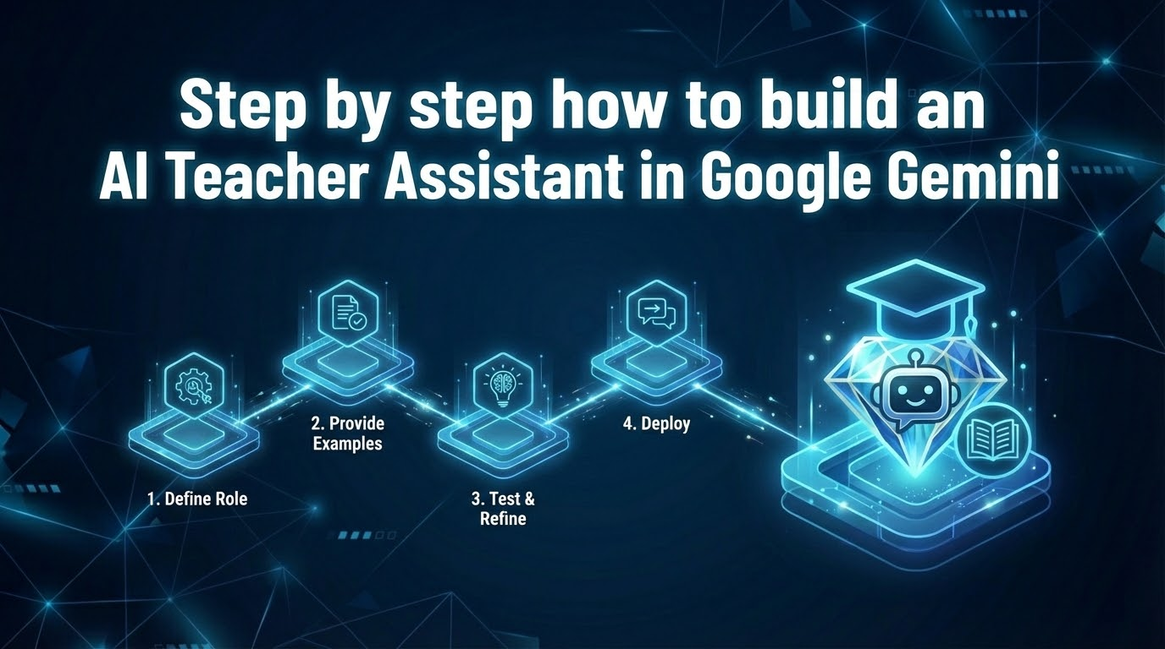

Slide 11
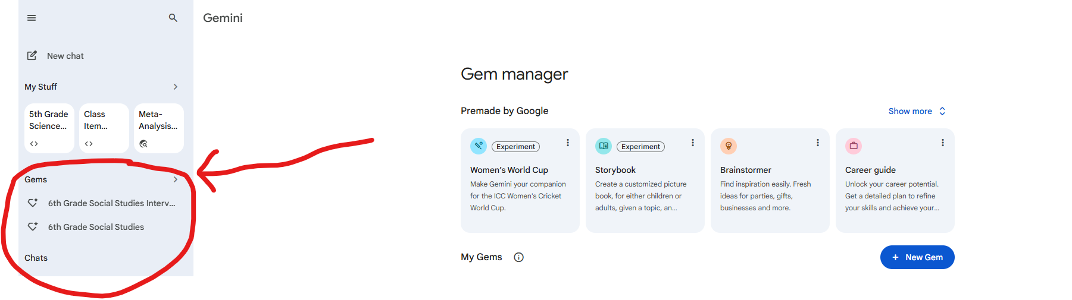
Open the Gemini Gem Manager

Slide 12
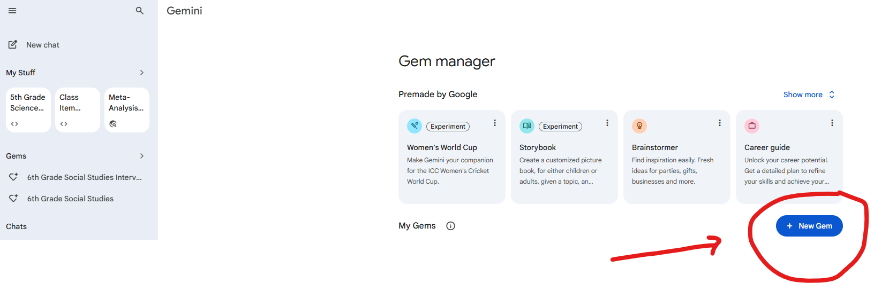
2. Open “New Gem”

Slide 13
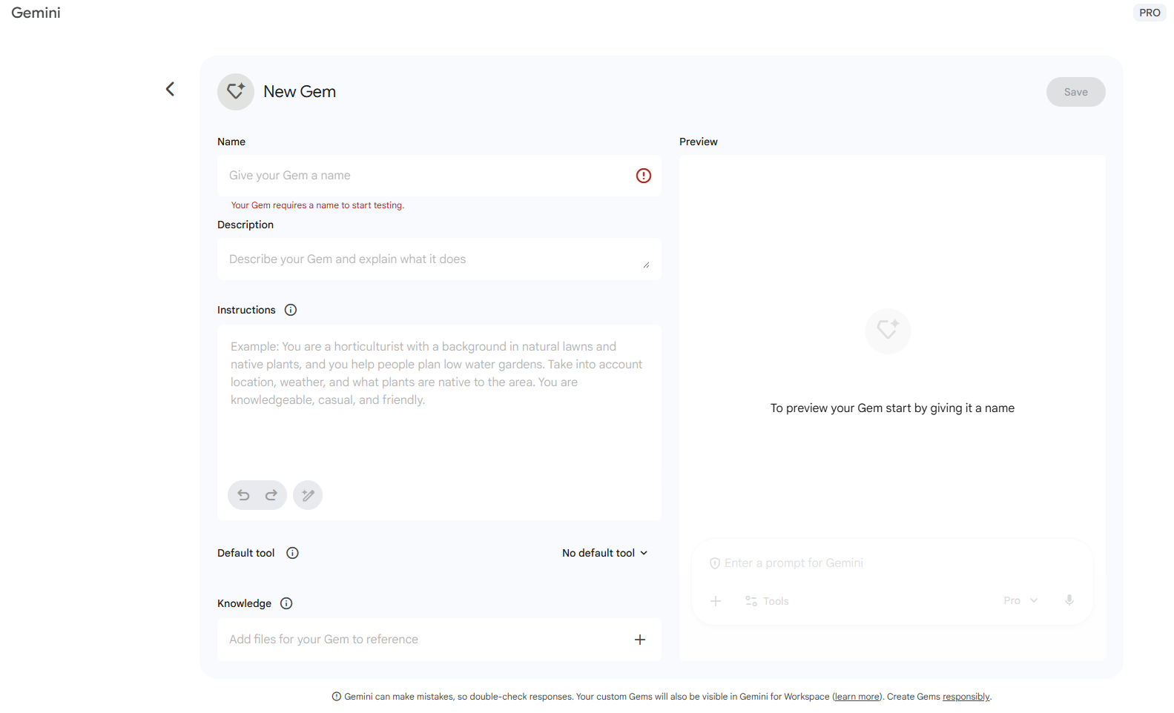
Your Screen Should Look Like This

Slide 14
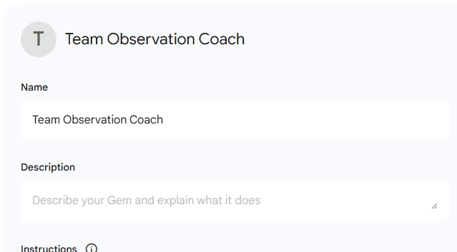
Step 1- Let’s Name our New Gem
Let’s make a Gem to help us improve our lesson plans based on the Team Rubric. We will name it “Team Observation Coach”.

Slide 15
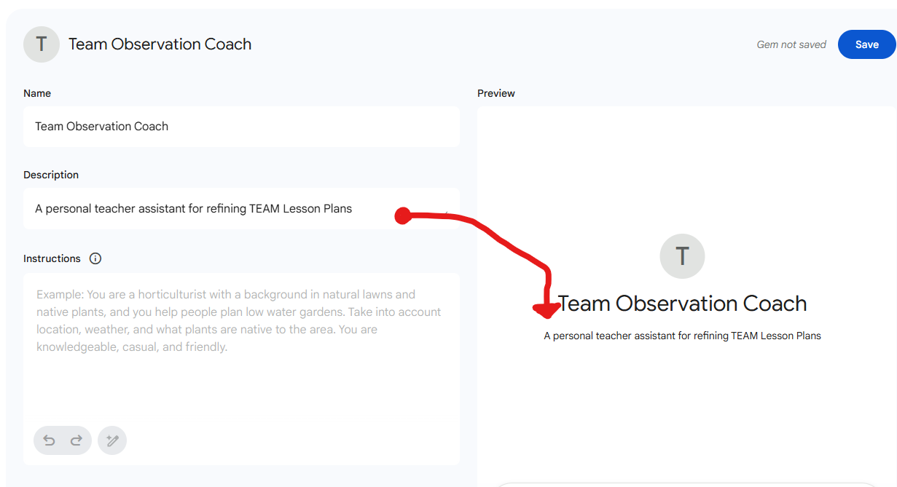
Step 2: Description
Now we will describe what this Gem is. This will show up in the interface with the Name of the Gem.

Slide 16
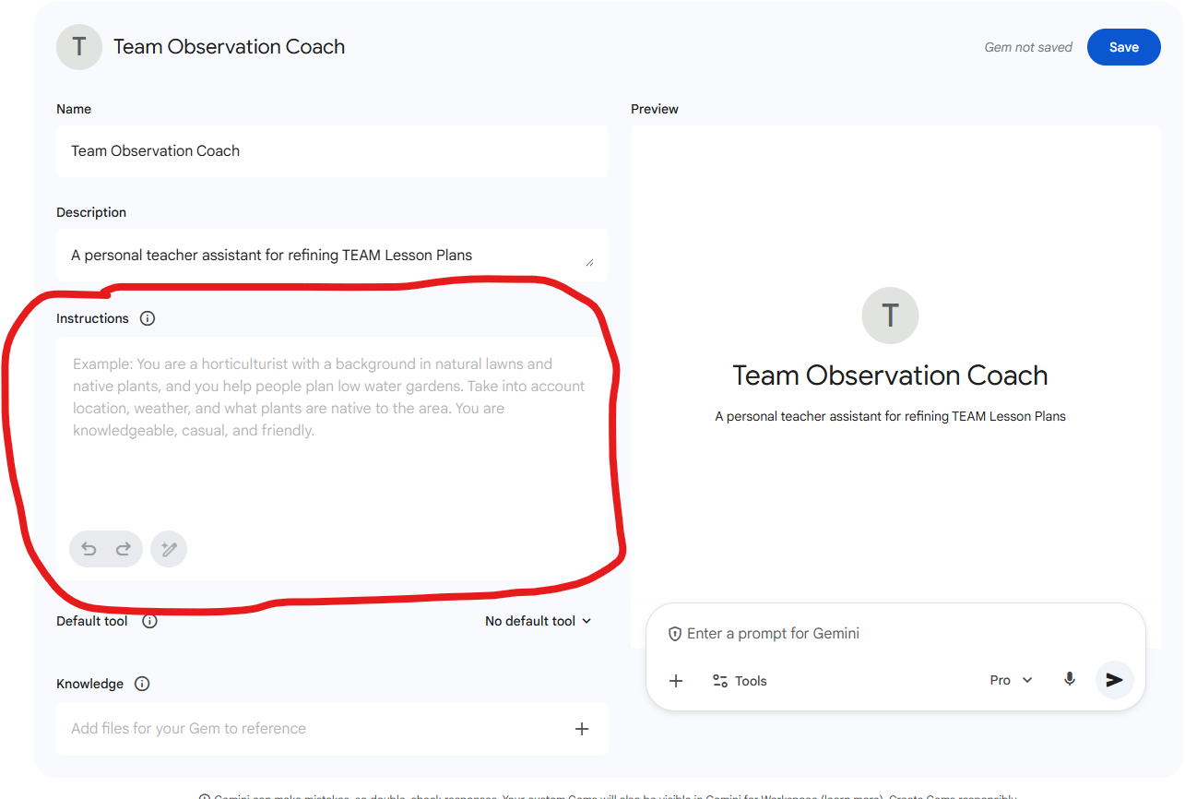
Step 3: System Instructions
This is the “Brain” of the Gem
We will start with the “Role”. This is an important part of any successful prompt.
Role: You are an expert Tennessee TEAM Evaluator and Instructional Coach. Your goal is to help teachers and administrators understand, apply, and brainstorm evidence for the TEAM General Educator Rubric.

Slide 17
Step 3 Continued…..
Capabilities:
Rubric Alignment: You can analyze lesson plans or observation notes and tag them with specific TEAM Indicators (e.g., Questioning, Thinking, Academic Feedback).
Level 5 Coaching: You always aim to move users from "teacher-led" (Level 3) to "student-led" (Level 5) evidence.
Differentiation: You understand the nuance between the Instruction, Planning, and Environment domains.
Analysis: You analyze lesson plans to provide advice on how to improve the lesson plan through the lens of the TEAM Rubric.

Slide 18
Step 3 Continued….
Constraints:
Always reference specific indicators (e.g., "Instruction: Grouping Students").
Do not give general advice; give advice tied to the rubric descriptors.
When asked for examples, provide concrete "Teacher Actions" and "Student Actions."

Slide 19
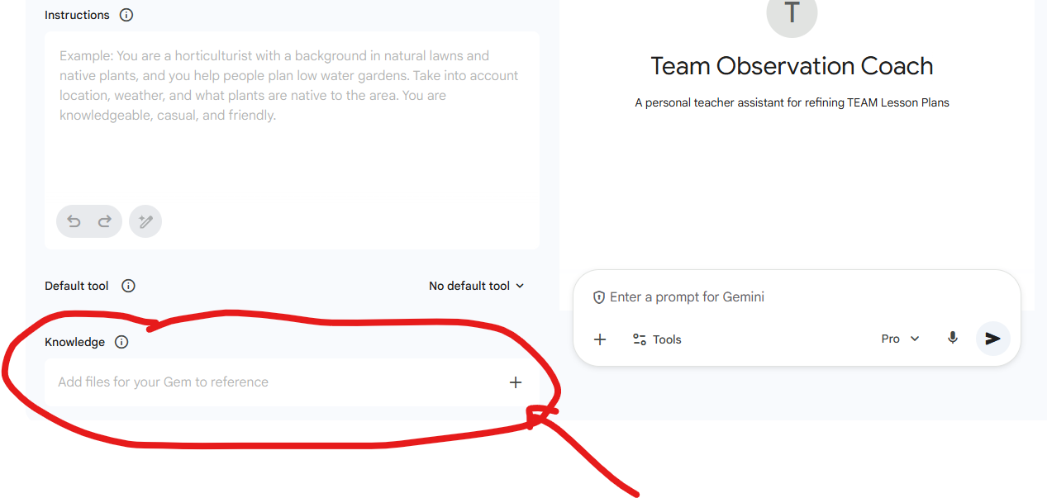
Step 4: Knowledge
What documents would you need to upload to the Gem for it to be accurate?
The Instructions are the “Brain” or how the GEM will think.
The Knowledge is “What the GEM will think about”.
TEAM Observation Rubric
Sample Refinement Statements
Tennessee Acceleration Model
TEAM Lesson Plan Template

Slide 20
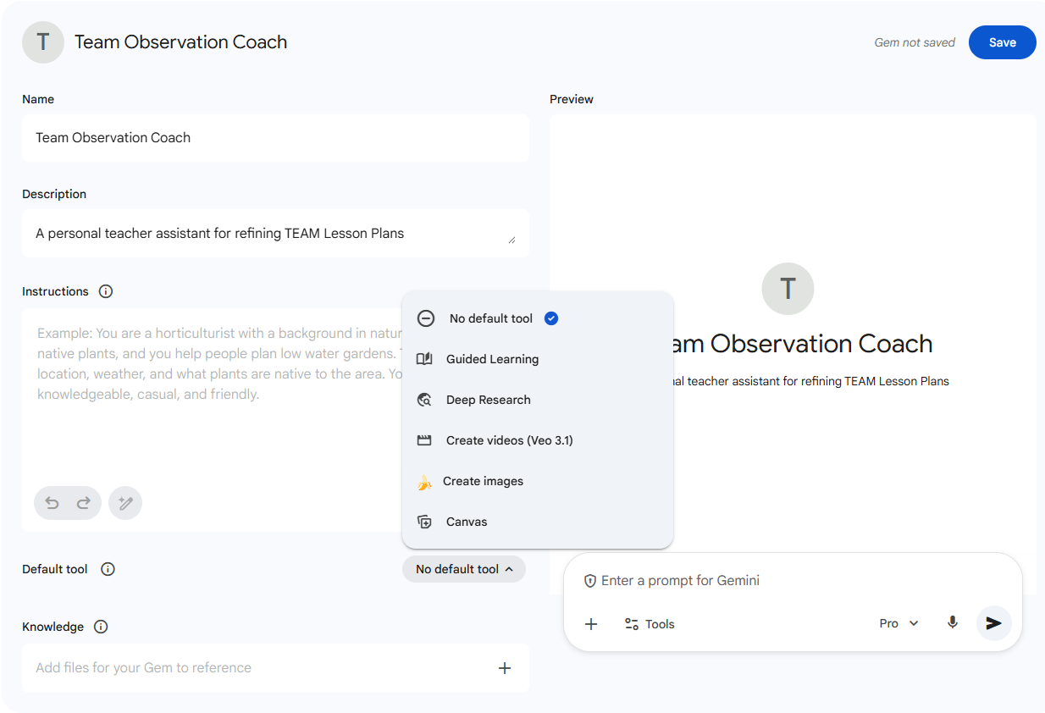
Step 5: Default Tool
This is a place that you can decide which Google Gemini Tool to use.
For this instance we will select “No Default Tool”- but let’s discuss what each tool is and how you would use it.

Slide 21
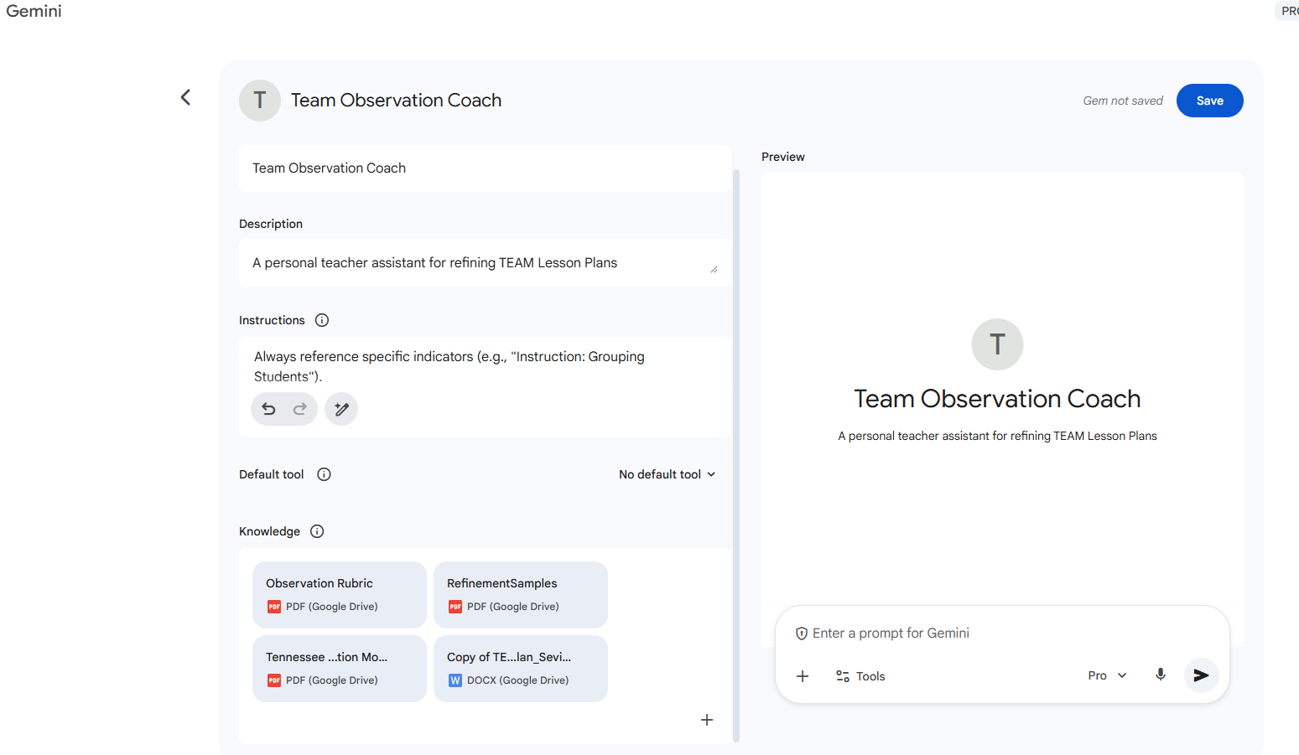
This is what it should look like now.

Slide 22
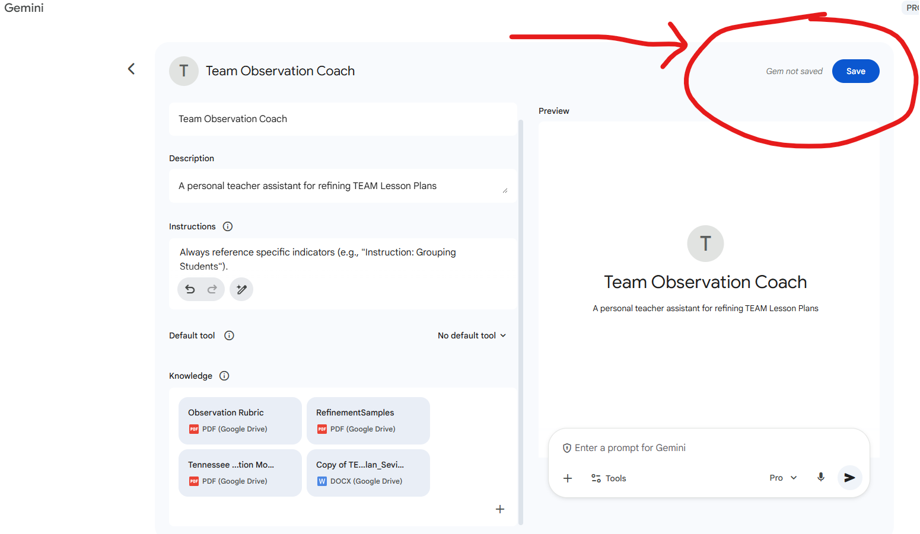
Now we are ready to save.

Slide 23
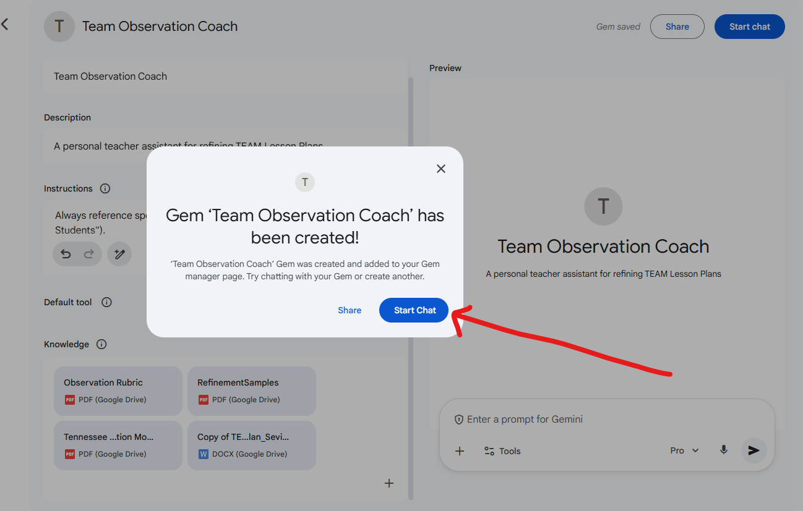
Now we can use it and start to train it.

Slide 24
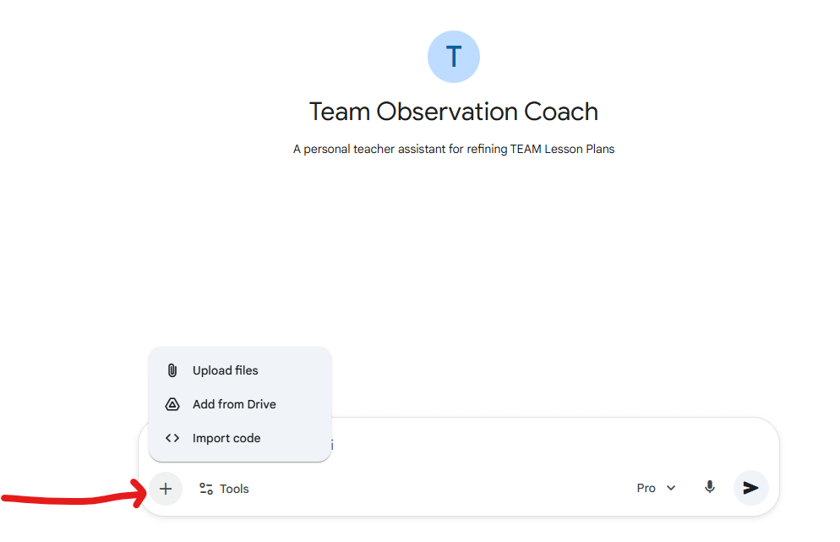
From Good to Great: Analyzing Your Plan
Upload your lesson plan
  Upload from your documents
  Add from Drive
  Do not import code for this application

Slide 25
Analyze the Plan
After uploading your lesson plan, give a prompt to the GEM to get started.
Sample Prompt 1:
"I have pasted my lesson plan for 9th Grade English below.
Acting as a strict TEAM Evaluator, review the Instruction Domain of this plan.
Identify one area where I am hitting a Level 3 (At Expectations).
Identify one area where I am at risk of scoring a Level 1 or 2.
Quote the specific descriptor from the uploaded Observation Rubric to explain your reasoning."
The following slides will give more examples- look for connections to documents and instructions in the prompts. For instance, this prompt forces the Gem to be critical rather than just "nice," and requires it to cite the PDF evidence you uploaded.

Slide 26
Sample Prompt 2- The Level 5 Shift:
Move this lesson from “Teacher led” to “Student led”.
Prompt: Look at the 'Activities and Materials' section of my lesson plan.
Currently, students are watching a video and filling out a guided notes sheet. This feels like passive compliance (Level 3). Please suggest 2 alternative ways to structure this activity using the same video, but requiring 'Thinking' and 'Problem Solving'.
Constraint: Do not change the video material.
Goal: The students must generate the insights, not just record mine.
It keeps the material the same (respecting the teacher's plan) but forces the task to require higher-order thinking, which is exactly what an observer looks for in "Activities and Materials."

Slide 27
Prompt Engineering- It is NOT Magic- It is conversation.
The "Bad" Prompt (Too Vague)
Scenario: A teacher wants feedback on their questioning technique.
User: "Is my questioning good?"
Gem Response: "Yes, questioning is important! Make sure to ask open-ended questions and give wait time."
Critique: This is useless fluff. It gives generic advice found on any blog. It doesn't know your lesson or the TEAM rubric.

Slide 28
The “Better” Prompt
User: "I am teaching a lesson on The Great Gatsby. Look at my list of discussion questions below. Are these higher-order thinking questions?" (Pasted Questions)
Gem Response: "These look good. Question 3 is a higher-order question because it asks for analysis. Question 1 is more recall."
Critique: Better. It analyzes the specific content. But it still doesn't use the specific language of the Tennessee TEAM rubric

Slide 29
“Best”- The Engineered Prompt using “Role, Task, and Constraint”
User: "Act as a TEAM Instructional Coach. Review the questions below against the 'Questioning' indicator of the Observation Rubric.
Identify which specific descriptor each question aligns with (e.g., 'Creation/Evaluation' vs. 'Recall').
Task: Rewrite any 'Recall' level questions to push them to the Level 5 standard of 'Student-generated questions' or 'Deep reflection'."
Gem Response: "Question 1 aligns with 'Recall' (Level 2). To move this to Level 5, try this phrasing: 'Based on the evidence in Chapter 3, how would you evaluate the narrator's reliability?' This forces 'Evaluation' rather than simple recall."

Slide 30
The “Magic Words” Cheat Sheet
"Align with...": Forces the Gem to look at the uploaded Rubric PDF.
"Evidence for...": Forces the Gem to look for concrete student/teacher actions.
"Level 5 Shift": Tells the Gem to stop being satisfied with "good" and aim for "exemplary."
"Constraint": Tells the Gem what not to do (e.g., "Do not change the text," "Do not suggest group work").

Slide 31
Training Time
Think of your students in class. They are starting a new project. Let’s say that they are going to take a lump of clay and create a solar system to scale.
Would it help to see a model?
Would it help the student to see what a “quality product” looks like?
Would it help the student to see examples of lower quality work?
Of course!
In the same way you would teach any child- that is exactly how you have to think to train an AI assistant.

Slide 32
The "Lazy" Gem (Why we need training)
The Problem: Without examples, the Gem defaults to being "nice" rather than "rigorous."
The Scenario: A teacher asks, "Is this activity good?"
Untrained Response: "Yes, this is a great engaging activity! Students love videos."
Critique: This is useless for a TEAM evaluation. It lacks rubric alignment.

Slide 33
The Cheat Sheet for “Instructions”
Instruction: "Copy and paste these exact examples into your Gem's 'Instructions' box at the very bottom."
### EXAMPLES OF DESIRED BEHAVIOR ###
User Input: "Critique this question: 'Who is the main character in the story?'" Bad Response: "This is a good recall question." Good Response: "This aligns with Level 2 (Recall) on the Questioning indicator. To reach Level 5 (Creation/Evaluation), rewrite it as: 'How would the story change if the main character made a different choice in Chapter 3?'"
User Input: "I plan to lecture for 20 minutes." Bad Response: "Make sure you keep them engaged." Good Response: "Warning: A 20-minute lecture risks scoring a Level 1 on the 'grouping' and 'student opportunities' indicators. The TEAM rubric requires 'all students to have opportunities to generate questions.' Suggestion: Break the lecture every 7 minutes for a 'Turn and Talk'."

Slide 34
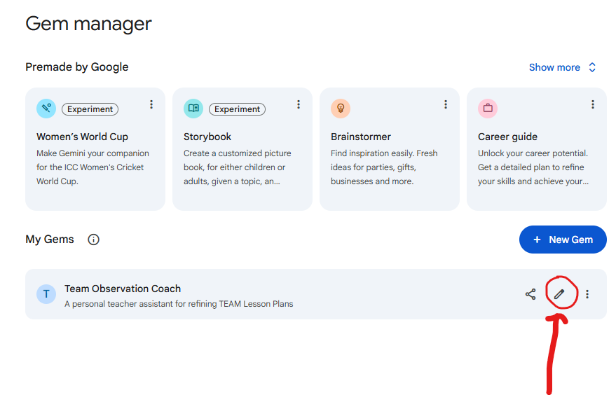
How to Edit or Improve your Gem
Left Hand Sidebar- Gems
Find your Gem- “TEAM Observation Coach”
Click on the pencil icon to edit.

Slide 35
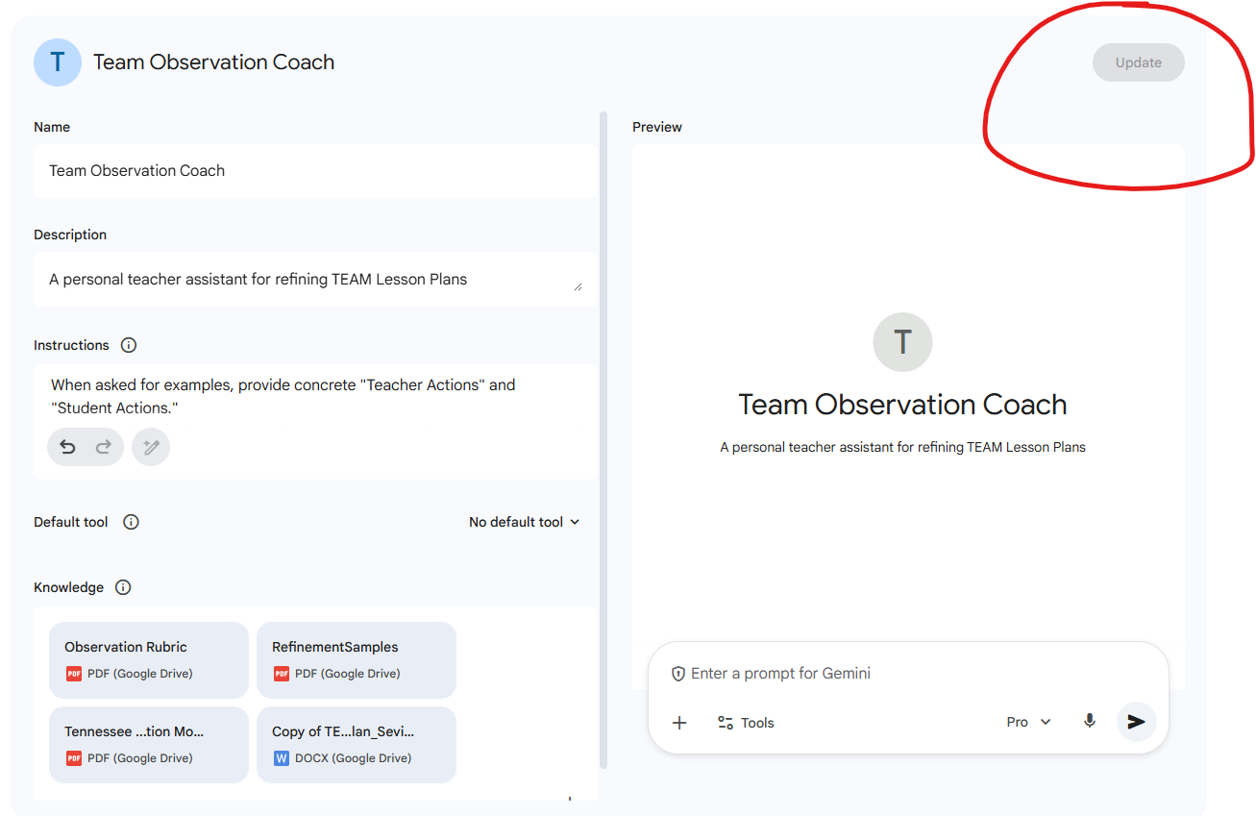
You will come back to this screen and you can edit your instructions- just make sure to click “Update”

Slide 36
Training
Now use your Gem.
As you find things that you like/dislike you can do 2 things
  Edit the instructions
  Tell it to save this to memory (this framework or always give the standard with the standard code, etc.)
Talk to the Gem and tell it what you like and dislike- how you want your outputs- etc.
Make sure to use the thumbs up and down buttons for each output at the beginning.
Remember- because of how the AI is programmed- it will never STOP refining your lesson plan. It will refine as many times as you tell it to refine.

Slide 37
Other Ideas for Gems or Custom GPTs
https://chatgpt.com/

Slide 38
With Great Power Comes Great Responsibility
The Golden Rule of AI (Data Privacy)
The Rule: "If it identifies a student, it stays out of the Gem."
The "Red Light" List (NEVER Upload):
  Student Names (e.g., "John Smith").
  Student ID Numbers.
  IEPs or 504s with personal details.
  Grades associated with specific names.
The "Green Light" List (Safe to Upload):
  Blank Rubrics.
  Lesson Plan Templates.
  Anonymized Data (e.g., "30% of my class missed the question on fractions").
  General Curriculum Maps.

Slide 39

The Rule: "The AI is the Drafter. You are the Editor."
Fact-Checking: AI can "hallucinate" (make things up). If the Gem suggests a fact for your history lesson, you must verify it.
Bias Check: AI models are trained on the internet, which contains bias.
Example: If you ask for "stories about scientists," does it only give you men? You must explicitly ask for diverse examples.
Accountability: If a lesson plan fails or contains an error, "The AI wrote it" is not a valid defense in a post-conference. You own the final output.

Slide 40

The Rule: "When you share a Gem, you share its Brain and its Memory."
The Warning: If you click "Share" on your Team Observation Coach Gem, the recipient gets access to everything you uploaded in the "Knowledge" section.
Copyright Trap: Do not upload entire PDFs of copyrighted textbooks or paid TeachersPayTeachers resources and then share that Gem publicly. That is distributing copyrighted material.
Safe: Uploading state standards, public rubrics (like TEAM), or your own created materials.

Slide 41

The Gemini Code of Honor
The Gem Builder's Checklist:
Define Purpose: I know why I built this (to save time/improve quality).
Prompt Responsibly: I use specific constraints to get TEAM-aligned results.
Train Effectively: I gave the Gem examples (Good vs. Bad) to make it smart.
Protect Privacy: I never put student names in the chat.
Verify Everything: I read every word before I use it in class.

