Slide 1
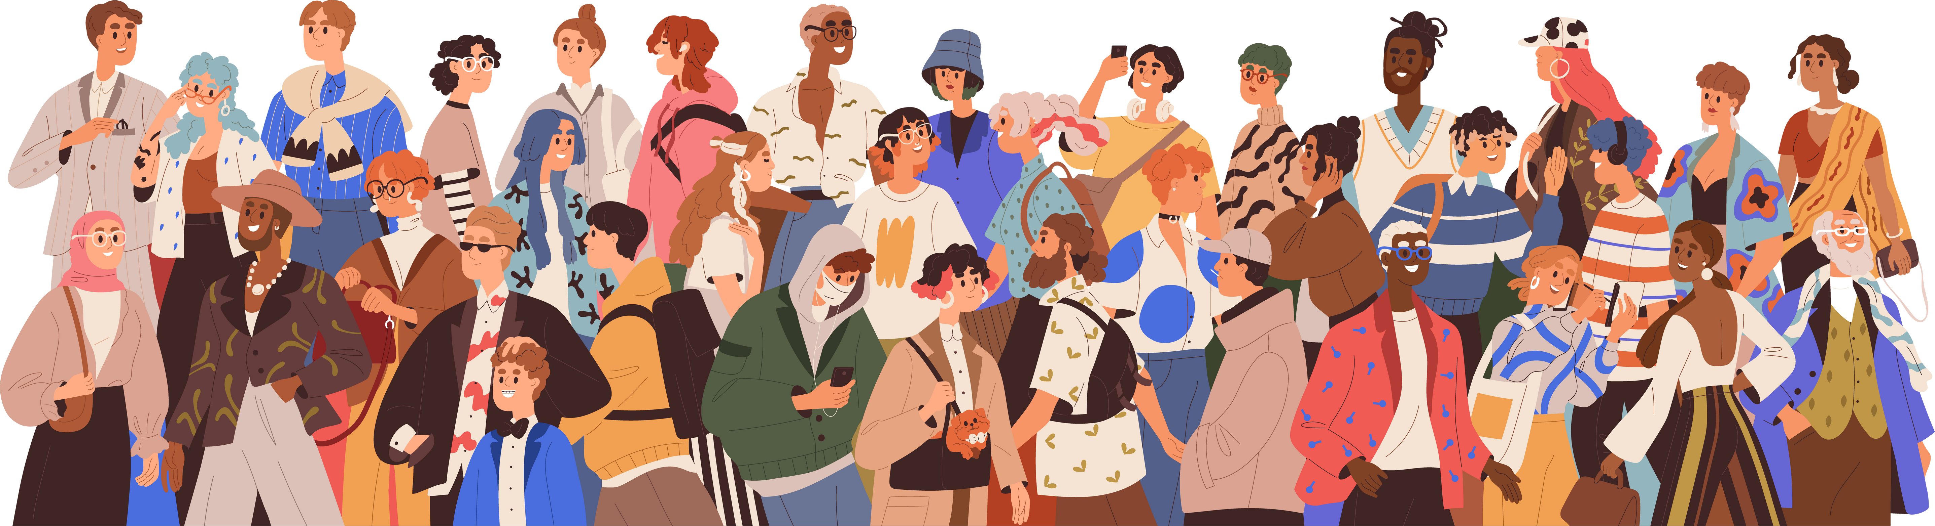
Collaboration and Co-Teaching:
Working Together
to Make Students Better
Ginna Winstead, M.Ed.
Clarksville-Montgomery County School System

Slide 2

Learning Targets
01
02
Collaboration:
Identify who you currently collaborate with and how effective it is in improving student achievement.
Identify ONE shift you can make to improve collaboration.
Co-Teaching:
Identify challenges you face with co-teaching.
Identify ONE shift you can make with your co-teaching practices to improve student achievement.

Slide 3
Agenda
01
02
03
Collaboration:
What is it?
How can I do it?
Why should I do it?
Co-Teaching:
What is it?
How can I improve how we do it?
Reflection:
What do students need?
How can I adjust what I do to serve them better?

Slide 4

Who am I and why am I here?
Nashville Native
Certified Pharmacy Technician
Server, Bartender, Manager
Pre-Med Student
Chemistry Teacher
Leadership Resident
Special Education Teacher

Slide 5
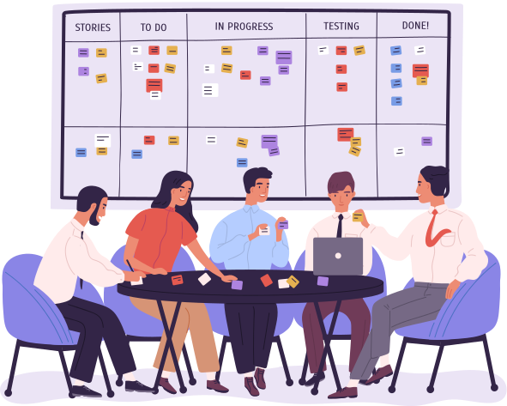
How would you define YOUR current collaborative opportunities in your building?

Slide 6


What is collaboration?

Slide 7
“Teacher collaboration in education involves teachers working together to lead, instruct, and mentor students with the goal of improving student learning and achievement.”
-Imed Bouchrika, PhD

Slide 8


That sounds great!
Estimated Statistics for
General Elementary School:
4 Special Education Teachers
6 Educational Assistants
120 Students for Core Support
37 “Inclusion” Classrooms
108 Students Receiving Interventions

Slide 9
How do we collaborate?
Within SPED Department:
Weekly Common Planning
Distribute district information
Confirm upcoming meetings
Share concerns with administration

Slide 10
How do we collaborate?
With our General Education Teachers:
Data Chats
Formal or Informal
Make Them a Priority
Creative Communication
Google
Classroom Visits
Be Present

Slide 11
WHY do we collaborate?
Teaching is HARD.
Teaching is NOT an independent activity.
ALL data drives decision making.

Slide 12

Data...
“School leaders and teachers may need more time, tools, expertise and professional development to collect, analyze and interpret data effectively.... Collecting data is essential, but it can increase pressure on educators who may already be overburdened with responsibilities....”
-Abbie Misha

Slide 13
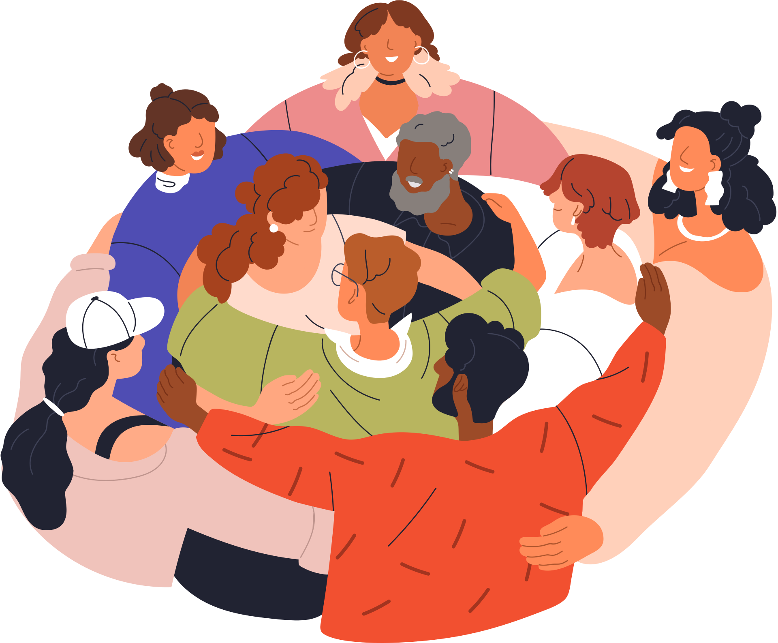
How can effective collaboration make data collection “easier”?

Slide 14
WHAT data do we discuss?
Student Performance
Student Behavior
And...
Upcoming Academic Tasks
Identify Hurdles in Advance
“What can I do to help?”

Slide 15



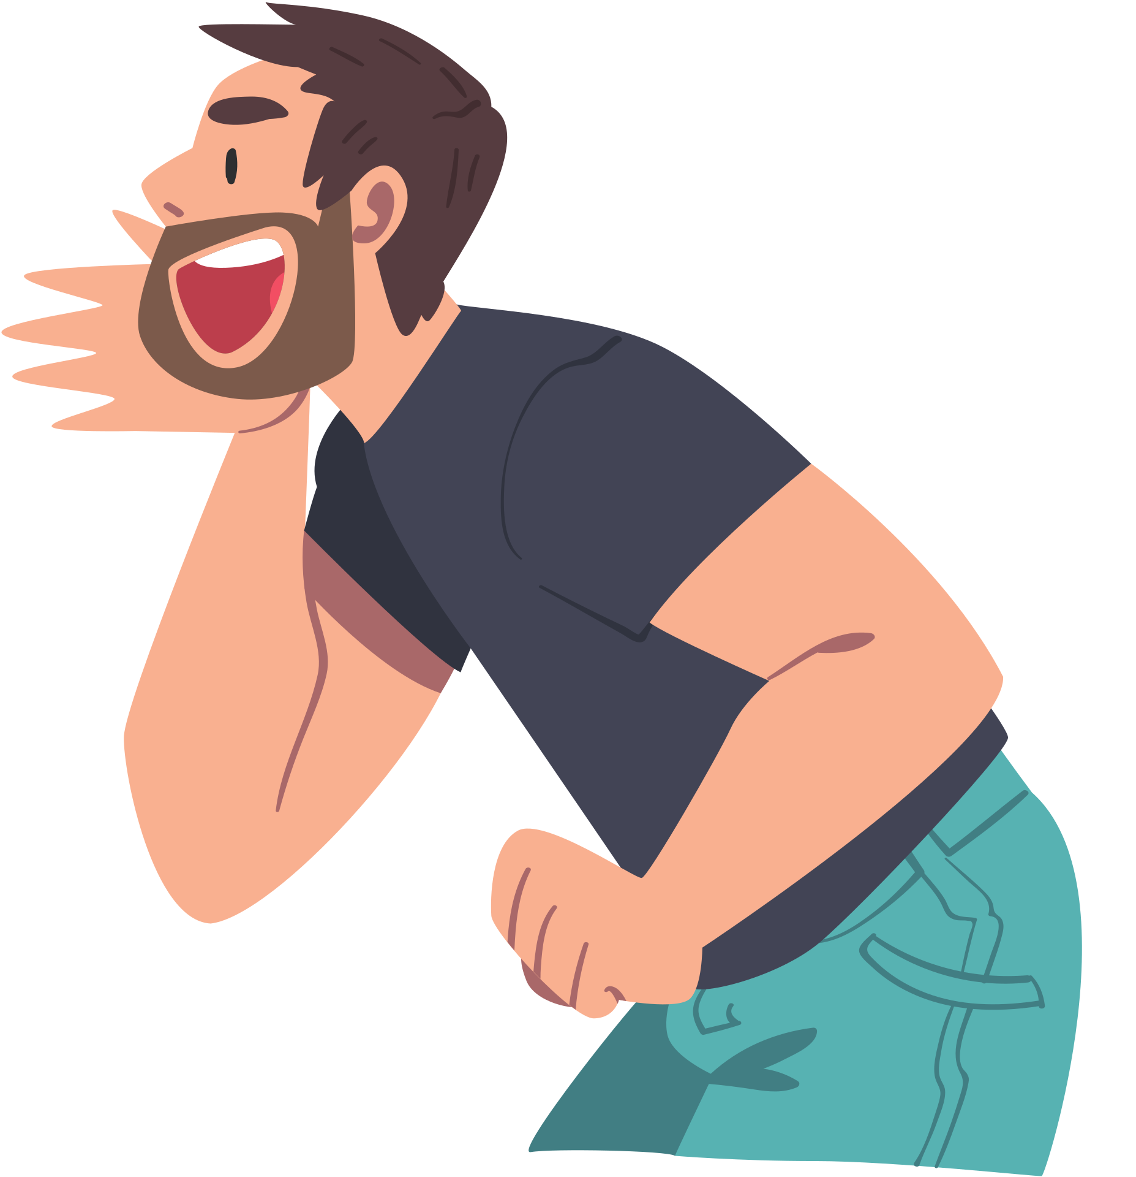
Co-Teaching

Slide 16
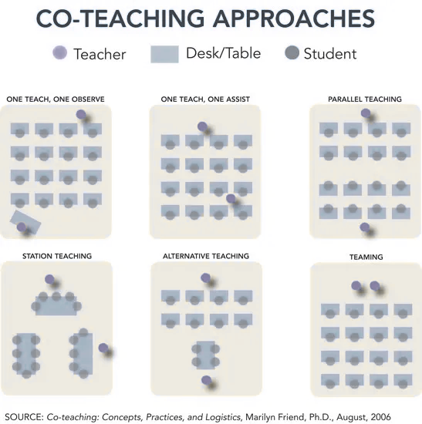
It’s more than following a model.
Teaching is not copy and paste.

Slide 17

Scenario #1
Students:
34 total
14 IEPs
5 SLD in Reading
4 Autism
5 OHI
2 BIPs
2 504s
You are teaching:
High School Biology
Core Support:
Educational Assistant who has only supported English classes

Slide 18
Scenario #2
Students:
25 total
4 IEPs
1 SLD in Reading
1 SLD in Math
1 Autism
1 OHI
8 in Tier 3 RTI
You are teaching:
Middle School Math
Core Support:
First Year SPED Teacher

Slide 19
Scenario #3
Students:
22 total
4 IEPs
1 Language Impairment
1 Autism
1 OHI
1 Gifted
2 in Tier 3 RTI
2 ELL
You are teaching:
2nd Grade Elementary
Core Support:
???

Slide 20
Co-Teaching
How would you approach each scenario as the classroom teacher?
How would you provide support as the educational assistant or SPED teacher?
How would you approach each scenario as an admin during an observation?
What could you do as the case manager to support everyone?

Slide 21
My Secrets to Coteaching?

Slide 22
My Secrets to Coteaching?
Respect that everyone is present to help each student.

Slide 23
My Secrets to Coteaching?
Respect that everyone is present to help each student.
Respect the classroom teacher’s rules, expectations, and procedures.

Slide 24
My Secrets to Coteaching?
Respect that everyone is present to help each student.
Respect the classroom teacher’s rules, expectations, and procedures.
Set clear expectations for what the core support person should do.

Slide 25
My Secrets to Coteaching?
Respect that everyone is present to help each student.
Respect the classroom teacher’s rules, expectations, and procedures.
Set clear expectations for what the core support person should do.
Be a united front for students.

Slide 26
My Secrets to Coteaching?
Respect that everyone is present to help each student.
Respect the classroom teacher’s rules, expectations, and procedures.
Set clear expectations for what the core support person should do.
Be a united front for students.
Communicate with everyone who works with the students receiving core support.

Slide 27
Learning Targets
01
02
Collaboration:
Identify who you currently collaborate with and how effective it is in improving student achievement.
Identify ONE shift you can make to improve collaboration.
Co-Teaching:
Identify challenges you face with co-teaching.
Identify ONE shift you can make with your co-teaching practices to improve student achievement.

Slide 28
Questions?
virginia.winstead@cmcss.net

