Slide 1
Tech Tools for Inclusive Instruction
UDL in Action

Slide 2
Session Objectives:
To provide administrators with an understanding of UDL principles and their significance in promoting inclusive education.
To familiarize administrators with universal tools that support the implementation of UDL principles.
To examine AI tools that can assist with making UDL lessons and activities, taking the burden off the teachers

Slide 3
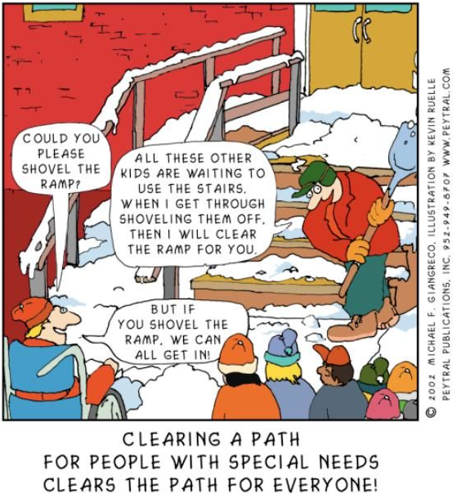
Introduction to Universal Design for Learning
Definition: UDL is an educational framework that aims to cater to the diverse learning needs of all students by providing flexible instructional methods, materials, and assessments.

Slide 4
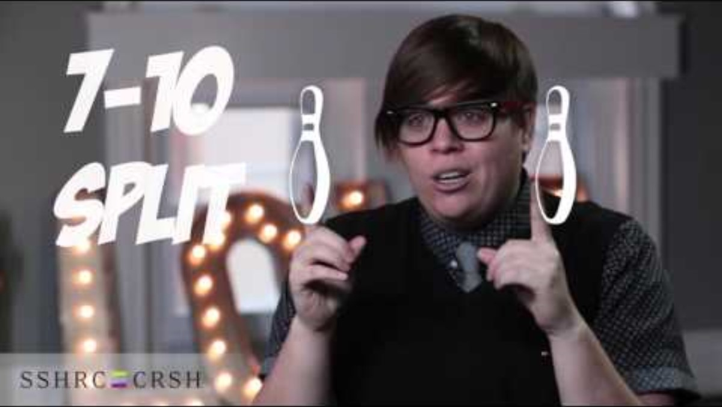
A UDL analogy – Bowling!
Notes:
Start at :48

Slide 5
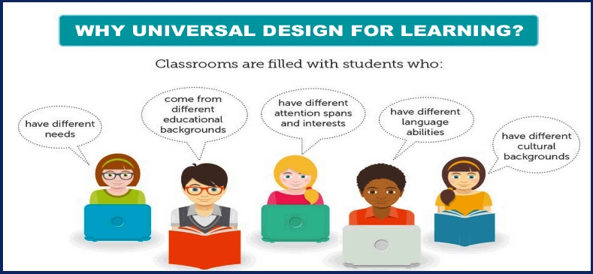
3 Guiding Principles of UDL
Multiple means of engagement
Multiple means of representation
Multiple means of action & expression
Notes:
Multiple means of engagement – Providing options to stimulate interest and motivation for all learners.
Multiple means of representation – Presenting information in various formats to cater to different learning styles
Multiple means of action & expression - Offering diverse ways for students to demonstrate their understanding and knowledge.

Slide 6
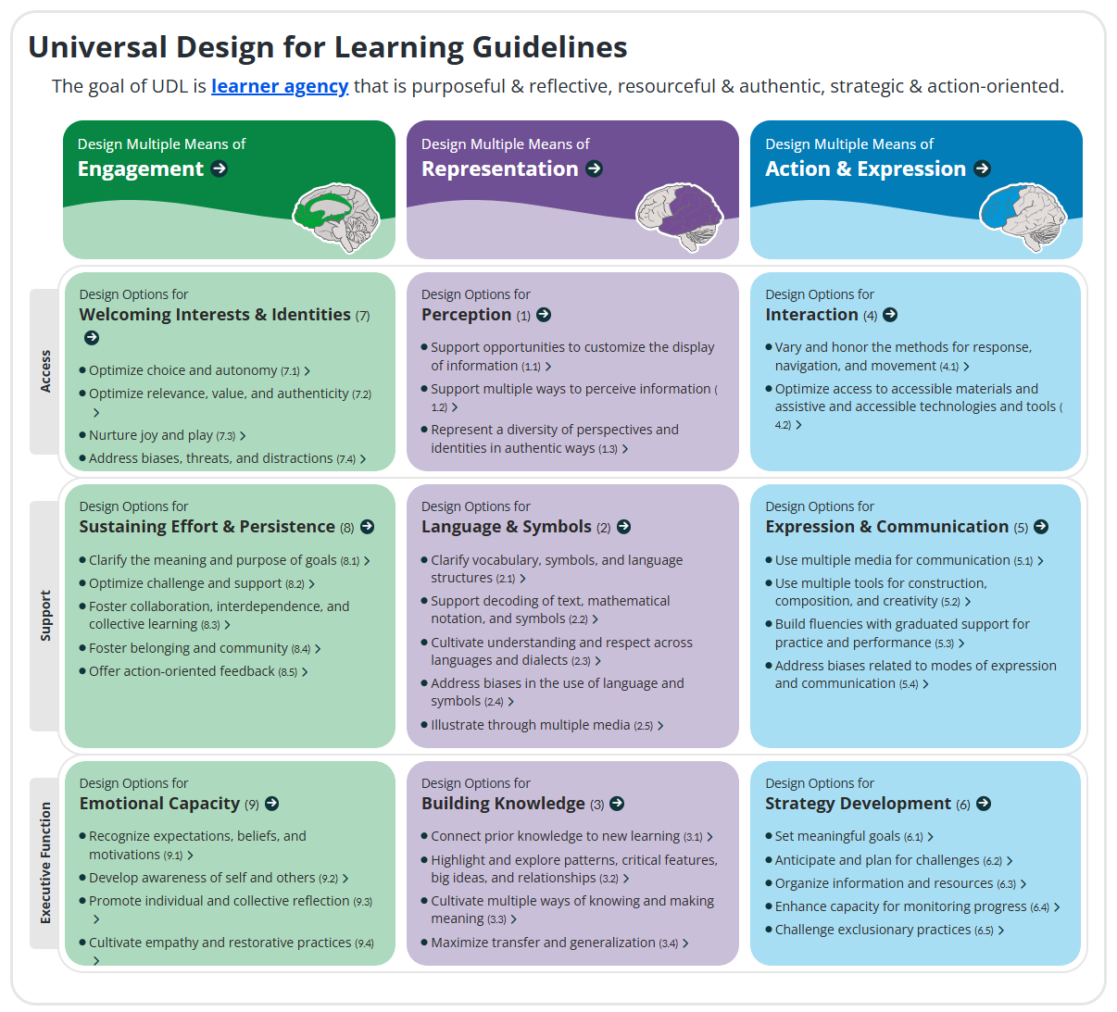
CAST.org
Universal Design for Learning｜CAST
The UDL Guidelines

Slide 7
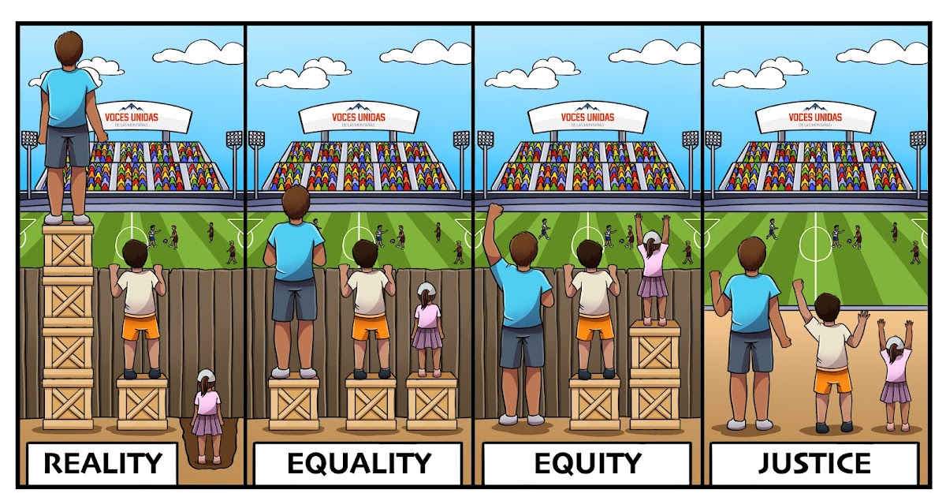
Benefits of UDL
Inclusivity – ensures that all students, regardless of their abilities, can access and participate in the learning process
Personalization – allow for personalized learning experiences, accommodating diverse strengths and needs
Equity – promotes equity by removing barriers and creating an accessible learning environment

Slide 8

Universal Design Tools
Tools every teacher & student has at their fingertips to enable universal design

Slide 9
Accommodations Tech Tools
Microsoft Immersive Reader & Edge Read-Aloud; Google add-ins & extensions (Read Aloud, Voice Reader, Text to Speech); Read&Write
Microsoft Dictate; Enable Voice Typing in Google Docs; VoiceIn extension for browsers
Captioning in Microsoft PowerPoint; Google Slides Live Captions; YouTube captions; Windows Accessibility Live Captions (Ctrl + Windows + L)
Open Dyslexic font (free to download); screen color filters; wide spacing; high contrast settings; line focus/reading tracker
Read-aloud?
Speech-to-Text?
Deaf or HoH?
Dyslexia?

Slide 10
ELL Accessibility Tech Tools
Translation in MS Word and Google Docs
MS PowerPoint also has translation and Live Caption translations (in the online version)
MS Immersive Reader has translation for read-aloud
Both MS Edge and Google Chrome have language options in Settings
Microsoft Translator for Education
Google Translate app

Slide 11

AI Tools for Creating UDL Lessons
Let AI do the heavy lifting!

Slide 12

Magic School AI
Text translator for ELL students
Choice Board (UDL) to create options for showing mastery
Group work generator for collaborative lessons
Real World Connections or Make It Relevant to increase motivation and investment
Text Rewriter to make leveled texts
Accommodation Suggestions for students with disabilities
Assignment Scaffolder breaks down assignments into manageable steps
Sentence Starters for students who need help getting started
Common Misconceptions to help the teacher foresee what may be confusing and how to address it

Slide 13

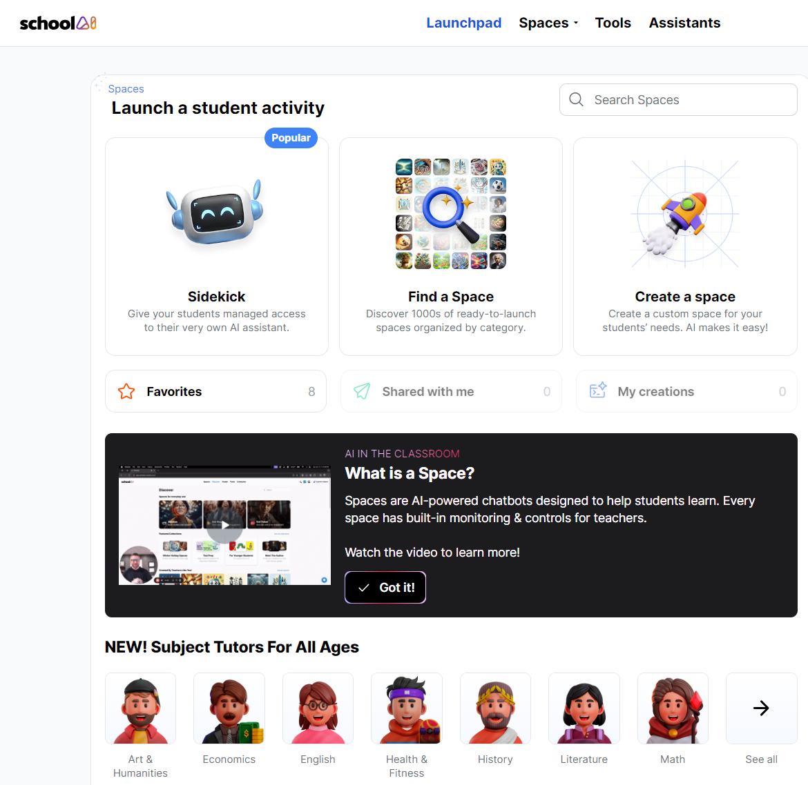
Many of the same tools at Magic School under the Tools tab
Create Spaces for students to “talk” to content experts, historical figures, book characters, etc.
Use the Sidekick for student tutoring

Slide 14
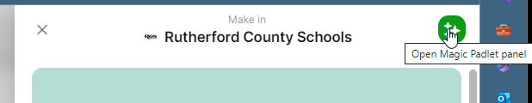
Padlet AI for Classroom Activities List
Choice Boards
Lesson Plans
Timelines
Historical Maps

Slide 15
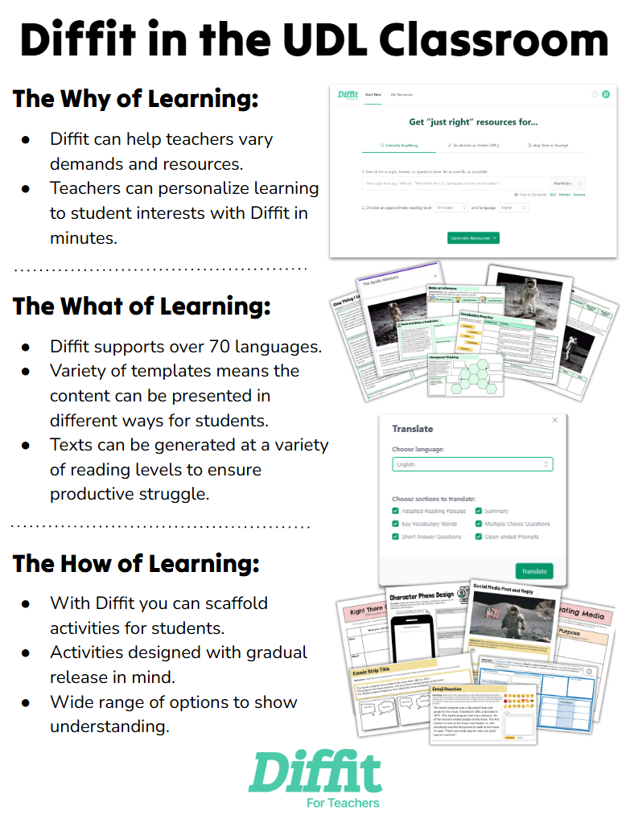
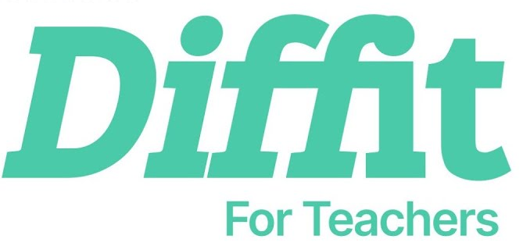
Can adapt reading passages to the just-right level for students
Over 70 languages to re-generate resources
Scaffolded activities chunk the reading and offer students multiple ways to show what they’ve learned
Activities are designed for gradual release to independent work
Wide range of activities for students to demonstrate understanding

Slide 16
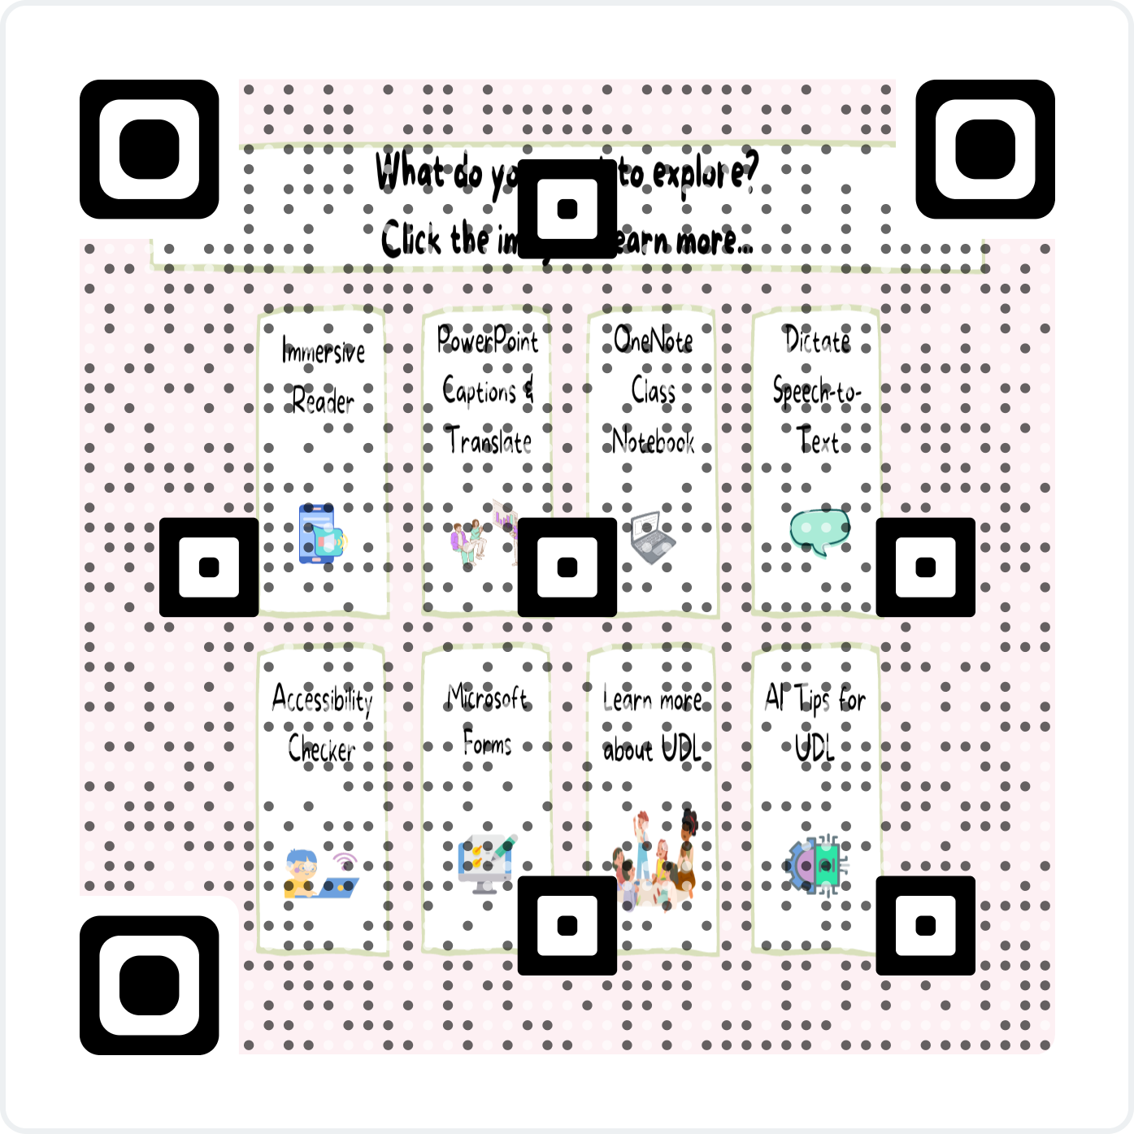
Choice Board
Time to explore on your own!
https://bit.ly/
UDL_ChoiceBoard

Slide 17


