Slide 1


Practical Tools for
Elementary School Counselors
Dr. Robb Killen
robbkillen@gmail.com
www.killencreations.com
X / Instagram: @Killencreations

Slide 2


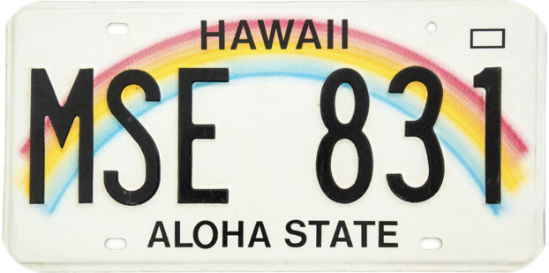



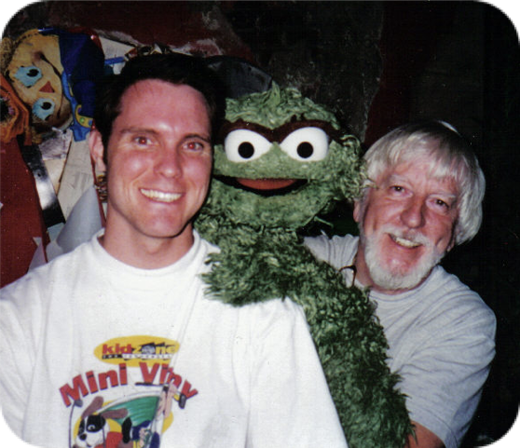
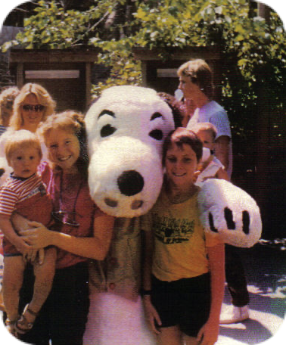
Who am I?
Notes:
Who am I?
I’ve been on a long road to where I’m at.
Child of 3, Hawaii, puppeteer, school counselor, author.
After my career as profession puppeteer, I got my master in school counseling and doctorate in educational leadership. I have worked in Metro Nashville, Currey Ingram Academy, Maury County public school central office, and The Covenant school.
Myself and my son were present during the tragic school shooting and had the privilege of walking with students and faculty through the recovery process.

Slide 3

Who Are We?
“Guidance Counselors or School Counselors: How the Name of the Profession Influences Perceptions of Competence” (Professional School Counseling, Vol. 22, Issue 1). Authors: Brett Zyromski, Ph.D., Tyler D. Hudson, M.A., Emily Baker, M.A., and Darcy Haag Granello, Ph.D. The Ohio State University. This study used a sample of 276 school counselors who were recruited for participation at a 2018 state counseling association conference in Ohio.
Notes:
I am first and foremost a school counselor…. Not a guidance counselor
First things first, in 1990, ASCA issued an official statement calling on the profession to change the title to “school counselor” rather than the previous title of “guidance counselor.”
WHY The title “guidance counselor” no longer encompassed the broad scope of work that was done by the professionals in the school Advocate to ensure the use of the title “school counselor” in all areas of your work by all educational stakeholders.
Use your title as a form of social capital to advance the recognition and legitimacy of the profession.
Adopt the title “school counselor” on all communication media, including business cards, door plaques, and digital communication such as email signatures, social media and websites.

Slide 4
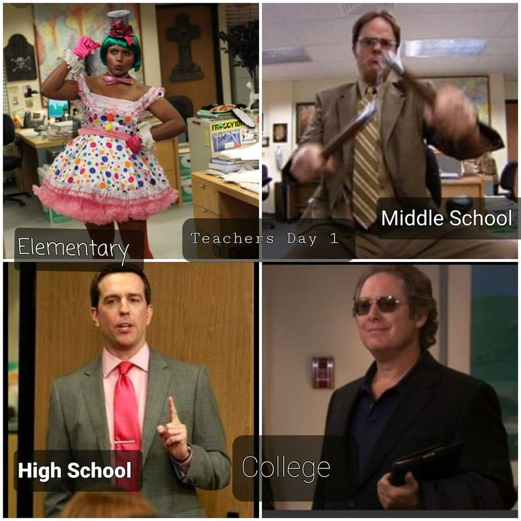
Who Are We?
*Graphic retrieved on 10-29-25 from: https://in.pinterest.com/pin/elementary-middle-school-high-school-college-teachers-meme-in-2025--249527635599227267/
Notes:
More than just school counselors…
We are ELEMENTARY School counselors. You can always spot an elementary counselor at a convention

Slide 5
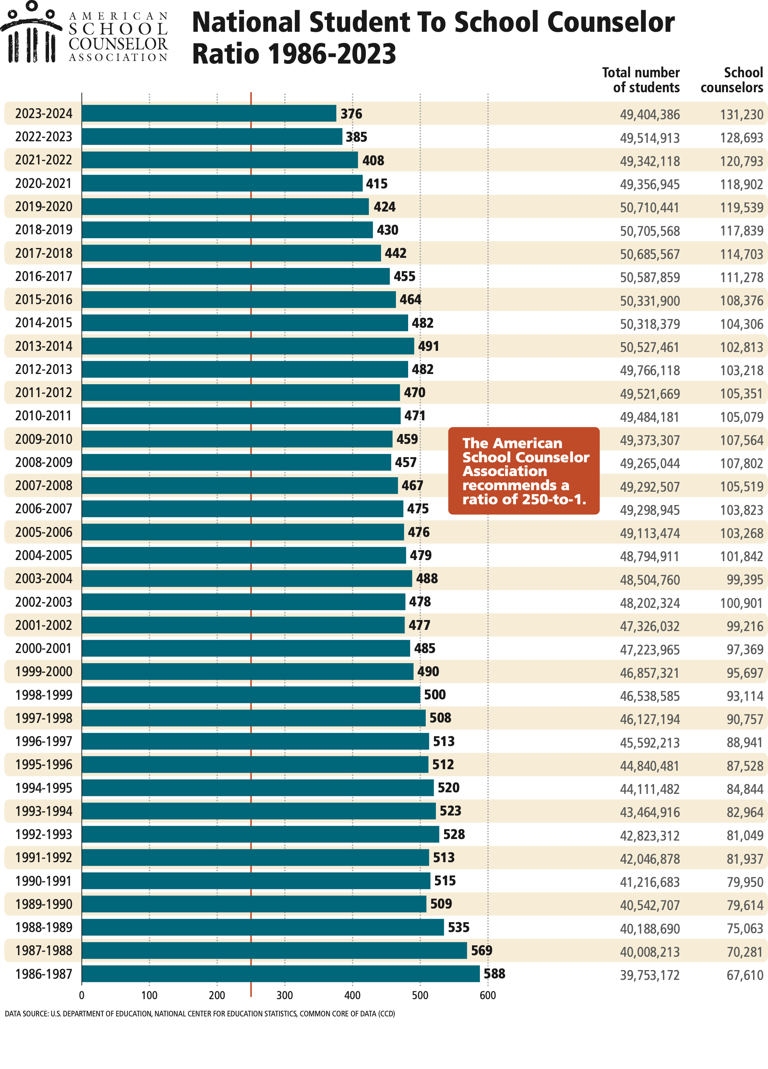
Who Are We?
Notes:
Recommended 250:1
Trending in the right direction

Slide 6
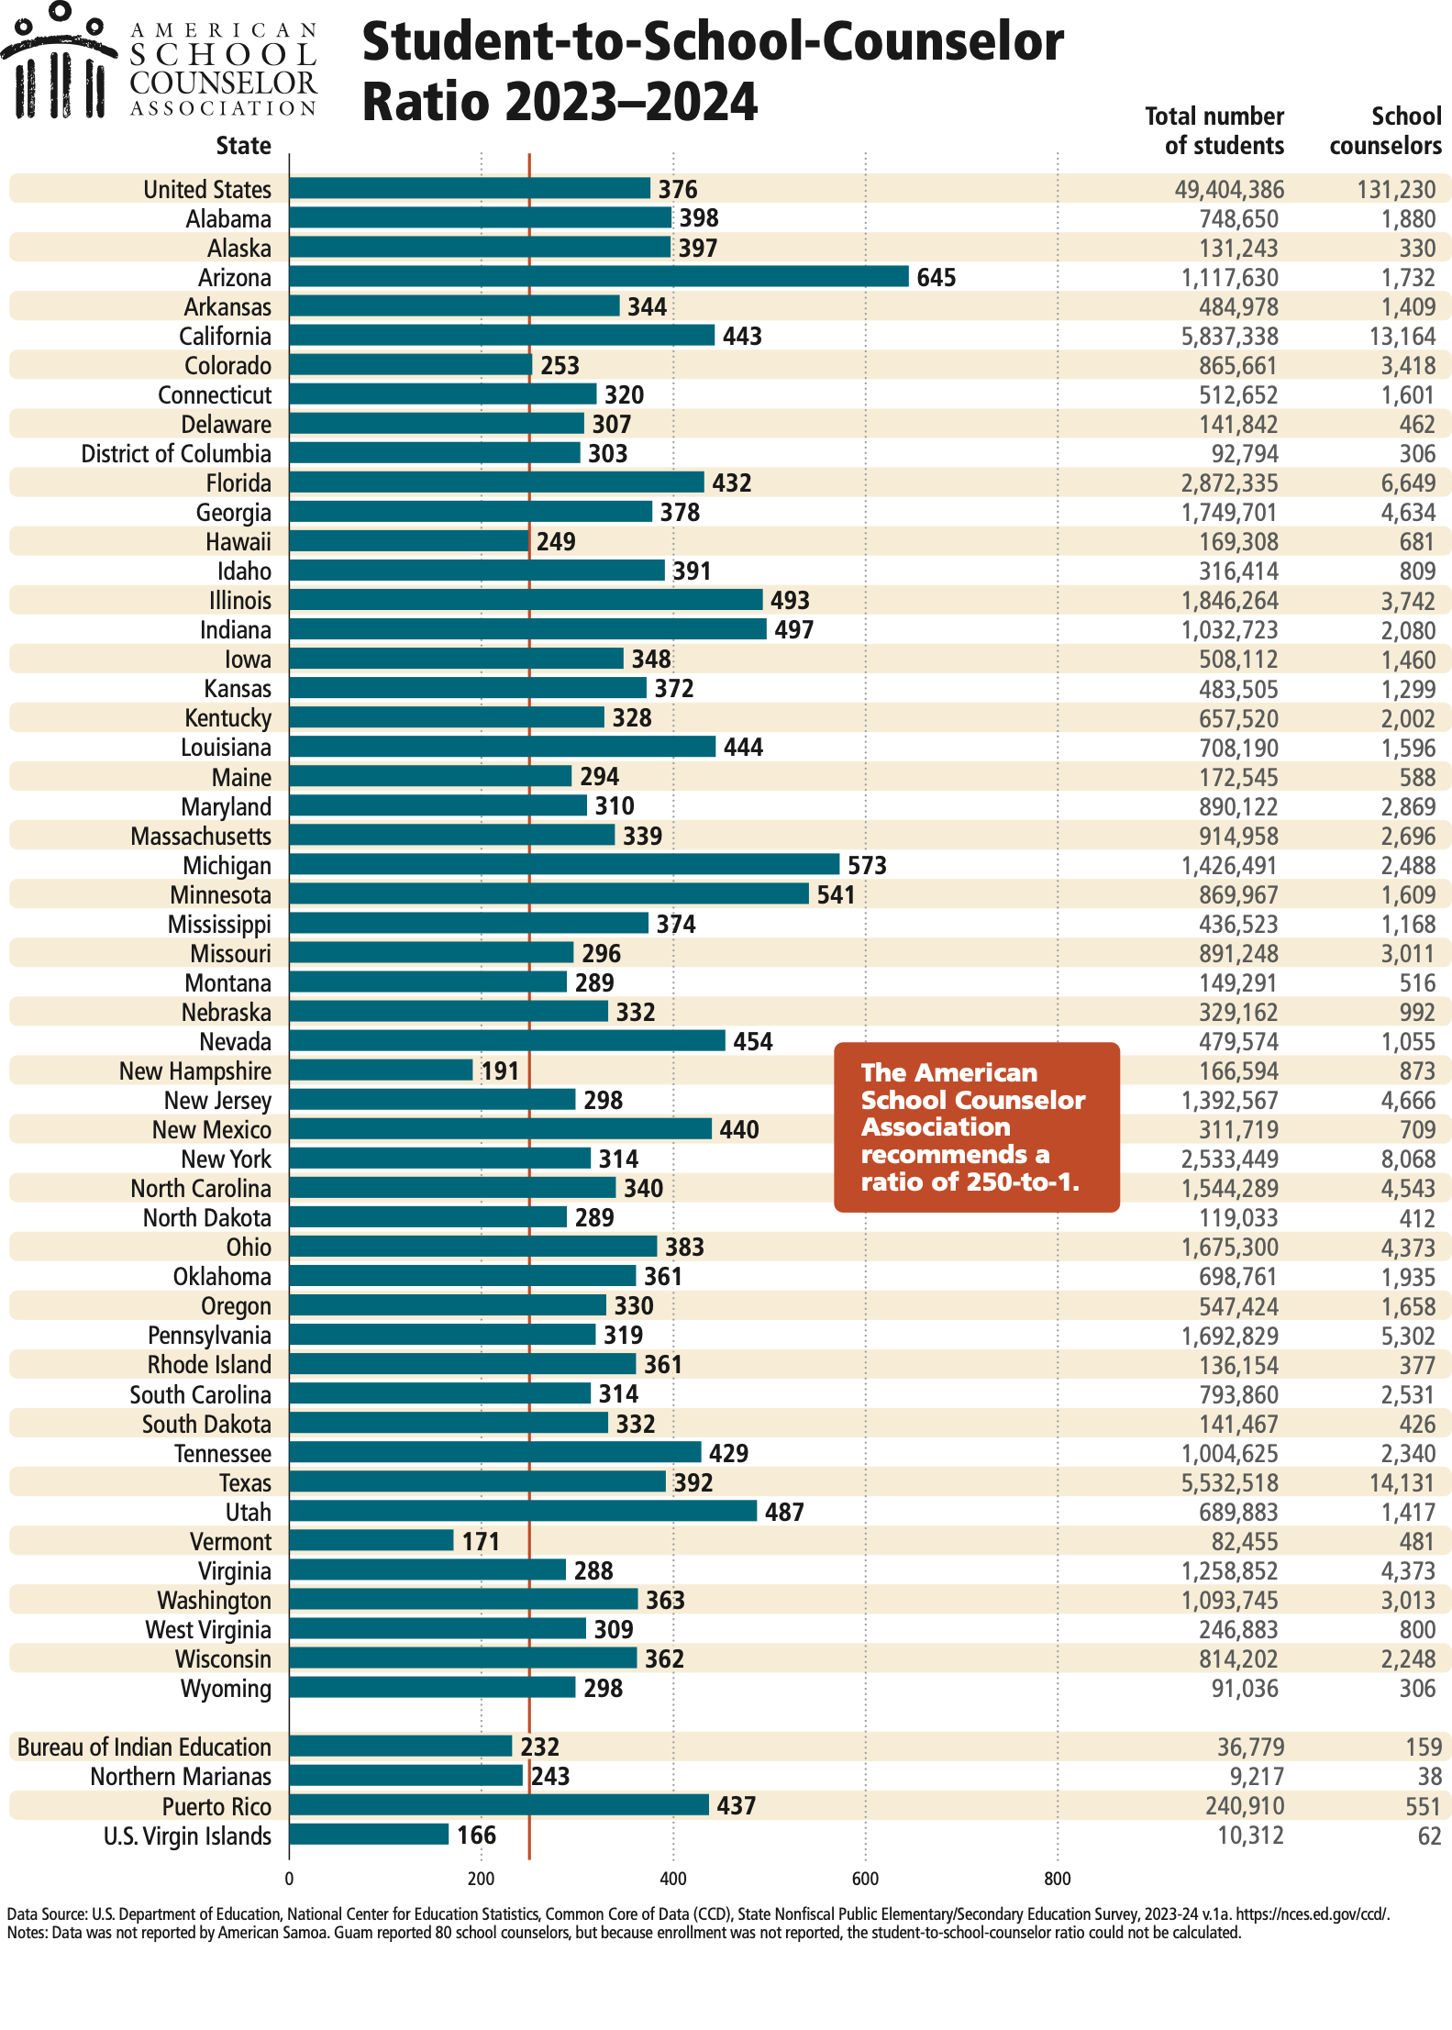
Who Are We?
Vermont: 171
New Hampshire: 191
Hawaii: 249
Colorado: 253
Tennessee: 429
Notes:
TN not the worst, but not the best either. Arizona 645
Let’s talk about making your program unique.

Slide 7
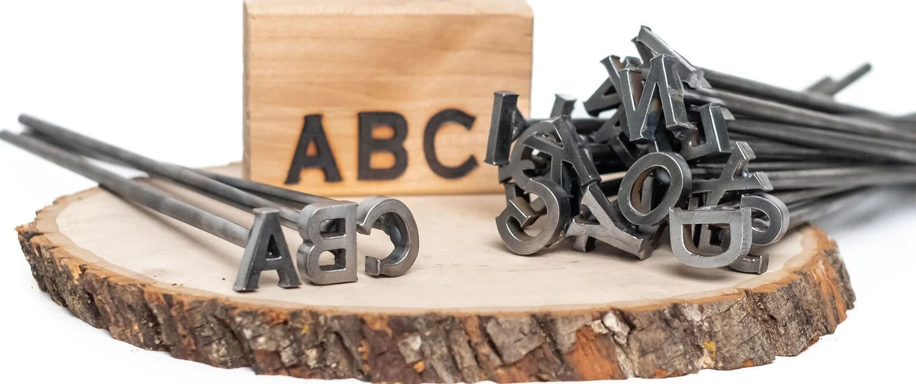
Branding
Retrieved on 10-29-25 from: https://www.etsy.com/listing/1327176725/a-z-alphabet-branding-irons-34-tall-26?ls=r&external=1&rec_type=ss&ref=landingpage_similar_listing_top-1&content_source=128f8ded3e8a78019d80c93f0559926d%253ALTd873bee520d9b98e0a3665bfa668e32ca0c5b8d5&logging_key=128f8ded3e8a78019d80c93f0559926d%3ALTd873bee520d9b98e0a3665bfa668e32ca0c5b8d5
Notes:
First of all, we are not good at promoting ourselves, but we can certainly need to do that for our program.
If we are going to advocate for it, people need to know about it. It comes back to the timeless concept of advertising which starts with branding.
You are a school counselor, but you are also unique in your counseling program approach.
Brand it, make it yours.
No one else will promote it as well as you. Don’t be shy to get it out there.
What makes your program unique. Is it your style, your hidden talent, you name, favorite color?

Slide 8




Branding
Notes:
Examples

Slide 9
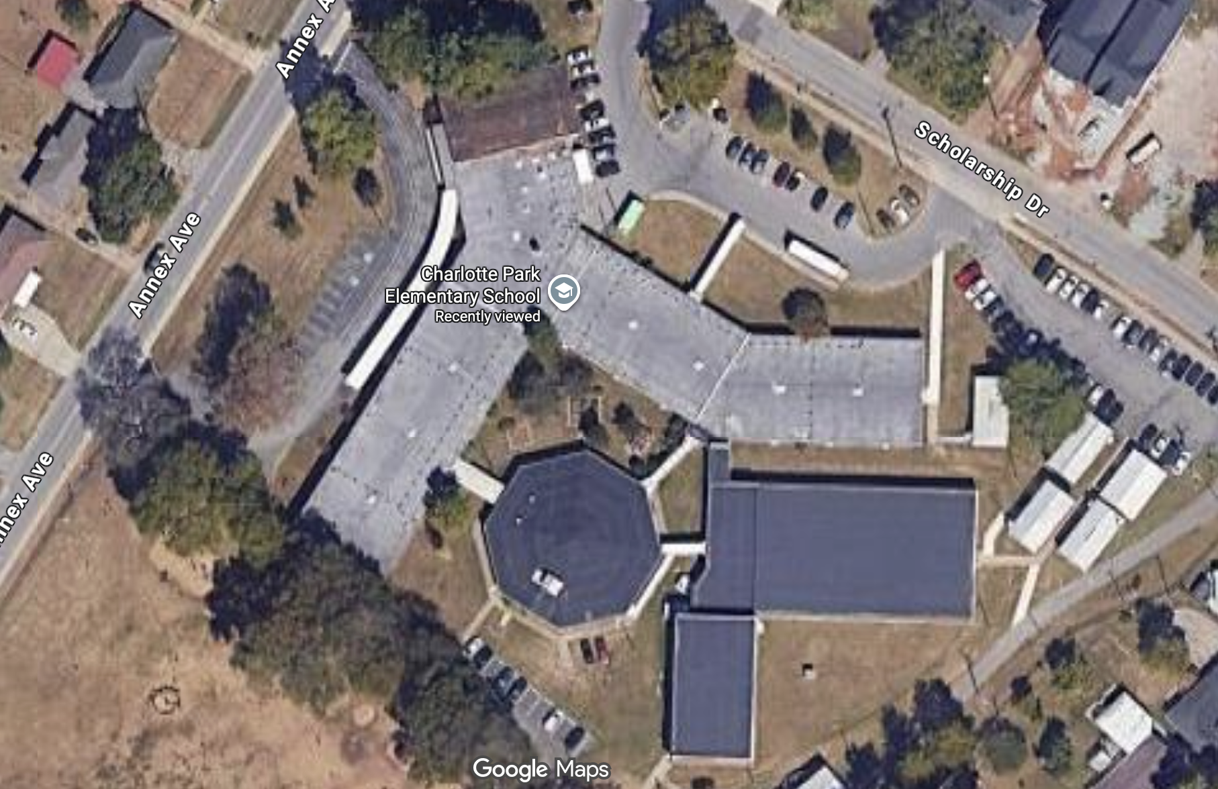
Branding

Slide 10


Branding
P O D
EOPLE
F
IGNITY

Slide 11
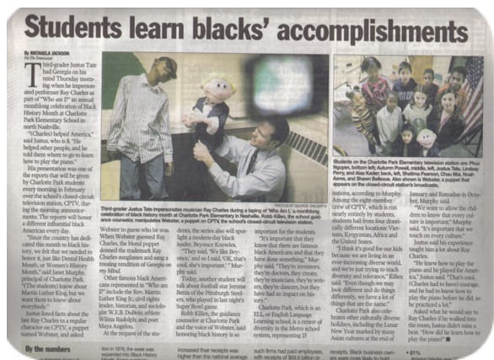
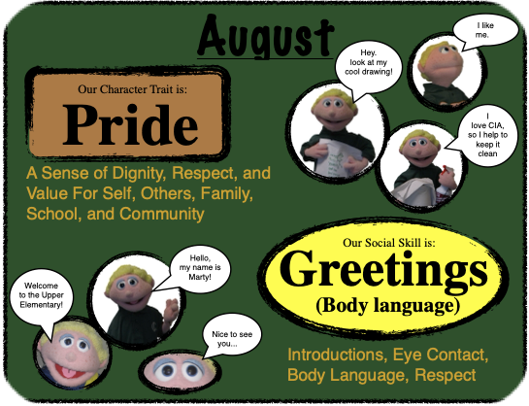
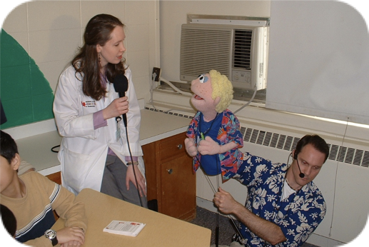
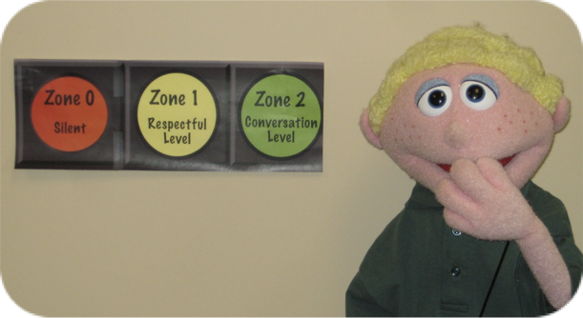



Branding
This week’s word from
the POD Squad:
Responsibility
You don’t have to use puppets...
Notes:
Expectations Signage
Special guests
Invite media for campaigns
Ask for space on sign

Slide 12

Branding
*Retrieved on 10-29-25 from: https://www.socialchamp.com/blog/social-media-icons/

Slide 13
Why We Are Here
Students who have greater access to school counselors and comprehensive school counseling programs are more likely to succeed academically and behaviorally in school; this is particular true for students in high-poverty schools.
Lapan, R. T., Gysbers, N. C., Bragg, S., & Pierce, M. E. (2012). Missouri professional school counselors: Ratios matter, especially in high-poverty schools. Professional School Counseling, 16 (2), 108-116. doi: 10.1177/2156759X0001600207
Targeted efforts by school counselors can improve students’ learning behaviors, including study skills, time usage and persistence.
Kayler, H., & Sherman, J. (2009). At-risk ninth-grade students: A psychoeducational group approach to increase study skills and grade point averages. Professional School Counseling, 12 (6), 434- 439. doi: 10.1177/2156759X0901200608
Stronger presence of school counselors in elementary schools reduces misbehavior and significantly improves boys’ academic achievement.
Carrell, S. E., & Hoekstra, M. (2014). Are school counselors an effective educational input? Economic Letters, 125, 66-69. doi: 10.1016/j.econlet.2014.07.020
There is strong evidence that elementary schools with comprehensive data-driven school counseling programs display higher academic outcomes compared to schools without such programs.
Wilkerson, K., Perusse, R., & Hughes, A. (2013). Comprehensive school counseling programs and student achievement outcomes: A comparative analysis of RAMP versus non-RAMP schools. Professional School Counseling, 16 (3), 172-184. doi: 10.1177/2156759X1701600302
*American School Counselor Association. (2015). Empirical research studies supporting the value of school counseling. Retrieved from https://schoolcounselor.org/getmedia/7d00dcff-40a6-4316-ab6c-8f3ffd7941c2/Effectiveness.pdf
Notes:
Let’s go back to the big Why
Why are we here?
Why are we needed?
Why do we do what we do each day in the schools?
Speaking of research and data… This is all found on the ASCA website

Slide 14
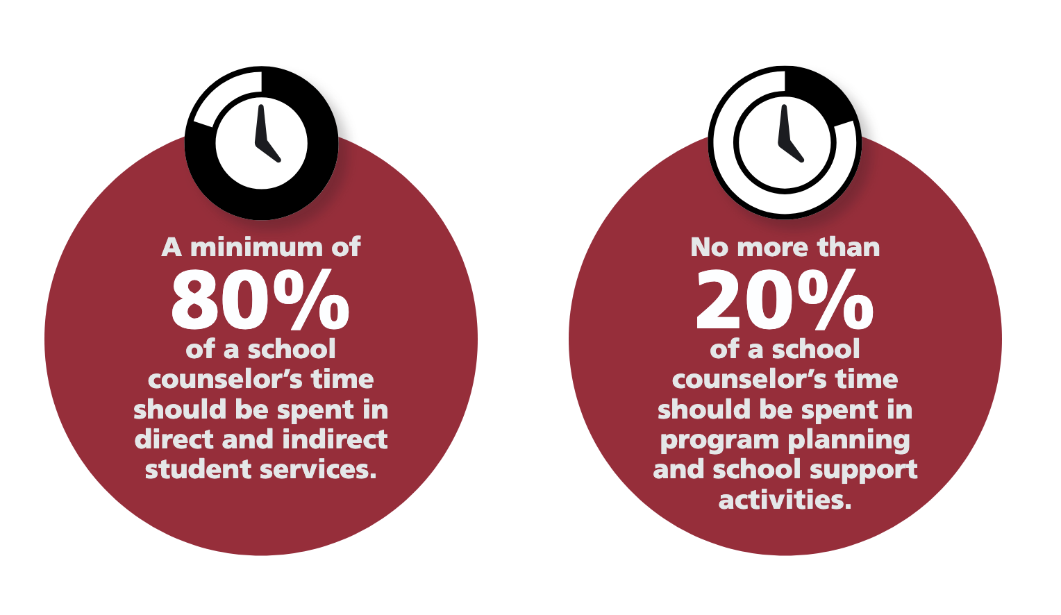

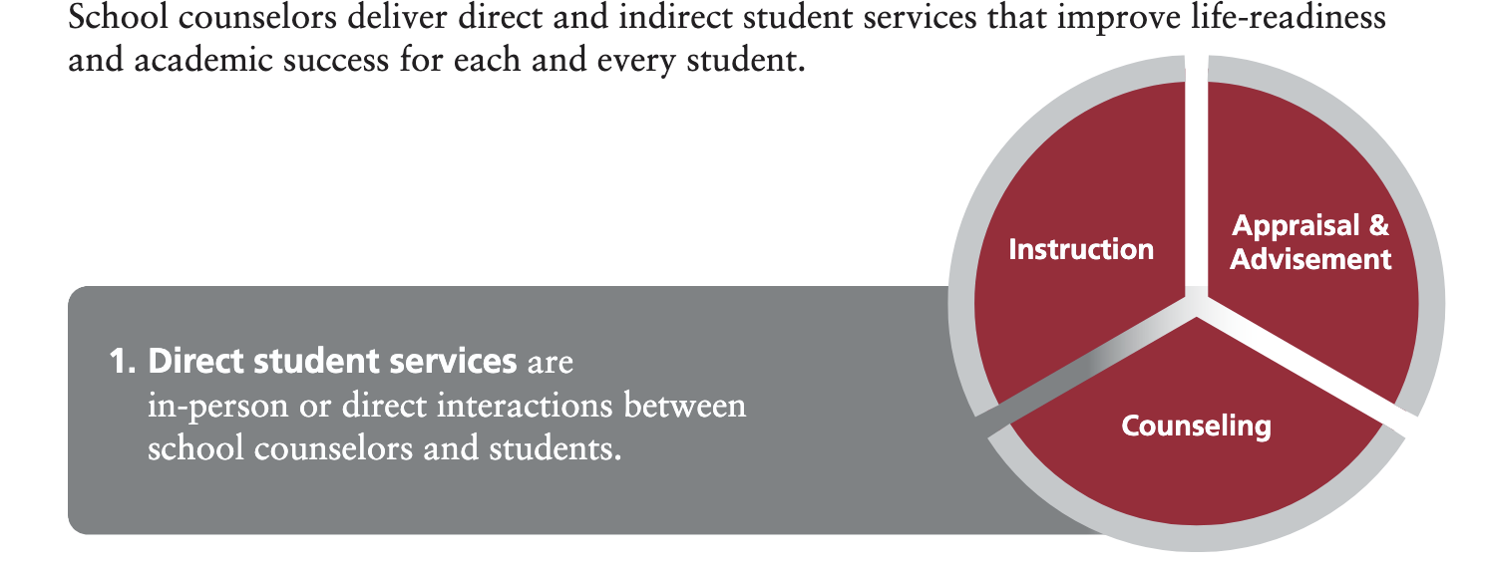
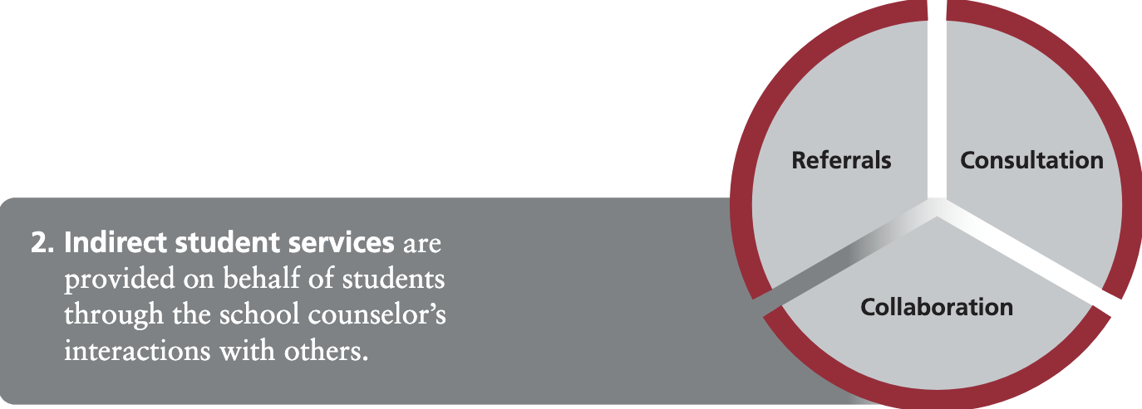
How Do We Get There?
American School Counselor Association. (2025). The ASCA National Model®: A Framework for School Counseling Programs (5th ed.). https://schoolcounselor.org/getmedia/097ddd89-fa7f-4c28-b8a4-0c219d24aaf7/asca-national-model-fifth-edition.pdf
Notes:
Ideal standard, hard to convince admin sometimes with demands they have and staffing. Advocate to stay out of rotation if at all possible

Slide 15


Perception
Notes:
Perception: The job is easy
Either doing nothing or just playing with kids (EXAMPLE of middle school internship-mentor)
***We need to constantly explain, justify and advocate for our position.
Schools run on data… We need to use data as well. You can get it in many areas.

Slide 16

Accountability
Notes:
DATA,DATA, DATA give us credibility and accountability
Can’t argue with the numbers, but you need to GET the numbers
I’ve got a few tips to Help you with data

Slide 17

Accountability
Notes:
First of all… time
You just saw the 80-20 recommendation. It’s one thing to say, “I spend too much time covering classes when we don’t have subs,” but it’s another to be able to show the specific numbers and time.

Slide 18
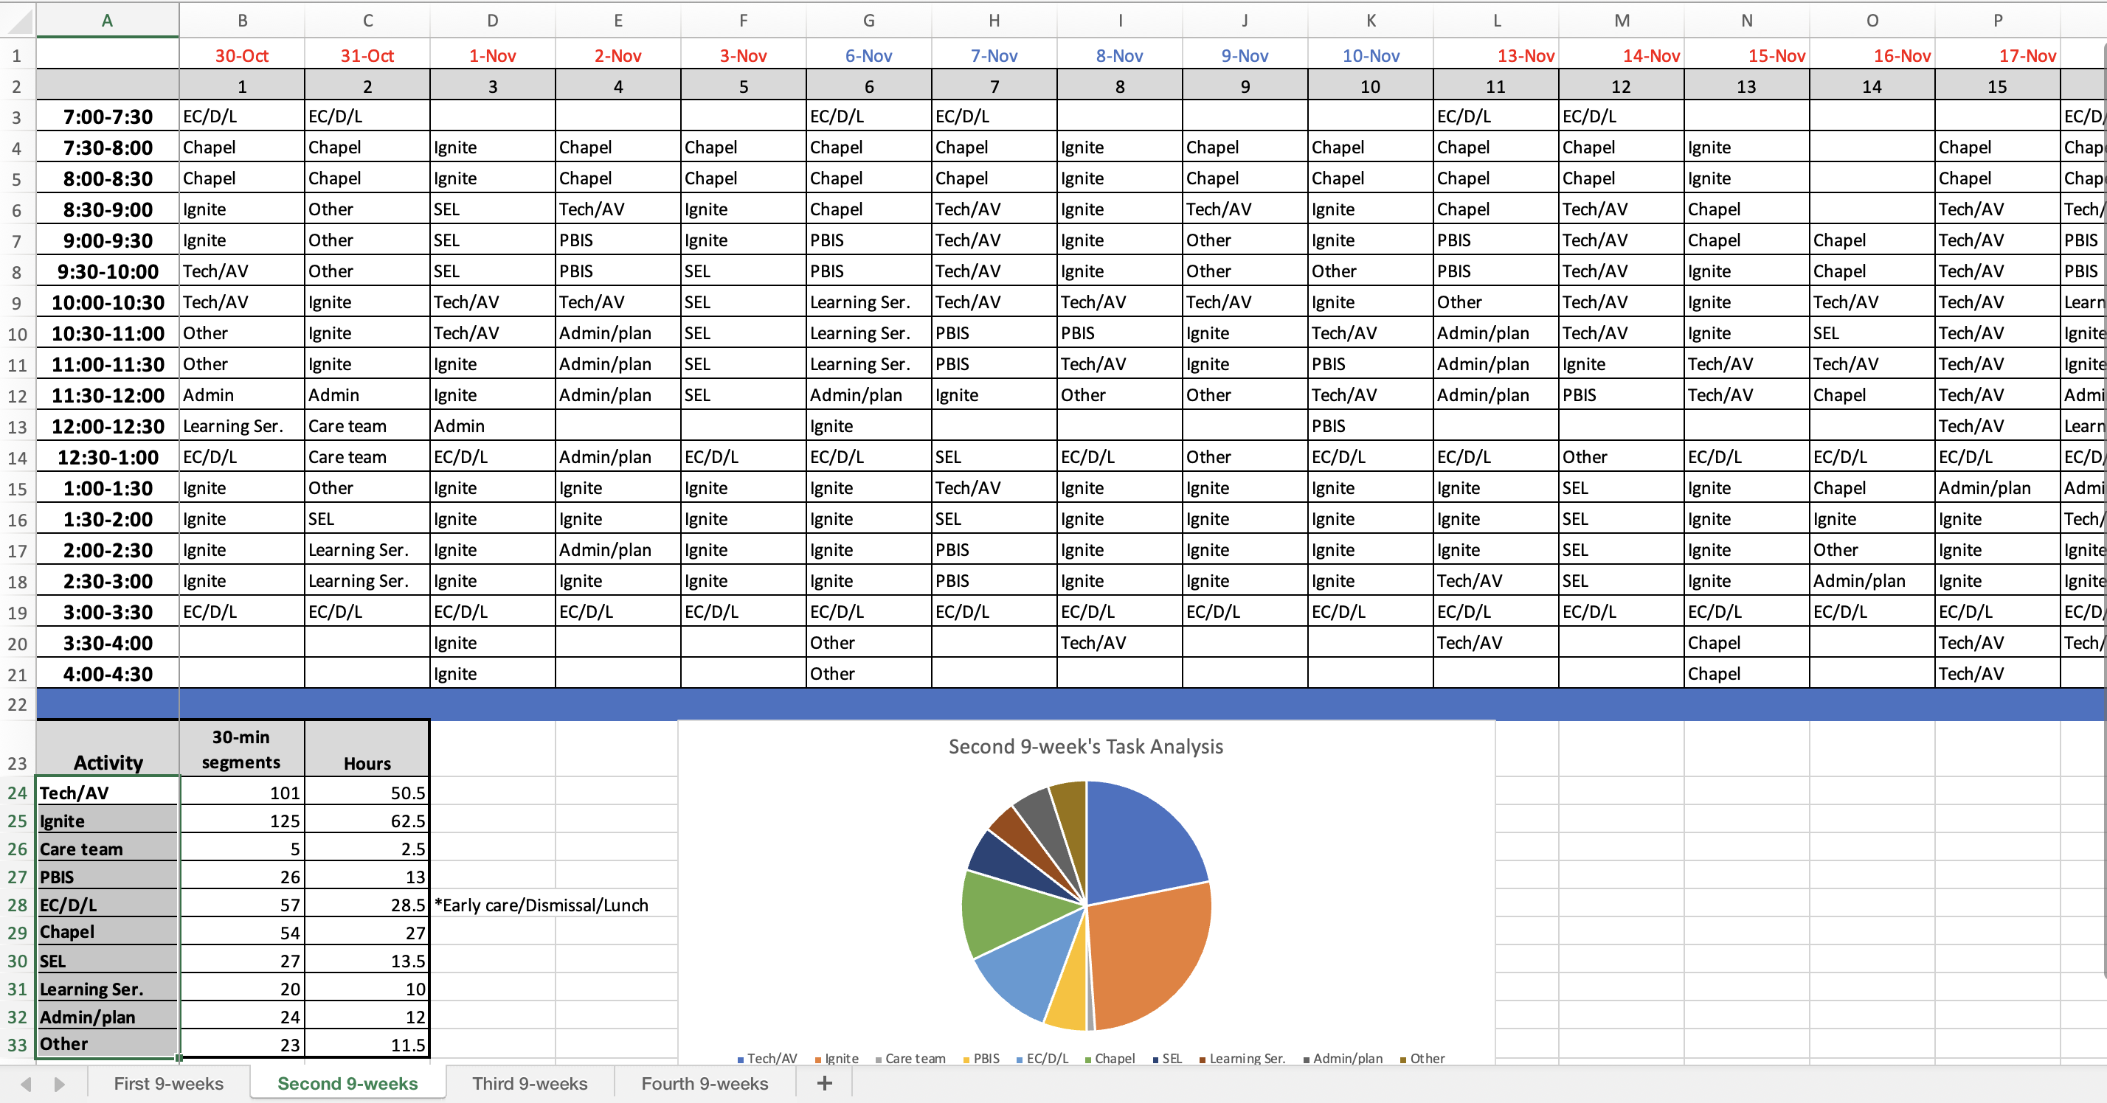
Accountability
Notes:
I developed this for myself and my counselors. There are paid version out there. SCUTA maybe $200/year

Slide 19
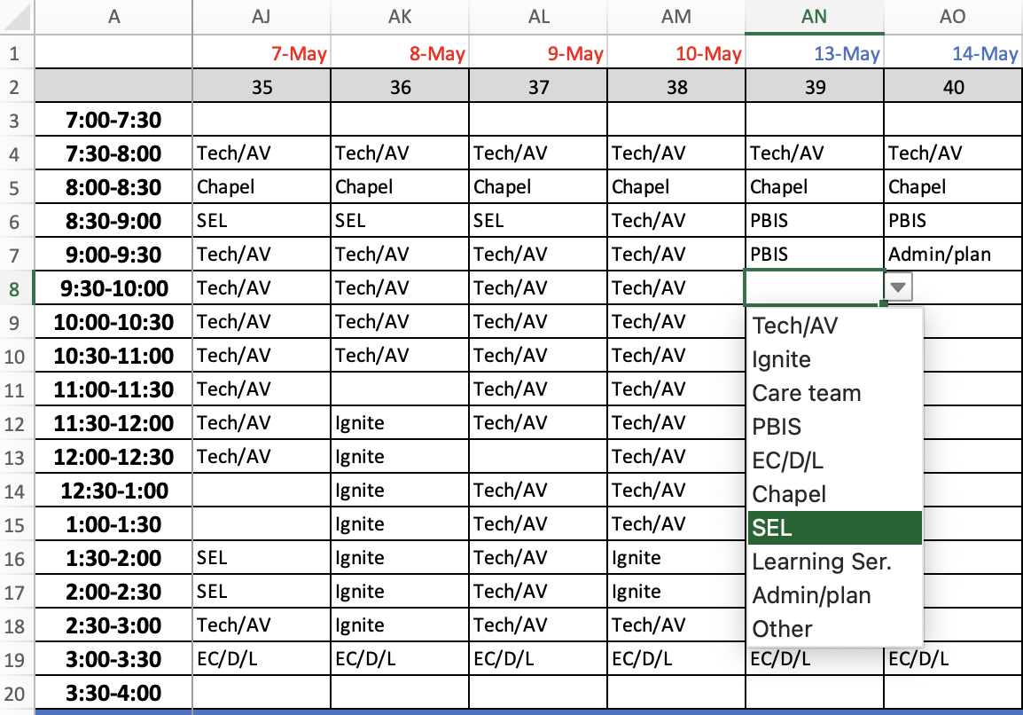
Accountability

Slide 20
Accountability
Notes:
Gather data from RTI-B behavior supports

Slide 21
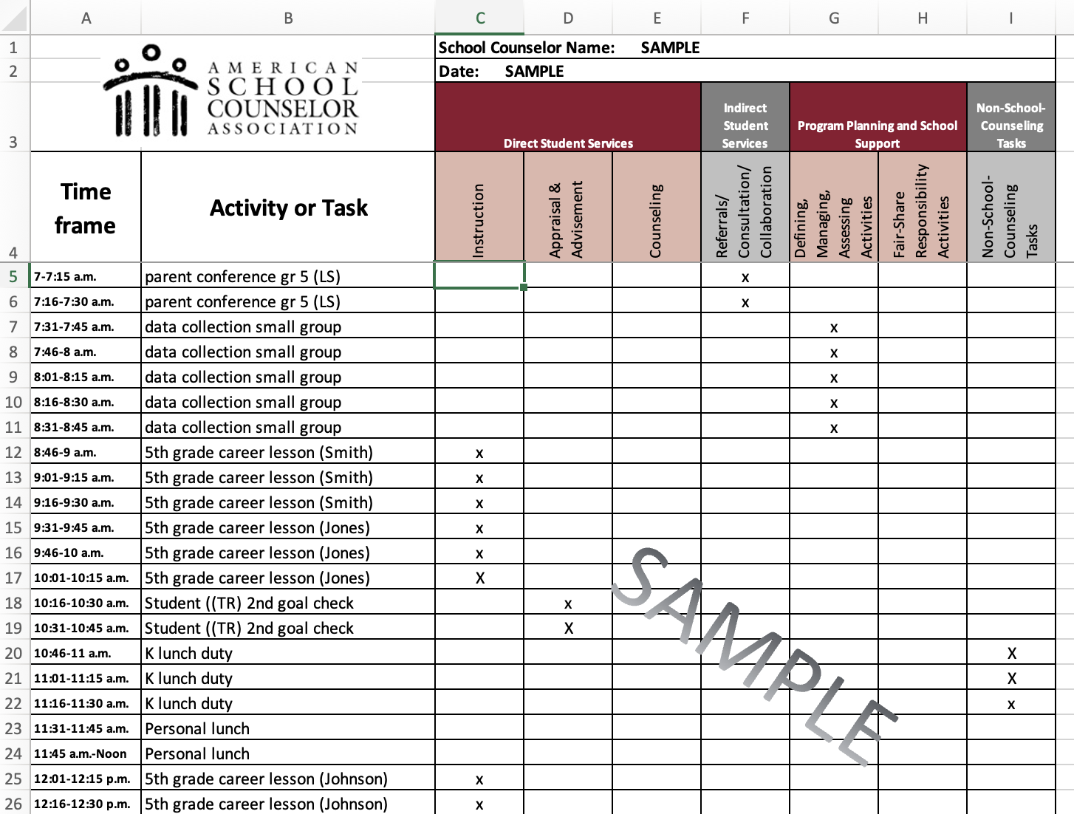
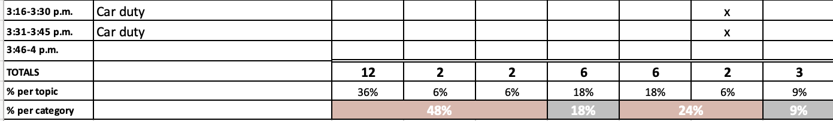
Accountability
Notes:
This one is from ASCA and is free also…regardless keep track of time. It is crucial data.
***I love to streamline the little time we have to accomplish all that is expected of us. Flow charts help to with standardization and gray areas and saves TIME, clarifies, standardizes.

Slide 22
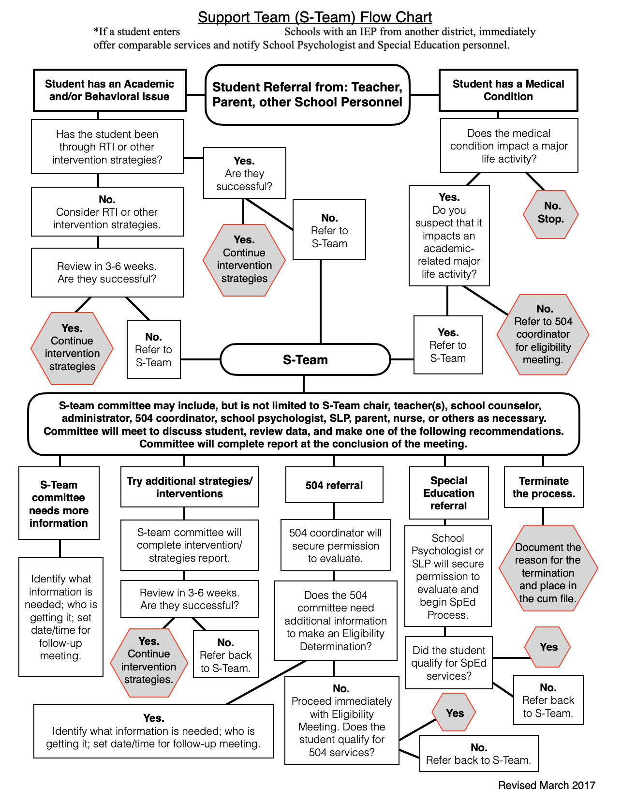
Flow Charts
Notes:
Having consistency and standardization
Run by admin prior to implementation. Make sure it aligns with district/school procedures

Slide 23
Flow Charts

Slide 24
Flow Charts
Notes:
The reasons we do s-teams and 504/sped is for a variety of reasons.
Now I’m going to shift gears a little and talk about some key underlying issues that you will no doubt encounter as an elementary school counselor.
Some of those reasons stem from adverse childhood experiences. Things we cannot control in the school. They just come to us that way. However, we can help to shore up these individuals and help them have a better chance at a health life.

Slide 25
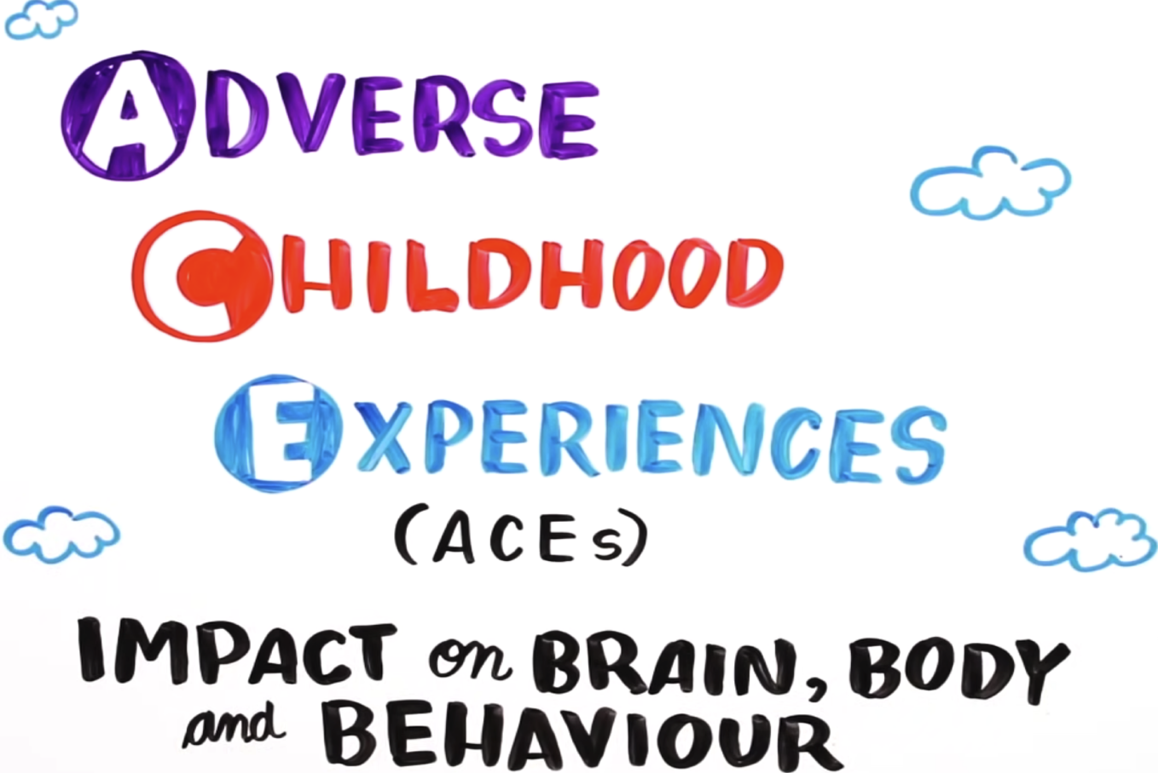
ACES
*Graphic retrieved on 10-28-25 from: https://thrivingschools.kaiserpermanente.org/resource_topics/aces/
Notes:
From 1995-1997 Kaiser Permanente collected survey data and compared to health records of over 17,000 patients.

Slide 26
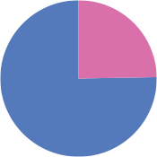
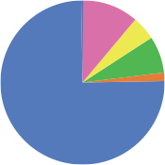
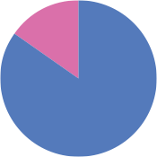
ACES
ACE Study Demographics
Participants were mostly white, middle-aged, college educated, and insured. They didn’t face many of life’s challenges such as poverty or racism.
11.2%
4.6%
24.8%
7.2%
15.1%
1.9%
75.2%
74.8%
84.9%
At least some college
White
Ages 40+
No college
Hispanic
Ages 19-39
Black
Asian
Other
Source: Centers for Disease Control and Prevention, Available at: https://www.cdc.gov/ace/about.htm
Notes:
About 75% white, 75% some college, and 85%, over 40 years, 46% over the age of 60 years
Despite skewed demographics it has opened out some great research on correlations with certain traumatic events experienced before the age of 18.

Slide 27

ACES
Brain Architecture
The early years of life matter because early experiences affect the architecture of the maturing brain. As it emerges, the quality of that architecture establishes either a sturdy or a fragile foundation for all of the development and behavior that follows ---
and getting things right the first time is easier than trying to fix them later.
Notes:
Spent many years in the remodeling world. In our work of repairing and fixing things, you could tell which houses were built solidly from the foundation up and which were patched together. It doesn’t take a structural engineer to know the difference. The early years of life matter because early experiences affect the architecture of the maturing brain. It is a crucial time for laying the foundation of future development. As it emerges, the quality of that architecture establishes either a sturdy or a fragile foundation for all of the development and behavior that follows ---
and getting things right the first time is easier than trying to fix them later.

Slide 28
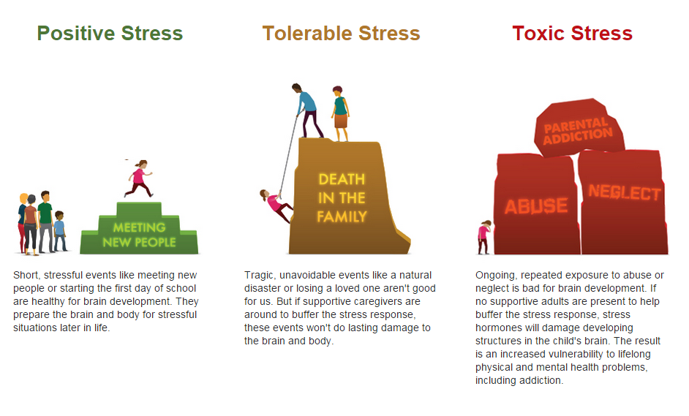
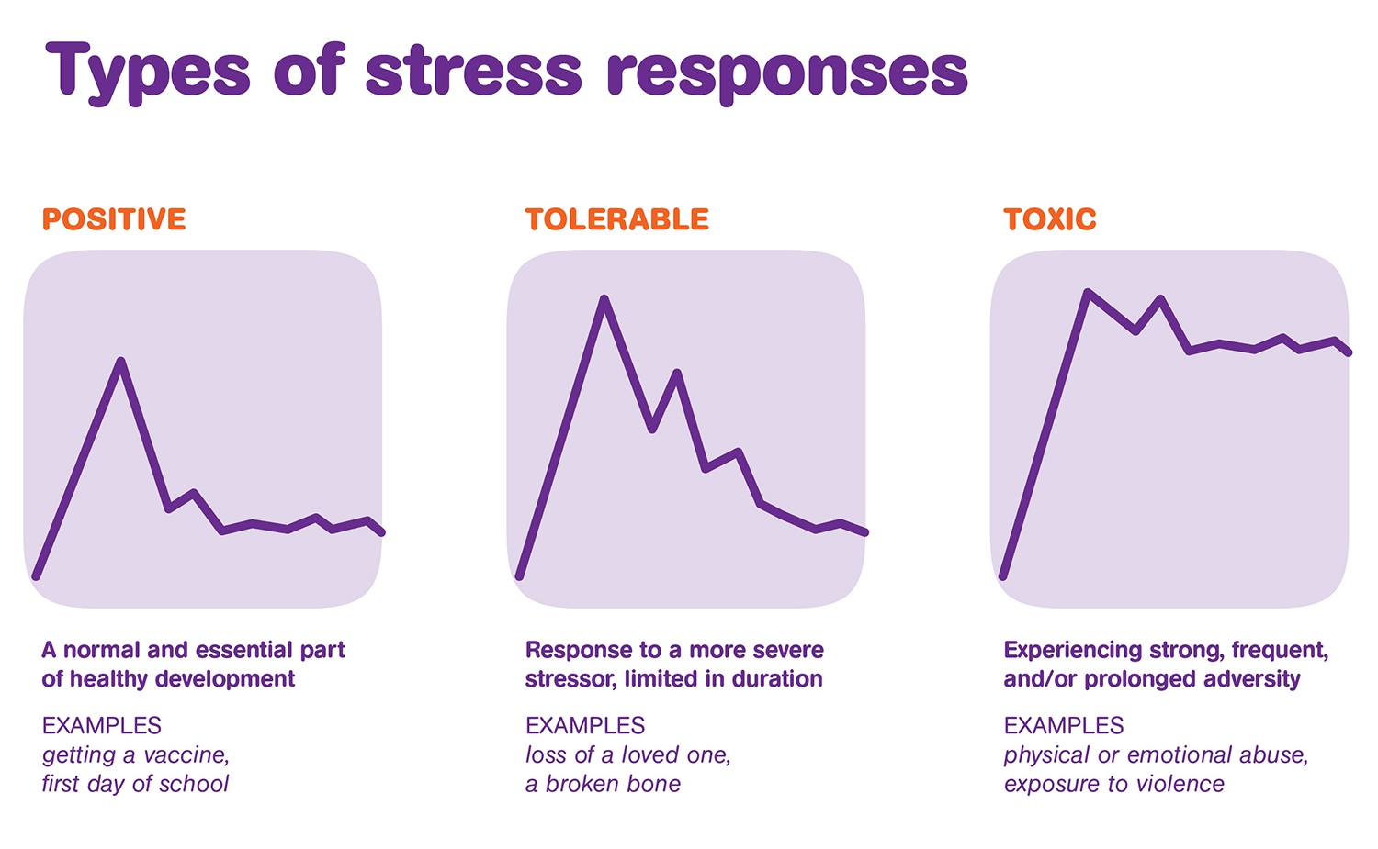
ACES
Notes:
Ongoing/repeated stress hormones damage developing structures in a child’s brain.

Slide 29
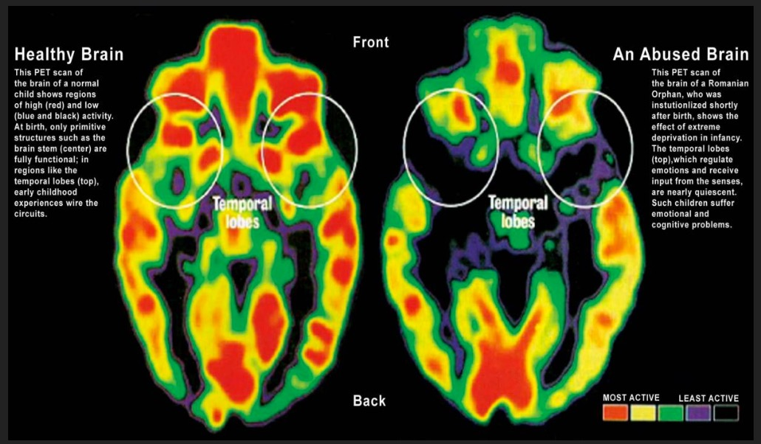
ACES
Experience Alters Brain Development
Normal vs. Neglected Brain
*As cited by Felitti & Anda, 2003; source CDC
Notes:
PET scans of healthy vs. abused child brain.

Slide 30
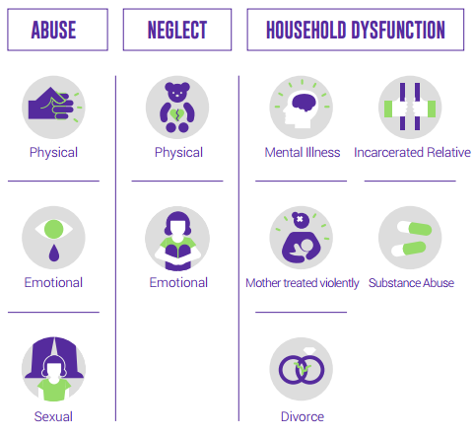
ACES
Adverse Childhood Experiences
Notes:
ABUSE: physical, emotional, sexual
NEGLECT: physical and emotional
HOUSEHOLD DYSFUNCTION: mental illness, incarceration of family member, violence against mother, substance abuse, divorce

Slide 31
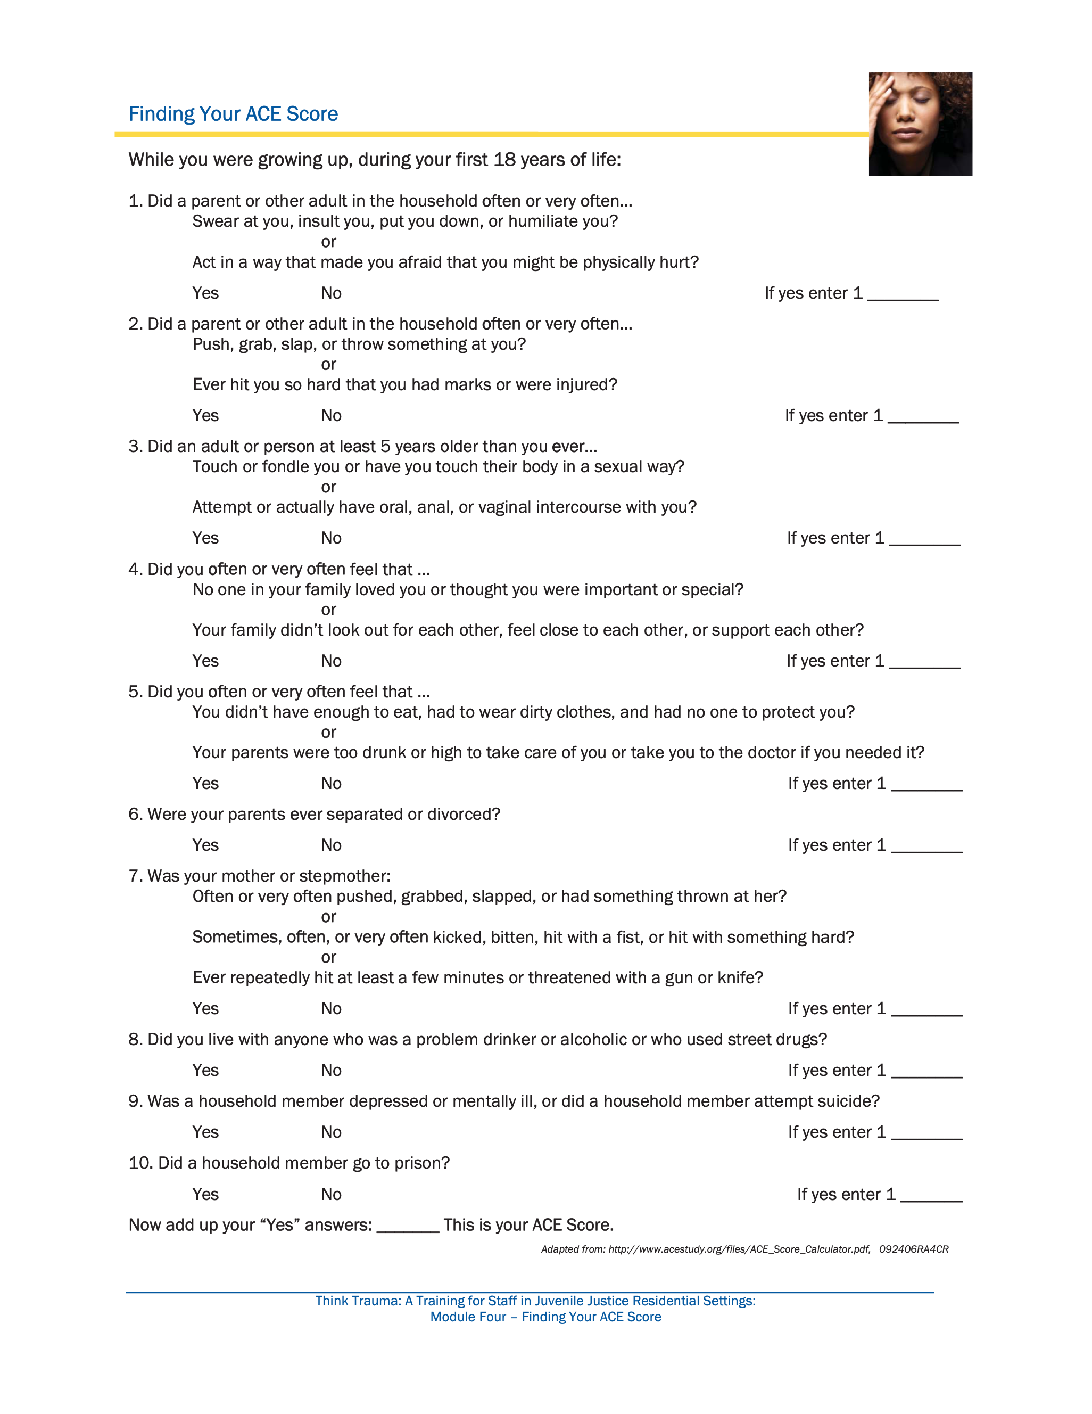
ACES
*Graphic retrieved on 10-28-25 from: https://ncjfcj.org/wp-content/uploads/2006/10/Finding-Your-Ace-Score.pdf

Slide 32
ACES
*Graphic retrieved on 10-28-25 from: https://ncjfcj.org/wp-content/uploads/2006/10/Finding-Your-Ace-Score.pdf
Notes:
The higher the score:

Slide 33
ACES
Risk Factors for Adult Substance Abuse Are Embedded in Adverse Childhood Experiences
Self-Report: Alcoholism Self-Report: Illicit Drugs
%
16
40
14
%
35
12
30
10
25
8
20
6
15
4
10
2
5
0
0
0
1
2
3
4
ACEs
0
1
2
3
4
5+
Source: Dube et al. (2002) Source: Dube et al. (2003)
Notes:
Stats from a few years ago. The higher the score:
Not only are there more health risks, it is also an economic strain on communities, highlighting the fact that this is a problem that affects all of us.

Slide 34
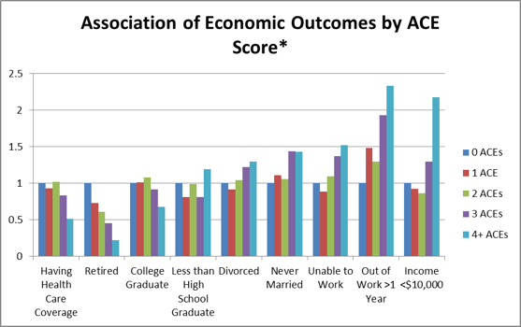
ACES
Association of Economic Outcomes by ACE Score*
* = All significant p>=0.05
Notes:
Some sobering correlations have stated:
Have 4 or more ACEs: Results in 5 - 10 years earlier death
Have 6 or more ACEs: Results in 20 years earlier death

Slide 35
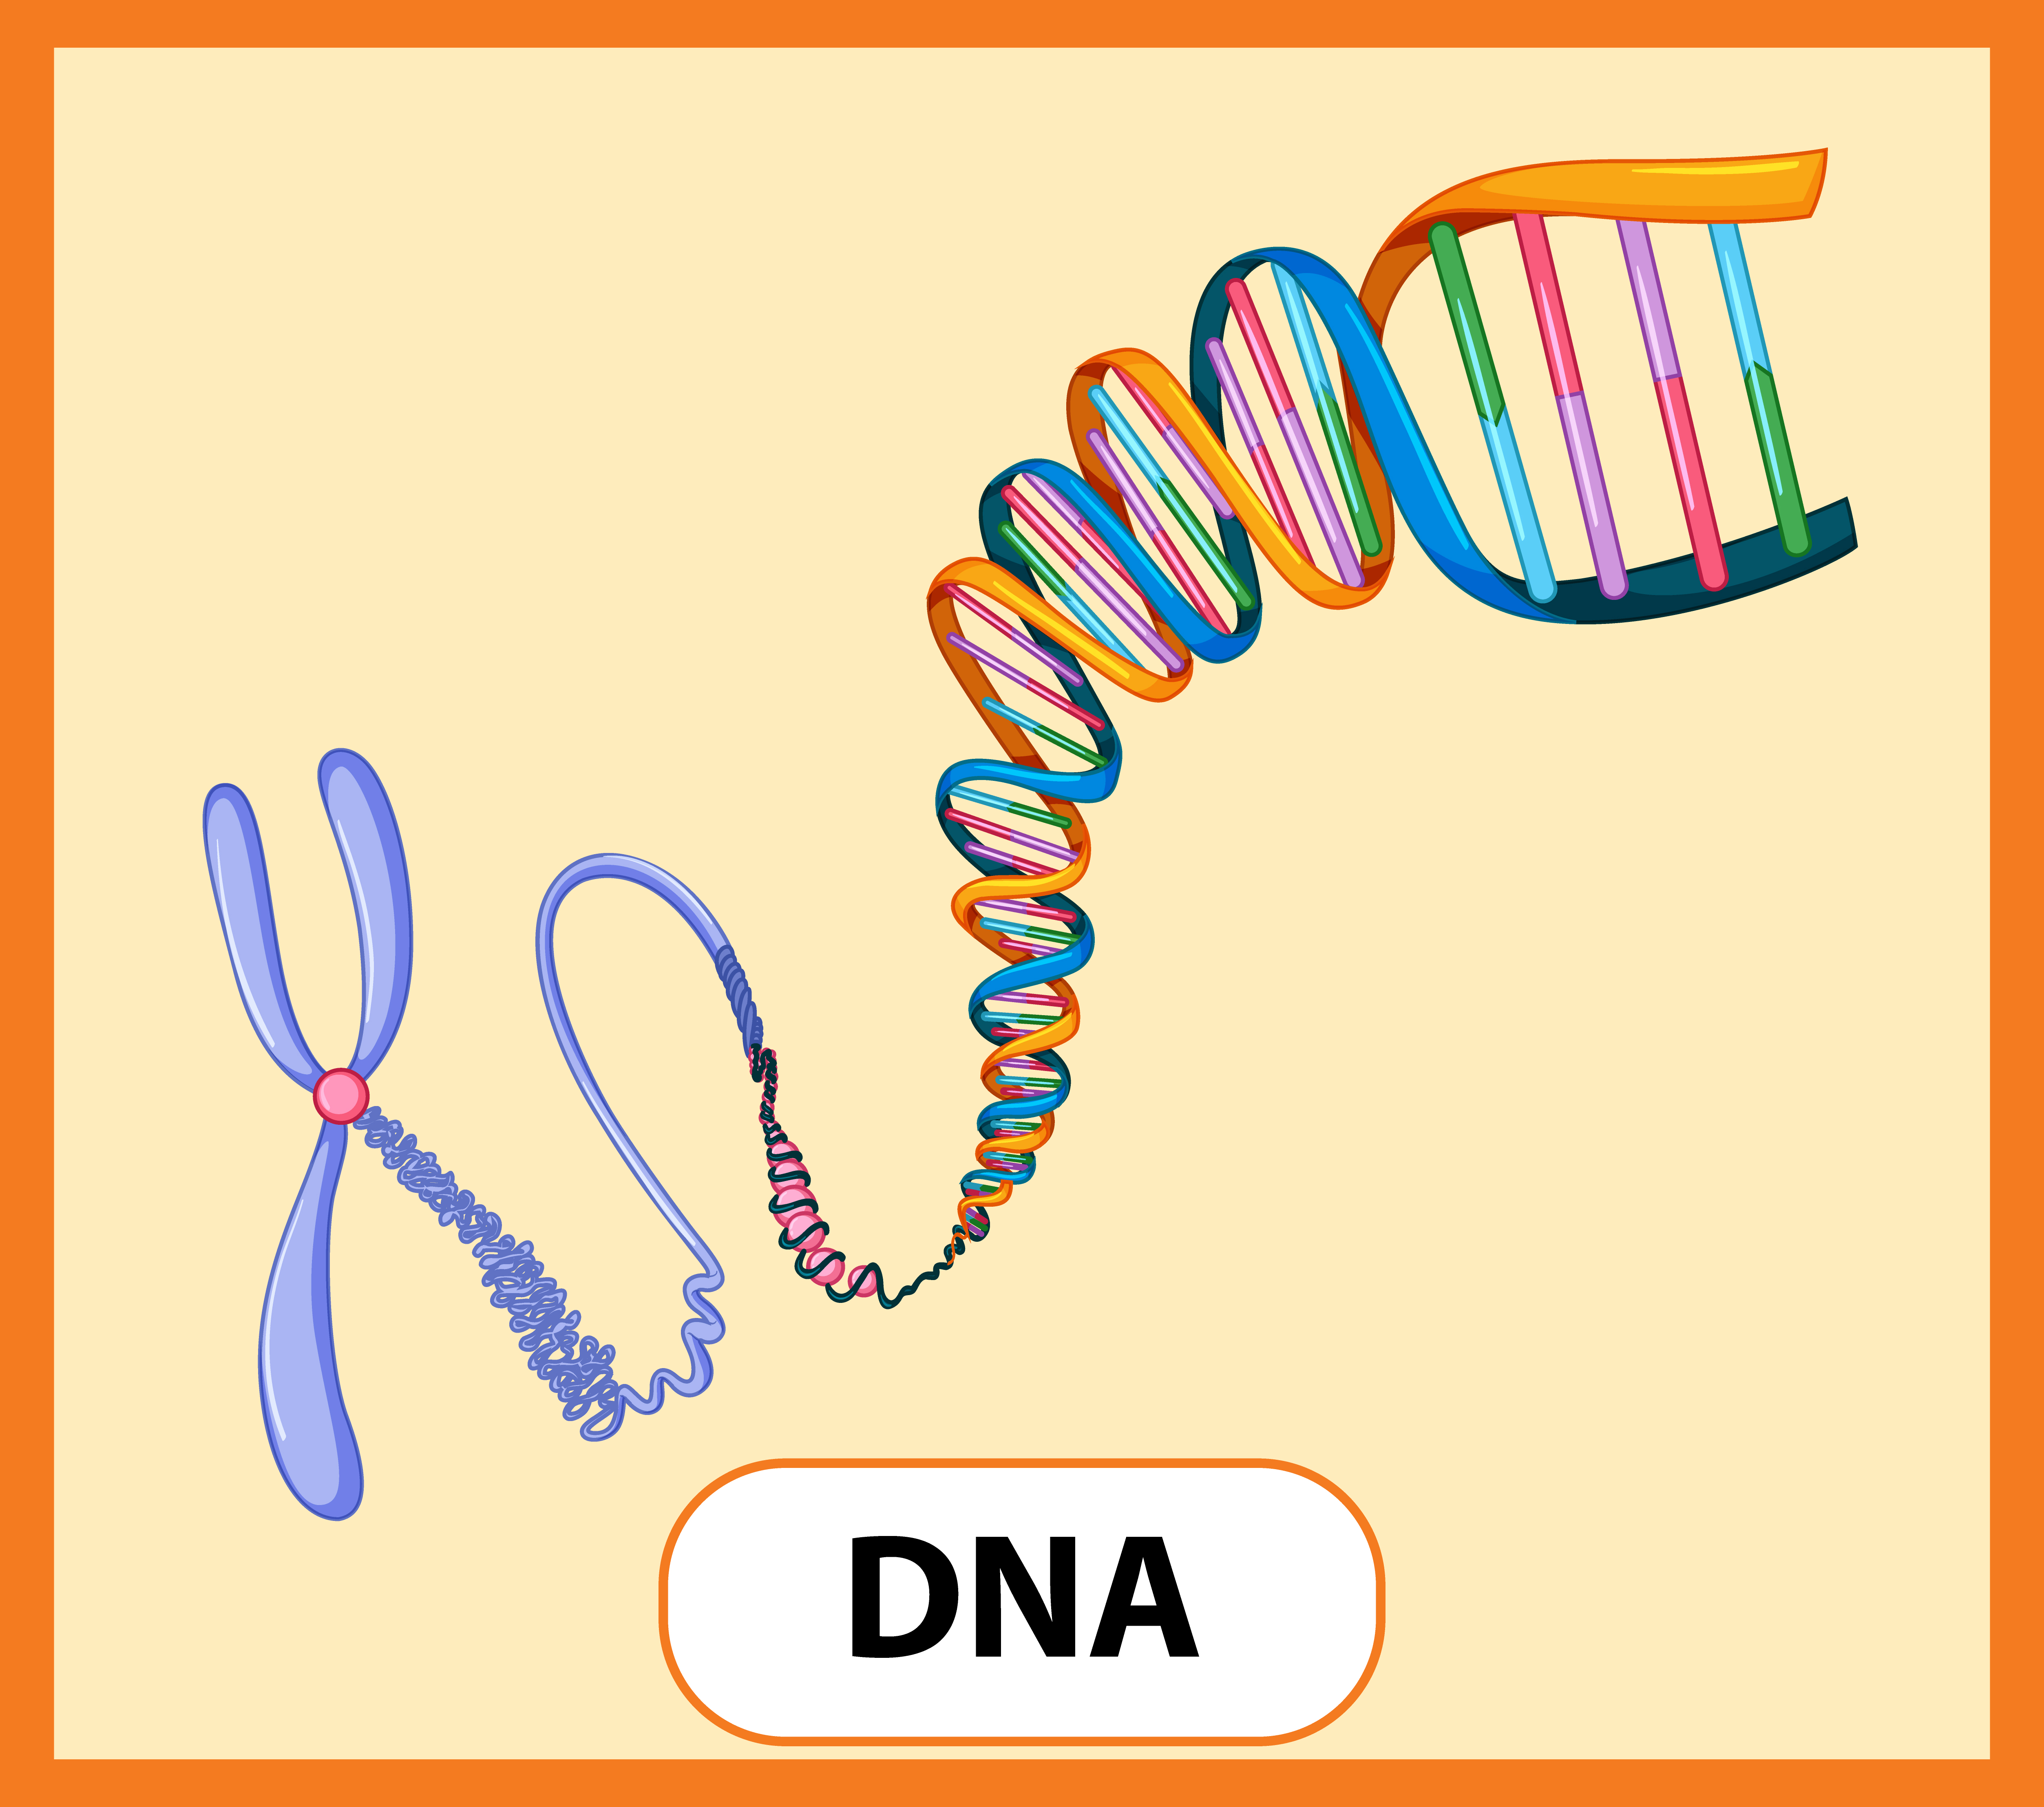

ACES
Toxic Stress Changes Gene Expression
Intergenerational Transmission of Stress Response in Male Mice
*Retrieved on 10-29-25 from: https://www.freepik.com/free-vector/educational-english-word-card-dna_14570385.htm#fromView=keyword&page=1&position=38&uuid=2572901b-1c18-41a5-8752-47c349d843ec&query=Genes
Notes:
Researchers exposed male mice to the smell of cherry blossom scent, and simultaneously delivered a mild electrical shock to their feet.
Learned behavior: Over time, the mice associated the cherry blossom smell with the painful shock and began to display a fear response whenever the odor was present, even without the shock.
When the conditioned male mice were bred with naive female mice, their offspring showed a significantly greater fear response to the scent than control mice.
These pups were also born with more scent receptors for cherry blossom and a larger part of their brain dedicated to processing that smell.
This inherited fear response extended to a second generation (the grandchildren of the original conditioned mice).

Slide 36
ACES
Are There New Adverse Childhood Experiences?
Are there “new” ACEs? YES!!
  Poverty
  Racism
  Peer Victimization, i.e., Bullying

Slide 37


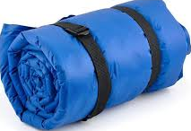


ACES
Activity: The Backpack
Notes:
Bring in backpack loaded with heavy things that represent worries and stresses that others may be carrying (helps with empathy). If you had to carry that around all day, you would be exhausted and unable to add more to your bag.
Some of the baggage is hidden internally
These activities can be for FACULTY and STUDENTS both

Slide 38


ACES
Activity: “Guided” drawing
Three simple rules
1) You will be provided simple directions
2) You may not ask clarifying questions
3) You may not look at another’s paper
Notes:
Sheet of paper and something to write/draw with
Draw a big circle,
Draw 2 triangles
Put a line through the circle
Draw s diamond on its side
* We all heard the same instructions, but why did all the papers look different?
* How does our background and experiences influence how we interpret new material?

Slide 39
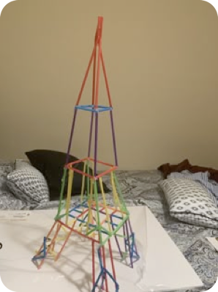
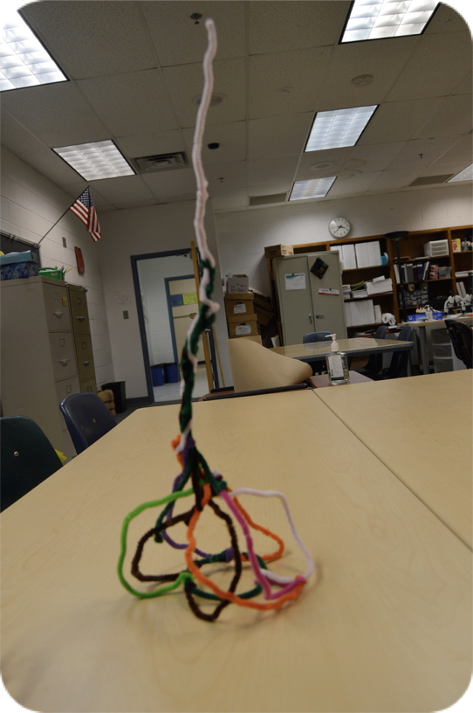




ACES
Activity: Building Towers
Notes:
Build empathy and understanding of how much unseen weight some people bring in.
Show activities for students such as the straws, paperclips, pipe cleaners, weights., etc.
Using all your materials (and nothing else), construct the tallest free-standing structure.
It’s NOT FAIR, some were given stronger building materials and their towers could only go so high. Others had more weights to support.
We can’t always see it, but know that we all have our unique set of building blocks and weights.

Slide 40
ACES
A Caution: ACES Are Not Destiny
Some children are more susceptible than others to toxic stress
There can be other adults to serve a buffering, caring role
There is a capacity to repair across development
Interventions can make a difference
Notes:
Another key aspect of school counseling and although we like to think it doesn’t trickle down to elementary, it is certainly becoming more and more prevalent.

Slide 41


Mental Health
Notes:
I don’t have to tell you that the prevalence of mental health concerns has risen over the past few decades.
I saw that first-hand as I served on the Governor’s advisory council for suicide prevention.
I developed a standardized triage procedure checklist
* Idea began as starting new job and counselors all using proff. judgement (which can vary)
* Browsed many other documents and decided to compile our own.
This policy is not to be misconstrued as something coming from TN BOE, but MCPS developed with guidance from TSPN
*** Don’t know about you, but when I’m in the crisis mode, the less I have to think about the better. Following a precise process that is standardized is so important. And you are speaking the same language as the mobile crisis counselors.

Slide 42
Suicide Behavior Procedure and Checklist
When any staff member identifies a student with suicidal ideation, making suicidal statements, writing suicidal notes, and/or exhibiting self-harm such as cutting or any similar at risk behaviors, the staff member will notify a contact immediately (i.e., school counselor, administrator, psychologist, or school designee).
The student should not be left alone at any point.

Slide 43
Suicide Behavior Procedure and Checklist
Key points to remember
  Take all threats seriously
  Contact counselor/administrator/psychologist/school designee immediately
  Do not leave student alone
  Staff members are not permitted to promise confidentiality or honor a previous promise of confidentiality if the student might harm himself/herself.
Notes:
NOW we get into the actual checklist.

Slide 44
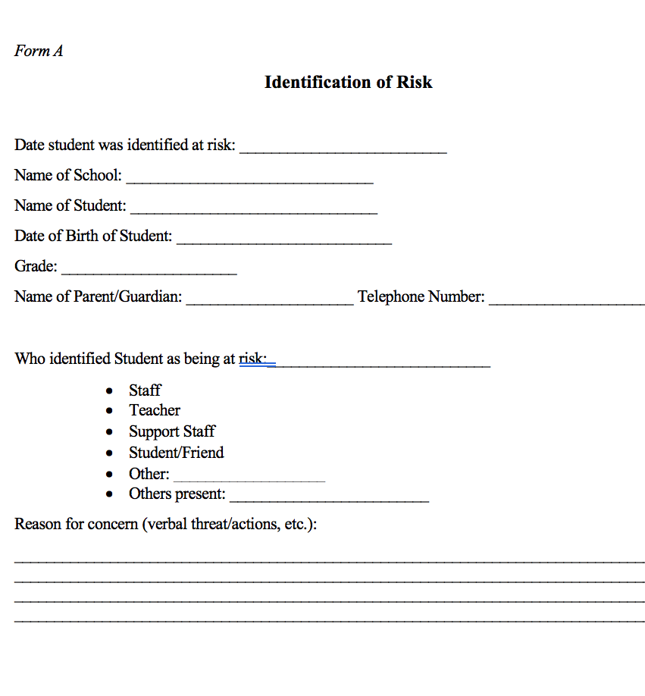
Suicide Behavior Procedure and Checklist
Identification of Risk
(Form A, Page 6: Identification of Risk)
  Completed by individual of initial contact with student

Slide 45
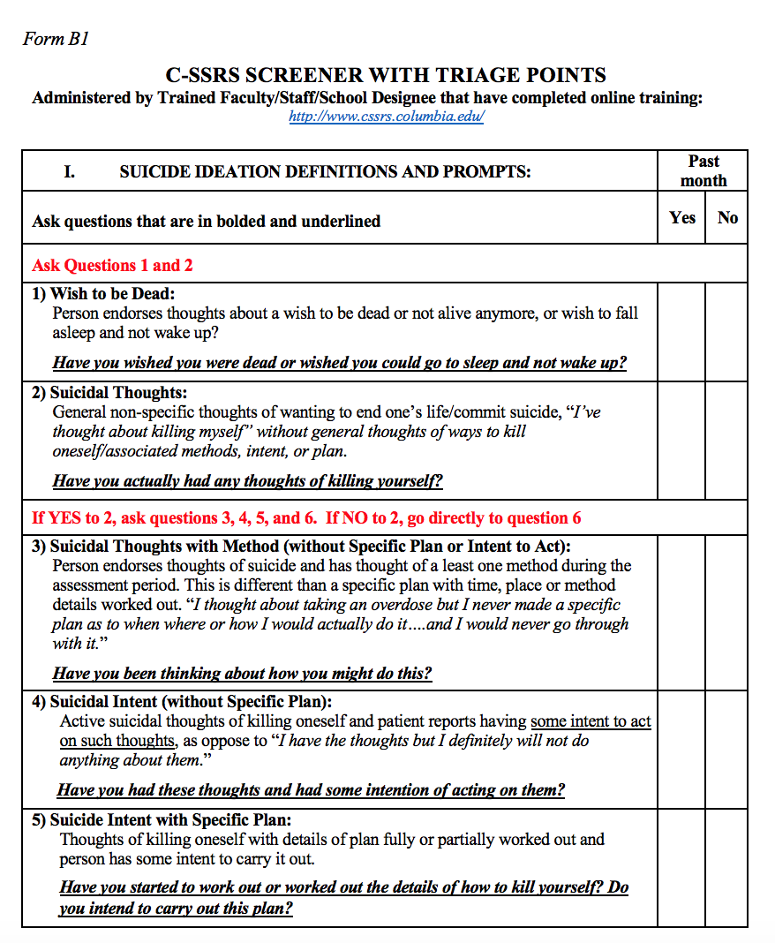
Suicide Behavior Procedure and Checklist
Administer Suicidal Screening
(Form B1, Page 7: C-SSRS Screener with Triage Points)
* (Form B2, Page 9: C-SSRS Risk Assessment, intended for use by psychologists, or other clinicians)
Video Tutorial found at: https://www.practiceinnovations.org/portals/0/CSSRS/shell.html
Notes:
There are two forms. We will just look at the screener which is what Mobile Crisis uses and we use. The full version is more clinical.

Slide 46
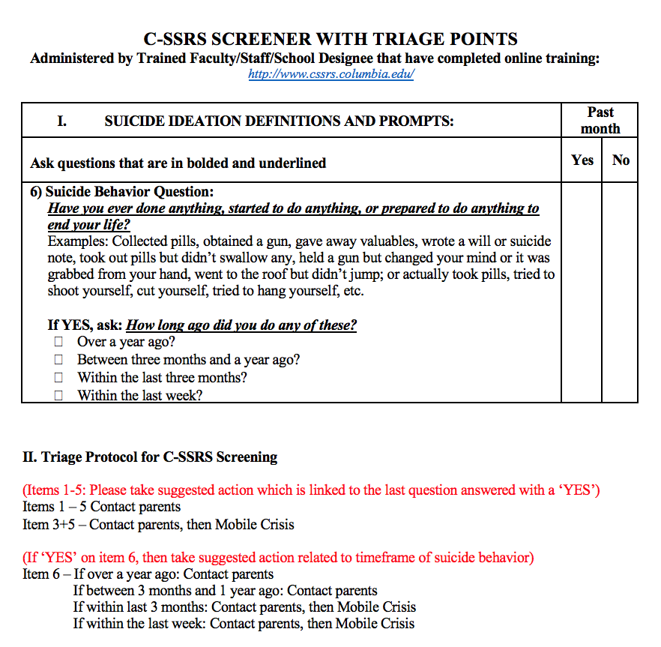
Suicide Behavior Procedure and Checklist
Determine Risk Level on C-SSRS Screener and Take Appropriate Action
(Form B1, Page 8: C-SSRS Screener with Triage Points)

Slide 47
Suicide Behavior Procedure and Checklist
Issues of Abuse and Neglect
  If a student indicates that parental abuse or neglect is the reason for contemplating suicide, parent/guardian contact should not be made. Instead, immediately inform the principal and follow protocol for calling DCS. When notifying DCS, it must be emphasized that immediate action is necessary to protect the child from harm. Contact Mobile Crisis, if needed (1-866-791-9222) utilizing local number.

Slide 48
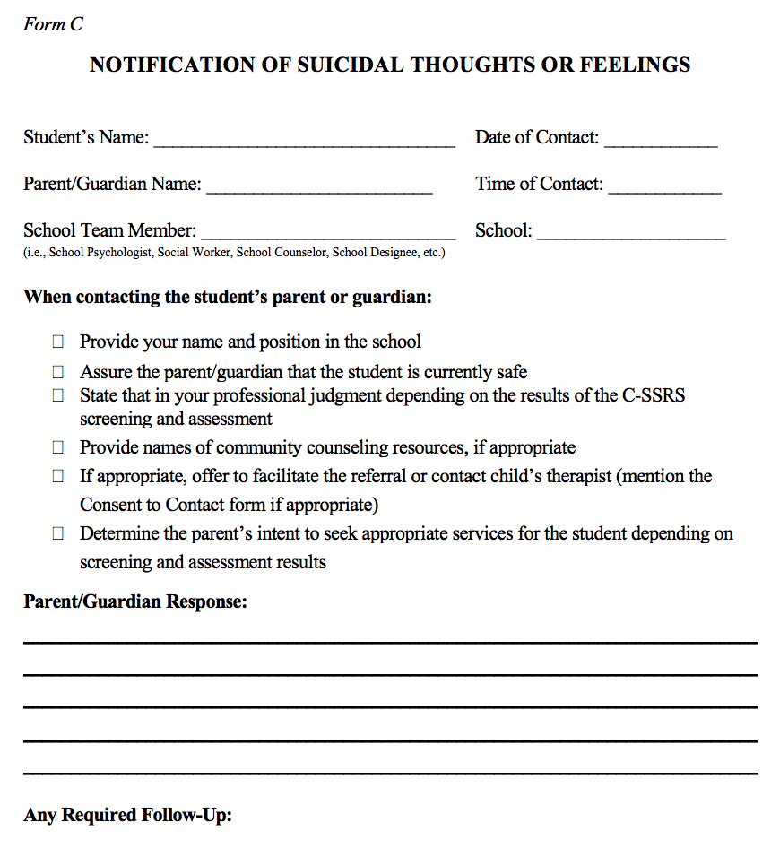
Suicide Behavior Procedure and Checklist
Parent Contact
(Form C, Page 10: Notification of Suicidal Thoughts or Feelings)
  Explain the reason for the phone call and explain that the parent/guardian must come to the school immediately to address safety issues with their child.
  If the parent/guardian is unable to be reached by phone, and could possibly be at home, contact the school resource officer (SRO) to make a home notification.
  If a parent/guardian refuses to get help for the student, please report to DCS.
  *Document if parent/guardian refuses to come to school.

Slide 49
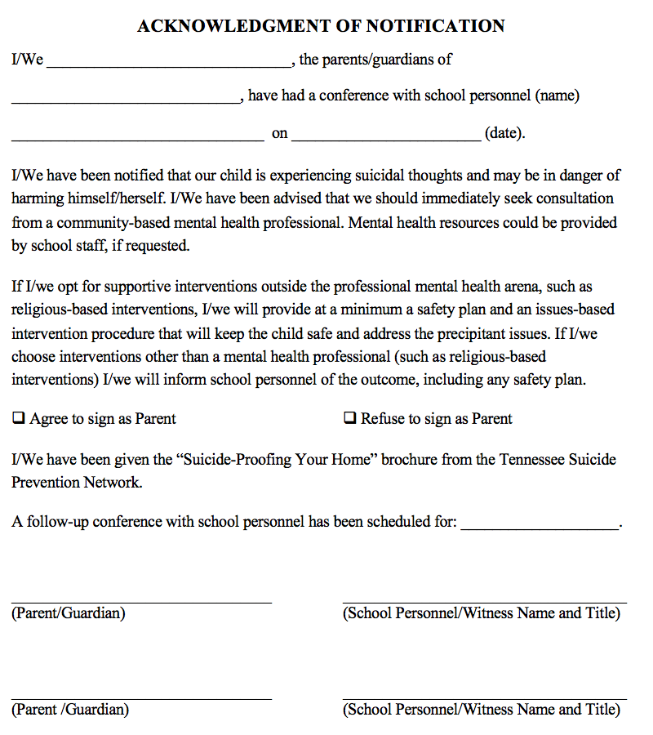
Suicide Behavior Procedure and Checklist
Meeting with Parent
(Form D, Page 11: Acknowledgement of Notification)
  Meet with parent/guardian and discuss threats and seriousness of the situation.
  Have parent/guardian provide input on circumstances that might relate to the issues addressed
  Have parent/guardian sign the Acknowledgement of Notification form. (Keep original and give a copy to the parents)
  Provide a copy of Suicide Warning Signs.

Slide 50
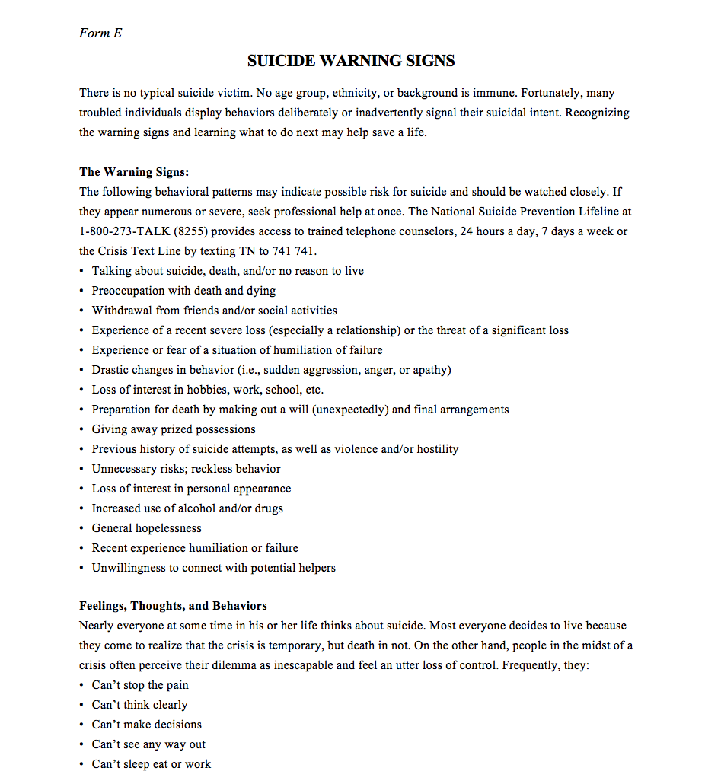
Suicide Behavior Procedure and Checklist
Meeting with Parent (continued)
(Form E, Page 12: Suicide Warning Signs)
  Provide a copy of Suicide Warning Signs.

Slide 51
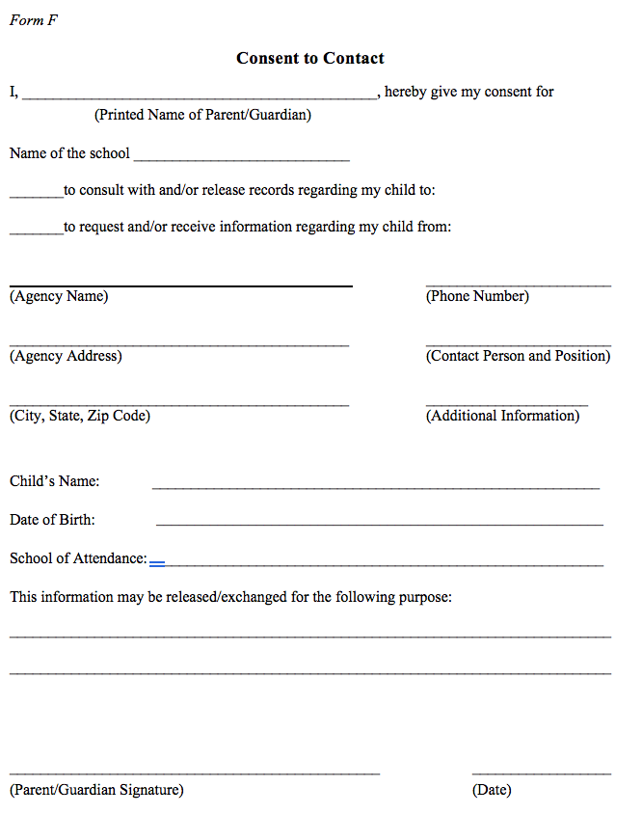
Suicide Behavior Procedure and Checklist
  Consent to Contact
  (Form F, Page 14)
    Explain the school’s response and the need for the immediate follow up (depending on risk level) by a mental health professional or physician. If parents request resource contacts, be sure to provide at least three possible resources. If they desire to connect with one specific resource, you may offer to help them set up an appointment.
    A Consent to Contact form may be filled out in order for the school to communicate with the professional(s) who will assess the child.

Slide 52
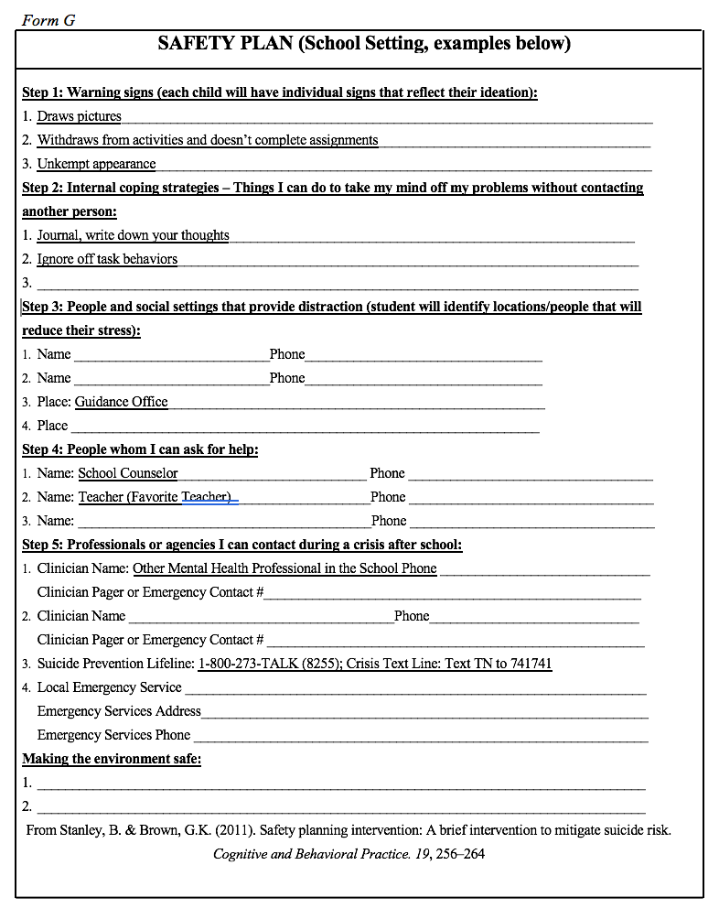
Suicide Behavior Procedure and Checklist
Safety Plan
(Form G, Page15: Safety Plan)
  The importance of restricting access to means of suicide and general safety planning should be stressed to the parent/guardian.

Slide 53
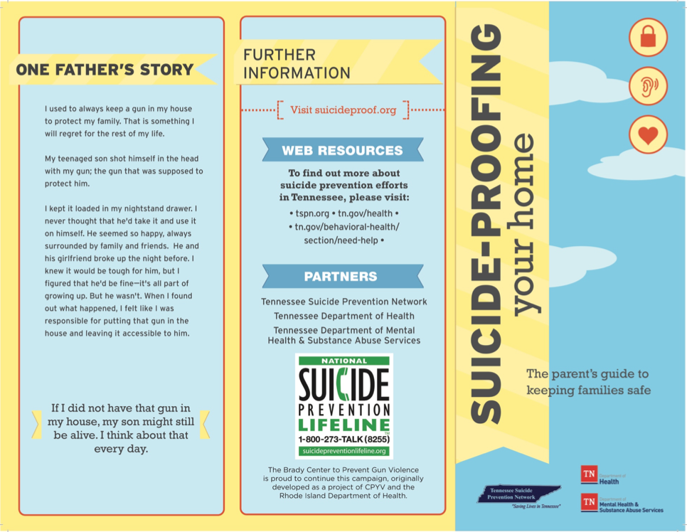
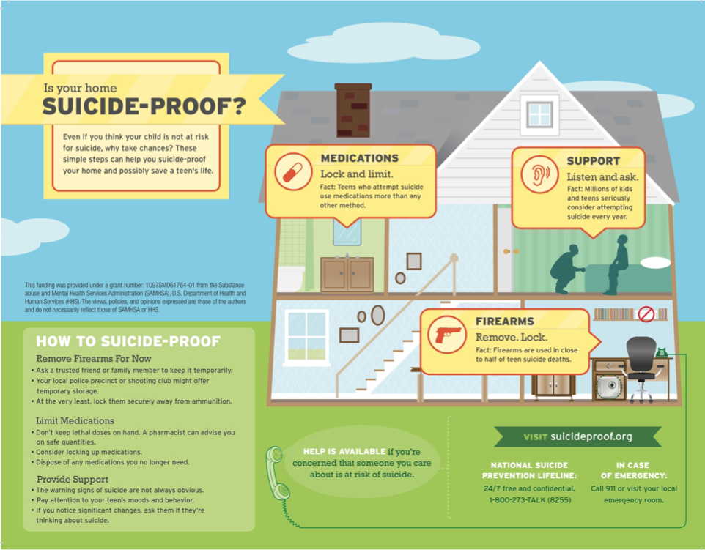
Suicide Behavior Procedure and Checklist
Safety Plan (continued)
(Form H, Page 16: Suicide-Proofing Your Home)
  Provide a copy of Suicide-Proofing Your Home.
  Provide contact for local Mobile Crisis, (1-866-791-9222), utilizing local number.

Slide 54
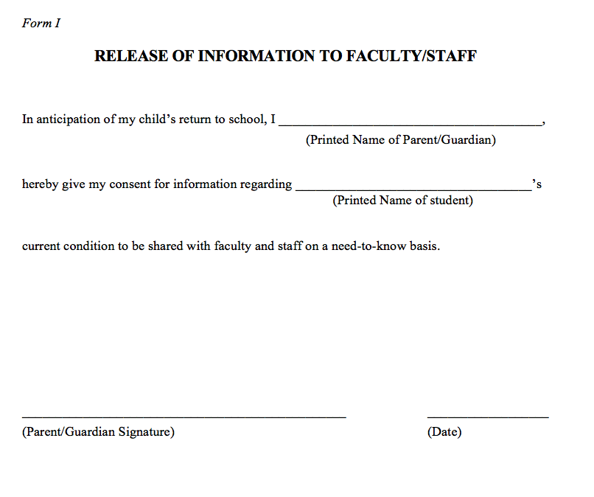
Suicide Behavior Procedure and Checklist
Plan for Student’s Return
(Form I, Page 18: Release of Information to Faculty/Staff)
  Parent/guardian may provide information on current condition and sign a Release of Information to Faculty/Staff (on a need-to-know basis).
Notes:
Parents may bring in information, but many times the student just shows up. But you can ask for permission.

Slide 55
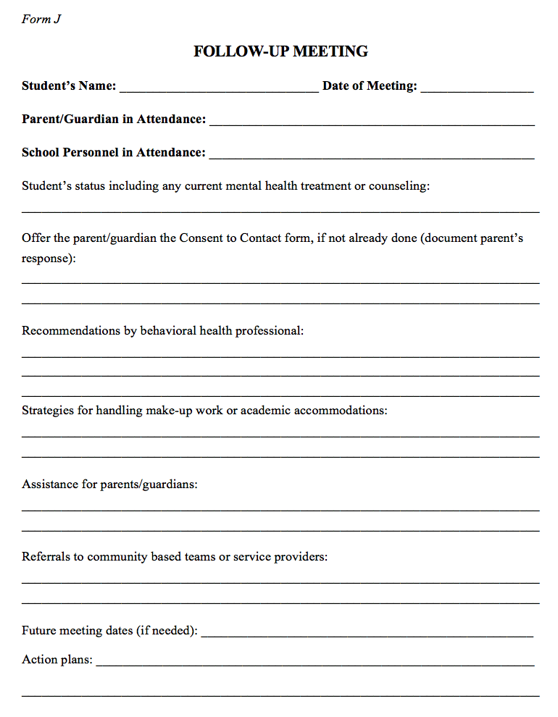
Suicide Behavior Procedure and Checklist
Student’s Return
(Form J, Page 19: Follow-Up Meeting)
  Incorporate engagement with families with the school and the student’s behavioral health needs to provide a safe environment for the child upon their return. Schedule follow-up meeting with student and parent/guardian within one week of return.
Notes:
We EVEN HAVE sample letters/announcements in our crisis plan.
***So far we talked about Branding your program, Counselor accountability, time tracking, flow chart assistance, ACES, and Suicide prevention.
Now, I’d like to land on one of the biggest areas for elementary school counseling and that is executive functioning. Obviously, all the students in your school are still in the developmental stages of their EF and therefore, providing skills and activities to help them is crucial.

Slide 56

Executive Function
Retrieved on 10-29-25 from: https://www.edutopia.org/article/7-ways-to-support-executive-function-in-your-classroom/

Slide 57

Executive Function
An “Air Traffic Control System” in the Brain
Executive functioning is group of skills that help us to focus on multiple streams of information at the same time, set goals and make plans, make decisions in light of available information, revise plans, and resist hasty actions. A key biological foundation of school readiness as well as outcomes in health and employability.
Notes:
Executive functioning is group of skills that help us to focus on multiple streams of information at the same time
We can set goals and make plans, make decisions in light of available information, revise plans, and resist hasty actions. We can also weigh the risk/reward cost in our heads.
EF is the foundation of school readiness as well as outcomes in health and employability.

Slide 58

Executive Function
Activity: Social Autopsy
1) What happened?
2) What was your mistake?
3) What social error was made?
4) What would you do next time or in a similar situation?
Lavoie, R. (2005). Social Skill Autopsies: A strategy to promote and develop social competencies. Retrieved from: http://www.ldonline.org/article/14910/
Notes:
Work at CIA, lots of EF issues. We would have to break down social interactions
A physical autopsy diagnoses a human or animal after it has passed away to examine what led to its death. Social autopsies do a similar thing with social interactions. This works great with students on the autism spectrum.
Don’t do in the heat of the moment, but when things are calm again.

Slide 59
Executive Function
Activity: Social Autopsy
1) What happened? Johnny yelled at me and shoved me.
2) What was your mistake? I told Johnny that his haircut looked like my dog’s head.
3) What social error was made? Johnny didn’t ask for my opinion.
I don’t have to say everything that pops into my head.
4) What would you do next time or in a similar situation? If he asks for my opinion, I can be honest, but kind. If I can’t think of anything, I can keep my mouth shut.
Lavoie, R. (2005). Social Skill Autopsies: A strategy to promote and develop social competencies. Retrieved from: http://www.ldonline.org/article/14910/

Slide 60


Executive Function
Activity: Watching sitcoms
* Retrieved on 10-30-25 from: https://www.freevector.com/old-television
Notes:
Get permission of families, but works best in small groups. No animation. Watch with sound off first. All you have is body language and context. The cheesier the better.

Slide 61



Executive Function
Activity: Sequencing
Notes:
Get at root of problem by working in reverse. What happened just before that? Example of CIA bully situation.

Slide 62
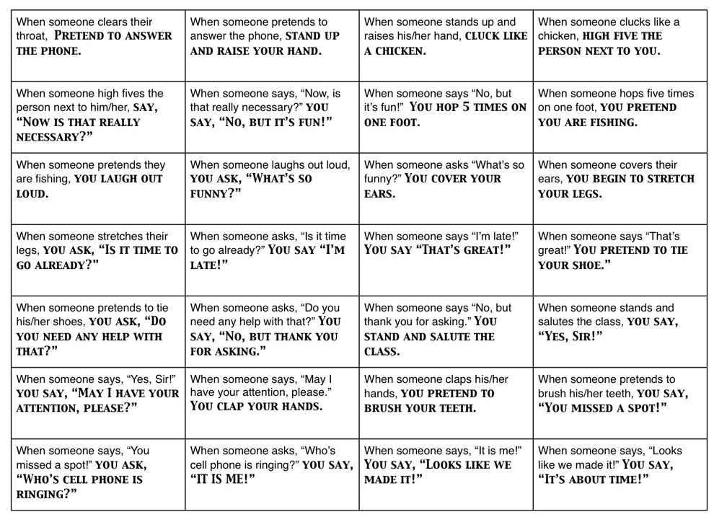
Executive Function
Activity: Crazy Sequence

Slide 63
Executive Function
Activity: Don’t Say, “Umm”
Choose someone to speak for 1 minute without saying “um” or “uh.”
Variation: To make more difficult, the speaker can’t say a word that starts with the letter “b.”
Notes:
Ask them to notice how much slower someone talks when having to think that hard before speaking. Also good for EMPATHY toward those with processing differences.

Slide 64
Executive Function
Activity: Buzz
While Counting to 50 one at a time, no one can say a number that contains a 7 in it. Instead, they must say “Buzz.”
If there is a mistake, the group starts over.
Variation: Use Multiples of 7
(Olson, C. 2000. Energizers: Calisthenics for the Mind. Minneapolis, MN: Educational Media Corporation)

Slide 65
Executive Function
Activity: Simon Says
Playing “Simon Says Pay Attention”
Play traditional game.
Then coach verbal self-reminders, “Don’t do it!”
(Can also play “Red light-Green light”)
(Yeager, D. & Yeager, M. 2008. Simon Says Pay Attention: Help for children with ADHD. Lafayette, LA: Golden Path Games)
*What you are not doing is just as important as what you are doing.

Slide 66
Executive Function
Activity: Museum On/Off Switch
Students are statues in a museum that come to life when the lights are off.
(Yeager, D. & Yeager, M. (2008). Simon Says Pay Attention: Help for children with ADHD. Lafayette, LA: Golden Path Games)

Slide 67

Executive Function
Activity: FireBall
4 simple rules
No talking
No bad passes
No dropped passes
No judging
Notes:
Using this for almost 20 years.

Slide 68

Questions/Comments

Slide 69


Thank You!
Contact me:
robbkillen@gmail.com
www.killencreations.com
X / Instagram: @Killencreations
Use code: NOV25
On my website to get your copy
for just $9

