Slide 1

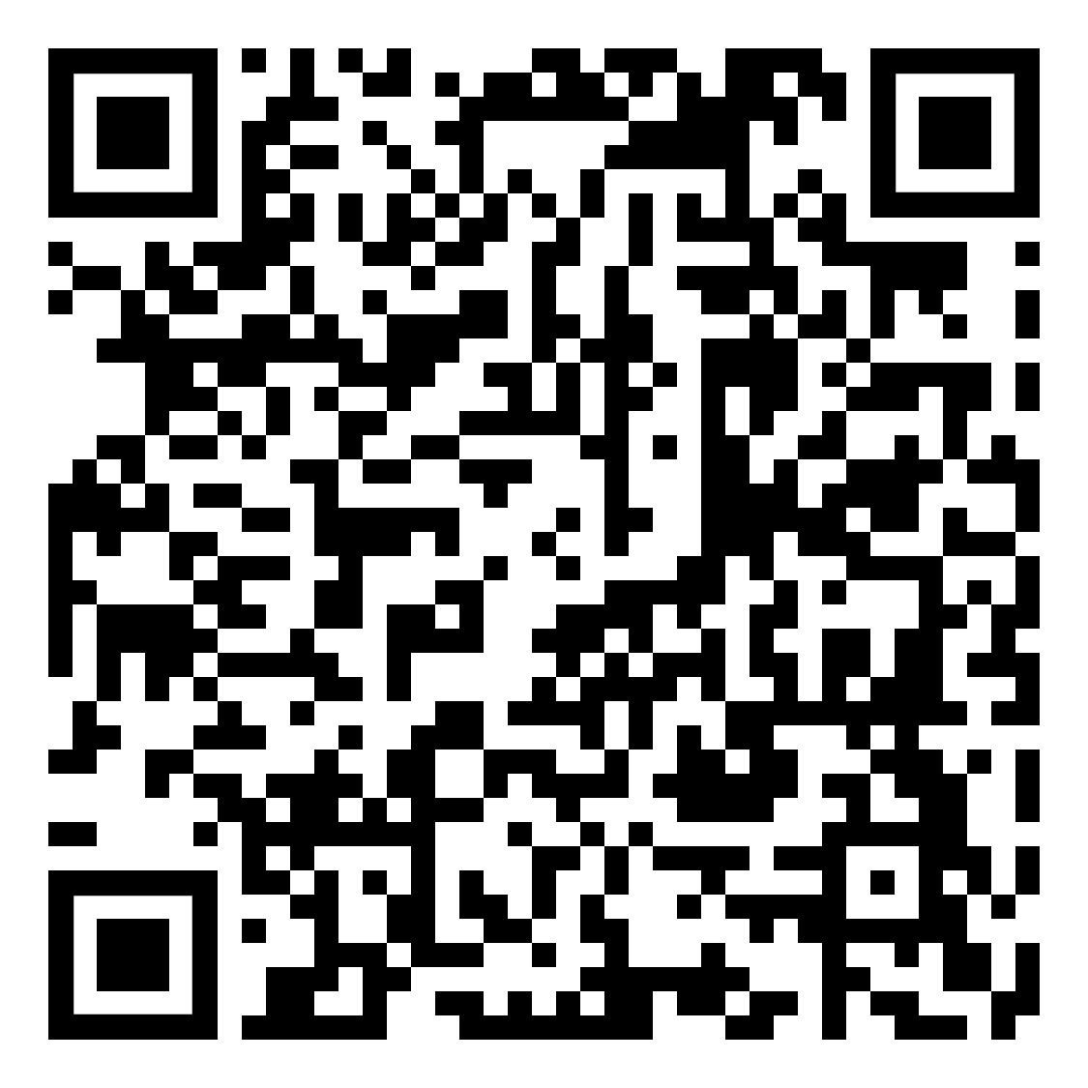
Crash Course to Small Groups in High School & Advocating for Your Role
Marisa Judkins
School Counselor
Coffee County Raider Academy
judkinsm@k12coffee.net
Notes:
Take hard copy of newsletters for ppl to see data up close if wanted
Take survey options
Tak ecurriculum of diff things I use
Print out

Slide 2
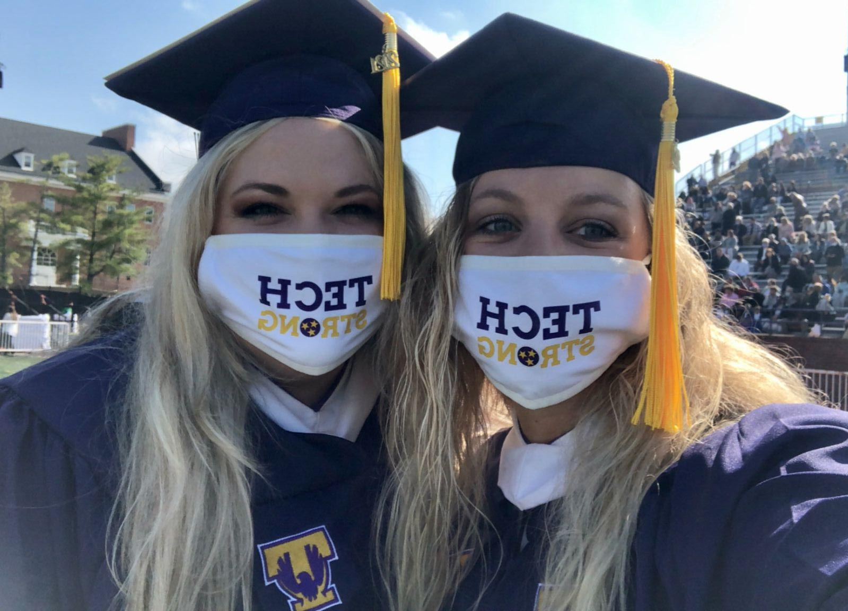
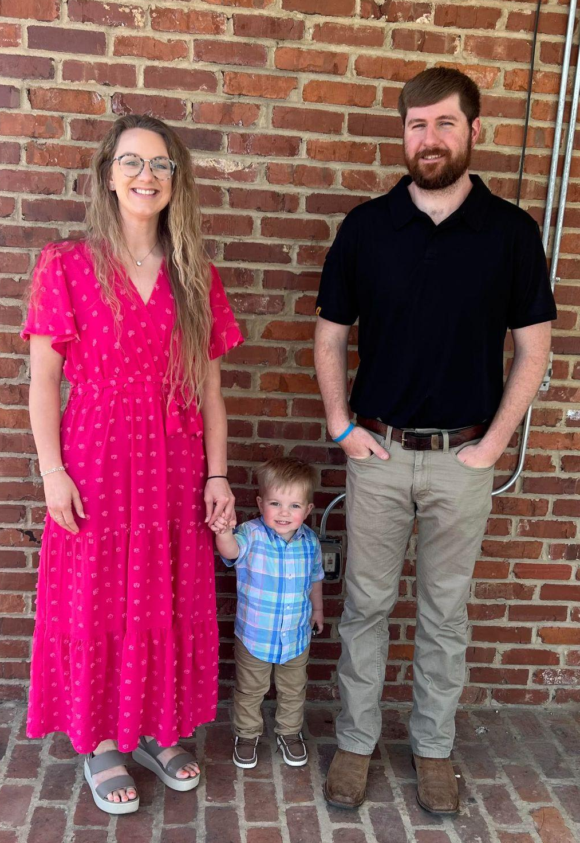
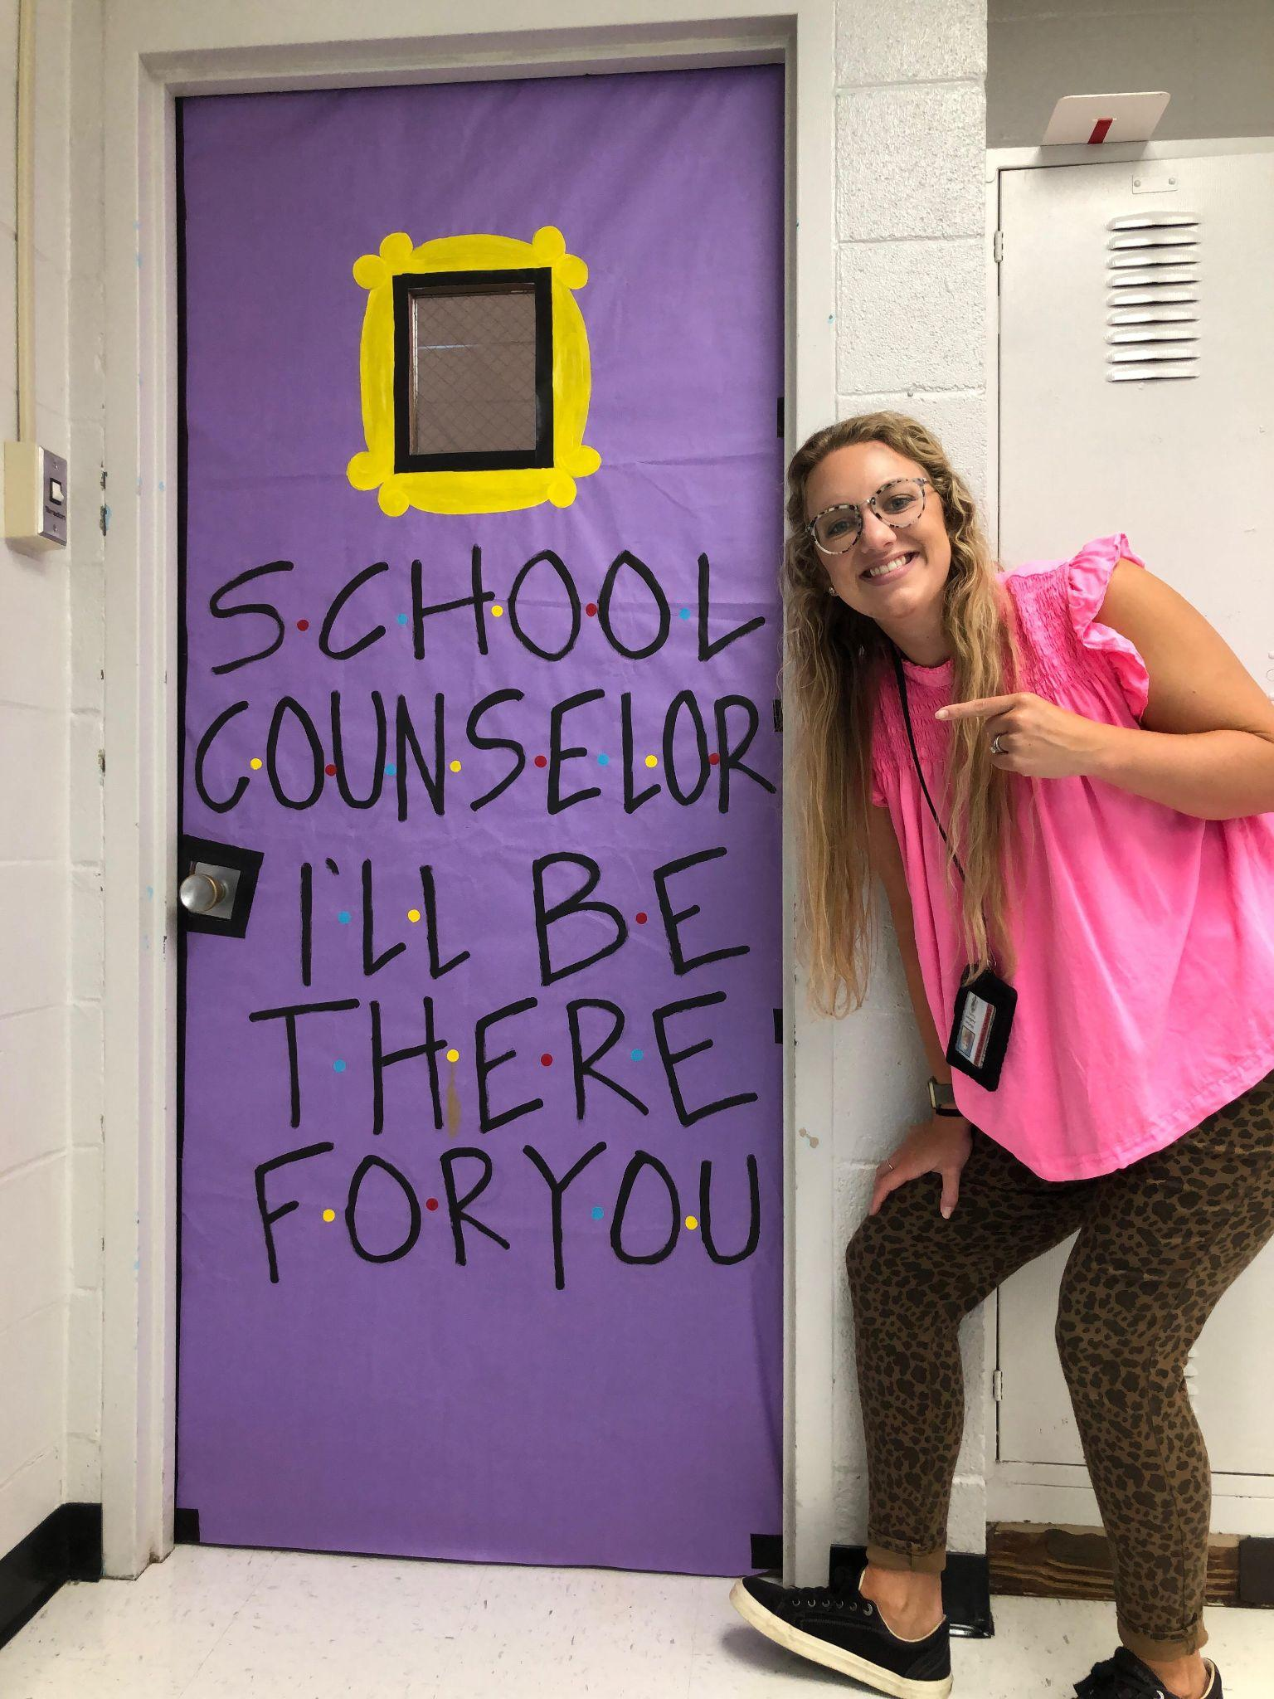
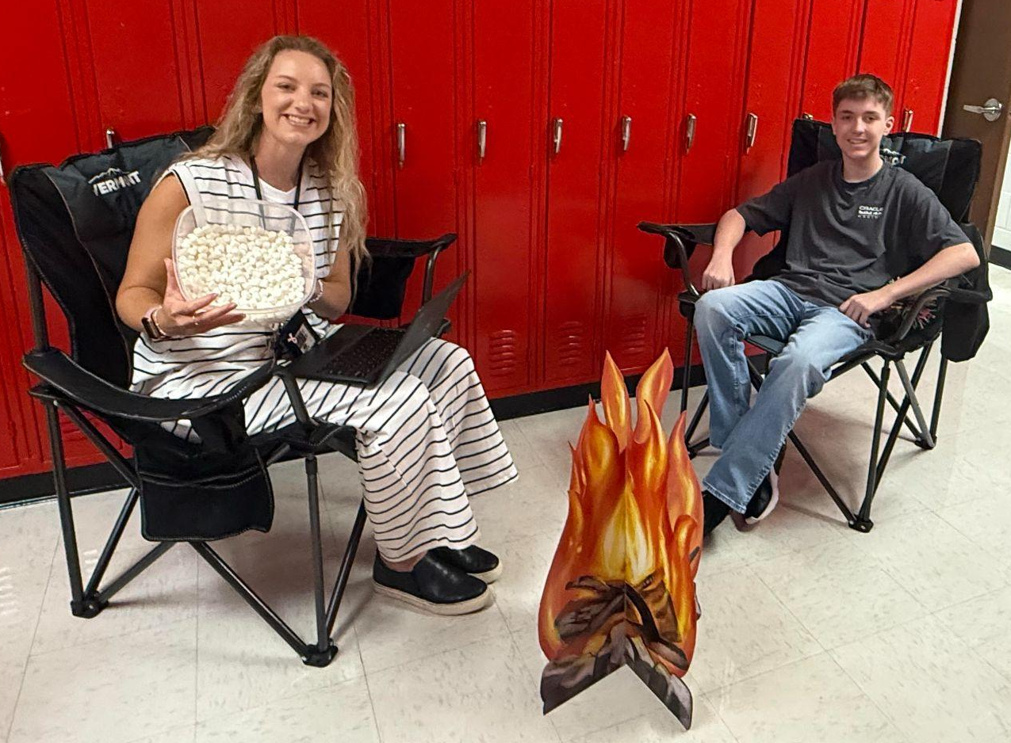
Introduction:

Slide 3
Demographics:
Around 450 students each year
9th grade only at our school
1 Full Time VBH Counselor
1 district wide social worker
1 district wide School Psychologist

Slide 4


My Responsibilities:
504 Coordinator
THAC Club Advisor
9th Grade Registration
McKinney Vento Liaison
School Counseling Program: weekly lessons, 1-1 sessions, small groups

Slide 5
How Role is Protected:
Assistant Principal: Testing Coordinator, Student Schedules, Attendance
Student Registrar: Enrollment, Transcripts
School Psychologist: Behavior Plans

Slide 6
Agenda:
Planning
Forming
Implementing
Advocating

Slide 7
Planning:
Choose a Topic
Decide when and how long
Find Curriculum
Present Plan to Admin

Slide 8
Planning: Choose a Topic: Reference:
Faculty needs Assessment
Student sign up form
Pre-Assessment Results
Minute Meetings Results
Faculty/Teacher referral form
Failure lists/ chronically absent

Slide 9
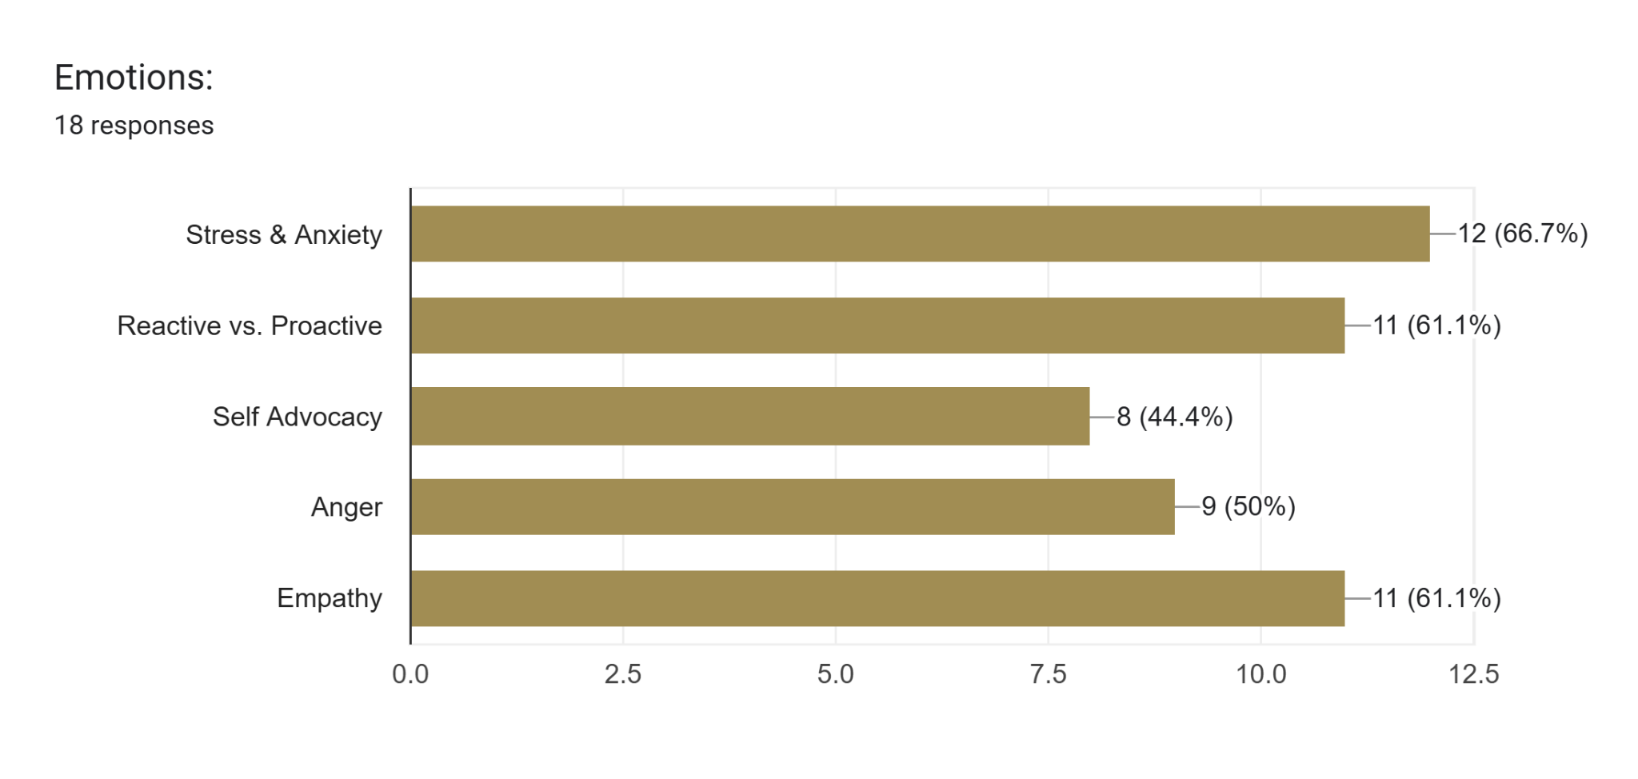
Planning: Choose a Topic
Reference:
Faculty needs Assessment

Slide 10
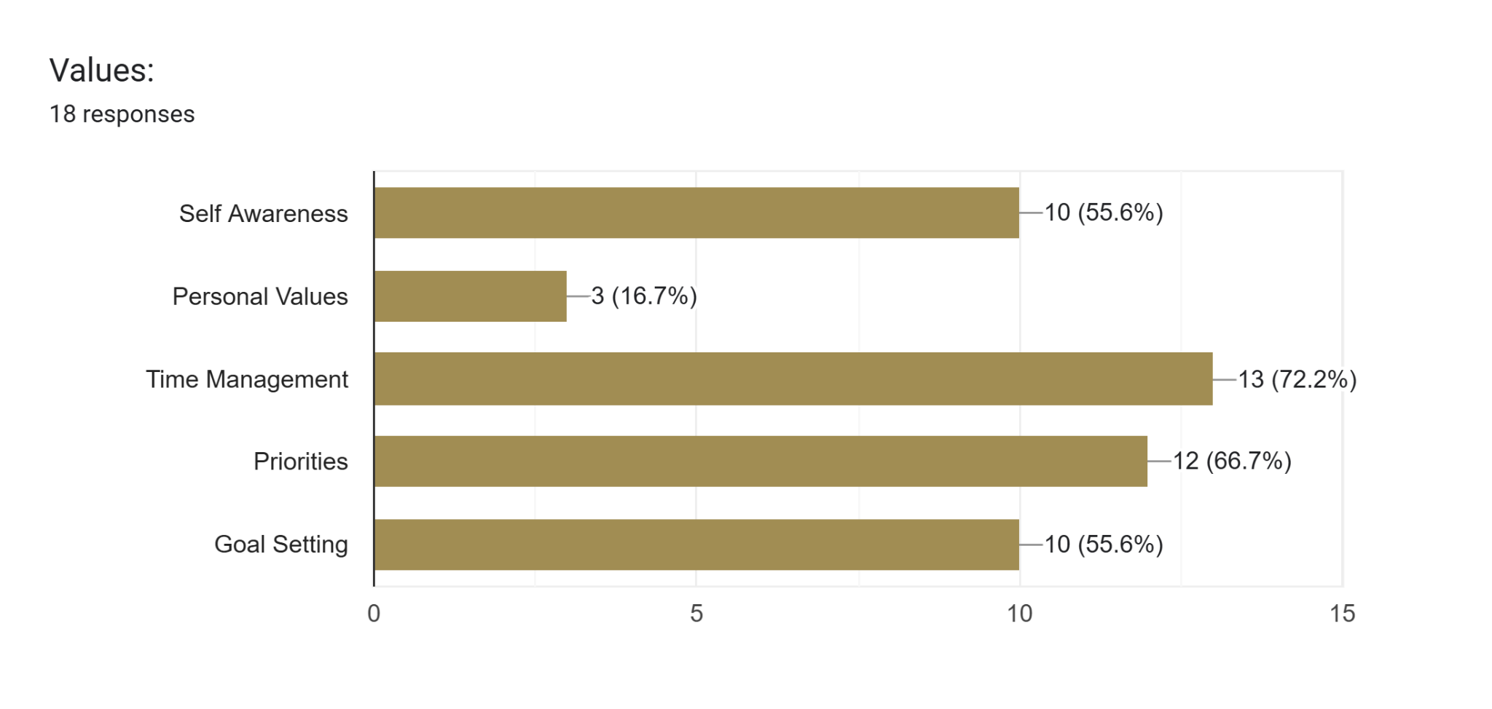
Planning: Choose a Topic
Reference:
Faculty needs Assessment

Slide 11
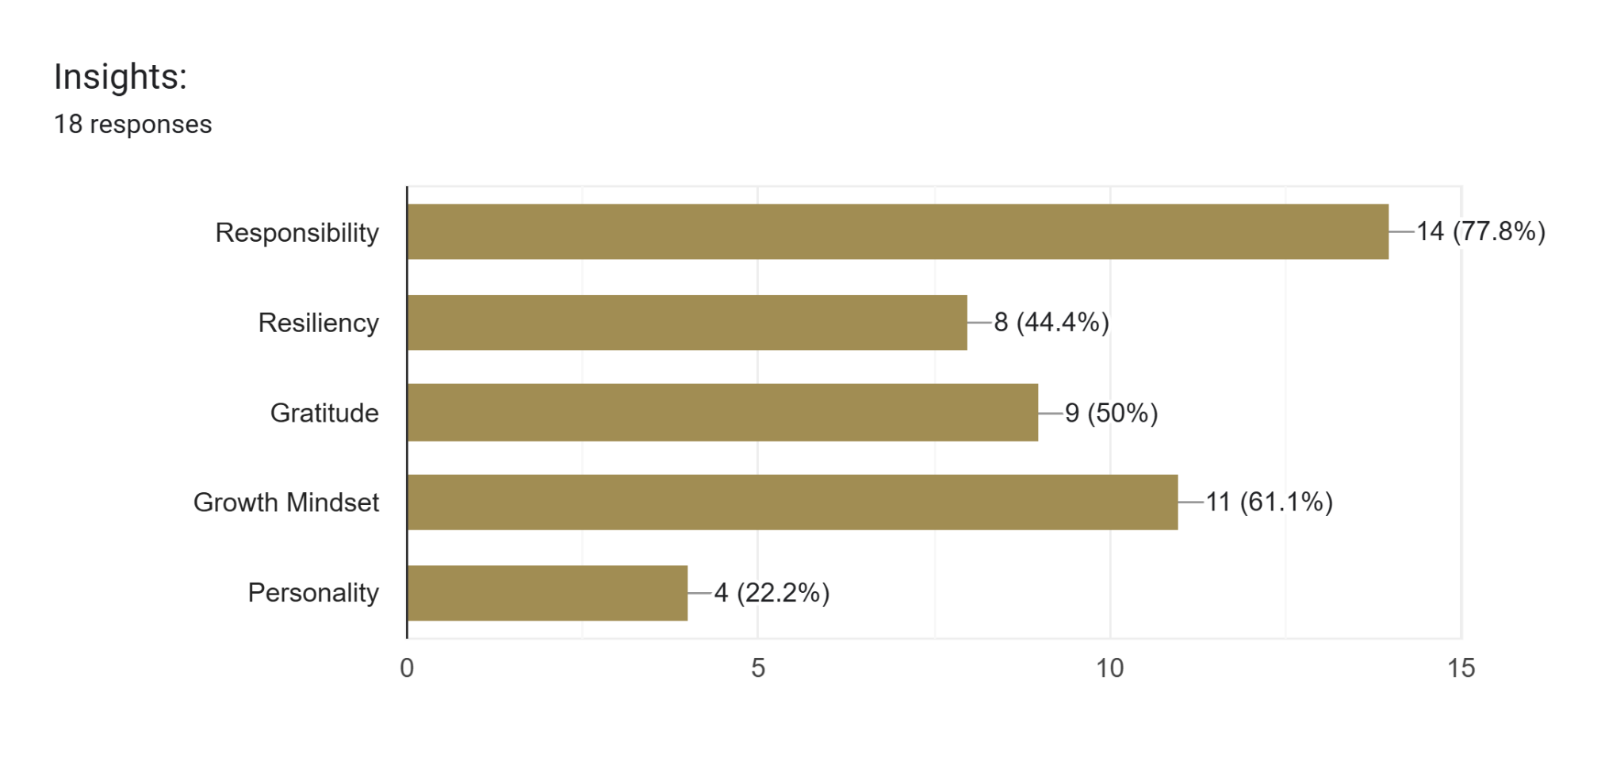
Planning: Choose a Topic
Reference:
Faculty needs Assessment

Slide 12
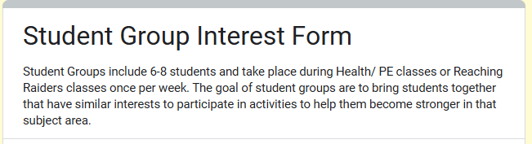
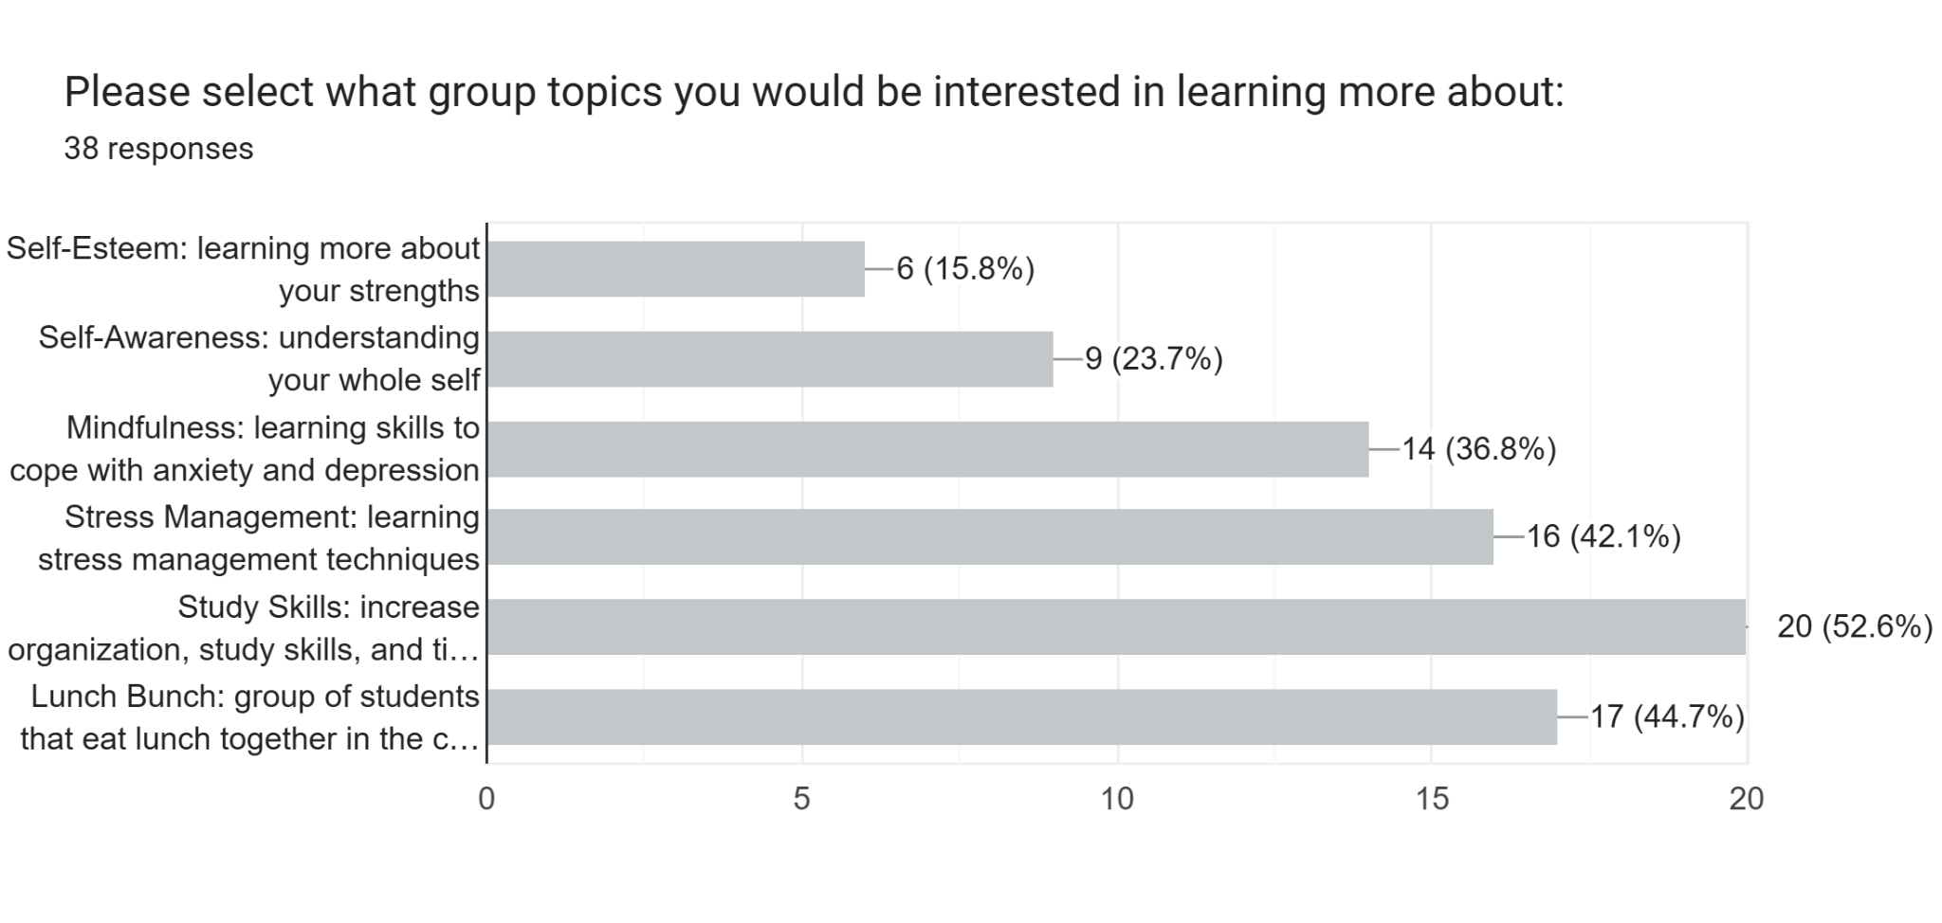
Planning: Choose a Topic
Reference:
Student sign up form

Slide 13
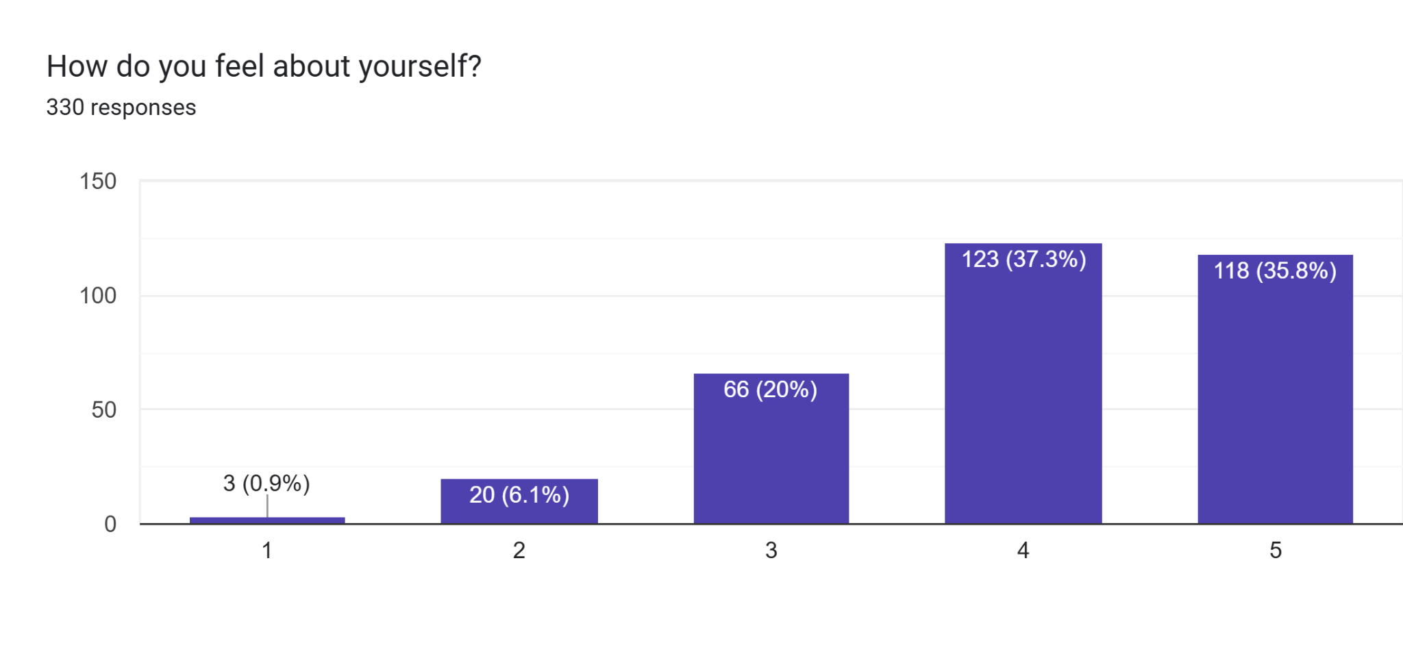
Planning: Choose a Topic
Reference:
Minute Meetings Results

Slide 14
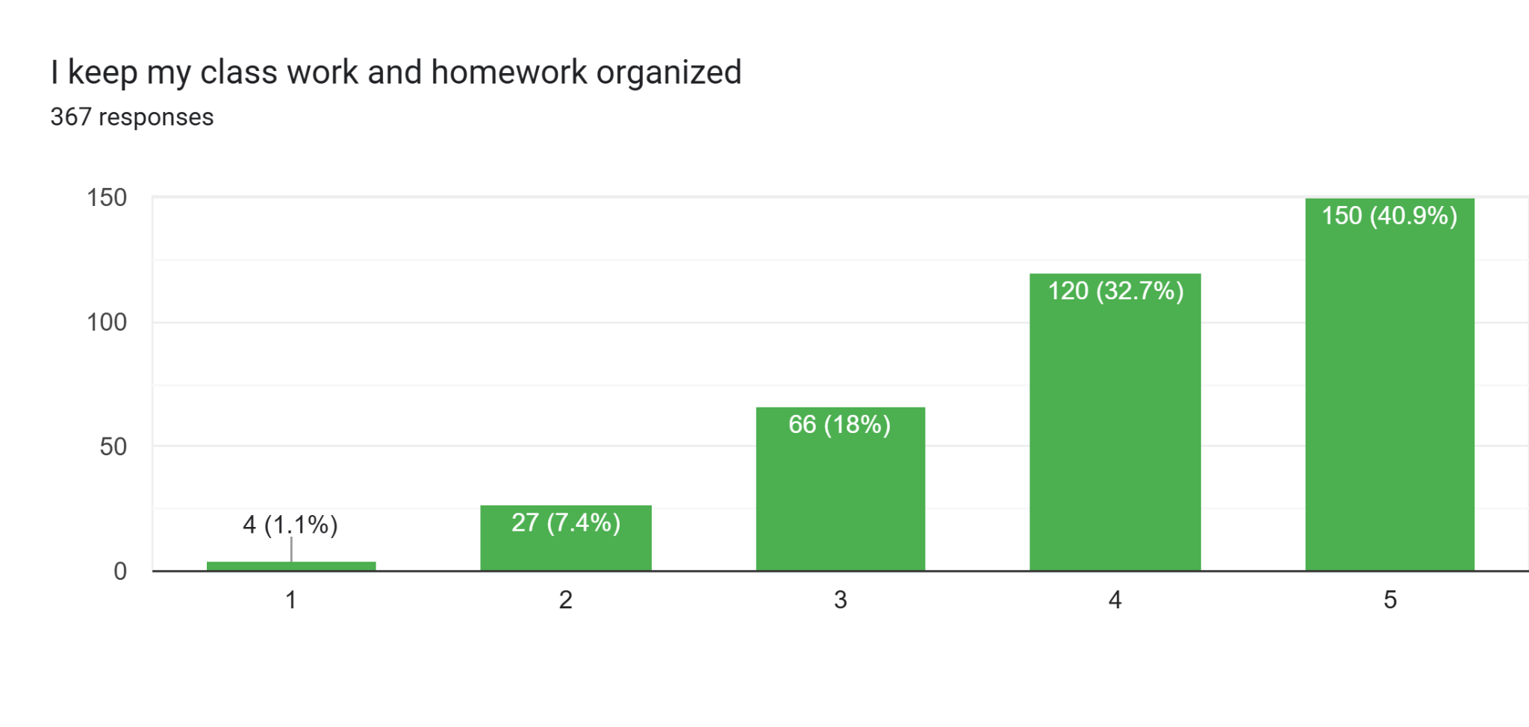
Planning: Choose a Topic: Reference:
Pre-Assessment results

Slide 15
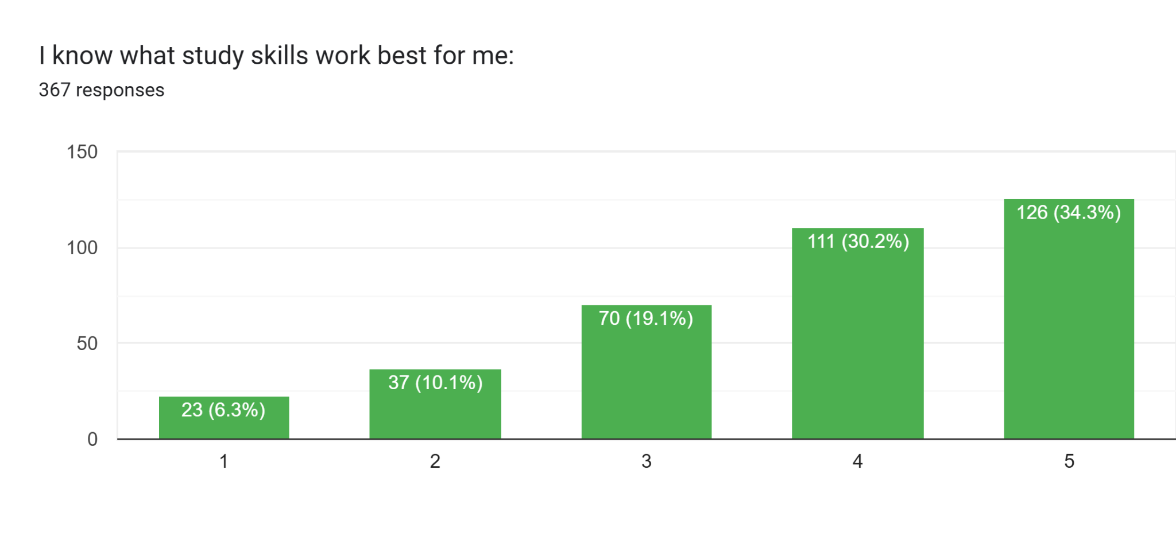
Planning: Choose a Topic: Reference:
Pre-Assessment results

Slide 16
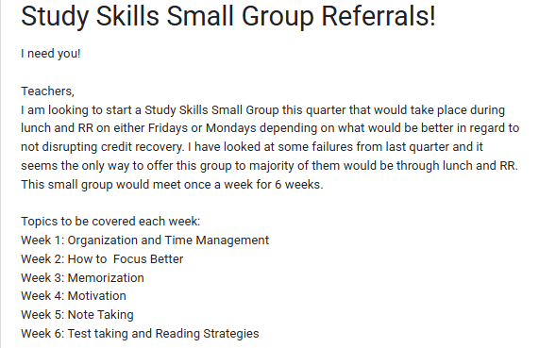
Planning: Choose a Topic
Reference:
Teacher referrals

Slide 17
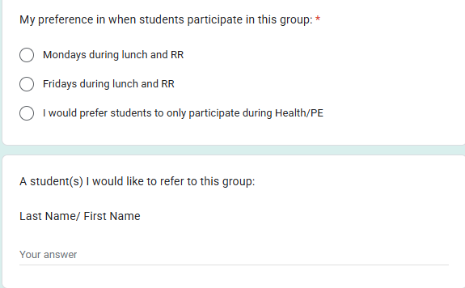
Planning: Choose a Topic
Reference:
Teacher referrals

Slide 18
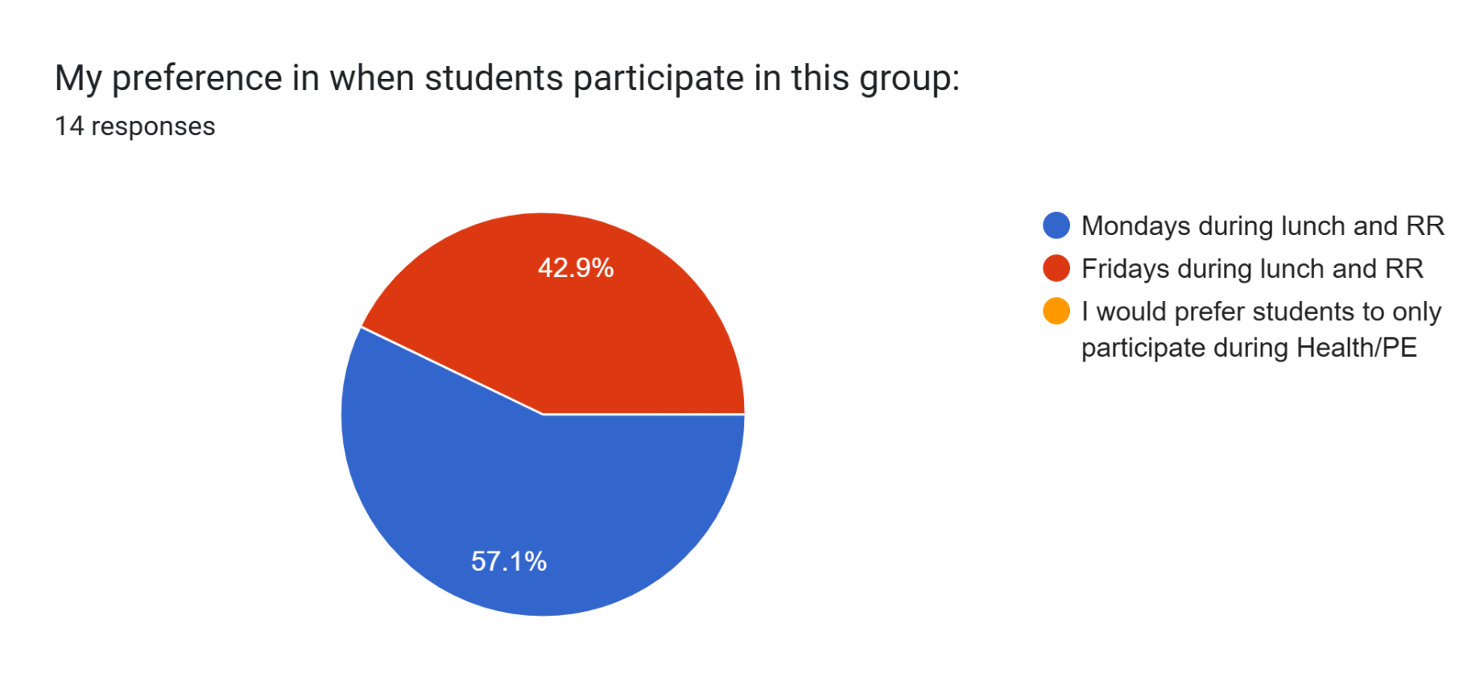
Planning: Choose a Topic
Reference:
Teacher referrals
Students: TR | demeanor | Health/PE | Yes/No when asked if interested | Absences:
Martinez Aguirre, Alexa | chill | 3 | Yes | 0
Smith, Damien | chill | 1 | Yes | 1
Gilliam, Rebecca | chill | 3 | Yes | 1
Ortiz, Belen | reserved | 3 | Yes | 1
Zaragoza, Saul | reserved | 3 | Yes | 1

Slide 19
Planning: Decide WHEN and how LONG
What period/time of day?
How many groups?
Plan for 1-2 weeks extra for make-ups
Utilize School Calendar for mapping it out

Slide 20
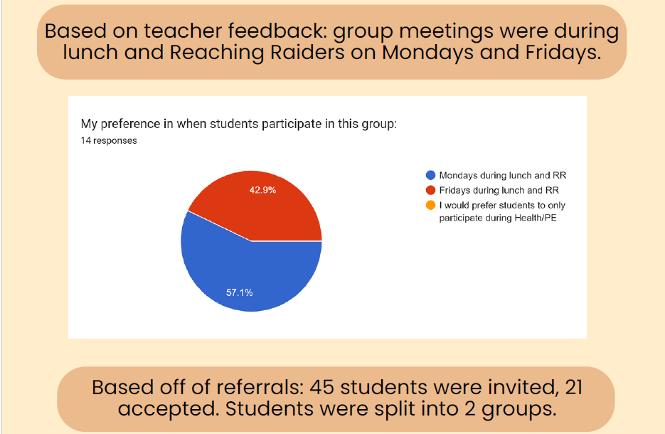
Planning: Decide WHEN and how LONG
What period/time of day?

Slide 21
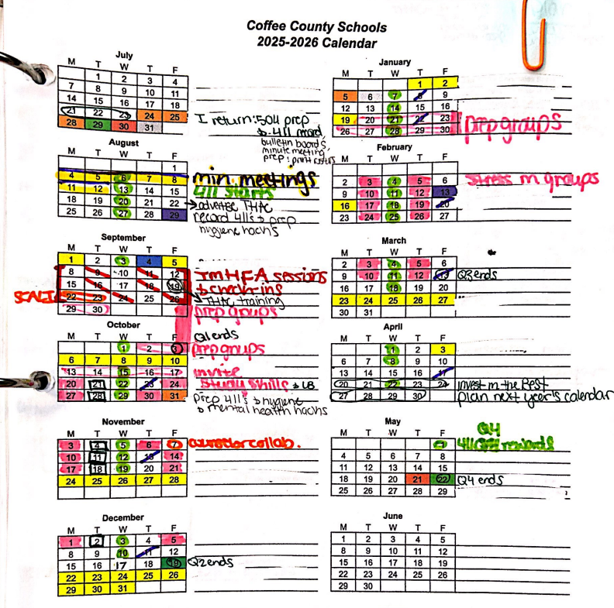
Planning: Decide WHEN and how LONG
Plan for 1-2 weeks extra for make-ups
Utilize School Calendar for mapping it out

Slide 22
Planning: Find Curriculum
Teachers Pay Teachers
Use material that outlines the ASCA standards: save time where you can!
Modify as needed
Find something you are comfortable with

Slide 23
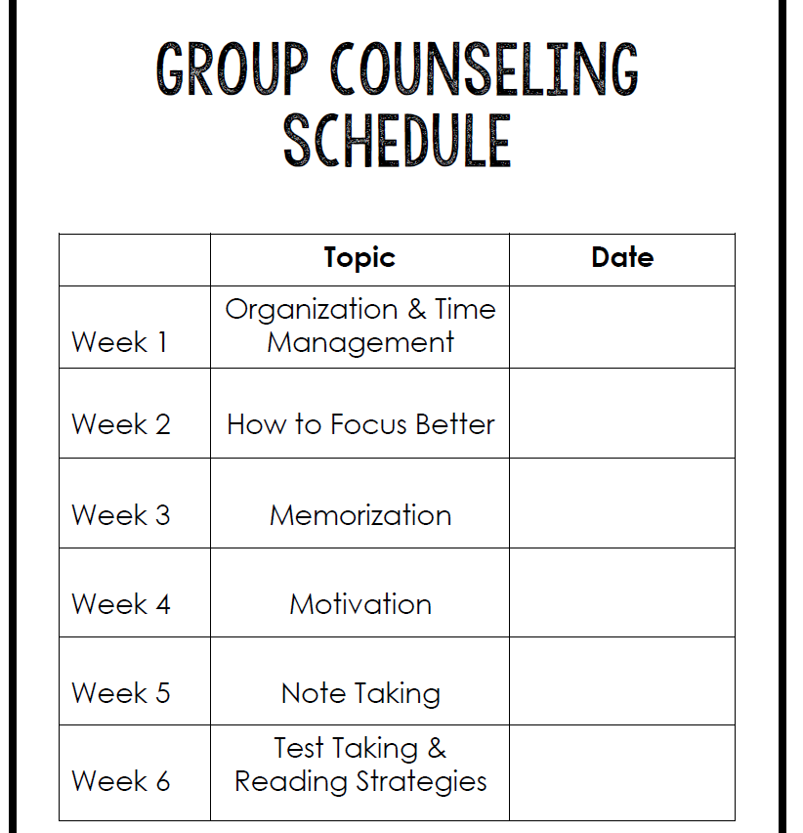

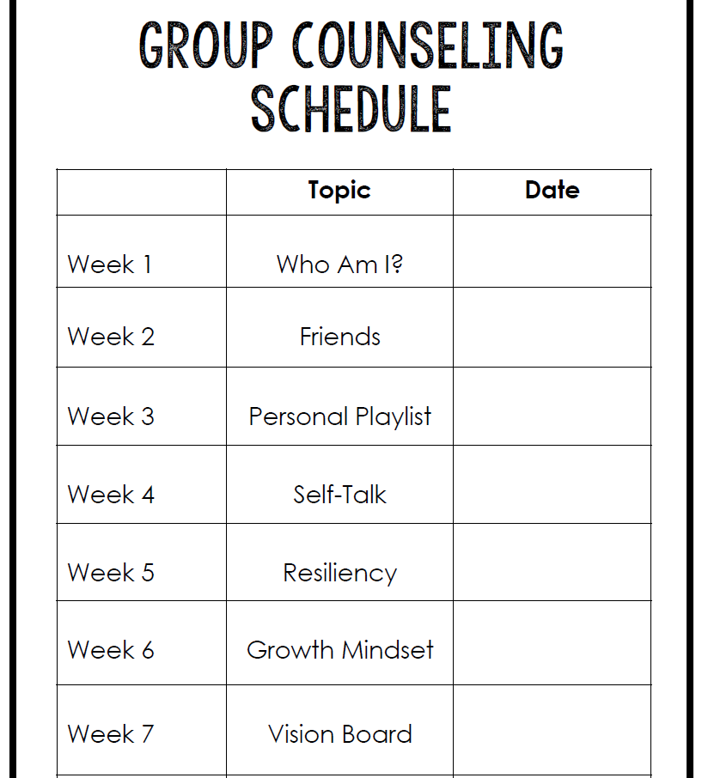
Planning: Find Curriculum
Teachers Pay Teachers:
My Favorites:
Study Skills:
Anxiety & Stress Management: SEL with Mrs. Carla
Self-Awareness:
Self Esteem:

Slide 24
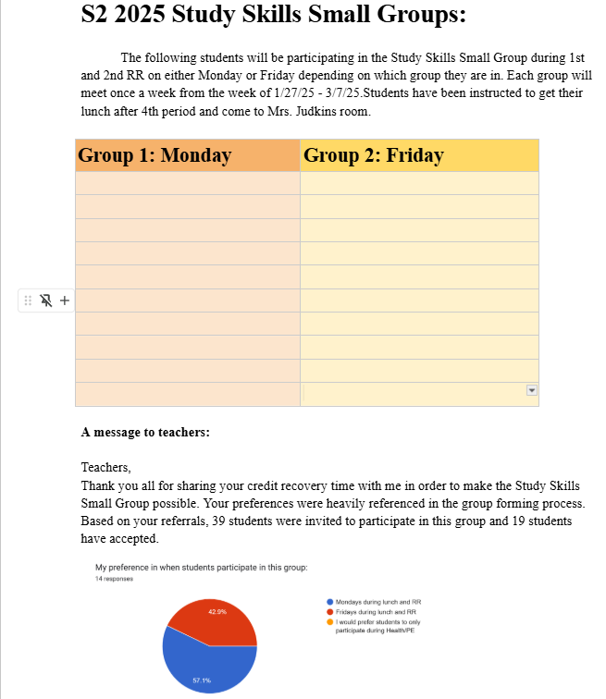
Planning: Present Plan to Admin
Present Summary
Explain your why

Slide 25
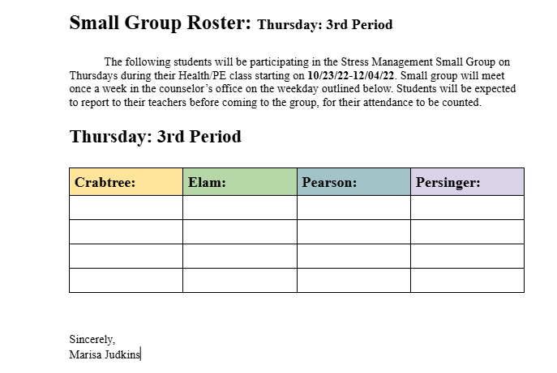
Planning: Present Plan to Admin
Include monthly visuals
ask for support in protecting your time

Slide 26
Forming:
Prioritize the Group Dynamic
Invite Students

Slide 27
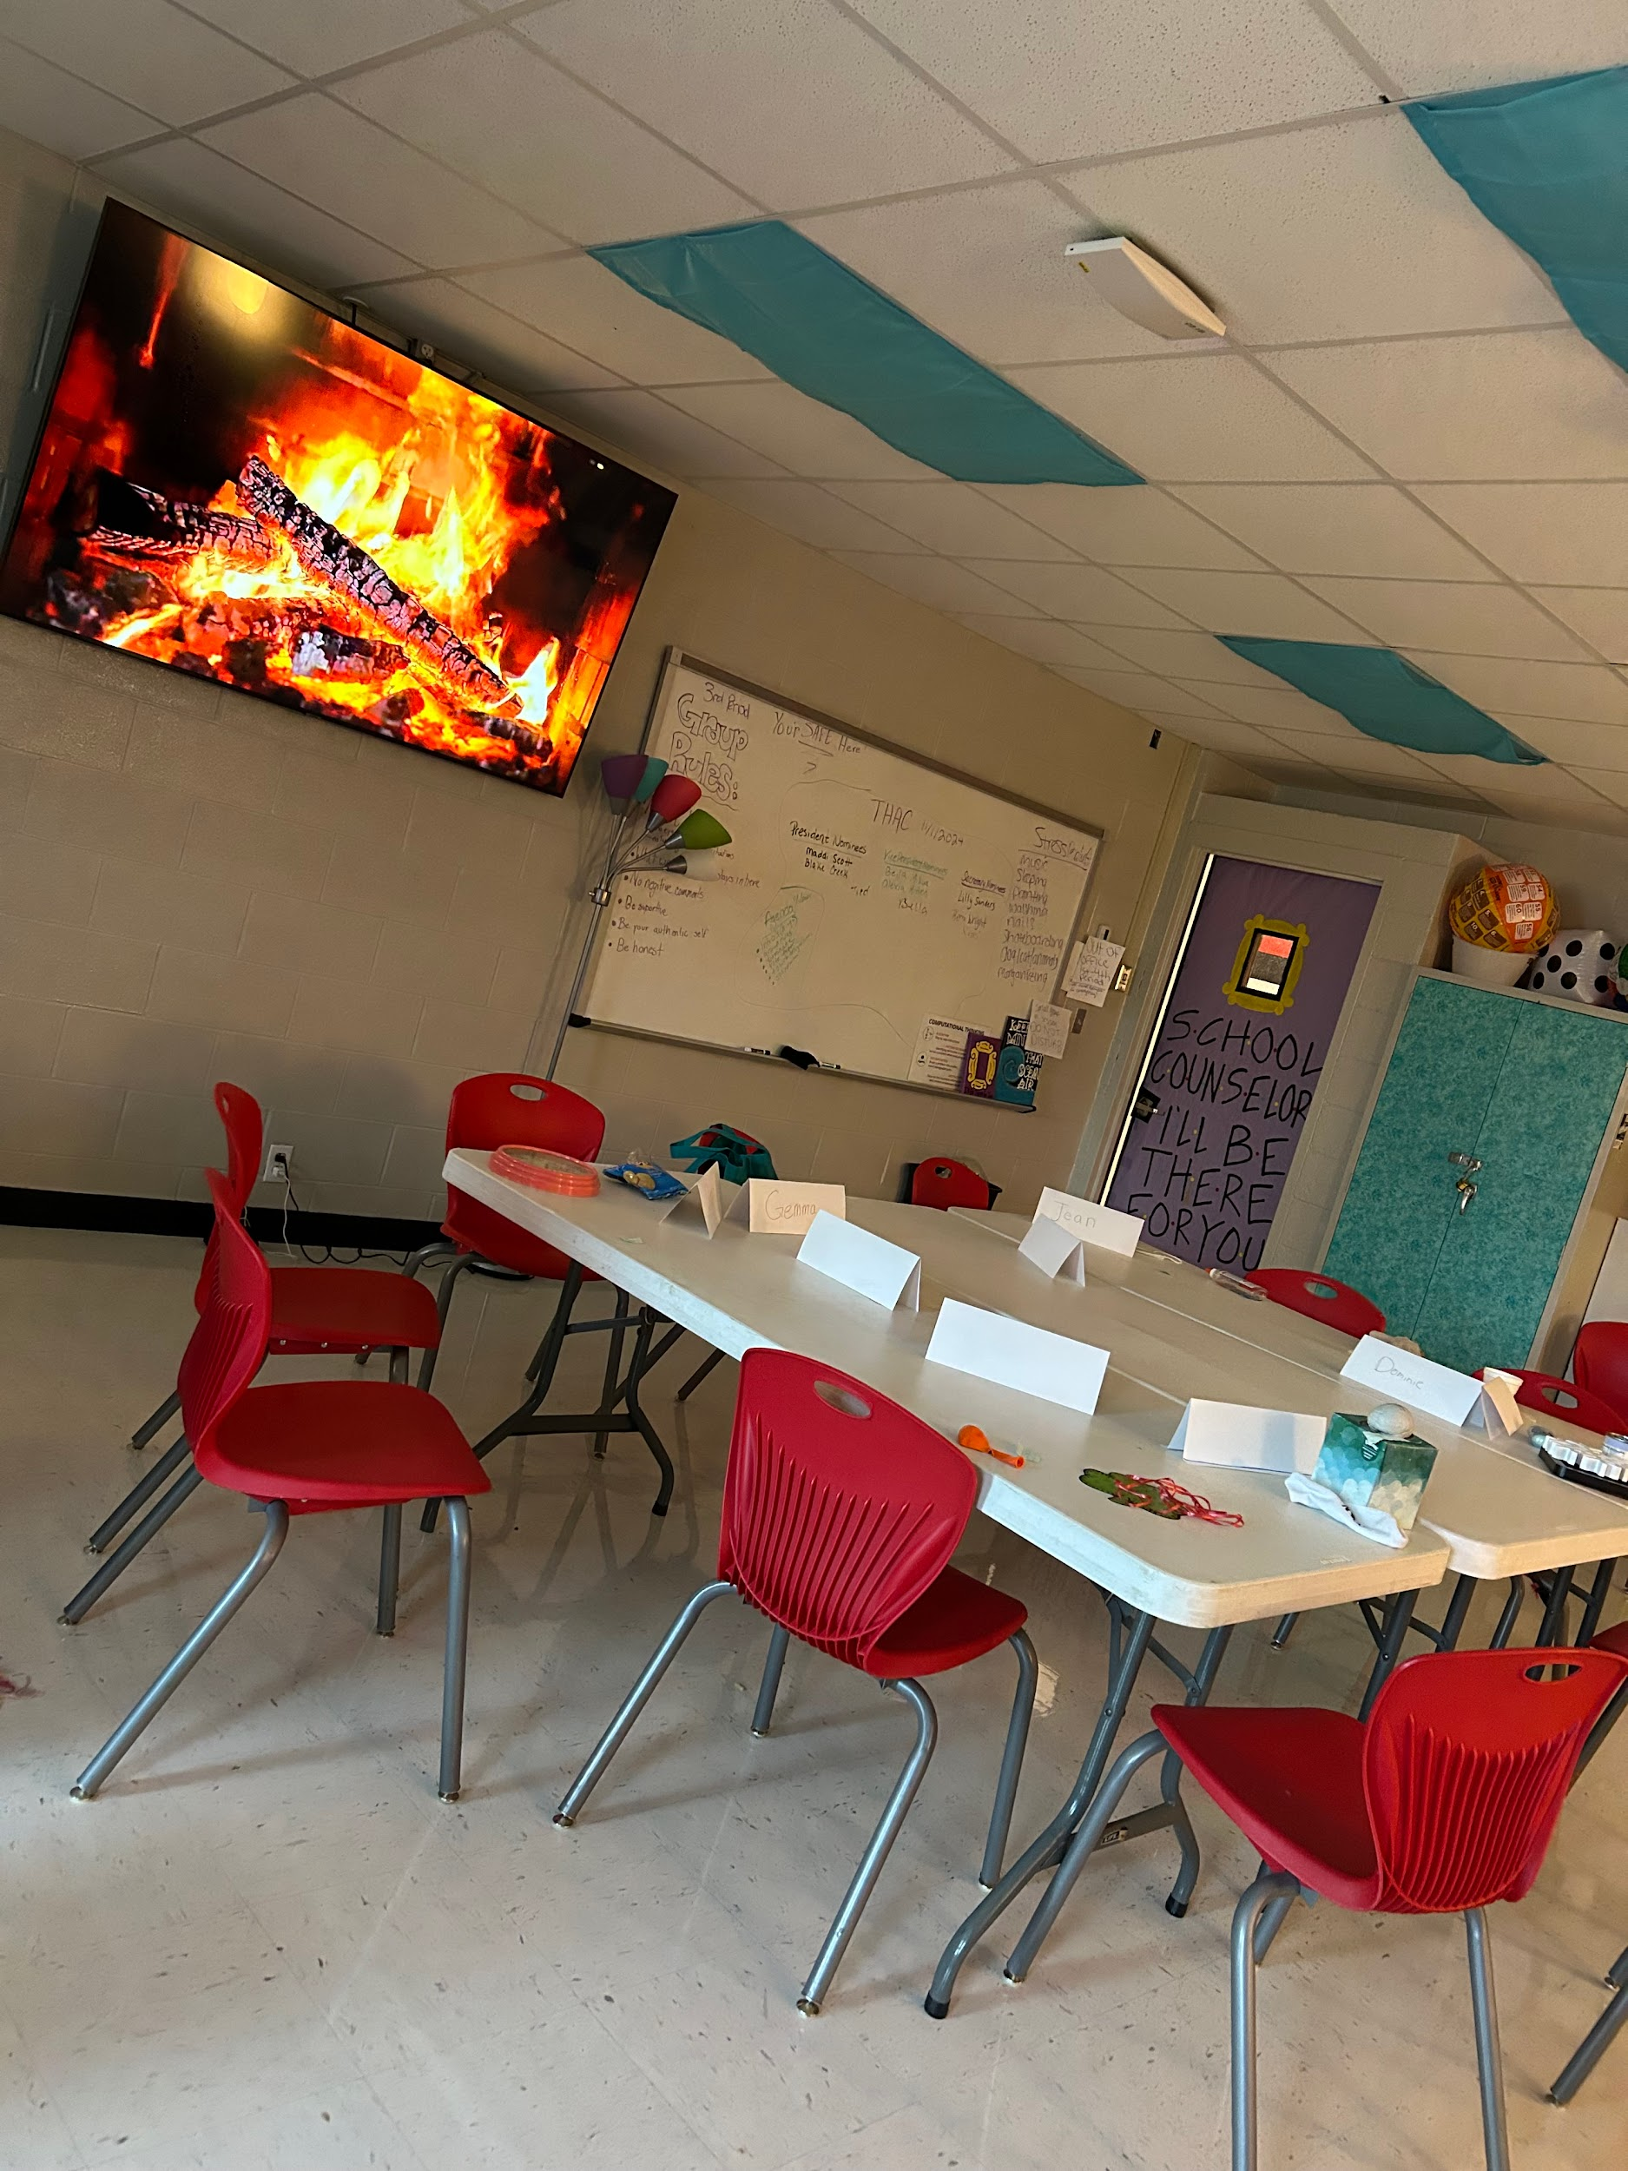
Forming: Prioritize the Group Dynamic
Goal: comfortable environment
Meet with students before invite: determine who would work well together

Slide 28
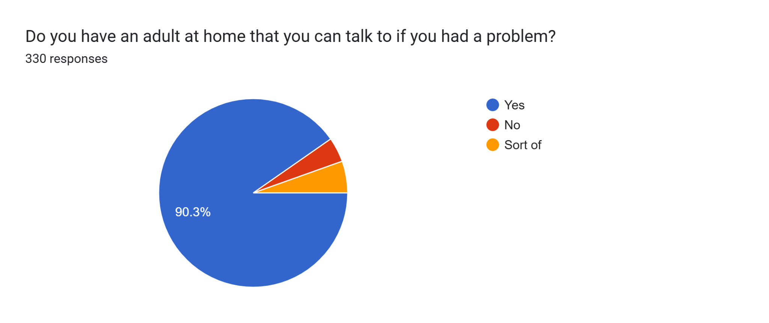
Forming: Prioritize the Group Dynamic
Be intentional: consider:
who signed up
who was referred
ACE’s
Personalities

Slide 29
Forming: Invite Students
Make it their idea
Find data
Make it casual
Parent Consents

Slide 30
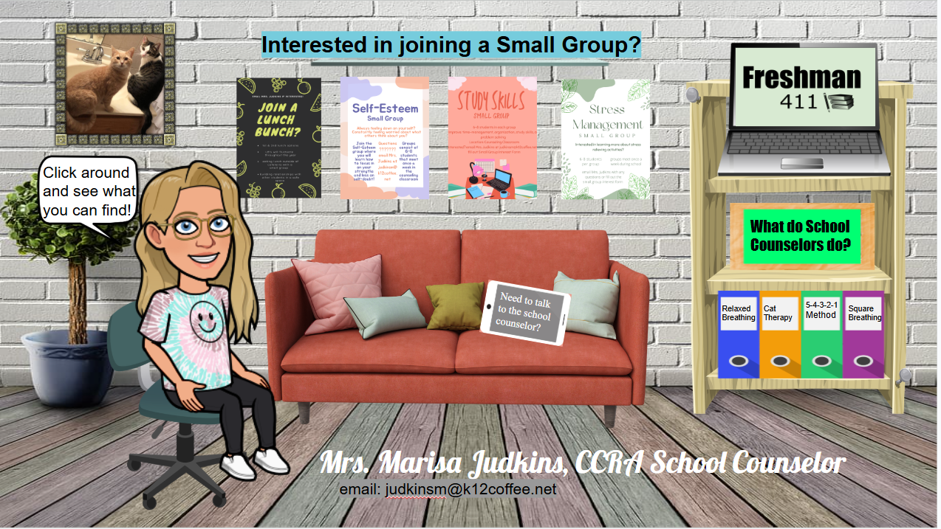
Forming: Invite Students
Make it their idea
Find data
Make it casual
Parent Consents

Slide 31

Forming: Invite Students
Make it their idea
Find data
Make it casual
Parent Consents

Slide 32
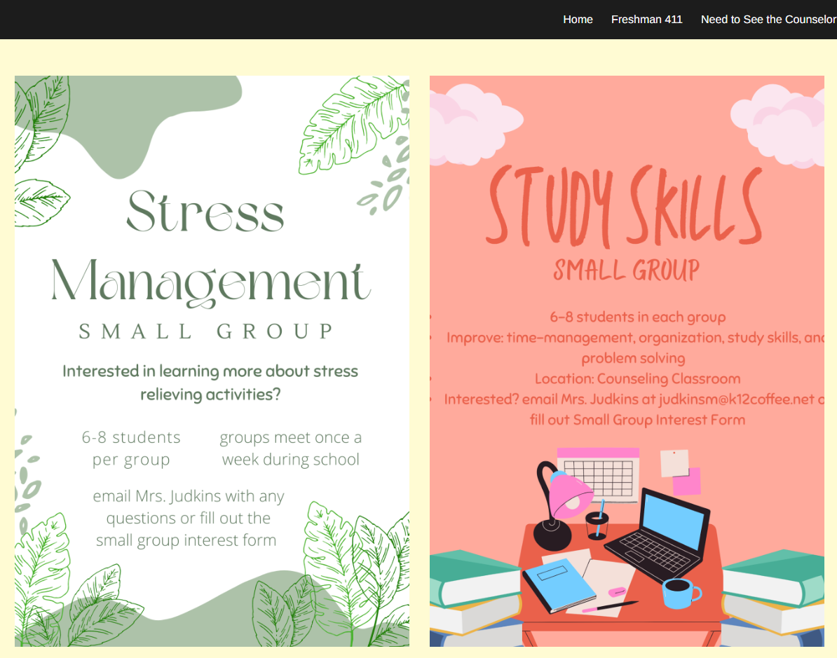
Forming: Invite Students
Make it their idea
Find data
Make it casual
Parent Consents

Slide 33

Forming: Invite Students
Make it their idea
Find data
Make it casual
Parent Consents

Slide 34
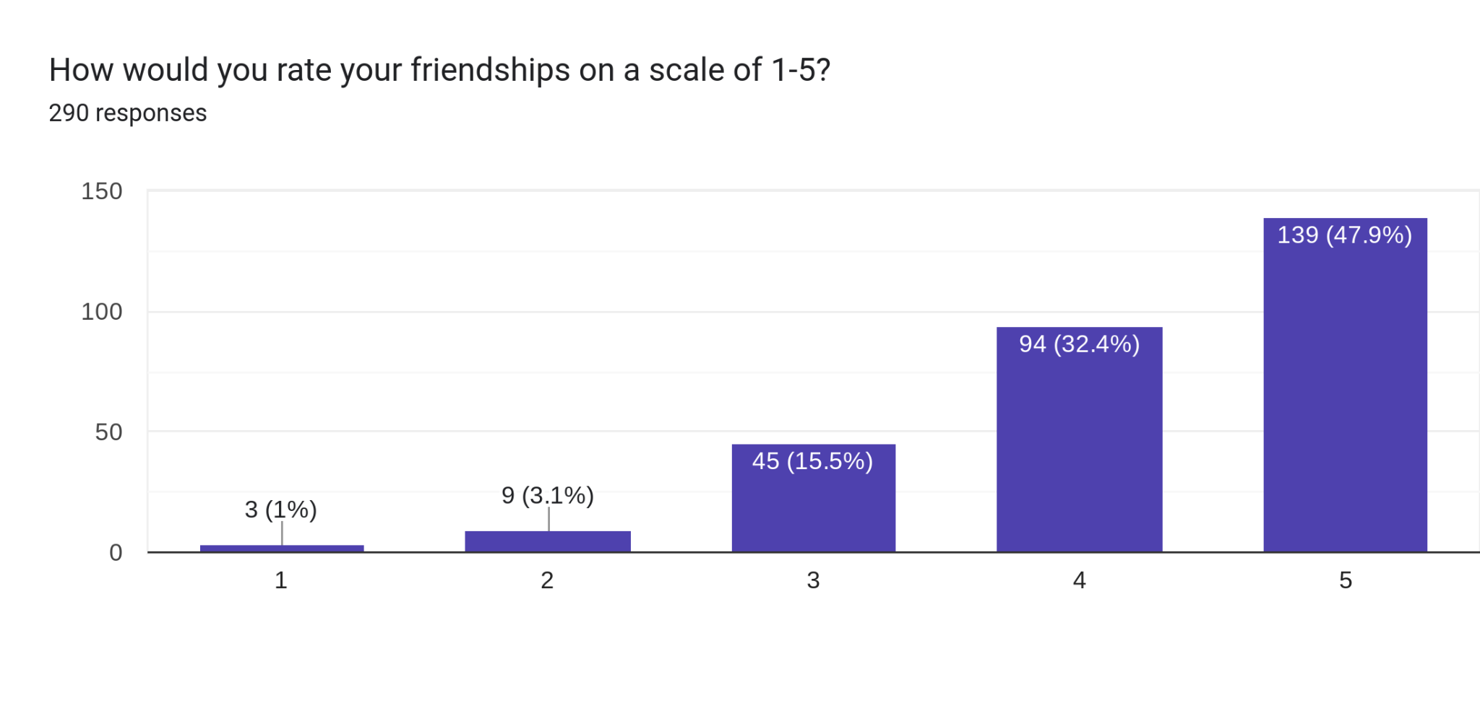
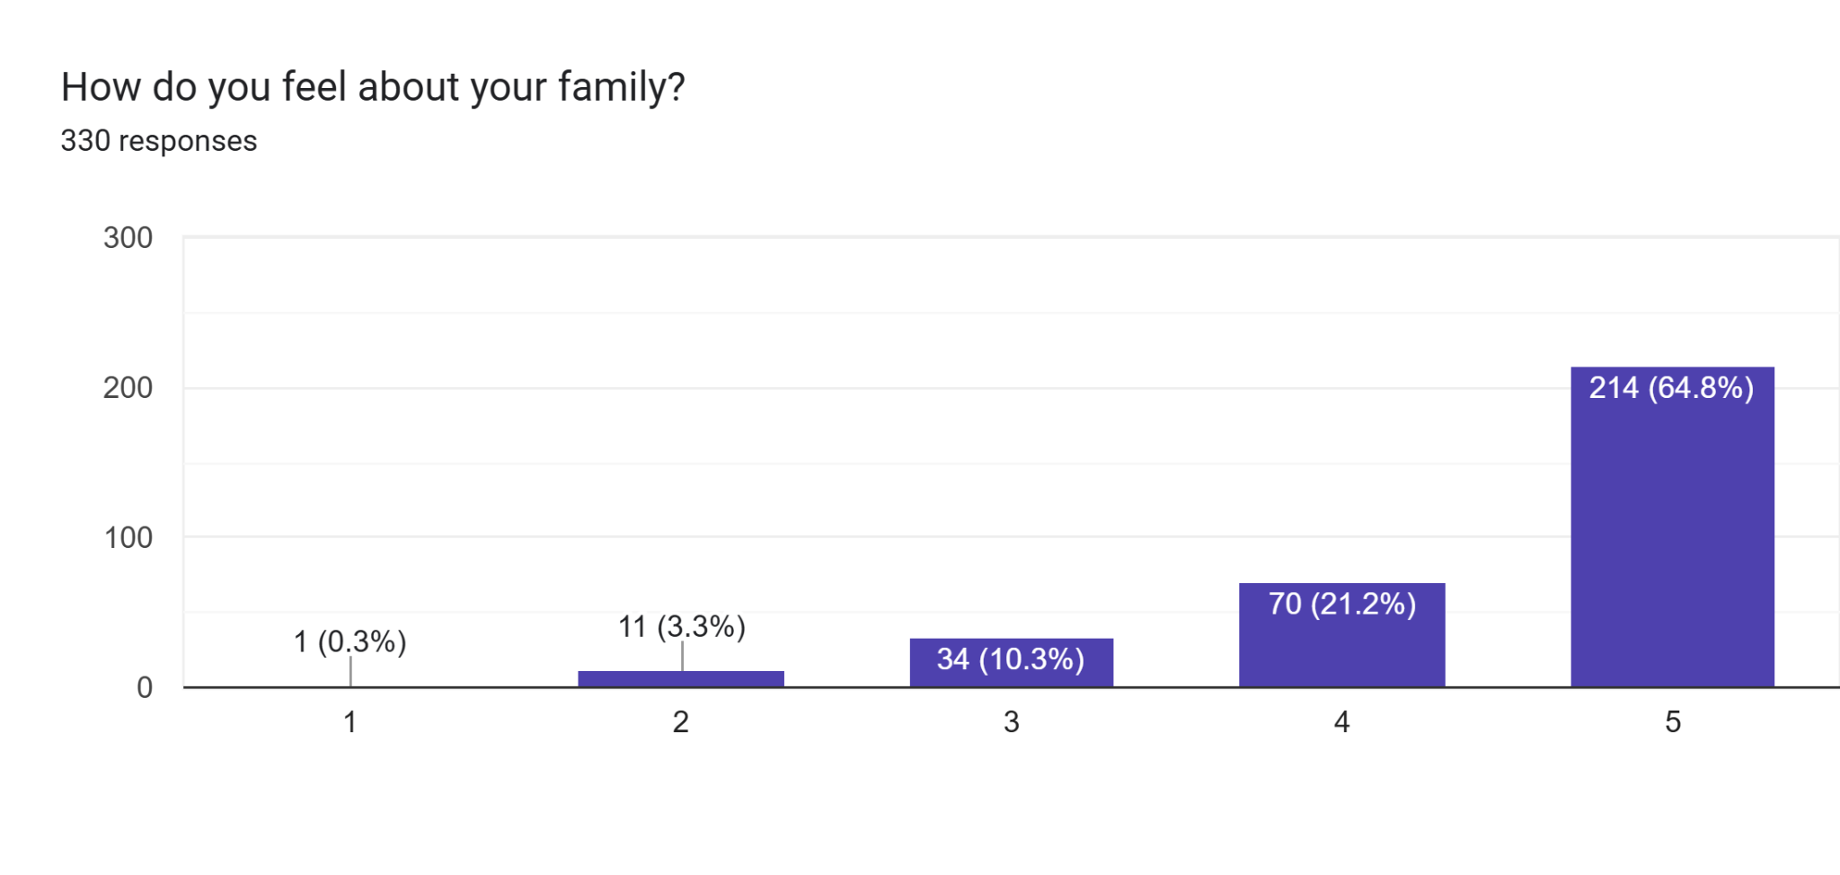
Forming: Invite Students
Make it their idea
Find data
Make it casual
Parent Consents
Notes:
Add google site screenshot

Slide 35
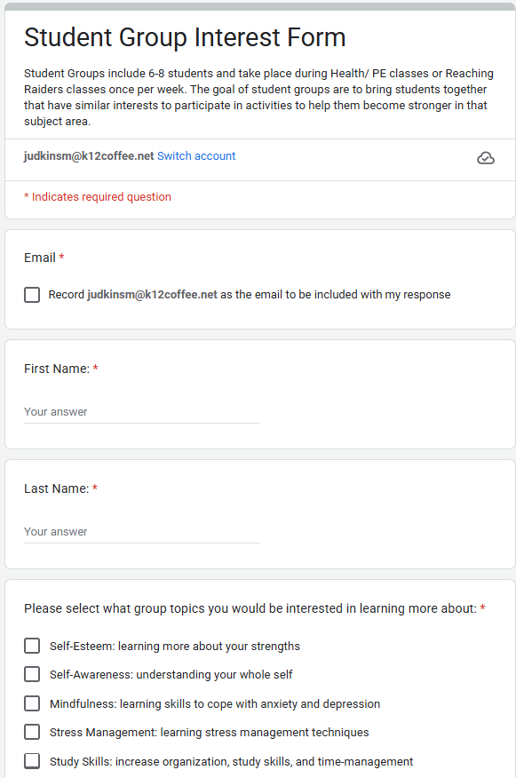
Forming: Invite Students
Stress management process
LB process
Study Skills process

Slide 36
Implementing:
Communicate!
1st Group
Protect the Group Dynamic
Last Group: Happy Closure

Slide 37
Implementing: Communicate
Share rosters and procedures,weekly!
Admin, office staff, teachers
lunch monitors, nurse
Remind students weekly: morning announcements, email

Slide 38
Implementing:
Communicate

Slide 39
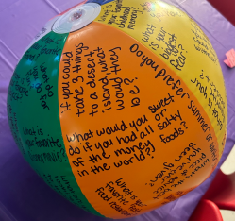
Implementing: 1st Group
Weekly expectation
Ice breakers: always!!!
Ground rules, awkward but important
Share schedule
Pre-test: super important!
Provide incentives

Slide 40
Implementing: PROTECT the Group Dynamic:
Members
Environment is key
Trust the process of the group but always plan ahead (Children’s book Ex)

Slide 41
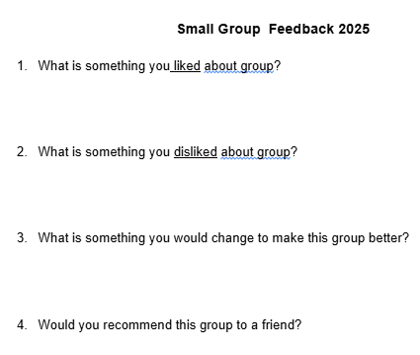
Implementing: Last Group: Happy Closure
Party day
Take folders
Recap
Post-test & Survey

Slide 42
Advocating:
Pre/Post Test
Student Survey Responses
Make data visually pleasing
Find the areas of growth
Reference data: End of Year Meeting

Slide 43
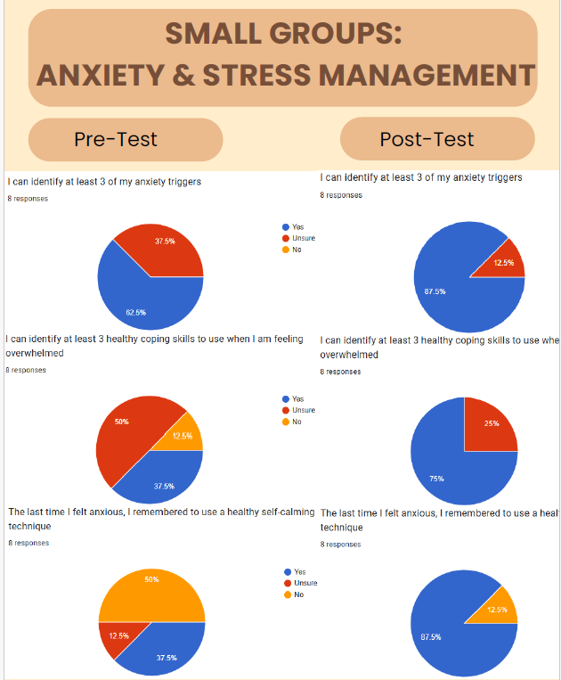
Advocating: Pre/Post Test & Survey
Create visuals
show baseline of understanding before group then after

Slide 44
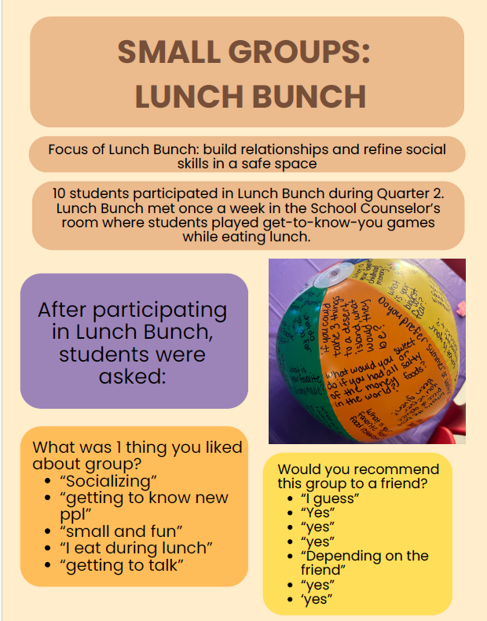
Advocating: Make it easy to read and share:!
Document student survey responses
Use as needed (when advertising next year)

Slide 45
Advocating: Study Skills: Student Survey
“It is very relaxing and quiet”
What was something you liked about
group?
“Talking about stuff that is important & talking to new ppl”
“There’s no judgement & it actually helps”

Slide 46
Advocating: Study Skills: Student Survey
What was something you liked about
group?
“How caring everyone is”
“Socializing and getting better study skills”
“Learning how to memorize & remember certain things”

Slide 47
Advocating: Study Skills: Student Survey
“How we missed 2 weeks and didn’t get to make them up”
What was something you disliked about
group?
“It’s on a Monday”
“How I was the only boy”

Slide 48
Advocating: Study Skills: Student Survey
What is something that would make group better?
“Longer periods”
“Different day and different form of communicating”
“more group activities besides answering questions”

Slide 49
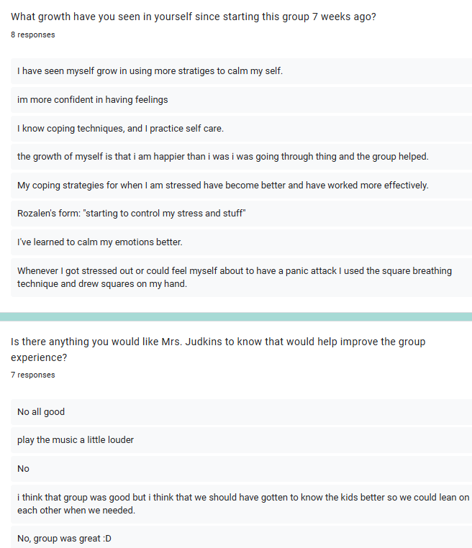
Advocating:
Stress
Management Data
Would you recommend this group to a friend?
Yes: 9

Slide 50
Advocating: Stress Management: Survey
“Everyone is very open to one another and kind”
What is 1 thing you liked about
group?
“How comfortable I feel in here”
“we can all talk and not feel judged”

Slide 51
Advocating: Stress Management: Survey
What is 1 thing you disliked about group?
“Missing gym”
“ just a lot in one day”
“how late it is in the week”

Slide 52
Advocating: Stress Management: Survey
“maybe a little more talking”
What is 1 thing that would make group better?
“doing more stuff with the members in the group”
“Louder music”
“Coping methods”

Slide 53
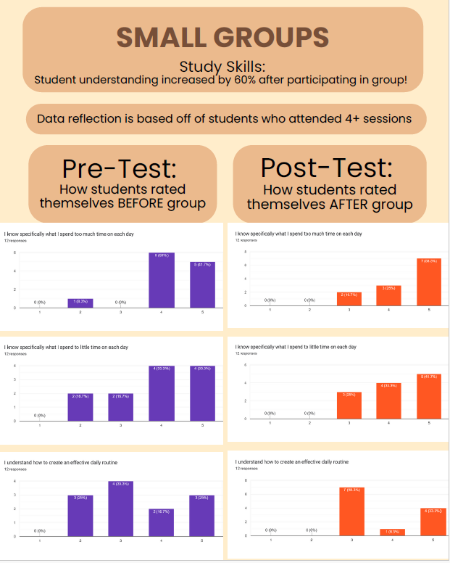
Advocating: Make it Easy to Read & Share:
Newsletters
Inservice/ PDs
End of Year Admin. Meeting

Slide 54
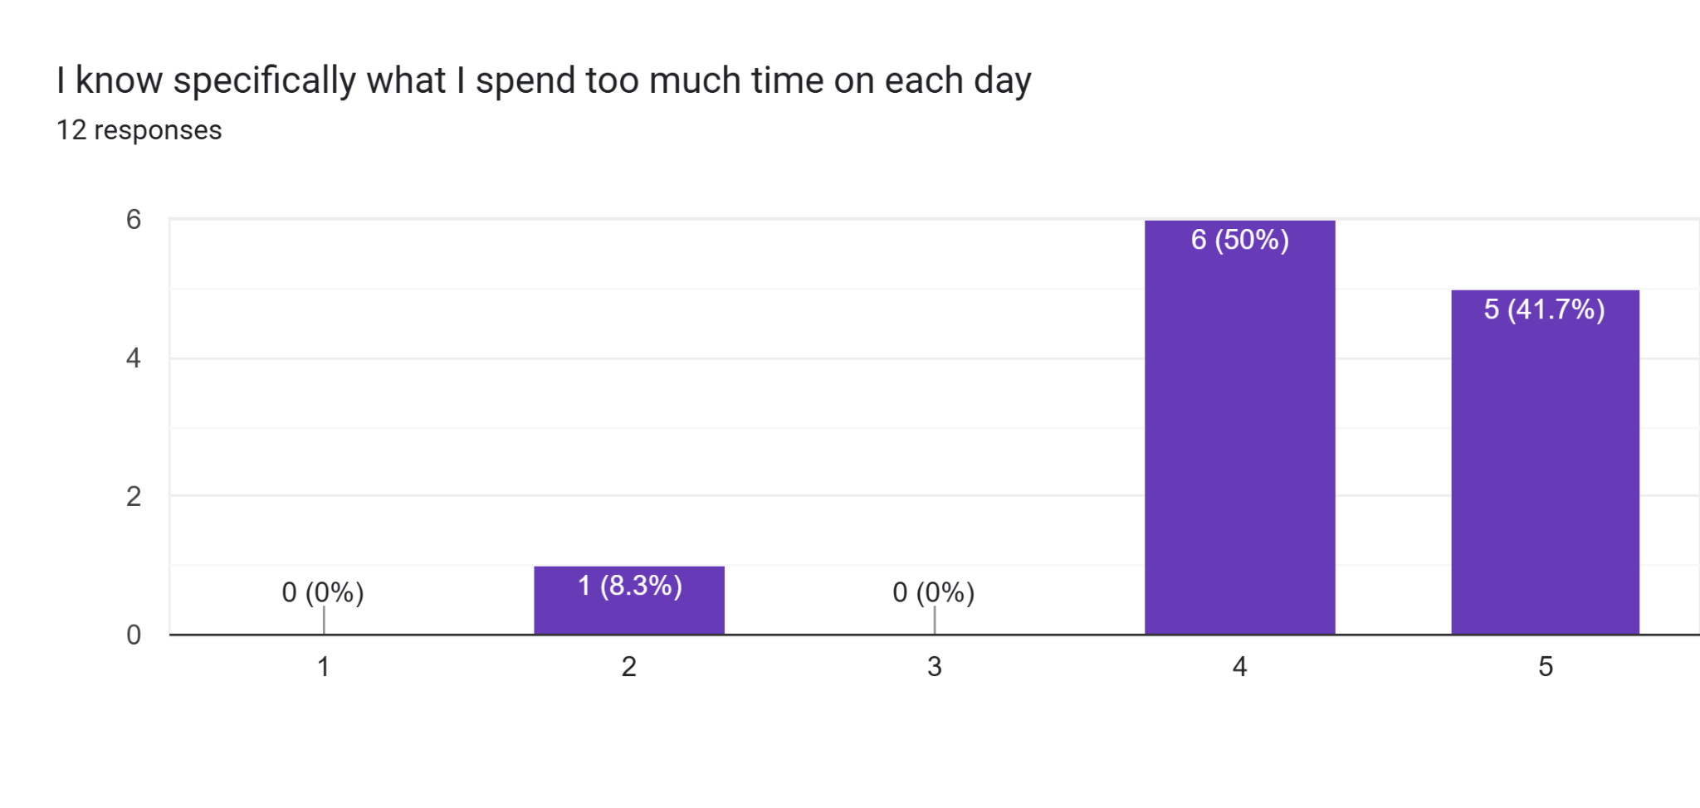
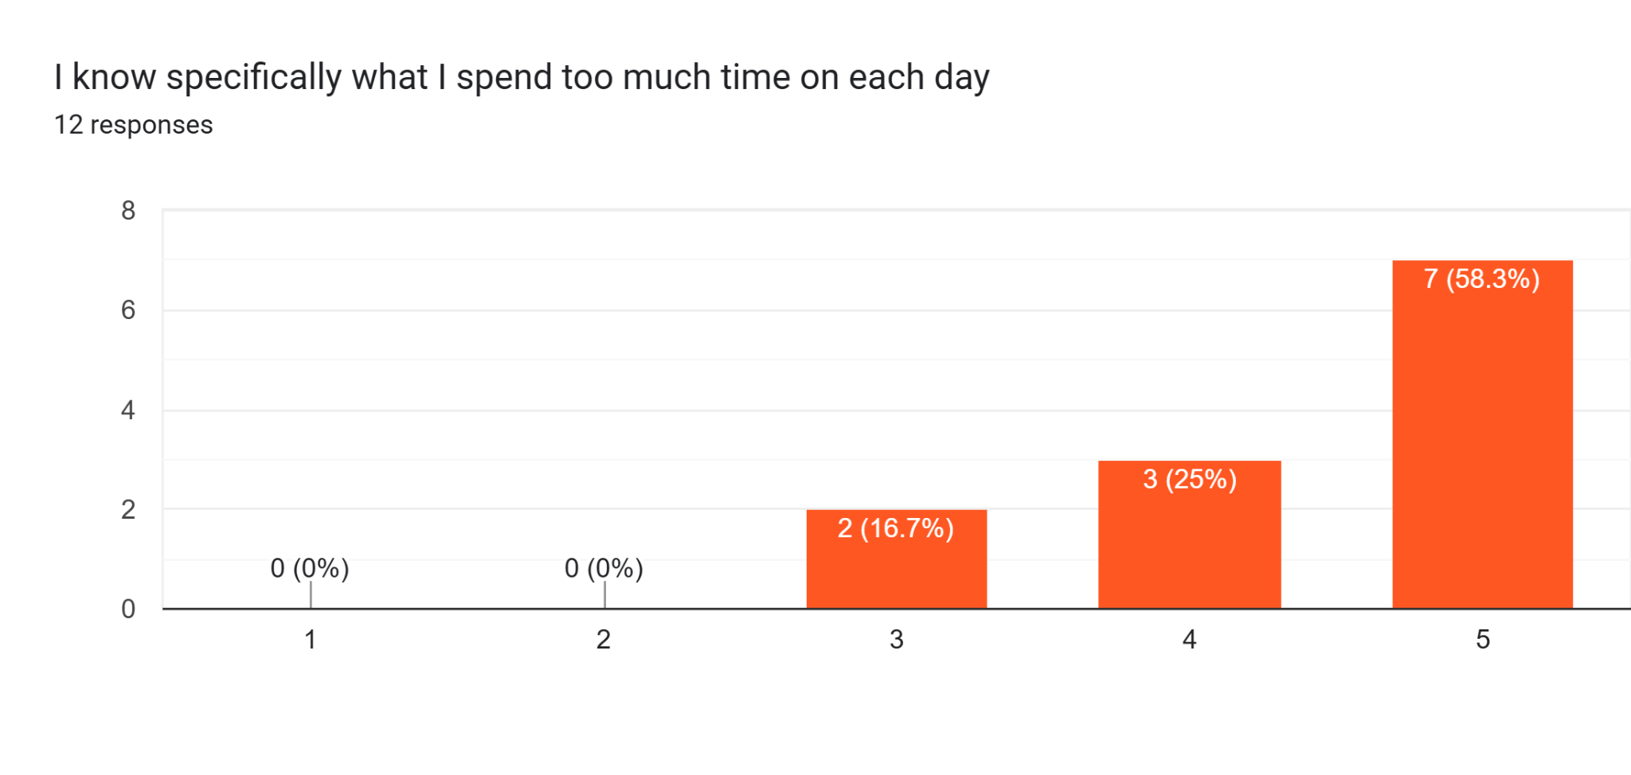
Advocating:
Study Skills: Areas of Growth
Pre Test
Post Test

Slide 55
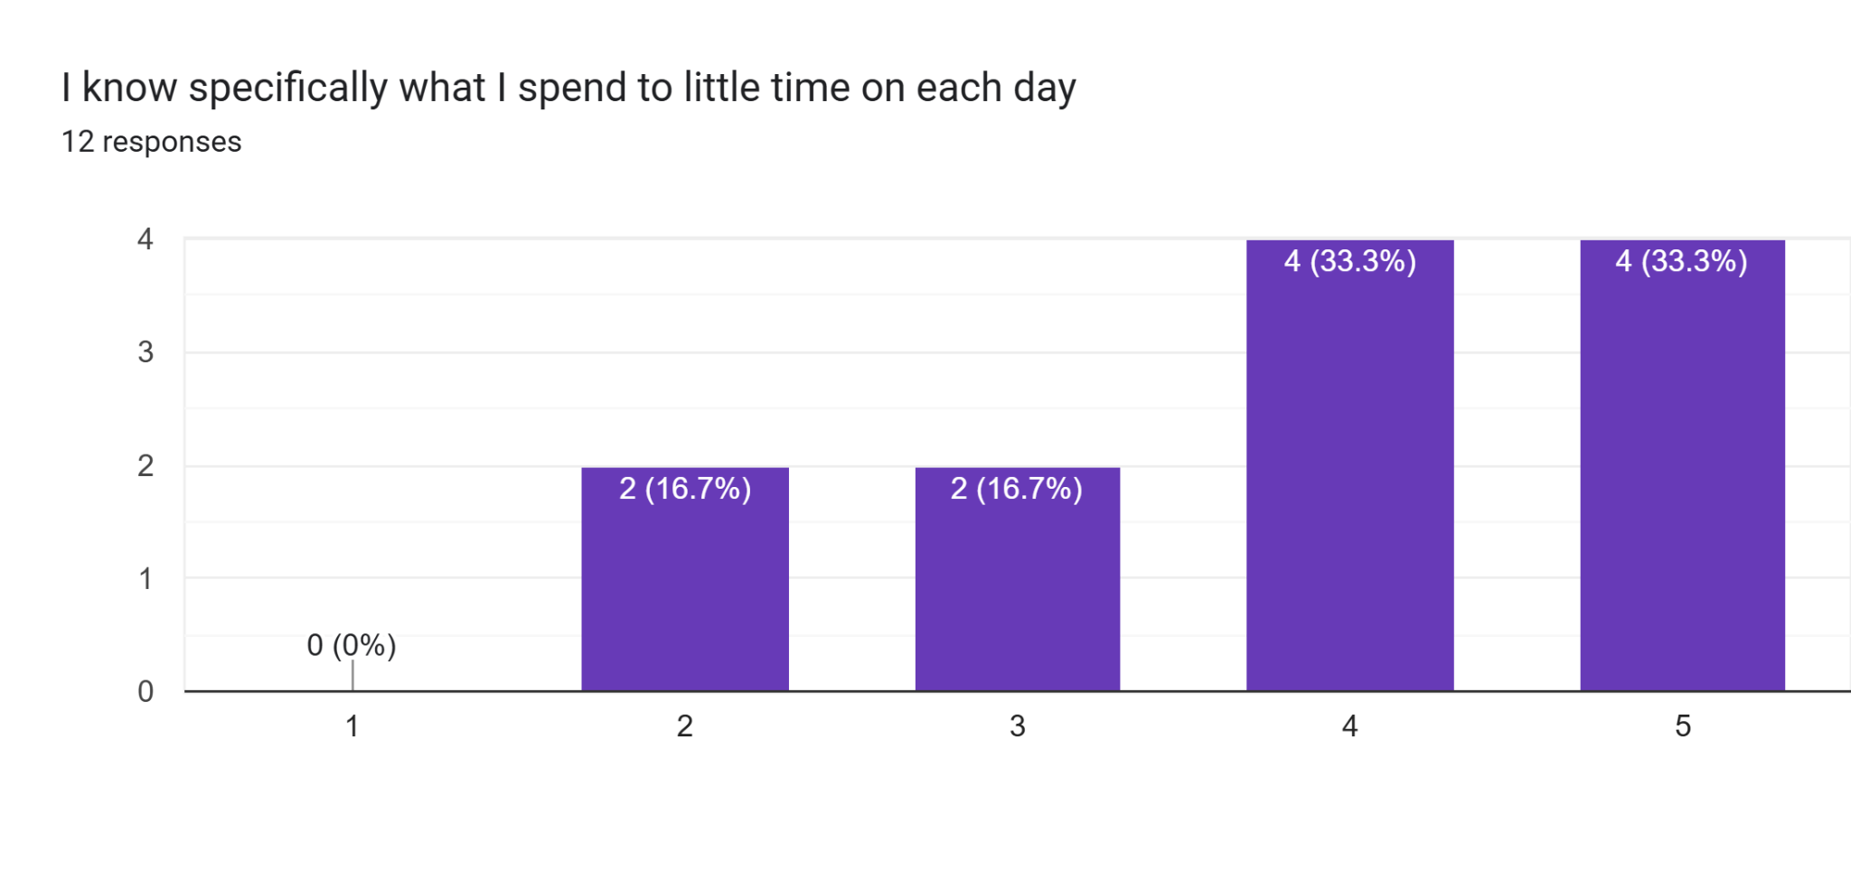
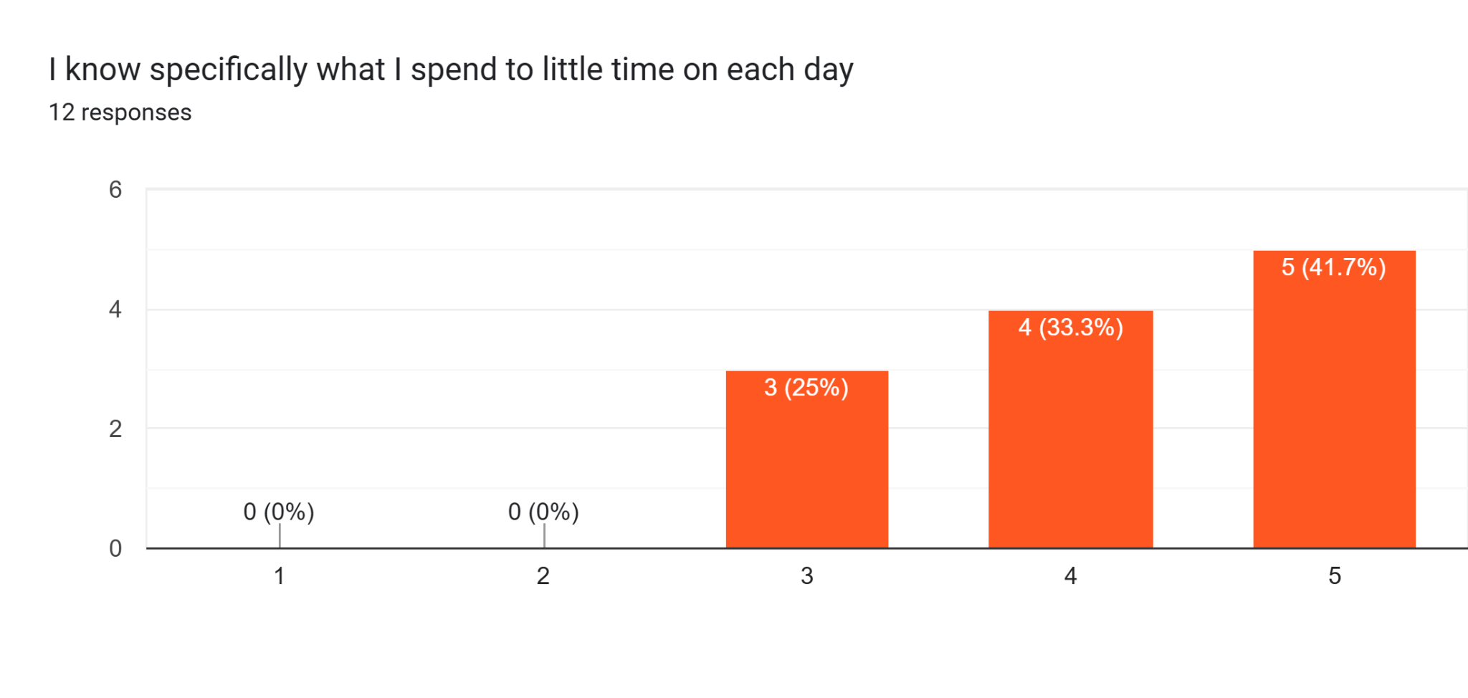
Advocating:
Study Skills: Areas of Growth
Pre Test
Post Test

Slide 56
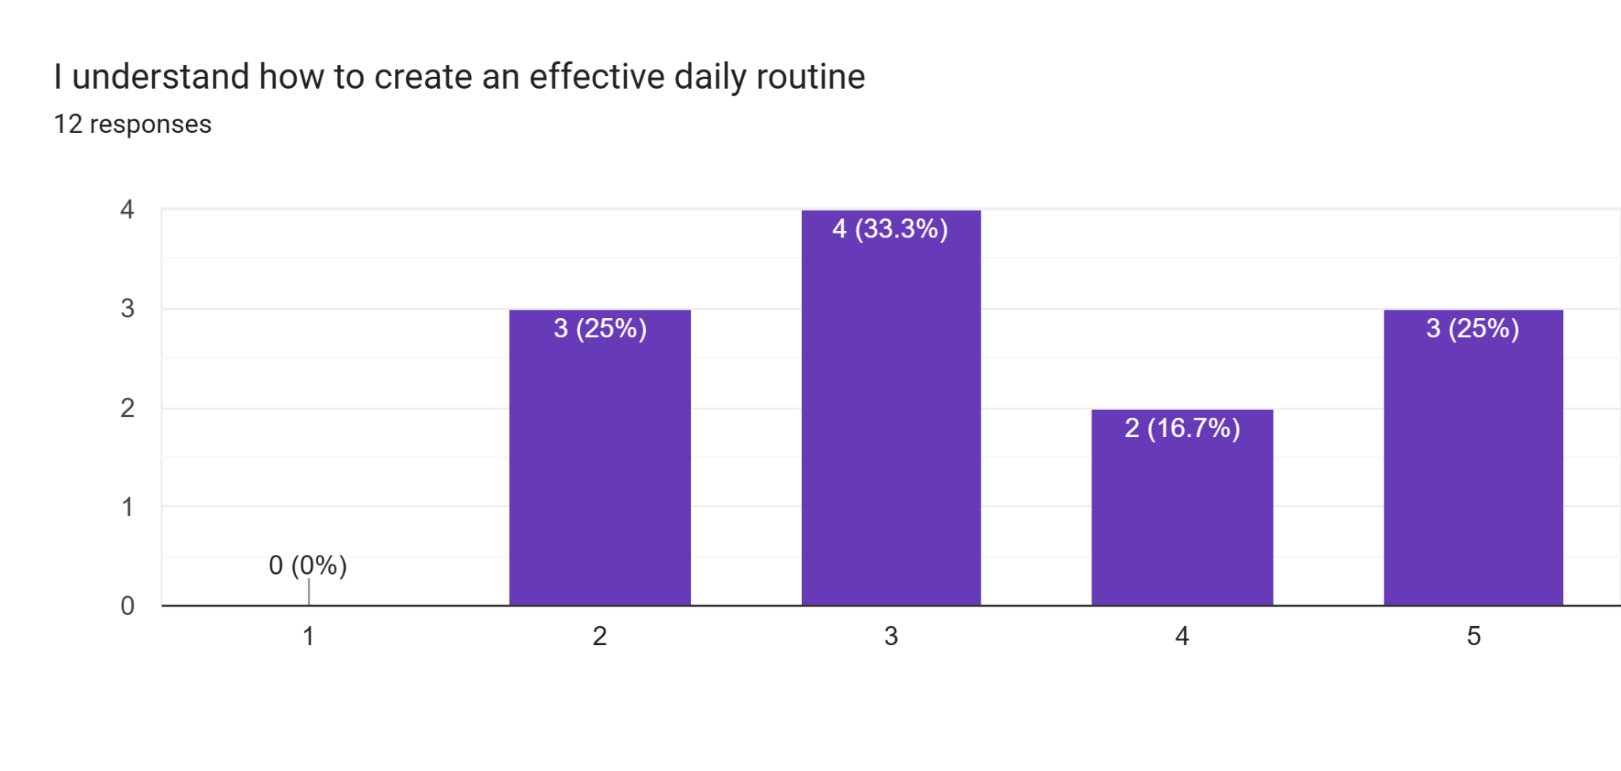
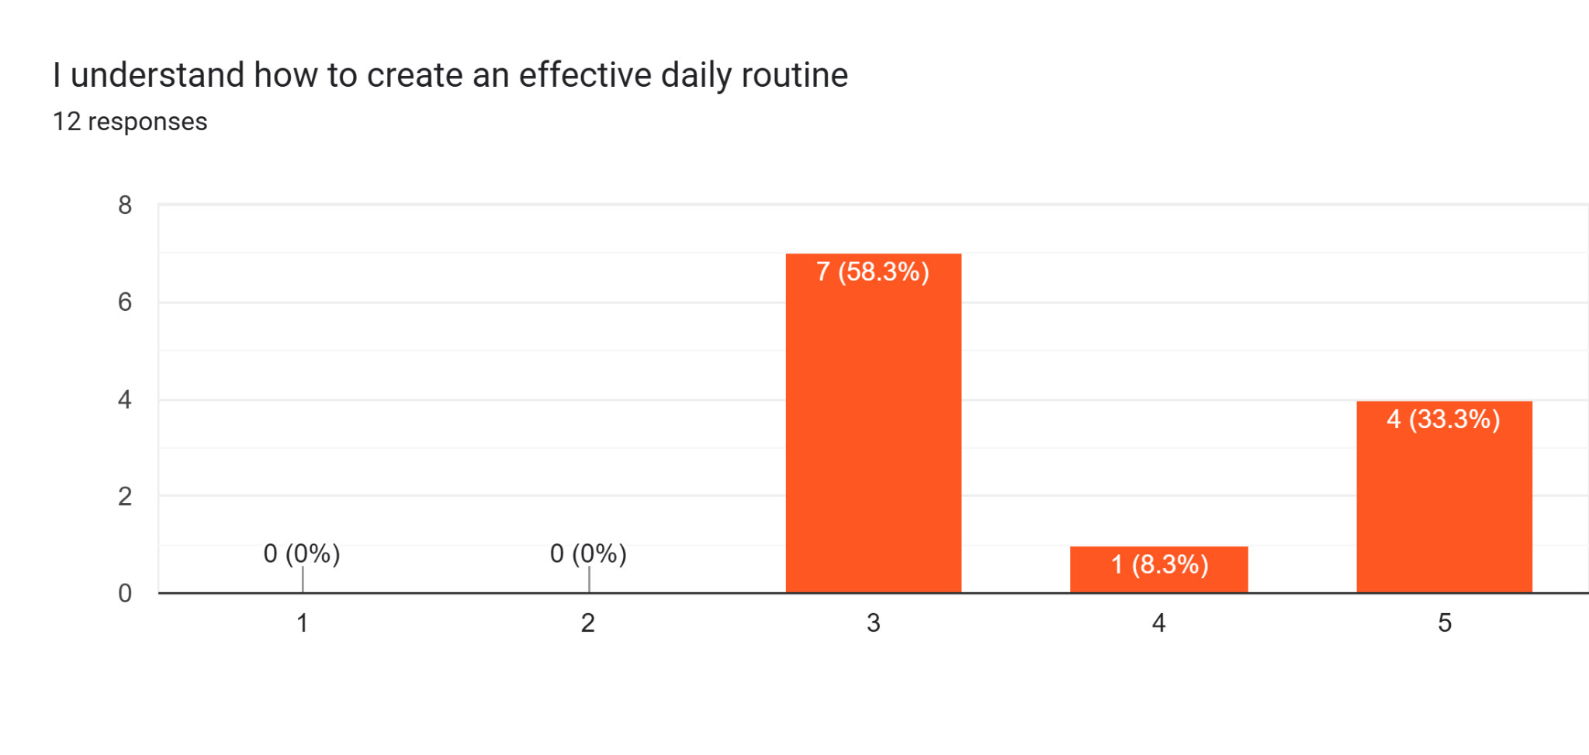
Advocating:
Study Skills: Areas of Growth
Pre Test
Post Test

Slide 57
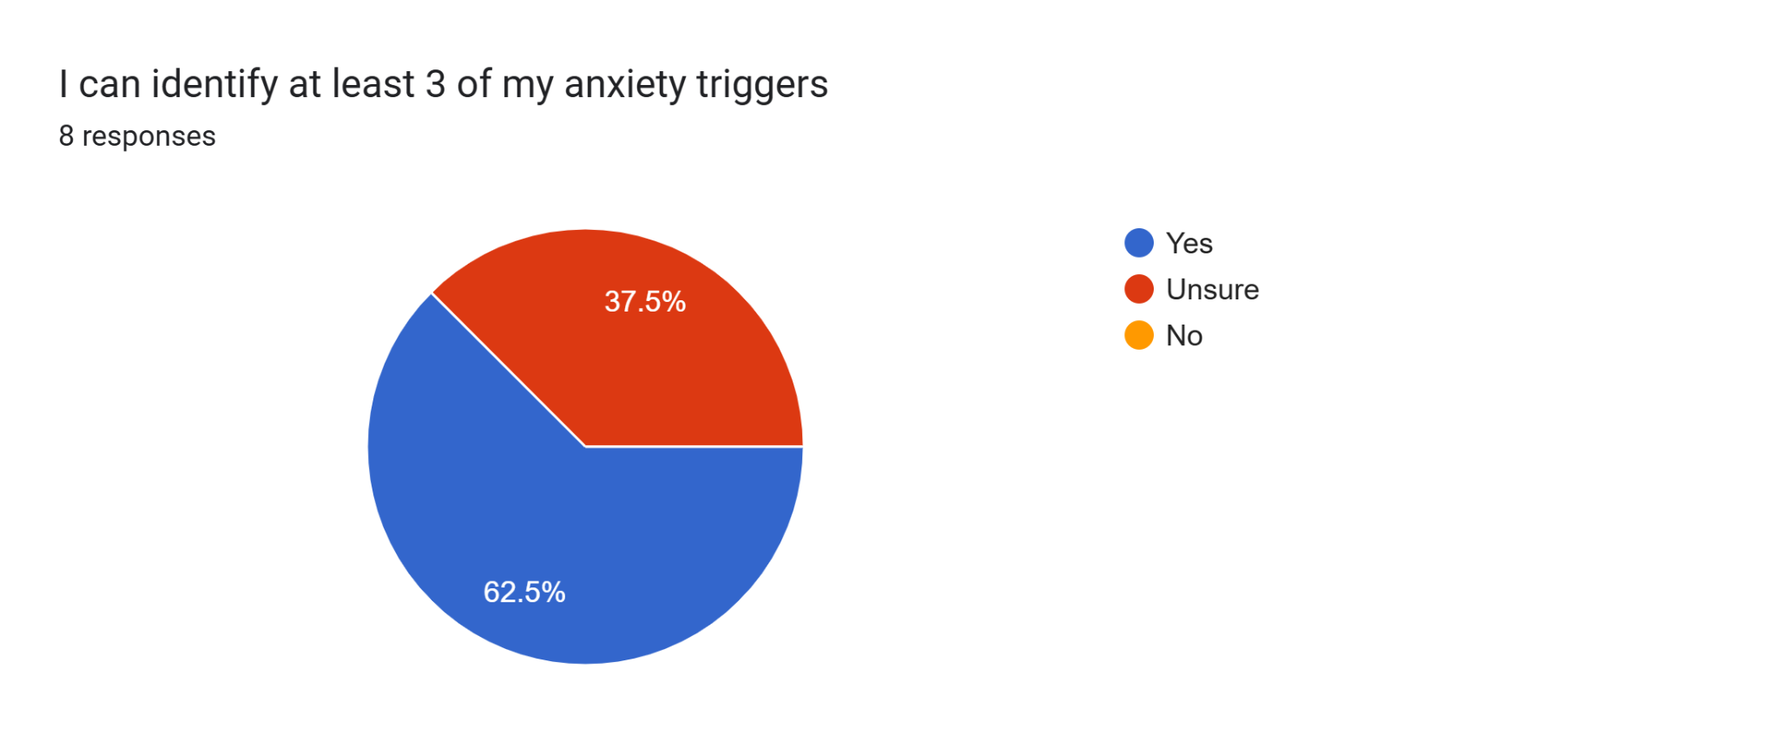
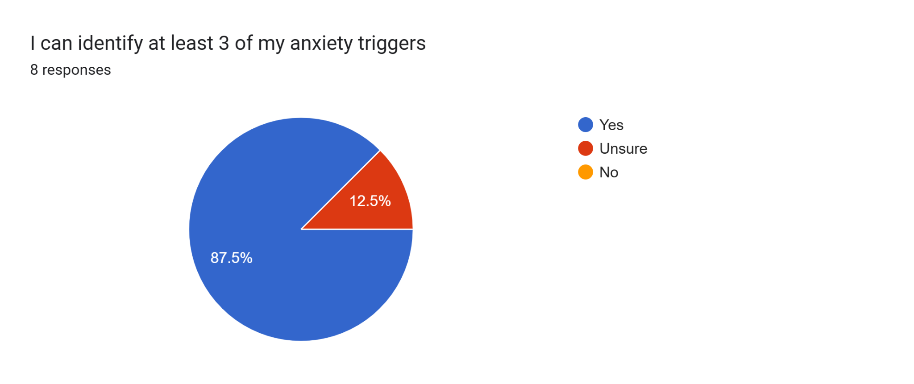
Advocating: Stress M: Areas of Growth!
Pre-Test
Post Test

Slide 58
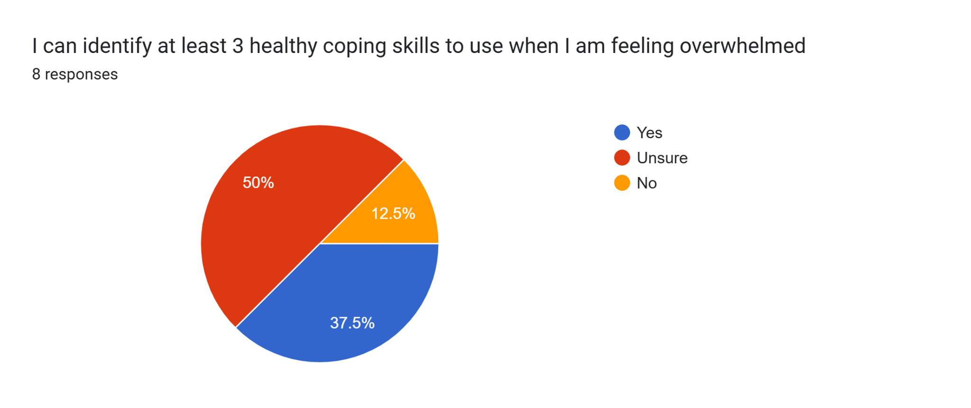
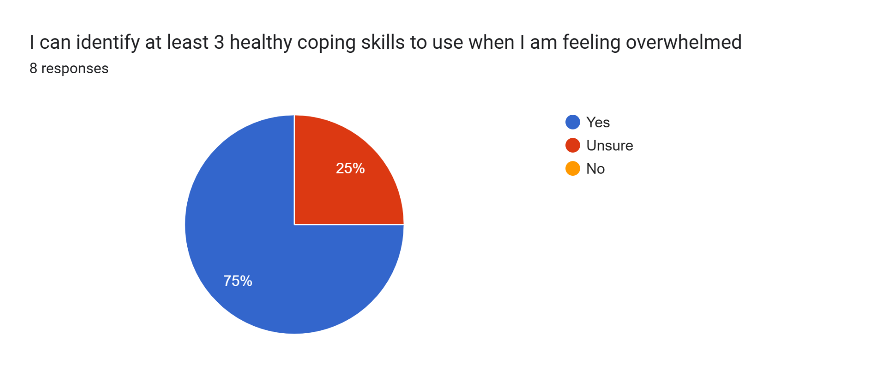
Advocating: Stress M:
Areas of Growth!
Pre-Test
Post Test

Slide 59
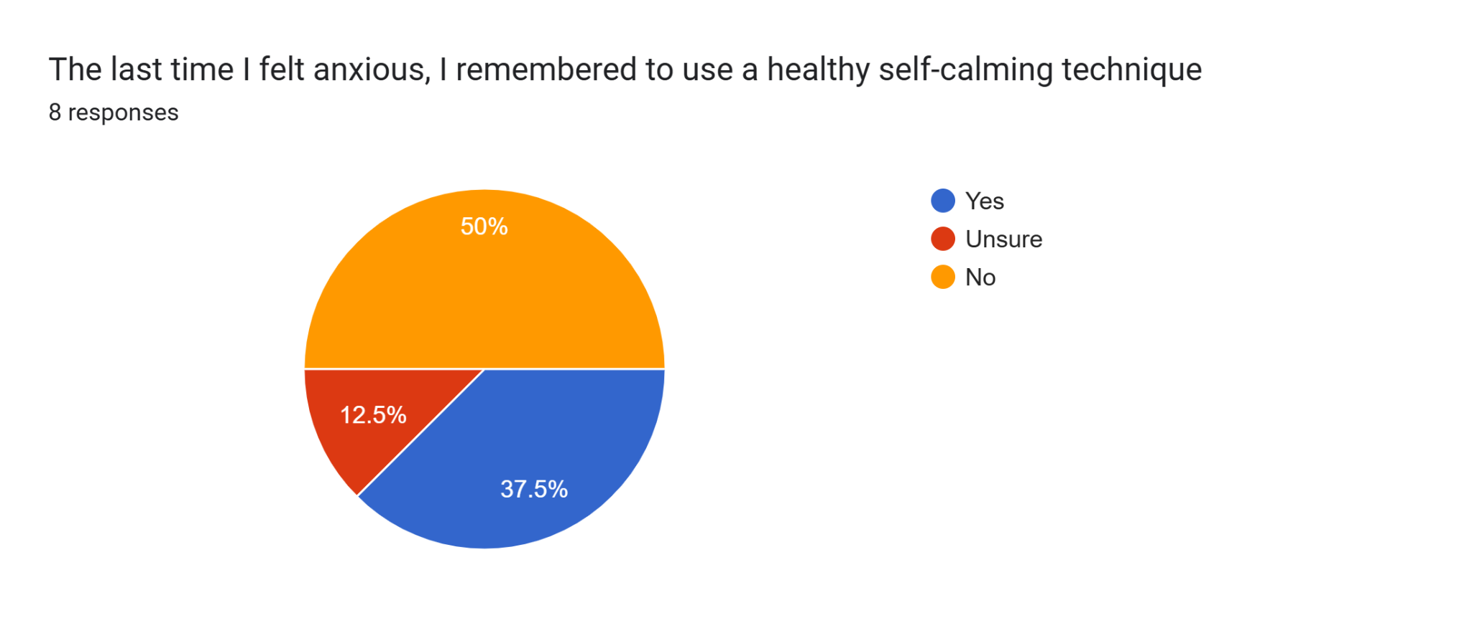
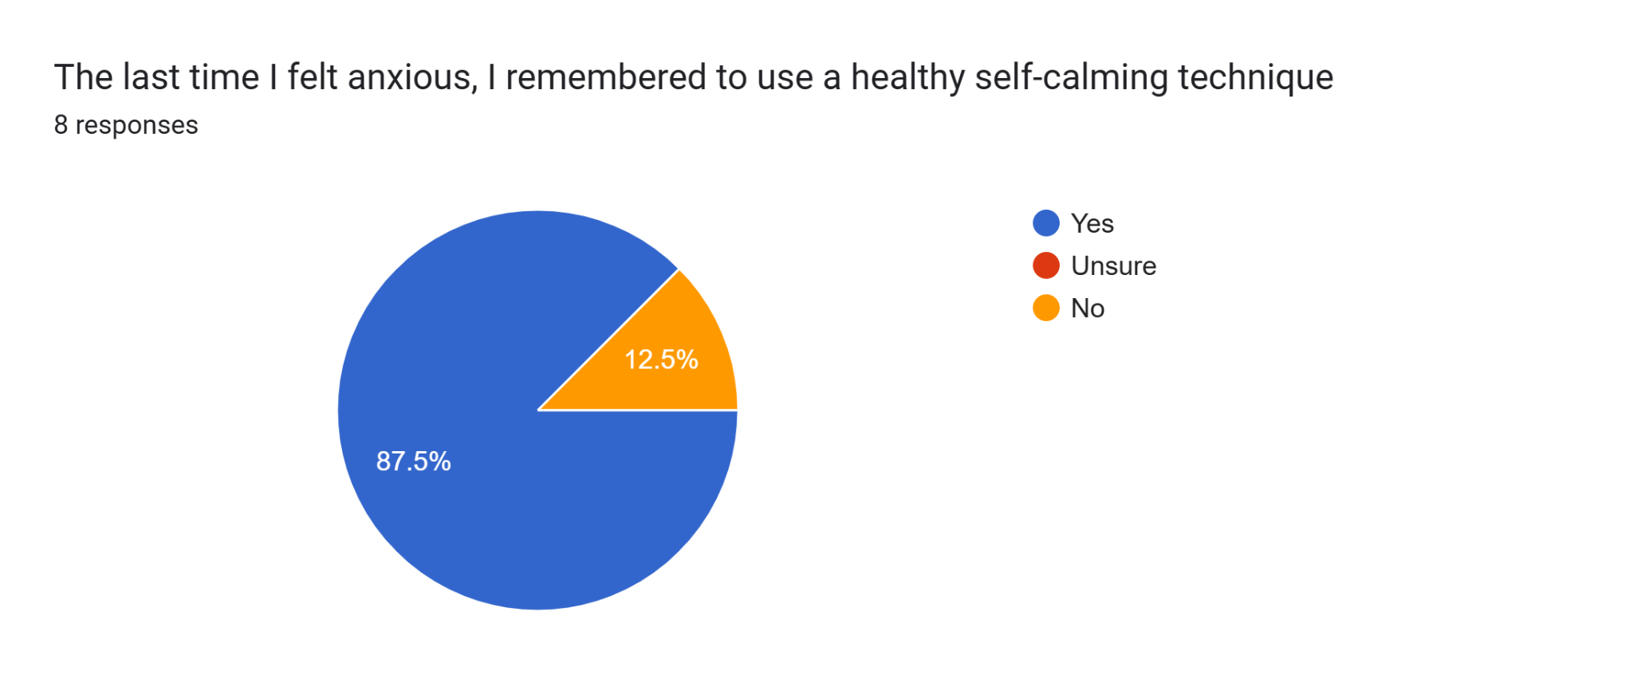
Advocating: Stress M:
Areas of Growth!
Pre-Test
Post Test

Slide 60
Advocating: End of Year Meeting : Share
what worked
what you want to improve/change
what a proposed plan is for next year and then ask for any help needed/changes needed

Slide 61
Resource Links:
SEL with Mrs. Carla: https://www.teacherspayteachers.com/Product/Anxiety-Stress-Group-Counseling-Curriculum-SEL-High-School-9657193
School Counseling Essentials:
https://www.teacherspayteachers.com/Product/Study-Skills-Group-Counseling-Curriculum-for-School-Counseling-Teens-4014990
https://www.teacherspayteachers.com/Product/Self-Esteem-Group-Counseling-for-Teens-includes-Google-Slides-virtual-option-3866421
Marisa Judkin’s Virtual Office:
https://docs.google.com/presentation/d/1hr-uW7JB8ieBagdBjWoYGdLLChqP_jlx-AE8W3FPqNs/edit?slide=id.p#slide=id.p

