Slide 1


Comprehensive School Counseling Programs
Dr. Amy E Baltimore, MEd, EdS, LPSC, NCC
TSCA Board Chair
MNPS Coordinator of SC and Advising

Slide 2
Welcome & Commitment to Growth
ENGAGING IN PROFESSIONAL DEVELOPMENT TOGETHER FOR STUDENTSUCCESS
Notes:
Welcome and thank you for your investment in professional growth.
Whether you embrace it or not, your engagement or lack of engagement with the school counseling program in your building can make or break the successful implementation of a comprehensive school counseling program.

Slide 3
Session Purpose
ALIGNING CSCP WITH TASL AND BEST FOR ALL
This session aims to explore how the Comprehensive School Counseling Program (CSCP) aligns with TASL Standard B and TDOE’s Best for All Vision
Notes:
Today I would like to talk with you about how a comprehensive approach to school counseling programming supports the TASL Standard B: Culture for Teaching and Learning which calls on instructional leaders to foster an inclusive, respectful, and safe environment that supports student learning and growth.
A CSCP grounded in the ASCA National Model and supported by the TDOE school counseling department directly advances this TASL standard by ensuring equitable access to academic development, and life-readiness skills for all students. In a CSCP, school counselors work collaboratively with administrators, educators, families, and community partners to build a culture where teaching and learning thrive.
This alignment also reinforces the TDOE’s Best for All Strategic Vision, which emphasizes three priorities—Academics, Student Readiness, and Educator Growth—and advances them through five initiatives that target interventions, encourage innovation, and strengthen safe, supportive environments.
By embedding a CSCP within the school’s instructional culture, school counselors help translate these statewide priorities into meaningful practices at the school level.

Slide 4
Learning Objectives
UNDERSTANDING ALIGNMENT AND EMBEDDING STRATEGIES
ALIGNING COUNSELING AND INSTRUCTION
ACTIONABLE EMBEDDING STRATEGIES
Integrating counseling with instruction maximizes student improvement, fostering a supportive environment where every student thrives academically and socially through collaborative efforts and shared goals.
Implementing effective strategies involves recognizing existing resources, leveraging data, and fostering a culture of inclusivity that empowers both educators and students, leading to sustainable success.
Notes:
By the end of this session, hopefully you will:
1. Understand the alignment between TASL Standard B and the ASCA CSCP Model.
2. Recognize how the CSCP supports TDOE’s Best for All priorities.
3. Identify actionable strategies to embed a CSCP into your school culture.

Slide 5
One word to describe your school culture?
Supportive
Innovative
Inclusive
Collaborative
Notes:
Make a note of what you choose - we'll come back to it later.

Slide 6
Integrating Counseling & Instruction
A UNIFIED APPROACH FOR SCHOOL IMPROVEMENT
Integrating counseling with instruction fosters a collaborative environment, maximizing student support and enhancing academic success through targeted interventions and inclusive practices within the school community.
Notes:
School improvement is maximized when counseling, academics, and leadership share a unified vision. (ABC-123)
Alignment ensures that student supports aren’t siloed but integrated within teaching and learning.

Slide 7

CSCP as a Systemic Framework
CSCP integrates counseling with academic strategies, ensuring equal access and support for all students' growth.
Notes:
The ASCA Model is a CSCP that provides a systemic framework for supporting all students—not just those in crisis. (MTMDSS)

Slide 8
Counselors as Leaders
ESSENTIAL ROLE IN STUDENT ADVOCACY
SCHOOL-WIDE LEADERSHIP
ADVOCATES FOR EQUITY
School counselors are integral in enhancing academic achievement by collaborating with families, the greater community, teachers and administrators to ensure students receive the support and resources they need to succeed.
Counselors advocate for equitable access to opportunities, addressing barriers to learning, and promoting an inclusive environment that supports the diverse needs of each and every student.
Notes:
When aligned with TASL Standard B, counselors become essential instructional leaders whose focus is on creating a positive, safe, and equitable learning environment.

Slide 9
How does the function of your school counselor align?
Strongly aligned
Somewhat aligned
Not aligned
Unsure

Slide 10
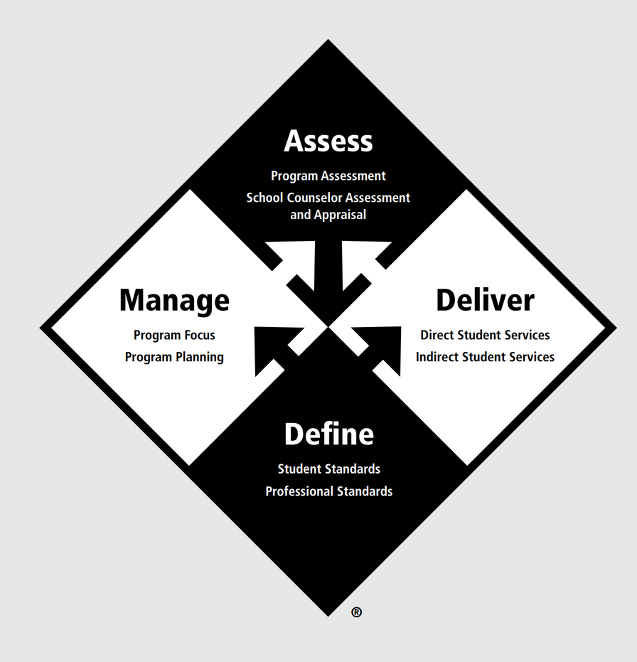
ASCA National Model
KEY COMPONENTS OF EFFECTIVE SCHOOL COUNSELING
The ASCA Model’s four essential components provide a comprehensive framework for school counselors to enhance student support and educational outcomes.
SYSTEMIC CHANGE, EQUITY FOCUS, AND PROACTIVE COUNSELING
The ASCA Model emphasizes systemic change by integrating equitable practices, ensuring that every student receives proactive counseling tailored to their unique needs and challenges.
Notes:
The ASCA National Model offers 4 Key components for effective school counseling programs:
1. Define – professional standards and student mindsets.
2. Manage – mission, vision, and data-driven goals.
3. Deliver – direct and indirect services.
4. Assess – program results and outcomes.
The ASCA Model provides a framework for systemic change, equity, and impact measurement.
It transforms counseling from “reactive" to proactive, programmatic, and aligned with instruction

Slide 11
School Counselor Roles
UNDERSTANDING THE FOUR KEY FUNCTIONS
ADVOCATE
LEADER
School counselors serve as advocates for students, ensuring their voices are heard and needs are met within the educational system and beyond.
In their leadership role, counselors guide initiatives and influence positive change to enhance student success and well-being.
COLLABORATOR
CONSULTANT
School counselors serve as collaborators when they engage all stakeholders in identifying and removing systemic barriers to student success.
School counselors as consultants discuss with internal and external support personnel regarding embedding interventions that will benefit student well-being and growth.
Notes:
• Advocate
• Leader
• Collaborator
• Consultant

Slide 12
Which role fits your school counselor best?
Advocate
Leader
Collaborator
Consultant
Notes:
Mini Activity:
Ask participants to identify which of these four roles they most associate with their counselor team.
How could a CSCP amplifies each role.

Slide 13
TASL Standard B
FOSTERING AN INCLUSIVE AND RESPECTFUL SCHOOL ENVIRONMENT
TASL Standard B emphasizes creating safe spaces that promote learning and growth, ensuring all students feel valued, respected, and supported within a diverse classroom setting.
Notes:
TASL Standard B: Culture for Teaching and Learning,
calls on instructional leaders to foster an inclusive, respectful, and safe environment that supports student learning and growth.
TASL Standard B emphasizes creating safe spaces that promote learning and growth, ensuring all students feel valued, respected, and supported within a diverse classroom setting.

Slide 14
CSCP Contributions
EQUITABLE ACCESS + PREVENTION STRATEGIES = CULTURE BUILDING
EQUITABLE ACCESS
PREVENTION STRATEGIES
CSCP ensures equitable academic and social-emotional access, providing all students with necessary resources and support to succeed in a diverse learning environment.
Through proactive intervention systems, CSCP establishes preventive measures that foster a positive school culture, addressing potential issues before they escalate and promoting student well-being.
Notes:
How the CSCP Advances Standard B -
Equitable access to academic and developmental skills-building resources, plus systemic prevention and intervention practices means that collaborative culture-building will take place with staff and families.
Equitable Access
CSCP ensures equitable academic and social-emotional access, providing all students with necessary resources and support to succeed in a diverse learning environment.
Prevention Strategies
Through proactive intervention systems, CSCP establishes preventive measures that foster a positive school culture, addressing potential issues before they escalate and promoting student well-being.
Talking Points:
Counselors who use a CSCP like the ASCA National Model operationalize the “inclusive and respectful environment” expectation through responsive services, developmental programming, and data-informed decision-making.
The CSCP ensures that every student’s voice and experience are reflected in school culture.

Slide 15
Current cultural challenge?
Attendance issues
Equity concerns
Student engagement
Belonging initiatives
Notes:
Have participants pair up and discuss one cultural challenge their school faces (e.g., attendance, belonging, equity).
Then ask: “How could a structured counseling program help address it?”

Slide 16

TDOE - “Best for All” Priorities
INTEGRATING ACADEMICS, READINESS, AND EDUCATOR GROWTH
The TDOE’s Best for All Vision emphasizes three critical priorities: enhancing academic performance, ensuring student readiness for future challenges, and supporting continuous educator growth for effective teaching.
Notes:
Best for All Strategic Vision
Three priorities:
1. Academics
2. Student Readiness
3. Educator Growth

Slide 17
TDOE - “Best for All” Initiatives
EXPLORING KEY FRAMEWORKS FOR STUDENT SUCCESS
The Best for All vision encompasses essential initiatives like Interventions, Innovation, and Safe Environments, ensuring a holistic approach to enhance student learning and growth opportunities.
Interventions
Innovation
Safe, supportive environments
Family engagement
Collaboration
Notes:
Five key initiatives reinforce these priorities:
• Interventions
• Innovation
• Safe, supportive environments
• Family engagement
• Collaboration
A school counselor implementing a CSCP will check all these boxes through responsive, data-driven collaboration

Slide 18
CSCP Alignment
INTEGRATING ESSENTIAL SKILLS FOR STUDENT SUCCESS
LIFE-LONG LEARNING SKILLS
DEVELOPMENTAL LEARNING
Effective study skills enable students to maximize their learning potential, fostering a culture of academic excellence through structured support and resource availability.
Social learning initiatives cultivate a safe, supportive environment, equipping students with the emotional intelligence necessary for resilience and effective interpersonal relationships, critical for lifelong success.
Notes:
Best for All Priority
CSCP Impact Example:
Academics - Counselors collaborate with teachers on study skills, goal setting, and data analysis.
Student Readiness - Programs build developmental skills, career readiness, and life planning.
Talking Points:
• The CSCP helps make Best for All actionable in every facet of the school community.
• Counselors become translators of state vision into local practice.

Slide 19
Indicators of Alignment
UNDERSTANDING THE KEY ELEMENTS FOR SUCCESS
Effective alignment relies on vision sharing, recognizing educator strengths, and implementing tiered SEL strategies, promoting a unified approach to enhance student outcomes and support.
Educator Growth
Vision for Culture
Leveraging Educator Strengths
Safe, Respectful Environments
Family Involvement
Shared Ownership
Recognition of Growth
Notes:
Indicators of Alignment
Educator Growth - Counselors deliver PD on mental health and equity-informed practices.
Vision for Culture - Counselor shares data during school improvement meetings.
Leveraging Educator Strengths - Joint college readiness lessons co-taught with teachers.
Safe, Respectful Environment - Tier 1 developmental programs like "class meeting" + Tier 2 small groups.
Family Involvement - Family workshops on student readiness and mental health.
Shared Ownership - Data walls showing academic, attendance, and behavior trends.
Recognition of Growth - Celebrating student and educator progress in assemblies/newsletters.

Slide 20

Making Data Meaningful
STRATEGIES FOR EFFECTIVE GROWTH TRACKING AND IMPACT
Utilizing meaningful data is crucial for tracking student growth, demonstrating the impact of counseling programs, and ensuring informed decisions are made to enhance educational outcomes.
Notes:
A CSCP makes data meaningful — not punitive.
For instance - school counselors will link student behavior to Student "Mindset and Behavior" Standards in order to identify lagging skills and suggest learning strategies for replacement behaviors giving meaning to the interventions we endeavor to implement.
Counselors who use a CSCP model will track student growth and use results reports to demonstrate impact on student achievement and school culture.

Slide 21
What data sources exist?
Student attendance records
Academic performance data
School climate/culture surveys
Family engagement needs assessments
MTSS/Behavior data tracking
Notes:
Ask: “What data sources already exist in your building that could be leveraged by the counseling program?”

Slide 22

Tennessee Middle School Success Story
Students celebrated their achievements after significantly reducing absenteeism and increasing academic proficiency through effective counseling support.
Notes:
How a School Counselor Transformed a Tennessee Middle School Through the ASCA Comprehensive School Counseling Program
At a middle school in rural Tennessee, chronic absenteeism had long been a challenge, with nearly one in four students missing 10% or more of the school year. Academic proficiency rates were below state averages, and many students reported feeling disconnected from their school community. Recognizing the need for systemic change, the school made a bold move: fully implementing the ASCA Comprehensive School Counseling Program (CSCP).
At the heart of this transformation was Ms. Johnson, the school counselor, who became a driving force in redefining student support.
Diagnosing the Problem
Ms. Johnson began by collecting and analyzing data on attendance, academic performance, and student surveys. Through this needs assessment, she identified patterns — students struggling academically were also those most frequently absent, and many cited feeling “unseen” or unsupported as a major reason for disengagement.
She presented these findings to the school leadership team and proposed a plan aligned with the ASCA National Model: a comprehensive, data-driven program that addressed students' academic, social/emotional, and college/career development needs.
Implementing the Program
Ms. Johnson led the implementation of the ASCA CSCP with fidelity. Key components included:
Tiered Interventions for Chronic Absenteeism: She established early-warning systems and initiated a mentorship program, pairing at-risk students with staff members. She also facilitated parent workshops and made home visits in collaboration with the school social worker.
Targeted Academic Support: Working with teachers, Ms. Johnson created small-group interventions focused on executive functioning, time management, and motivation. She also organized after-school tutoring sessions and check-ins for students flagged through progress monitoring.
Building a Culture of Belonging: Recognizing that a sense of connection was vital, Ms. Johnson introduced peer leadership programs, student voice circles, and a “Start With Hello” campaign that trained students to be inclusive and welcoming.
Individual Student Planning: Through structured goal-setting sessions, Ms. Johnson met with every student at least once per semester to discuss academic progress, future goals, and personal concerns.
Data-Driven Advocacy: She consistently used data to refine interventions, present results to stakeholders, and advocate for more inclusive policies—such as flexible attendance policies for students dealing with trauma or family instability.
The Results
Within just one school year, the impact was clear:
Chronic absenteeism dropped by 15%, with more students consistently attending school and engaging in class.
Academic proficiency increased, particularly in math and English, with many students showing gains on state benchmarks.
Student surveys reflected a 25% increase in reported sense of belonging, with students citing improved relationships with peers and adults in the building.
A Model for the District
Ms. Johnson’s leadership in implementing the ASCA CSCP didn’t just improve outcomes at her school—it became a model for other schools in the district. Her approach was featured in a regional education summit, and she now mentors other school counselors in building data-informed, student-centered programs.

Slide 23
Revisit Activity:
School Culture Impact
Positive Engagement
Inclusive Environment
Collaborative Leadership
Student Empowerment
Notes:
Return to the one word participants wrote at the beginning about their school culture.
Ask: After going through this information with me, how do you think a comprehensive counseling program could shape or strengthen that word?

Slide 24
Key Takeaways
UNDERSTANDING THE IMPORTANCE OF CSCP
STRUCTURE & STRATEGY
COLLABORATION
CSCP provides a clear, operational organizational framework that promotes MTMDSS and ensures that all counseling initiatives are aligned with educational goals.
Effective implementation of CSCP relies on collaborative efforts among counselors, educators, and administrators, fostering a school culture environment that benefits every student.

Slide 25
Alignment
CSCP, TASL STANDARD B, BEST FOR ALL
UNIFIED VISION
SCHOOL-WIDE LEADERSHIP
A unified vision between counseling and instruction enhances student outcomes, encouraging collaboration among educators to create a supportive learning environment that maximizes student success.
Counselors can play a crucial role as school leaders, leveraging their unique perspectives to integrate developmental learning with academic goals and fostering a successful educational experience for each and every student.
Notes:
(ABC-123)
The divergent voice

Slide 26

Resources
KEY FRAMEWORKS FOR COMPREHENSIVE SCHOOL COUNSELING PROGRAMS
The ASCA Model (5th Ed) and TDOE CSCP model provide vital guidance for implementing effective counseling programs that promote student success and well-being.
Notes:
https://www.schoolcounselor.org/getmedia/097ddd89-fa7f-4c28-b8a4-0c219d24aaf7/asca-national-model-fifth-edition.pdf
https://www.tn.gov/education/families/student-support/school-counseling.html

Slide 27

Optional Handouts
ADDITIONAL RESOURCES FOR EFFECTIVE CSCP IMPLEMENTATION
Notes:
https://www.schoolcounselor.org/getmedia/ee8b2e1b-d021-4575-982c-c84402cb2cd2/Role-Statement.pdf
https://www.schoolcounselor.org/Standards-Positions/Position-Statements/ASCA-Position-Statements/The-School-Counselor-and-School-Counseling-Program

Slide 28


Thank You for Your Commitment!
LET'S COLLABORATE TOGETHER

