Slide 1

What English Learners Need to Thrive Across All Subjects
Knowledge and Methods

Slide 2
Problem:

Slide 3
Problem:
The student is not fully proficient in the language of instruction.

Slide 4
Continuum of Instruction

Slide 5
Continuum of Instruction
Discovery / Exploratory
Problem Solving
Explicit Instruction

Slide 6
Continuum of Instruction
Discovery / Exploratory
Problem Solving
Explicit Instruction
Limited English
Below grade level
Learning disabilities

Slide 7
Continuum of Instruction
Discovery / Exploratory
Problem Solving
Explicit Instruction
Limited English
Below grade level
Learning disabilities
Advanced English
High levels of content knowledge

Slide 8

Comprehensible Input: New language that is comprehensible to the language learner due to a combination of prior knowledge and context.

Slide 9
Comprehensible Input: New language that is comprehensible to the language learner due to a combination of prior knowledge and context.

Slide 10

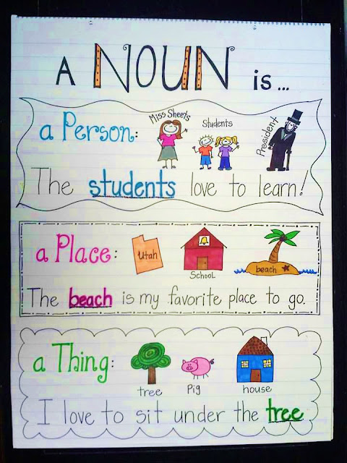
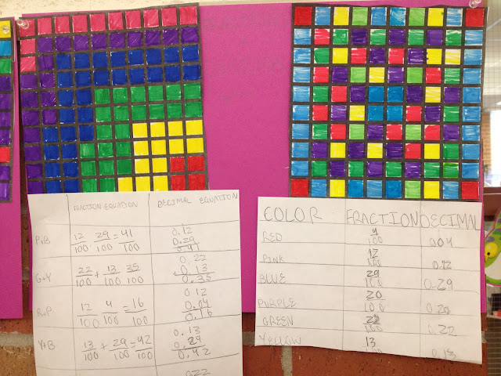

Means of Adding Context to a Lesson:
Visuals
Modeling
Hands-on Activities
Demonstrations
Props & Gestures
Realia
This Photo by Unknown Author is licensed under CC BY-SA-NC
This Photo by Unknown Author is licensed under CC BY-ND
This Photo by Unknown Author is licensed under CC BY
This Photo by Unknown Author is licensed under CC BY-NC

Slide 11
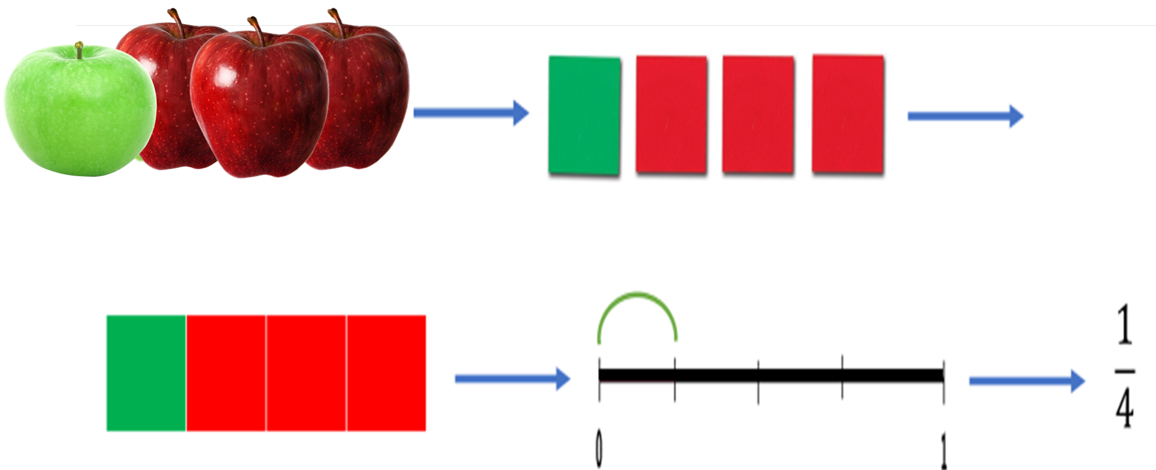
Math: Use visuals to transition from concrete to abstract.

Slide 12
Math: Use visuals to make concepts visible.

Slide 13



Slide 14

?!

Slide 16


Slide 17


Slide 18


Slide 19
Use visuals to expand concept knowledge
Range of Examples
Example: vacation

Slide 20




stock image
stock image
stock image
Vacation
Taking time off from work or school to do fun, relaxing things with friends or family.
stock image

Slide 21





Organism
stock image
stock image
An individual living thing.
stock image
stock image
stock image

Slide 22
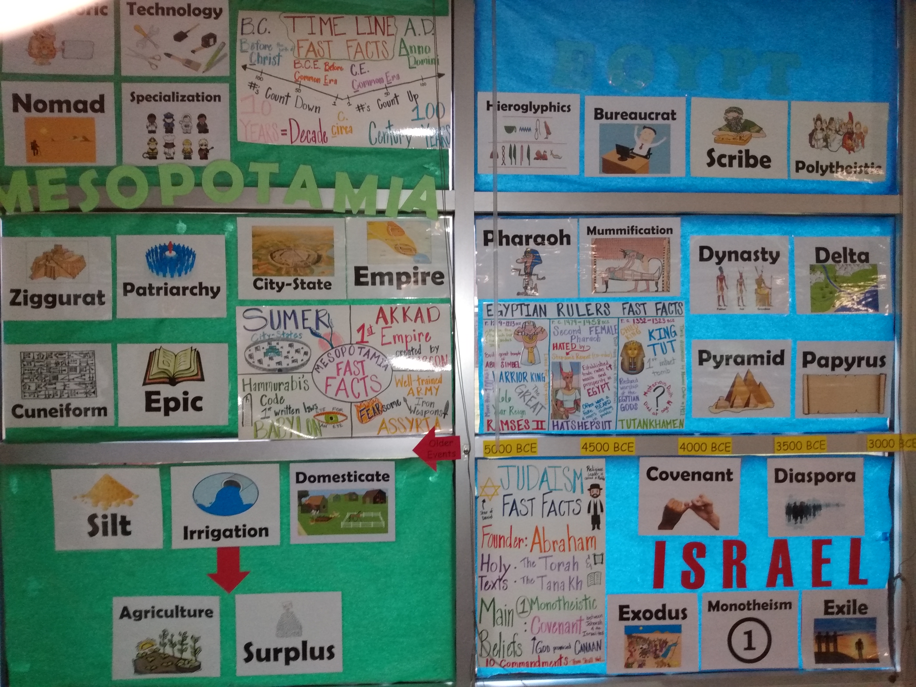
Academic Word Banks with Visuals

Slide 23
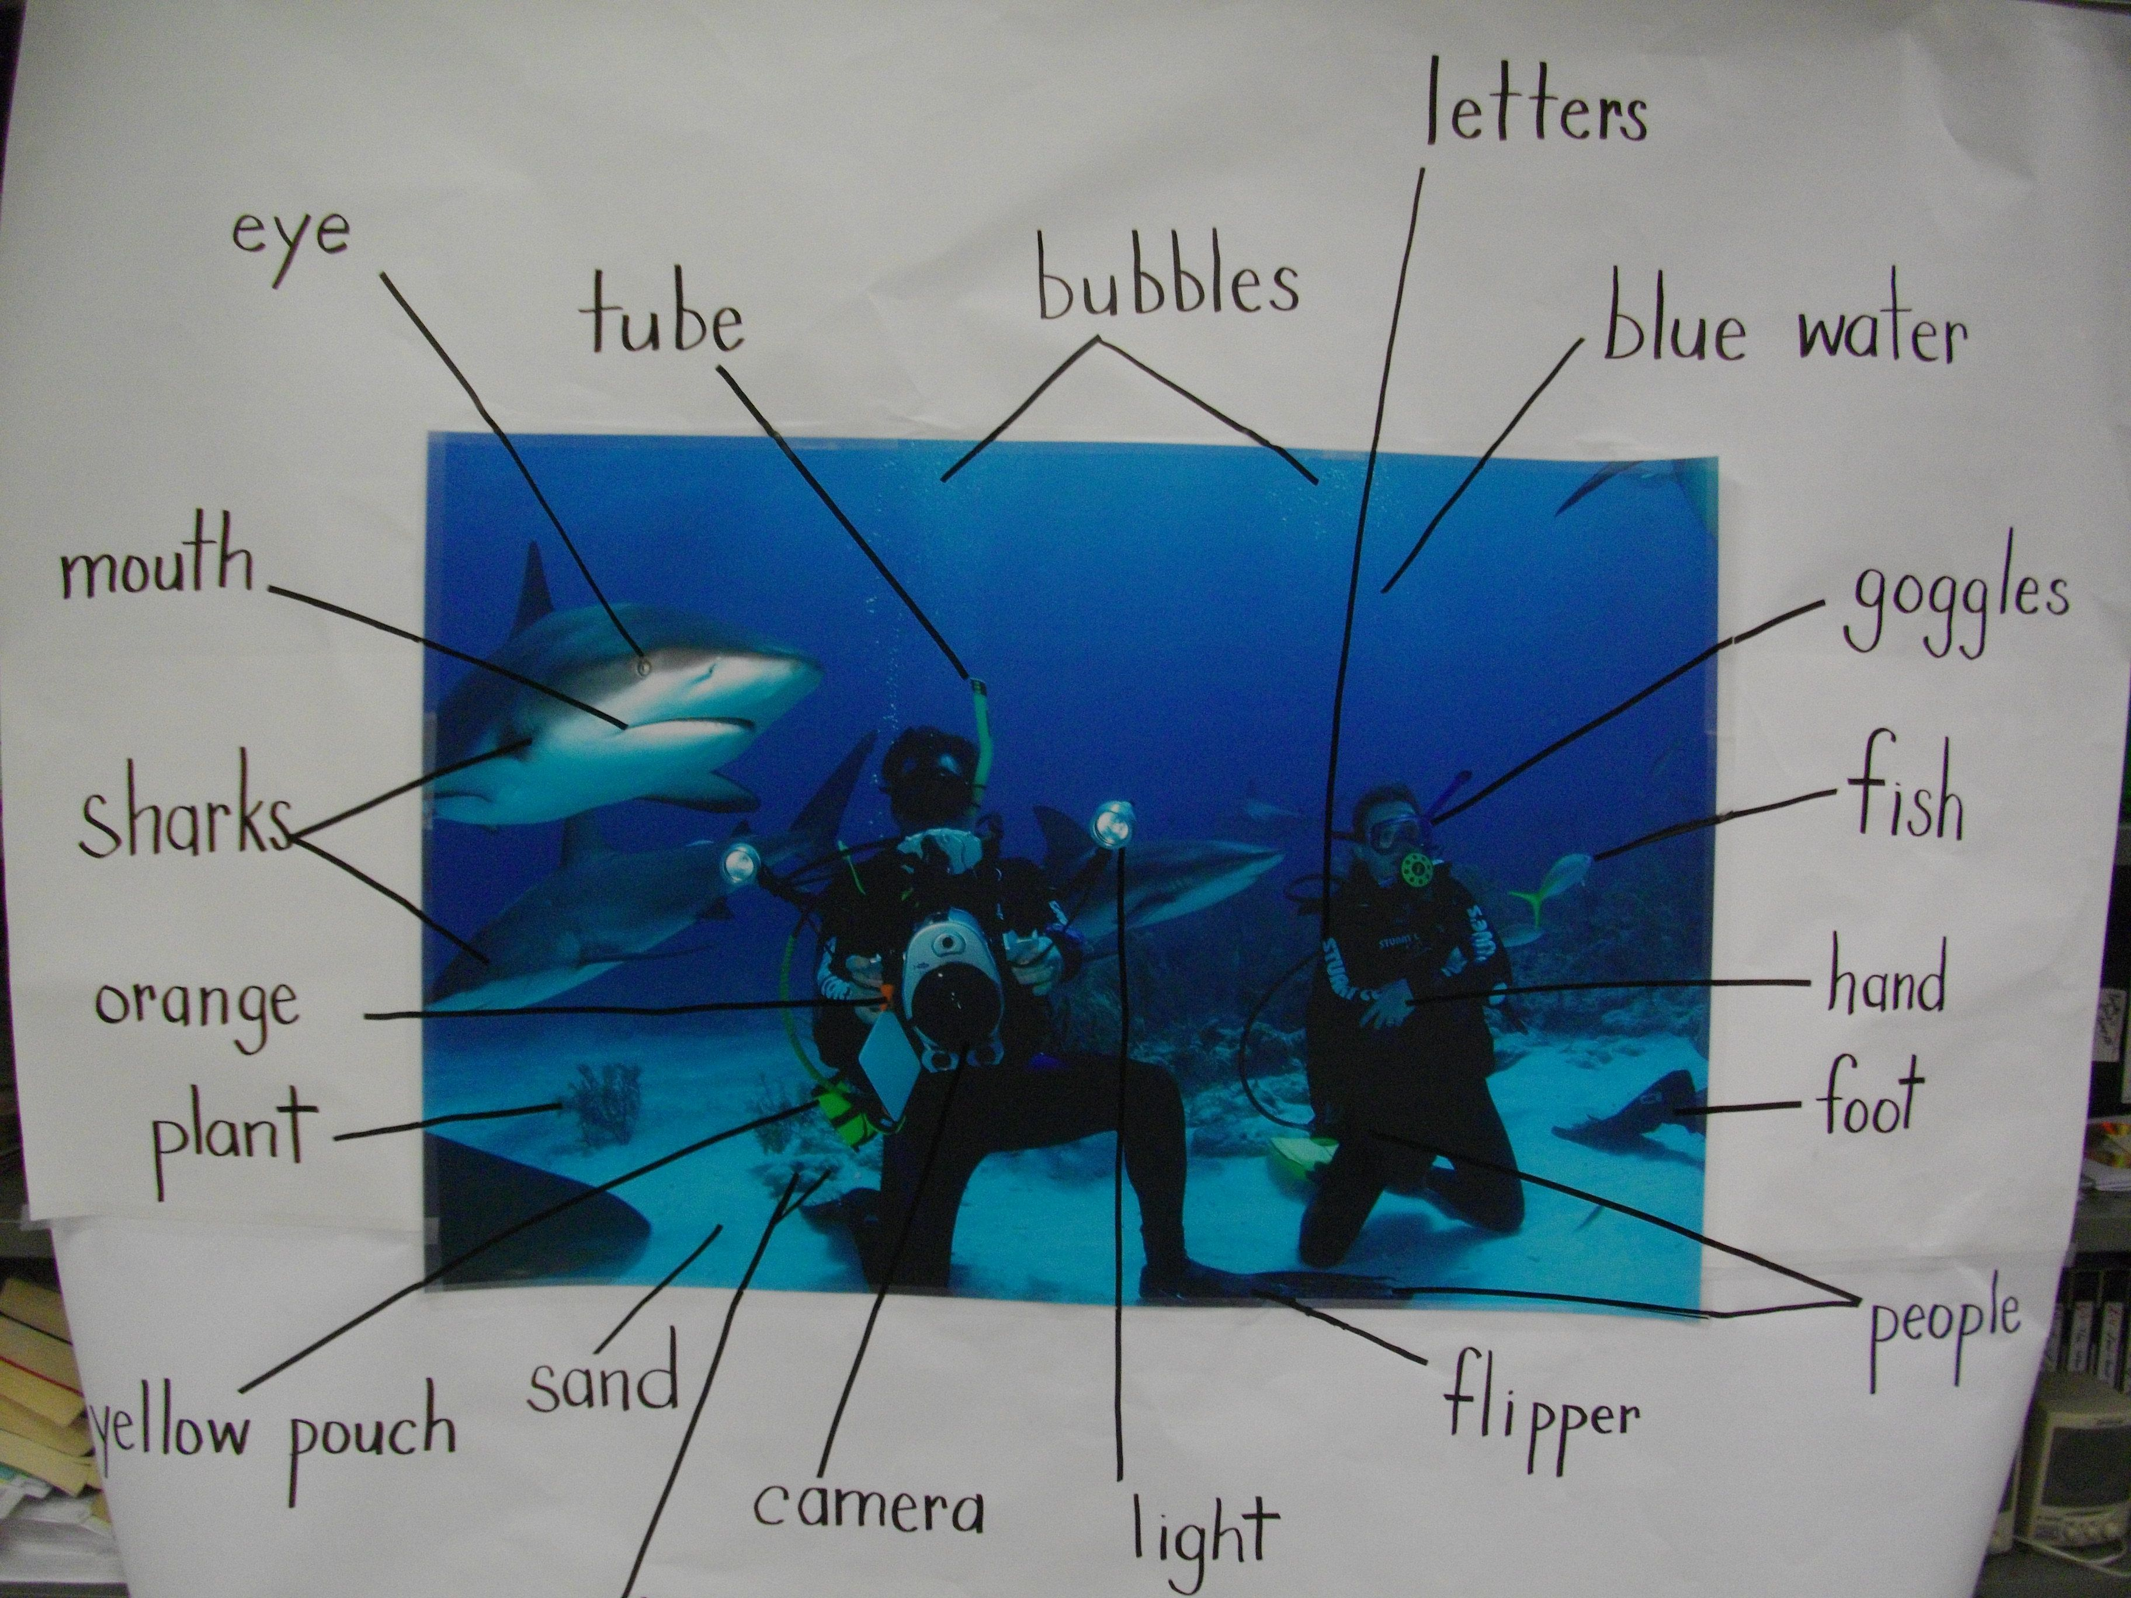
Frontload vocabulary: Picture Word Inductive Model (PWIM)
This Photo by Unknown Author is licensed under CC BY

Slide 24
Ideas for Modeling
Model the task while giving directions verbally
Think-alouds with gestures and visual support
Use “I do, we do, you do” with visual demonstrations
Model language frames
Provide a finished example

Slide 25
Speaking

Slide 26

Speaking: Utilize Small Groups to Enhance Engagement and Deepen Learning
Allow ample time to process concepts & questions
Give everyone in the group a role or task
Chunk learning
Be specific
Monitor the groups
This Photo by Unknown Author is licensed under CC BY-SA

Slide 27

Strategically Group Students for Speaking
AI generated
Best Practice:
Triads - a newcomer, a bilingual or intermediate student, and a native English speaker

Slide 28


Reading and Writing

Slide 29




LANGUAGE DOMAINS
Listening
Speaking
Reading
Writing

Slide 32
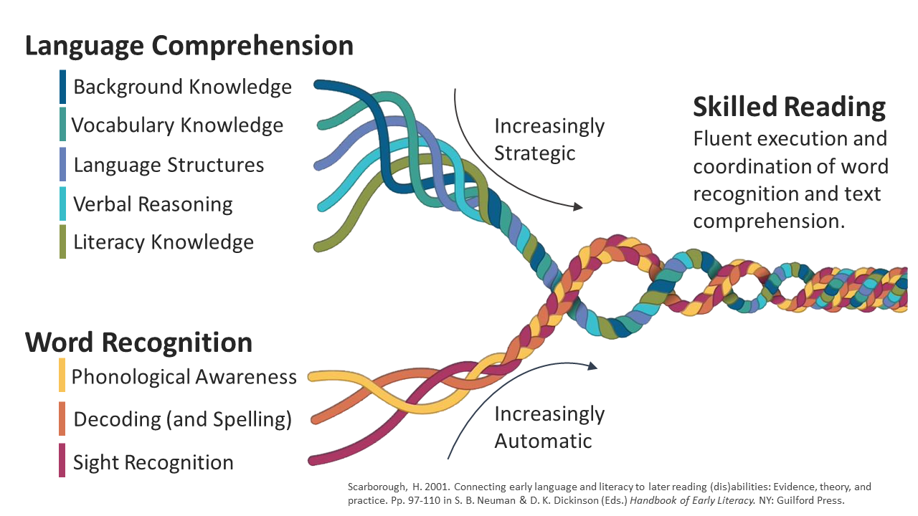
Components of Reading

Slide 33
More time allocated for:
Vocabulary Instruction
Foundational Skills
Close Reading Strategies

Slide 34

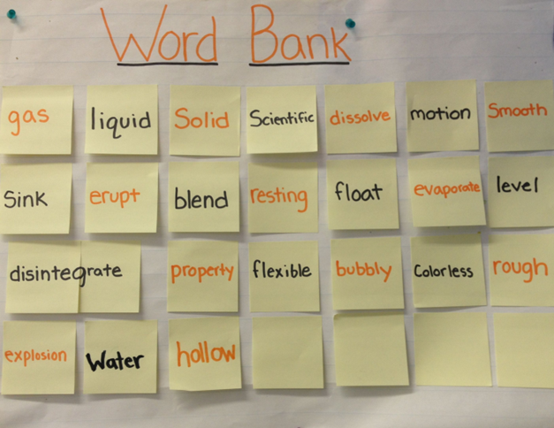
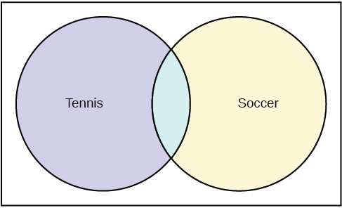
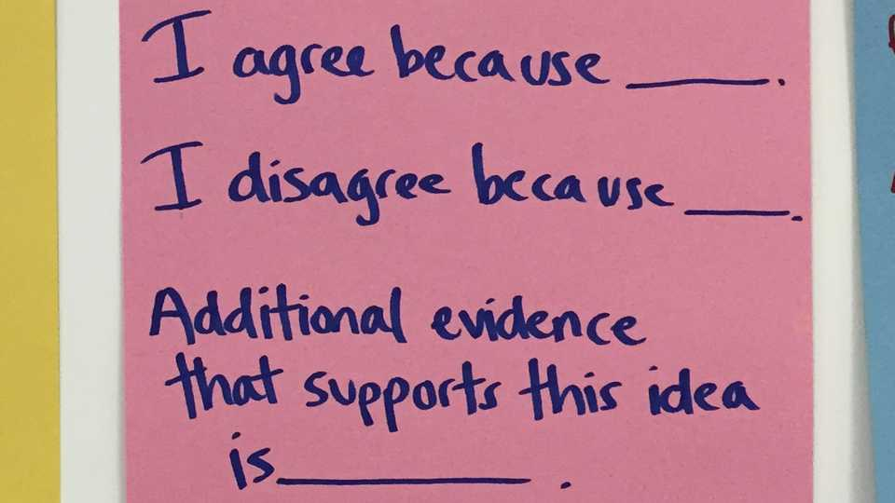
Key Linguistic Instructional Scaffolds words, phrases, and key structures:
Visualized
Provided
Organized
Notes:
7

Slide 35
Who is responsible for remediation?
ESL teacher?
Reading interventionist?
Classroom teacher?
All of the above?

Slide 36
Summary ELLs Need:
Full range of instruction: explicit – discovery learning
Comprehensible input
Opportunities to process their learning through speaking
Intensive instruction in reading and writing
Linguistic scaffolds for independent work

