Slide 1
Empowering Multilingual
Speakers and Writers with Dynamic Strategies
11/21/2025
Dr. Allie Hinson
Contact me:
aahinson@lipscomb.edu
allie.hinson@sumnerschools.org

Slide 2
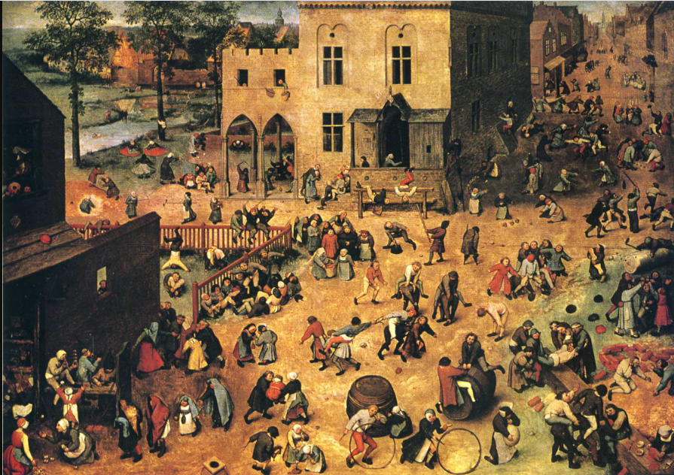
DO NOW
I see
I notice
I think
I wonder
Bruegel, P.(1560). Children’s Games.

Slide 3
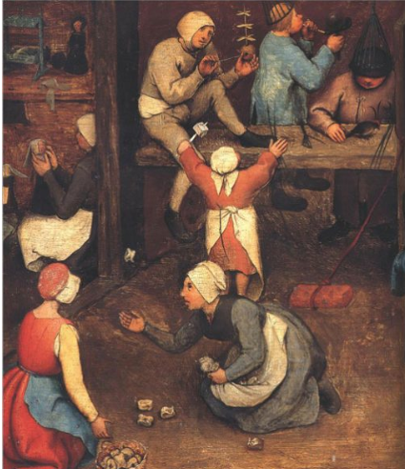
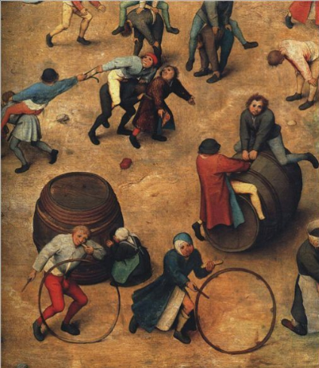
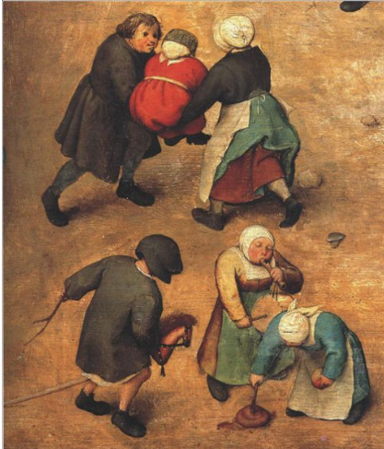
Zoom In
What are the children doing?

Slide 4
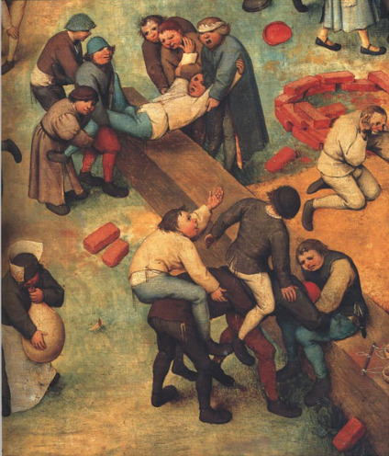
Compare and Contrast
Both pictures show ____ and ____.
One difference is ______.

Slide 5
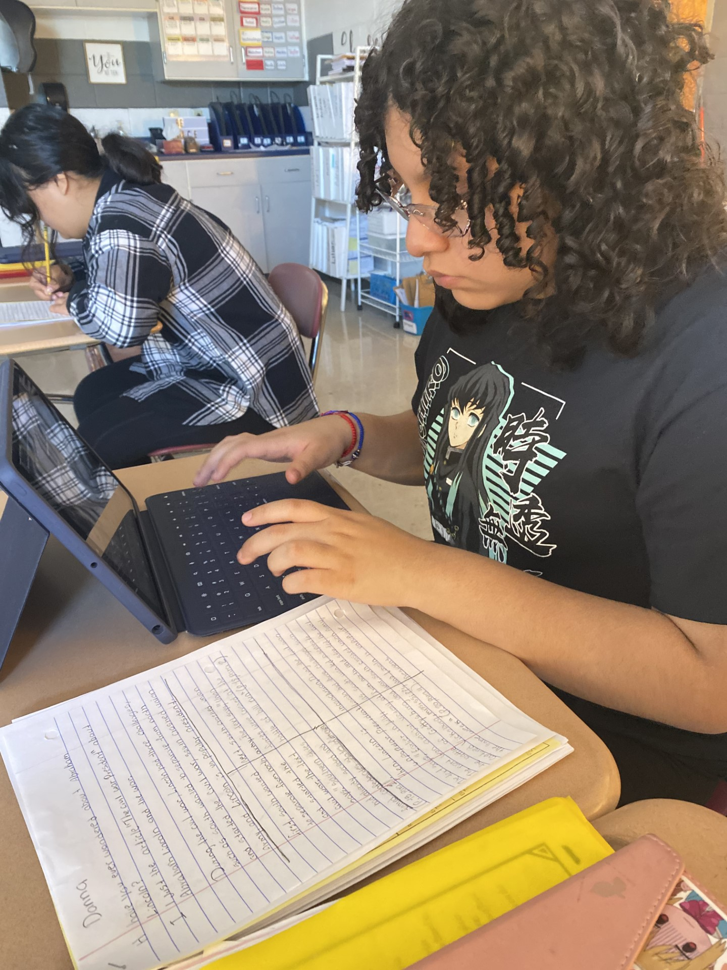
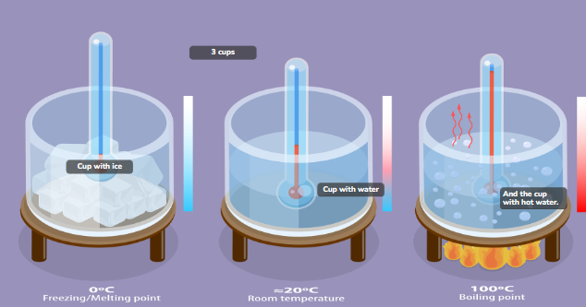
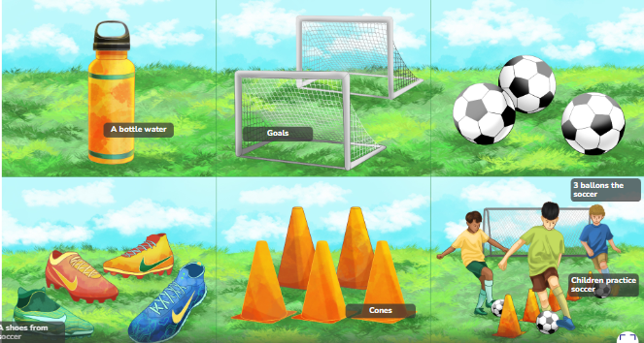
Diana’s Writing
October February
First, I can see 3 cups, one cup with ice and I think with low temperature. Next, I see that the next cup has some water, or the ice dissolved. then the water begins to boil at a much higher temperature, and as the ice becomes water and boils, it evaporates, perhaps it is an experiment in science. In conclusion, it is impressive how ice melts and becomes boiled water. Maybe this project or experiment will teach us some very interesting science.
I see, a children's playing soccer. I notice, they no have shoes. I think, the children's like play fútbol I wonder, why they no have shoes It looks like, the grass and look children's playing.

Slide 6
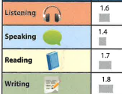
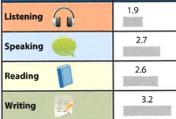
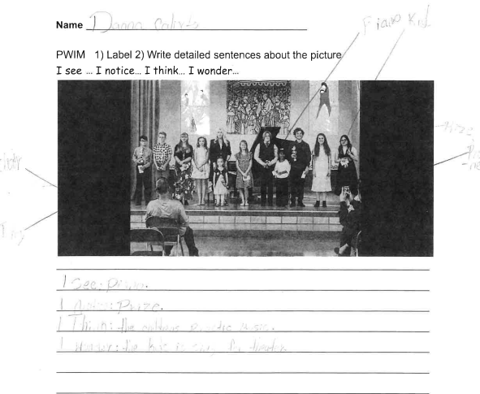
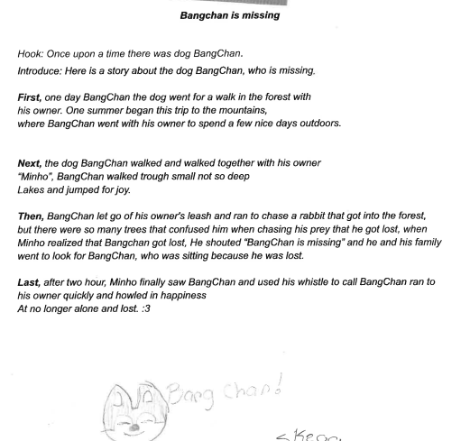
August, 2023 February, 2024
Growth/ 7 months:
L 0.3 R 1.3
S 1.3 W 1.4

Slide 7
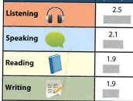
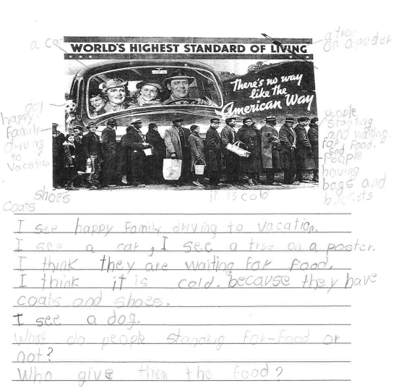
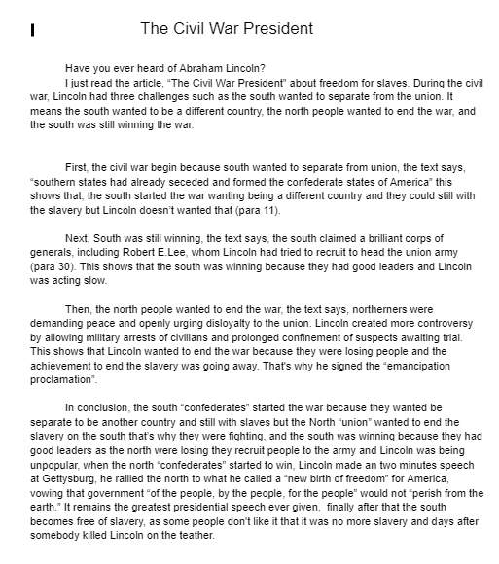
August, 2023 February, 2024
3.6
4.2
3.9
3.9
Growth/ 7 months:
L 1.1 R 2.0
S 2.1 W 2.0

Slide 8
What skills EL students need to grow in speaking and writing?
Turn & Talk

Slide 9
What skills EL students need to grow in speaking and writing?
How to use vocabulary
How to respond to prompts
How to organize words in a sentence
How to organize ideas

Slide 10
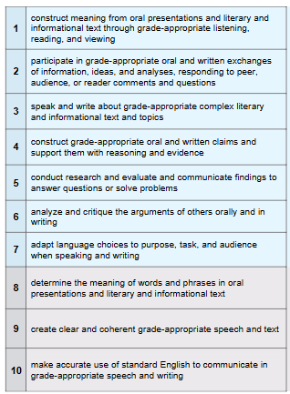

ELPA Standards
Speaking
Writing
ELPA21.(2025). Organization of the ELP standards

Slide 11
Speaking and Writing
- output
- thinking process.
Arranging thoughts and words on a page/in mind and articulating them coherently
Academic Success

Slide 12
Halliday’s language-based theory of learning
Learning through Language
Learning Language
Learning
about Language
Lems, Soro, & Charles, 2024, p. 5

Slide 13
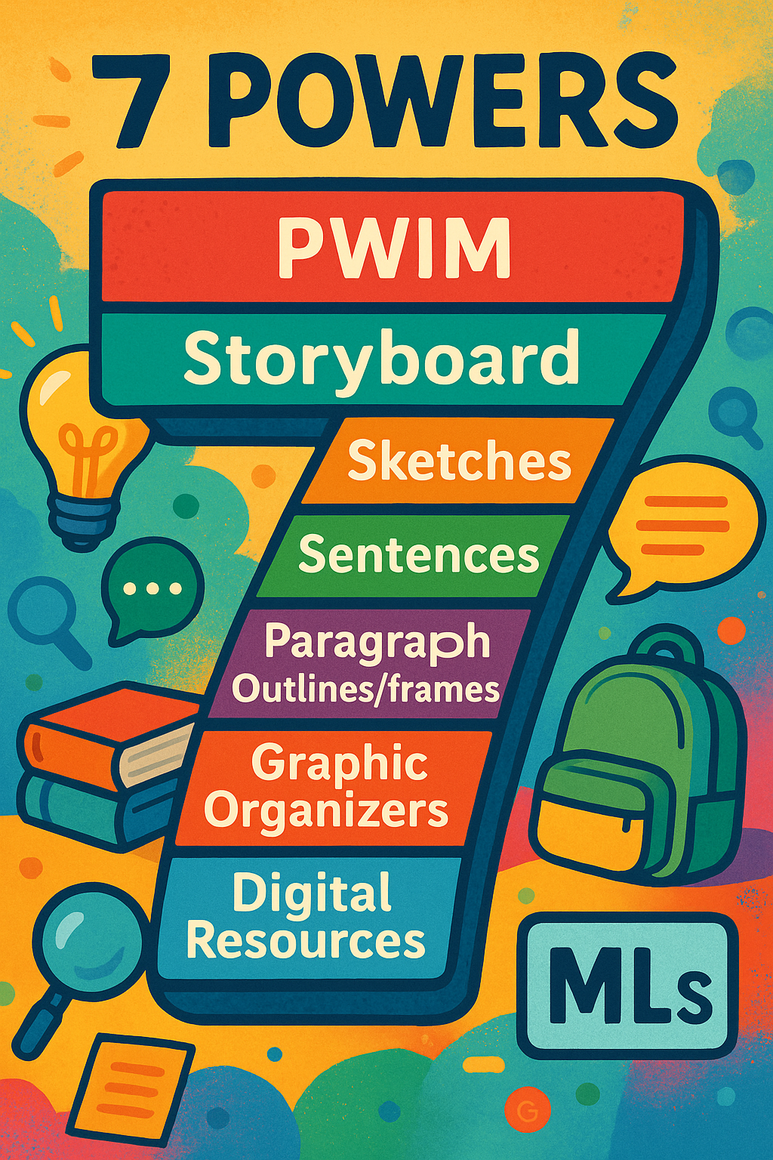
Writing
Power of PWIM
Power of Storyboard
Power of Sketches
Power of Sentences
Power of Paragraph Outlines/frames
Power of Graphic Organizers
Digital Resources

Slide 14
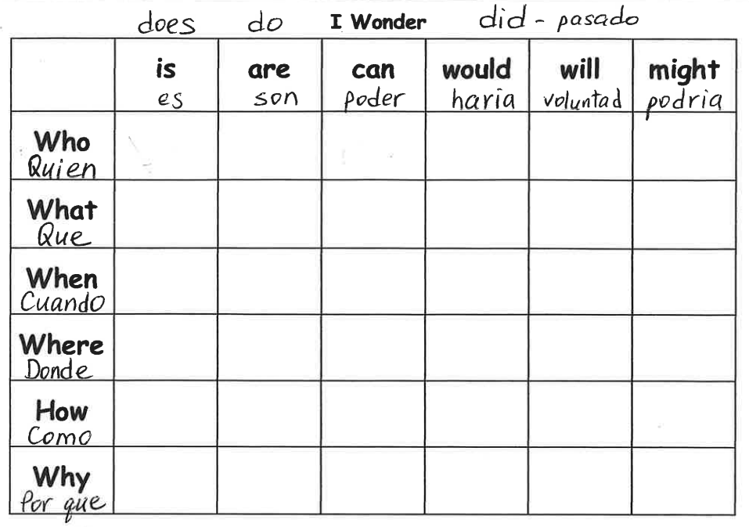
The Power of PWIM
(Picture-Word Inductive Model)
I see _______.
I notice _____.
I think _____.
I wonder _____.

Slide 15
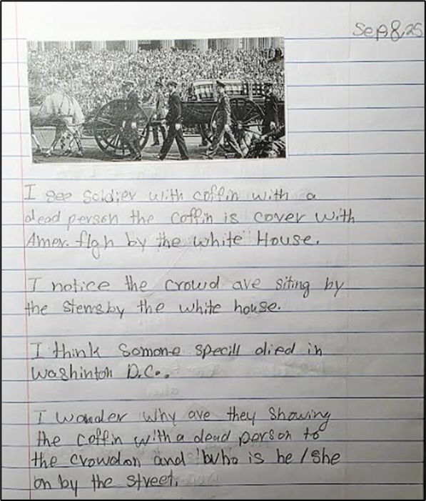
PWIM
I see _______.
I notice _____.
I think _____.
I wonder _____.

Slide 16
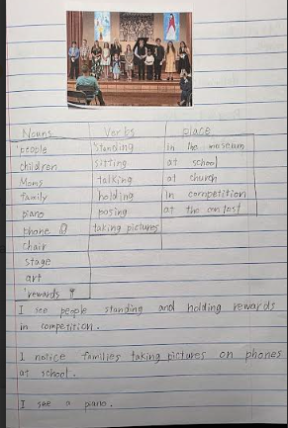
PWIM
Scaffolds:
word bank
pointing
sorting
acting out words
saying a sentence

Slide 17
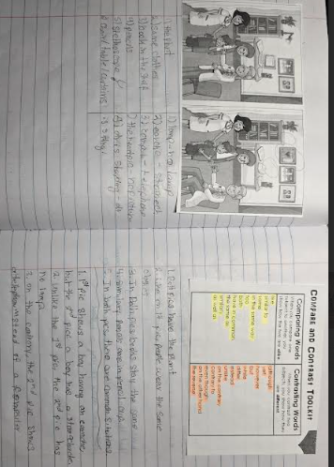
PWIM
Compare-Contrast
Scaffolds:
circle differences
partners talk
word bank
model

Slide 18

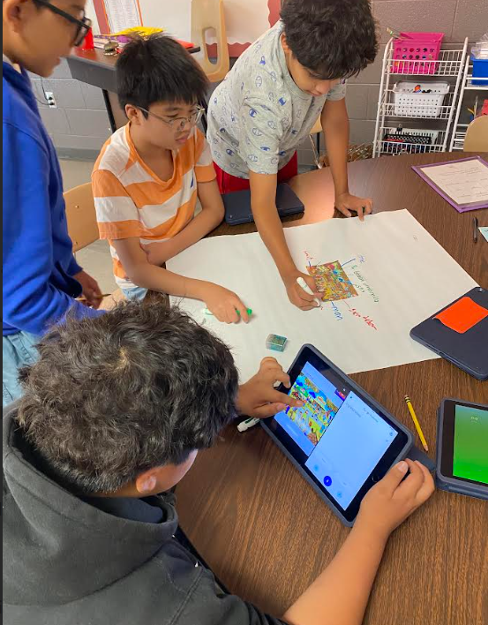
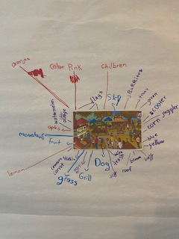
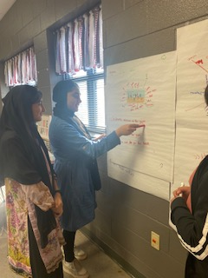
Small groups and Presentation - Rotations

Slide 19
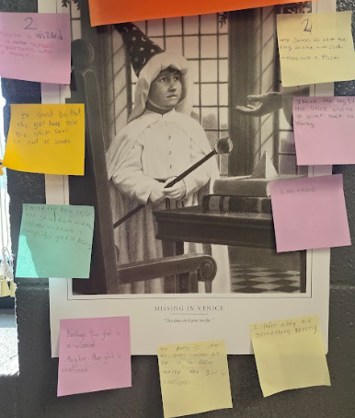
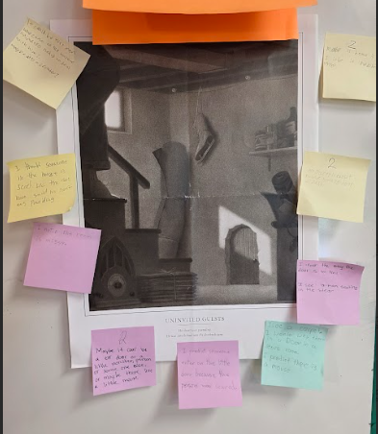
PWIM: Sticky chat

Slide 20
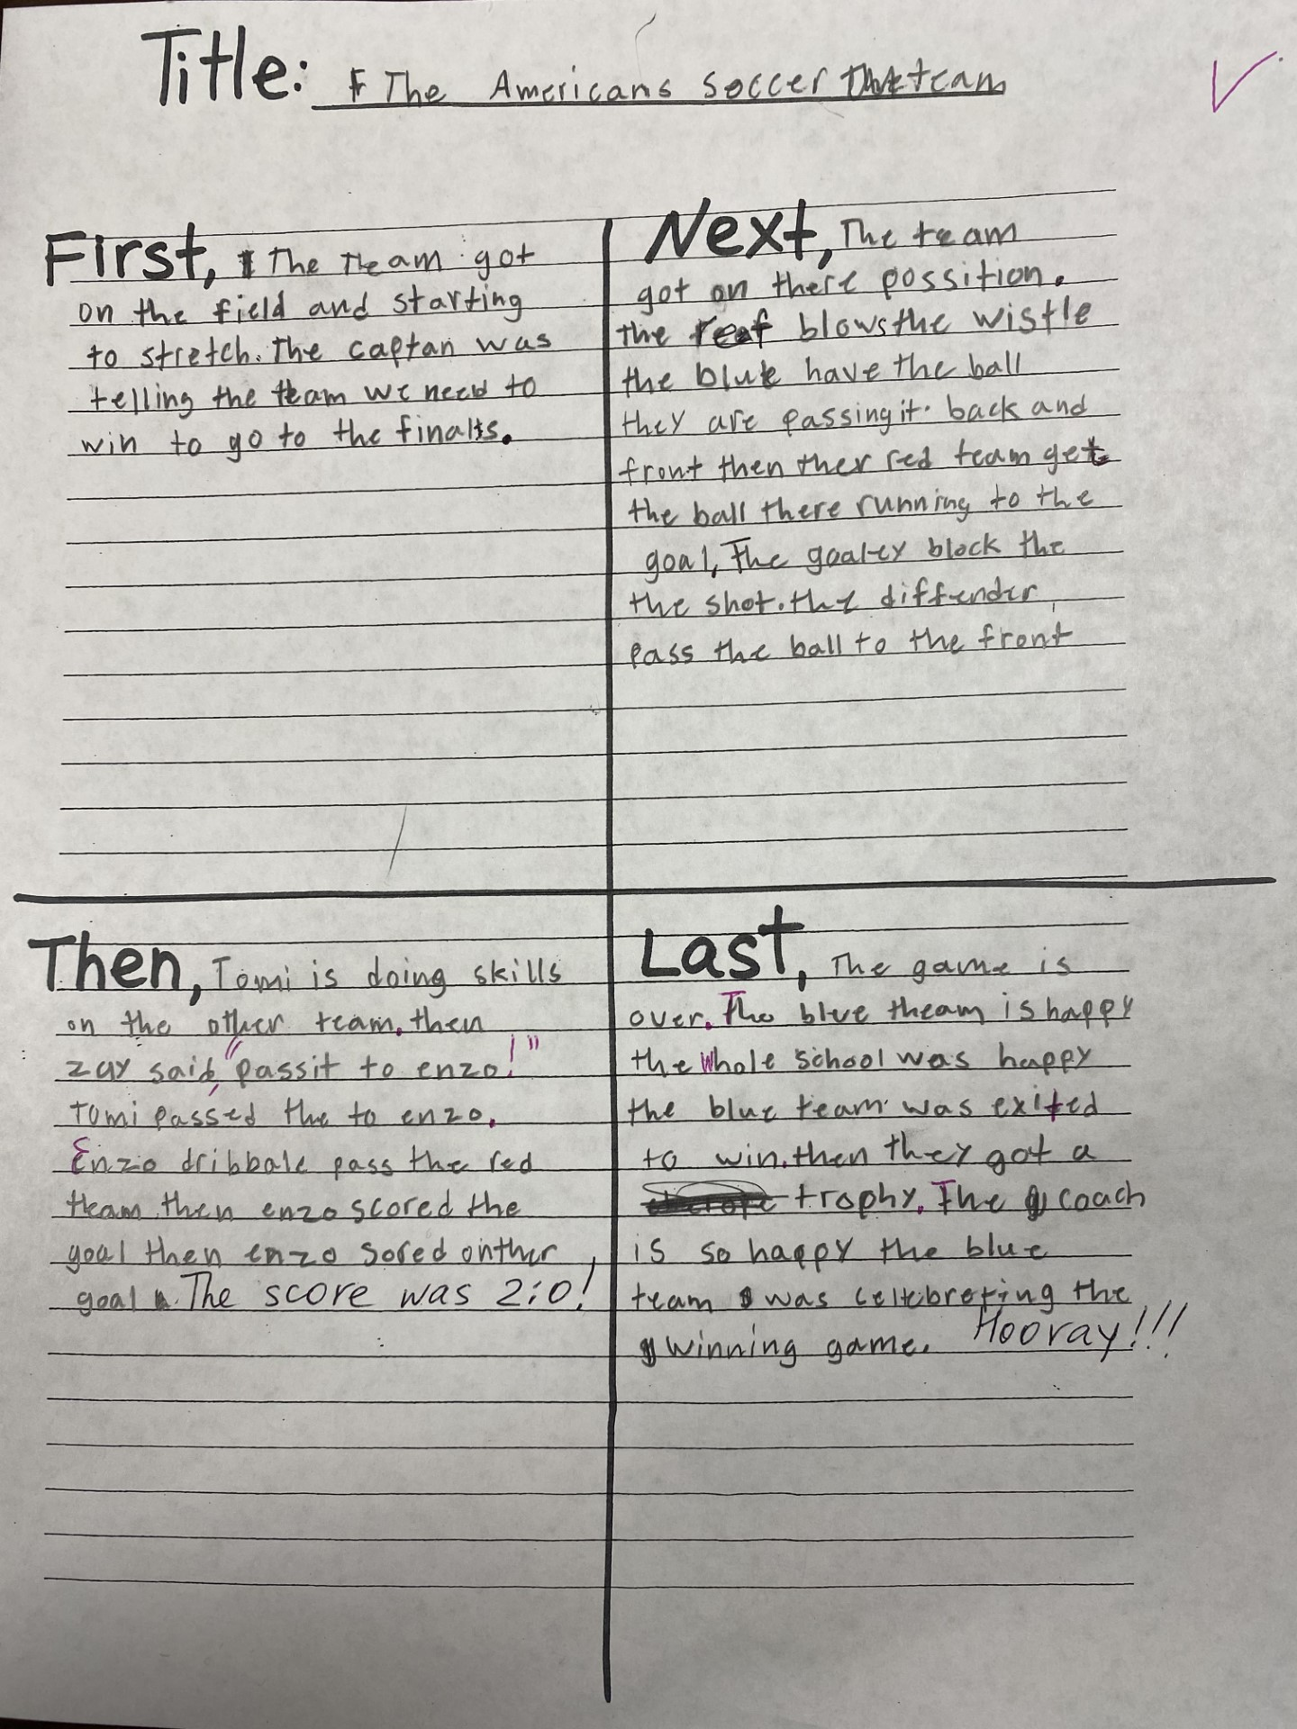
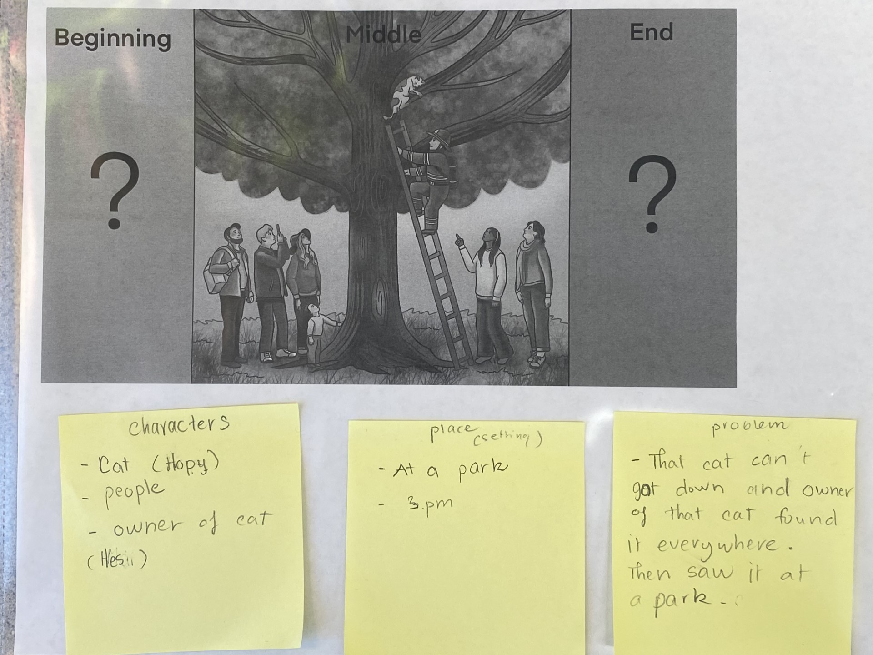

2. Power of Storyboard

Slide 21

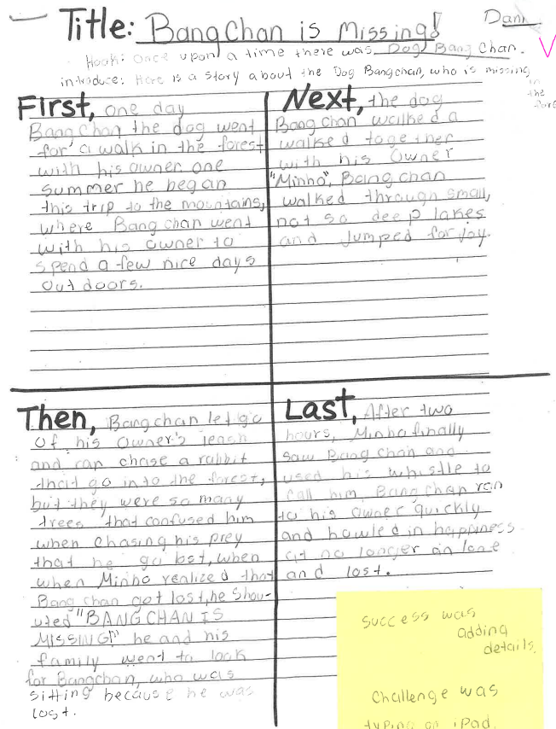
2.

Slide 22
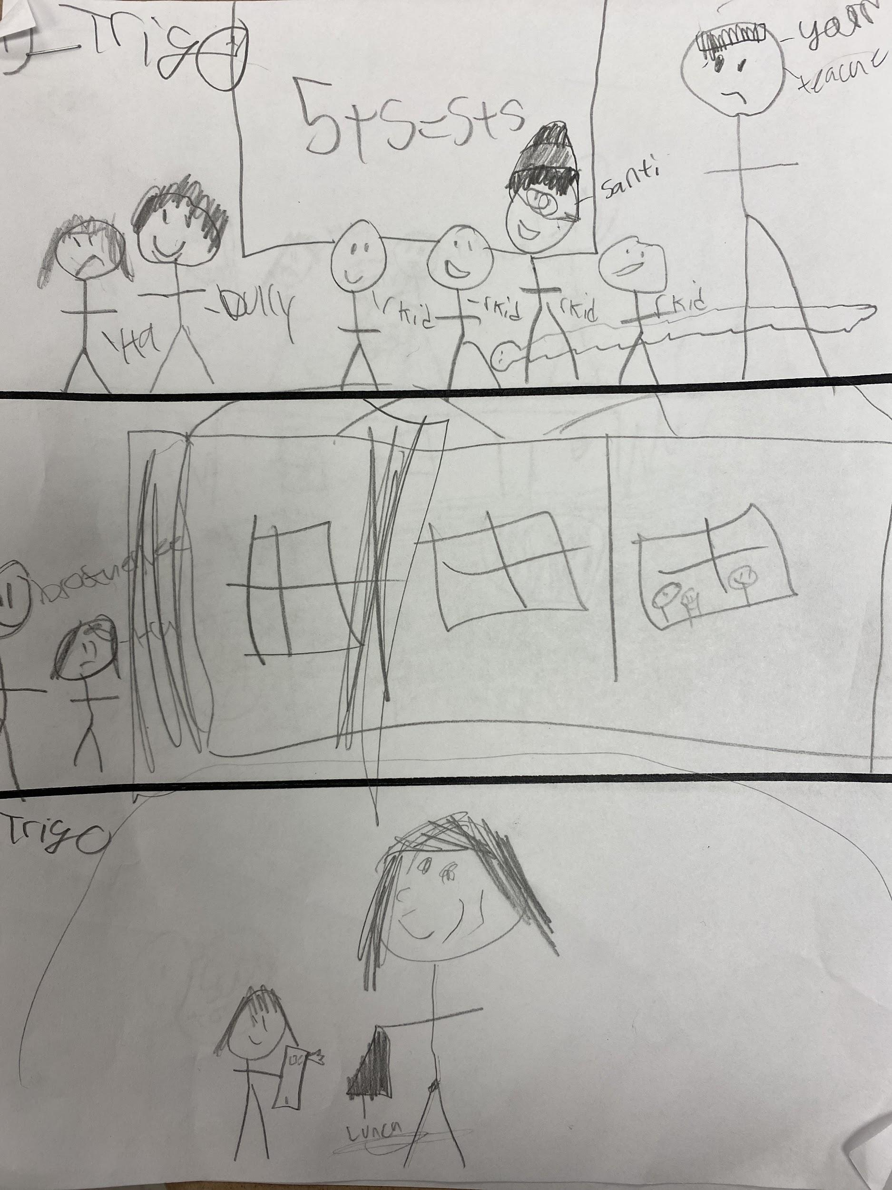
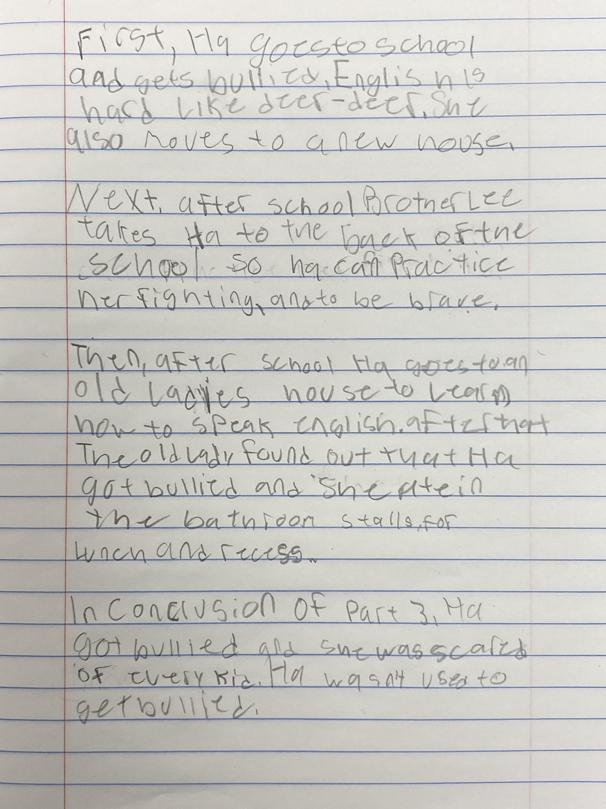
3. Power of Sketches
Sketch notes to Text
Text to Graphics and then Graphics to Text
6th grade
EL
Level 3 Reading
Level 2 Writing

Slide 23
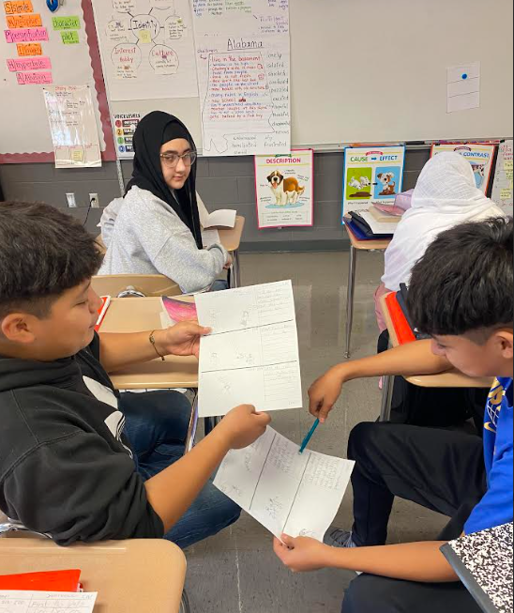
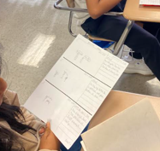
Read - Stop - Sketch - Jot – Talk - Write More

Slide 24

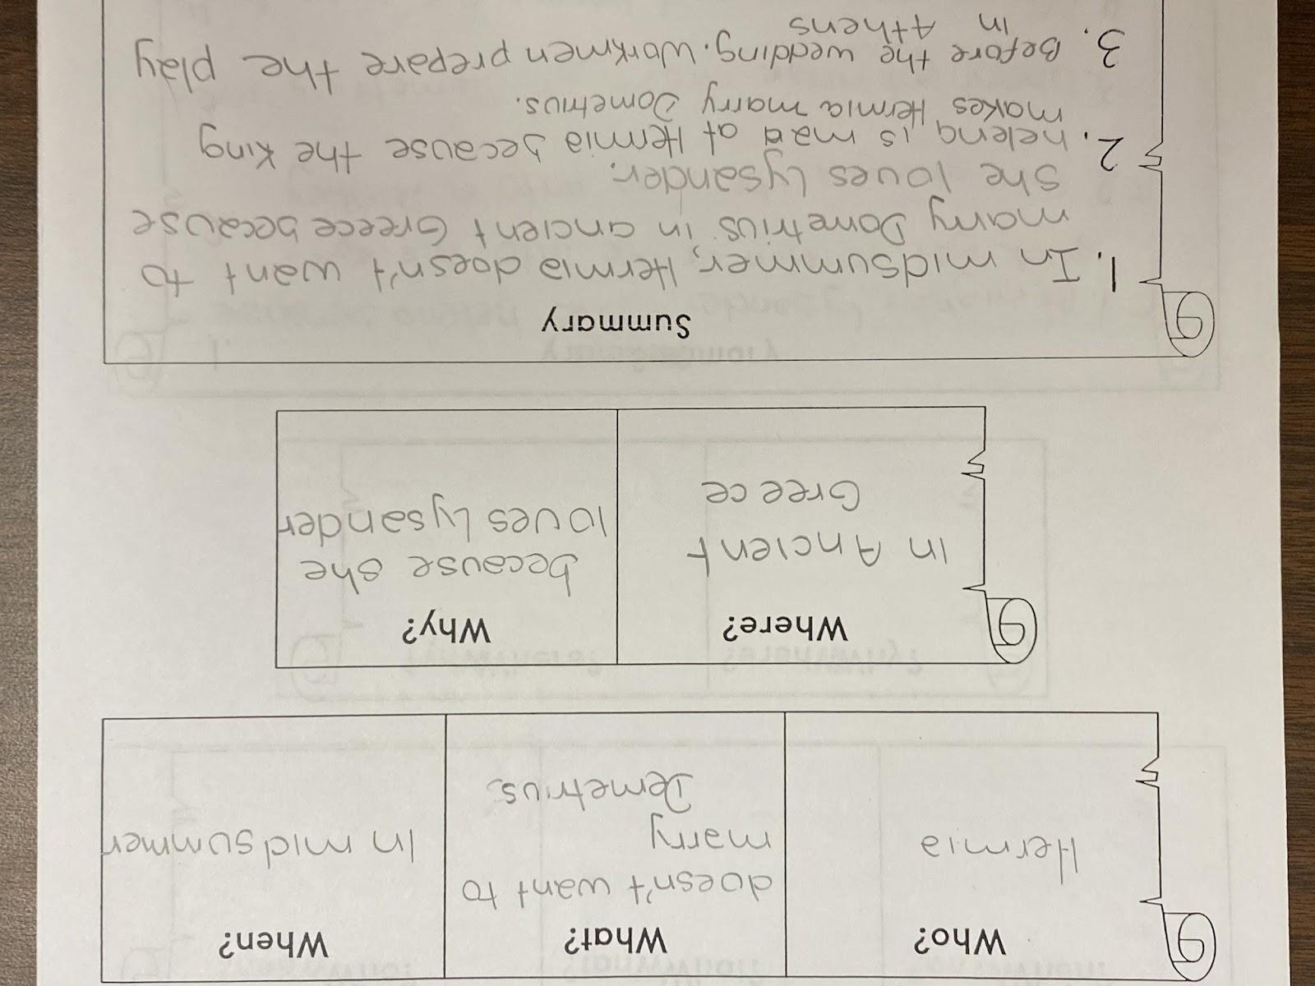
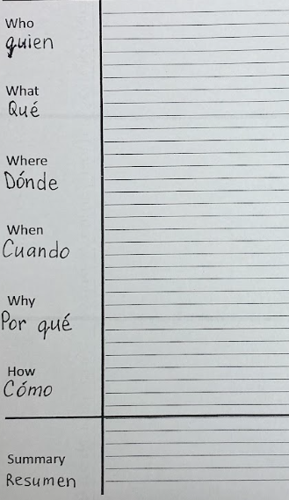
4. Power of Sentences

Slide 25

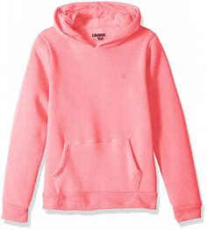
Expand the sentence
She had a plan.
Who?
*When?
Why?
After school, Ha had a plan to change coats, so she can escape from the Pink Boy.
Hochman & Wexler (2024)

Slide 26

Expand the sentence
He chased Ha.
Who?
*When?
Why?
After school, ____ ____________ _________.
Hochman & Wexler (2024)

Slide 27
Sentence Types
Write a sentence of each type using the word diagram.
Statement: The diagram represents ½.
Question: Is a diagram a visual representation?
Command: Draw a diagram that has four sides and measures 360 degrees.
Hochman & Wexler (2024)

Slide 28

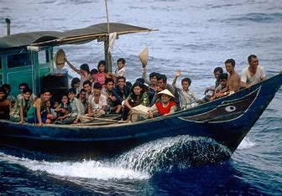
because/but/so
1.Ha’s family faced many challenges because ___.
2. Ha’s family faced challenges, but ____.
3. Ha’s family faced challenges, so _____.

Slide 29
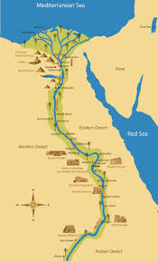
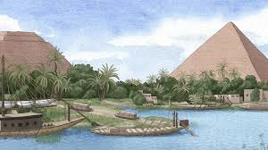
because/but/so
Complete the sentence stems.
The Nile was beneficial to ancient Egyptians because it provided fertile soil for farming.
The Nile was beneficial to ancient Egyptians, but annual flood waters caused destruction.
The Nile was beneficial to ancient Egyptians, so the river was worshiped as a god.
Hochman & Wexler (2024)

Slide 30
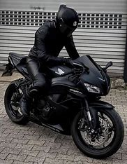

What if?...
If Brother Vu did not teach Ha karate, __________.
If Brother Vu did not come on his motorcycle,______.
If ___did not____, _________.

Slide 31
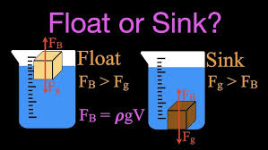
What if?
If an object has a higher average density than a liquid, the object is not buoyant enough to float.
Hochman & Wexler (2024)

Slide 32
Clarifying
Can you elaborate?
Can you clarify?
What do you mean by __?
Can you tell me more about __?
What makes you think that?
How do you know?
Supporting
Can you give an example?
What evidence can you provide?
Can you show me where it says that?
Can you be more specific?
Questions
Zwiers, 2009

Slide 33
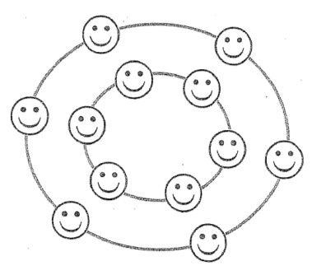
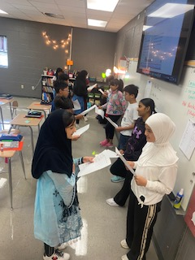
Inside and Outside Circle Two Lines
Sentences in Speaking
Gregory & Kuzmich, 2007

Slide 34
5. Power of Paragraph Outlines
T.S. Winter is a unique time of year.
1.
2.
3.
4.
C.S. Clearly, winter is an exciting season!
Hochman & Wexler (2024)

Slide 35
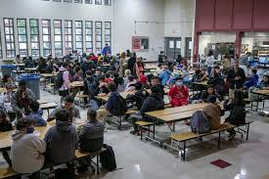
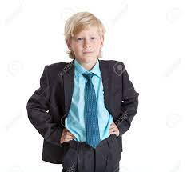
SPO (Single Paragraph Outline)
T.S. At her new school, Ha faces many challenges to overcome.
1.
2.
3.
4.
C.S. In conclusion,
Done?
Revise by reading it to self.
Edit Capitalization/
Punctuation
Draw a picture

Slide 36
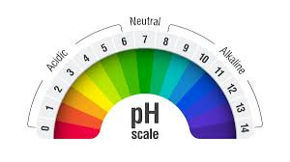
T.S. It is easy to find the pH balance of a liquid.
first 1. clean container
next 2. fill w/few in. of liquid
then 3. dip test strip/few sec.
finally 4. compare color/litmus scale
C.S. If you follow these simple steps, you can determine if a liquid is acidic, neutral, or alkaline.
It is easy to find the pH balance of a liquid. First, thoroughly clean the container you are using. Next, fill the container with a few inches of the liquid you are testing. Then, dip the test strip in the liquid for a few seconds. Finally, compare the color you see to the litmus scale. If you follow these simple steps, you can determine if a liquid is acidic, neutra;, or alkaline.
Hochman & Wexler (2024)

Slide 37
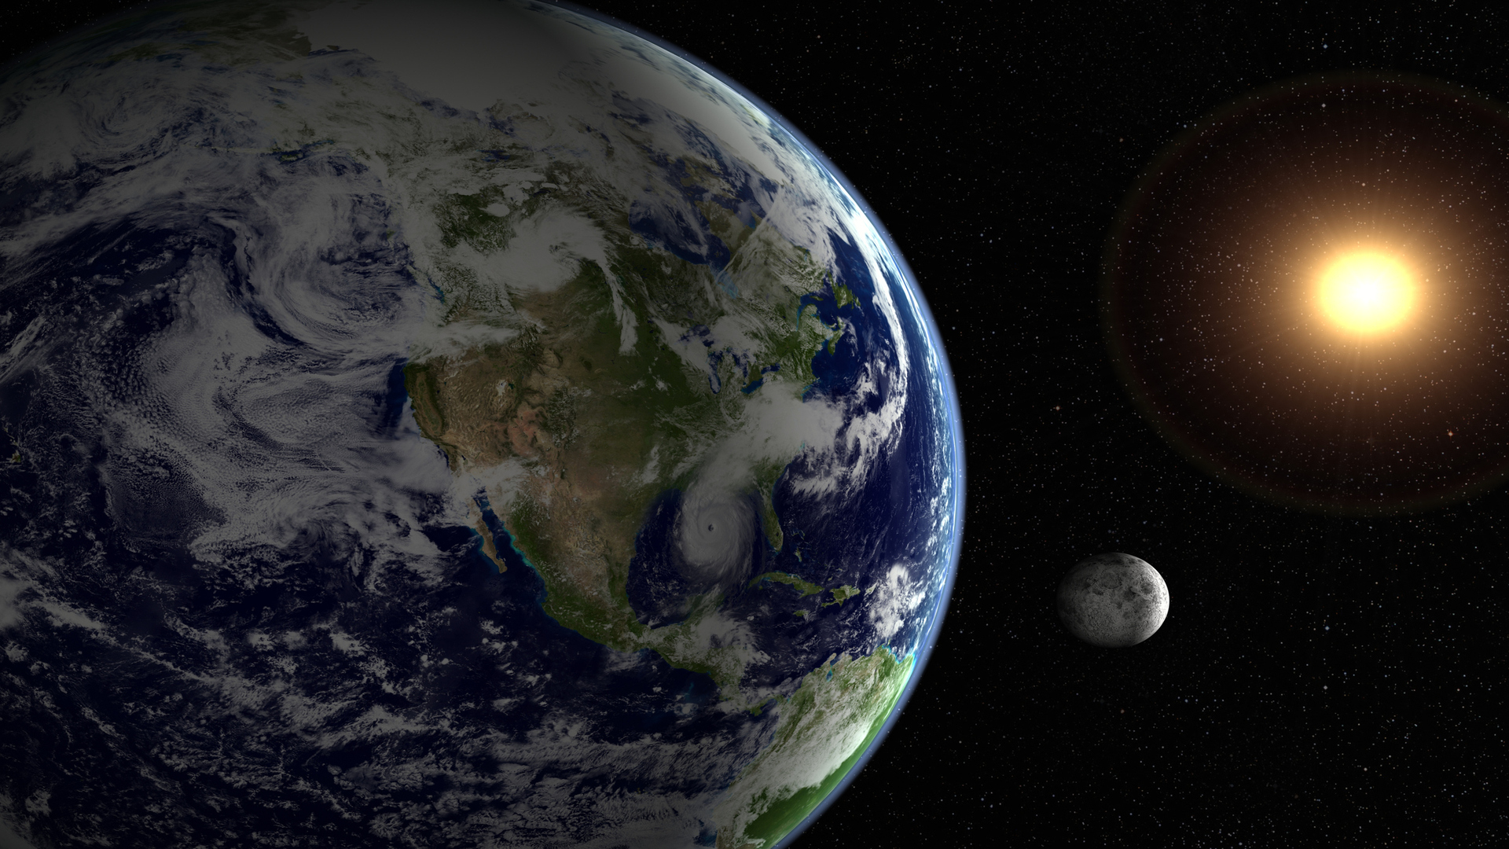
How are the Earth and the Moon similar and how they are different?
Paragraph Frames
First, the Earth and the moon are similar because both ____________.
Also, both ___________
Last, both __________.
Next, the Earth and the moon are different because ___________
Also, the Earth , but __________.
Last, the Earth _____, but ____.
In conclusion, these are the reasons how the Earth and the moon are similar and different from each other.

Slide 38
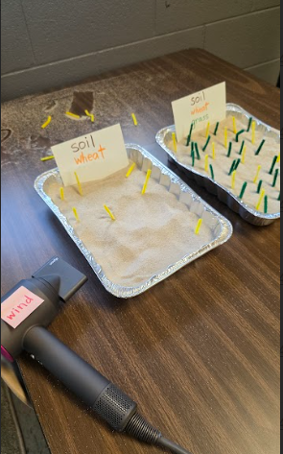
Paragraph Frame
You need the following materials such as ____.
First,
Second,
Third,
Fourth,
In conclusion,

Slide 39
Abbr. | Writing
ToS | I vote for to be the next president of the colony Jamestown. I have two reasons to explain my choice.
E | First, is _____________. The text says, “ ” (p. ). Second, __________ is ________. The text says, “ ” (p. ).
E | This means . This also shows that _____________________________________.
C | In conclusion, now you see why I vote for ____________________.
ToSEEC Paragraph Writing
Wit and Wisdom (n.d.)

Slide 40
Roving Paragraphs
It is important to understand the Bill of Rights because ___________.
Rove around the room and find a partner. Share your sentence.
In addition, ______________.
*You can borrow or steal your partner’s response.
Rove again. Share TWO sentences to a different partner.
Also, __________________.
*It is crucial to read everything you have written so far.
Finally, _____________.
Salva, 2024, p. 107

Slide 41
6. Power of Graphic Organizers:
from 4 squares to an essay
H
I
T
ToS
E
E
C
C
Hook: Introduce Background: Theme/Claim
Body Paragraph 1 ToS/Reason Evidence Elaboration Conclusion | Body Paragraph 2 ToS/Reason Evidence Elaboration Conclusion
Body Paragraph 3 ToS/Reason Evidence Elaboration Conclusion | Conclusion Restate Theme/Claim differently Say more
X 3

Slide 42
6. Scaffolds
Hook: Choose one Introduce Background: I just read an article titled “ _____” by ____ about ____. Theme/Claim: Sentence frame
Body Paragraph 1 First, The text states, “ “ (p. ). This shows that So, | Body Paragraph 2 Second, The text states, “ “ (p. ). This means that So,
Body Paragraph 3 Last, The text states, “ “ (p. ). This shows that So, | Conclusion In conclusion, (see theme/claim) Say more
H
I
T
ToS
E
E
C
C
X 3
Wit and Wisdom (n.d.)

Slide 43
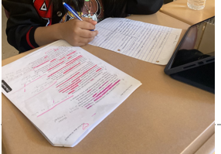
6. Scaffolds

Slide 44
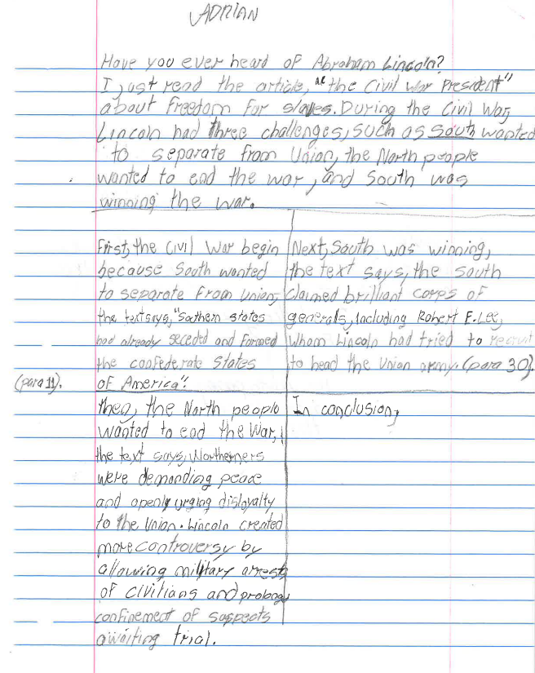


Adrian - growth 2 levels in writing

Slide 45


6. Graphic Organizers

Slide 46



6. Graphic Organizers - narrative

Slide 47


6. Scaffolds

Slide 48

ELPA21 Writing 2
Writing Conference
Peer Editors
Self-evaluation

Slide 49


6. Graphic Organizers

Slide 50



7. Digital Resources - Writing
noredink.com
From grammar/conventions practice to daily writing to essays with scaffolds.
writable.com
Assign a short/extended response prompts to practice writing skills for State Assessments
quill.org
Sentence/response writing, error correction activities with immediate feedback. Directions are in 16 languages.

Slide 51



7. Digital Resources - Writing
magicschool.ai
Level any text to adapt it to a reading level, translate and summarize it. Generate songs, games, vocabulary, sentence starters, DOK questions, etc.
app.diffit.me
Generate any text and questions aligned to TN Standards, level and translate it.
pobble.com
Speaking and writing prompts on 3 levels (*Today’s Pobble 365 –free)

Slide 52



7. Digital Resources - Reading
uniteforliyteracy.com
Read along while you listen to these audiobooks.
readworks.org
Read and listen to texts on any topic, complete activities, and track students’ progress
getepic.org
Open a free account with your school e-mail. You can find audiobooks and academic videos for all ages.

Slide 53



7. Digital Resources Reading/Speaking
All Things Animal TV – YouTube channel of educational videos. Perfect for initiating speaking.
allthingstopics.com
Videos, texts, quizzes, and fun speaking activities on any topic
classroomcereal.com
Funny texts with grammar errors for students to find while being emerged into a twisted plot.

Slide 54



7. Digital Resources – Reading/Speaking
newsinlevels.com
Current news, short, differentiated texts with a video and audio, are great for class discussion.
jeopardylabs.com
Vocabulary practice while having fun in the classroom.
esolcourses.com
Free digital lessons, quizzes, texts on any topic

Slide 55




7. Digital Resources Listening/Speaking
eslfast.com
Short conversations and audio will take your listening activities to the next level.
eslvideo.org
ESL videos (dialogues and songs) with quizzes for beginners and intermidiate. Preview each video.
learningenglish.voa.com
Videos for listening and speaking practice.
esl-lab.com
Boost everyday comprehension skills at 3 levels

Slide 56
Writing - 7 Powers
Power of PWIM
Power of Storyboard
Power of Sketches
Power of Sentences
Power of Paragraph Outlines/frames
Power of Graphic Organizers
Power of Digital Resources

Slide 57
Final Thoughts…
Strive for messiness
Don’t overfocus on language development
Don’t overdo the use of sentence frames
Don’t focus on “correct” language use
Don’t miss opportunities to develop language in every activity
Zwiers, 2020, p. 40-42

Slide 58
References
Bruegel, P. (1567). Children’s Games. Journal of Historians of Netherlandish Art. https://jhna.org/articles/homo-ludens-pieter-bruegels-childrens-games-humanist-educators/
ELPA21.(2025). Organization of the ELP standards. Retrieved from https://elpa21.org/wp-content/uploads/2025/04/20210715_Organization-of-the-ELP-Standards_ELPA21.pdf
Ferlazzo, L. & Sypnieski, K. (2018). The ELL teacher’s toolbox: Hundreds of practical ideas to support your students. Jossey-Bass.
Gregory, G., & Kuzmich, L. (2007). Teacher teams that get results: 61 strategies for sustaining and renewing professional learning communities. Thousand Oaks, CA: Corwin Press.
Hochman, J. S. & Wexler, N. (2024). The Writing revolution 2.0: A guide to advancing thinking through writing in all subjects and grades (2nd ed.). Jossey-Bass
Lems, K., Soro, T. M. & Charles, G. (2024). Building literacy with multilingual learners: Insights from linguistics (3rd ed.). The Gulford Press.
Salva, C. (2024). Boosting achievement: Reaching students with limited or interrupted formal education (2 ed.). Seidlitz Education.
Wit and Wisdom (n.d.) https://greatminds.org/english/witwisdom
Zwiers, J. (2009, April). How to start academic conversation. ASCD, Vol. 66, No.7. Retrieved from https://www.ascd.org/el/articles/how-to-start-academic-conversations
Zwiers, J. (2020). The Communication effect: How to enhance learning by building ideas and bridging information gaps. Corwin.

