Slide 1
It Starts at the Top: School Leadership that Moves the Needle for English Learners
Bleshette Coulter and Erica Rayburn
Hamilton County Schools

Slide 2
Session Goals
Explore effective professional development practices for Content and ENL Teachers
To identify effective ways to implement ENL supports in content area classrooms

Slide 3
Effective Professi0nal Development
What are the components of effective professional development?

Slide 4
Effective Professional Development
Is content focused
Incorporates active learning utilizing adult learning theory
Supports collaboration, typically in job-embedded contexts
Uses models and modelling of effective practice
Provides coaching and expert support
Offers opportunities for feedback and reflection
Is of sustained duration
Darling-Hammond, L., Hyler, M. E., & Gardner, M., with assistance from Espinoza, D. (2017). Effective teacher professional development (Research brief). Learning Policy Institute. https://learningpolicyinstitute.org/product/teacher-prof-dev

Slide 5


Professional Development Experience
Algebra I
Math Practice + ENL Supports + Upcoming Content

Slide 6
Worked Example

Slide 7
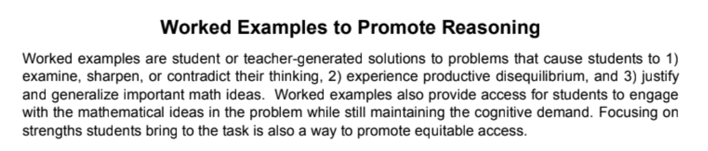
Teachers Development Group. (2021). Worked Examples to Promote Reasoning. Teachers Development Group.

Slide 8
The 8 Standards for Mathematical Practices
Make sense of problems & persevere in solving them
Reason abstractly & quantitatively
Construct viable arguments & critique the reasoning of others
Model with mathematics
Use appropriate tools strategically
Attend to precision
Look for & make us of structure
Look for & express regularity in repeated reasoning
Tennessee Department of Education. (n.d.). Mathematics standards. Tennessee Department of Education. https://www.tn.gov/education/districts/academic-standards/mathematics-standards.html

Slide 9

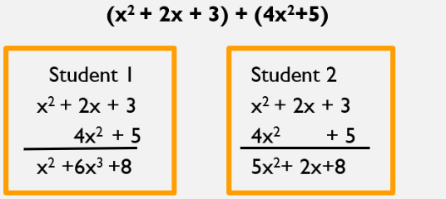
Which solution makes the most sense mathematically to you? Why?
más sentido

Slide 10
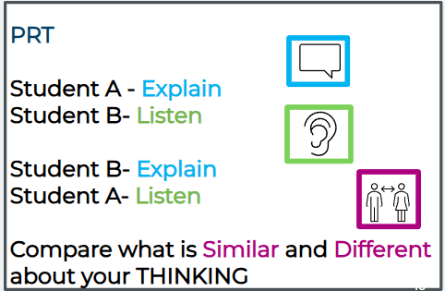

Structured Math Talk
Listen
and
Compare

Slide 11


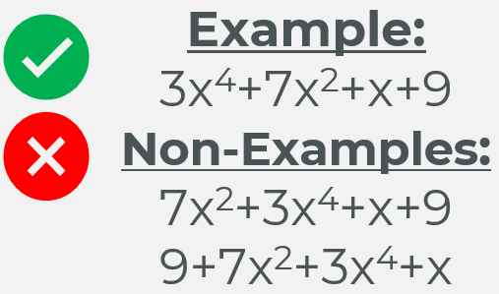
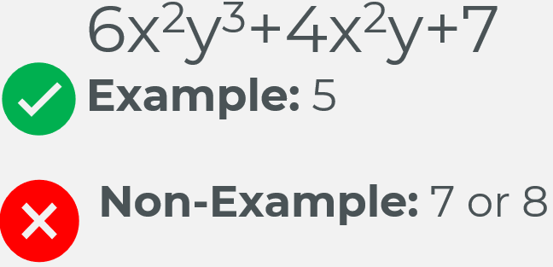


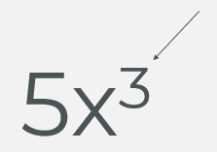


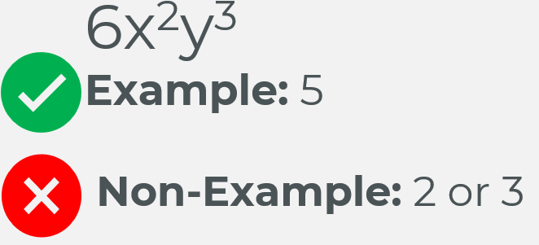
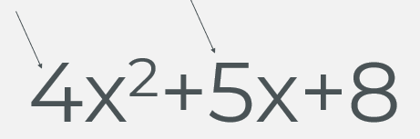


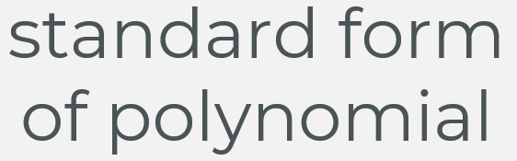


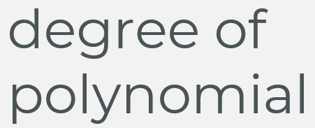
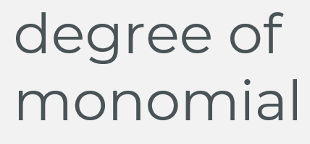
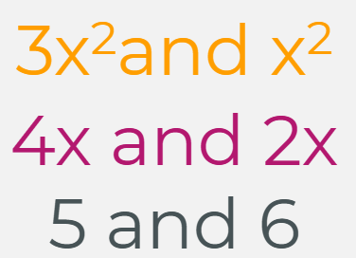

Word Sort

Slide 12
Word Wall

Slide 13
Structured Math Talk
Listen
and
Compare

Slide 14
Which solution makes the most sense mathematically to you? Why?
más sentido

Slide 15

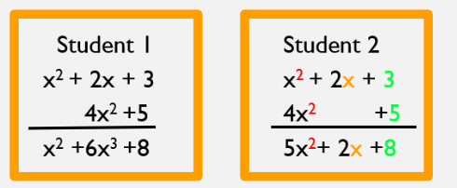
Which solution makes the most sense mathematically to you? Why?
más sentido

Slide 16
Reflection
How did the word sort and word wall provide access without reducing the rigor of the worked example?

Slide 17
Debrief
What are all the components that provided support to all students?
Routines
Mathematical Practices
Language Supports

Slide 18
Professional reflection and Next Steps
How did this demonstration incorporate elements of effective professional learning for adults?
As a leader, how could you incorporate this in your schools?

Slide 19
Questions ?

