Slide 1
Beyond Pull-Outs Building Sustainable ESL-Classroom Collaboration Models Repositioning ESL Teachers as Core instructional Partners
Dr. Malcolm J. Martin
CARTWRIGHT ELEMENTARY
Bedford County Schools

Slide 2

Session objectives
Reframe the traditional “pull-out” mindset to address teacher isolation.
Identify key models and strategies for ESL-classroom collaboration.
Evaluate current school practices and identify areas for inclusion.
Develop actionable steps to foster a more integrated & collaborative ESL framework.

Slide 3
Who’s Really Being Pulled Out?
Notes:
“Traditionally, when we talk about 'pull-out,' we mean pulling students out of the classroom for ESL services. But here’s the uncomfortable truth we don’t always acknowledge:
We’re also pulling our ESL teachers out—out of planning, out of teams, and often out of core decision-making.
We unintentionally isolate them from the academic life of the school. They’re running from room to room, rarely sitting with a team to plan, reflect, or problem-solve. The result? Students may get language support, but it’s fragmented. And teachers—both general education and ESL—lose out on the collaboration that drives student growth.”
Prompt for the audience:
“Take a second and think—at your school, when was the last time your ESL teacher was at the table for a PLC or data meeting? Are they being pulled from classrooms—or pulled out of community?”

Slide 4
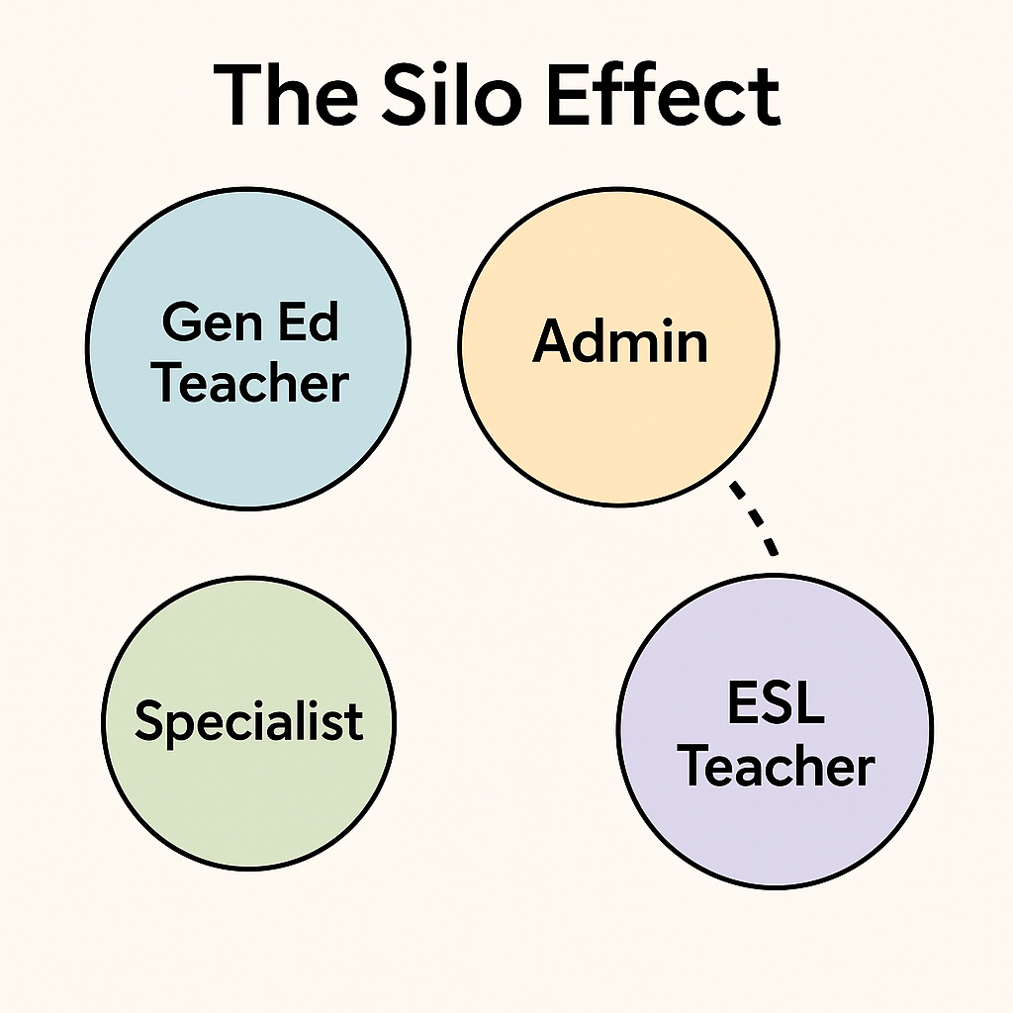
Silo effect
When ESL teachers are left out of the core instructional loop, we create silos, and silos weaken learning for everyone.
Missed alignment of content & language goals
Gaps in communication between teachers
ESL teacher seen as a separate service, not a partner
Students receive fragmented support
Notes:
“When ESL teachers are not included in the rhythm of the school—PLCs, data meetings, curriculum planning—they get siloed. And siloed roles lead to siloed instruction.
Think about it: If a grade-level team plans a math unit without ESL input, the language demands of that unit might never be considered. And if the ESL teacher works in isolation, the classroom teacher may not know how to reinforce language objectives when the ESL teacher isn’t there.
The problem isn’t just lost communication—it’s lost opportunity. Multilingual learners thrive when everyone is working from the same playbook. Without that shared playbook, we unintentionally create instructional gaps.”

Slide 5

Why it matters
Multilingual learners are everyone’s responsibility.
Language learning happens in every subject, not just ESL sessions.
ESL teachers bring unique expertise in language development and scaffolding.
Collaboration leads to aligned goals and coherent support.
Notes:
When ESL teachers are not part of the school’s instructional core, the quality of learning for multilingual students suffers.
Language is not a stand-alone subject. It’s woven into math, science, social studies, art—you name it. If ESL teachers are left out of planning and discussion, we miss critical opportunities to embed language objectives across the curriculum.
These teachers have specialized strategies to make content accessible without watering it down. But if they’re isolated, those strategies stay siloed—and students receive inconsistent support.
When we pull ESL teachers in—into PLCs, into data talks, into lesson planning—students benefit from unified goals and consistent scaffolding in every class.”

Slide 6
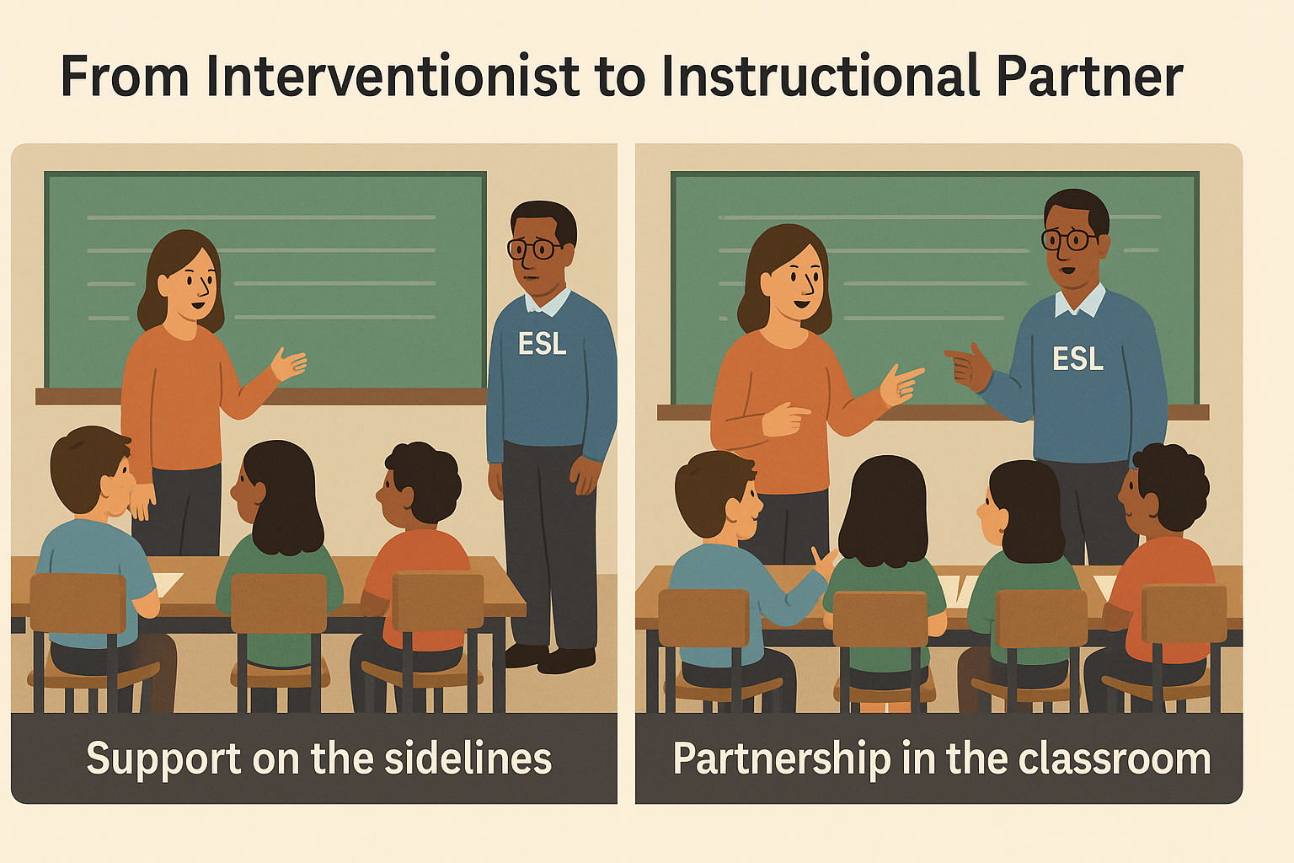
a collaborative mindset From Interventionist to Instructional Partner
Shift language from “my kids” to “our kids”
Focus on shared goals: academic + language growth
Value ESL teachers as content collaborators
Collaboration = joint ownership of outcomes
Notes:
In many schools, ESL teachers are still seen as interventionists—they take students, work with them, and bring them back. But in a collaborative model, they’re partners in the core instructional mission.
That means:
They’re not just reacting to classroom instruction—they’re shaping it.
They’re not ‘helping with vocabulary’ after the fact—they’re integrating language goals into the lesson design.
When we adopt this mindset, we stop dividing responsibility and start sharing ownership. These aren’t ‘your ESL students’—these are our students. And the measure of success is not just language proficiency—it’s academic achievement plus language growth.”

Slide 7
Integrated, Intentional, Instructionally Aligned
Integrated
ESL services happen in the flow of classroom instruction, not as an afterthought.
Language development goals are embedded in content lessons.
Intentional
Joint planning time ensures lessons target both academic content and language skills.
Strategies and supports are chosen deliberately based on student needs.
Instructionally Aligned
ESL and Gen Ed teachers use the same academic goals, pacing, and assessments.
Alignment prevents gaps and redundancy, keeping instruction cohesive.

Slide 8
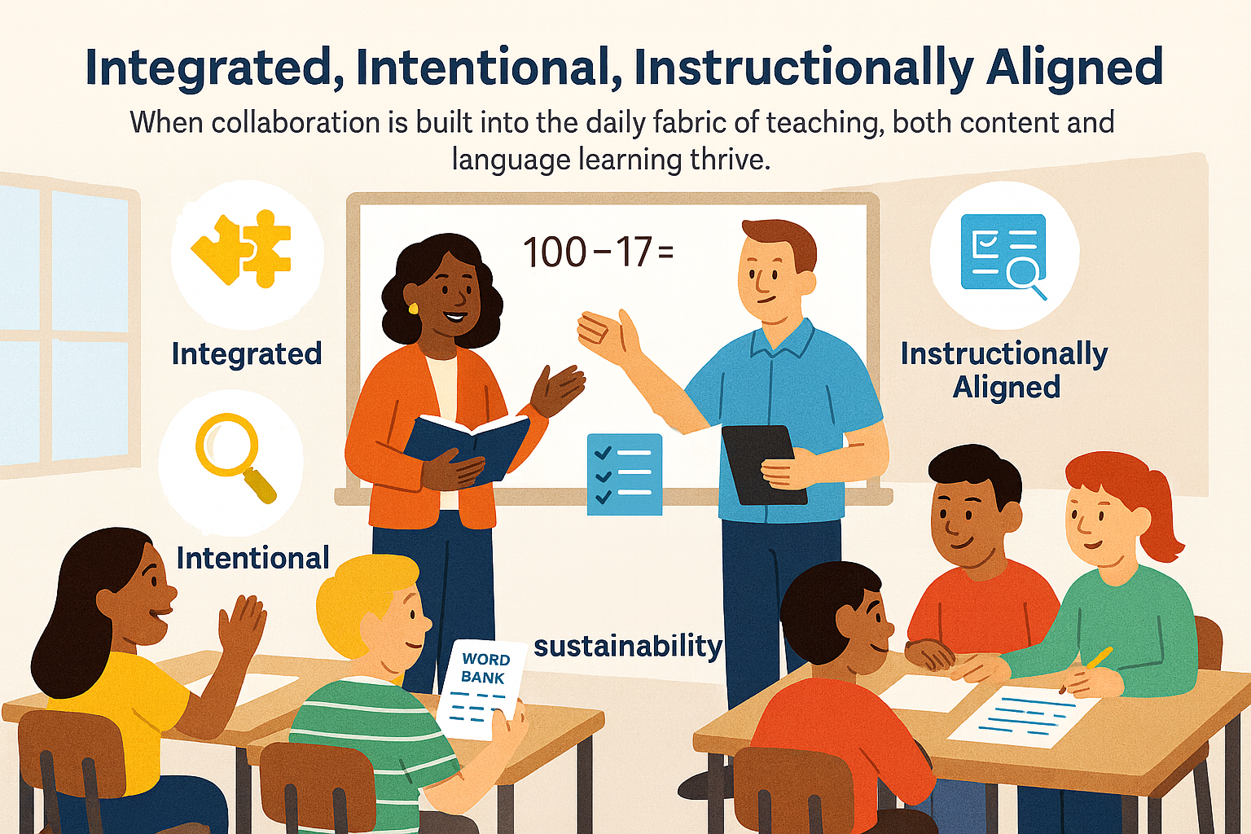

Slide 9
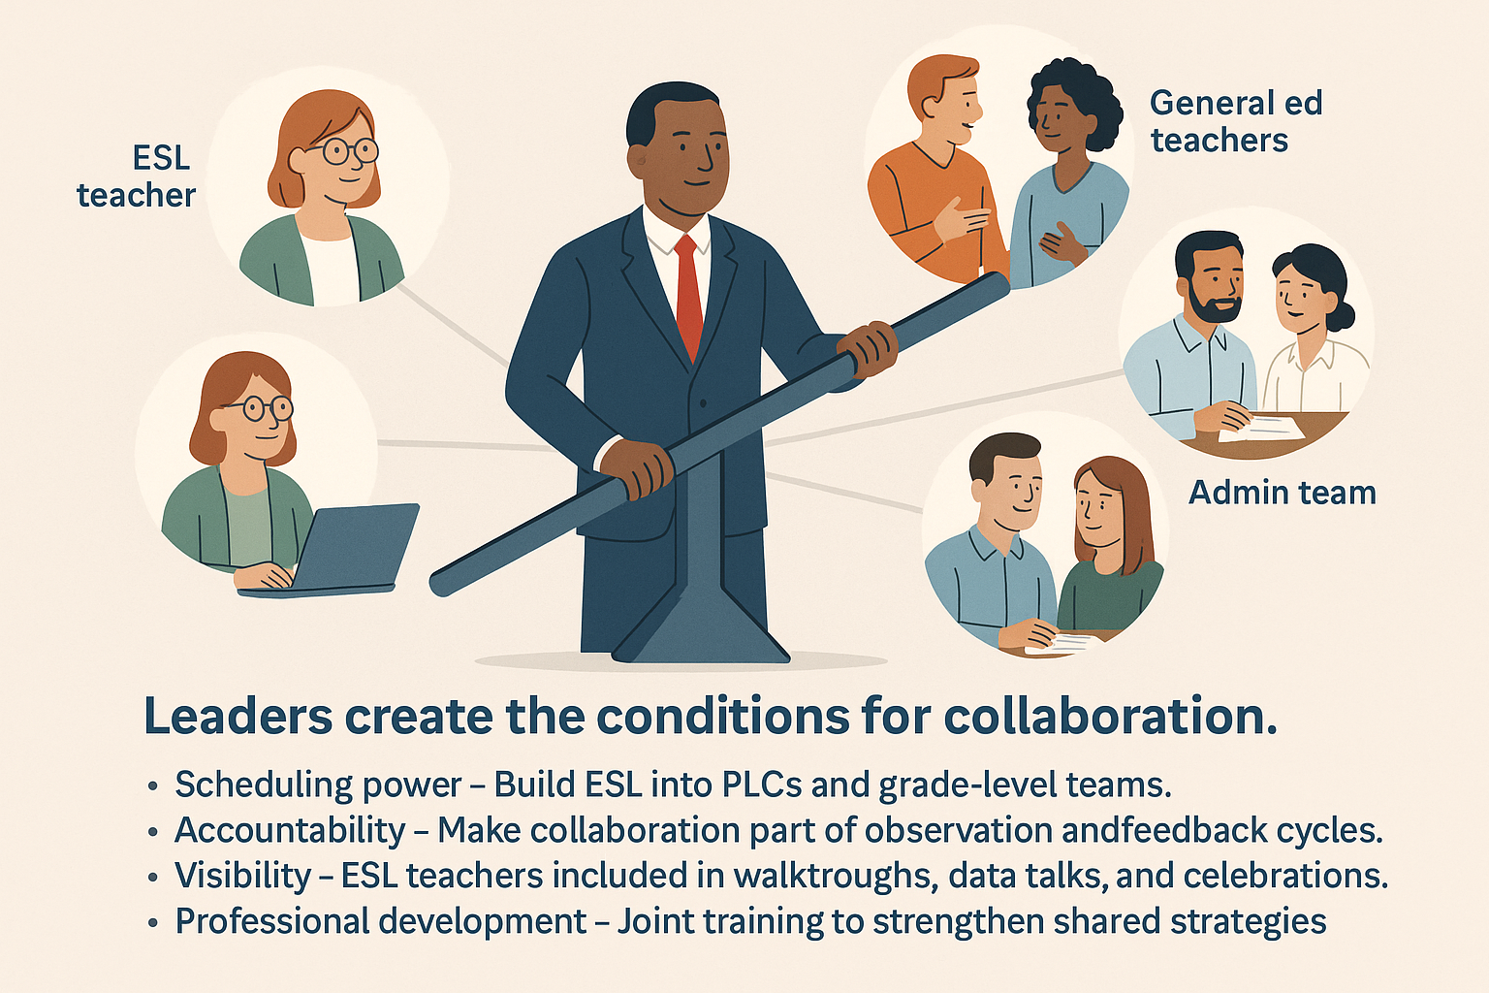
Leadership is the Lever
Notes:
Collaboration doesn’t happen by accident—it happens by design. And that design is in the hands of school leadership.
Leaders are the ones who decide:
Who sits at the PLC table.
Who gets invited to data talks.
How the master schedule is built.
When ESL teachers are deliberately placed in collaborative spaces, the message is clear: they’re not support staff on the fringe—they’re instructional partners at the core.
This isn’t just about feel-good teamwork. It’s about systems that require shared responsibility for multilingual learners. Without leadership setting the tone and making the time, collaboration will always be optional—and optional collaboration usually means no collaboration.

Slide 10
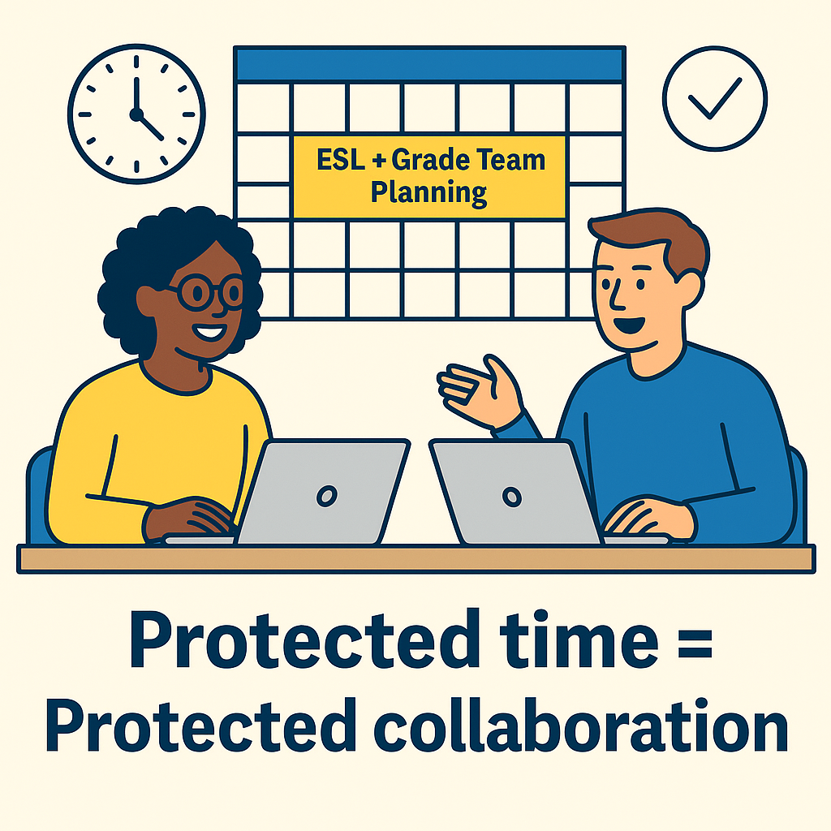
SCHEDULING AS EQUITY YOU CAN'T COLLABORATE IF YOU CAN'T MEET
Protect ESL teacher planning time with grade-level teams.
Avoid packing ESL schedules with only pull-out and testing.
Coordinate push-in times with core instruction.
Make collaboration non-negotiable in the master schedule.
Notes:
Time is the number one barrier I hear about when it comes to collaboration between ESL and general education teachers.
We say we value collaboration, but if we don’t build it into the schedule, we’re saying it’s optional—and optional usually means it won’t happen.
Protected planning time between ESL teachers and grade-level teams is not a luxury—it’s equity. Without it, planning will always be reactive, and supports will always be patchwork.
The master schedule is one of the most powerful tools leaders have. If we prioritize joint planning in the schedule, we send a clear message: this work matters, and it will happen.

Slide 11
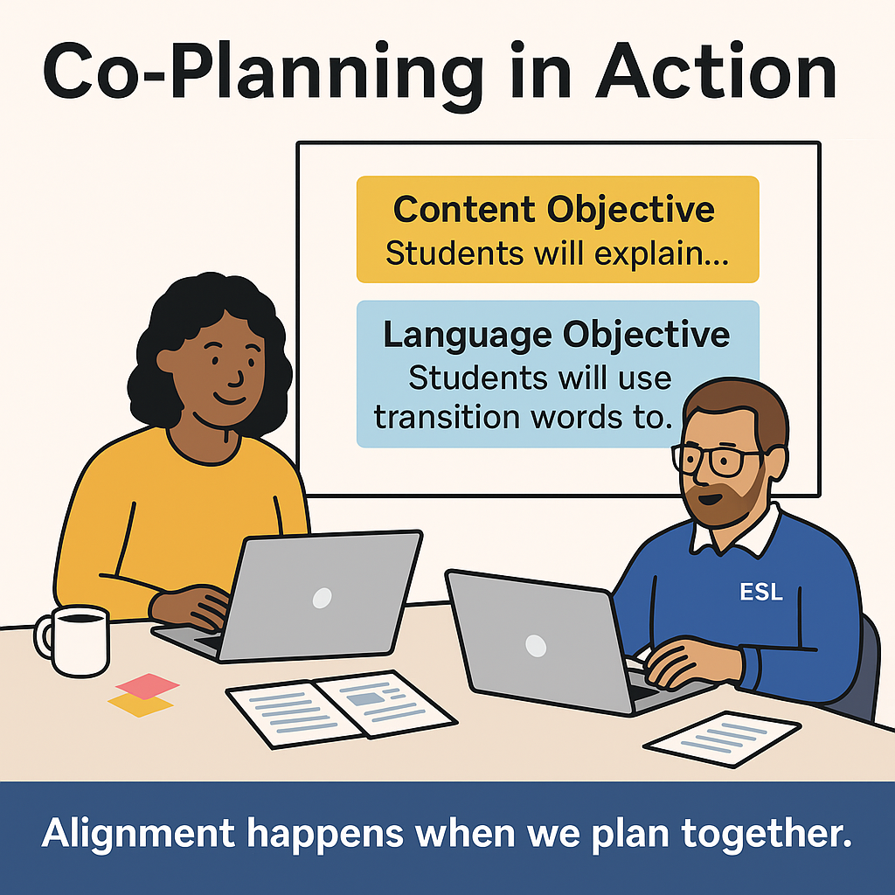
Co-Planning in action
Integrate language and content objectives from the start.
Share responsibility for lesson delivery and assessment.
Review student work together to adjust instruction.
Keep it consistent—make co-planning a regular habit.
Notes:
Co-planning is where the magic happens—it’s not just about dividing tasks, it’s about creating instruction together.
In a strong co-planning session:
The ESL and classroom teacher start with both content and language objectives on the table.
They discuss strategies for making the lesson accessible without lowering expectations.
They look at actual student work to decide what needs reteaching, extension, or language support.
They plan assessments together so they’re measuring both content mastery and language growth.
Co-planning is not ‘when I have time’—it’s built into the routine. When it’s consistent, lessons are more cohesive, students hear consistent messages, and the instructional partnership grows stronger.

Slide 12
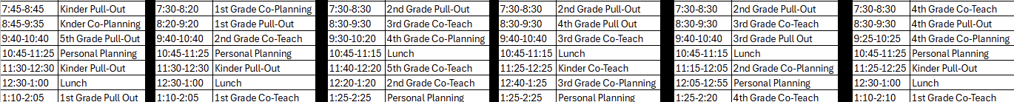
Co planning/scheduling in action

Slide 13
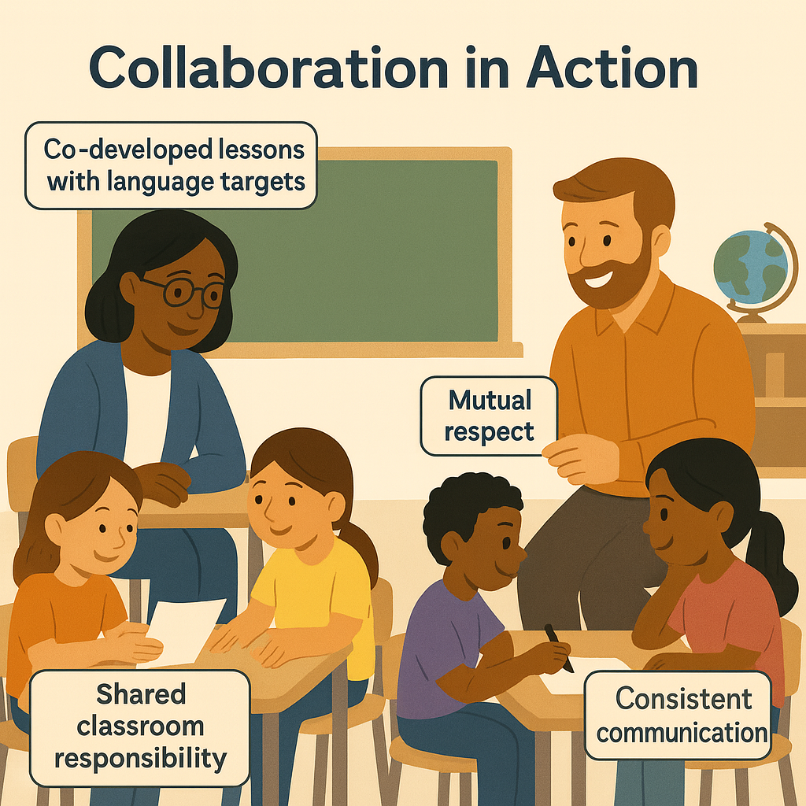
Signs of strong collaboration
Lessons include both academic and language goals.
Teachers share delivery and support equally.
Students benefit from cohesive strategies.
There’s visible rapport and trust between teachers.
Notes:
When collaboration is working, it’s obvious—both in the classroom and in the results.
You’ll see:
Lessons that blend content and language goals naturally.
Teachers taking turns, jumping in to support each other, and building on each other’s teaching.
Students who understand that both teachers are there for them, not just one for content and one for language.
Mutual respect and easy communication between co-teachers.
When you see this in action, you’re not just watching instruction—you’re watching a partnership that makes learning more accessible, rigorous, and joyful.

Slide 14
What's holding us back
What are the barriers to stronger collaboration in your school?
Notes:
Every school has challenges to collaboration—and we can’t fix what we don’t name.
The most common ones I hear are:
Time: No protected planning built into schedules.
Misunderstanding of ESL Role: Seeing ESL teachers as support staff instead of instructional partners.
Compliance-Only Mindset: Focusing only on paperwork or testing, not instructional collaboration.
Fixed Schedules: Master schedules that make collaboration impossible.
Understaffing: ESL teachers stretched too thin across multiple grades or buildings.
These barriers aren’t permanent. But we can’t wish them away—we have to design systems that dismantle them.”

Slide 15
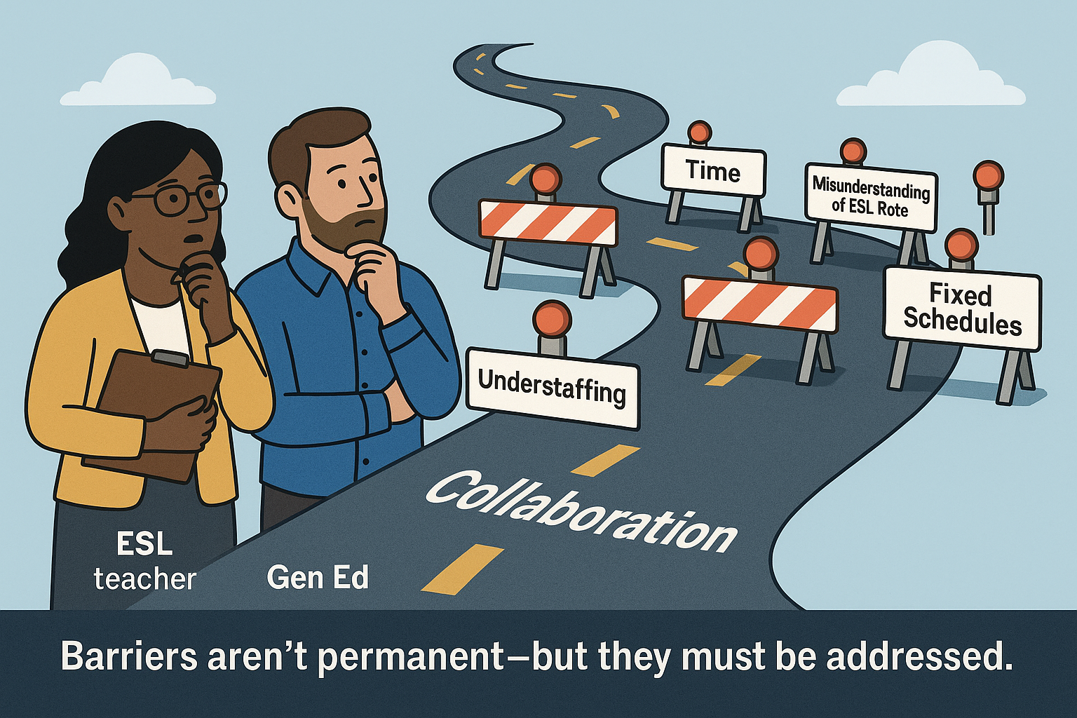
Time: No protected planning built into schedules.
Misunderstanding of ESL Role: Seeing ESL teachers as support staff instead of instructional partners.
Compliance-Only Mindset: Focusing only on paperwork or testing, not instructional collaboration.
Fixed Schedules: Master schedules that make collaboration impossible.
Understaffing: ESL teachers stretched too thin across multiple grades or buildings.

Slide 16
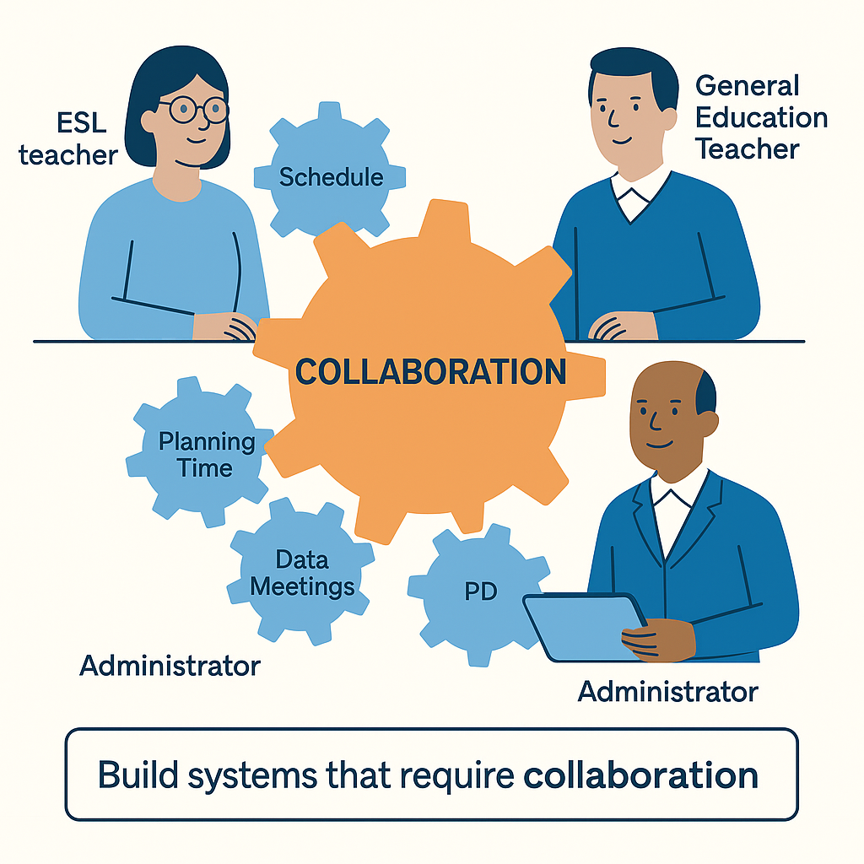
Shift the system, not the people
Collaboration is a system design decision, not just a personal choice.
Schedules, PD, and data meetings should require ESL inclusion.
Protect planning time and make it non-negotiable.
Embed ESL collaboration into accountability structures.
Notes:
“If collaboration is only happening because one teacher is willing to make it work, it’s fragile. When that teacher leaves or gets too busy, it falls apart.
We need systems that make collaboration the norm:
Master schedules that require ESL planning time with grade-level teams.
Data meetings that include language and content discussion.
Professional development that’s joint between ESL and general education staff.
Administrative follow-up and accountability so collaboration isn’t optional.
When you design the system right, collaboration becomes part of the culture—not just an act of goodwill.”

Slide 17
This Isn’t About Working Harder, It’s About Structuring Smarter
We need systems that make collaboration the norm:
Master schedules that require ESL planning time with grade-level teams.
Data meetings that include language and content discussion.
Professional development that’s joint between ESL and general education staff.
Administrative follow-up and accountability so collaboration isn’t optional.
When you design the system right, collaboration becomes part of the culture, not just an act of goodwill.

Slide 18
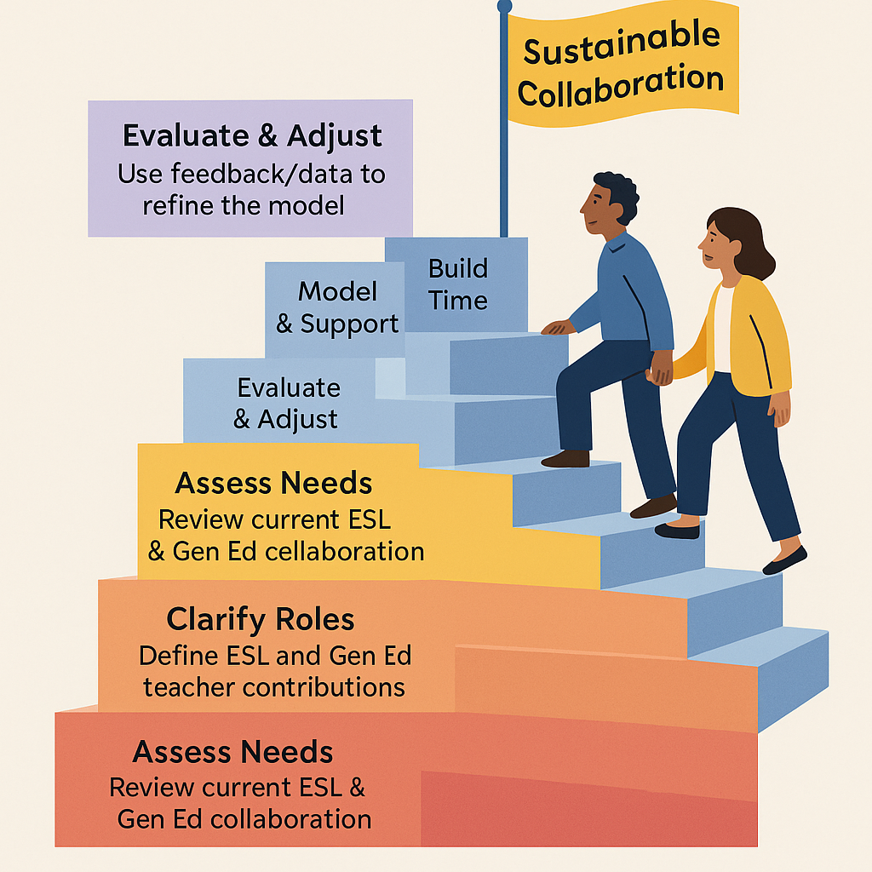
Steps to Build Sustainable Collaboration
Start small - focus on one grade or team first.
Define expectations so collaboration isn’t ambiguous.
Prioritize scheduling to protect joint planning.
Support consistently - leaders participate in the process.
Review regularly - make adjustments based on results.
Notes:
Collaboration doesn’t happen by accident—it’s designed. Here’s a step-by-step framework you can use:
Assess Needs: Look at where collaboration is happening and where it isn’t.
Clarify Roles: Teachers need to know exactly how they work together.
Build Time: Without dedicated time, collaboration will always be inconsistent.
Model & Support: Leaders should attend meetings, model collaboration, and provide resources.
Evaluate & Adjust: Check in, gather feedback, and adapt the process.
If you climb these steps deliberately, you’ll create a model that’s not just a good idea, but a sustainable reality.”

Slide 19
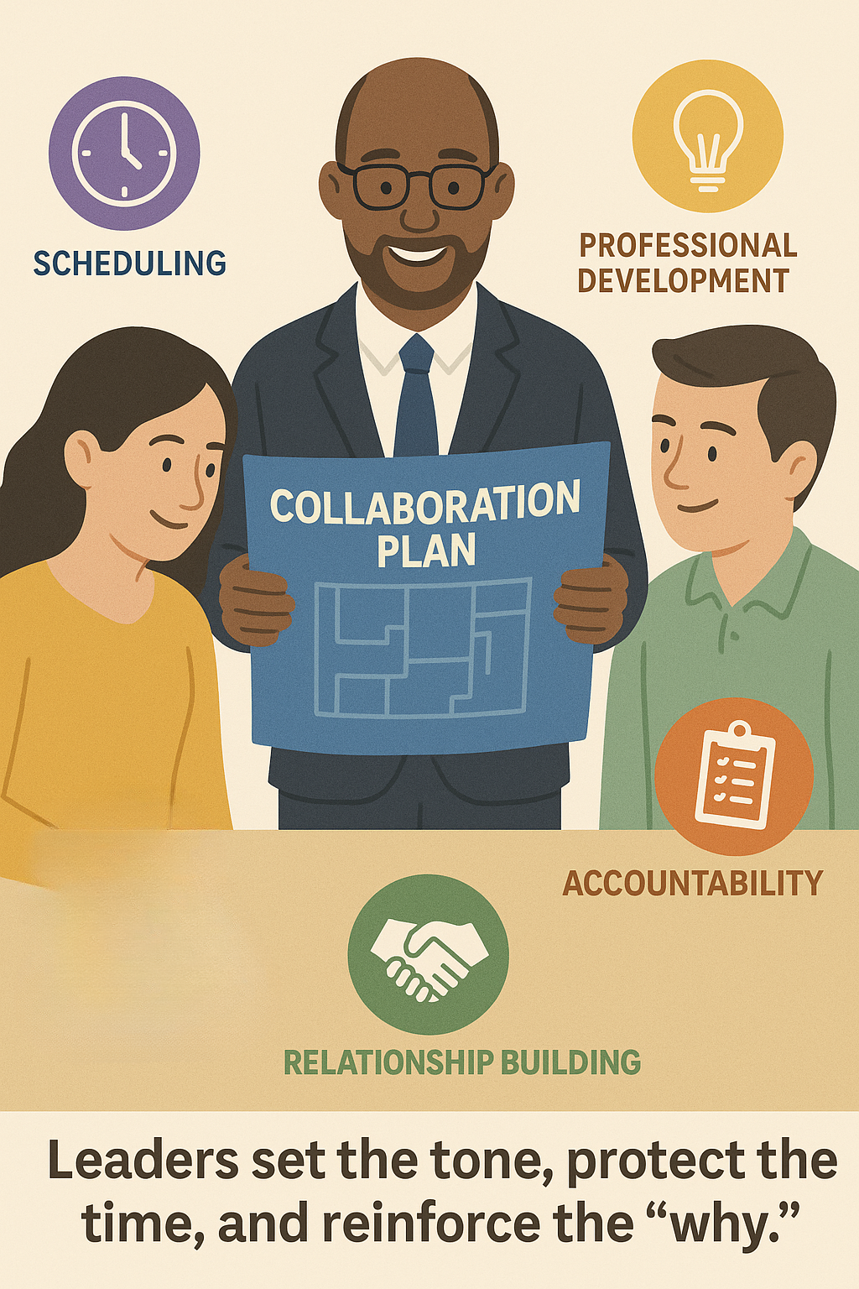
Leadership that sustains collaboration
Embed collaboration into master schedules.
Monitor and celebrate ESL + Gen Ed co-planning.
Provide joint professional learning opportunities.
Address barriers quickly, model problem-solving.
Recognize and celebrate collaboration success stories.
Notes:
When ESL teachers feel siloed, it’s often because leadership hasn’t fully built collaboration into the school’s culture and systems.
Leaders need to:
Ensure collaboration is visible in the master schedule.
Check in and celebrate successes so teachers know the work matters.
Provide PD that both ESL and Gen Ed teachers attend—together.
Address challenges quickly and visibly so teachers see collaboration is a priority.
Your leadership presence in this work signals that collaboration isn’t a side project—it’s part of how your school operates.”

Slide 20
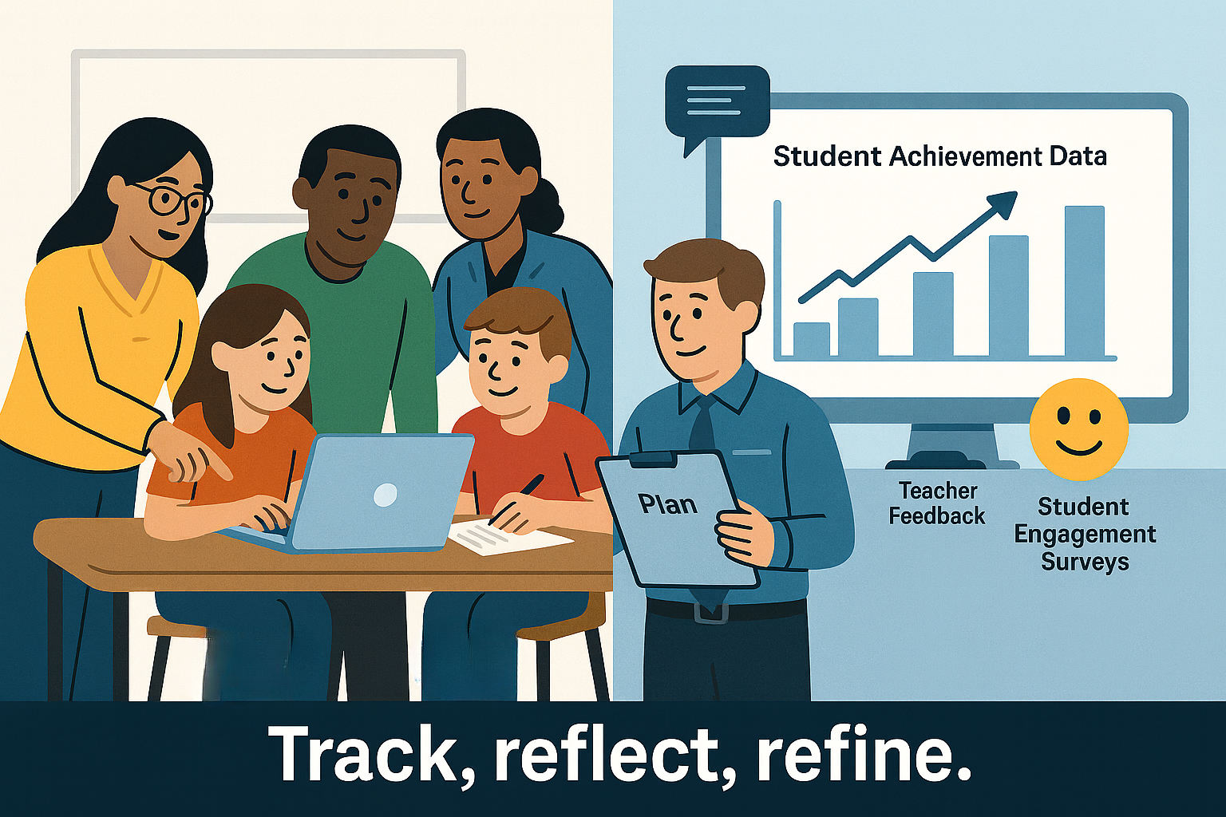
Measuring the impact of collaboration
Notes:
Implementation is only half the story, impact matters.
Track your multilingual learners’ growth, not just on language scores but on content mastery. Use teacher surveys and informal feedback to find what’s working and where the process needs adjusting. Observe classrooms for student engagement.
The key is to make measurement a normal part of the cycle so you can refine and sustain the work.

Slide 21
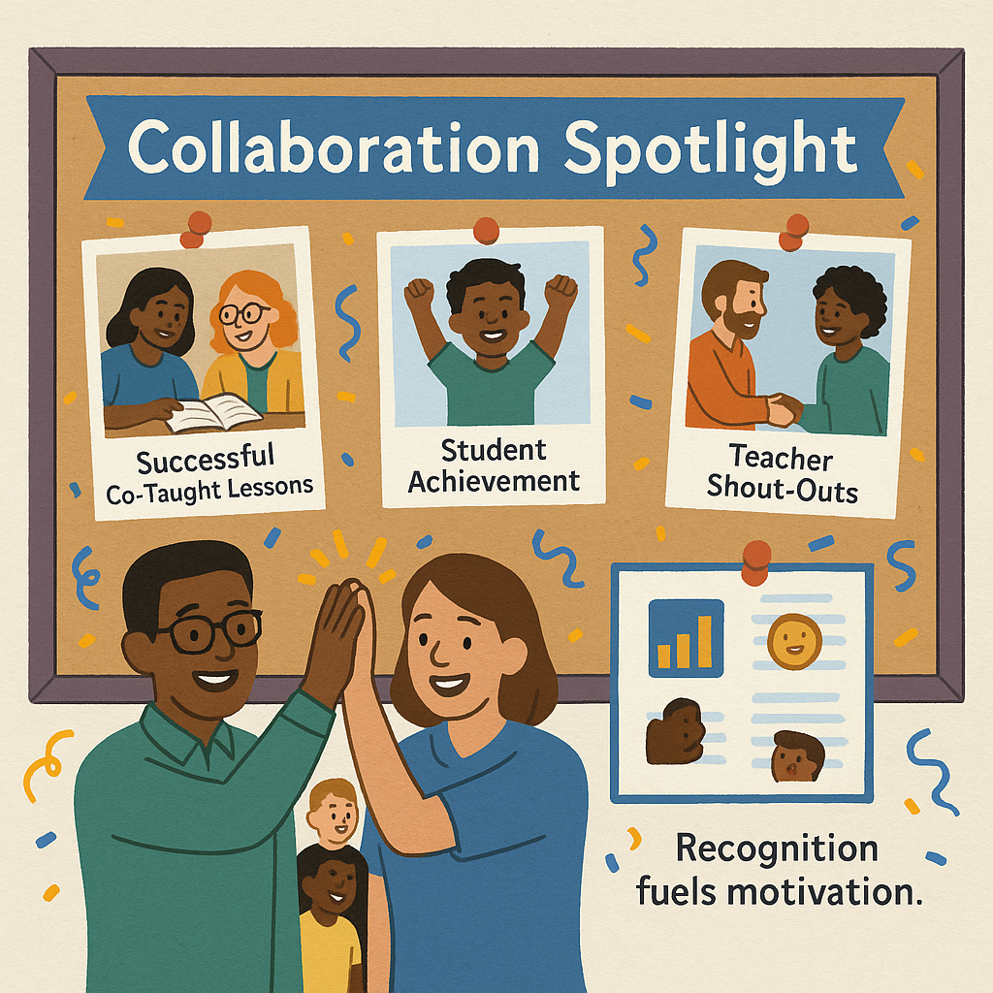
Small wins build big change
Highlight teacher collaborations in newsletters or staff meetings.
Share stories of how collaboration helped students succeed.
Post visuals of co-planning or co-teaching in action.
Recognize both ESL and Gen Ed teachers equally.
Notes:
When you recognize collaboration publicly, it reinforces its importance and shows others it’s valued.
You can feature a ‘Collaboration Spotlight’ in your weekly staff memo, share photos of co-teaching in action, or highlight specific student success stories that resulted from this teamwork.
Recognition fuels motivation—it’s a signal that the time and effort teachers are putting into collaboration matters.”

Slide 22
Next 3 steps
What’s one policy I can adjust or advocate for?
What’s one opportunity to elevate my ESL team this month?
How can I build co-planning into the school schedule?
Notes:
“Think about these as practical, immediate actions you can take back to your school.”
“Policies don’t have to be big—sometimes a small tweak to a schedule or protocol makes a big difference.”
“Elevating your ESL team can be as simple as giving them the mic at a faculty meeting or highlighting their work in a newsletter.”
“Co-planning is the glue of collaboration—look for even 15-minute windows you can protect.”

Slide 23
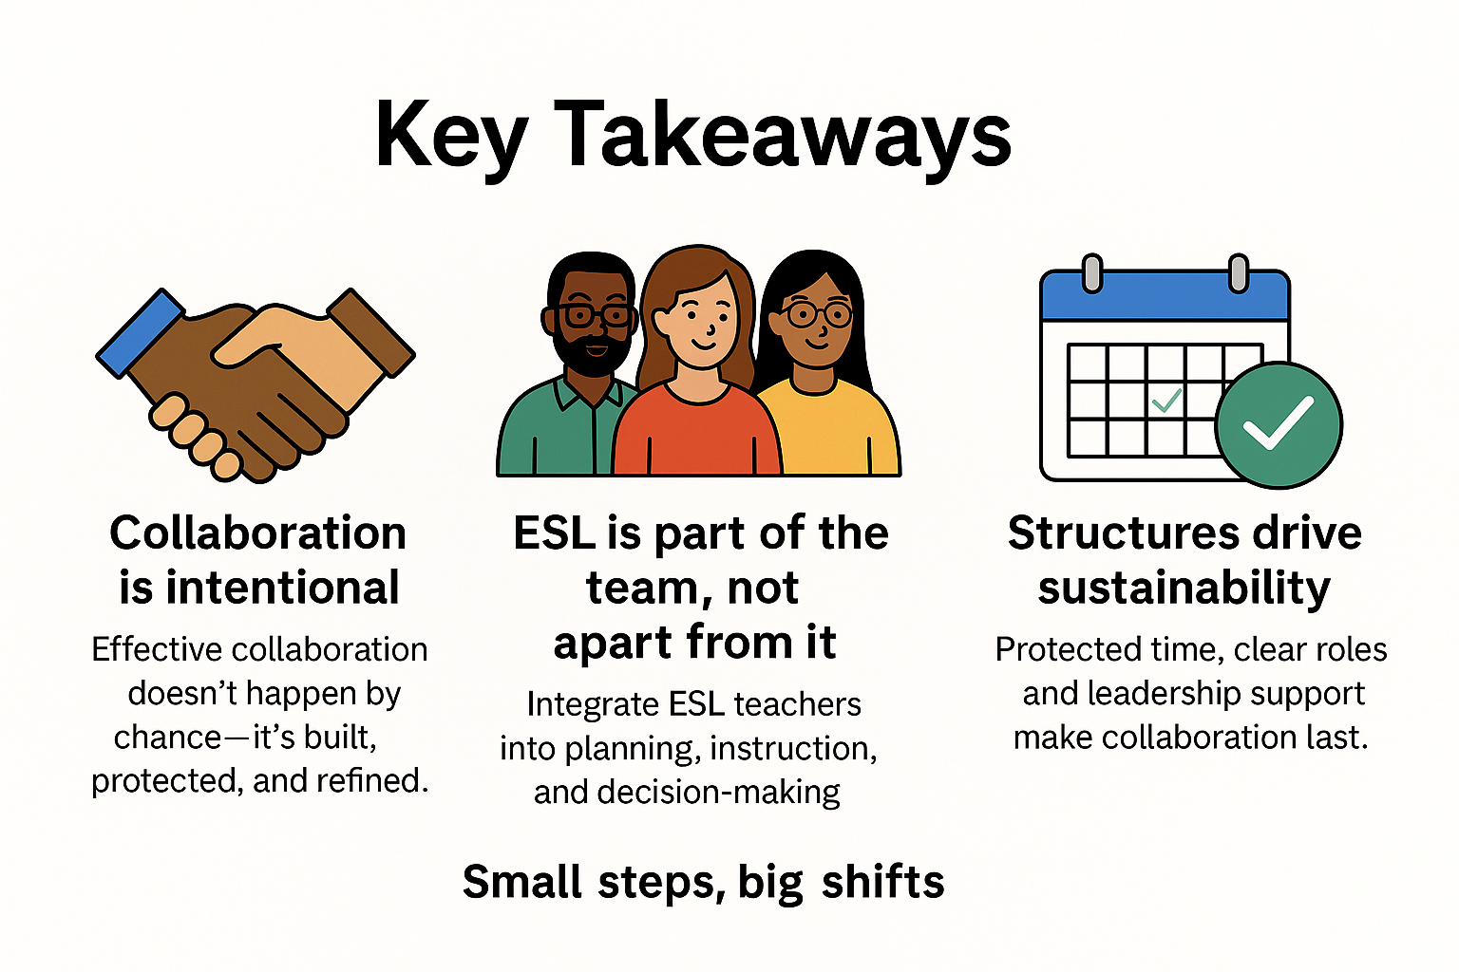
Key takeaways *collaboration isn't a luxury, it's a necessity for equity & achievement

Slide 24

Questions?

Slide 25
Contact info
Dr. Malcolm J. Martin
martinm1@bedfordk12tn.net

