Slide 1













Support your teachers:
Effects of a rigorous and supportive coaching cycle
Joshua Reese, Beth Disney, Jessica Williams

Slide 2
Beth Disney
Special Education Coach
disneye@loudoncounty.org
Joshua Reese
Special Education Supervisor
reesej@loudoncounty.org
Who We Are
Jessica Williams
Special Education Coach
goochj@loudoncounty.org

Slide 3

Agenda
Our Story
Why Coaching?
The Cycle
Coaching Strategies
Tips and Tools

Slide 4
Learning Objectives
Participants will learn new strategies for supporting both new and veteran teachers.
Participants will learn new strategies to support instructional quality and IDEA compliance
Participants will explore district created tools (forms, rubrics, etc…) utilized in coaching conversations

Slide 5


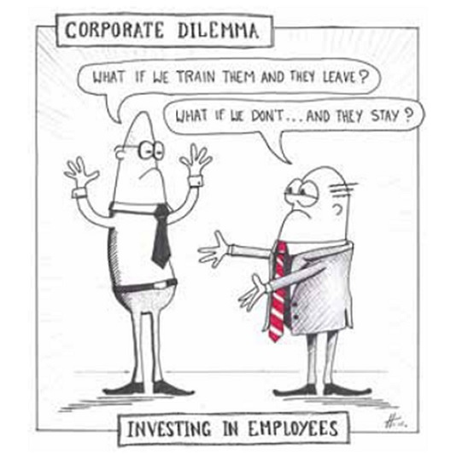
New job! What are we doing?
What is going on in our classrooms?
Are our students growing?
Are our teachers’ writing compliant IEPs?
Are teacher evaluations an accurate depiction of teacher quality and performance?

Slide 6
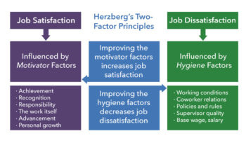



Why Coaching?
Raise teacher expectations but provide quality support
Insights into teacher’s strengths and weaknesses
Insight into school level procedures and support

Slide 7
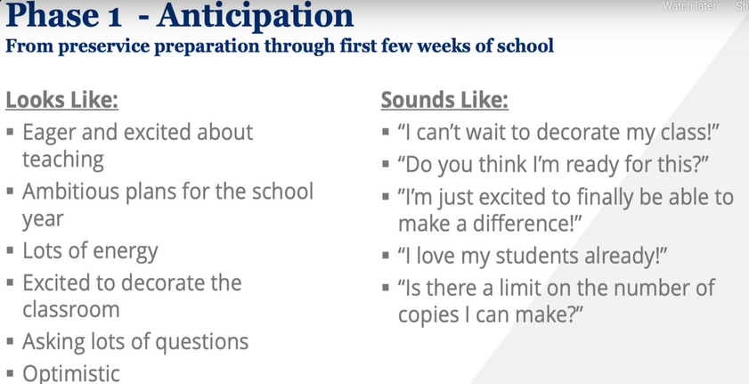
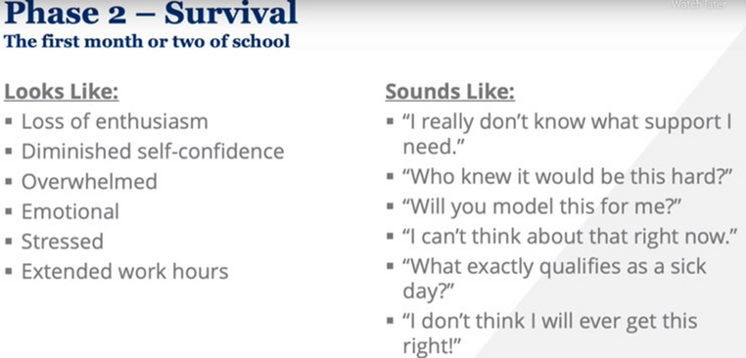
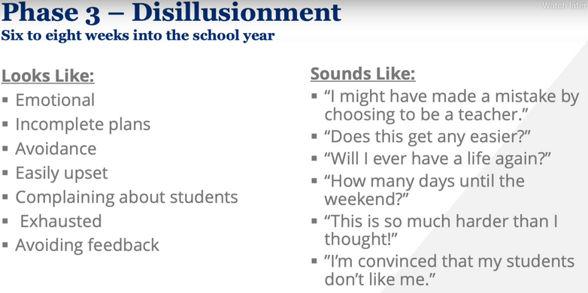
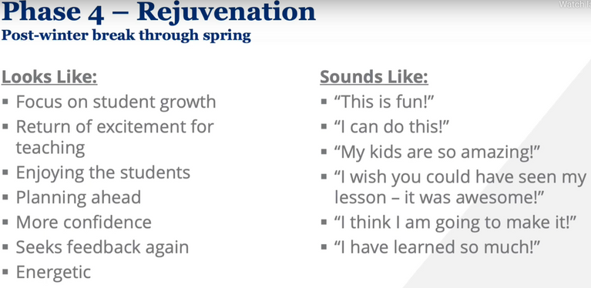
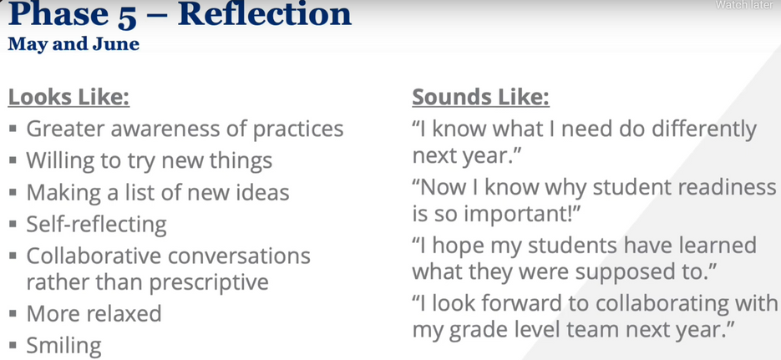
The Phases of Teaching Every Teacher Experiences

Slide 8


Teacher retention
50% more teachers retained after establishing the coaching cycle
2021: Retention rate 60%
2022: Retention rate 90%
2023: Retention Rate 88%
2024: Retention Rate 94%
Because It Works
APR Results
20 Needs Assistance
21 Needs Assistance
22 Meets Requirements
23 Needs Assistance
24 Meets Requirements
Monitoring and Compliance
98ᵗʰ percentile (3 of 148) in LEA compliance per TDOE
99ᵗʰ percentile in alignment between self monitors and state monitors (9 of 222, 12 of 222 possible findings)
Measurable Annual Goals-83% compliant vs state avg 30%

Slide 9
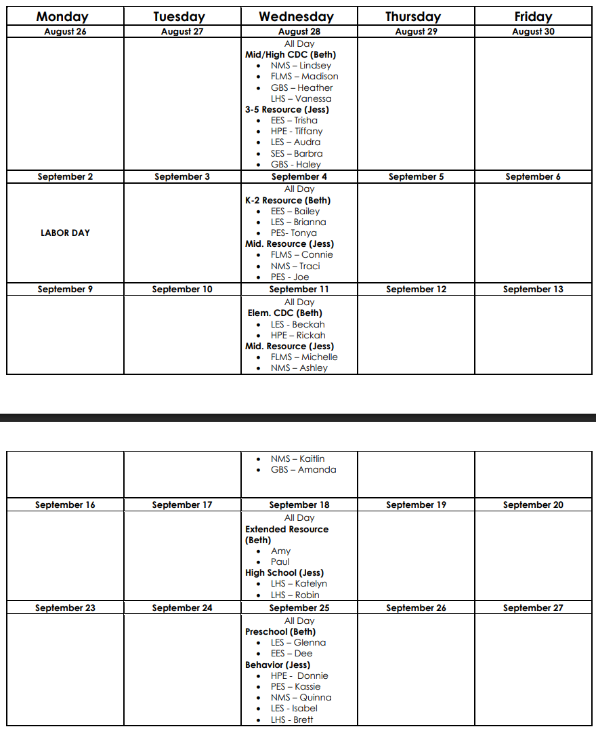
Pre-planning for Coaching/Data Team Meetings

Slide 10
Year Long Schedule for Coaching Meetings
August-September
With “Cohorts”
Full day
Break up into groups:
Group A focus on curriculum and making sure that there is alignment between PLAAFPs, Goals, and Instruction.
Group B group will focus on breaking down S/E, adaptive, and pre-vocational data and PLAAFPs and then if we get time analyzing any academic data.
November - December
With “Cohorts”
Full day
Break up into groups:
Group B focus on curriculum and making sure that there is alignment between PLAAFPs, Goals, and Instruction.
Group A group will focus on breaking down S/E, adaptive, and pre-vocational data and PLAAFPs and then if we get time analyzing any academic data.
January-February
Coaching Menu
March-April
With “Cohorts”
Full day
“Round Table” discussion to allow for collaboration, Problem solve for upcoming school year and work day

Slide 11
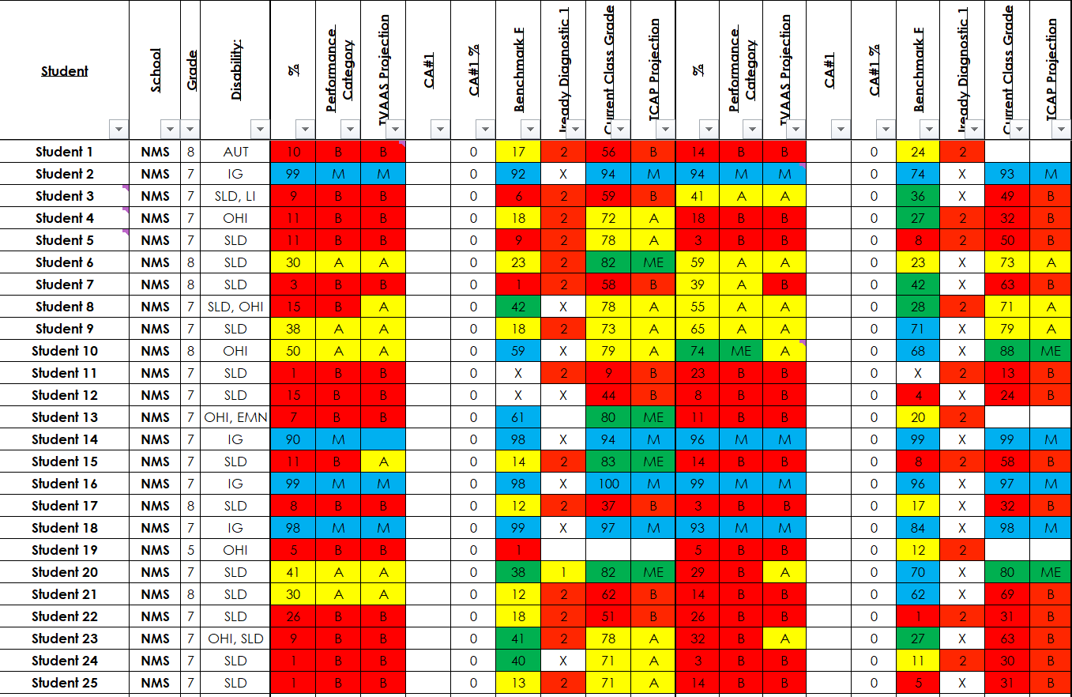
9/3/20XX

Slide 12
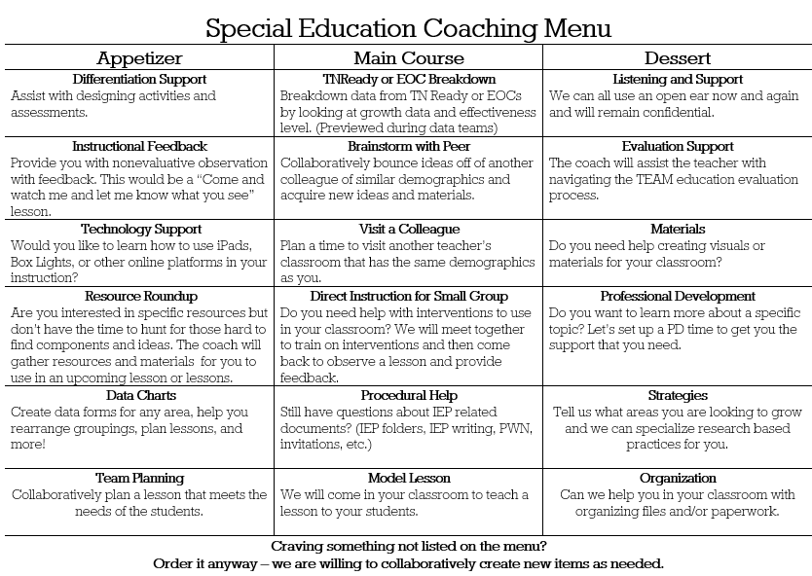
Coaching Menu
(January - February)

Slide 13
Allow us to evaluate whether the high-quality IEPs are being implemented as written in order to see alignment between IEPs (PLAFFPS and MAGS) and intervention.
01.
Walkthroughs
Help improve our implementation and alignment practices by having follow-up conversations with special education teachers.
Throughout the school-year
02.
Use similar model as the general eduction coaches
03.

Slide 14
Coaching Strategies
Create IEP resources
New Teacher Training
Sample IEPs from start to finish
Examples for each section of the IEP
“Menus”
Summer Training
"Refresher Training" in Winter as needed
IEP meeting support, IEP review, PWN review

Slide 15



Plan district professional development sessions grouped by teacher needs
What We Do
Plan Professional Learning Communities based on compliance updates, teacher requests and needs.
Providing ongoing professional development based on teacher, building, and district needs.
Collaborates with teachers and principals in determining appropriate resources and support for teachers

Slide 16
Creating Leadership Capacity
*New Model*
One Teacher Leader from each school
Half Day Sub
Present with materials and topics for “Teacher Leaders” to take back and redeliver during school level PLC days, parent teacher conferences, plan time, etc.
Topics are based on Teacher Surveys. Some examples include:
Write high-quality PLAFFPs and MAGS
Self-evaluate IEPS using rubrics

Slide 17
What’s Next?
Loudon County SPED
Continue to collect feedback from teachers on coaching practices and targeted support
Strengthen paraprofessional training and onboarding strategies
Support capacity building and problem solving among school level teams
Create space for cross district and discipline collaboration
*Joshua Reese - SPED Director
(reesej@loudoncounty.org)
*Beth Disney - SPED Coach
(disneye@loudoncounty.org)
*Jessica Williams - SPED Coach
(goochj@loudoncounty.org)

Slide 18


