Slide 1



WORKING TOGETHER FOR IMPACT
The Administrative Team’s Role in Special Education
Lauren Bauer, Ed.D.
Adam Demonbreun, M.Ed.
Charles Farmer, Ph.D.

Slide 2
TODAY’S OBJECTIVES
We will:
Consider How EXPECTATIONS Ensure Clarity and Shared Understanding for your Special Education Team.
Examine ACCOUNTABILITY Systems that Monitor Progress and Cultivate a Culture of Ownership and Responsibility.
Review SUPPORTS that Deliver Timely Guidance, Resources, and Encouragement that Empowers Teachers to Grow and Succeed in their Roles.

Slide 3

Our Promises to You
Keep it real
Provide you with practical ideas
Give you actionable takeaways

Slide 4
EXPECTATIONS: FOUNDATIONAL
Federal, TDOE, and district policies and procedures are your policies and procedures
Understand the eligibility (p. 23) and IEP processes (p. 7)
Your role as the LEA (p. 15)

Slide 5
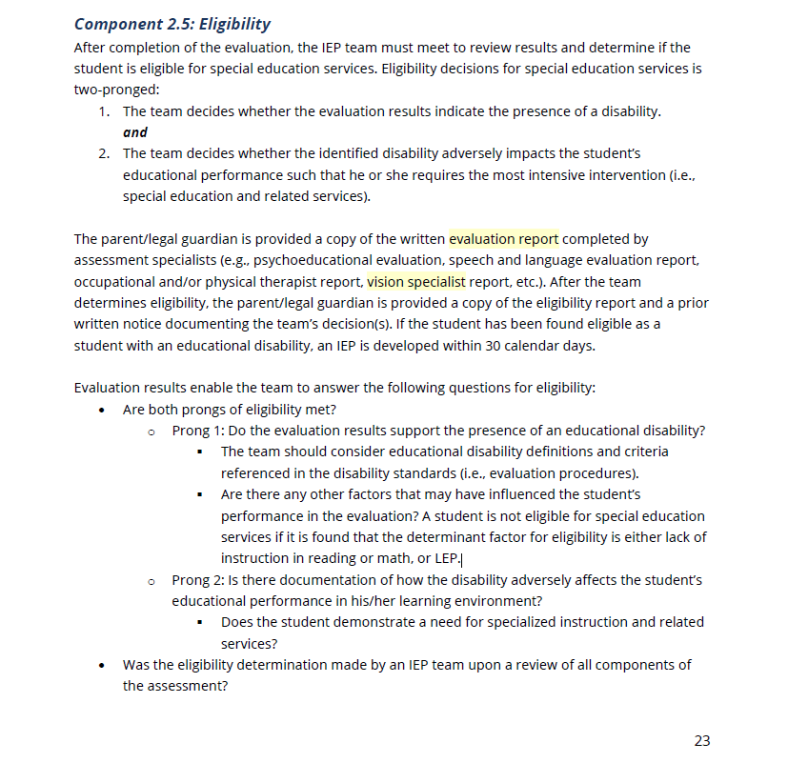
TDOE SPECIAL EDUCATION FRAMEWORK

Slide 6
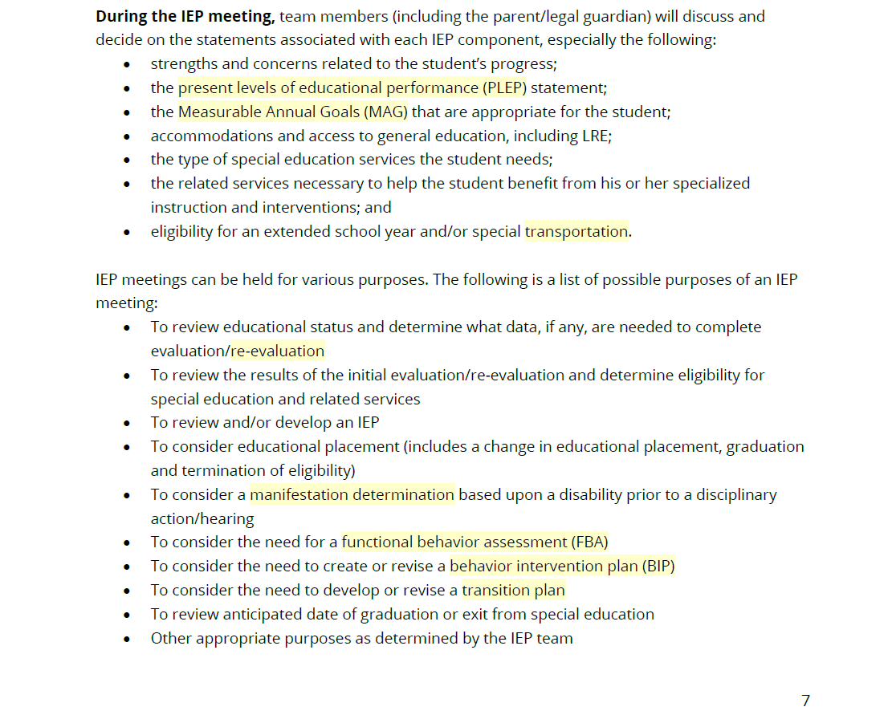
TDOE SPECIAL EDUCATION FRAMEWORK

Slide 7
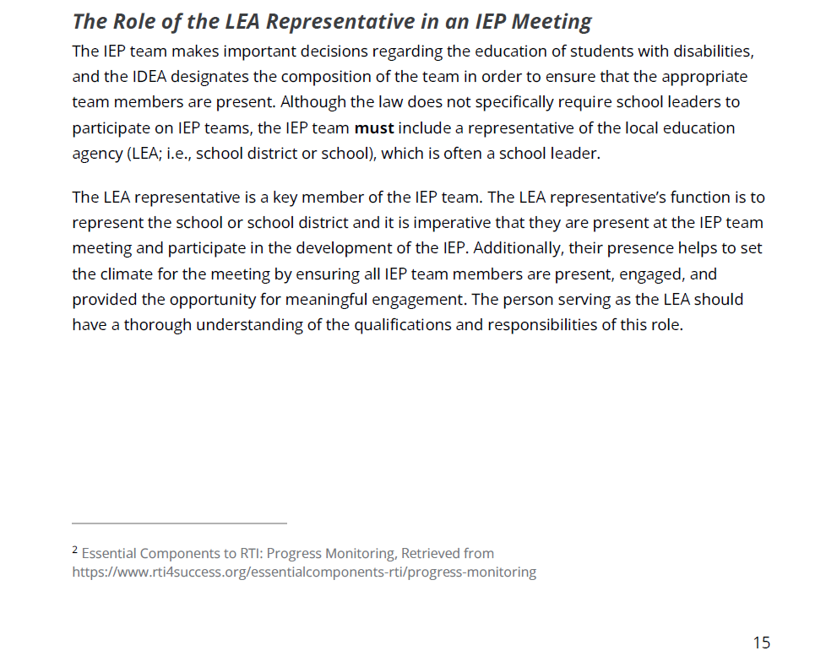
TDOE SCHOOL LEADER’S COMPANION GUIDE

Slide 8
EXPECTATIONS: COLLABORATION
Common planning
PLC process (regular meeting time, working agenda, norms, etc.)
Service providers- SLP, OT/PT, Behavior Specialist, Autism Specialist, School Psychologist

Slide 9
EXPECTATIONS: ACADEMICS
Classroom supports by Sped teachers
Inclusion
Pull-out
Extra dose
Interventions, Tier I extension, etc.

Slide 10
REFLECTION
In what ways do I ensure all staff understand their roles and responsibilities in support students with disabilities?
In what ways do I actively participate in the IEP meetings and demonstrate a deep understanding of the process?
How do I evaluate my areas of growth in supporting students with disabilities at my school?

Slide 11
ACCOUNTABILITY: PROGRESS MONITORING
Clear and consistent intervention program
Balanced approach to progress monitoring
Fidelity checks are crucial
Periodic data meetings to evaluate student progress

Slide 12
ACCOUNTABILITY: CULTURE OF OWNERSHIP
Fall 2019
TSI Designation for Special Education (2nd percentile)
Fall 2025
47th percentile

Slide 13
Share your intervention plan with your neighbor. Consider what components of your process are working well. What areas might need your specific attention?
TURN AND TALK

Slide 14
SUPPORTS: GUIDANCE
Let your teacher leaders lead.
Expect the team to have a solutions-oriented voice. When they do, let them have some victories no matter how small it seems to you.
Delicate balance between trusting and verifying.
Listen.
Engage. You cannot abdicate your responsibility as LEA.

Slide 15
SUPPORTS: RESOURCES
Always set aside funds for your Special Education Department. They don’t have to know about it...remember, even small wins matter.
Instructional Materials
Behavior Plan Rewards
Professional Learning
Our job is to support. If staff provides a logical and coherent plan, it should be easy to do.

Slide 16
WHOLE GROUP CONVERSATION
What does support look like in your building?

Slide 17
For Review
You are the Leader so set the example. Model expectations.
You are the Leader so hold yourself and others accountable.
You are the Leader so let no obstacles get in the way.

Slide 18
Thank You!
What Question Do You Still Need Answered?

Slide 19
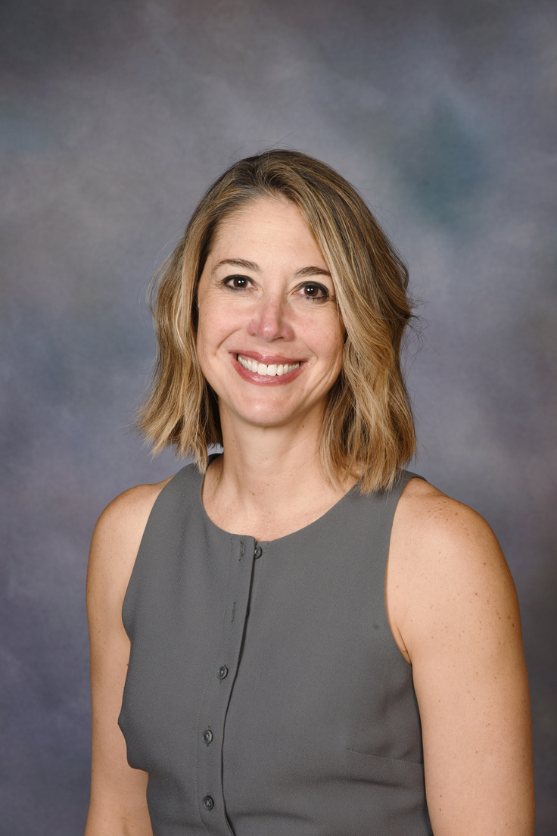
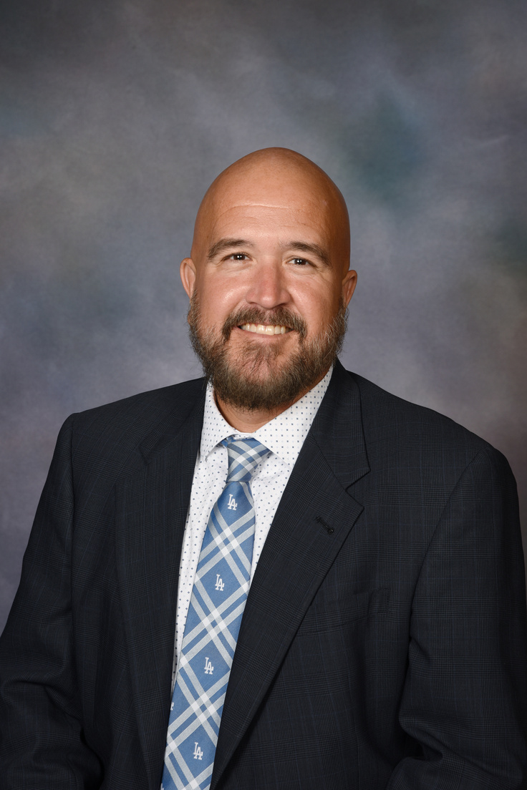
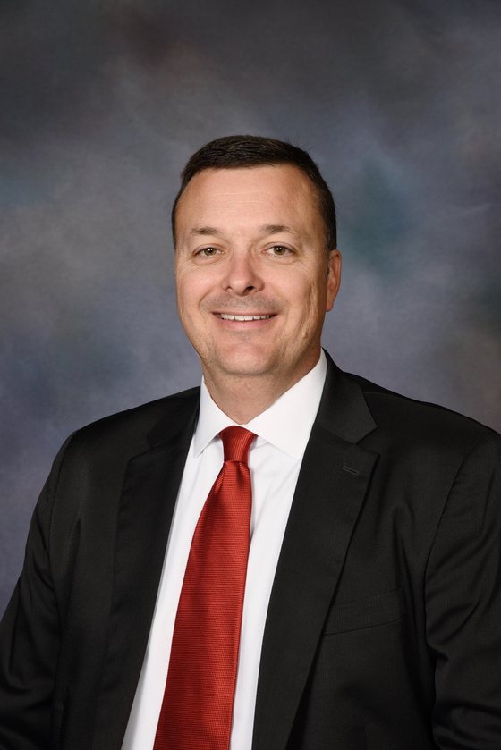
OUR TEAM
LAUREN BAUER, ED.D.
ADAM DEMONBREUN, M.ED.
CHARLES FARMER, PH.D.
BAUERLAU@FSSD.ORG
850.830.0734
DEMONBREUNADA@FSSD.ORG
615.775.8196
FARMERCHA@FSSD.ORG
615.881.6807
@FSSDFMSPRIN (X)
@CFARMER_EDU (INSTA)

