Slide 1
Empowering Special Education Through
Collaboration, Creativity, and Consistency.
A Framework for Lasting Impact
Presented by:
Mary Gramer, COTA/L (Franklin Special District)
Camille Schluep, Special Education Teacher (Franklin Special District)

Slide 2
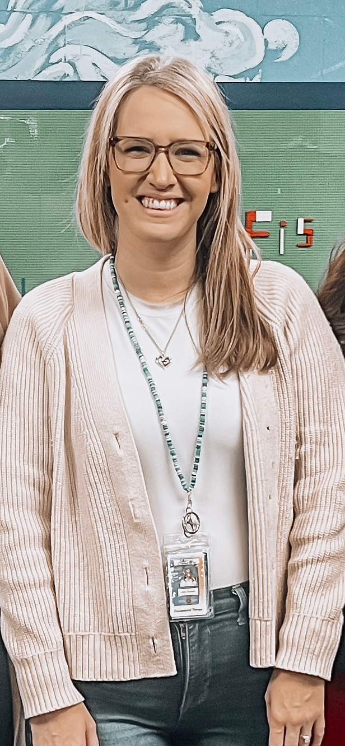
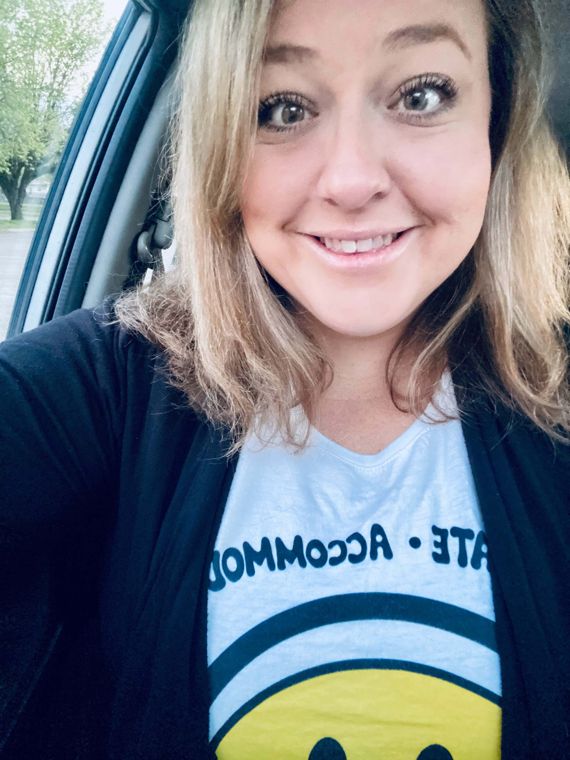
Presenters:
Mary Gramer
Licensed Certified Occupational Therapy Assistant
Camille Schluep
Special Education Teacher

Slide 3
Agenda
01
Introductions
02
Collaboration
03
Creativity
04
Consistency
05
Q&A

Slide 4
Collaboration, Creativity, and Consistency.
A framework for lasting impact in your Special Education Classroom

Slide 5

Collaboration

Slide 6
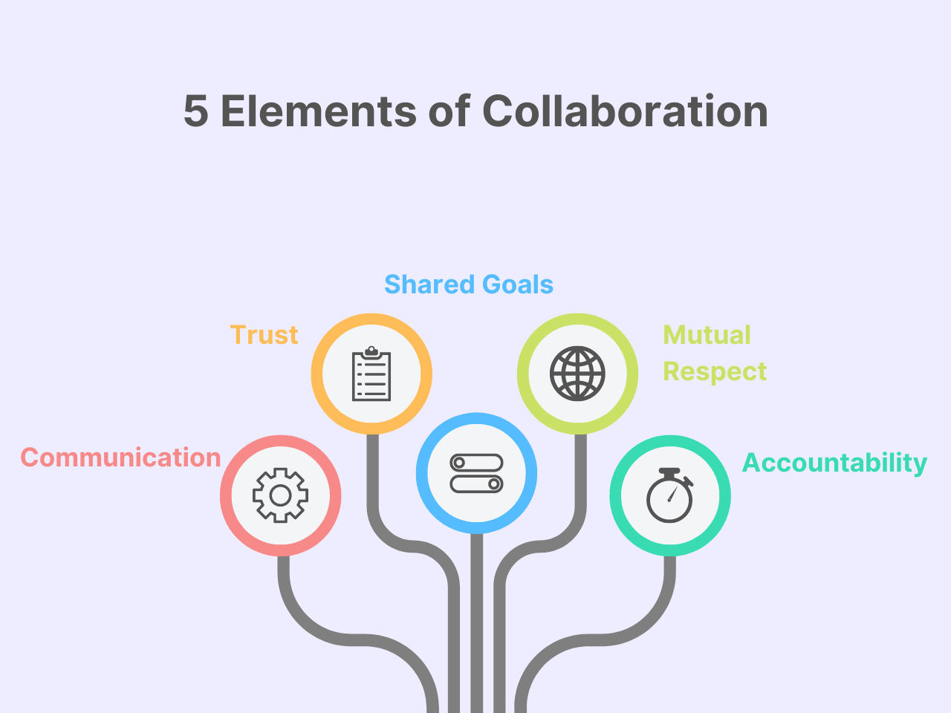

Slide 7
Why is collaboration important?

Slide 8
Benefits the student.
Enhances the understanding of student needs.
Improves instruction and supports.
Compliance and Regulations (IDEA).

Slide 9
Who should you collaborate with regularly?

Slide 10
The Student
The Students’ family
General Education Teacher
Related Service Providers
Paraprofessionals/TA
Administration
Instructional Coaches

Slide 11
What should collaboration look like in Special Education?

Slide 12
Planning with related service providers to support the students’ IEP goals.
Attending grade level PLC’s to review data and discuss accommodations or modifications for future assessments.

Slide 13
Collective responsibility to educate the student.
Discussing strategies to maintain consistency across settings.
Providing student based training to help support all stakeholders.

Slide 14
Checking in with paraprofessionals who support the student.
Teaching new behavior strategies to all team members.
Reviewing iep and behavior data as a collaborative team.

Slide 15
Speech and Language Therapist can collaborate with the students team to provide communication boards, visuals, and support with implementation of communication devices in the general education setting.

Slide 16
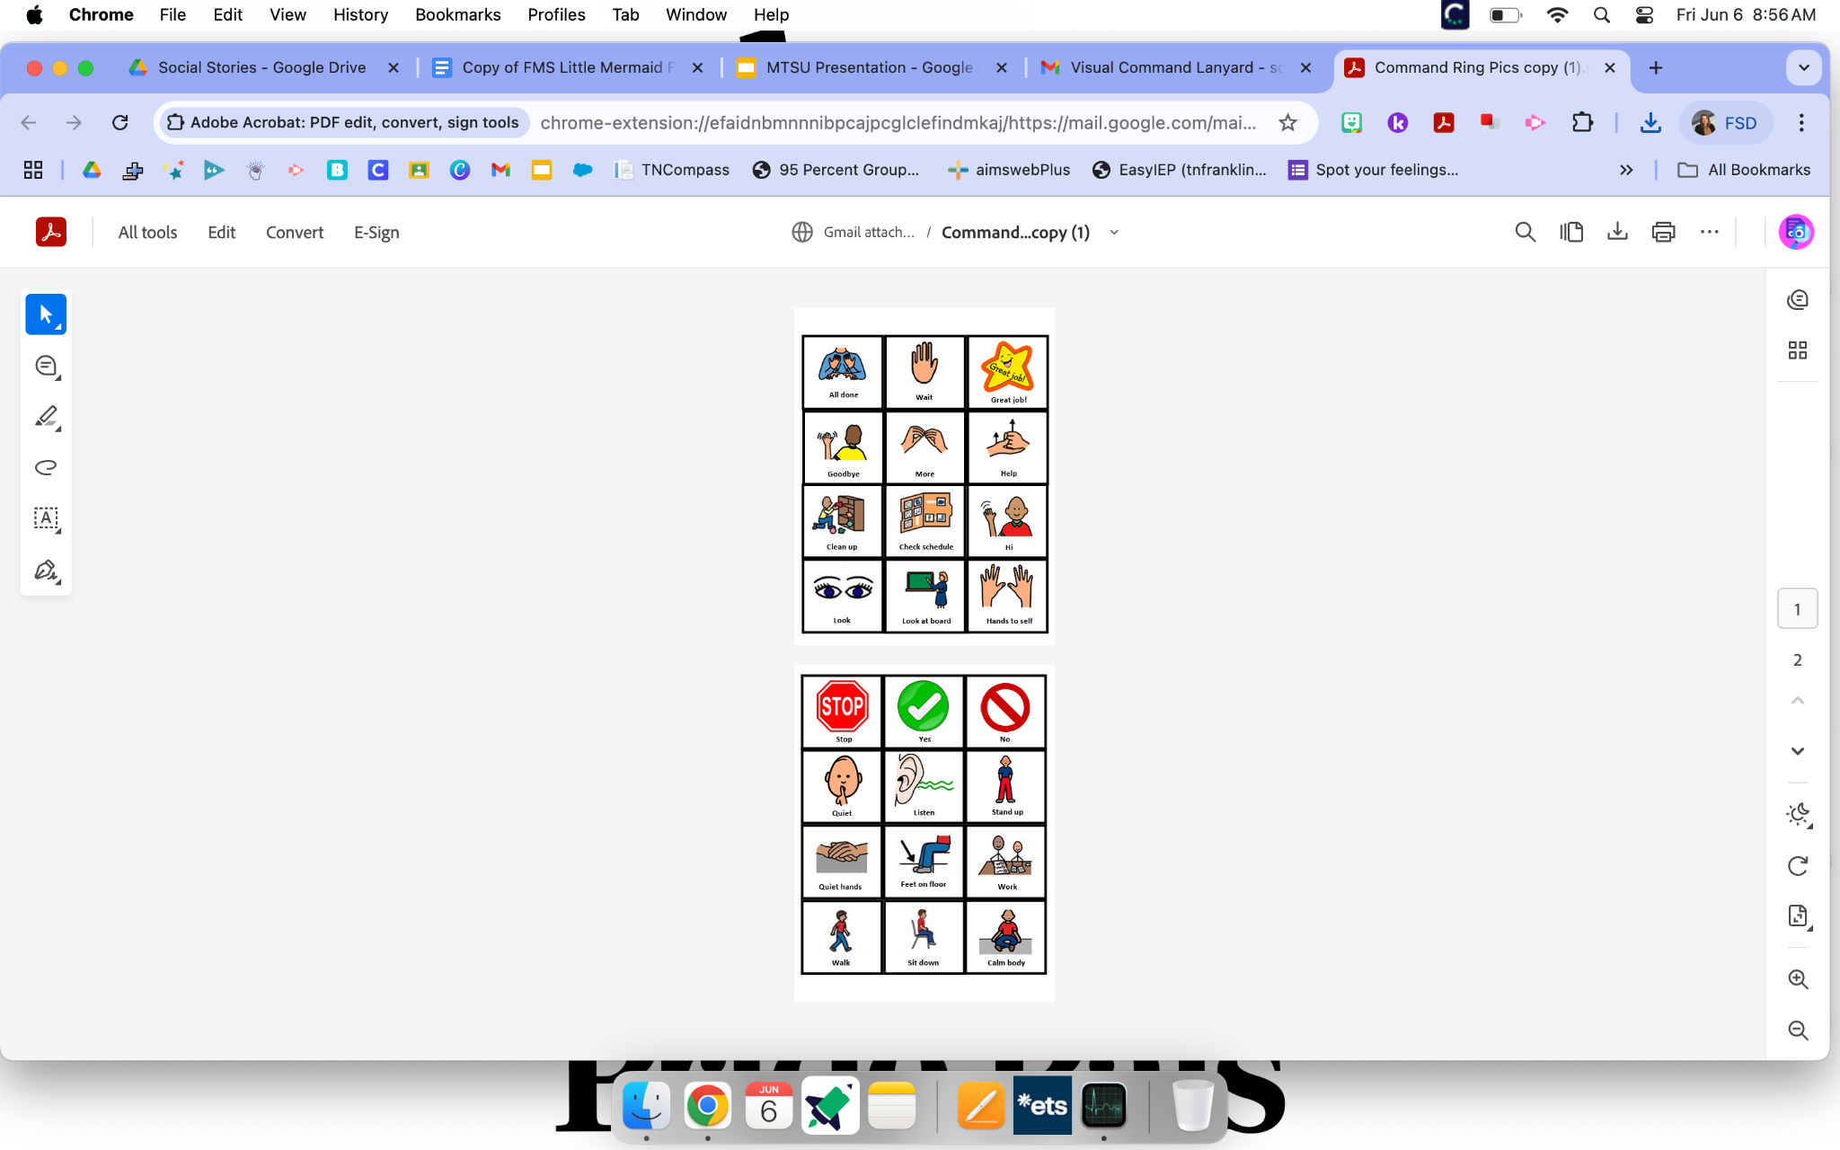
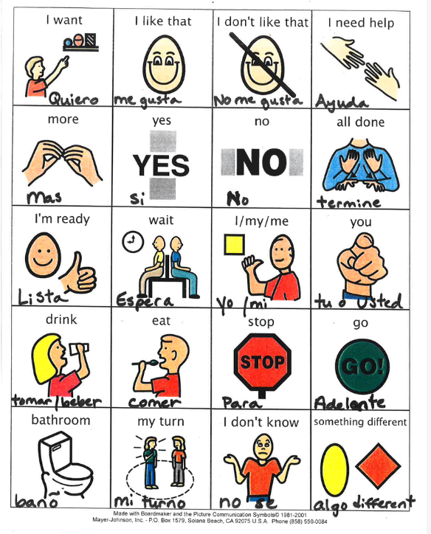
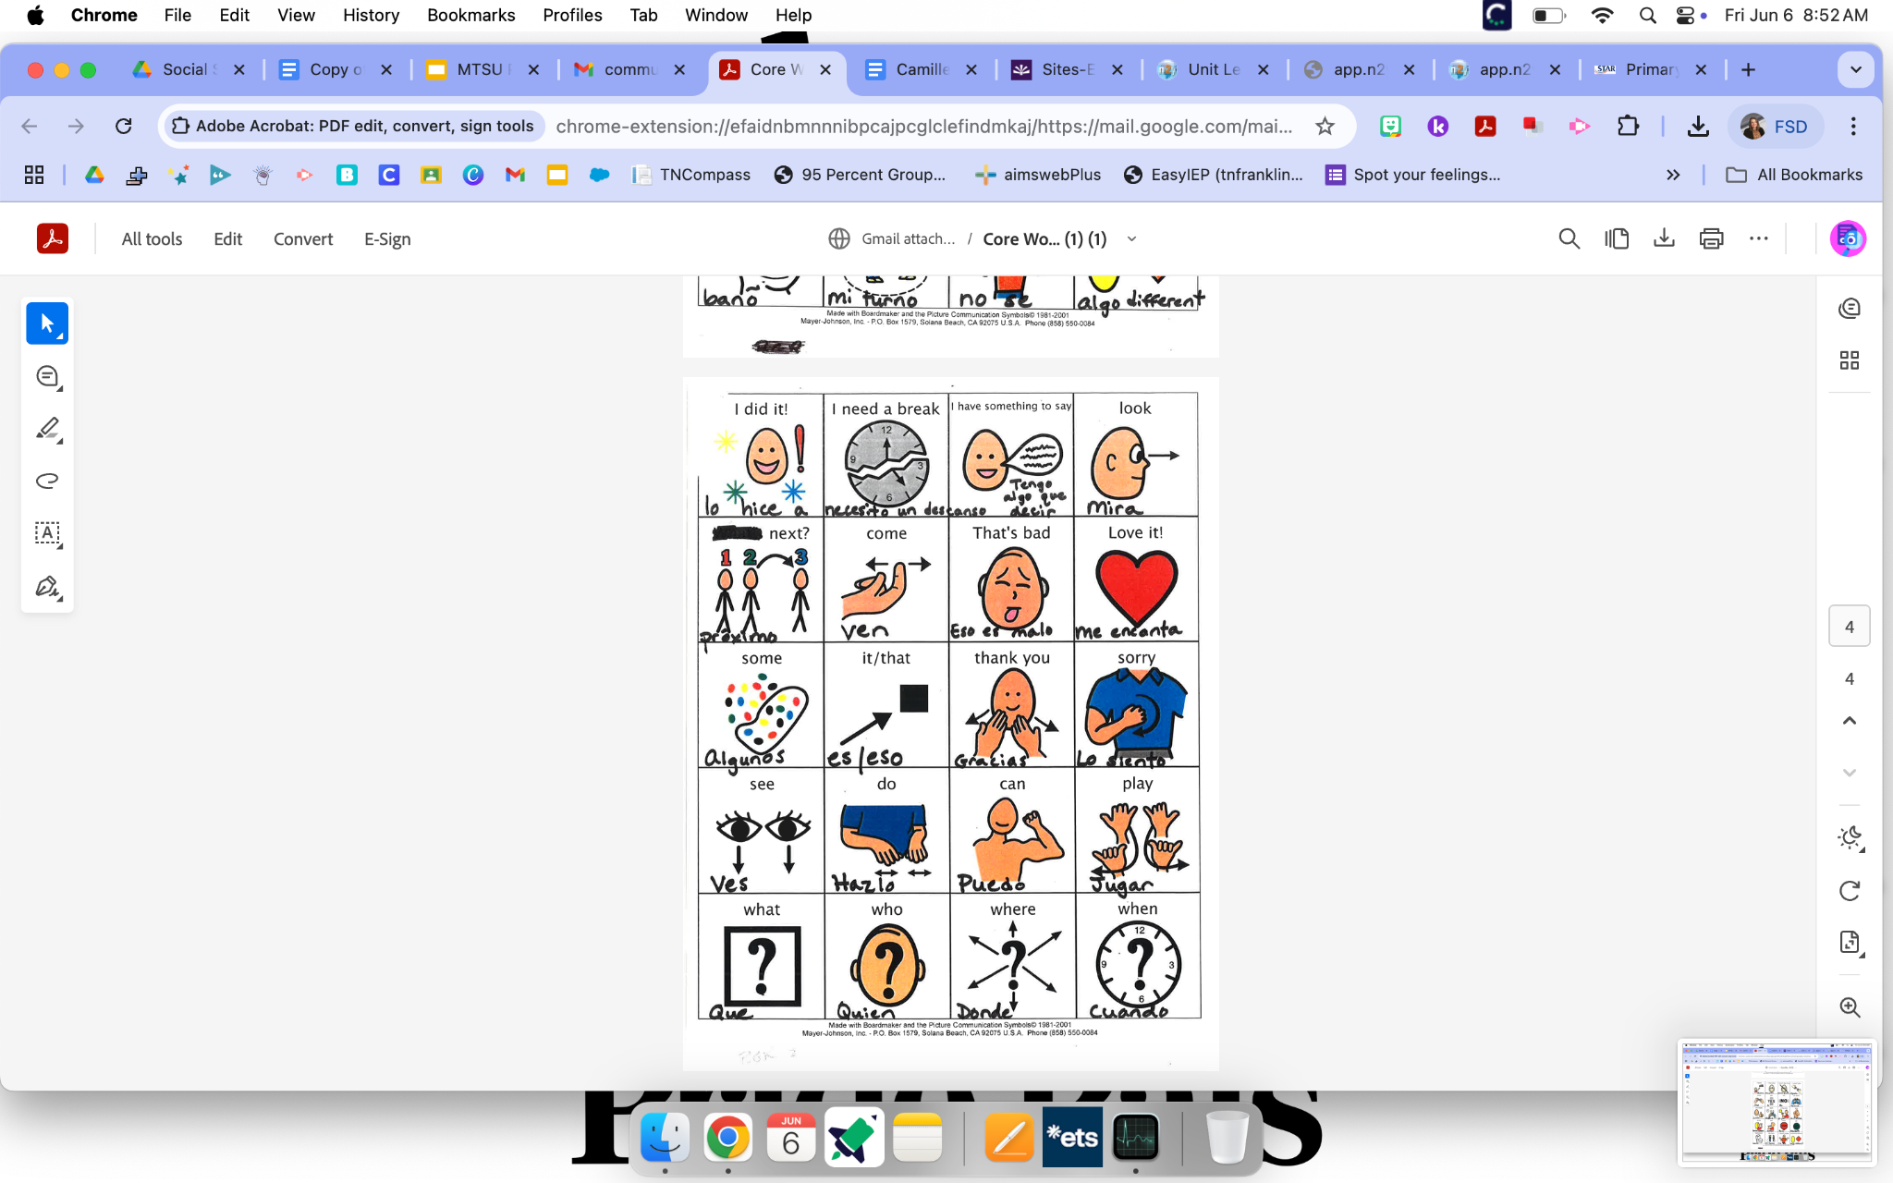

Slide 17
Collaboration with the related arts team is vital to ensure accessibility for the student during special school performances. (Programming devices, providing visual cue cards and scripts)

Slide 18
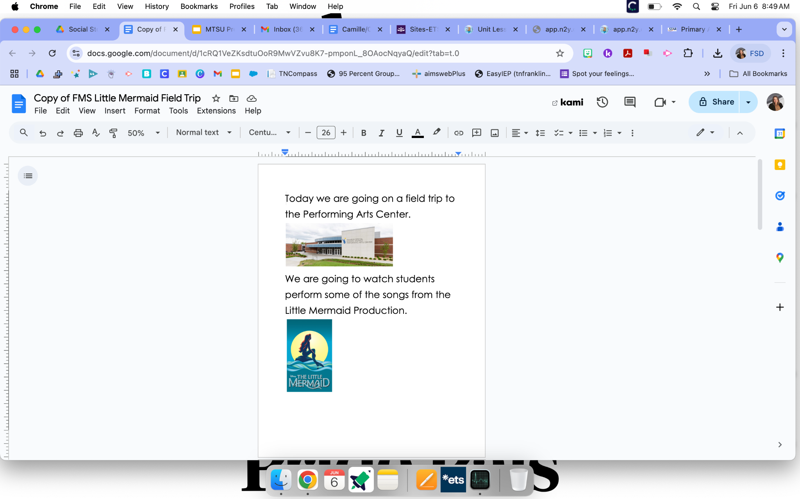
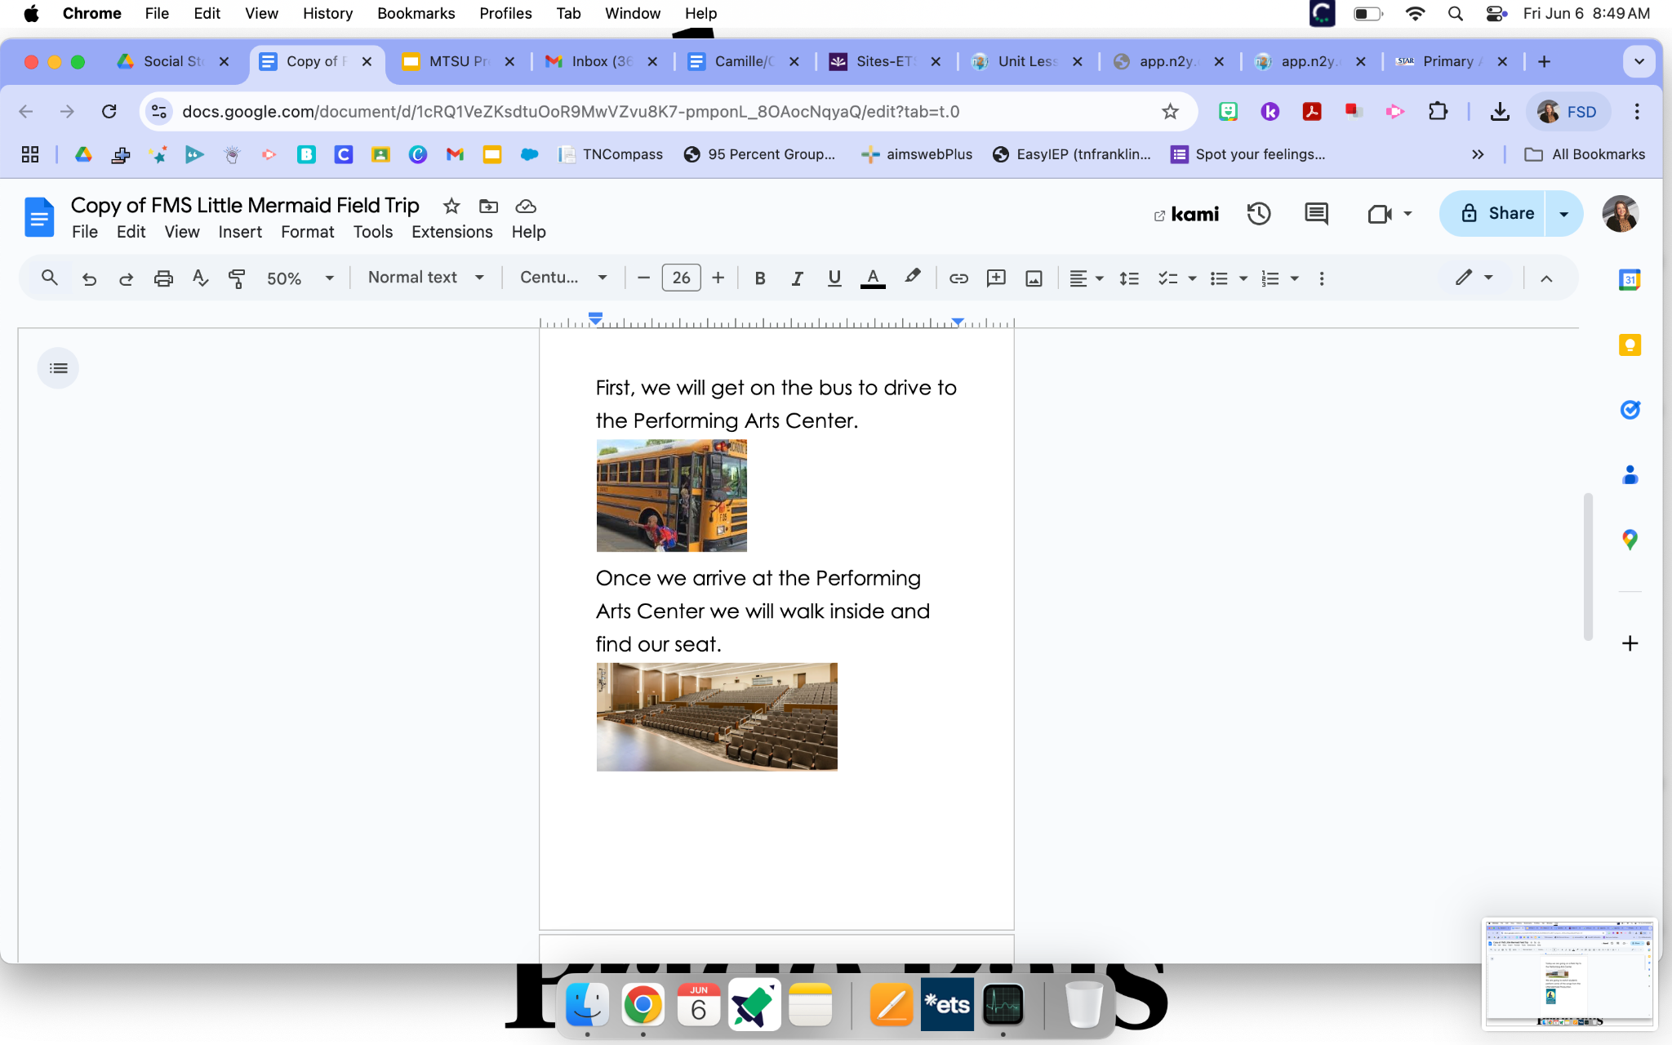

Slide 19
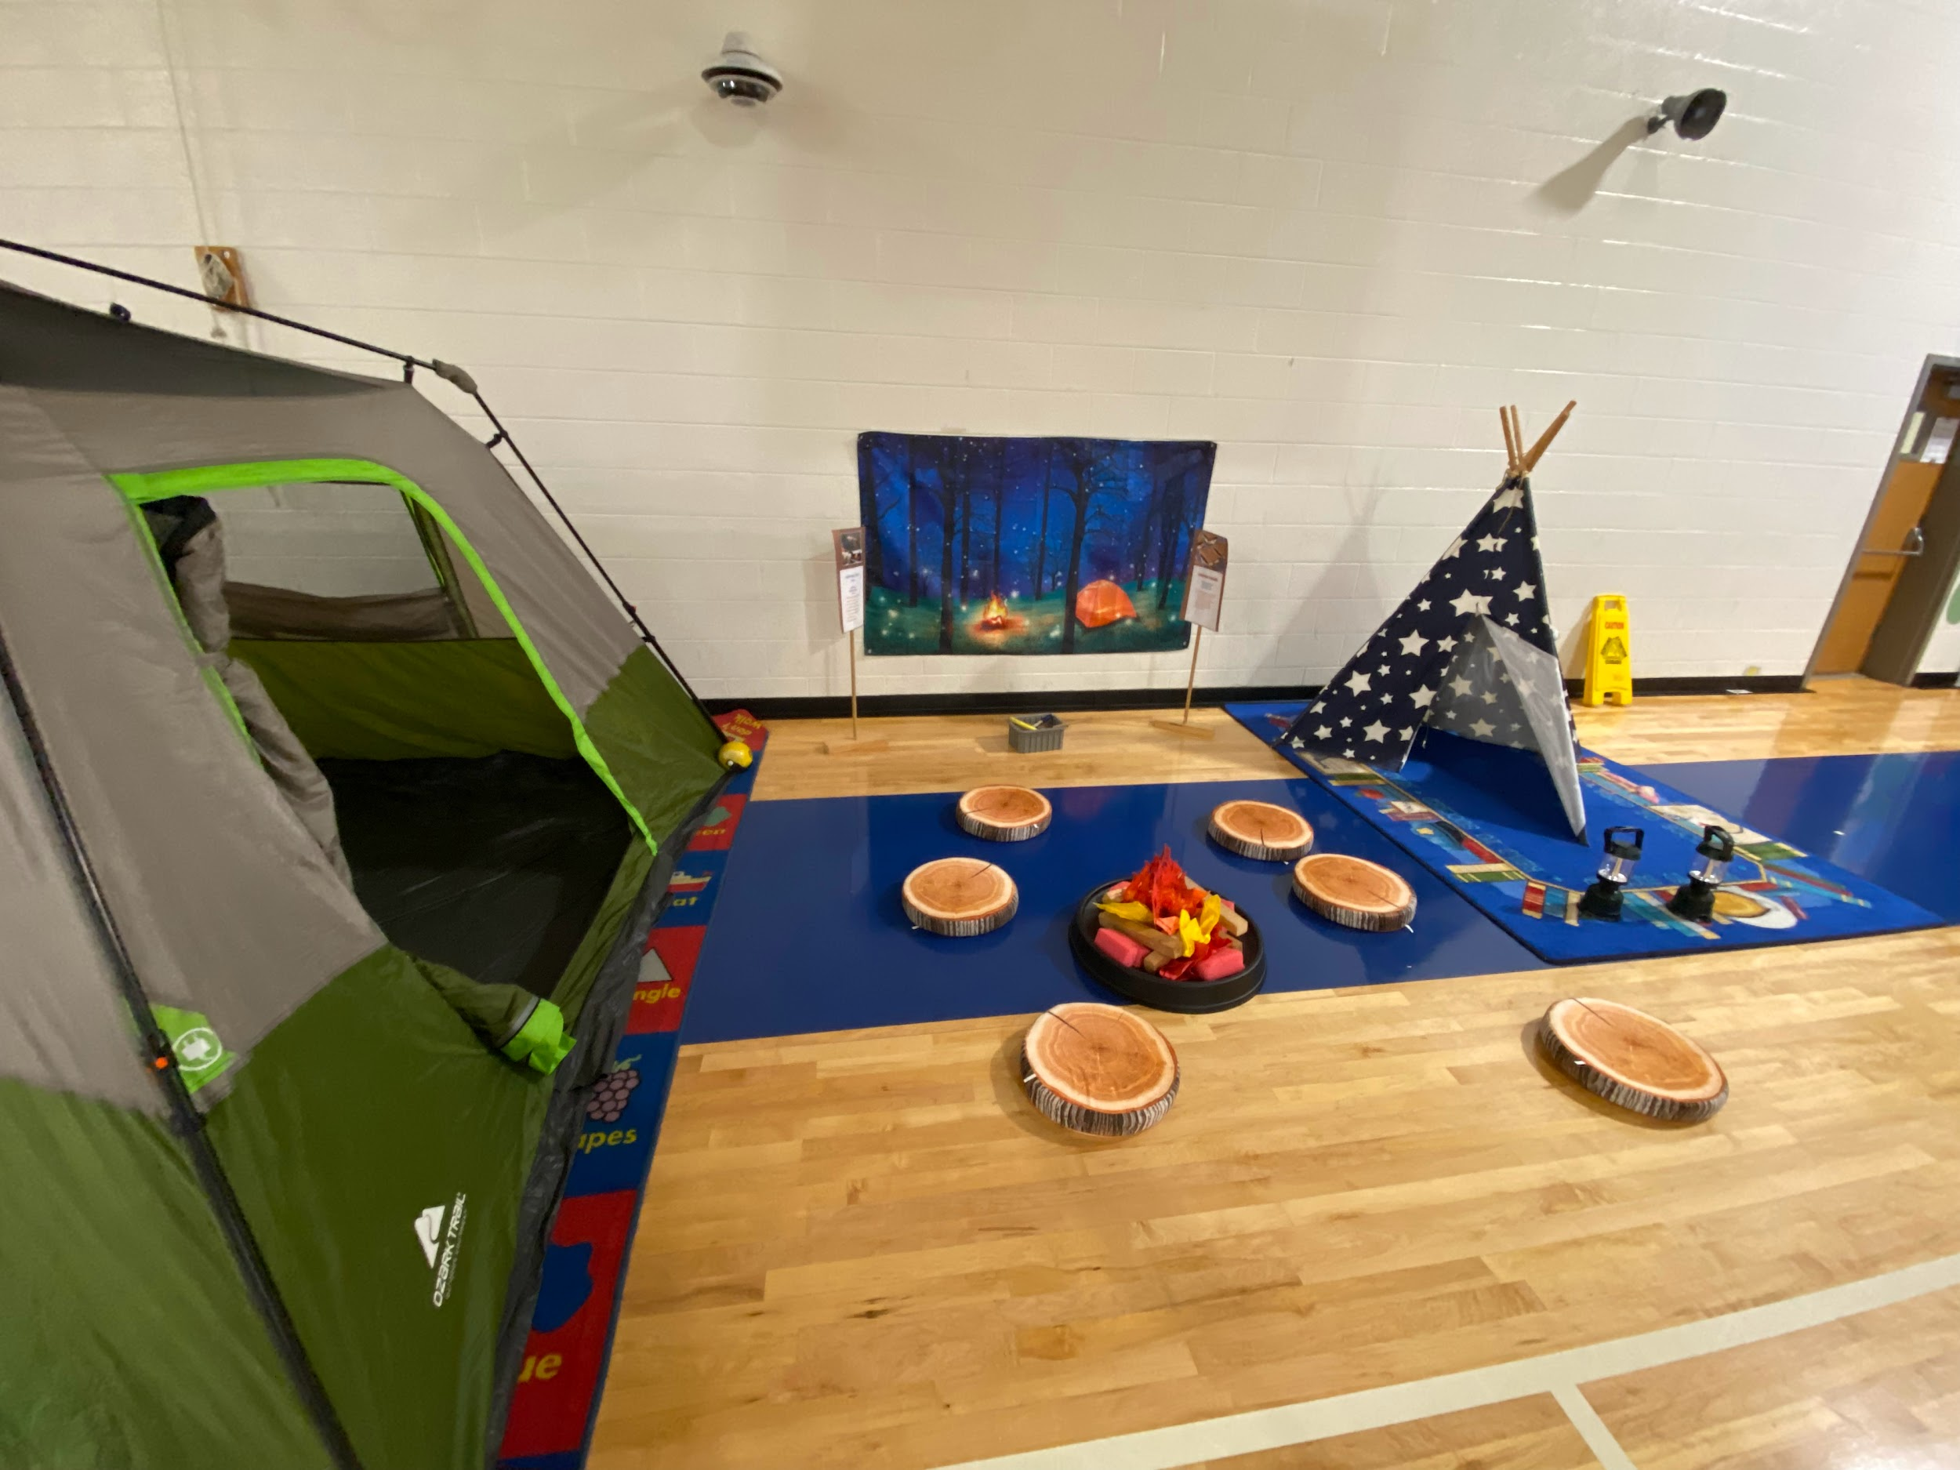
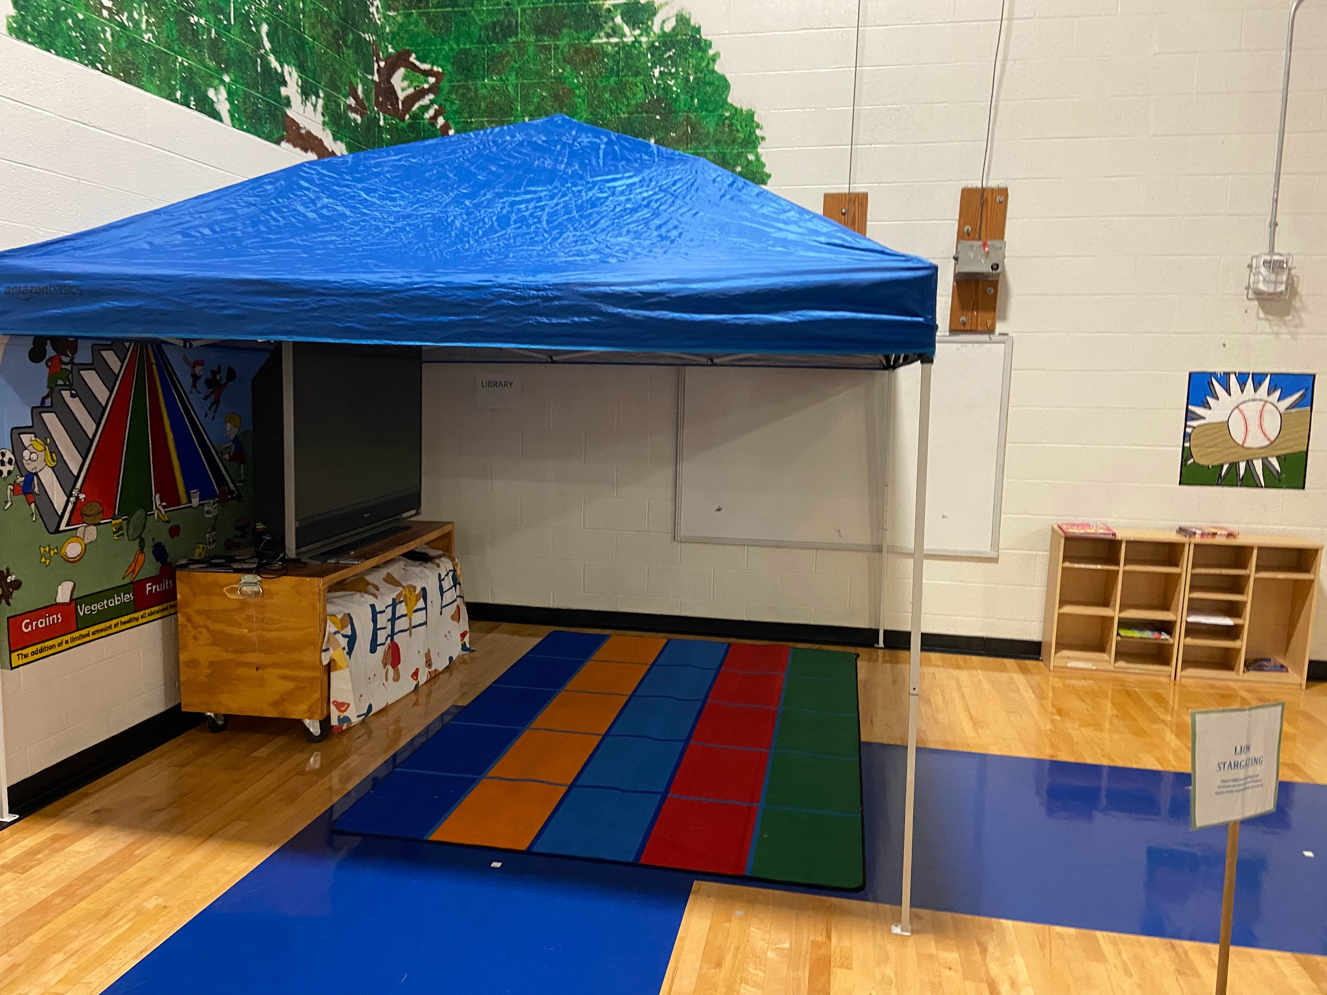
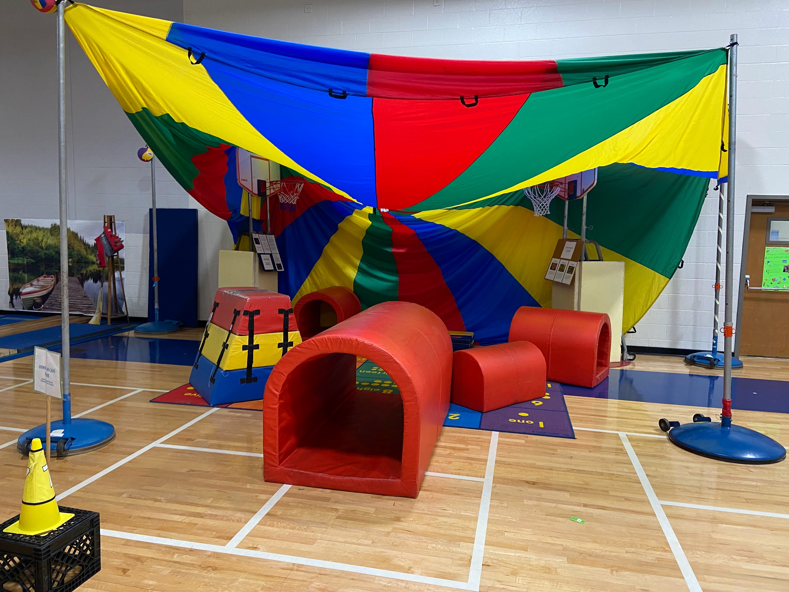
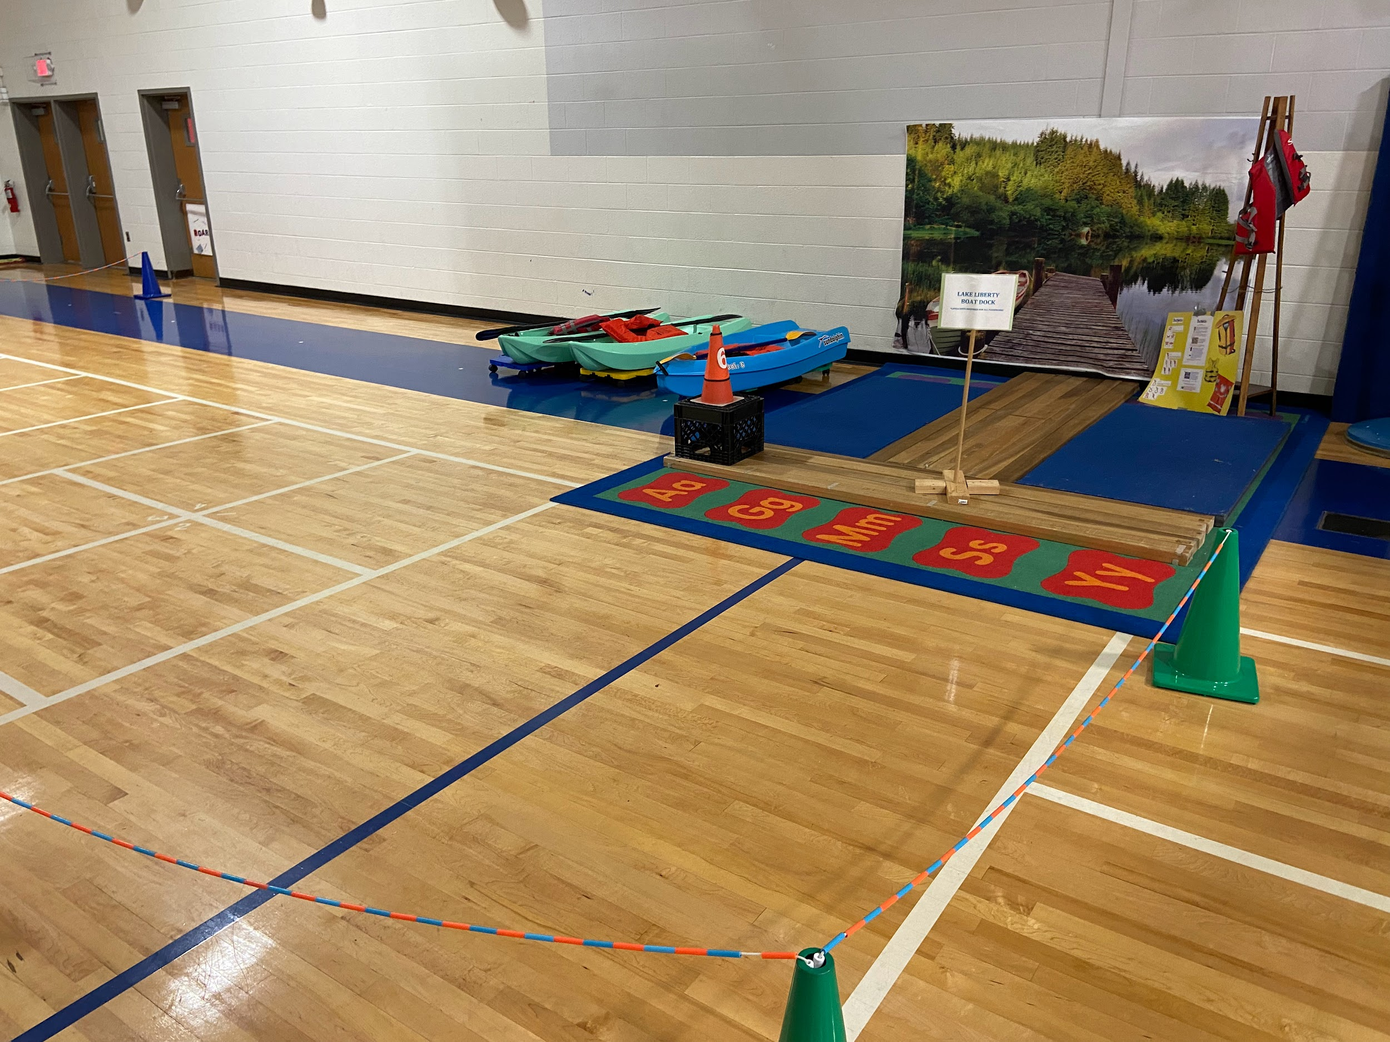
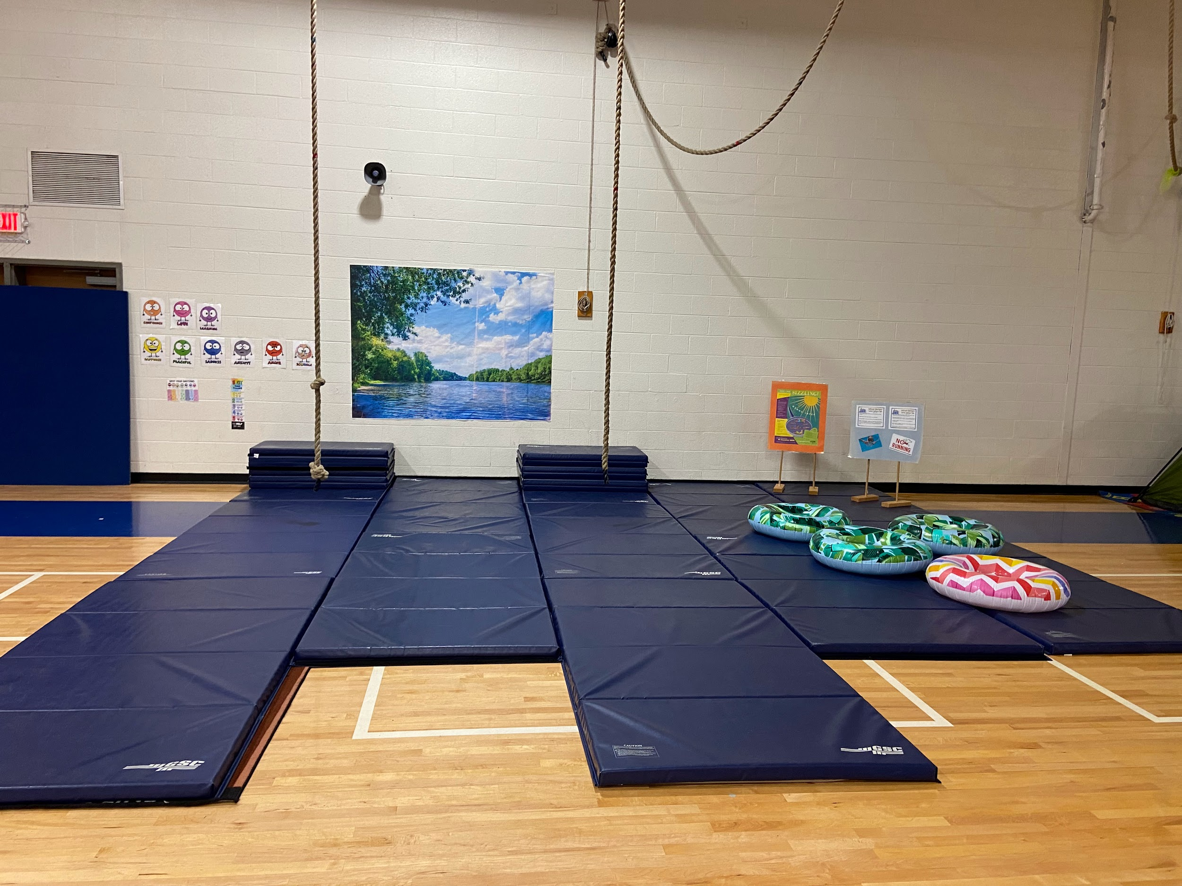
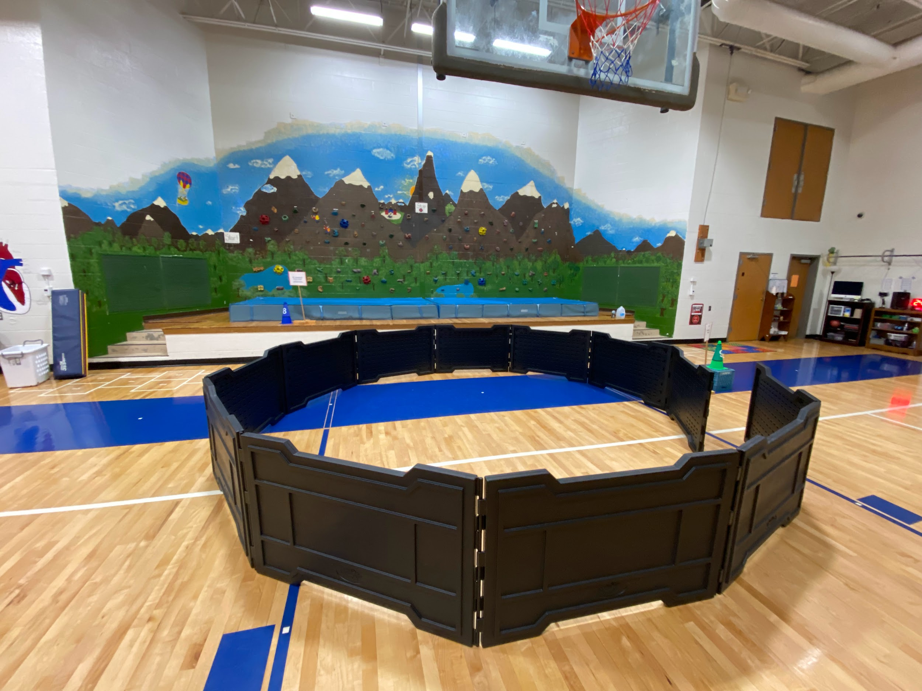

Slide 20
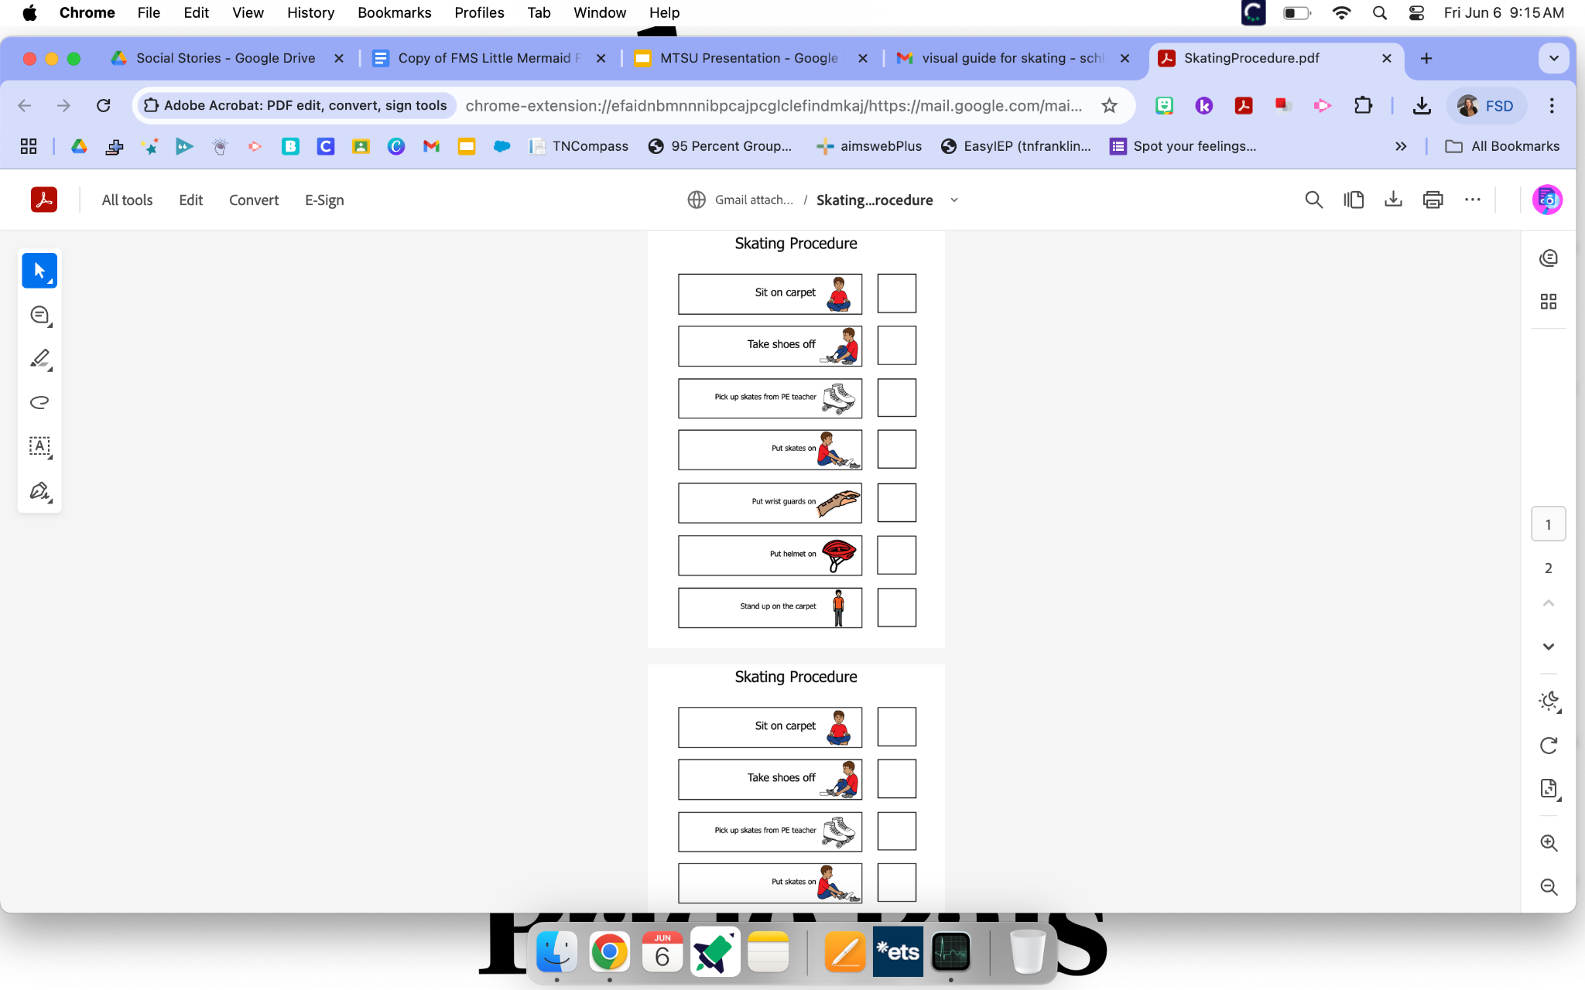
Setting up for success

Slide 21
Physical Therapist can collaborate with the PE team to ensure that students have adaptive equipment, and appropriate supports to participate in class and special events (field day, fun run, unified sports)

Slide 22
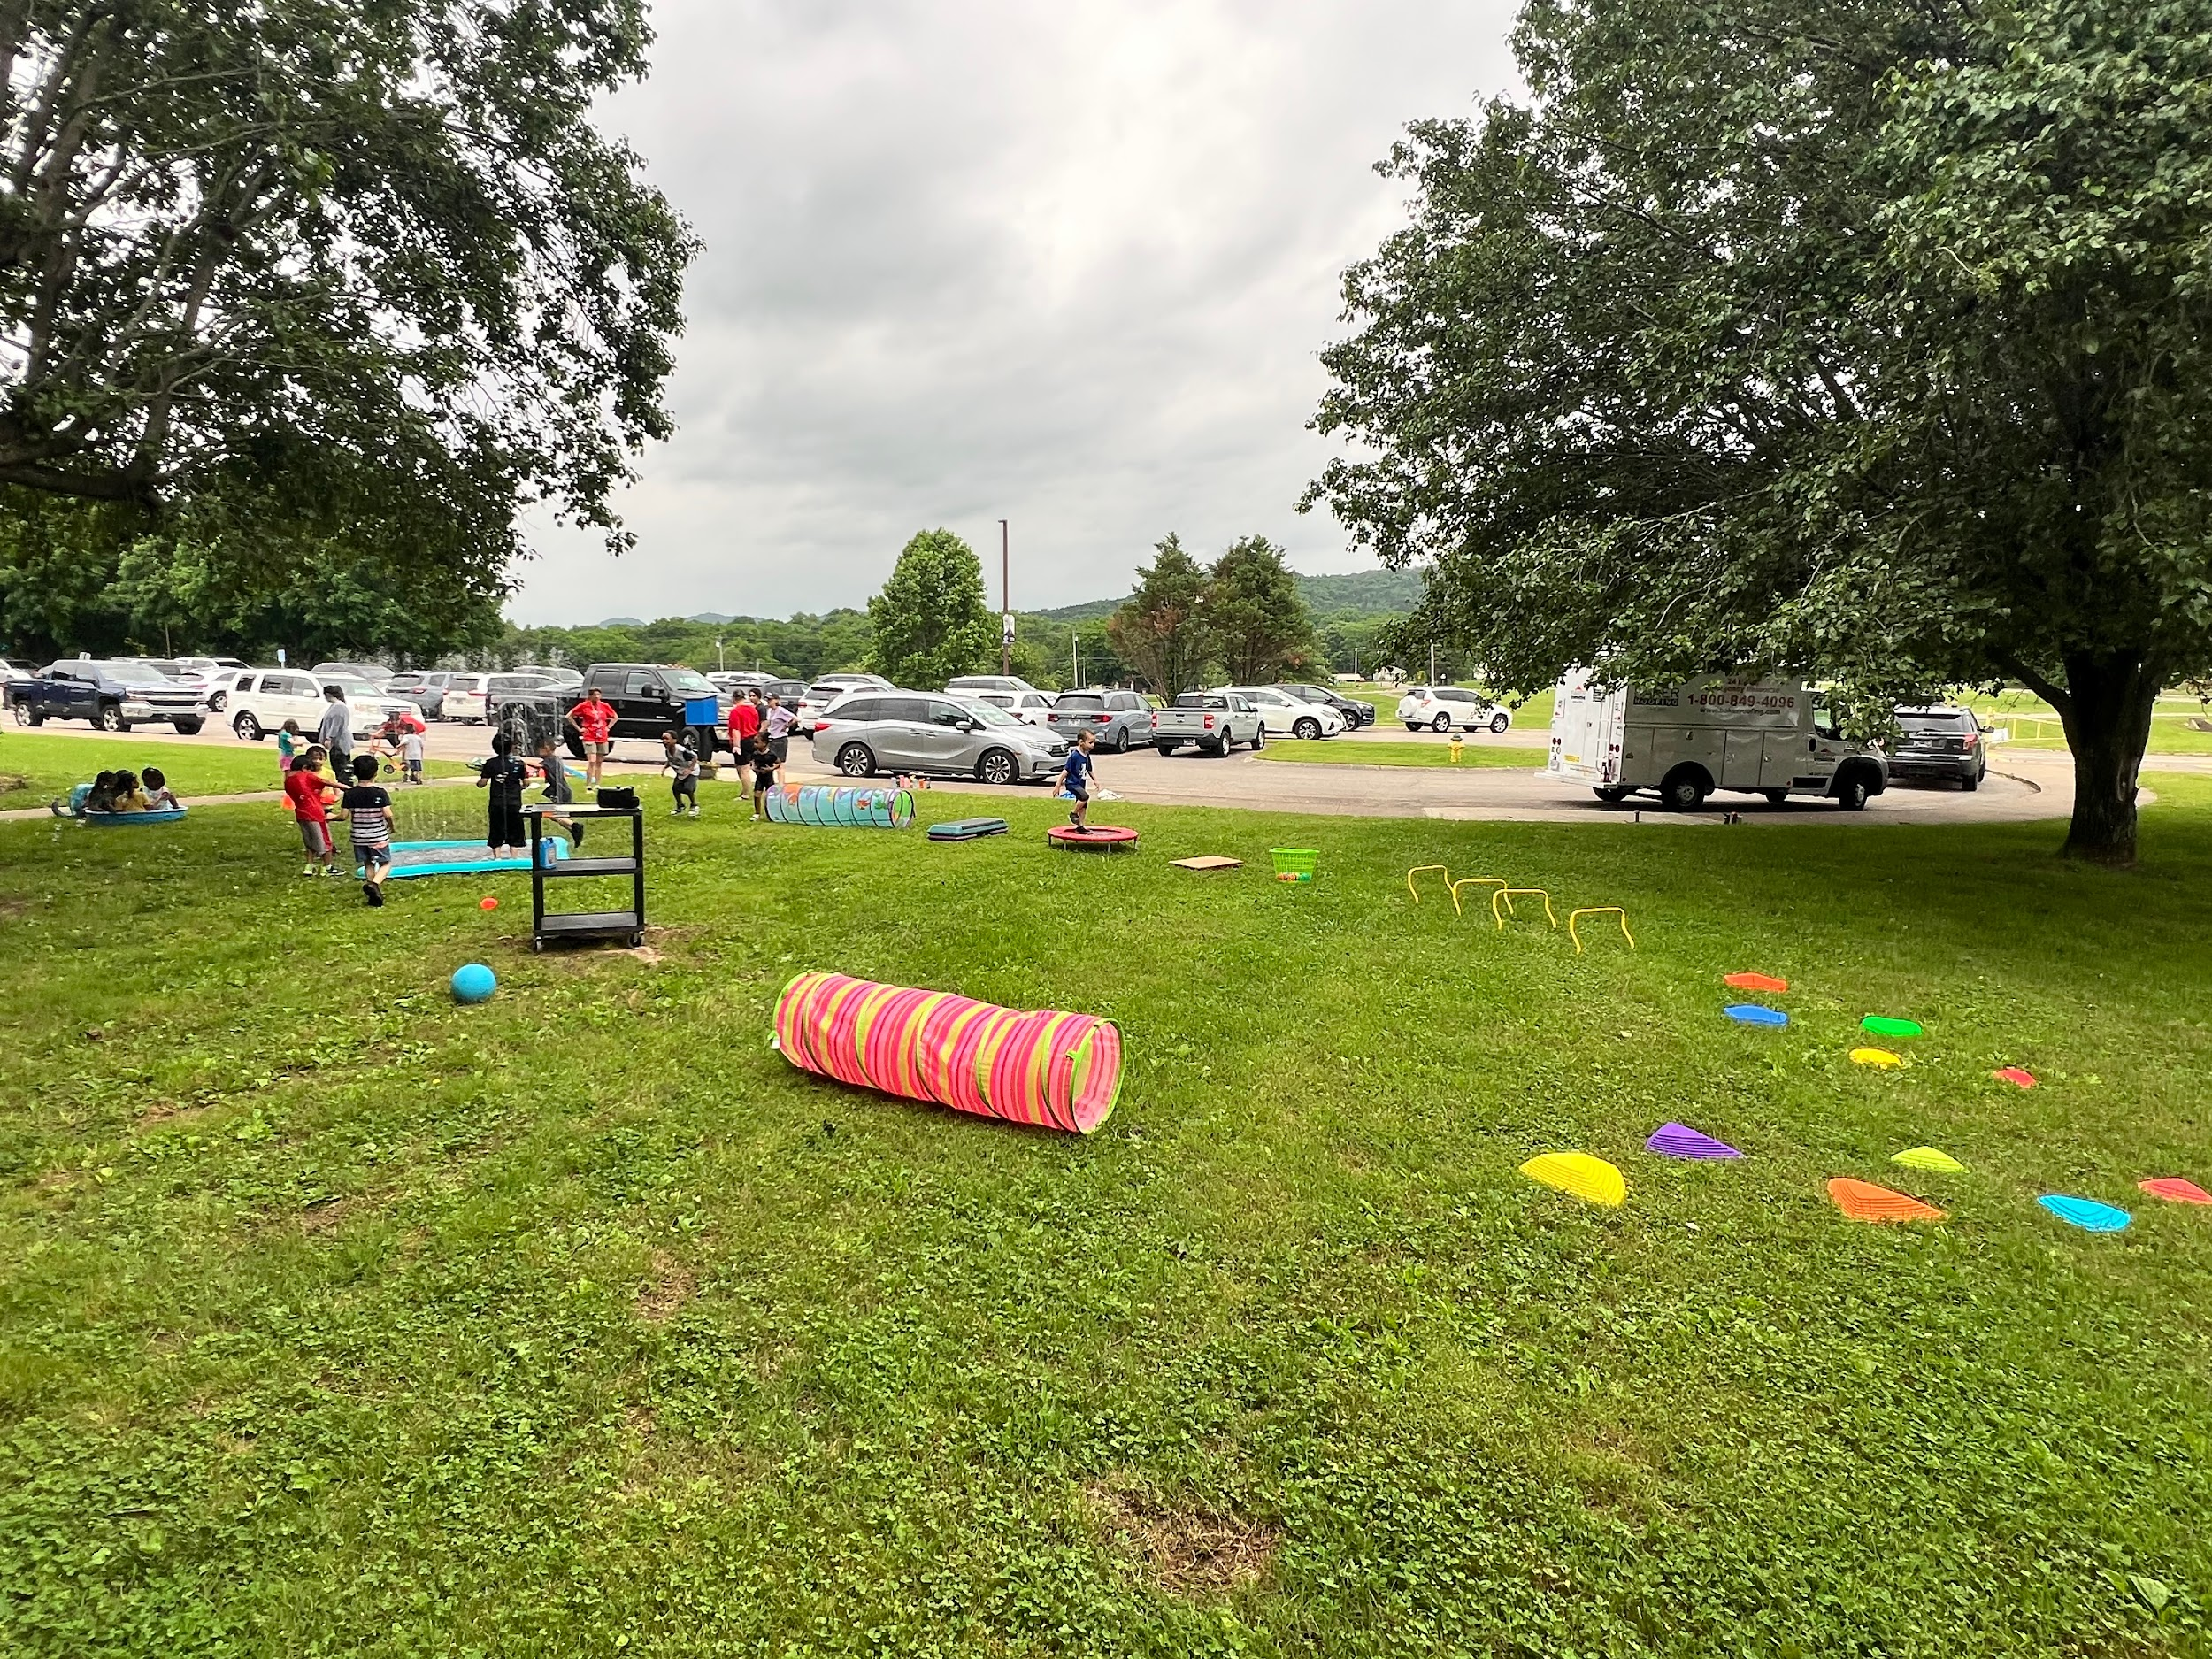

Slide 23
How can I achieve effective collaboration in my school setting?

Slide 24
Create Norms
Define and Delegate Roles
Schedule Time
Document and Plan
Ask for input
Adjust the systems that are not fostering collaboration

Slide 25
Creating Norms:
  Maintain focus on the students needs
  Communicate clearly and listen carefully
  Share your views willingly and respectfully

Slide 26
  Ask and welcome questions for clarification
  Be open to the ideas and views presented
  Honor time limits and stay on task

Slide 27
Define and Delegate Roles

Slide 28
Student:
The expert of their individual strengths, needs, voice, and perspective. Their progress is a meter for collaboration. If they feel their needs are not being met the team needs to get curious and collaborate again.

Slide 29
Parent/ Guardian: the expert of their child's strengths, areas of need, progress across school/home, historical and medical knowledge of their child's development, and future educational/life goals.

Slide 30
General Education Teacher: the expert of the general education curriculum & essential standards, implementing the students accommodations, modifications, and assistive technology in the general education classroom, and providing differentiated instruction in the general education classroom.

Slide 31
Special Education Teacher:
The expert of the student’s deficit areas, student strengths, learning styles, educational background, iep goals, interventions, behavior supports, accommodations,modifications, assistive technology across all settings.

Slide 32
Related Service Providers:
The experts for their skill area (OT,PT,SLP, etc.) they support the students participation and success in all of their educational settings. Educating team members on specific supports, assistive technology, or adaptations required for the student to access the curriculum.

Slide 33
Paraprofessional:
The expert on implementing accommodations, modifications, and behavior supports under the direct guidance of the special education teacher while fostering independence in the general education classroom.

Slide 34
LEA/Admin:
The expert on district/school policies and ensures the students IEP is implemented with fidelity by monitoring schedules, staffing, and materials/curriculum are provided to implement the services documented.

Slide 36

Creativity:

Slide 37
Related Service Providers can creatively collaborate with IEP team members to meet student needs and foster consistency across settings.

Slide 38
Related Service Providers creatively collaborate by:
sharing information at IEP meetings
demonstrating use of assistive technology
meeting with appropriate team members to support students' goals
providing feedback for classroom supports (i.e. fine motor tasks, sensory supports, adaptations for PE, communication visuals)

Slide 39
OT supports may include:
fine motor boxes
handwriting supports/strategies
adaptive equipment (i.e. positioning)
sensory supports (i.e. vests, tactile bins, chewy)
cutting supports (i.e. darkened outline, adaptive scissors)

Slide 40

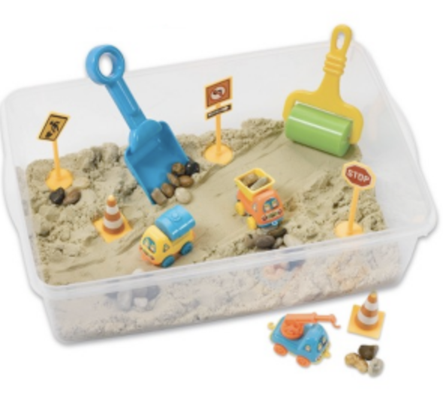

Slide 41
Engaging students in creative sensory embedded fine motor activities creates opportunities for language exposure, problem solving, sensory input, independence skills and builds stamina for work tasks.

Slide 42
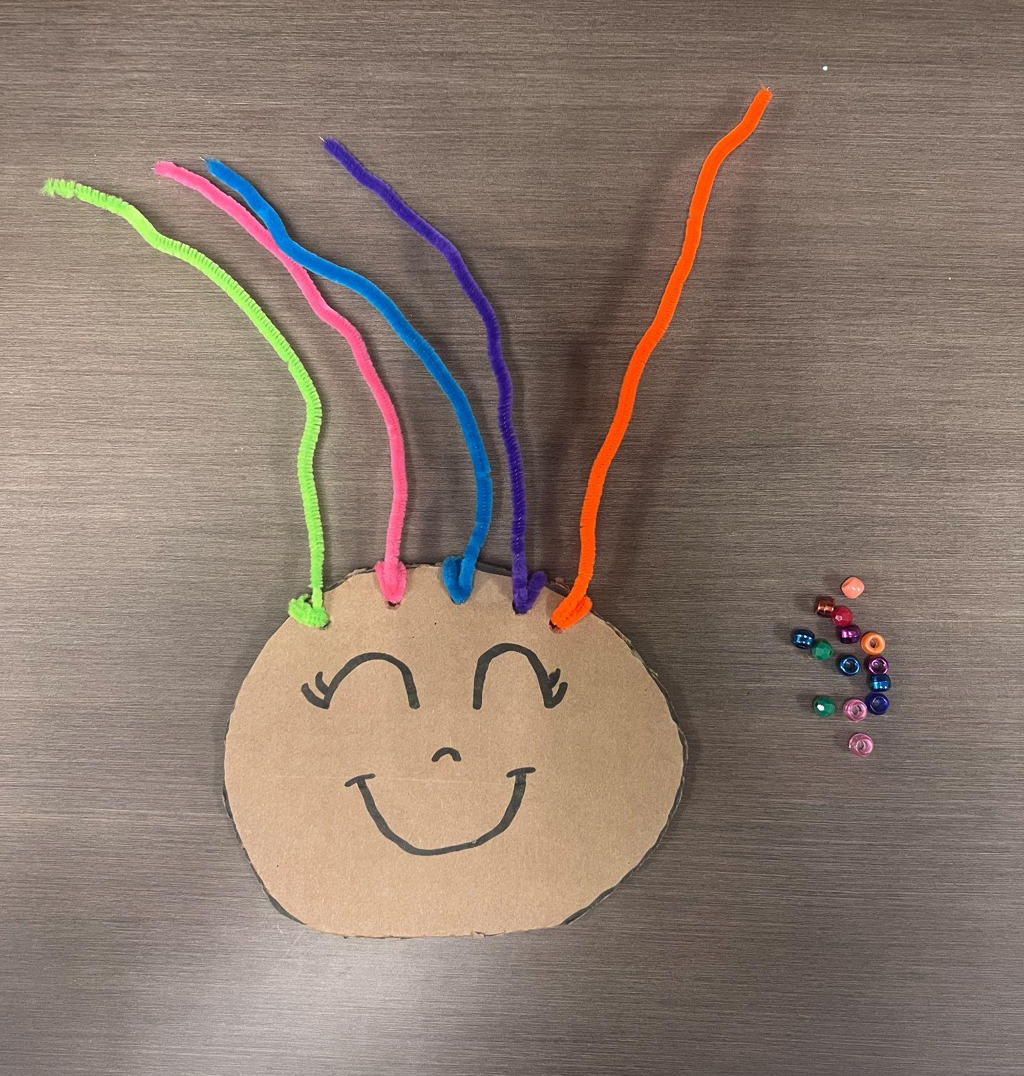
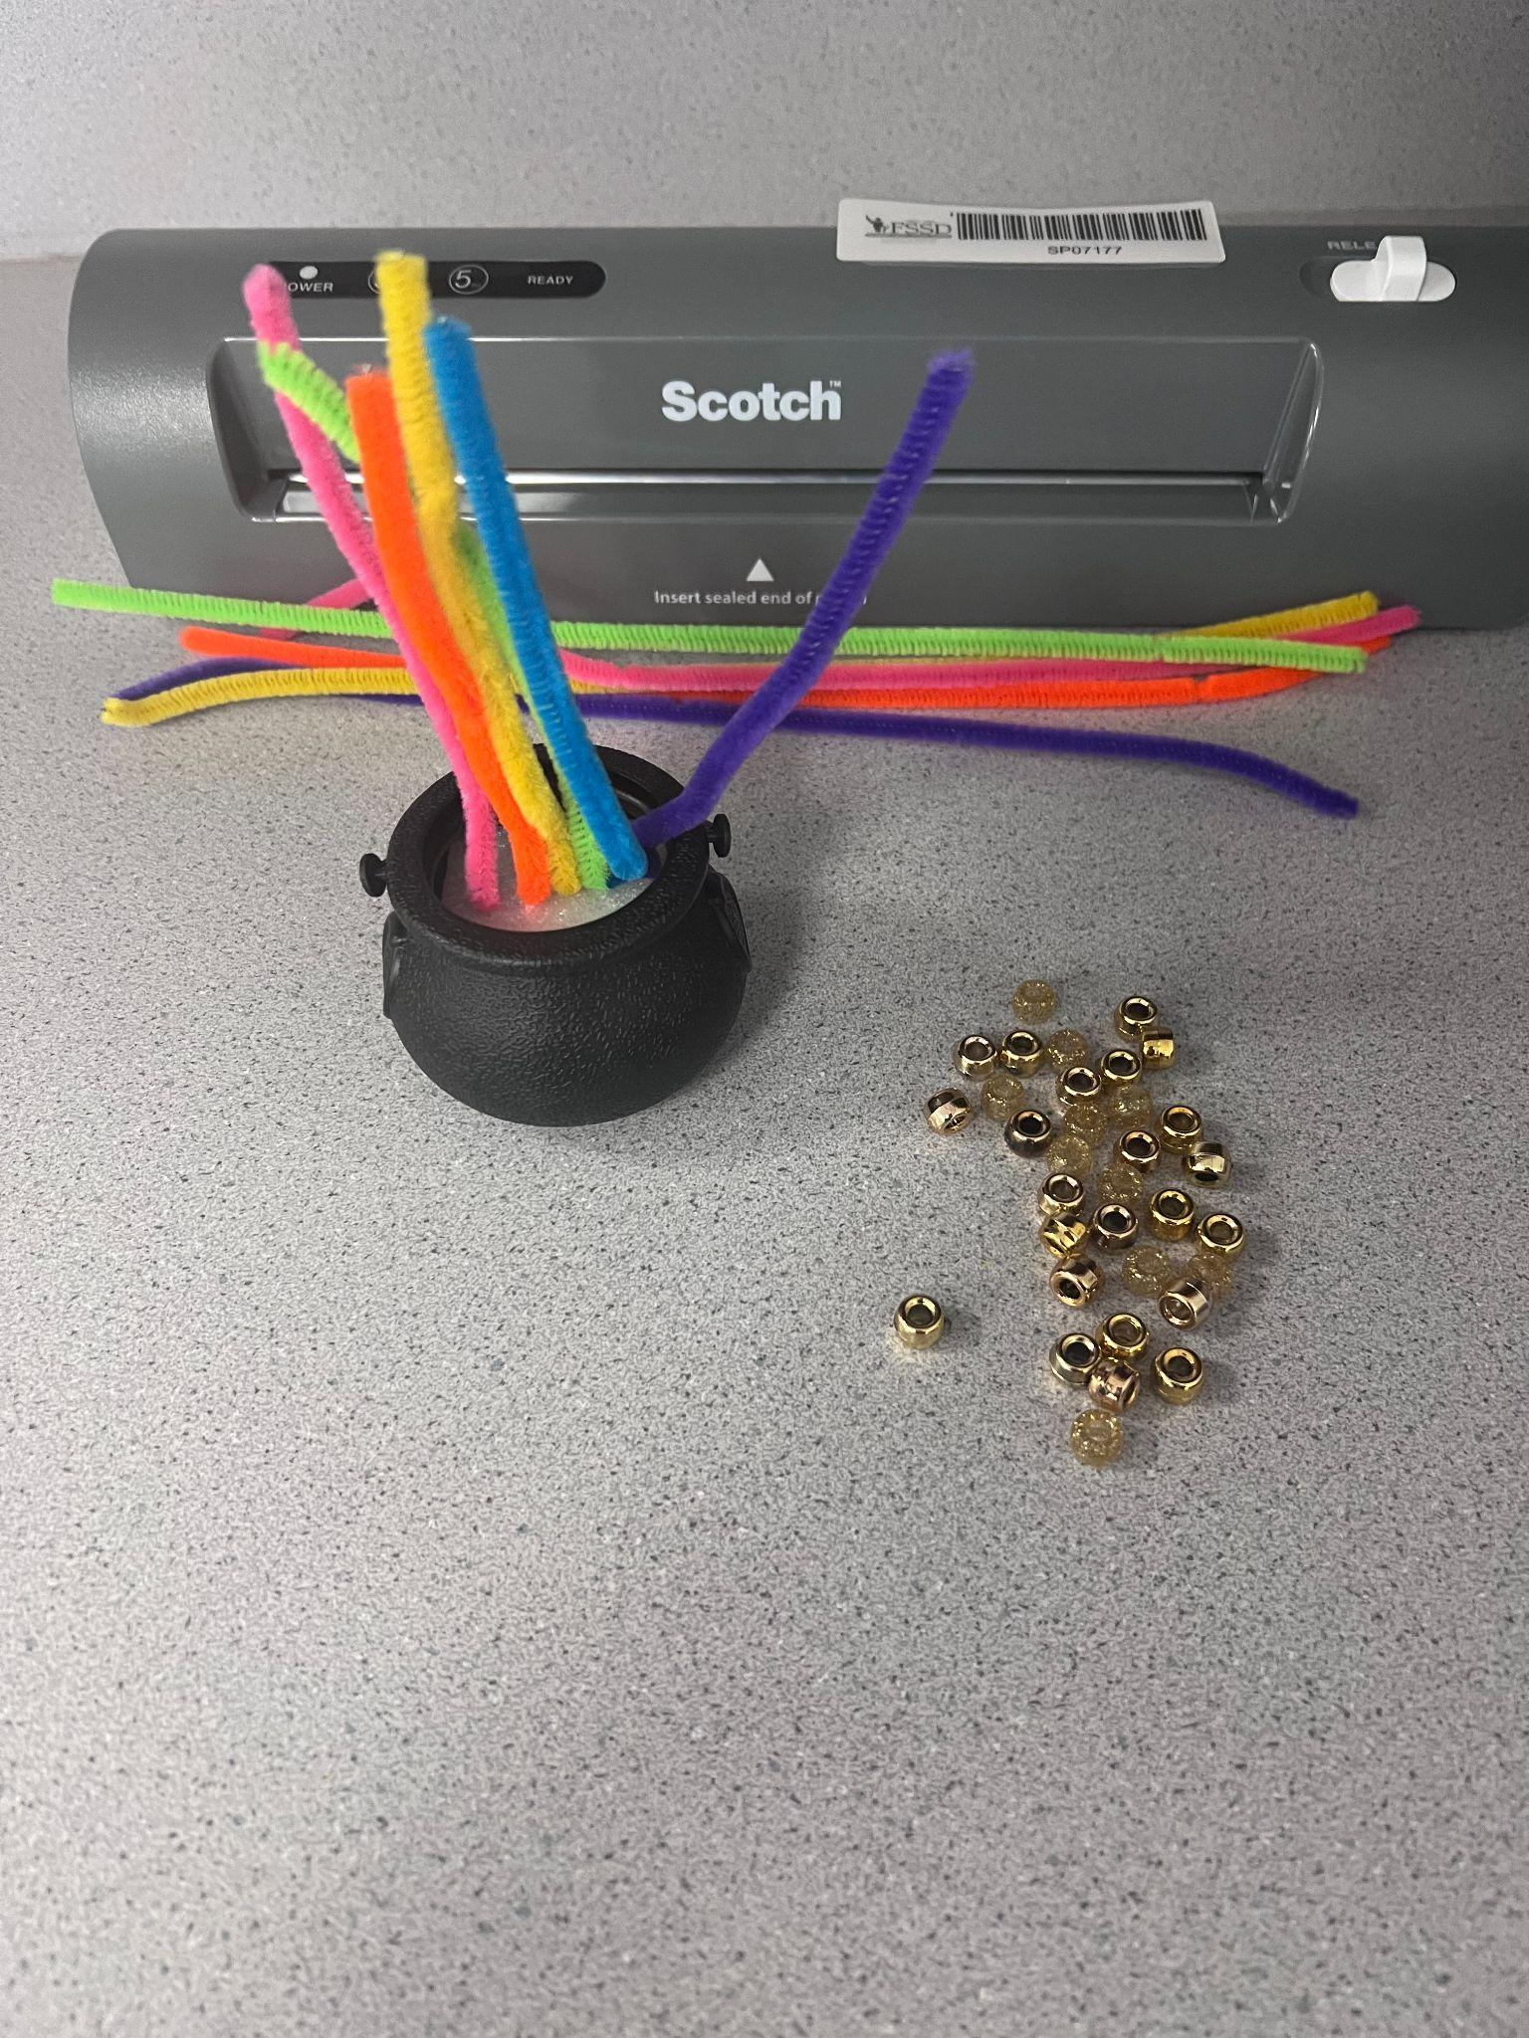

Slide 43
Educating team members on a students individualized needs and how to support them across settings ensures consistency.

Slide 44
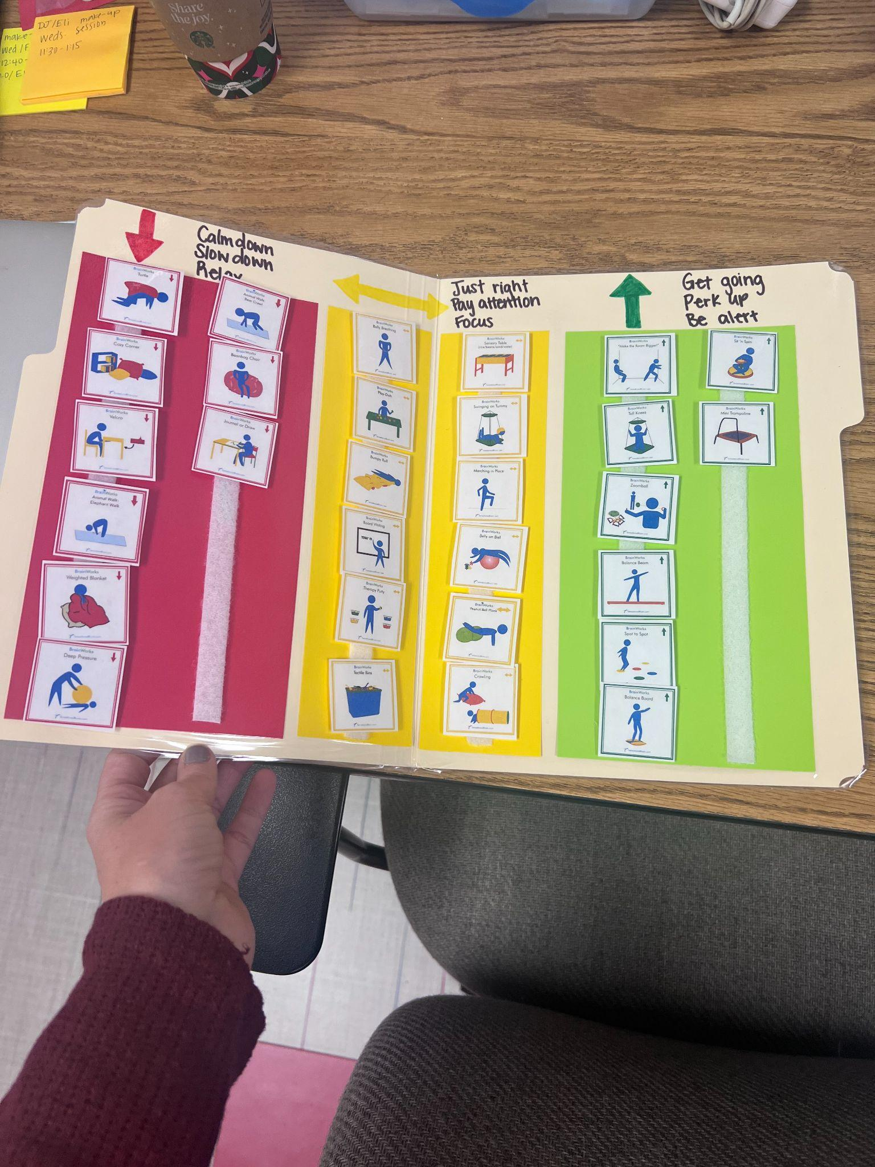
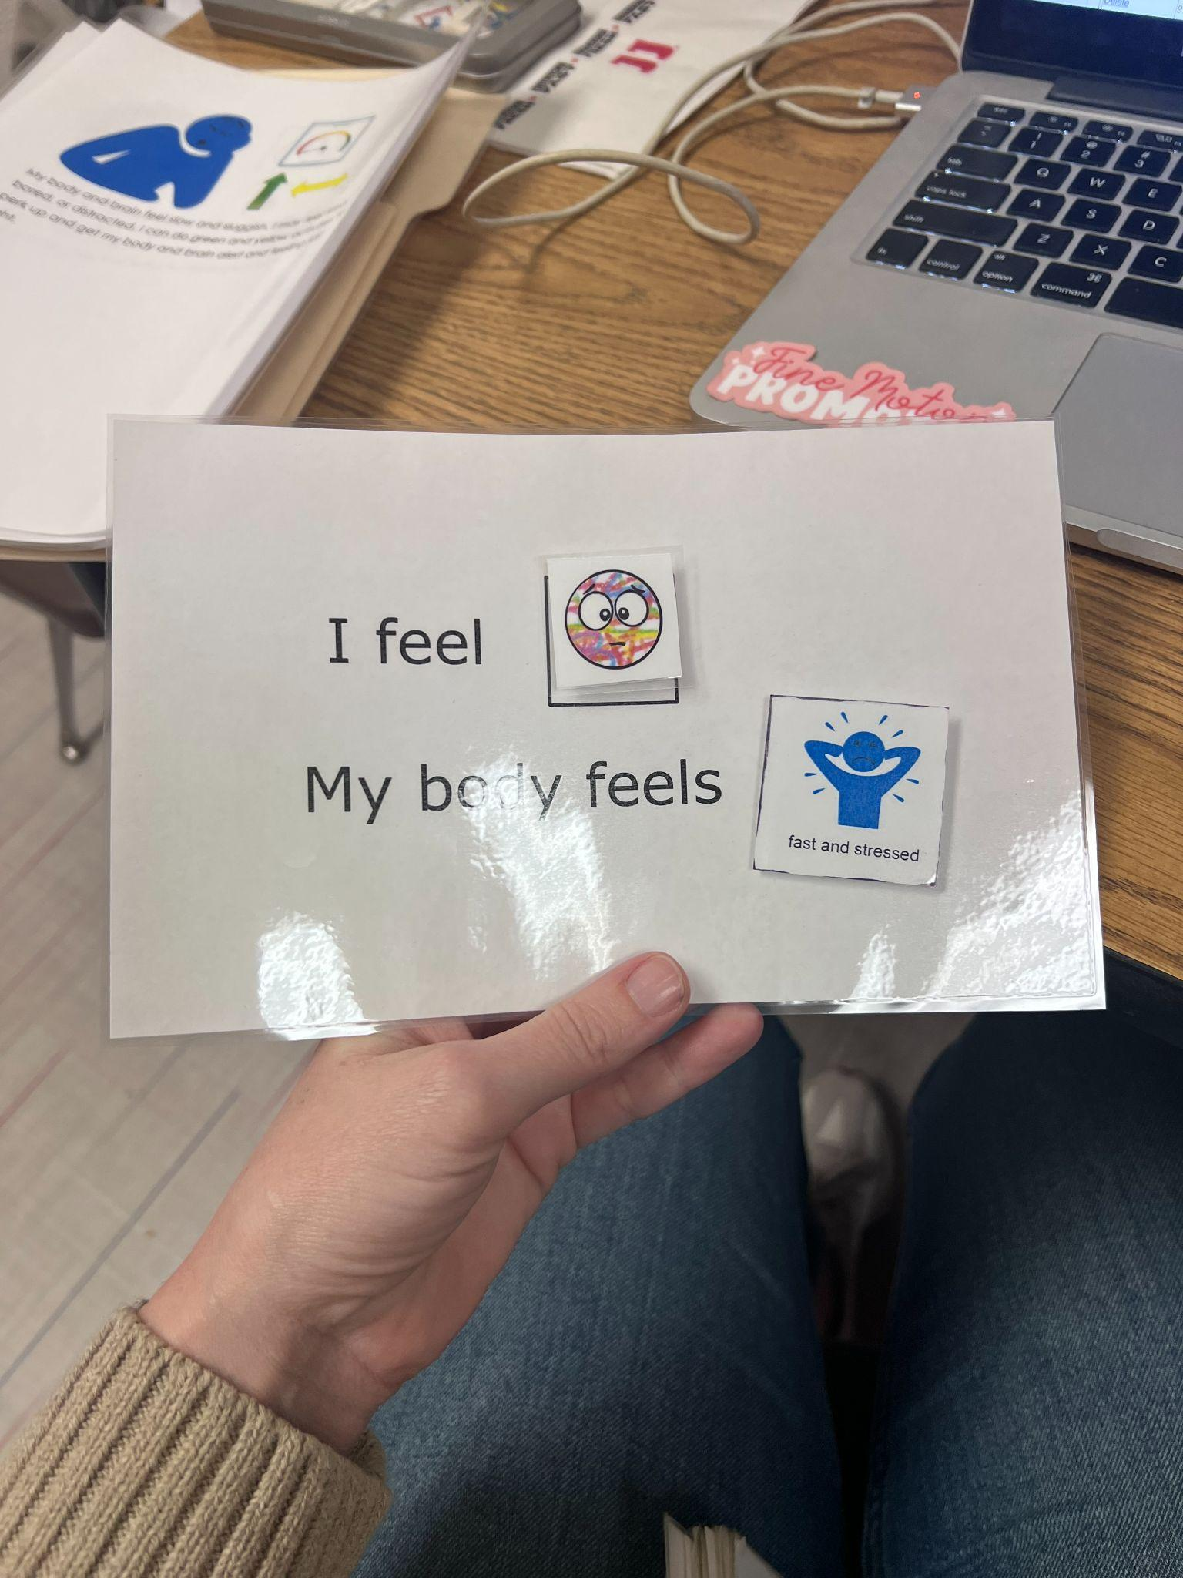

Slide 45
OT professionals collaborate with different staff members (i.e. SPED teacher, autism consultant) to help support the student's goals across settings.

Slide 46
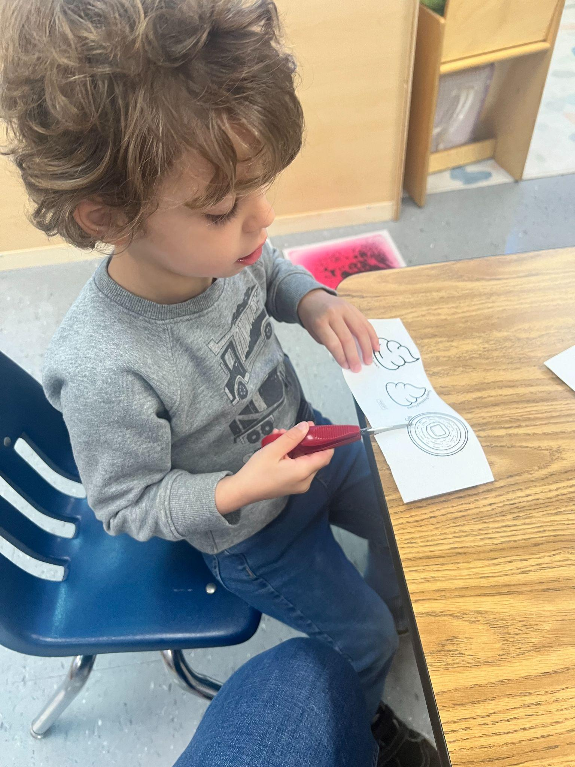
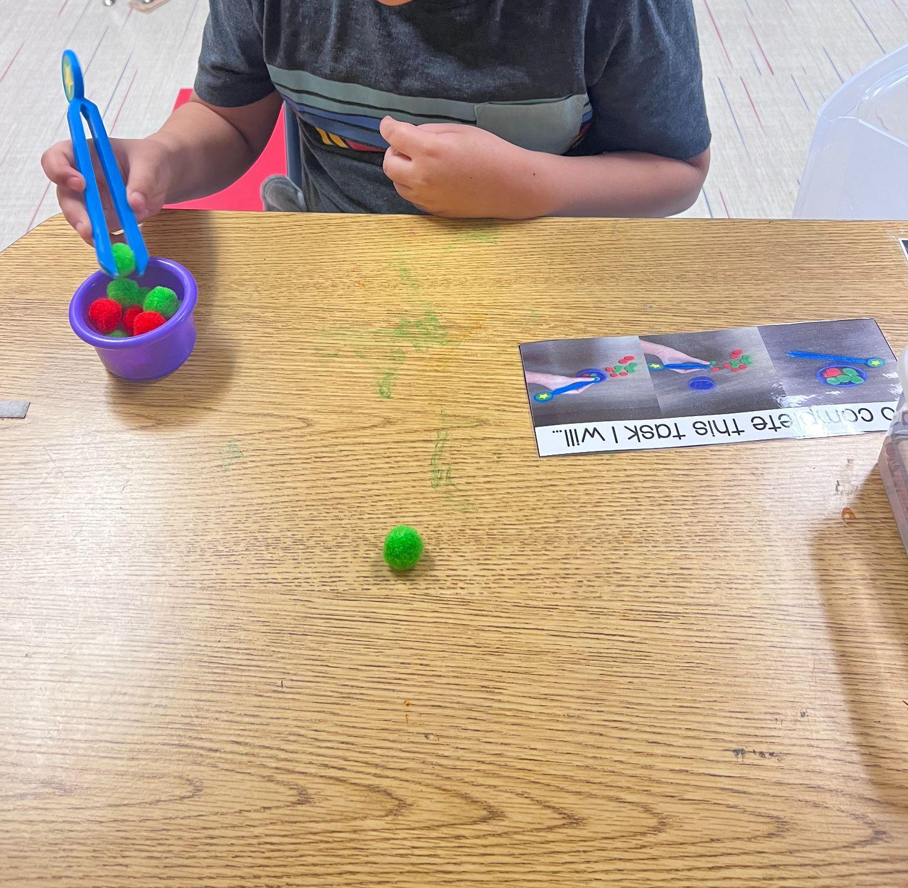

Slide 47
How can I educate a students team about their individualized needs?

Slide 48
Professional Development provided by the related service team. (OT,PT,SLP)
Individualized training on adaptive equipment.
Observation
Feedback forms

Slide 49
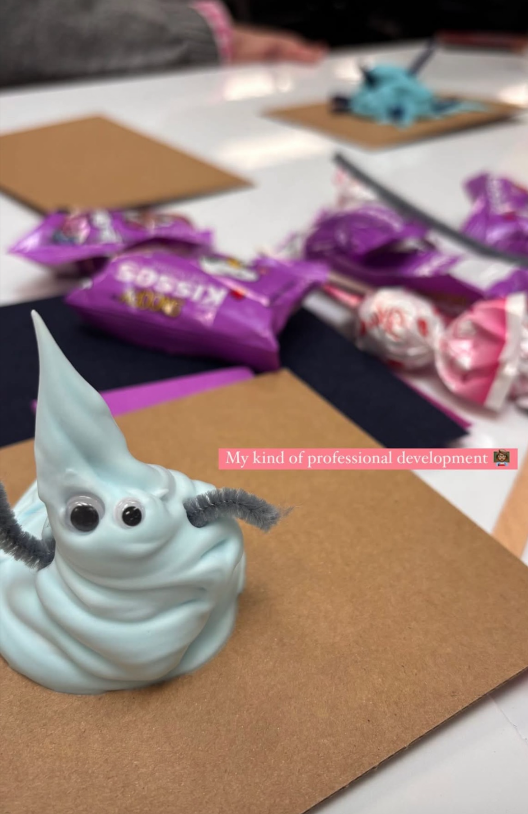
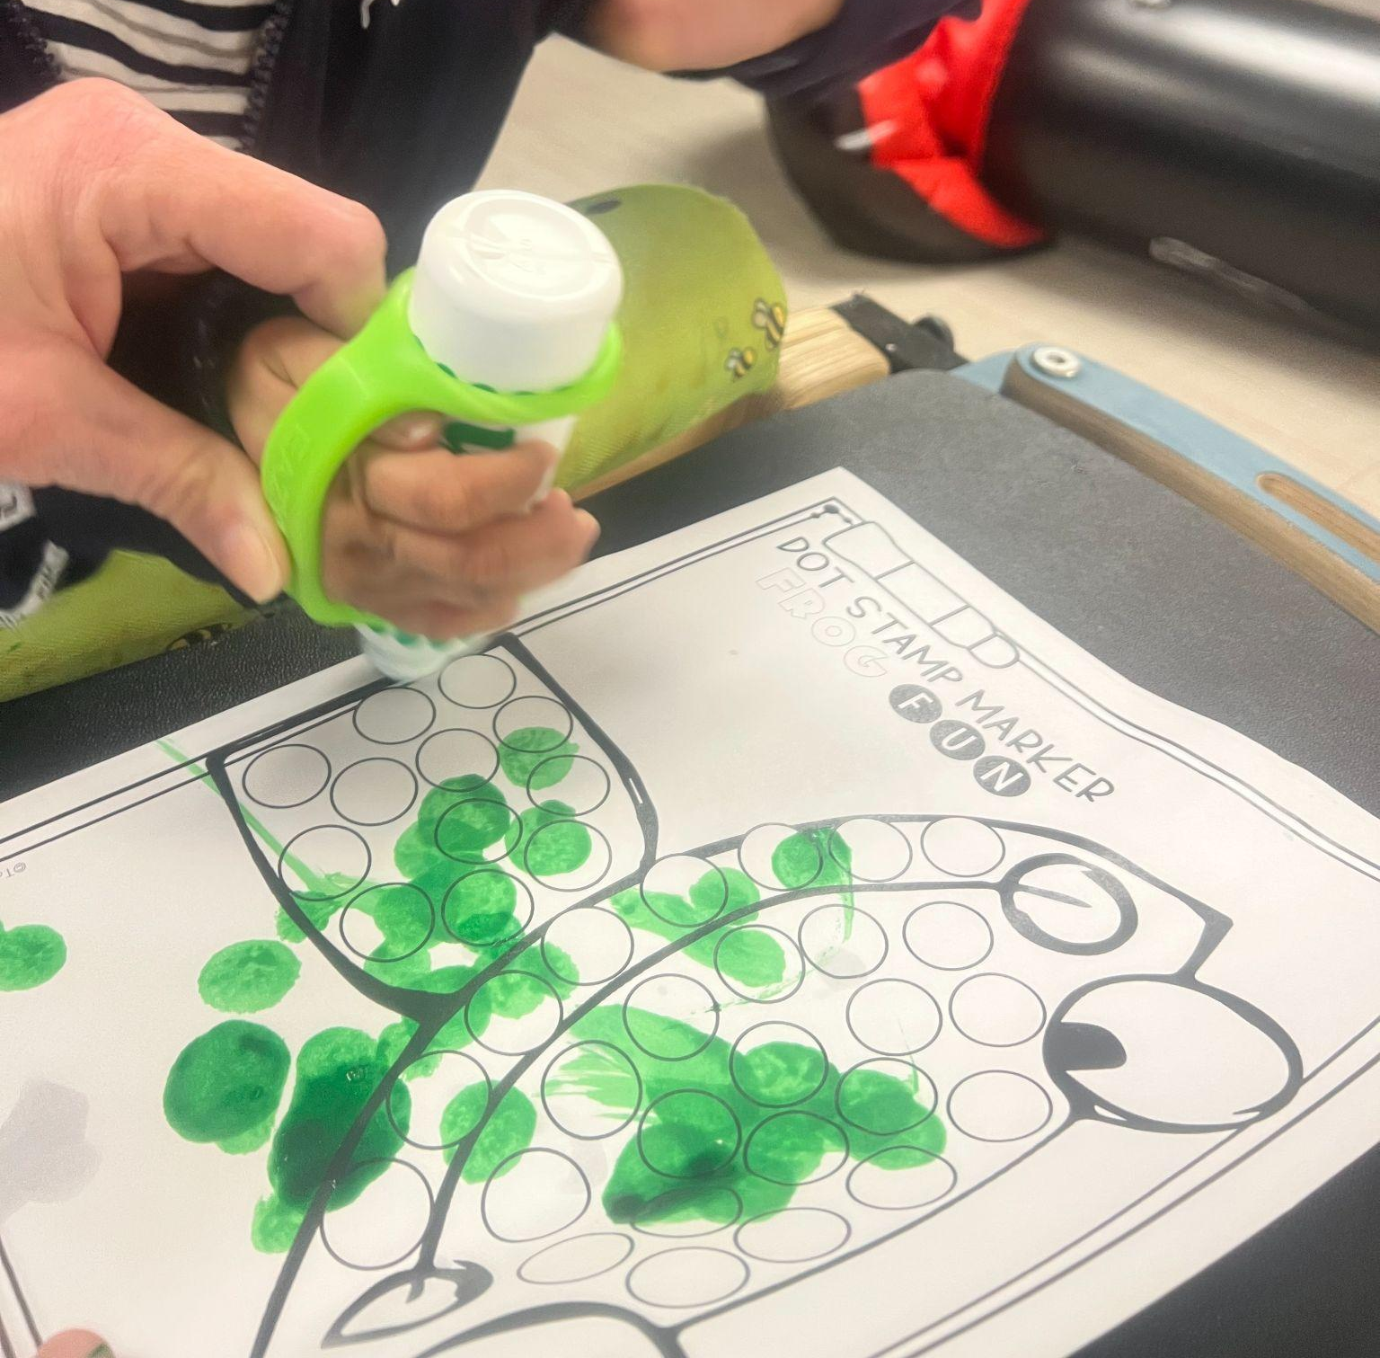

Slide 50

Consistency

Slide 51
Fosters growth, independence, equity, fidelity, and accountability across team members.

Slide 52
“Most human behaviour is learned observationally through modeling: from observing others one forms an idea of how new behaviors are performed, and on later occasions this coded information serves as a guide for action” (Bandura, 1977).

Slide 53
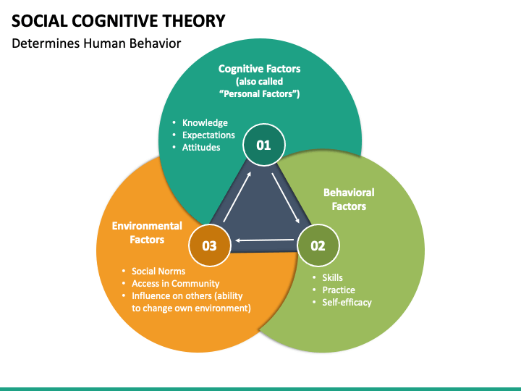

Slide 54
Set students up for success:
Planning activities/tasks based on a students cognitive and fine motor development ensures access, engagement, and development of skills.

Slide 55
Empowering Paraprofessionals

Slide 56
Data collection
Discrete Trial
Work Systems
Expectations
Behavior Intervention Plans
Inclusion expectations

Slide 57
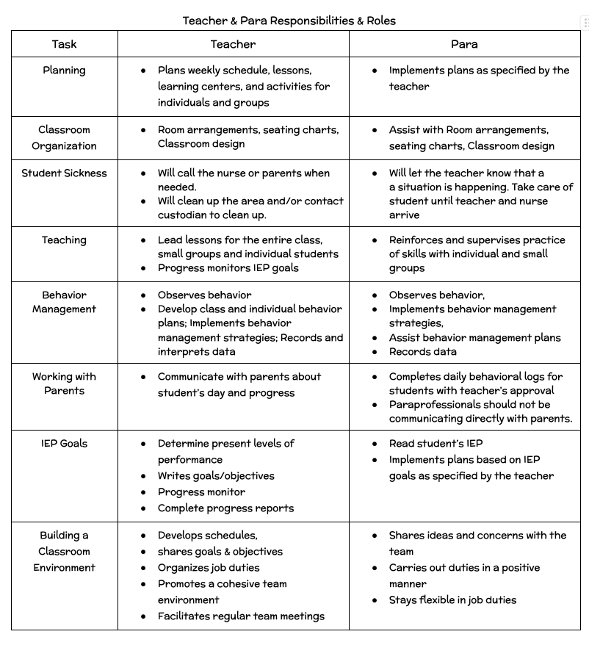
Paraprofessional Expectations

Slide 58
Teaching Classroom Systems and Procedures for all areas of your classroom ensures consistency across staff and settings.

Slide 59
Visually providing classroom expectations and frequently reviewing them with all members of the classroom.
Ensuring that all staff implement the same expectations across settings. Reteach the expectation to staff as needed.

Slide 60
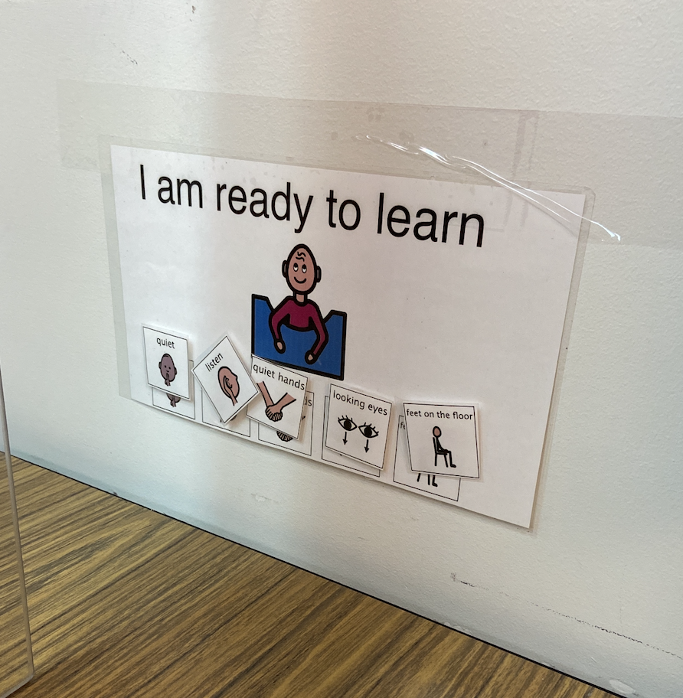
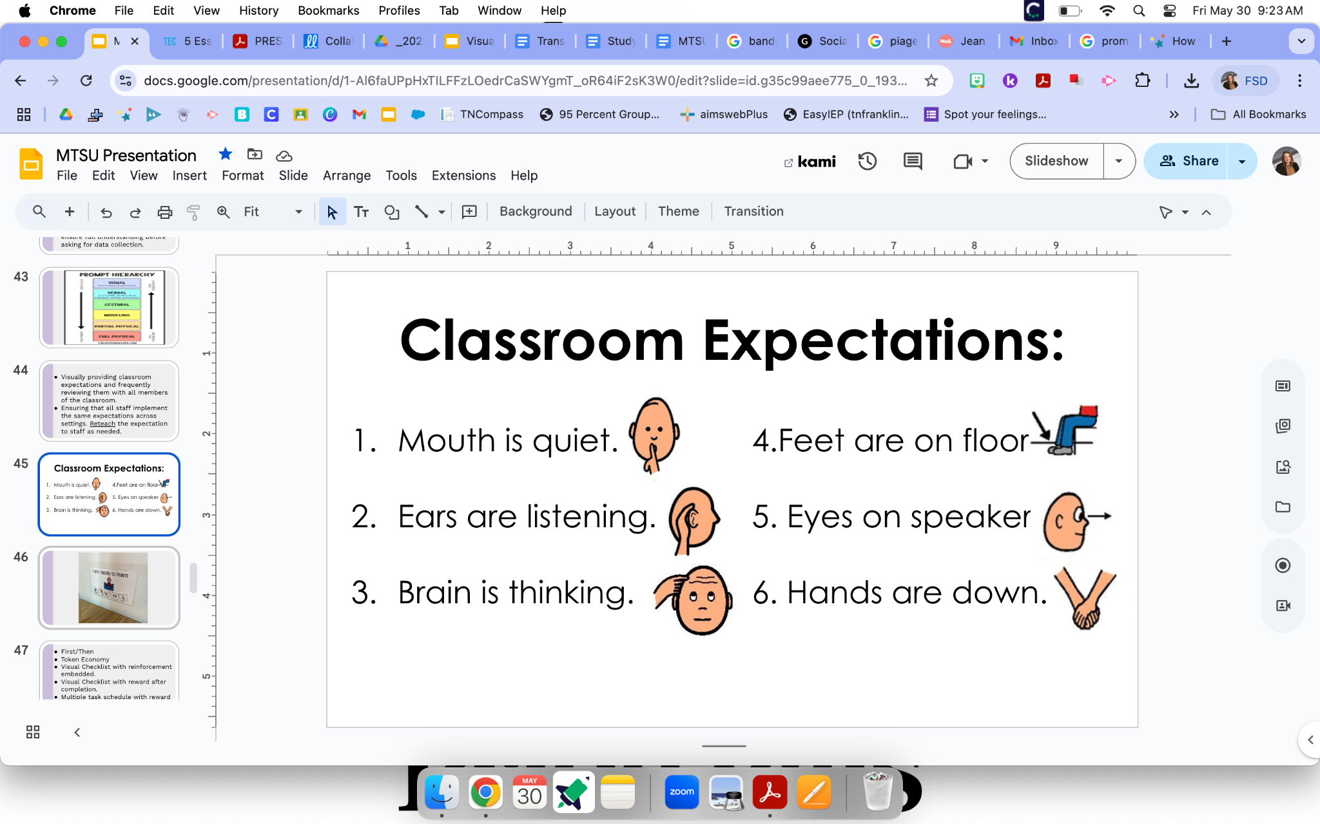

Slide 61
First/Then
Token Economy
Visual Checklist with reinforcement embedded.
Visual Checklist with reward after completion.
Multiple task schedule with reward after completion.
Daily Classroom Schedule

Slide 62
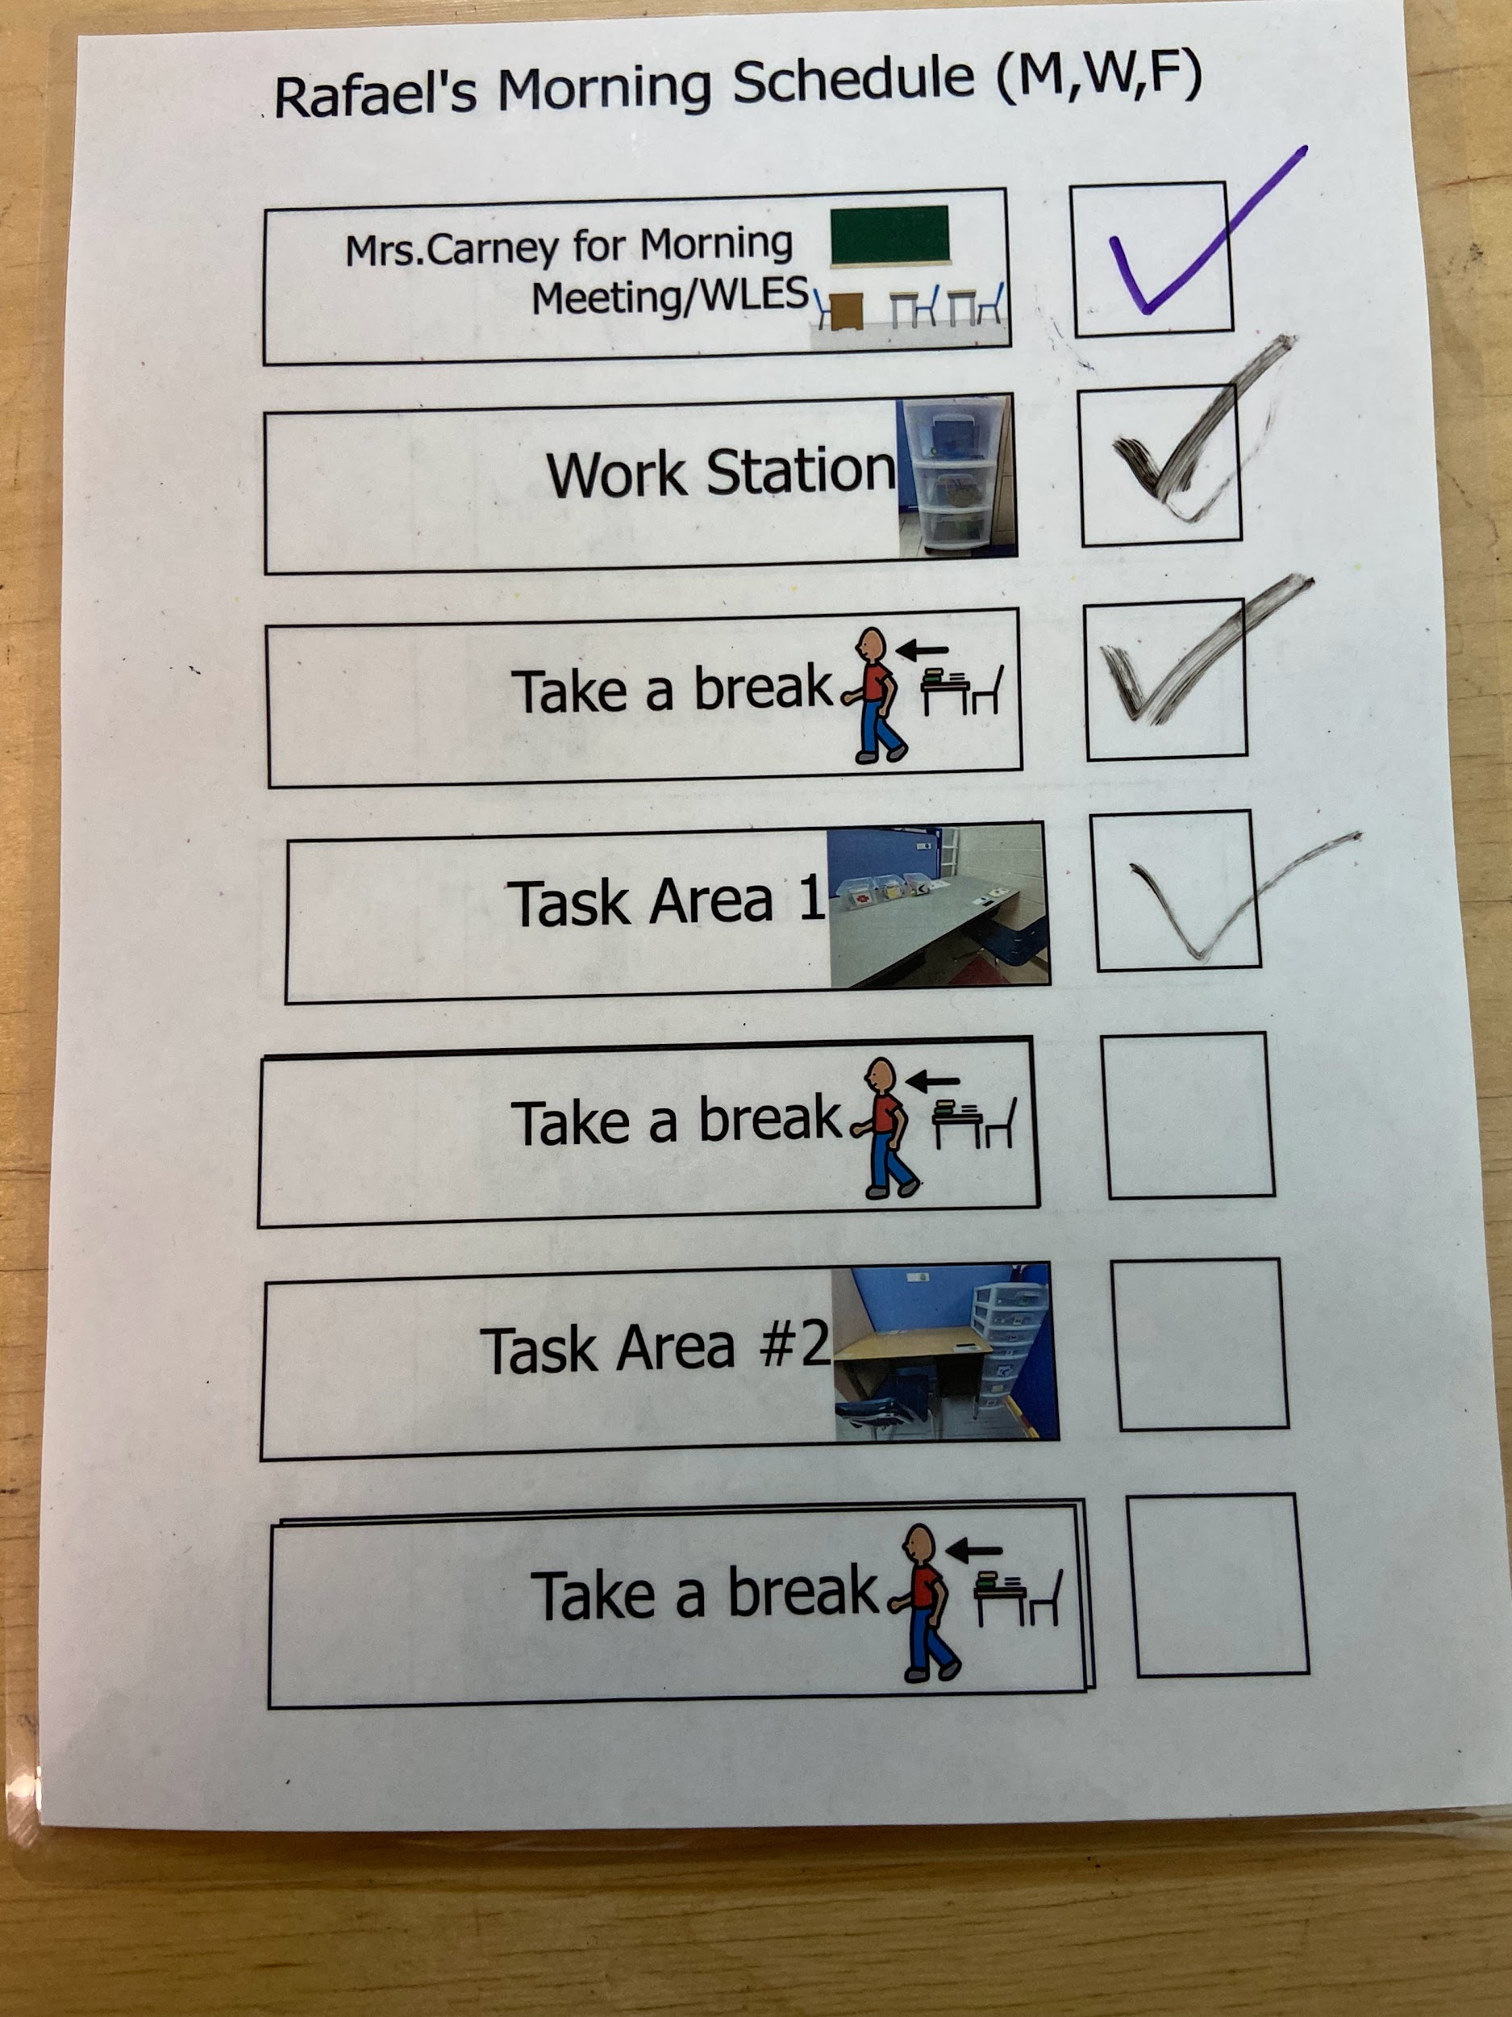
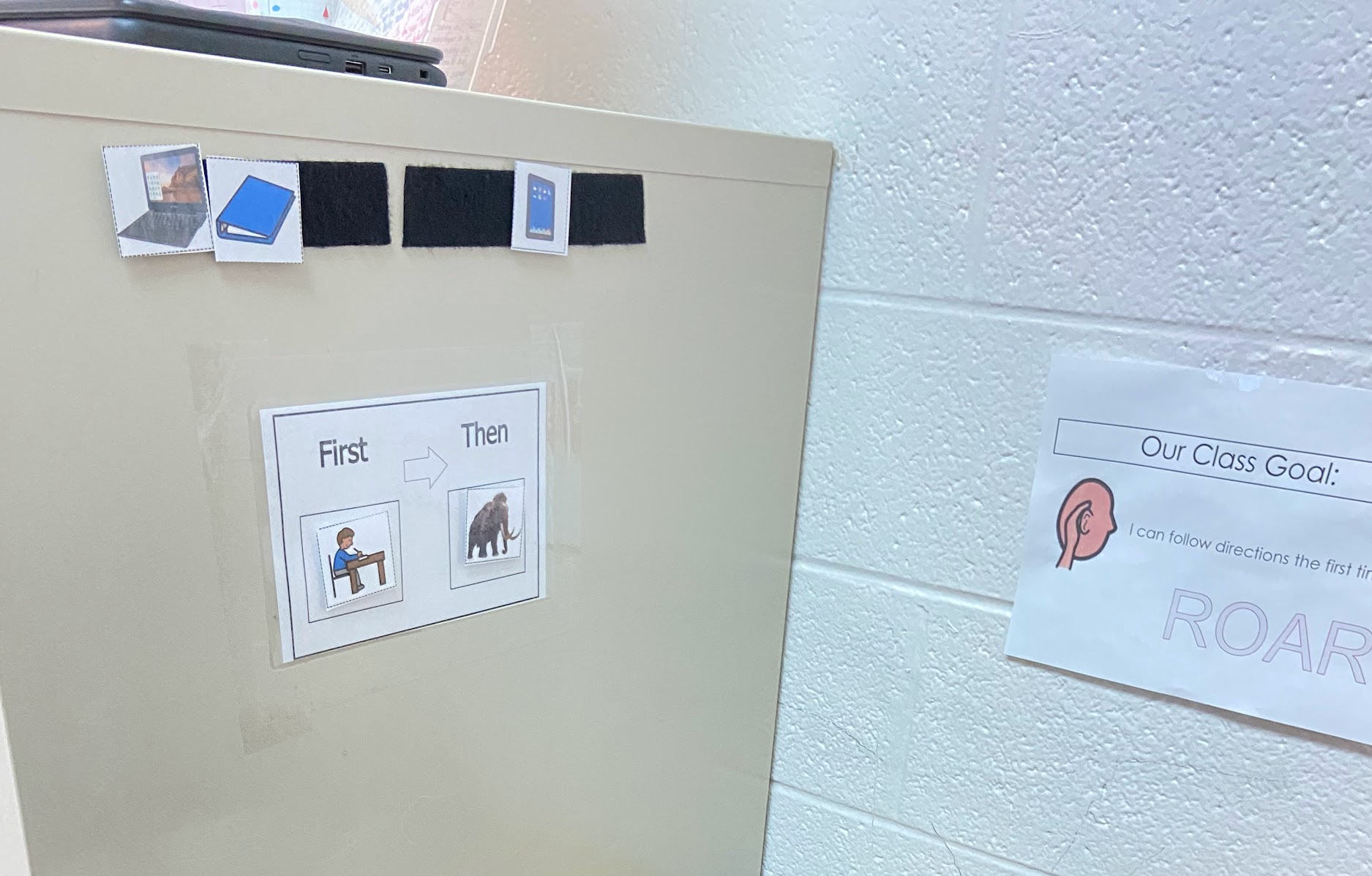
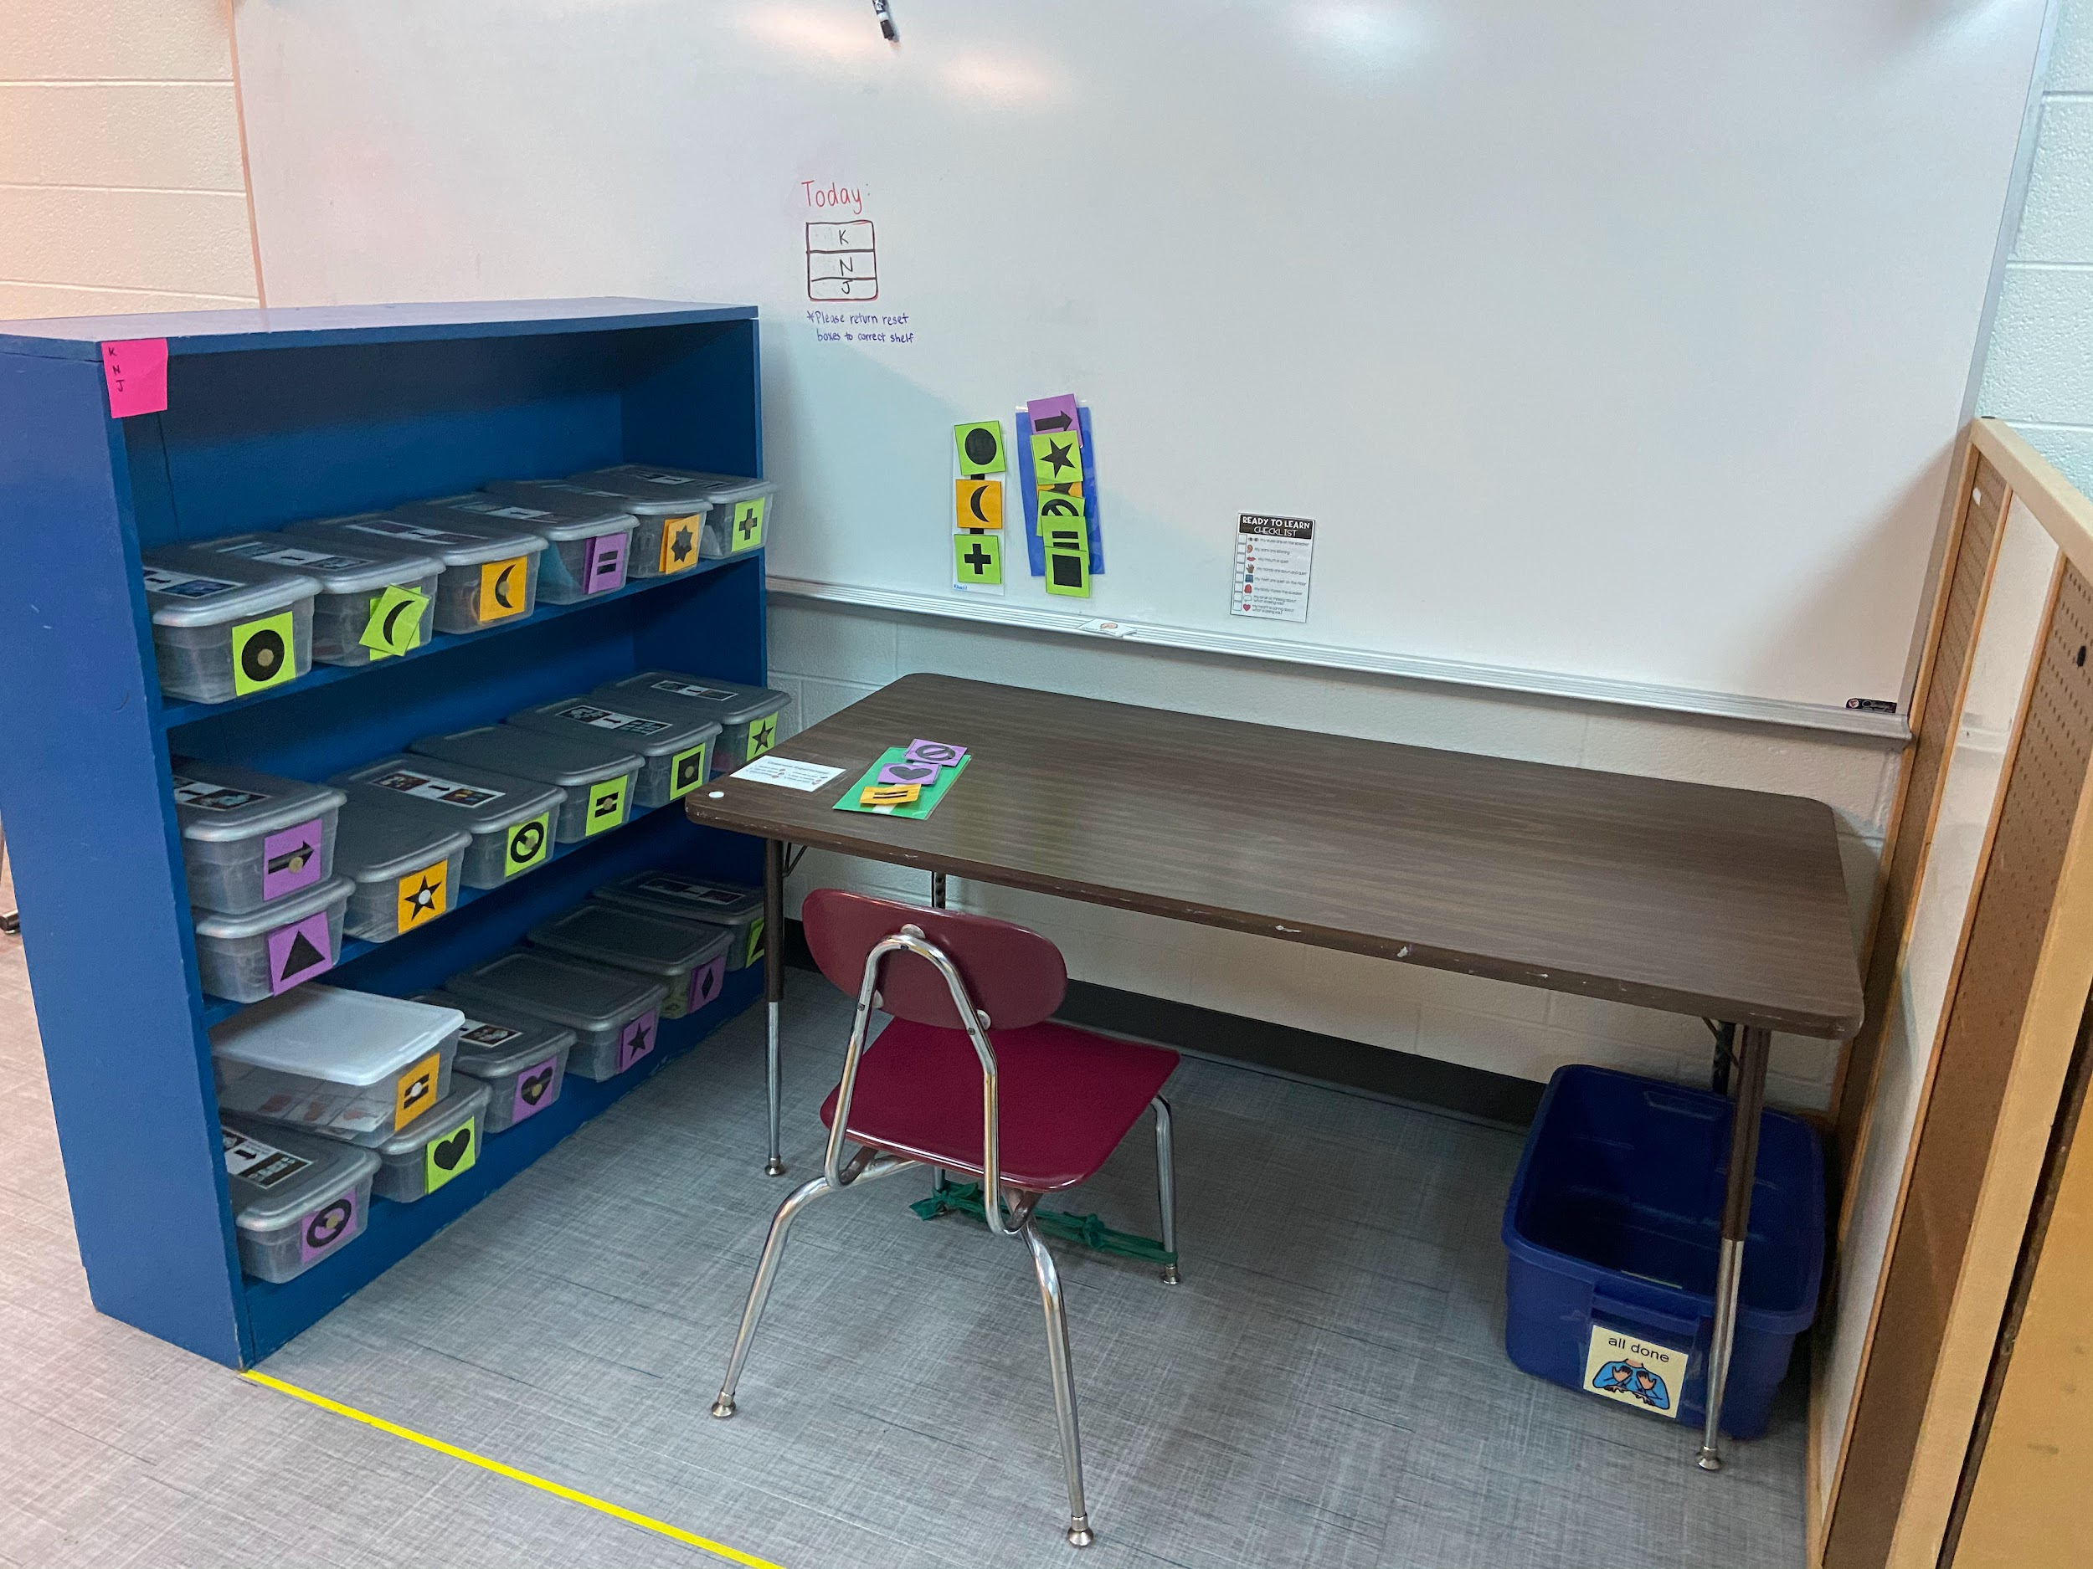

Slide 63
Prompting Hierarchy:
Train staff on the hierarchy and clearly establish what level each student requires for specific skills.
Post a visual reminder for staff.
Data Sheets should be specific about what level of prompting was required to complete the skill.

Slide 64
When reviewing a students “At-a-glance” with paraprofessionals and teachers, emphasize the level of prompting allowed within the goal and ensure full understanding before asking for data collection.

Slide 65
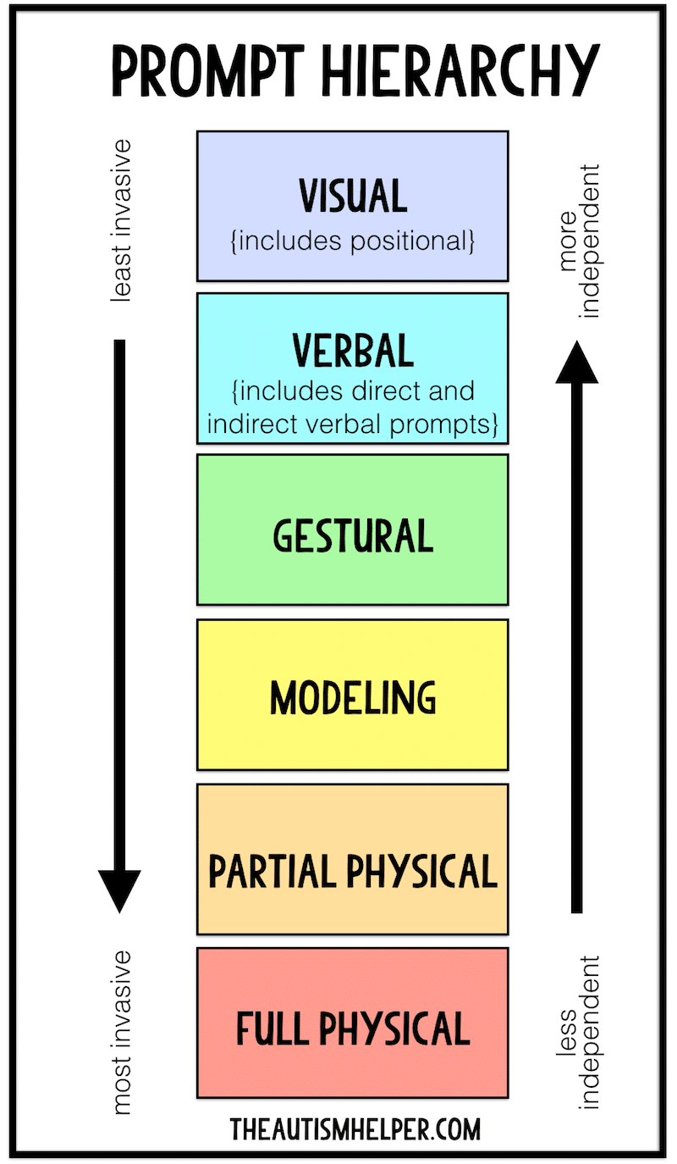

Slide 66

Wait Time

Slide 67
Make it known to the staff working with the student the amount of wait time that is appropriate for each student when working on skills.

Slide 68
Ensure that the student is able to experience an appropriate amount of struggle before beginning the prompting hierarchy.

Slide 69
Supporting the student in their struggle will teach self regulation, and self advocacy.
Intervening too early can create learned helplessness and leads to reinforcement of undesirable behaviors.

Slide 70
Work Systems

Slide 71
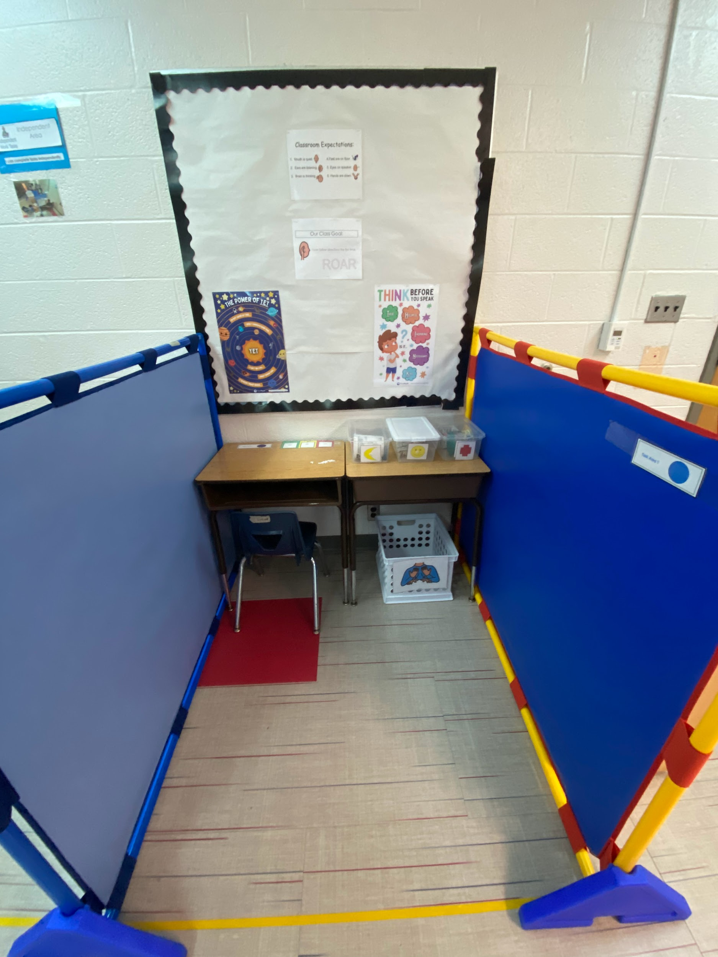
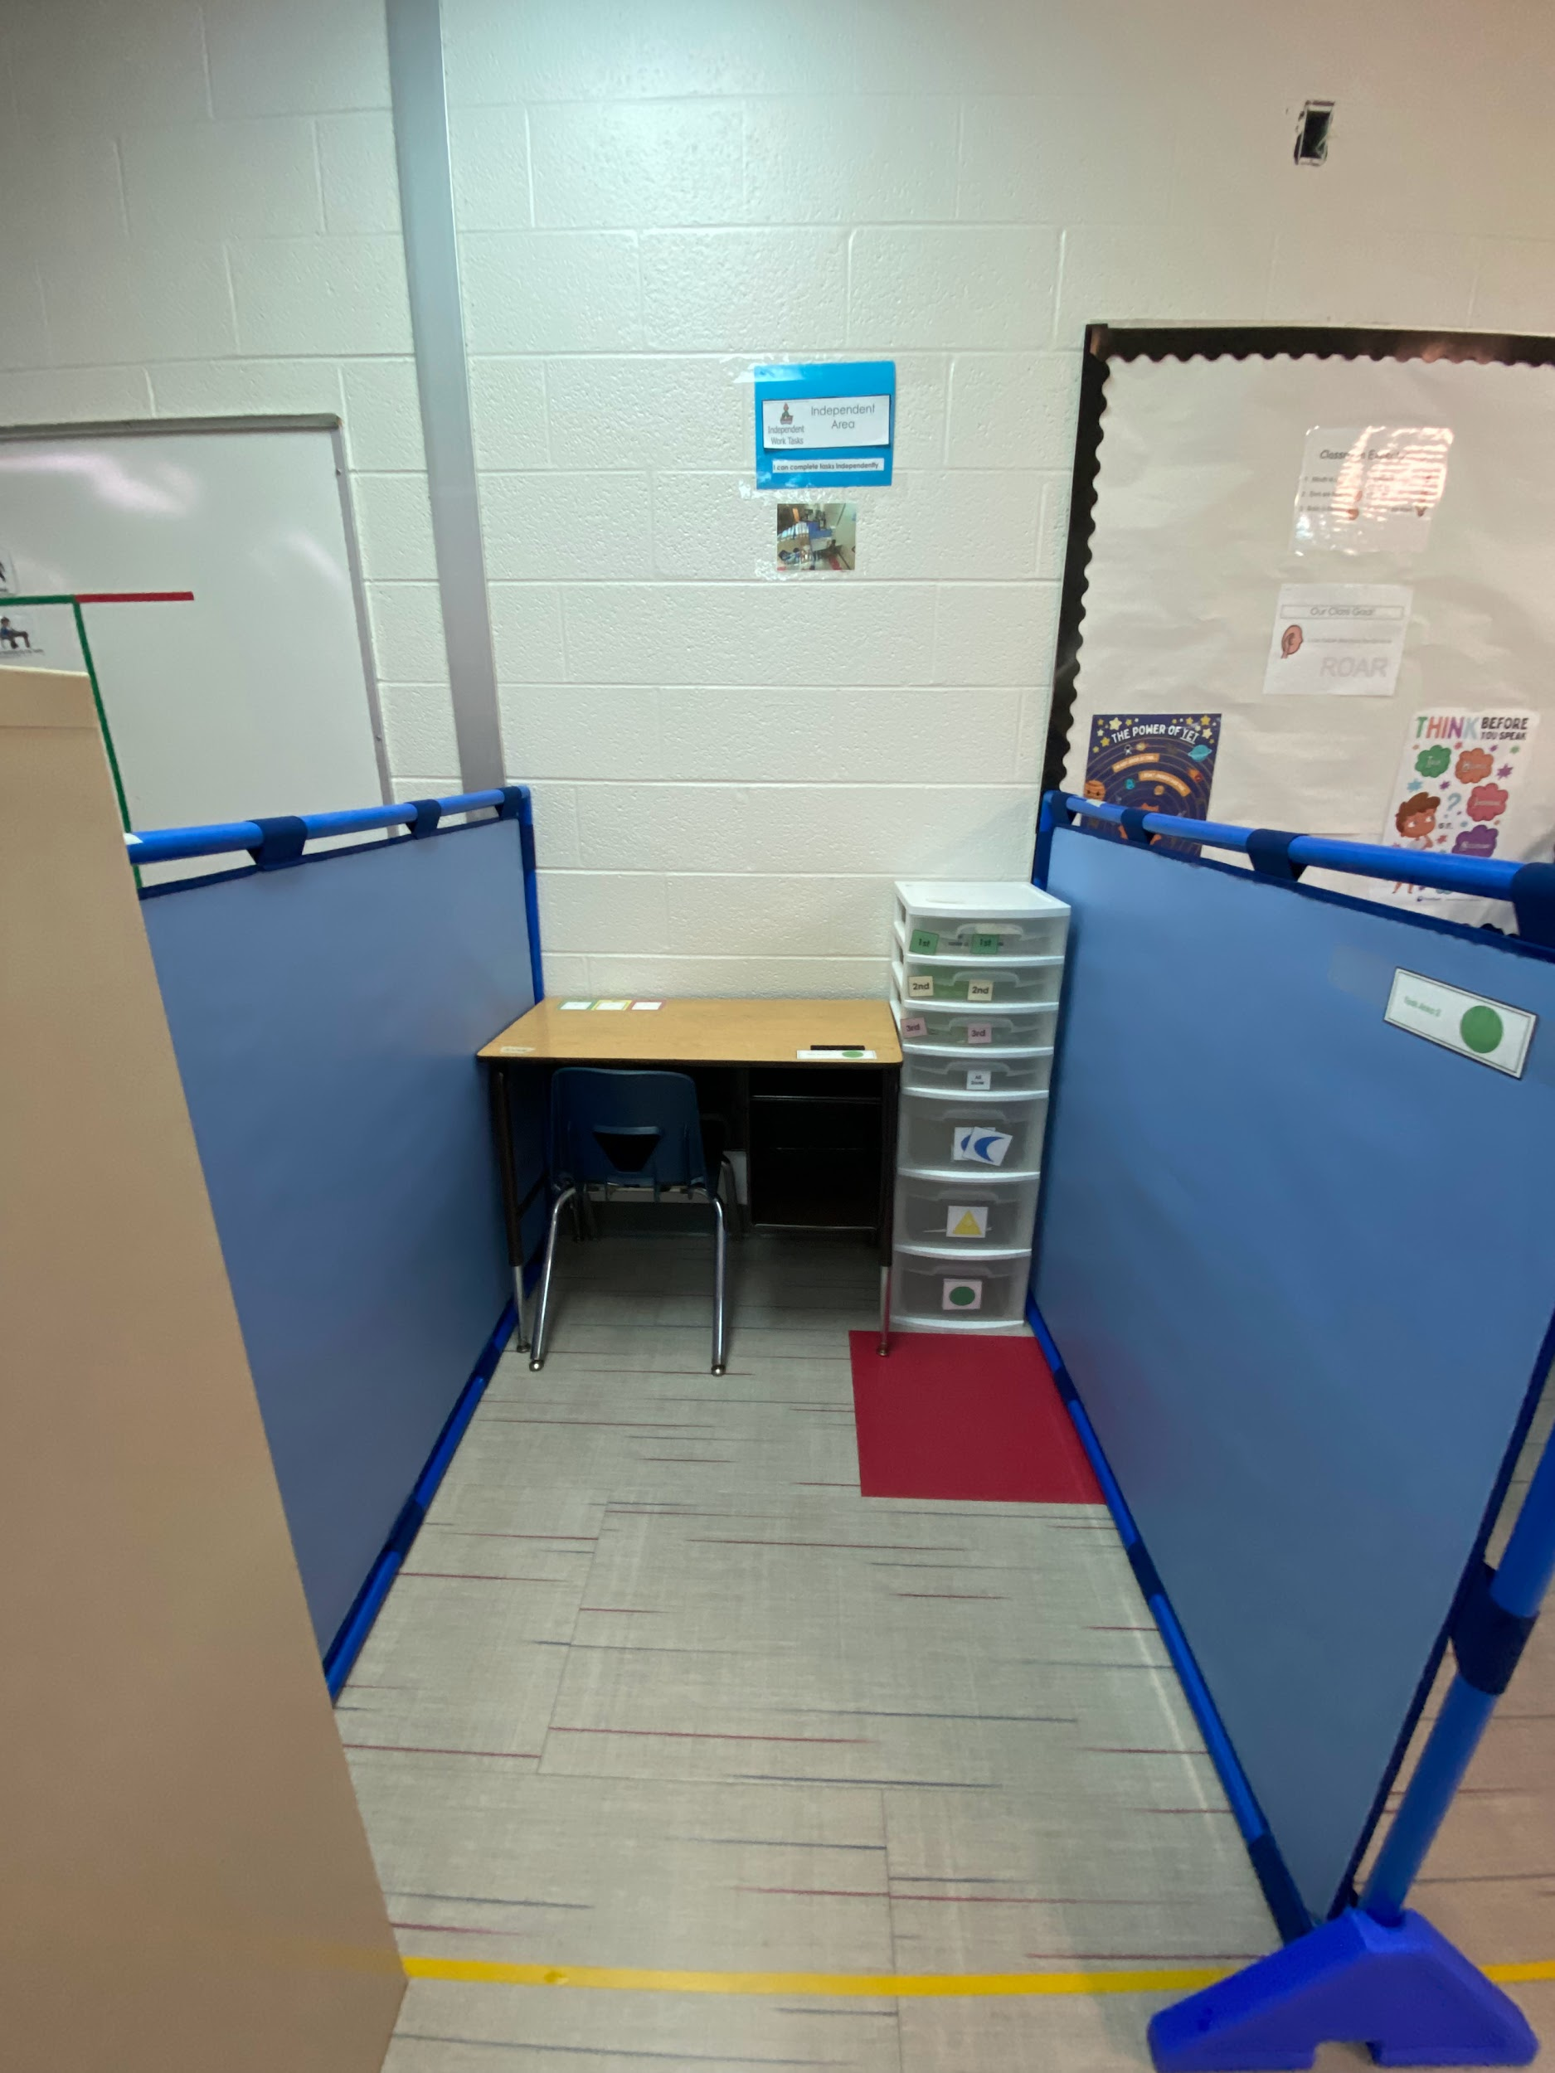

Slide 72
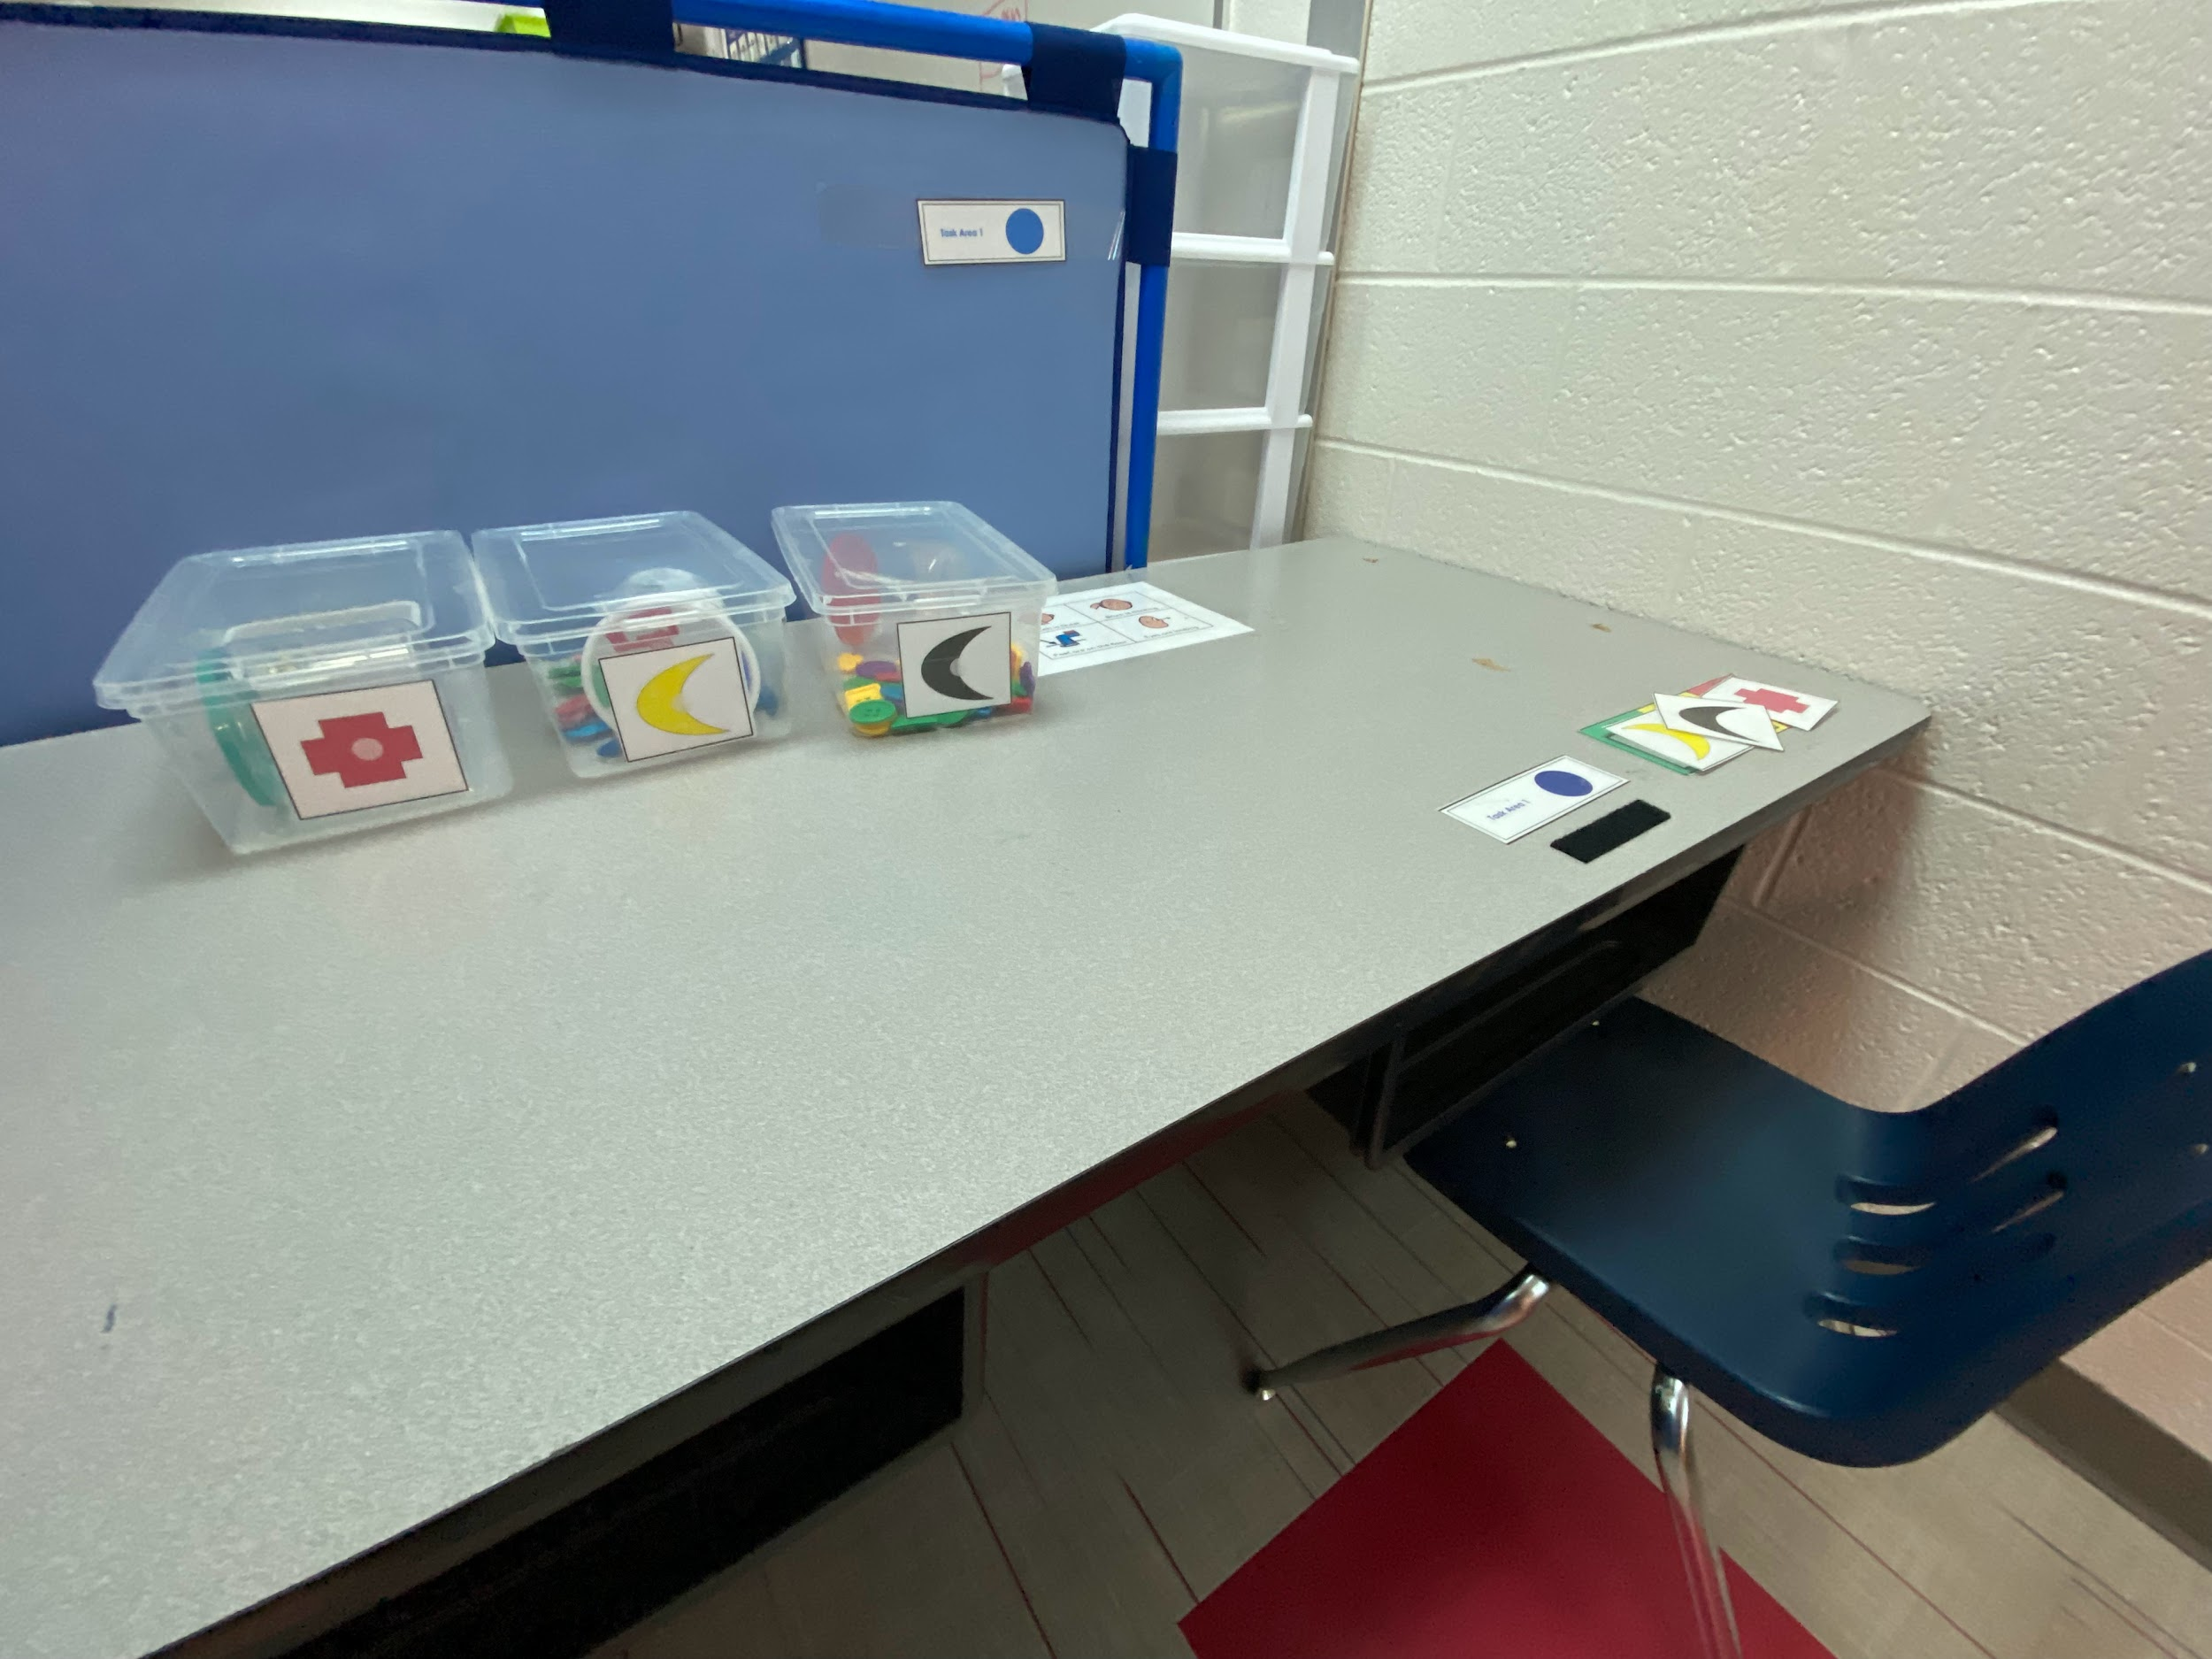
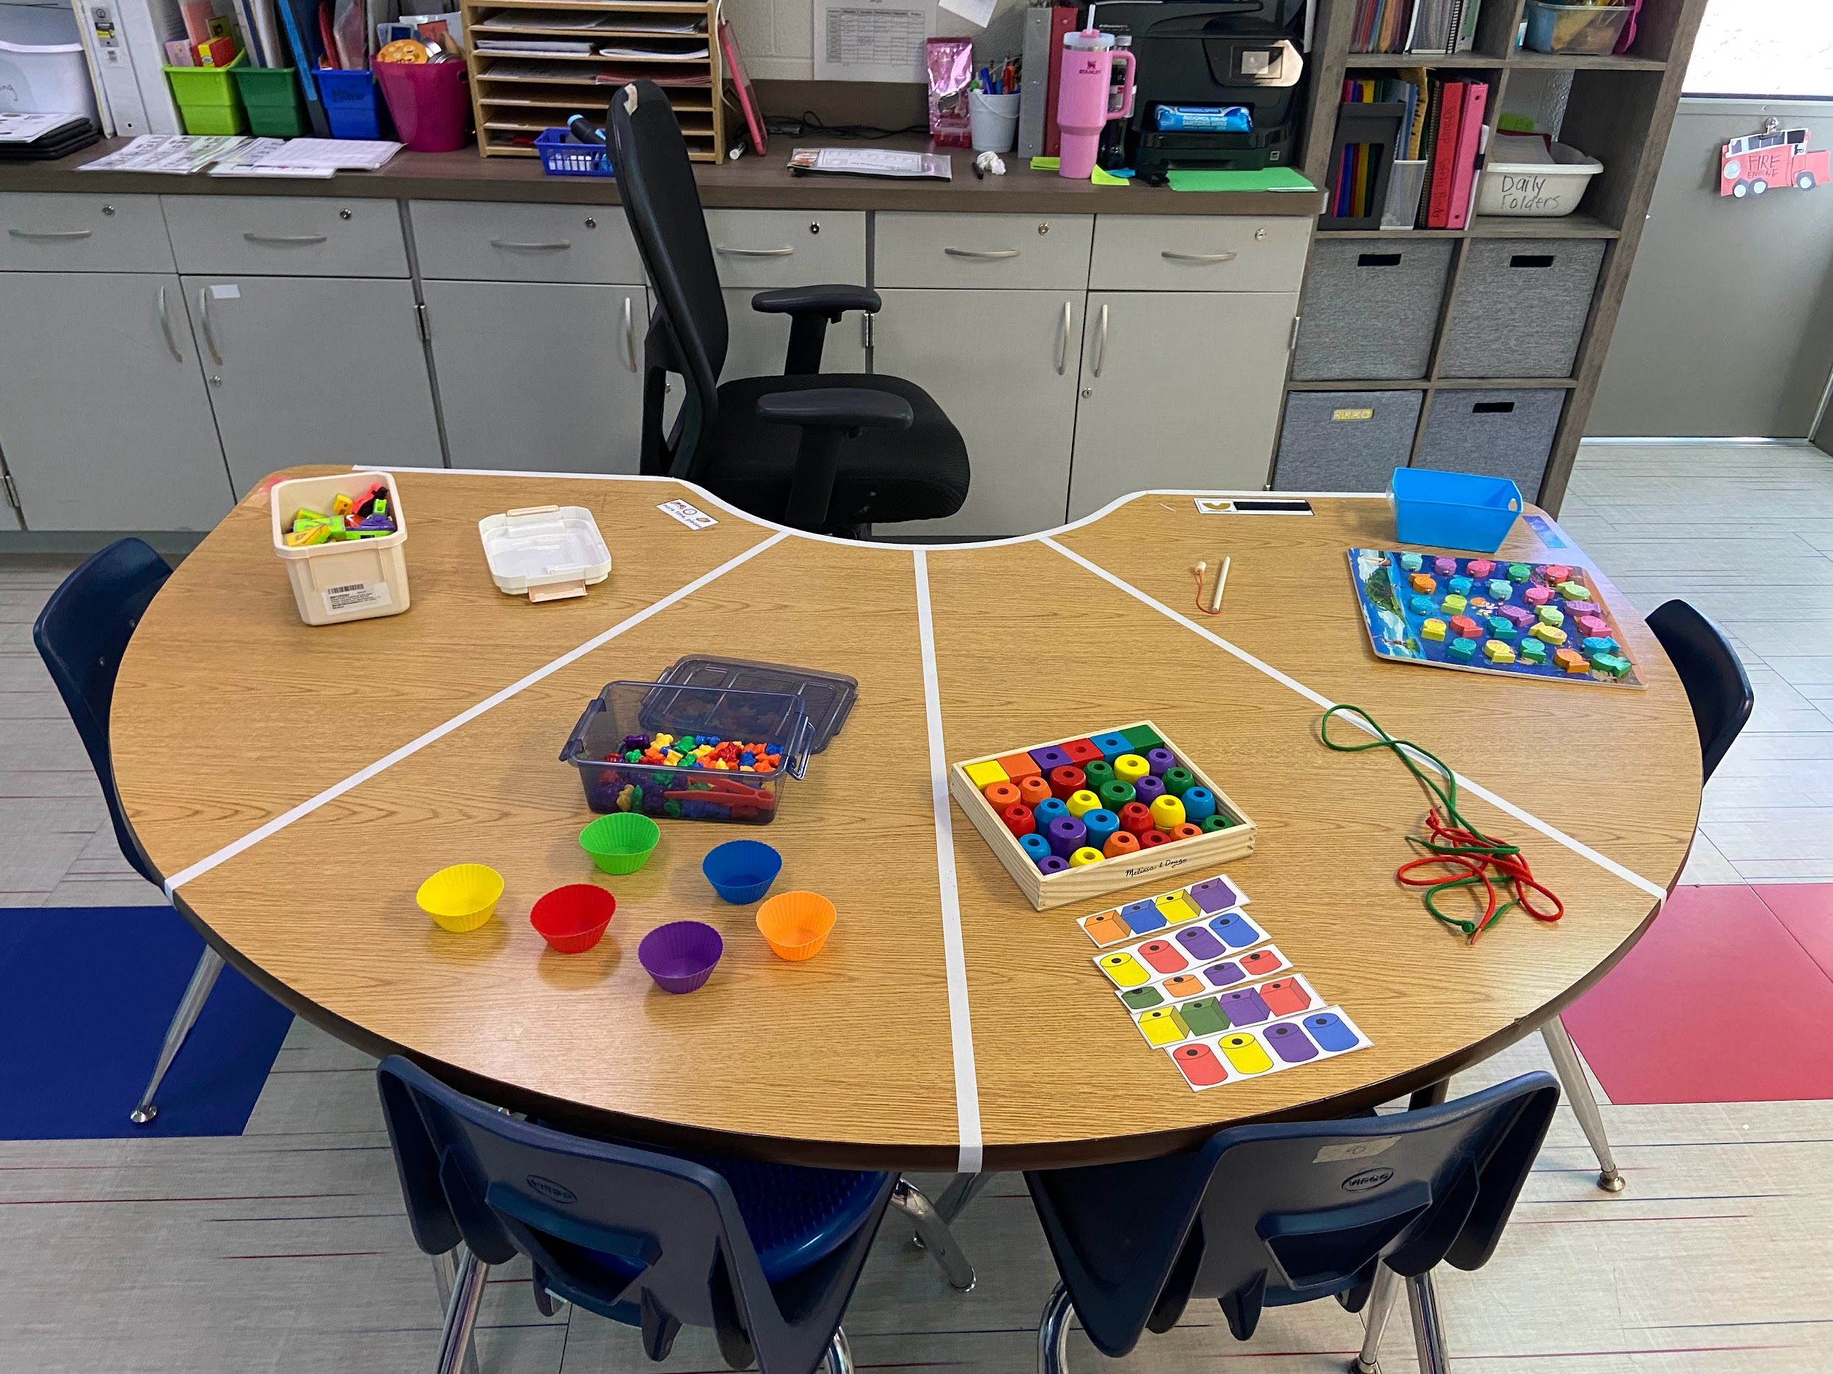

Slide 73
Teaching the skills of following directions, and working independently is vital for success across settings.

Slide 74
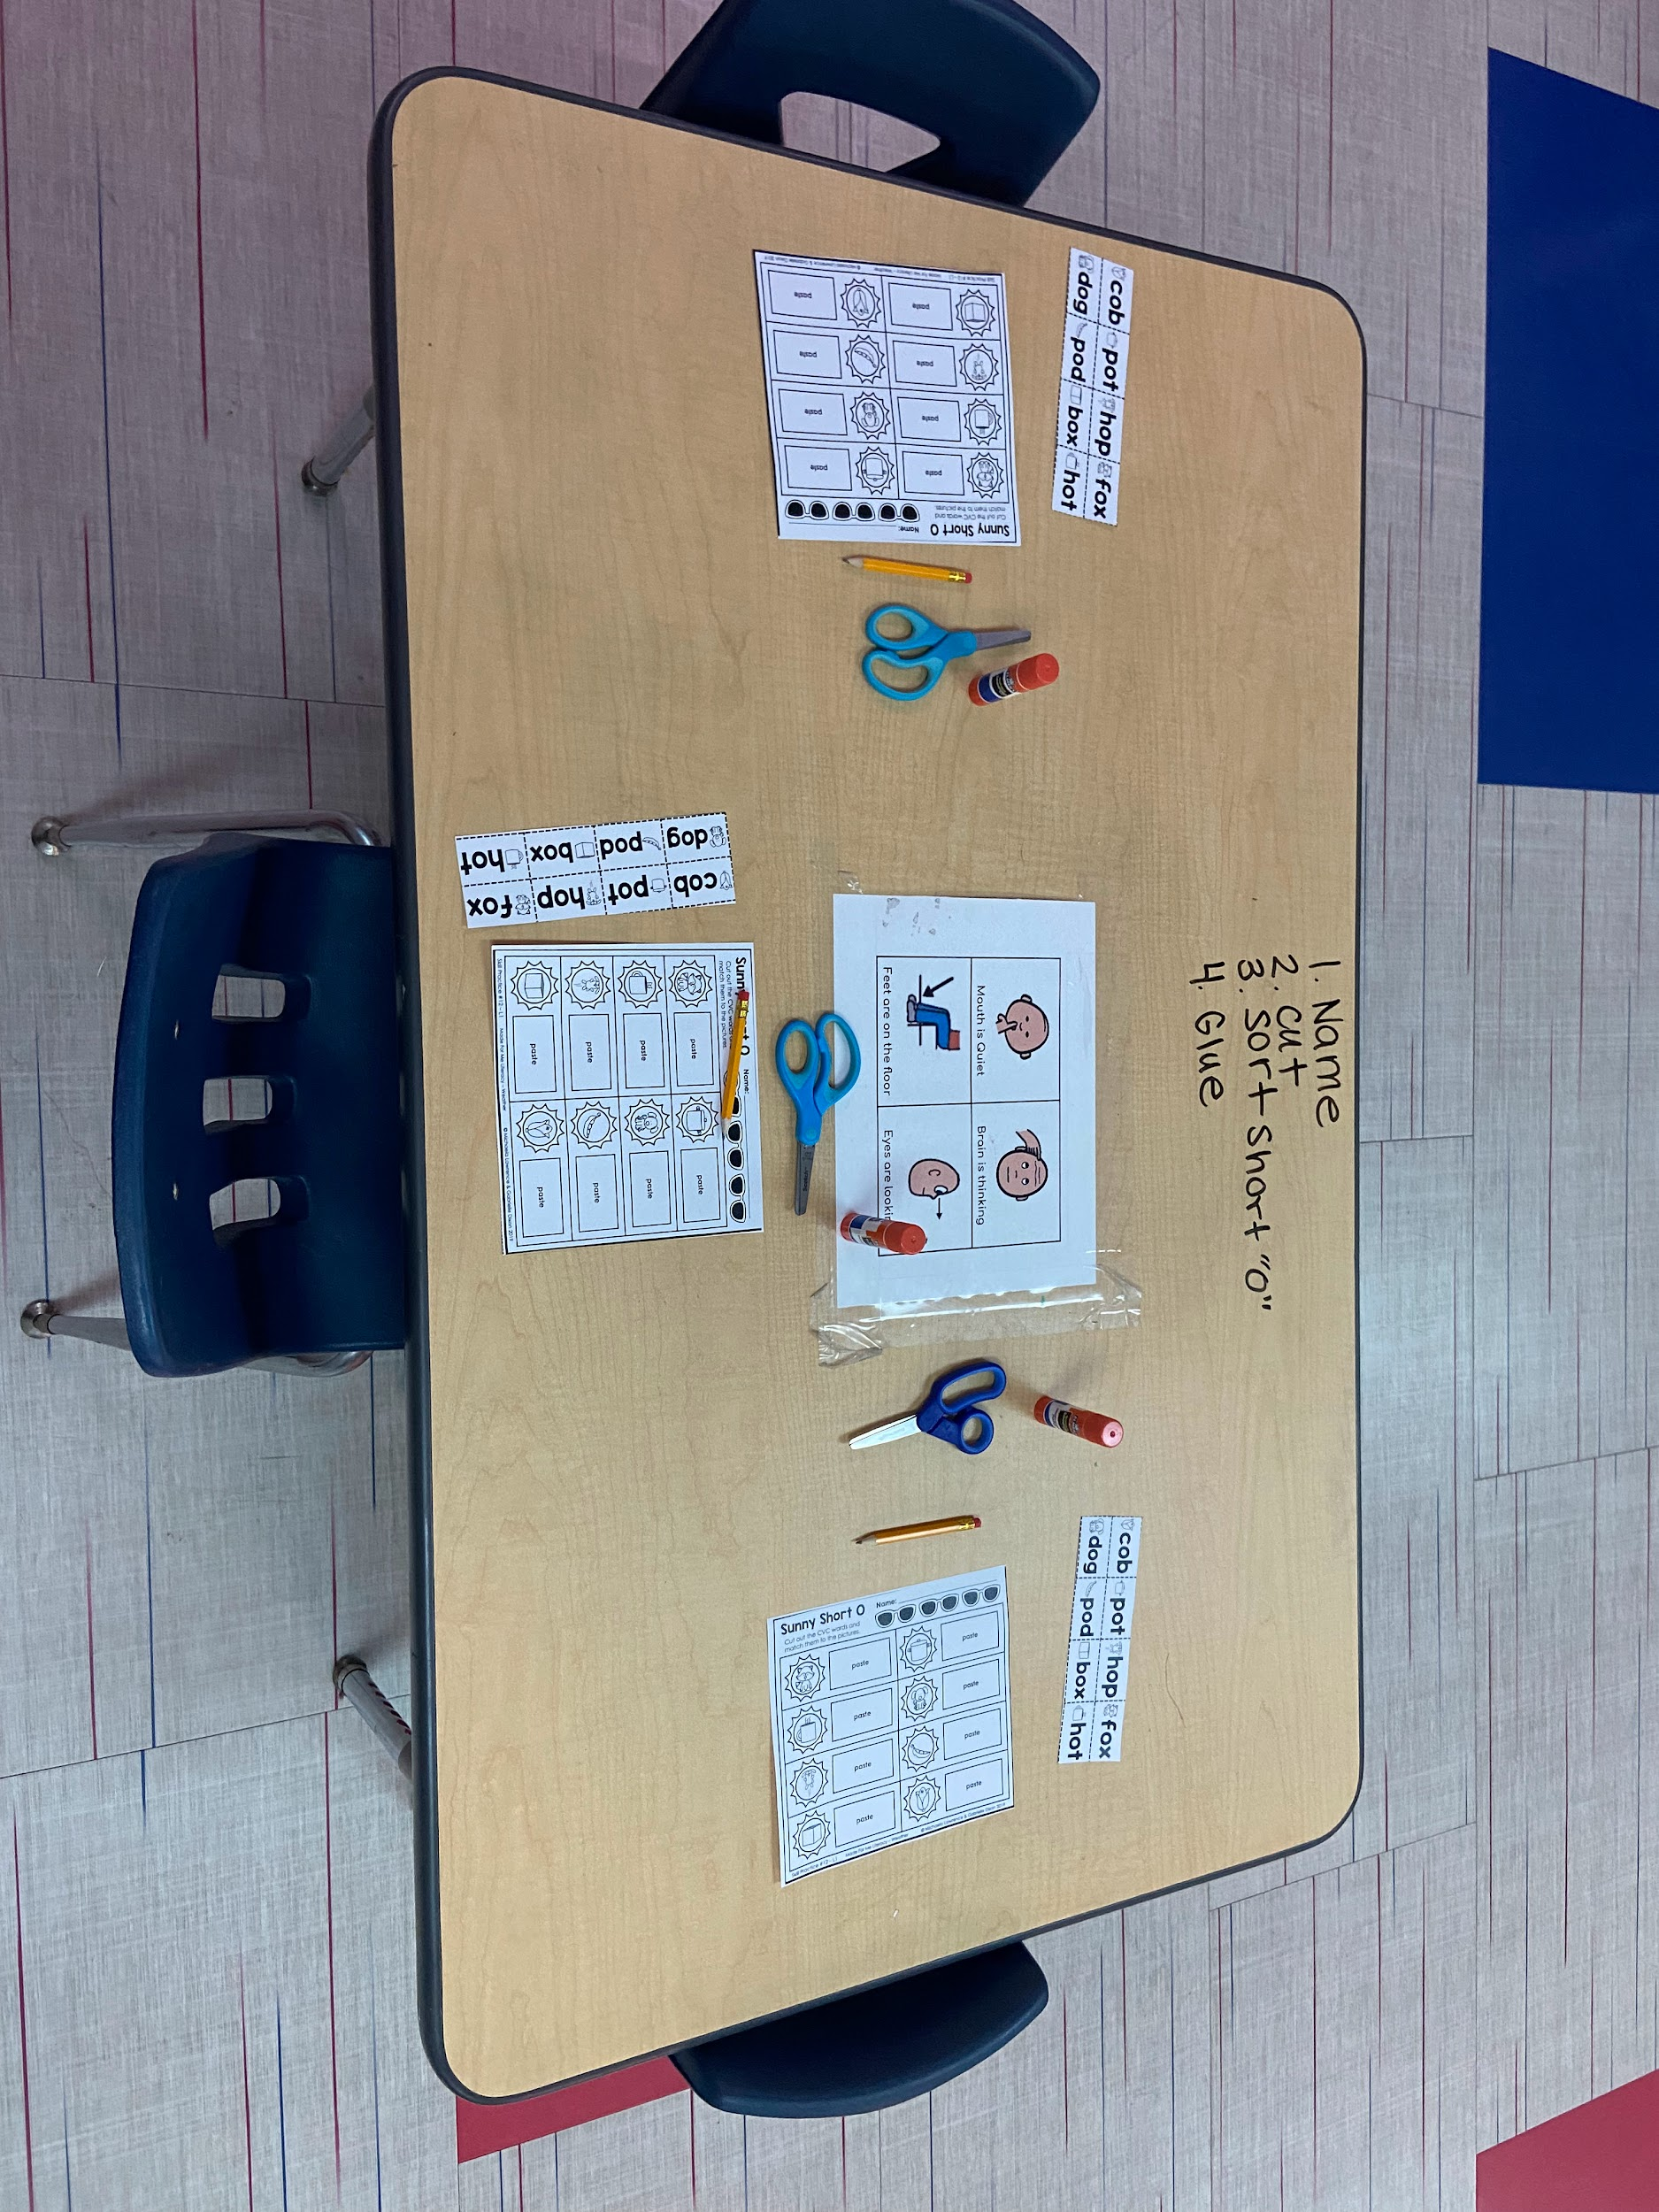

Slide 75
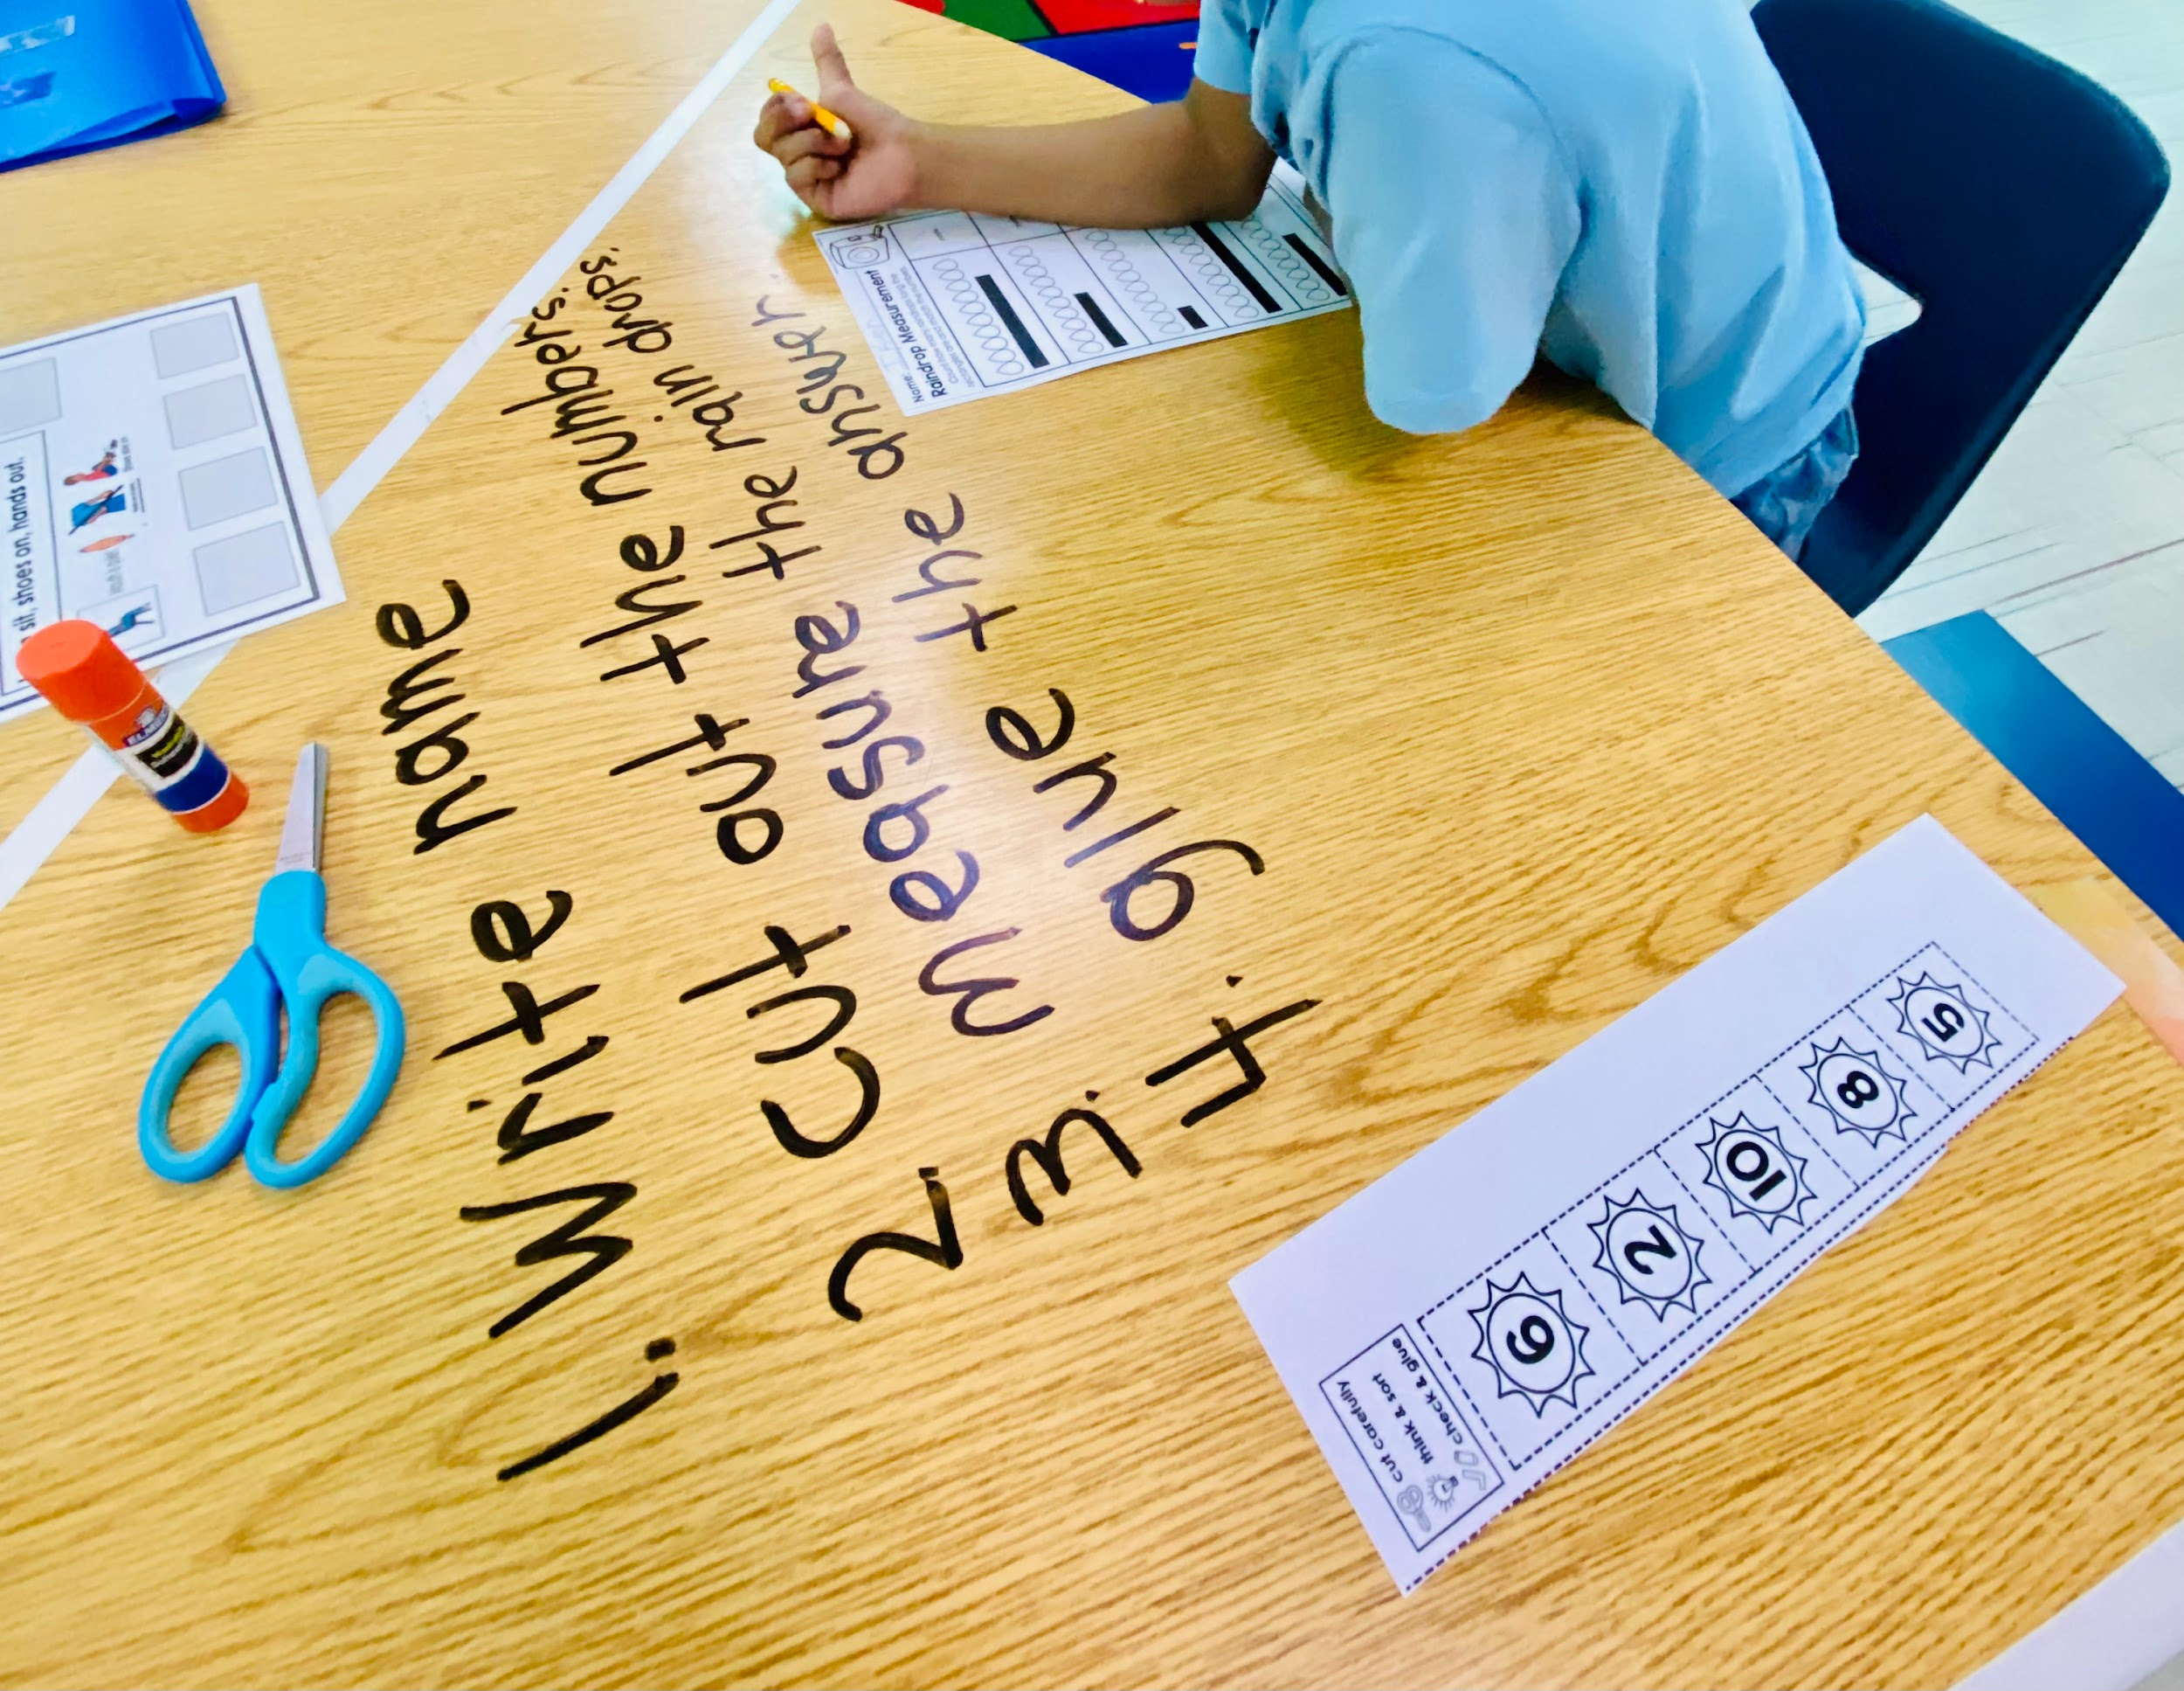

Slide 76
Expectations for Classroom Areas

Slide 77
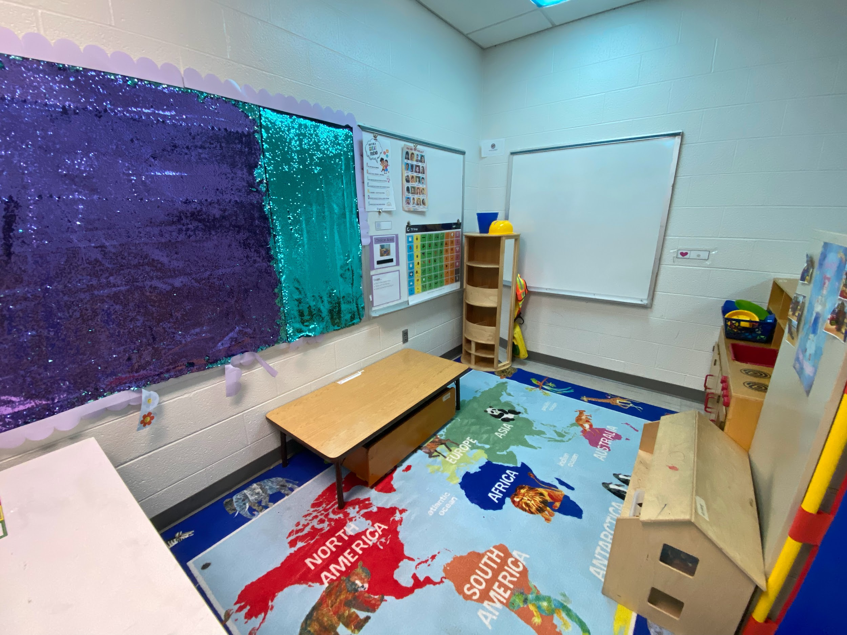
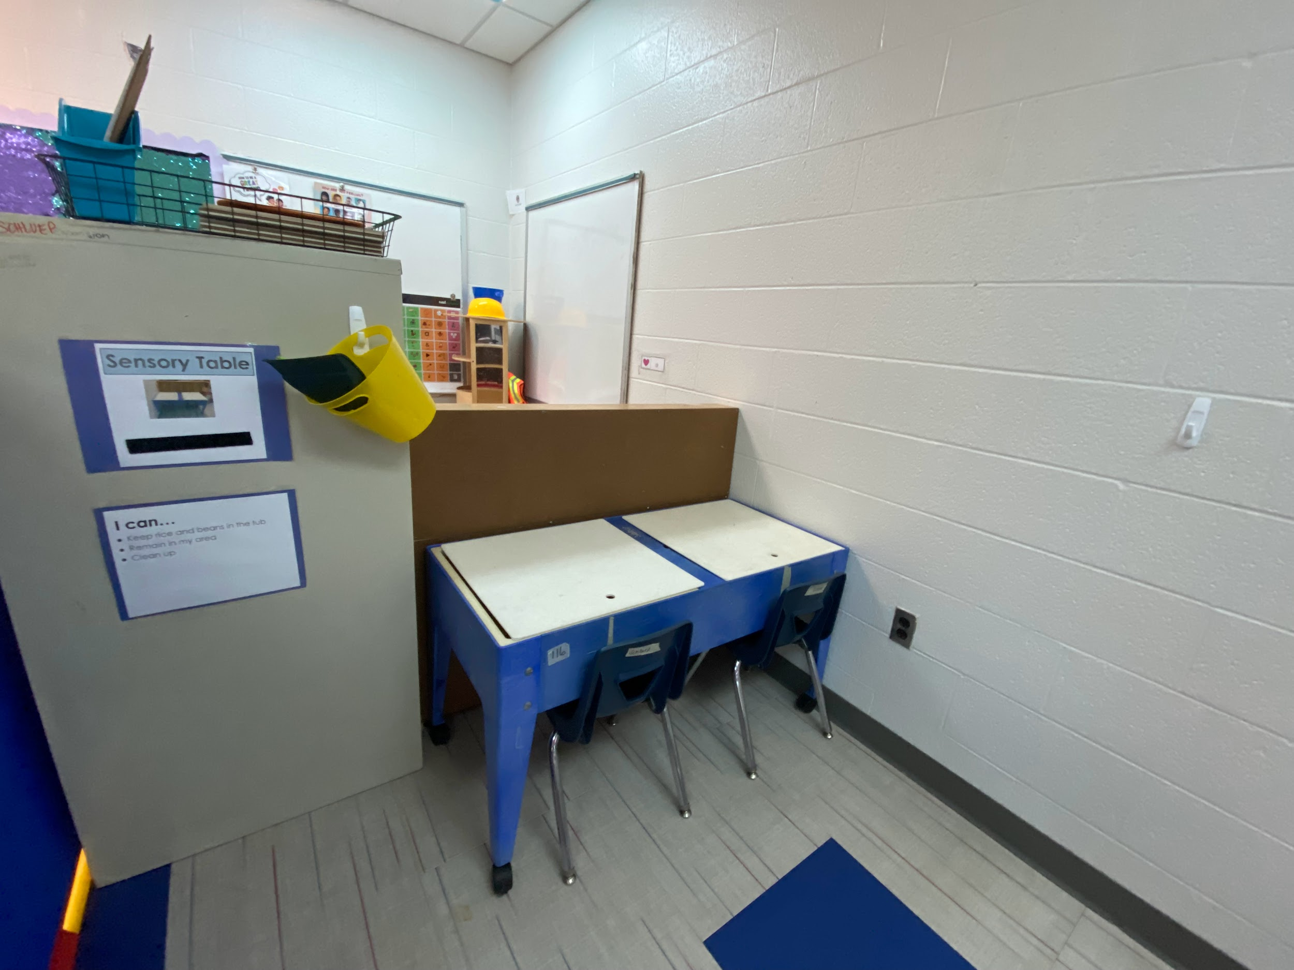

Slide 80
Using this framework ensures that your students’ environment is conducive to learning and growth through collaboration, creativity, and consistency.

Slide 81
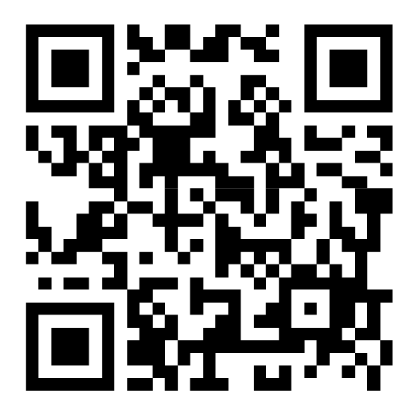
Questions
Comments
https://forms.gle/RWop6ftG14Ajsw5N9
Schluepcat@fssd.org
Gramermar@fssd.org
Scan Me

Slide 82
References:
https://www.nea.org/nea-today/all-news-articles/building-culture-classroom-collaboration
https://theecmconsultant.com/elements-of-collaboration/
https://www.gerardfriel.com/instructional-design/social-learning-theory/
https://theautismhelper.com/use-prompts-effectively-efficiently/
https://www.sensationalbrain.com/
https://www.lwtears.com/
https://www.dianealber.com/collections/spot-series?gadid=508726564025&gad_source=1&gad_campaignid=19555317509&gbraid=0AAAAABrc5K4e0oVmDbqOS9YAi476rxvB4&gclid=EAIaIQobChMIzIOTjIPbjQMVhZ5aBR1YrwgaEAAYASAAEgK4rPD_BwE

