Slide 1

No Confusion Inclusion
Mrs. Jennifer Munsey, Science Teacher, West Middle School &
Dr. Wendy Wilkerson, Director of Special Education
Tullahoma City Schools

Slide 2
About us…

Slide 3
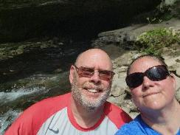
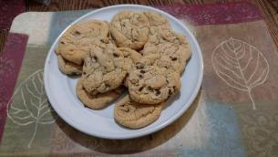
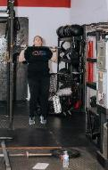
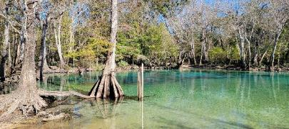
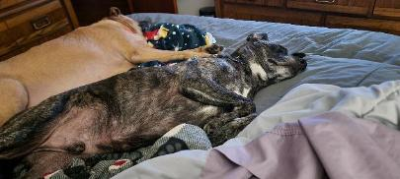
Mrs. Munsey
MTSU, Mississippi State, & South Dakota State University

Slide 4
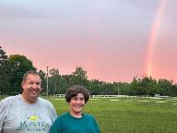


Dr. Wilkerson
MTSU, WKU, EKU, & UK
Notes:
WENDY: 2.5 min

Slide 5
Mock Lesson
Notes:
WENDY: When you walked in, you were given a card. Your card might have a disability described on it. If so, when participating in this mock lesson, please act as though you’re an individual with characteristics of that disability. (Pause and allow participants to read and think about their disability or not.) If your card has a star on the back, then you might be asked to be a star today! If you’re not willing to be a part of this activity in front of others, trade your card now. (2 minutes max)
We’re asking you to participate in a mock lesson from the Open SciEd Science curriculum. Mrs. Munsey is the certified Science teacher, and I am the educational assistant assigned to her class who may or may not be of high quality. You are in 8th grade. You and your classmates make-up a mix of 51% students without IEPs and 49% of SWDs. 5 min

Slide 6
Introduce Lesson
Notes:
JEN: Munsey gives instructions as though she is teaching her actual students. Wendy is walking around with the wrong materials (tulip cards), confused, and coaching the students to do the wrong thing or is critical of them. This goes on for about 10 minutes. Wendy might even prompt some participants to help show confusion.

Slide 7
How did you feel during this part of the lesson?
Notes:
WENDY: CONFUSED?

Slide 8
Access for All:
SPED law, rule, & policy expectations
IDEA & Section 504
Notes:
IDEA, TDOE, local districts-5 minutes

Slide 9
Disabilities
A person’s disability is not necessarily something you can see
Every disability and person with a disability is different

Slide 10
Some History about Individuals with Disabilities
as far back as 1800s- marginalization of people w/ disabilities
1920s-WWI veterans w/ disabilities & expectations of government
1930s-improvements in technology & gov’t assistance; self-reliance & self-sufficiency of individuals w/ disabilities
1940s-1950s-WWII veterans increased pressure on gov’t

Slide 11
More History about Individuals with Disabilities
1960s Civil Rights Movement
1973-Rehabilitation Act- 1st disability legislation-equal opportunity
1975-Education Act for All Handicapped Children
1990-renamed previous act the Individuals with Disabilities Education Act (IDEA); also the Americans with Disabilities Act (ADA) passed
Notes:
We will discuss some of these laws in more detail in a few minutes.

Slide 12
Individuals with Disabilities Education Act (IDEA)
Free Appropriate Public Education (FAPE)
Least Restrictive Environment (LRE)
Continuum of Services
Inclusive Practices

Slide 13
Intro to Video
Notes:
JEN: video will be shown from downloaded file

Slide 14
Link video to good teaching & SPED

Slide 15
Accommodations from SWDs in this class
Directions in alternative formats
Preferential seating
Repeat instructions verbatim
Retest opportunities
Type/record answers
Directions broken down
Rest/breaks
Photocopies of notes
Redirection
Notes:
Clearly, Mrs. Munsey had these accommodations in her mind when teaching this lesson.

Slide 16
Accommodations from SWDs in this class
Copy of teacher notes
Extended time
Reduce/minimize distraction
Chunking
Provide to-do list
Visual timer
Provide choices
Transition prompts
Notes:
Clearly, Mrs. Munsey had these accommodations in her mind when teaching this lesson.

Slide 17
How can you prevent confusion with inclusion?
Independently, please write on individual sticky notes 3 ways that you can prevent confusion with inclusion. All of these suggestions will be gathered into ONE document and shared later as a resource for you.

Slide 18
Questions?

