Slide 1

TDOE Updates
Jaime Grammer
Brittany Slagle
Sheri Smith
© 2022 Tennessee Department of Education
© Tennessee Department of Education

Slide 2
DISCLAIMER – Generative AI Tools
The State of Tennessee does not currently permit the use of Generative
AI tools, such as Otter, in meetings hosted on state resources. Meetings with contractors, vendors, and subrecipients are not public meetings and may involve discussion of protected state data. Generative AI tools are not adequately regulated and are designed to train on data that is collected and may misrepresent data or release protected data to the general public. While the State supports your desire to maintain
documentation of the meeting and what you learn, please respect our decision to safeguard information and do not attempt to use tools such as these. If you choose to use a tool such as this, the State will block that tool from the meeting.

Slide 3

Agenda
CSH Updates
CCTE Updates
Project RAISE Updates
Q & A

Slide 4
CSH Updates
Jaime Grammer
School Counseling Manager

Slide 5
Resources
Role Matrix Documents
  Advancing Comprehensive School Mental Health Pilot
Conflict Resolution Guidance Document
Guide to Student Re-entry
Notes:
Talking Points:
The role matrix documents highlight the roles and responsibilities of each of these roles in the school setting. It differentiates the scope of practice for each. (Highlight districts that will be participating and details about the pilot)
Chapter 676 of the Public Acts of 2024 directed the Tennessee Department of Education to develop a conflict resolution program that may be adopted and implemented by local education agencies (LEAs) and public charter schools. The program aims to assist students in any of the grades kindergarten through 12 (K-12) in developing the skills necessary for nonviolent conflict resolution, including, but not limited to, communication skills, social skills, and relaxation techniques. The Conflict Resolution Guidance Document contains best practices and strategies that can assist LEAs in implementing a conflict resolution program
Effective school re-entry planning is essential for students transitioning back after significant absences due to psychiatric hospitalization or other crises. The re-entry plan should outline available services, define expectations, and specify supportive interventions and staff responsible for implementation and documentation.

Slide 6
Stay Connected
School Counseling Advisory Council
School Counselor Regional Response Team
School Counselor Teams page
School Counselor Connection
School Counselor Listserv
Regional School Counselor Collaboratives
Notes:
Talking points:
There are so many ways for school counselors to stay connected to updates and with each other. Applications for the School Counseling Advisory Council will open on July 15 and the information to apply is on our website.
School Counselor Regional Response Team sign up will be in the August Newsletter
School counselor Teams page sign up will be in the August newsletter
We will again host regional fall and spring collaboratives- dates and locations TBD and will be in the August edition of the newsletter

Slide 7
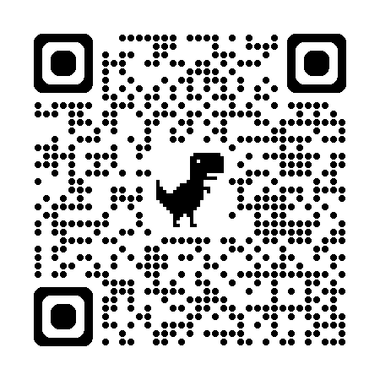
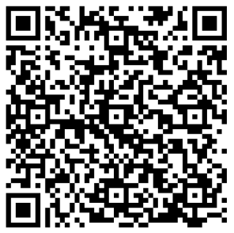
QR Codes
Newsletter Listserv
Notes:
QR Codes to sign up for the newsletter and listserv

Slide 8
CCTE Updates
Brittany Slagle

Slide 9

Connecting it All Using the High School and Beyond Plan
Brittany Slagle Ed.S
Manager of Individualized Advising| Division of
Postsecondary, Workforce, CTE & Military Readiness
© Tennessee Department of Education

Slide 10
Middle School Courses
There are three middle school courses offered in Career Exploration.
  Career Awareness, Grade 6
  Career Exploration, Grade 7
  Career Advising and Planning, Grade 8
Career and technical education (CTE) introductory courses can also be offered in middle school.
These courses have been revised, and a new version will be available for the 2025-26 school year.
Notes:
BS These courses have been slightly revised, mostly formatting, and will be available in 2025-26. They will updated on our website in late spring.

Slide 11
Career Interest/Aptitude Survey
Tenn. Code Ann. § 49-6-412 states:
A Local Education Agency (LEA) shall make an interest inventory such as the Kuder assessment, Myers-Briggs Type Indicator® personality inventory, the Armed Services Vocational Aptitude Battery (ASVAB), the College Board Career Finder, or other interest or career inventory available to public middle schoolers or ninth graders to assist students in determining the students' interests and in making career decisions.
To help inform a student's high school plan of study, each LEA shall administer a career aptitude assessment to students in grade seven (7) or grade eight (8).
Upon administering a career aptitude assessment to students in grade seven (7) or grade eight (8), an LEA shall provide the students with information on CTE opportunities offered by the LEA in which the student is eligible to participate.
Notes:
AM Provide updates on the list during this slide (if the new list isn’t comms approved say it will be soon)

Slide 12
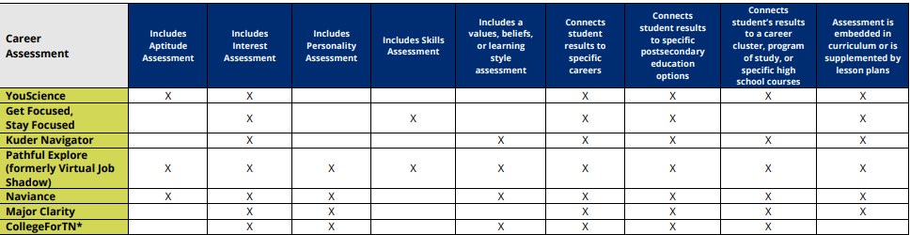
Career Assessment List
The Tennessee Department of Education (department) maintains a list of vendors who provide career assessment information.
  Career Assessment List
Notes:
AM Provide updates on the list during this slide (if the new list isn’t comms approved say it will be soon)

Slide 13
The High School and Beyond Plan (HSBP)
State Board of Education Middle School Policy 2.102 and High School Policy 2.103 include this information regarding a HSBP:
  The HSBP will cover grades 8 through two years post-graduation, considering academic strengths, career assessment results, and other indicators. It will include elective focuses, CTE programs, and opportunities to build technical and employability skills.
Notes:
BS FAQ

Slide 14
The High School and Beyond Plan (HSBP)
State Board of Education Middle School Policy 2.102 and High School Policy 2.103 include this information regarding a HSBP:
  At the oversight of a school counselor, beginning in the 2023-24 school year, all 8th-grade students will develop an HSBP that is reviewed at least annually and updated as needed for student use. Requirements of the HSBP can be fulfilled by a student’s Individualized Education Program (IEP) Transition Plan or 504 Plan.
Notes:
BS FAQ

Slide 15
The High School and Beyond Plan (HSBP)
State Board of Education Middle School Policy 2.102 and High School Policy 2.103 include this information regarding an HSBP:
  Students will take a career aptitude assessment in grades 7 or 8, develop the plan starting in grade 8, take a career interest inventory by grade 9, select an elective focus by grade 10, and extend the plan through two years post-graduation by grade 11.
Notes:
BS FAQ

Slide 16
The High School and Beyond Plan (HSBP)
State Board of Education Middle School Policy 2.102 and High School Policy 2.103 include this information regarding a HSBP:
  The plan will be reviewed and revised annually based on the student’s academic progress and changing career goals, with input from trained school staff.
  A current version of the plan will be included in the student’s cumulative record.
Notes:
BS FAQ

Slide 17




Timeline of HSBP Development
8
9
10
11
Administer career aptitude assessment (7th/8th)
Draft initial HSBP with student, parent, and other stakeholders through grade 9
Administer career interest inventory
Update the HSBP through at least grade 11.
Revisit and revise with students to solidify elective focus, EPSOs, and work-based learning (WBL) goals
Discuss alignment of courses with goals
Revisit and revise plan to extend to two years post secondary
Add deadlines and important dates (FAFSA, TN Promise), college apps, etc.)
Notes:
BS While including more steps, opportunities, and discussions are highly encouraged, these are the required steps that must be included by grade level.

Slide 18
HSBP Template Requirements
Districts have autonomy over the template they use; however, some requirements must be included:
  Course mapping for grades 8 through 12
  Student’s academic, postsecondary, and career goals for grades 8 through two (2) years postsecondary
  Information regarding elective focus aligned to career assessment results
  EPSOs, industry credentials, and WBL experiences related to the student’s goals
  Key deadlines for postsecondary or workforce applications and financial aid deadlines
HSBP FAQ

Slide 19
Virtual Office Hours
Virtual Office hours will be held to provide support for questions related to HSBPs, as well as a time for Career Coaches to pop in for individual support.
All office hours will be held virtually through Microsoft Teams from 2:00-3:00 p.m. ET (1:00-2:00 p.m. CT).
  Dates
    June 10
    July 29
    August 12
    August 26
    September 9
    September 23
*more dates to come for Spring 2026
    October 7
    October 21
    November 4
    November 18
    December 2
    December 16

Slide 20
Project RAISE Updates
Sheri Smith

Slide 21





Project RAISE
(Rural Access to Interventions in School Environments)
$25,000 in 2025 and Other Initiatives
Sheri Smith, TDOE, School Counselor Consultant, Project RAISE
© Project RAISE
© Project RAISE

Slide 22
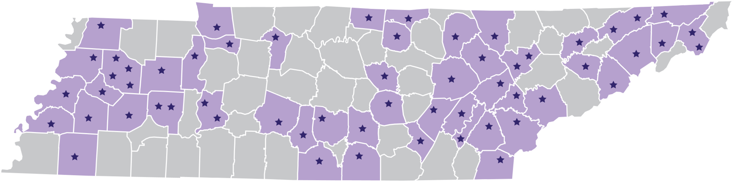
Project RAISE Rural School Districts
The project began in 2023 with 40 school districts.
Project RAISE is currently working with 58 of the 93 rural school districts.
Project RAISE school districts are located across the state in east, middle, and west Tennessee.
Stipend payments:
  School Counseling interns = $20,000
  School Psychology interns = $60,000
  School Social Work (BSW) interns = $15,000
  School Social Work (MSSW) interns = $20,000
  Field-based/site supervisors = $1,500/semester
© Project RAISE

Slide 23
Project RAISE Rural Districts Include:
Northwest: Benton County Schools, Bradford Special School District, Crockett County Schools, Dyer County Schools, Gibson County Special School District, Humboldt City School District, Milan Special School District, Obion County School District, South Carroll Special School District
Southwest / Memphis: Fayette County Public Schools, Haywood County Schools, Henderson County Schools, Jackson-Madison County School District, Lauderdale County School District, Lexington City Schools, Tipton County Schools
South Central: Bedford County Schools, Coffee County School District*, Franklin County School District, Lawrence County School System*, Lincoln County Schools, Marshall County School System, Maury County Public Schools, Perry County Schools
Mid Cumberland: Cheatham County School District, Houston County School District, Stewart County School System
© Project RAISE

Slide 24
Project RAISE Rural Districts Include:
Upper Cumberland: Bledsoe County Schools, Clay County Schools, Cumberland County School District, DeKalb County School District*, Fentress County Schools, Jackson County School District*, Macon County Schools, Warren County Schools
Southeast: McMinn County Schools, Meigs County Schools, Polk County Schools, Rhea County School District, Sequatchie County Schools
East: Anderson County Schools, Blount County Schools, Clinton City Schools*, Grainger County School District, Jefferson County Schools, Loudon County Schools, Morgan County School District, Monroe County Schools, Roane County School District, Scott County Schools
First: Carter County Schools, Cocke County School District, Elizabethton City Schools, Greene County Schools, Hawkins County School District, Rogersville City Schools, Sullivan County Schools, Washington County Schools
© Project RAISE

Slide 25

Reflections on Years 1 & 2 Project RAISE Interns
School Counselors
23 Interns
School Psychologists
17 Interns
School Social Workers
16 Interns
2 Years=
Total 56
Interns
© Project RAISE
Notes:
Add bullet

Slide 26
Reflections on Years 1 & 2
Over the last two years, Project RAISE:
implemented a pilot program to develop a mentorship model for rural school districts;
awarded funds to 41 school districts to recruit and retain fully licensed school-based mental health professionals; and
received approval to implement a Grow-Your-Own program for school psychologists
© Project RAISE

Slide 27
2024-2025 Project RAISE Recruitment & Retention Grants
School Counselors
Recruitment
17
School Psychologists
Recruitment
18
School Social Workers
Recruitment
4
Retention
79
Project RAISE IS making a difference in the landscape of school based mental health in rural Tennessee districts through recruitment and retention grants.
© Project RAISE
Notes:
Add bullet

Slide 28
Year 3 Plan
Recruit currently licensed professionals
Grow your own for school psychologists
Retain current employees
Recruit and retain interns
© Project RAISE

Slide 29
New Funding Opportunities
Project RAISE districts will be eligible to receive a total of $25,000 for the 2025 – 26 school year.
Funds are available for the sole purpose of paying a recruitment/hiring bonus to already licensed applicants and/or a retention bonus for currently employed school-based mental health professionals.
New hires or current personnel must be fully licensed/credentialed to practice as school counselors, school psychologists, and/or school social workers in the state of Tennessee.
© Project RAISE

Slide 30
Prior to receiving funds, districts must:
submit request form, including budget sheet;
commit to utilize funds as needed/appropriate for the district, but only for the stated purpose,
register as a vendor with the University of Tennessee; and
sign a Memorandum of Agreement.
Requirements
© Project RAISE

Slide 31
After receiving funds and before the end of the school year, the district will:
submit budget verification sheet;
provide the name, license #, and amount of award for each employe; and
provide reporting and/or tracking information requested by Project RAISE.
Requirements
© Project RAISE

Slide 32
Currently accepting up to 15 candidates for the 2025 – 26 school year.
Candidates must be enrolled in an approved school psychology program beginning Fall 2025. Approved programs include:
  Lipscomb University
  Middle Tennessee State University
  Tennessee Tech University
  University of Memphis
  University of Tennessee, Knoxville
  University of Tennessee at Chattanooga
  Eastern Washington University
  Murray State University
Grow Your Own
© Project RAISE

Slide 33
The candidate must remain employed with the school district while completing required coursework and for five years after becoming fully licensed.
Project RAISE will pay tuition costs directly to the university with a $50K maximum benefit.
The district may consider if additional supports are available to the candidate (e.g., time off to attend class, funding to cover additional costs/fees).
The district will submit the application once the candidate has been accepted to an approved university program.
Grow Your Own
© Project RAISE

Slide 34
Bonus Opportunity for Former Interns
Former Interns who will continue to be employed in a Project RAISE district for a second year will be eligible for a project bonus.
Districts should not allocate/award Recruitment and Retention funds for former interns.
Payments will be made directly to the individual after confirming their employment status for the 2025 – 26 year.
© Project RAISE

Slide 35

Going Forward
Mention Project RAISE funds and benefits in recruitment efforts, job announcements, and when extending offers.
Consider your district’s needs when determining how to distribute these funds.
Think about sustainability beyond Project RAISE.
© Project RAISE
© Tennessee Department of Education
© Tennessee Department of Education

Slide 36

Join Us at the Project RAISE Kickoff
The Kickoff will offer the following:
engaging sessions for district administrators,
networking opportunities with Project RAISE interns, supervisors, and university program partners, and
TASL credit.
Space and travel-related costs available for three district-level administrators.
© Tennessee Department of Education

Slide 37
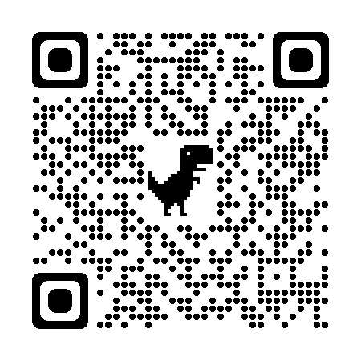
Thank You!
  Project RAISE
  projectraisetn.com
  projectraise@utk.edu
Sheri Smith​
School Counselor Consultant, TDOE​
Sheri.A.Smith@tn.gov​
615-775-3672
© Project RAISE

Slide 38

Contact Information
Jaime Grammer – Jaime.Grammer@tn.gov
Brittany Slagle- Brittany.Slagle@tn.gov
Sheri Smith- Sheri.A.Smith@tn.gov
Permission is granted to use and copy these materials for non-commercial educational purposes with attribution credit to the “Tennessee Department of Education”. If you wish to use the materials for reasons other than non-commercial educational purposes, please contact the office of general counsel at (615) 741-2921.

