Slide 1
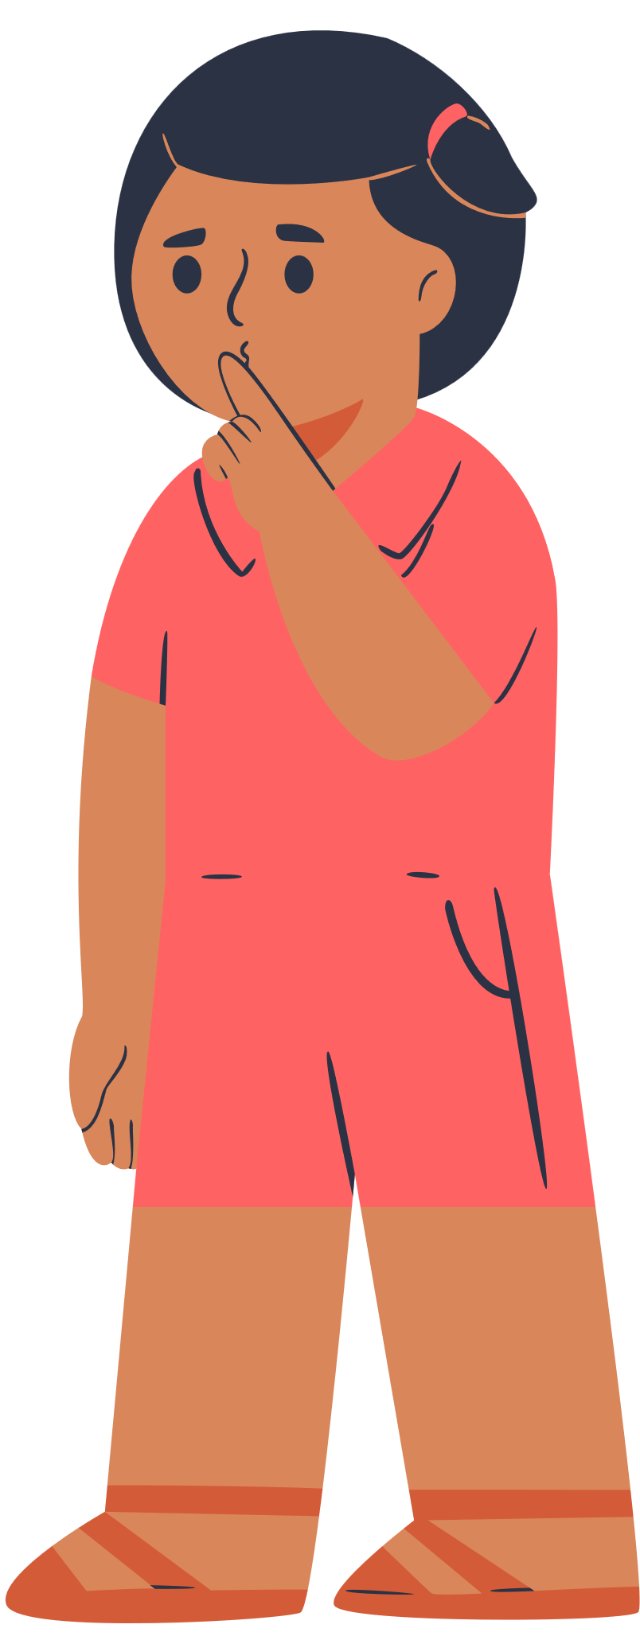
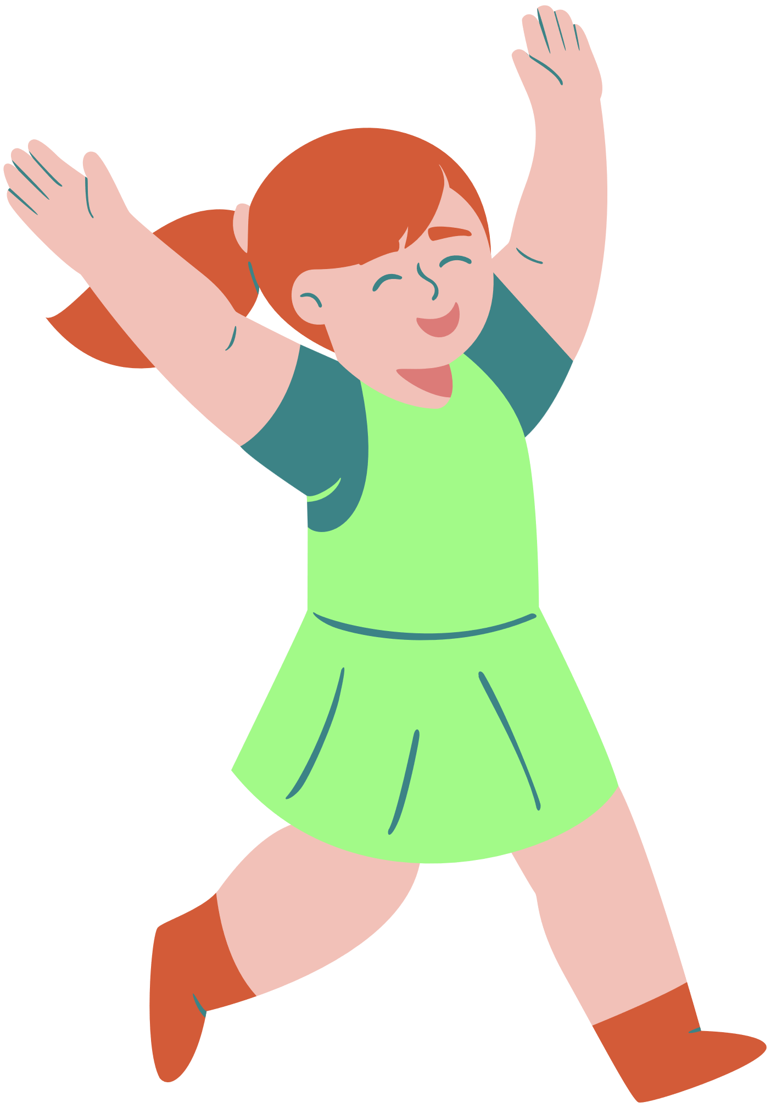
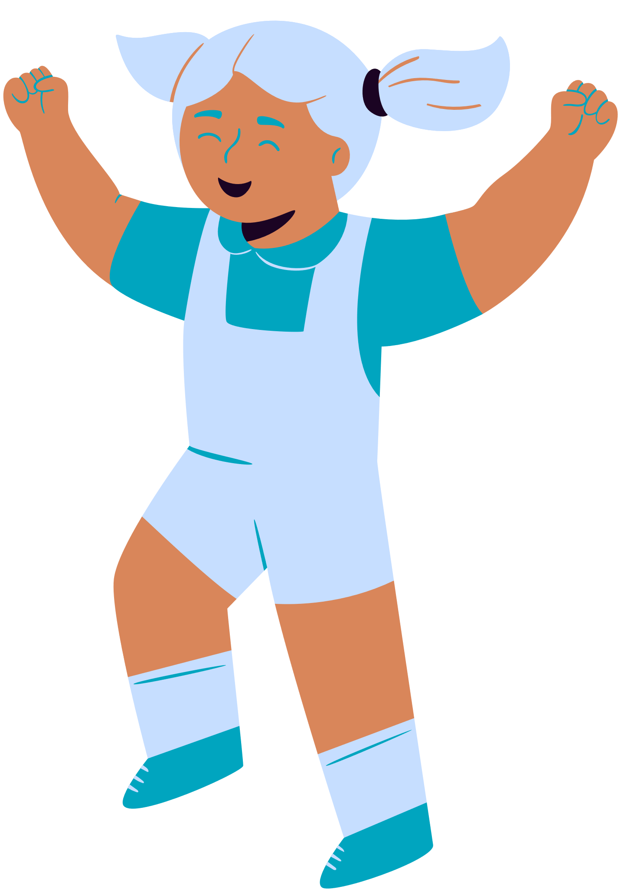
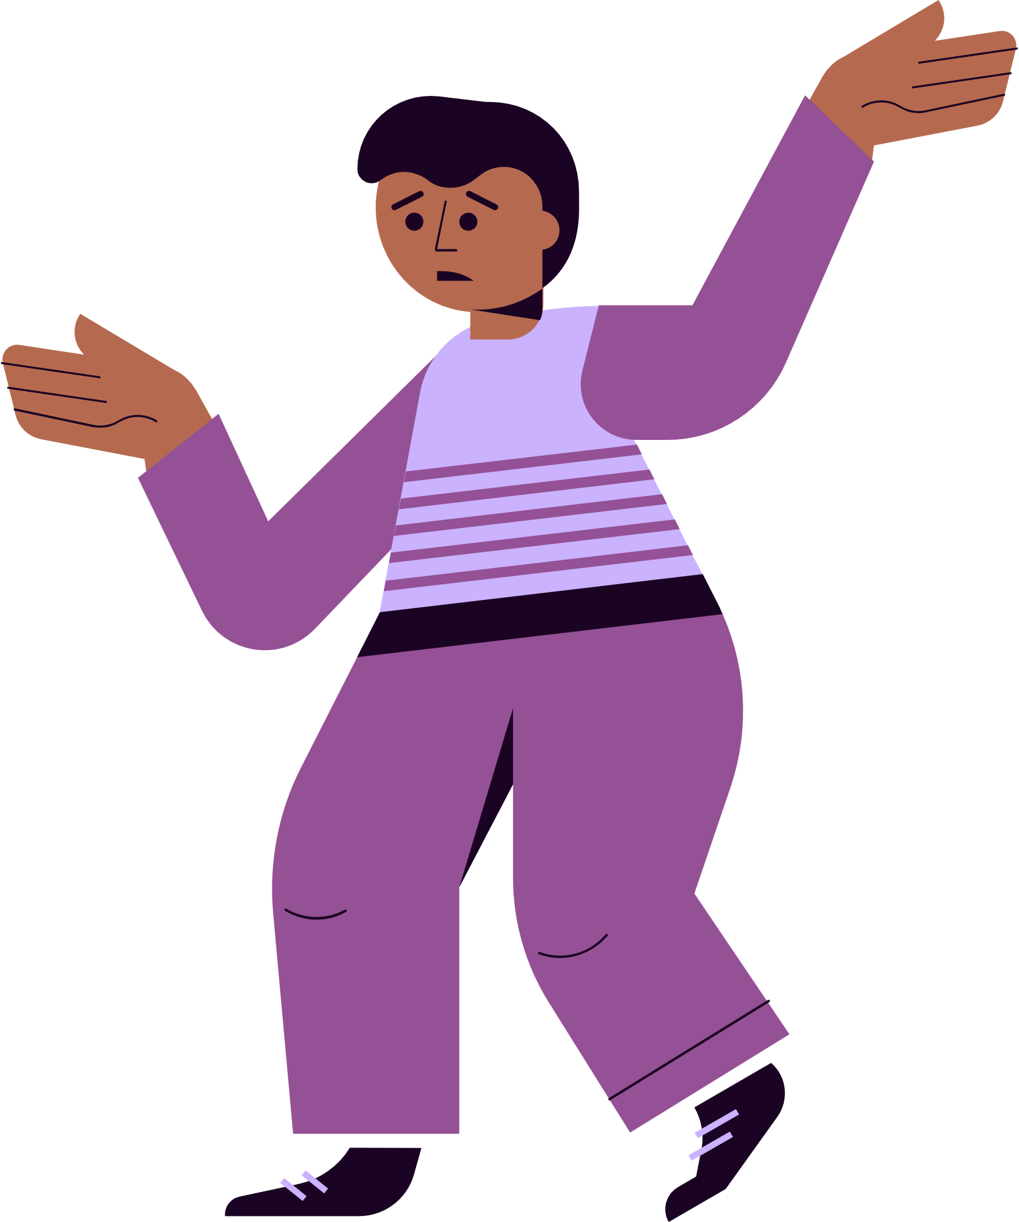
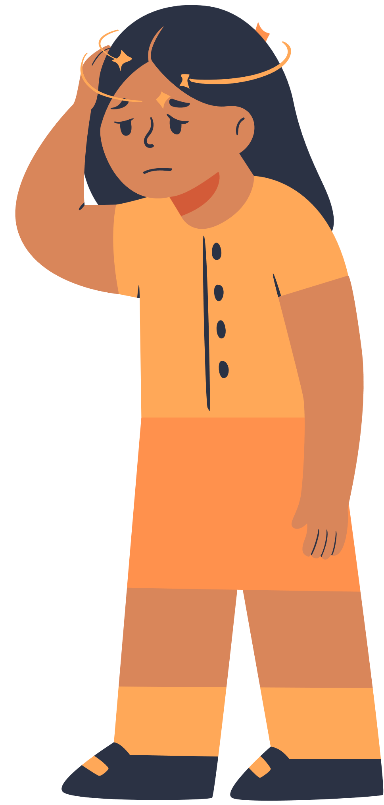
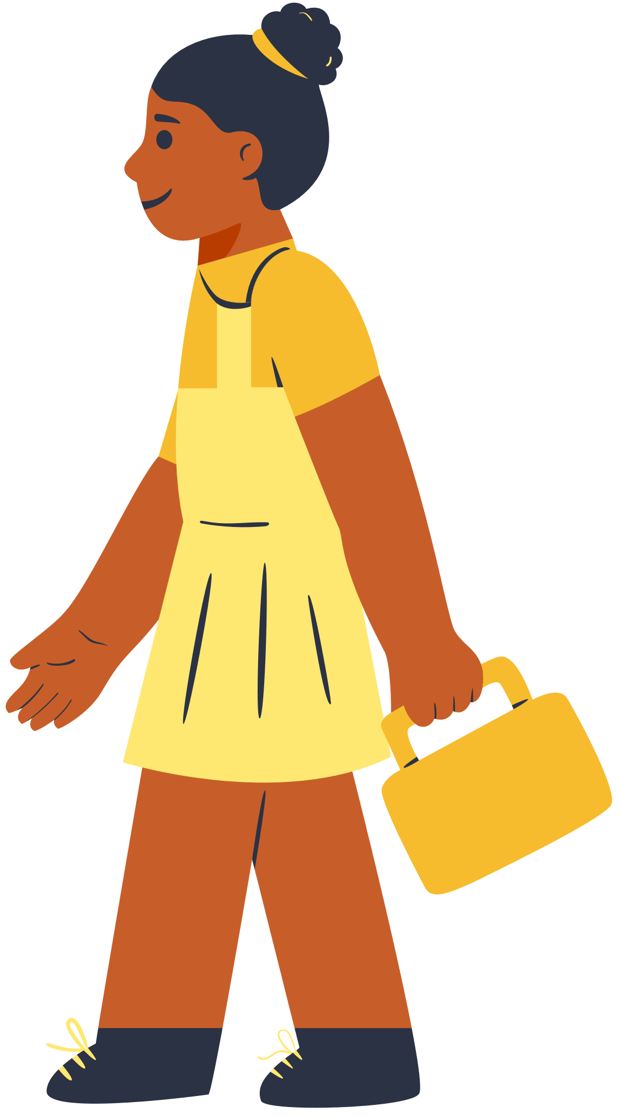
R-E-S-P-E-C-T
cLASSROOM CONTRACTS AND COMMUNITY BUILDING FOR PROACTIVE CLASSROOM MANAGEMENT

Slide 2
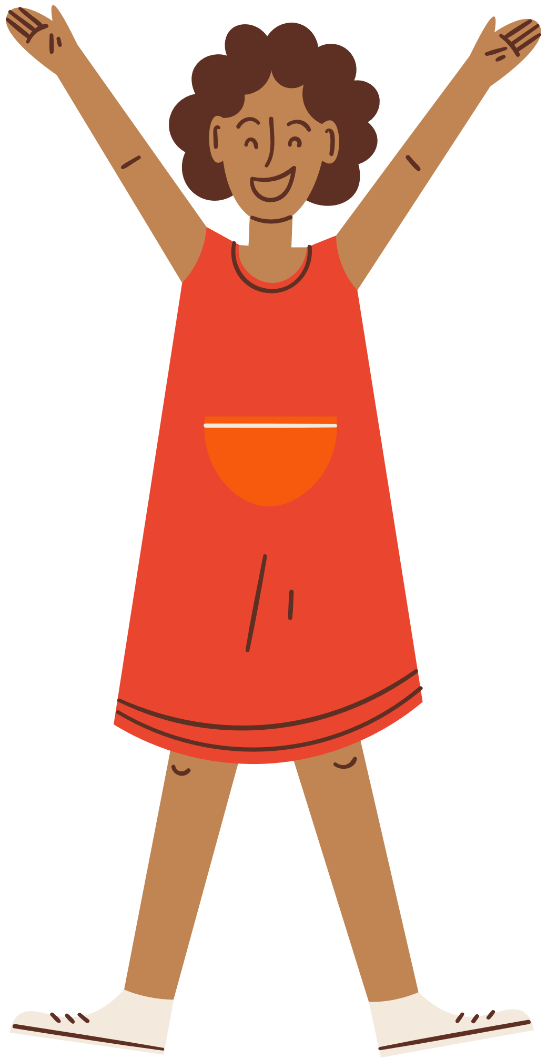
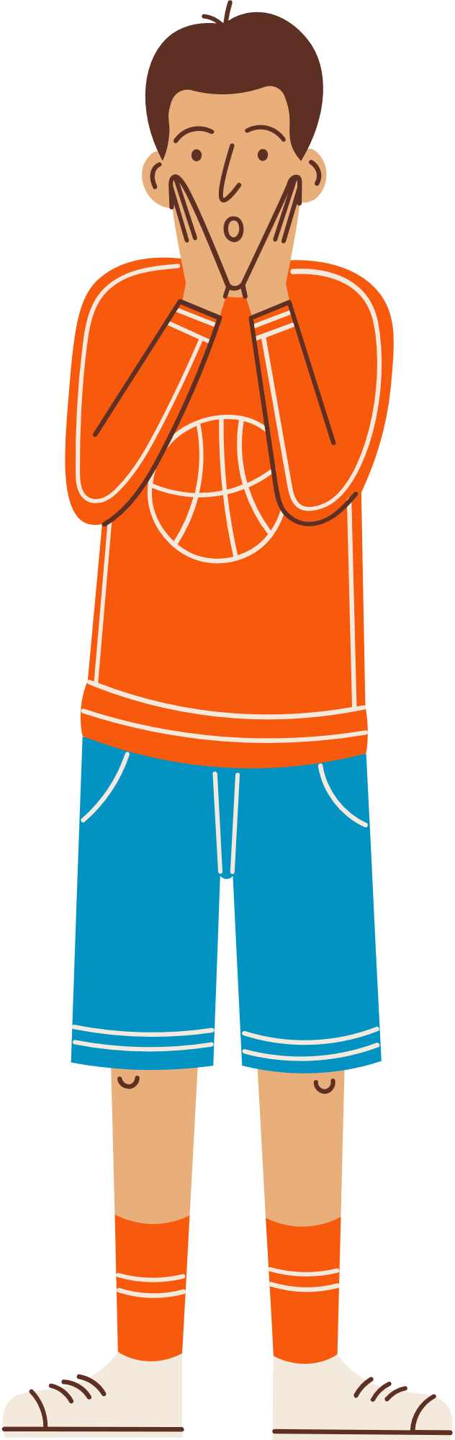
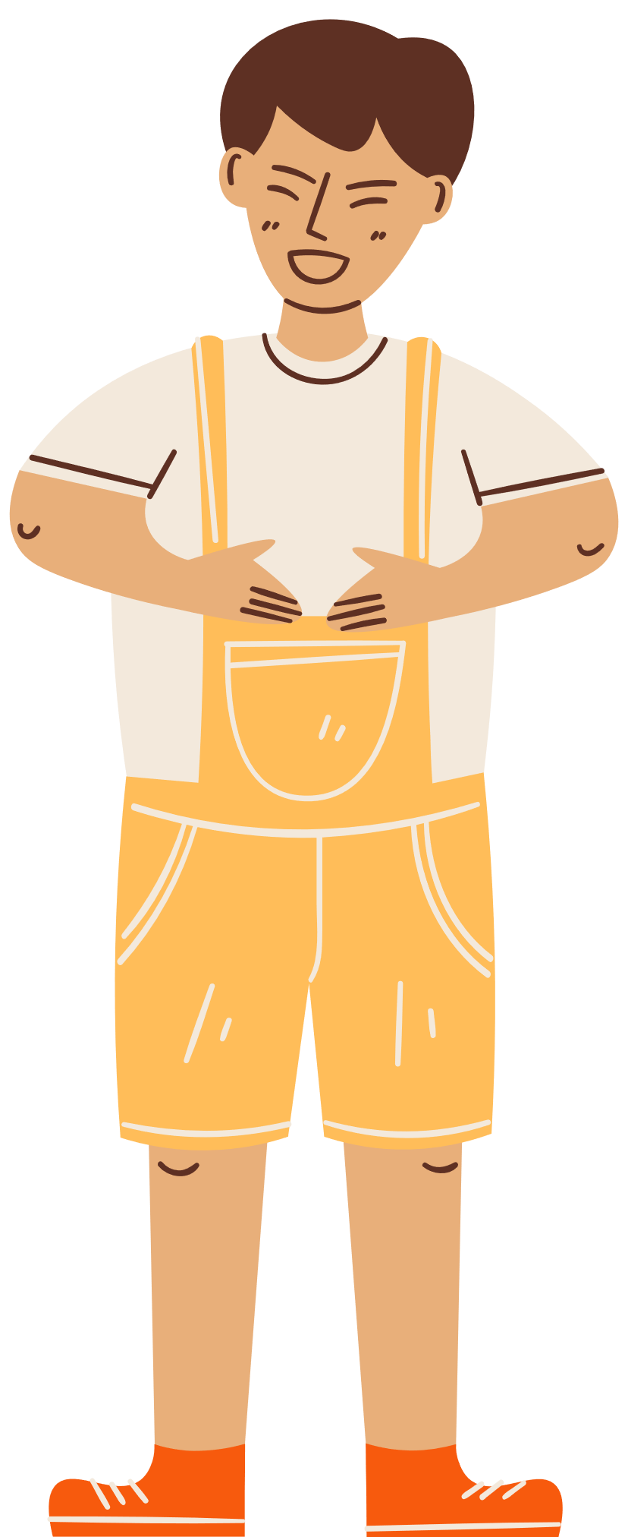
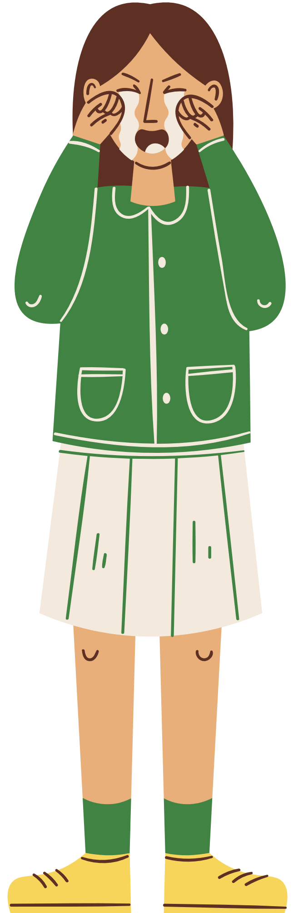
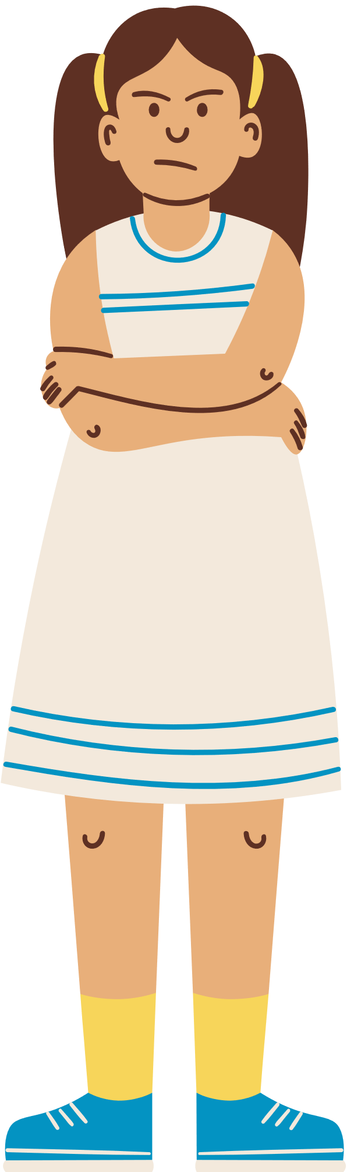
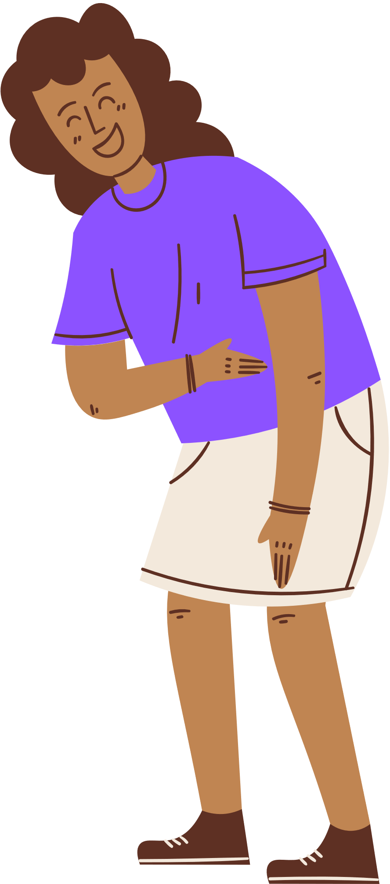
  Classroom contracts/respect agreements
  neuroscience 101
  community-building through routines
AGENDA

Slide 3
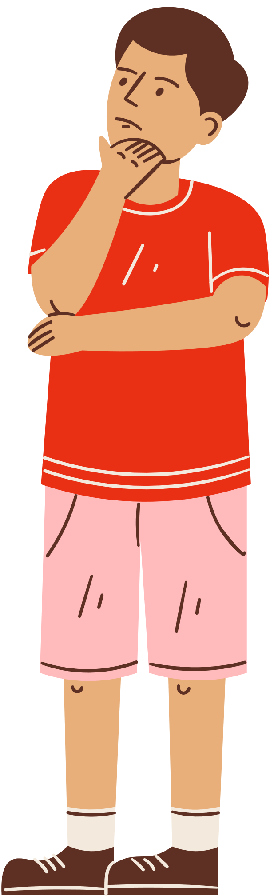
objectives
  Attendee will learn what a classroom contract/respect agreement is.
  Attendees will learn how to facilitate creation of a classroom contract/respect agreement.
  Attendees will learn why relationships and community are essential to classroom management.
  Attendees will learn how to facilitate classroom circles.

Slide 4
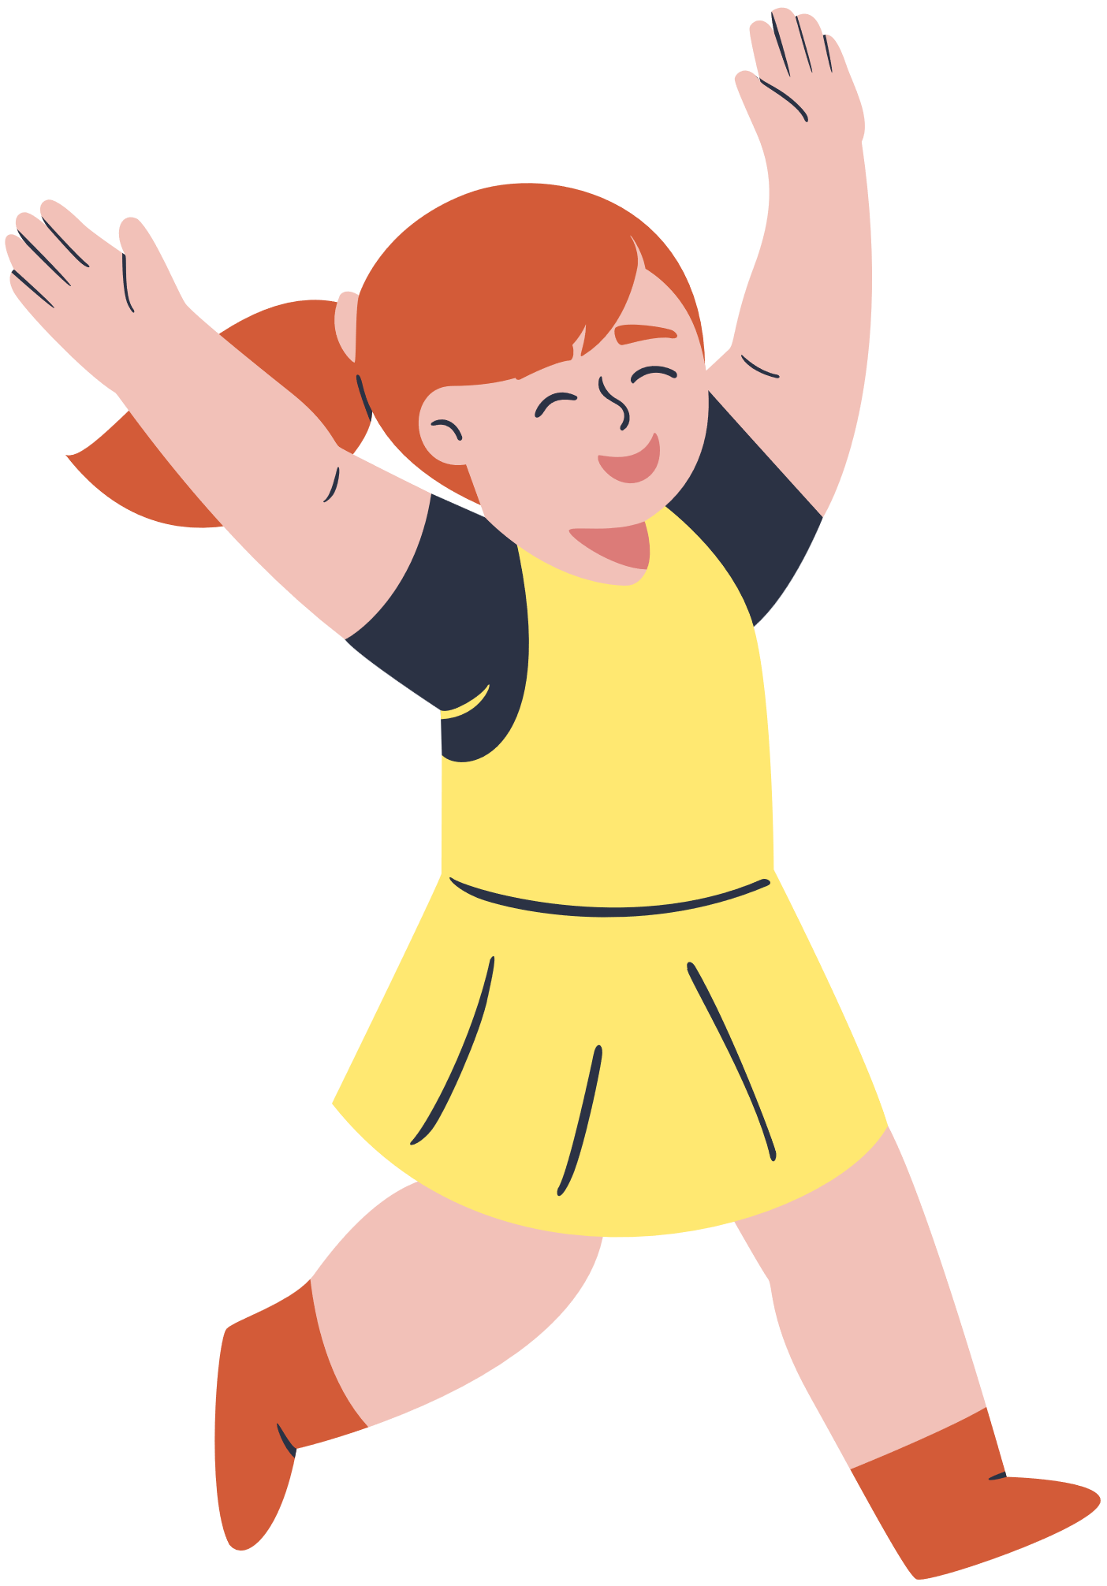
rules for the session
In order for the session to go smoothly, I need everyone to abide by these rules:
No cell phones
No side conversations
Hold questions until the end
Stay seated
Active listening
Thank you!
Is this overkill? Does it sound very respectful?

Slide 5
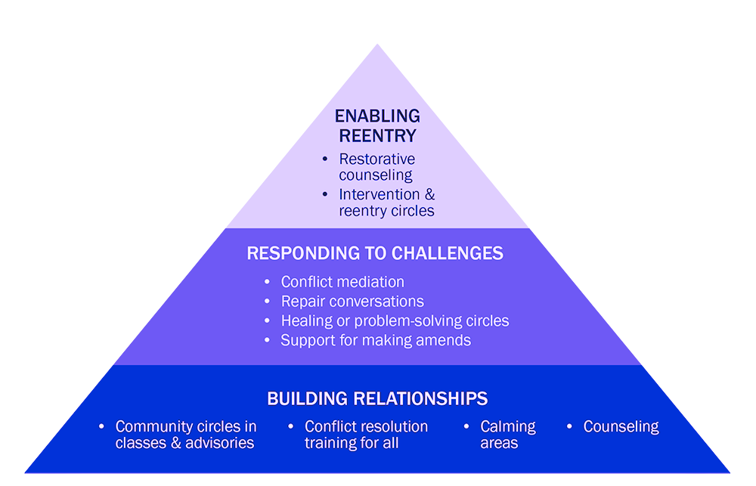
RESTORATIVE PRACTICES

Slide 6
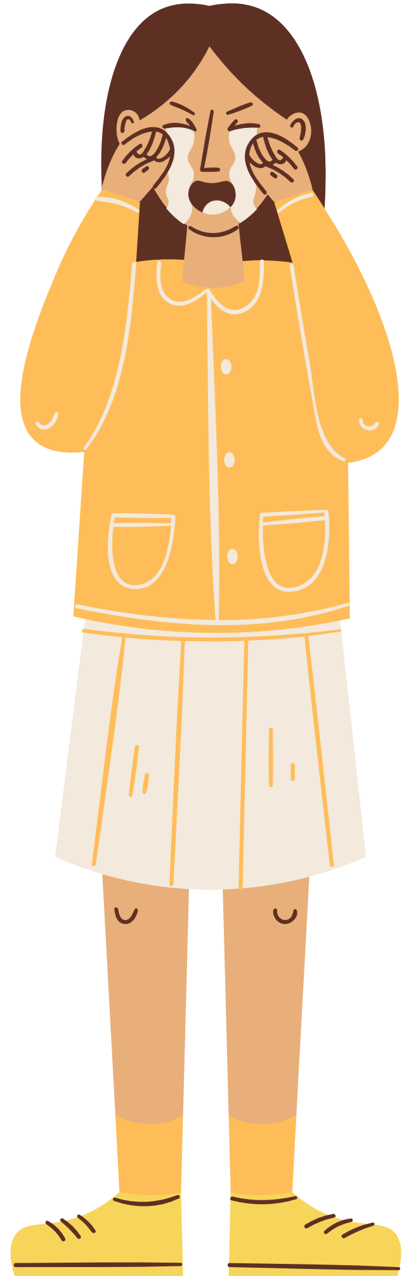
What Are the Impacts of Restorative Practices?
A growing body of research indicates that well-implemented restorative practices:
  improve student behavior
  decrease fighting and bullying
  reduce office referrals and classroom removals
  reduce suspensions and expulsions
  decrease disciplinary disparities
  improve school climate, including relationships between students and teachers and student feelings of connectedness to school

Slide 7
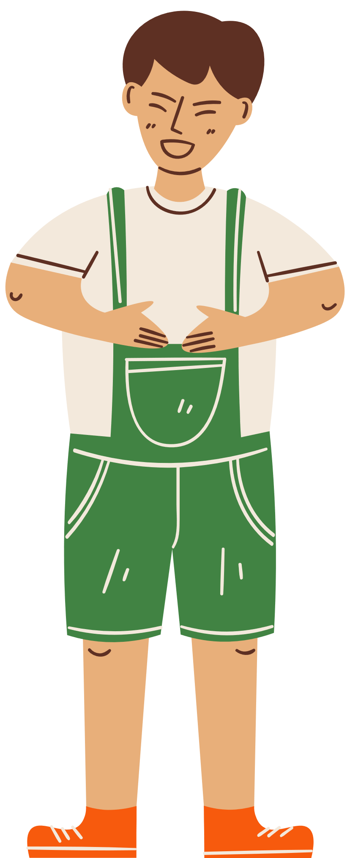
key elements of restorative practices in the classroom
  Involving students in the creation of the contract
  Using classroom meetings to discuss the contract
  Using restorative questions to address conflicts
  Building a strong sense of community

Slide 8
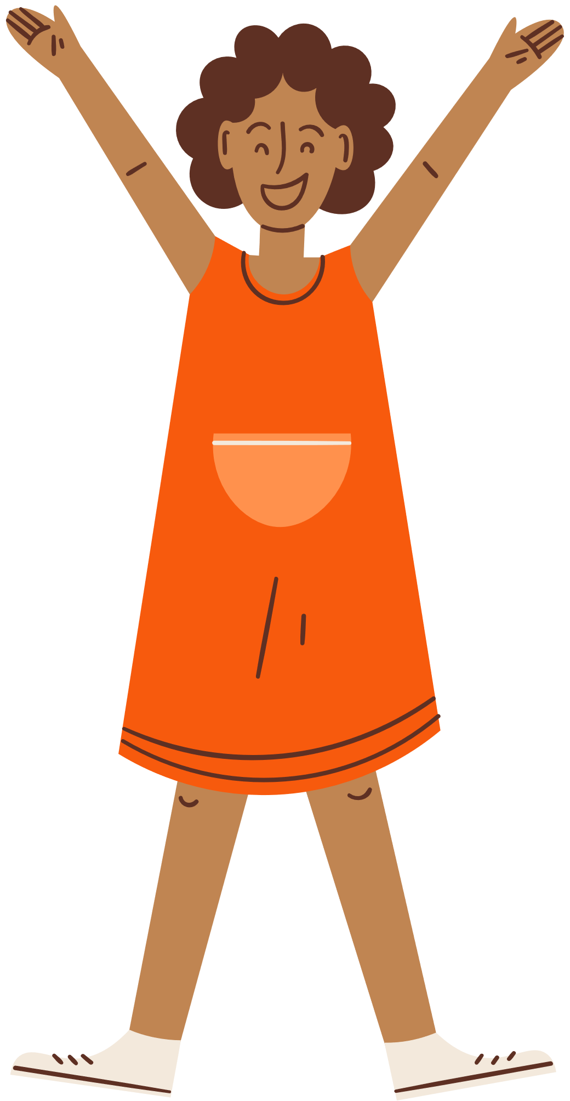
CLASSROOM CONTRACT/
respect agreement
Focuses on building a positive classroom community where students feel safe, supported, and valued, rather than relying on traditional punishment for misbehavior. It emphasizes accountability, relationship-building, and repairing harm caused by conflict.

Slide 9
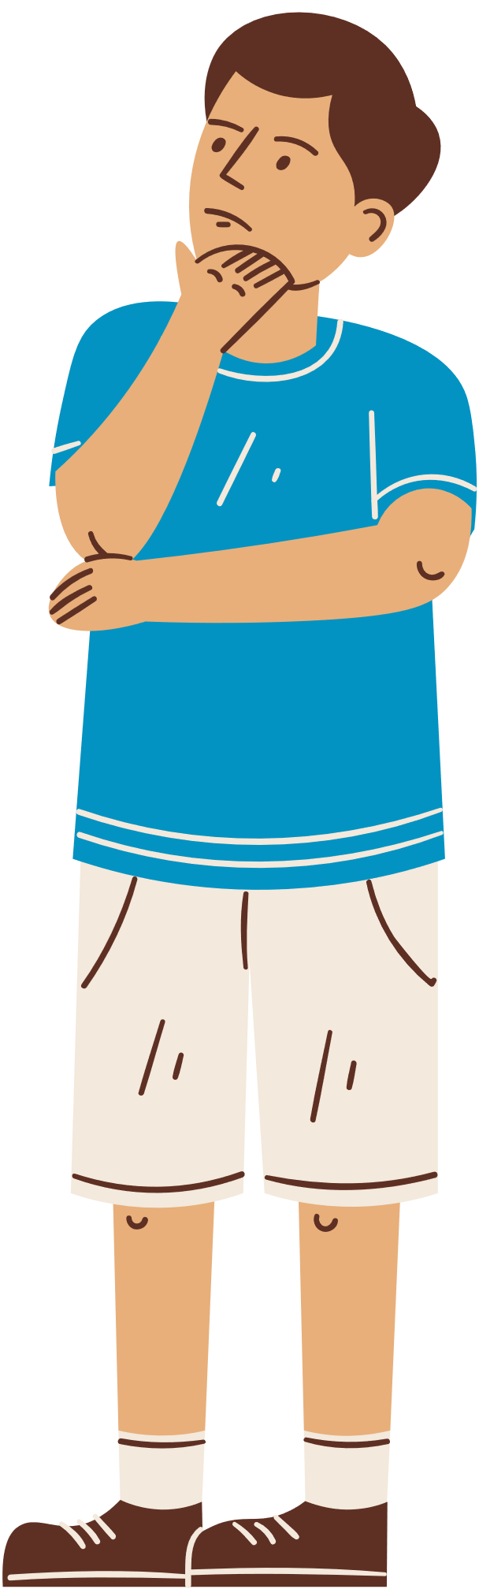
what does it do?
Addresses how people will treat others and spaces in the classroom by discussing how
  Students treat other students
  Students treat the teacher
  Students treat things/the classroom
  Teacher treats students
But why not just have rules?

Slide 10
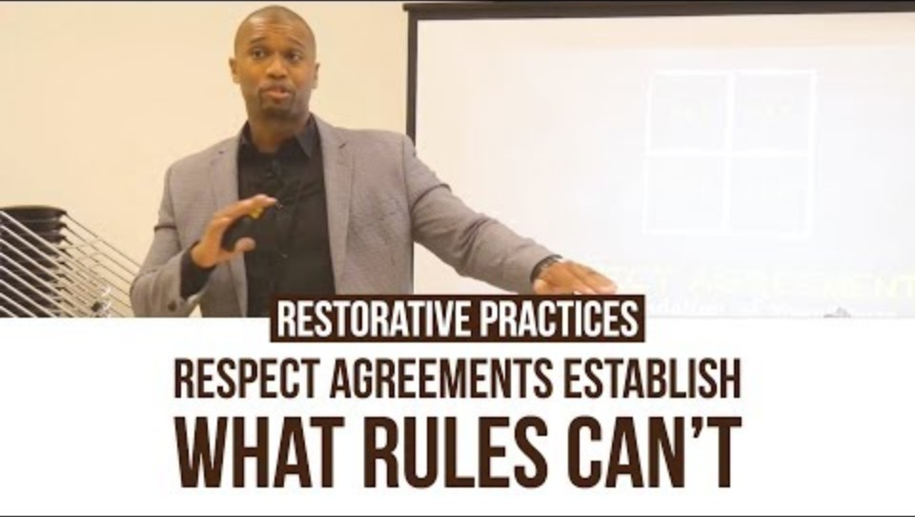

Slide 11

how does it work?
STUDENTS respecting STUDENTS | STUDENTS respecting TEACHER
What bothers you about how others treat you? How do you want others to treat you? Why? | How do you think your teacher wants to be treated? Why?
TEACHER respecting STUDENTS | STUDENTS respecting CLASSROOM/SCHOOL
What bothers you the most about how adults treat you? Why? | How do you treat your home? Why? How do you want others to treat your things?

Slide 12
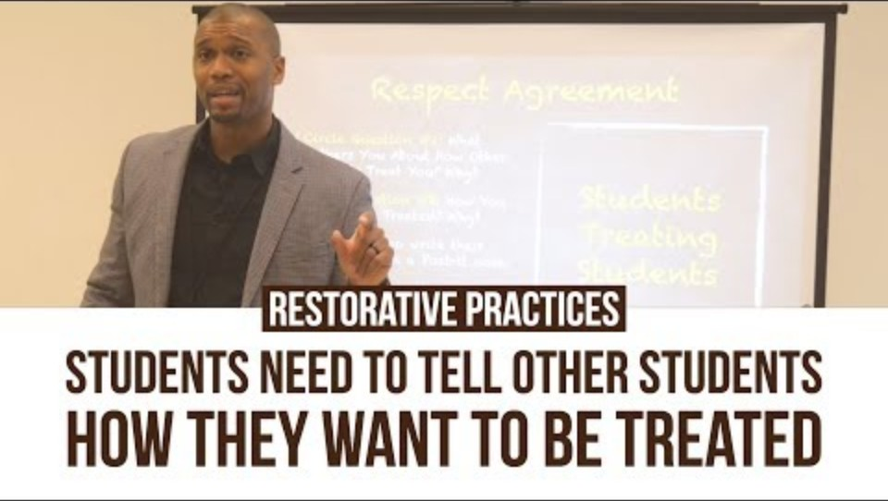
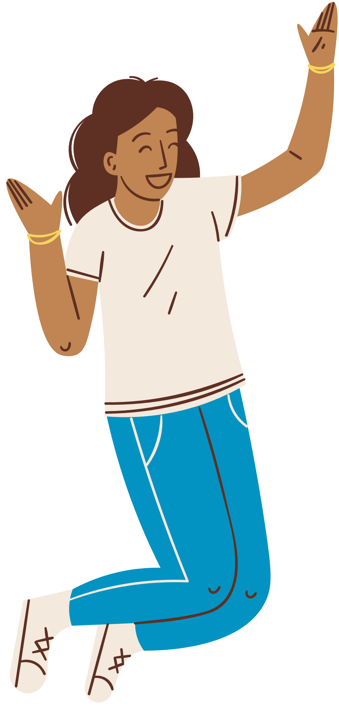
the why behind it

Slide 13
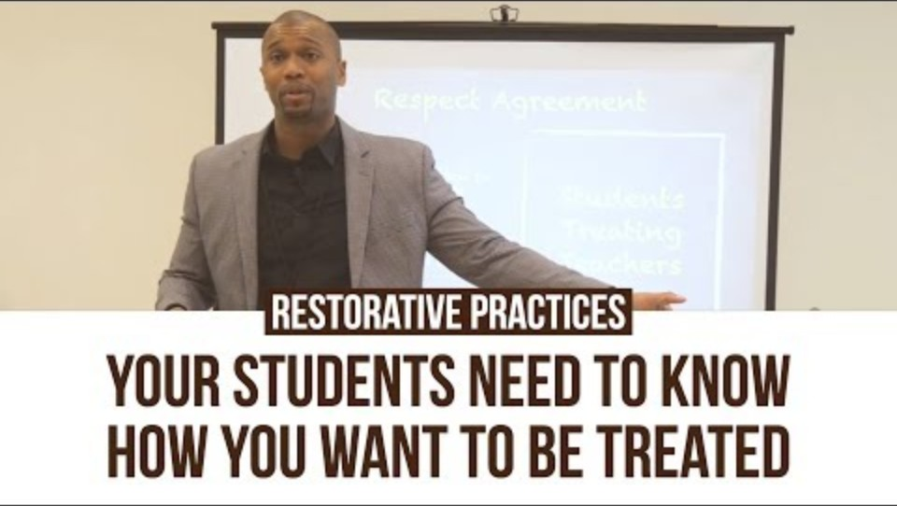
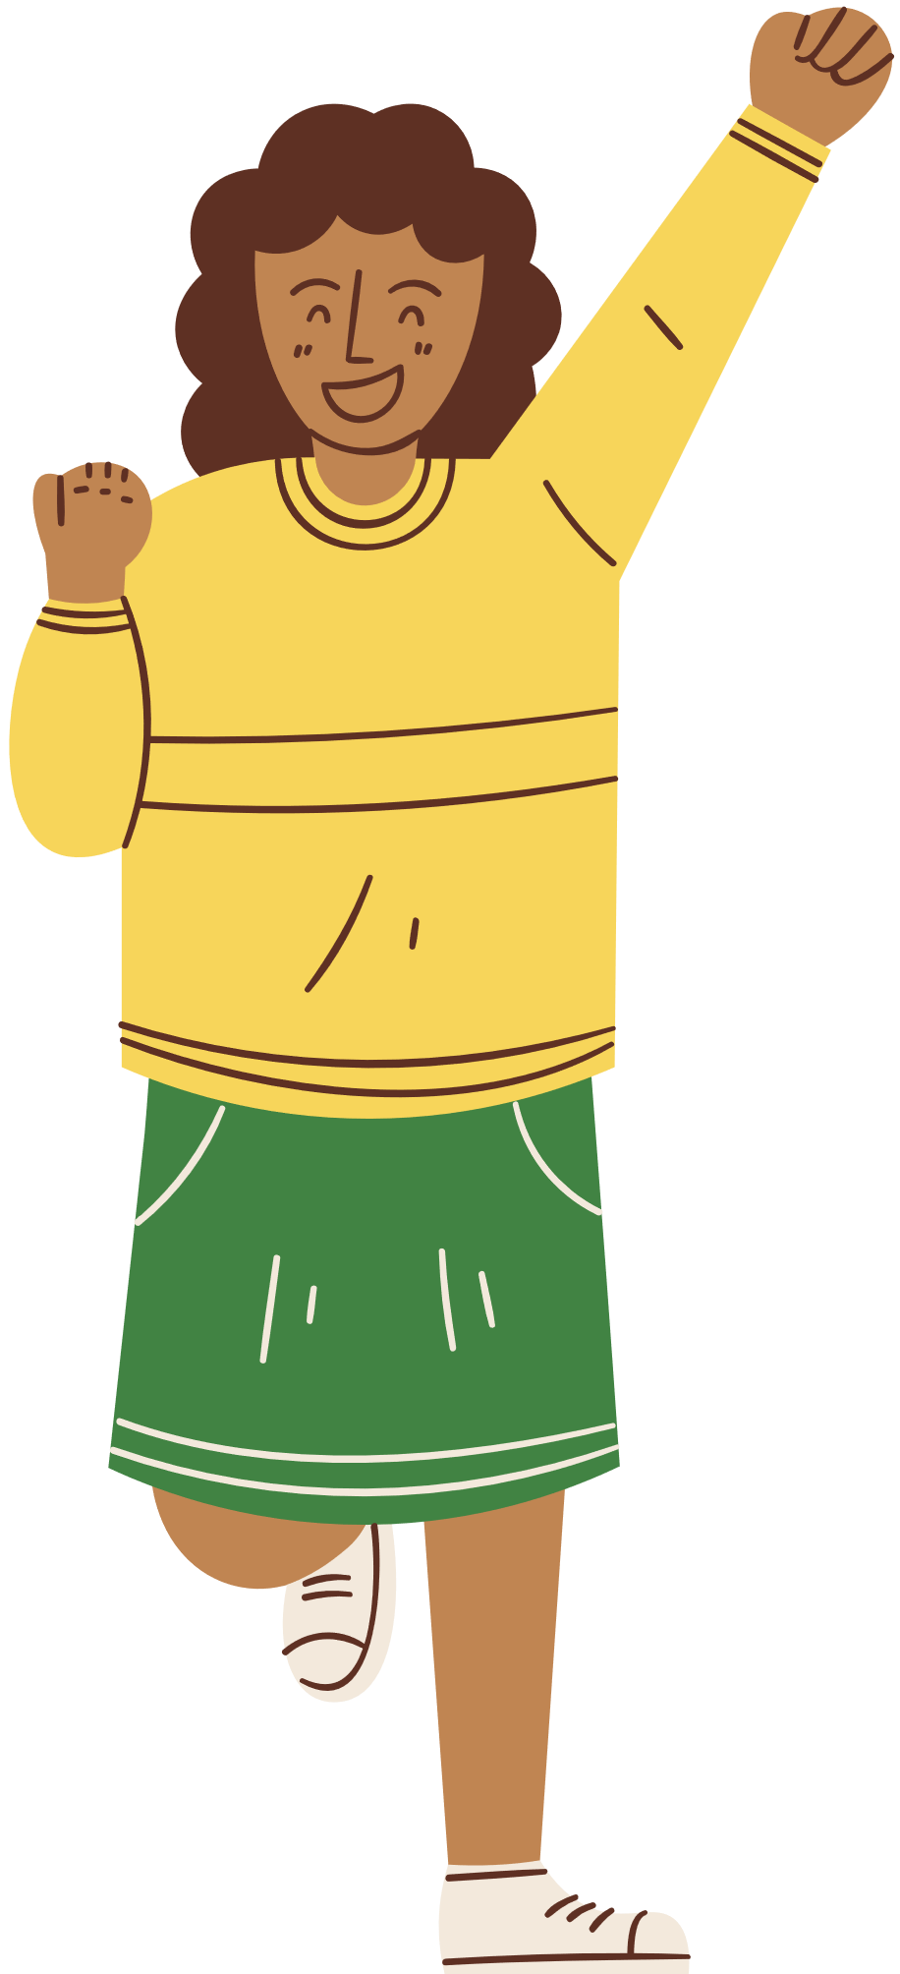

Slide 14
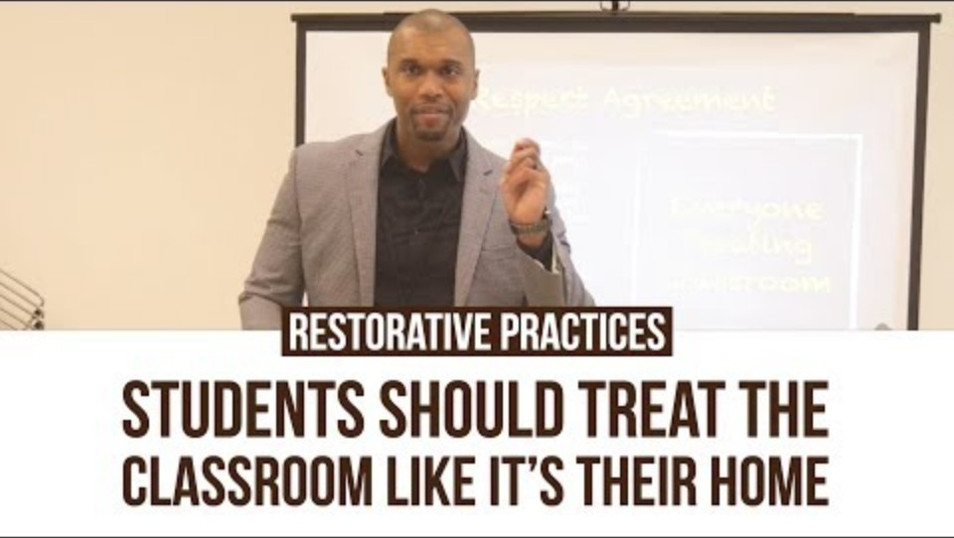

Slide 15
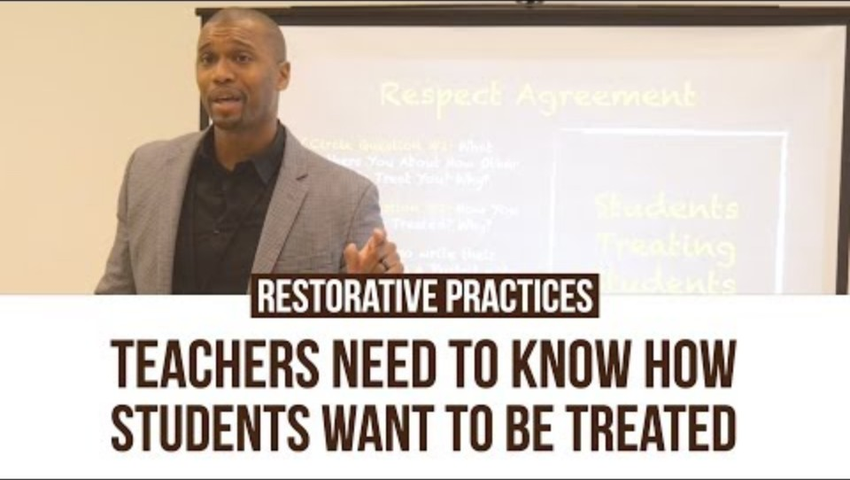
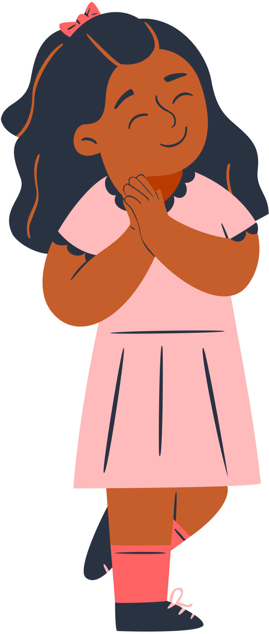

Slide 16
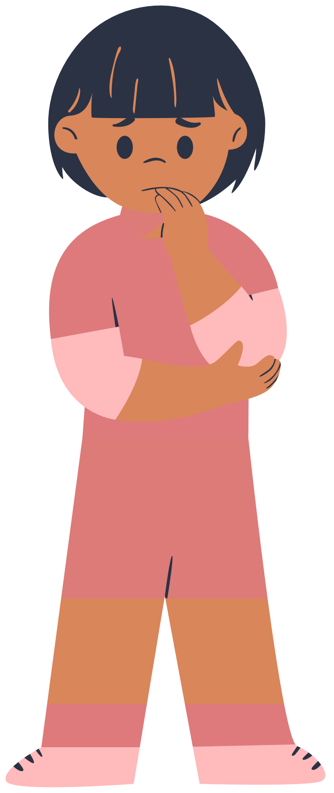
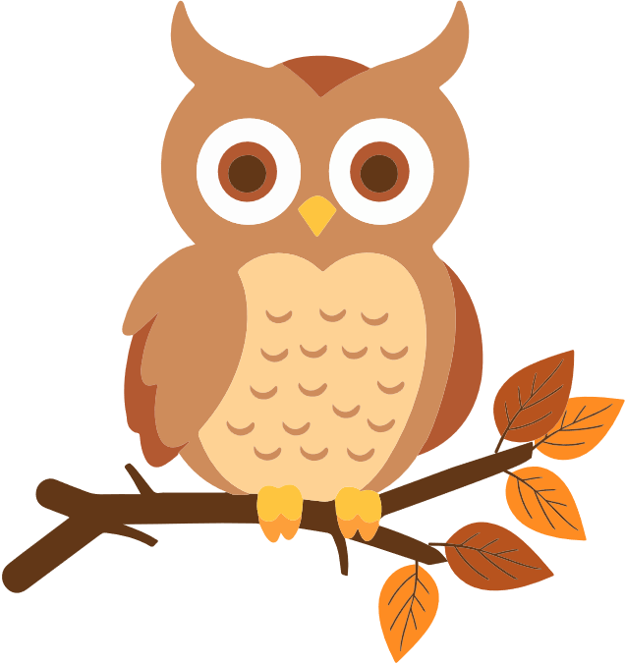

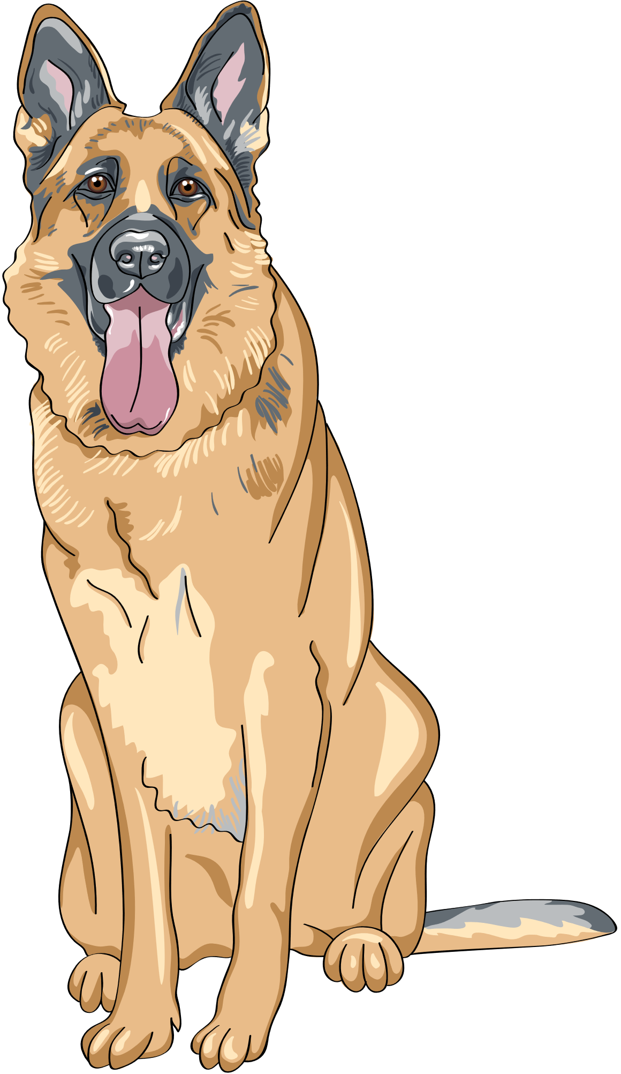
neuroscience 101
Prefrontal Cortex (PFC)-in charge of attention and decision-making; your wise owl
Hippocampus-in charge of memory storage and retrieval; your elephant that never forgets
Amygdala-in charge of perceiving danger and initiating survival instincts; your guard dog

Slide 17
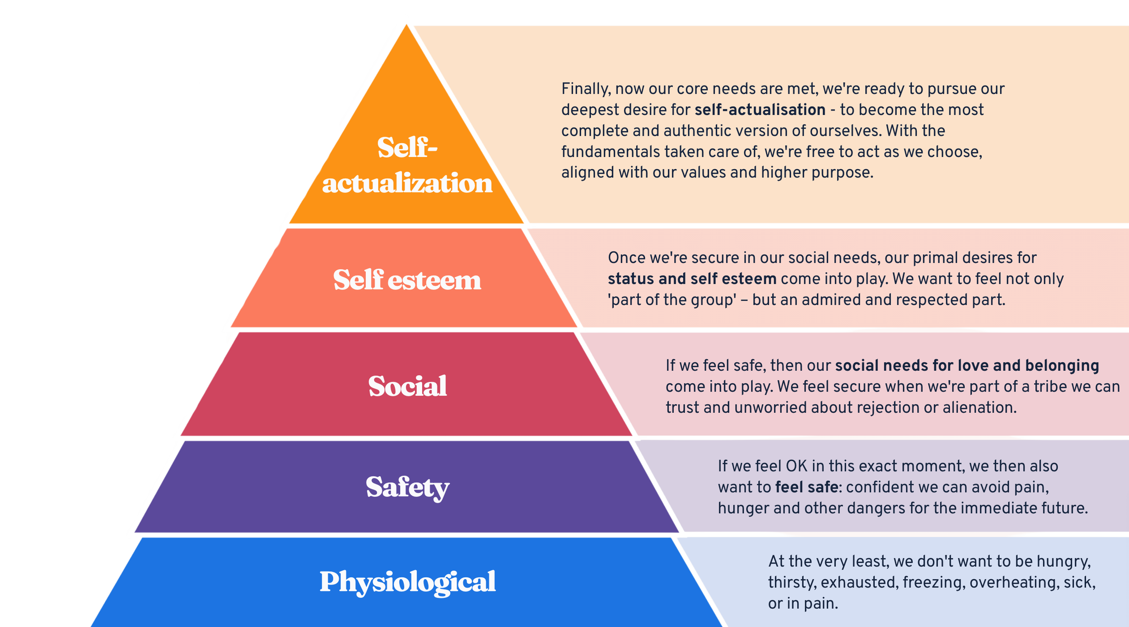
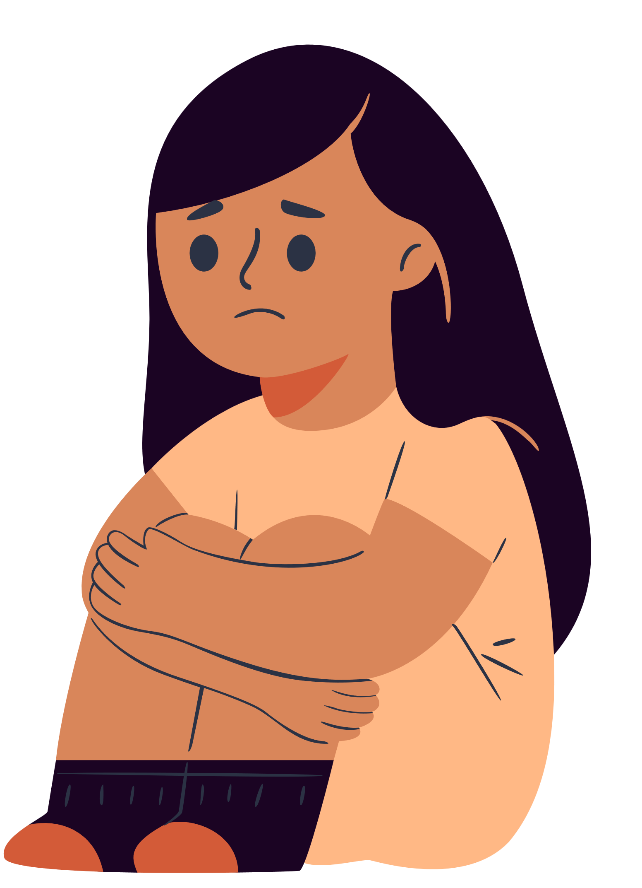
maslow’s hierarchy of needs

Slide 18
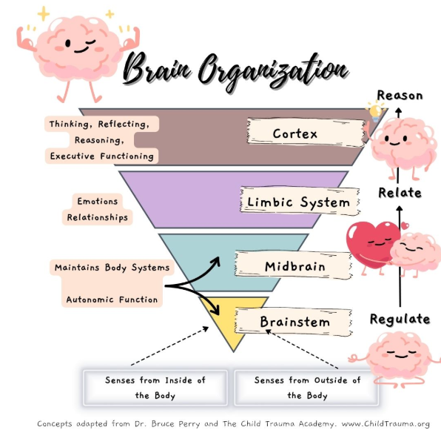
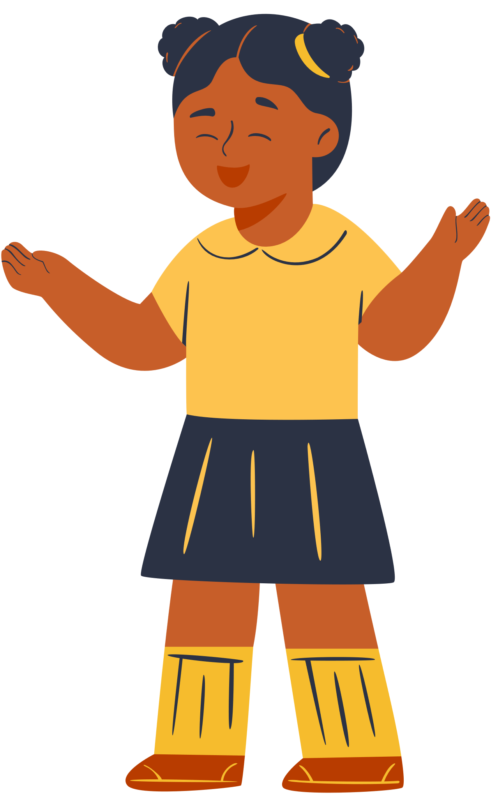
bruce perry and brain organization

Slide 19
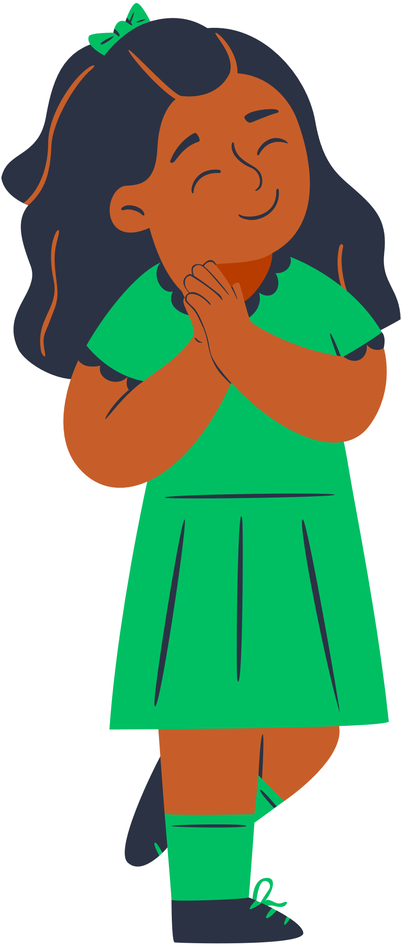
Why this matters
Safe brains learn better.
(Limbic system, amygdala, physiological & safety levels)
Loved brains learn better.
(Limbic system, amygdala & hippocampus, social level)
Confident brains learn better.
(Cortex, PFC & hippocampus, self-esteem & self-actualization levels)

Slide 20
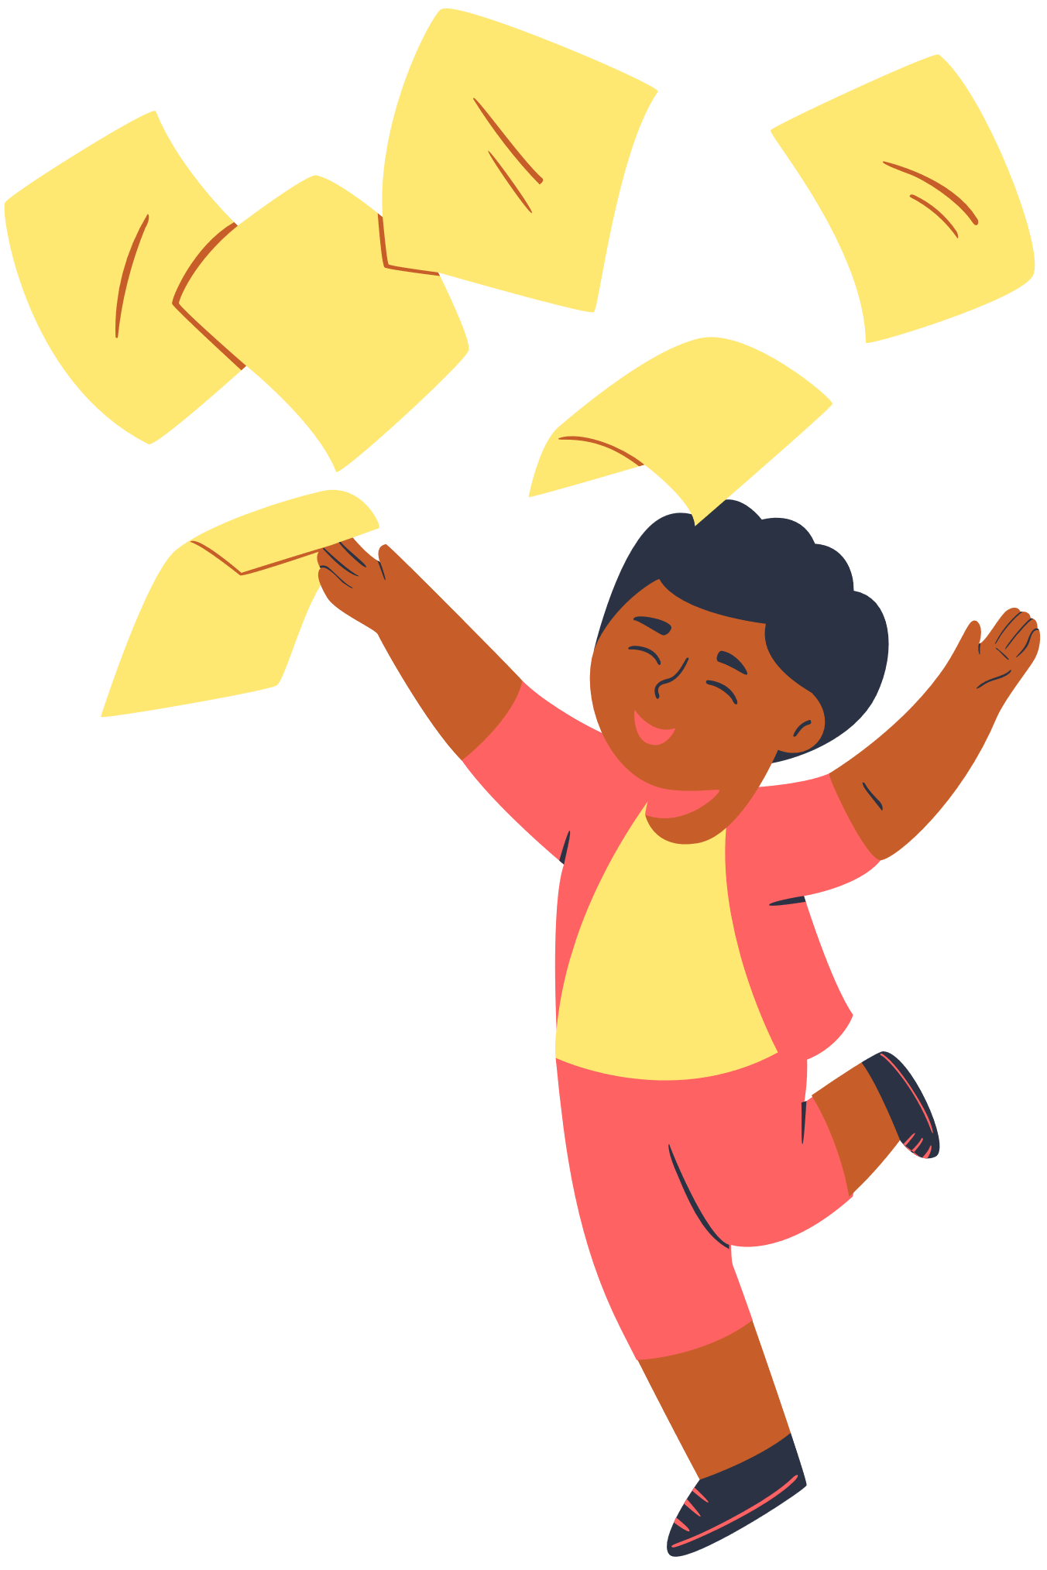
community-building in the classroom
  The easiest way to foster belonging is to build a sense of community within the classroom through empathy.
  To foster empathy, students have to talk to each other.
  Class circles get kids to talk and look at each other.

Slide 21
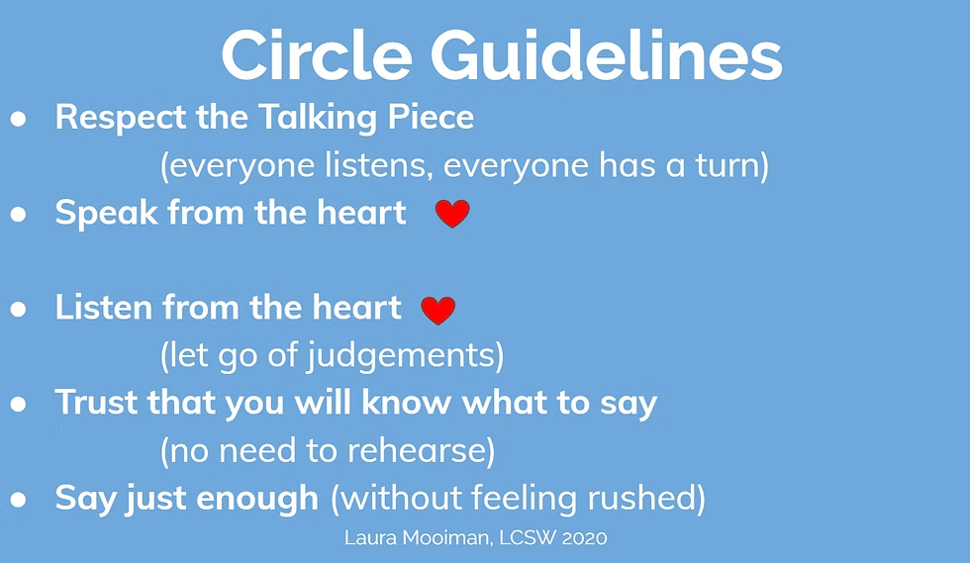
guidelines for circles

Slide 22
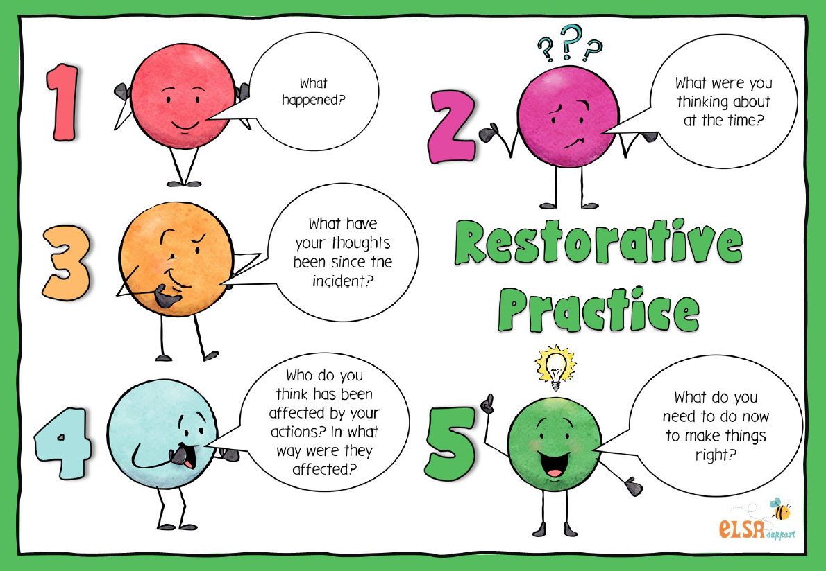
Restorative questions

Slide 23
other community-building ideas
Get-to-Know Games
Lunch with the Teacher
Teacher Minute Meetings
Venn Diagrams
Grade-level Competitions
Group Challenges
Class Cheer/Handshake
Vulnerability
Student Spotlight
Talent Share
Routines
Classroom Goals
Classmate Interviews

Slide 24
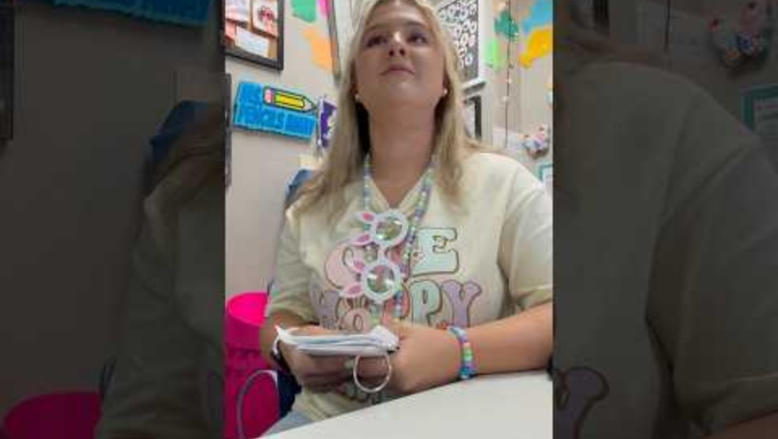
other community-building ideas

Slide 25
why will kids work for some adults at school but not others?
RELATIONSHIPS!

Slide 26
QUESTIONS?

