Slide 1

Individual and group counseling strategies in elementary school
Kushana Collier, School Counselor,
Waverly Belmont ES, MNPS

Slide 2






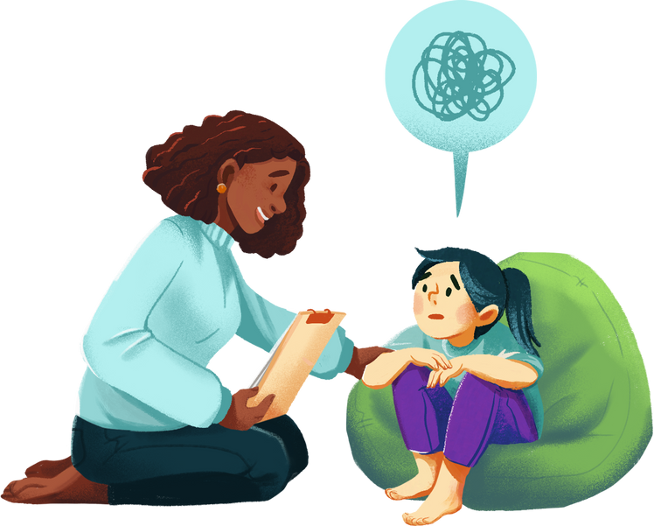
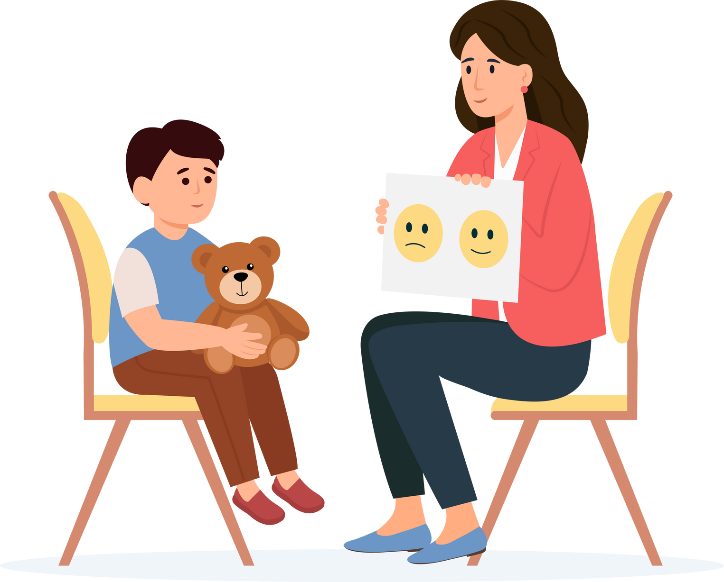
What we do
Our Goal
Providing emotional support
Facilitating academic guidance
Promoting social skills development
Implementing behavioral interventions
Collaborating with teachers and parents​
Notes:
I understand we are all counselors, but this page serves as a reminder of our "why," some of us may have personal reasons that have guided us on this journey as well.

Slide 3


Building a foundation for success
  Early intervention is key
  School Counseling supports academic, social and emotional growth
  School Counselors create a safe and supportive learning environment
  School Counseling helps students develop coping skills and resilience
Notes:
As school counselors, we play a crucial role in supporting not just academic growth, but also social and emotional development.
school counseling provides a safe and supportive environment where students can thrive.
By helping students develop coping skills and resilience, we’re not just addressing immediate concerns, but we are building a solid foundation for their future success.
Remember, every interaction is an opportunity to make a lasting impact in a child’s life.
So, as we move forward, let’s keep in mind the vital role we play in shaping our students' experiences.

Slide 4
Development of counseling Intervention
Universal Behavior Screener
MTSS-B Team
Intervention
Screening tool used to help identify students at risk of future academic, behavioral or emotional difficulties in school
Multi-Tiered System of Support for Behavior
Tier I
Tier II
Tier III
2x10
Check-in /Check-out
Scheduled Breaks
Meaningful Work
Group Counseling
Individual Counseling
Notes:
At my school one tool that is used is the Universal Behavior Screener,
this screening tool is essential for identifying students who may be at risk of facing academic, behavioral, or emotional challenges.
Next, let’s touch on the Multi-Tiered System of Support for Behavior, or MTSS-B. It operates on three levels:
- Tier I provides universal support for all students.
- Tier II offers targeted interventions for those who need a little extra help.
- Tier III involves intensive support for students with more significant needs.
We utilize several strategies, such as the 2x10 approach, which is a two-minute check-in with a student for 10 consecutive days. Check-in/check-out- these students have positive adult interactions twice a day normally in the morning and afternoon. Meaningful work is where a student is assigned a job in the school that helps with belonging and curb behaviors.
Remember, the goal here is to foster a supportive environment where each student can thrive academically and emotionally.

Slide 5

Individual counseling- tier III
Meeting individual needs
Focus on one-on-one interactions
Specific student concerns (bullying, anxiety, family issues, academics)
Builds a trusting relationship

Slide 6

Group counseling- tier II
Small Group
Peer support
Shared experiences
Development of social skills
Encourages empathy and teamwork

Slide 7

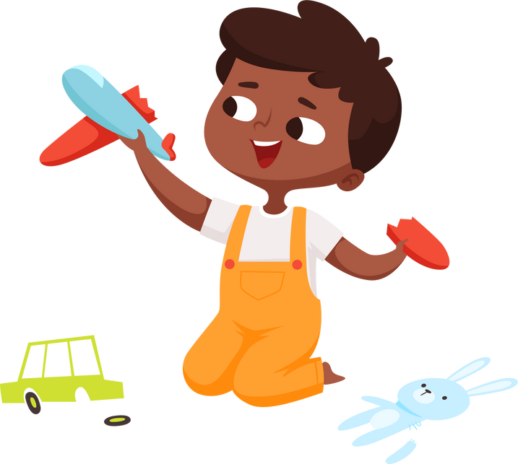
Individual and Group counseling
Strategies
Cognitive Behavior Therapy- identifying and changing negative thoughts
Play therapy- using toys and games to work through feelings/emotions
Notes:
Let’s look at Cognitive Behavior Therapy.
This approach helps kids identify and change negative thoughts that may be affecting their emotions and behaviors.
Next, we have Play Therapy. This method utilizes toys and games, creating a safe space for children to express and work through their feelings. The longer I do this it still amazes me how play can unlock emotions that words sometimes can’t convey.

Slide 8


Individual and Group counseling
Strategies
Art Therapy- expressing feelings/emotions through drawings
Solution focused brief therapy- focusing on solutions and strengths
Notes:
Next, we have Art Therapy and Solution Focused Brief Therapy in our counseling practices.
1. Art Therapy allows individuals to express their feelings and emotions through drawings. This can be especially powerful for those who find it difficult to articulate their emotions with words. By using art, we create a safe space for expression and healing.
2. Focused Brief Therapy, this approach emphasizes focusing on solutions and strengths rather than problems. It encourages kids to envision their goals and work towards them, fostering a sense of empowerment.
3. All of these therapies can be utilized in individual and group counseling settings, providing diverse strategies to meet the unique needs of our kids.
Each format offers unique benefits. Individual counseling provides personalized support, while group counseling fosters shared experiences, enhancing social skills and empathy among peers.
These strategies are essential in creating a comprehensive approach to supporting our students. Let’s keep these in mind as we move forward.

Slide 9
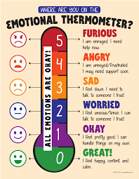
flow of intervention
Temperature Check
Read/discussion
Activity
Read or listen to a story about the topic. Leaving time for discussion, questions and input.
Games
Drawing
Modeling clay
Cut and Paste
Role Playing
Notes:
Room set up: I try to have my room set up for the group or individual session before I go to pick up the kids. Calming music playing on my screen and a timer ready for one of the students to set when it is time. I have a calendar of the session meeting days, so the students know when we start and end. The hardest part for me is ending a session because usually the students are not ready for the sessions to end.
Beginning of lesson: I start with a temperature check in. This will let me know which way I need to go with the lesson. Sometimes, if a student is experiencing heighten emotions, I may pivot for a moment to allow emotional regulation.
Next, we'll read or listen to a story relevant to our topic, allowing ample time for discussion and questions. This step fosters a collaborative environment where everyone can share their insights.
Lastly, we'll move into our activities. Here, we have several interactive options:
- Games to create a comfortable environment for kids to be open about their feelings.
- Drawing allows for creative expression of feelings.
- Modeling clay provides a tactile way to explore emotions.
- Cut and Paste activities can be a playful way to process information.
- Role Playing gives kids a chance to practice real-life scenarios in a safe space.
This year, I will try a new model of bi-weekly 15-minute sessions. I envision this being a more focused session to help with the topic we are discussing. The first session will be about procedure to ensure flow of the lesson. I tried this out the last few weeks of school and it went well with the shorten time. I also feel this will allow me to have more groups this year.

Slide 10

Ethical Considerations
Confidentiality
Informed Consent
Obtaining consent for group counseling from parent
clearly explain harm to self and other to students and parents
Collaboration
Working with parents, teachers and other staff to meet the needs of the students
Notes:
Let's dive into the important topic of Confidentiality in our counseling practices.
Firstly, it’s essential to clearly explain to both students and parents the boundaries of confidentiality, especially when it comes to harm to self and others. This ensures everyone understands the limits and protects our students.
Next, we’ll discuss Informed Consent. This is a vital process where we obtain consent from parents for group counseling. It's about ensuring that they are fully aware and supportive of the interventions.
Collaboration is key in our approach. Working together with parents, teachers, and other staff is crucial to meet the diverse needs of our students. I always inform the teacher and parents of the topic we are working on and any carry over skills for the classroom and at home.
Lastly, we must always keep in mind Ethical Considerations. These principles guide our practices and help us maintain integrity in our work.

Slide 11

Assessments
DATA Collection
  Pre and Post survey
  Determination of effectiveness
  Being fluid
Notes:
Enhancing Counseling Practices: Key Elements to Consider
Understanding Pre and Post Surveys
First and foremost, it’s vital to recognize the significance of pre and post surveys. These tools enable us to collect valuable feedback from our students before and after interventions, facilitating effective progress measurement.
Assessments and Resources
Next, let's delve into Assessments and Resources. These components are essential for evaluating the effectiveness of our interventions. By employing a variety of assessments, we can customize our approach to address the unique needs of each student.
Lastly, let’s focus on the importance of adaptability. Flexibility is crucial in counseling; we must modify our strategies in response to the data we gather to ensure we provide the best support possible.

Slide 12
Resources
https://counselorcollab.com/
www.Canva.com
School Counseling Lessons
Read aloud books
https://www.yourcounselingcompass.com/login
  Story Time with Ryan and Craig
  Vooks
  Story Time at Awnie’s House
  Story time with Faye
Book references:
15- minute Counseling Techniques that work
by Amanda Edwards
15-Minute Focus: Behavior Interventions: Strategies for Educators, Counselors, and Parents
by Amie Dean
Notes:
First, I want to highlight The Responsive Counselor website. This platform is a treasure trove of information and resources specifically tailored for counselors.
The Counselor Collab has similar offerings, but they are laid out differently. The Counselor Collab has a monthly calendar and lessons that can be used. My district purchased the membership for all elementary and middle school counselors in the district.
Reading aloud can be incredibly impactful, not just for students but also for parents. For example, Story Time with Ryan and Craig offers delightful and engaging content that can help foster connections and understanding.
Additionally, we have Vooks, which combines animation with storytelling, making it captivating for young minds. And don’t forget Story Time at Awnie’s House and Story Time with Faye. These resources provide various narratives that can spark discussions and encourage emotional expression among students.
These tools are not just about entertainment; they play a vital role in creating a supportive environment for our students. Thank you for your attention!

Slide 13
Thank you!

