Slide 1
EXECUTIVE FUNCTIONING SUPPORTS FOR
SMALL GROUPS & CLASSES
SMALL GROUPS & CLASSES

Slide 2


LAURA
LAURA
FILTNESS
FILTNESS

Slide 3
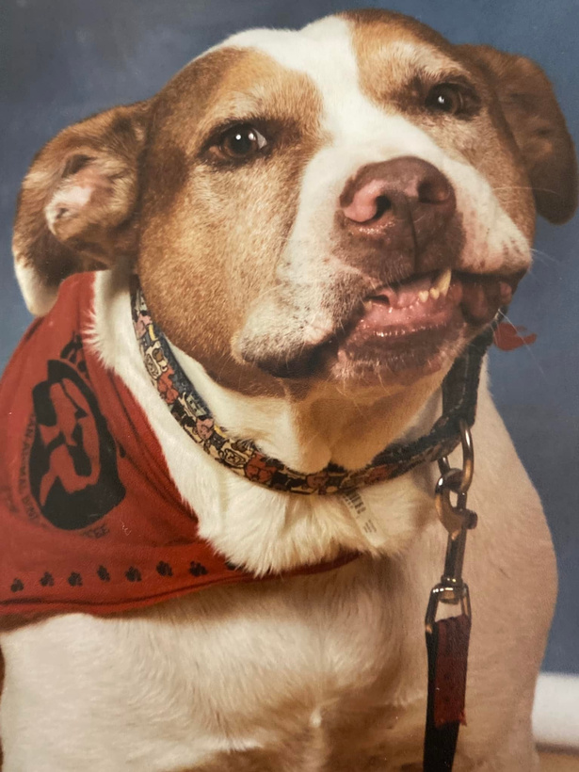

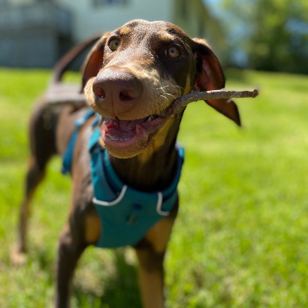
BROOKLYN
BOSS
BINDU
MY FAMILY
MY FAMILY

Slide 4

ABOUT ME
ABOUT ME
•Dog mom
•Struggling plant lover
•Counselor for over 12 years
•Yoga teacher
•Help you Dweller
•Unofficial librarian
•ADHD partner

Slide 5
WHAT ARE WE DOING TODAY?
WHAT ARE WE DOING TODAY?
Review
Scenario
Identify
Learn
Resources
What is ADHD?
Types, facts, other diagnosis.
The 6 are.as of executive functioning that are impacting.
Support strategies for each area.
More resources for you to keep using in the future!
Let’s look at a situation!

Slide 6



TYPES OF ADHD
TYPES OF ADHD
ADHD -PI (FORMALLY ADD)
ADHD- (COMBINED)
ADHD- (HI)
Notes:
ADHD-primarily hyperactive/impulsive (hi)
PI- primarily inattentive
Combined type
Presentations can change over time

Slide 7
  What most people think of when they hear ADHD
  Impulsive, active emotions that boil up fast
  Higher risk for conduct problems
  Fidget, leaves area, unable to play quietly, interrupt, restless, difficulty waiting their turn, little sense of danger
  Least common
TYPES OF ADHD
TYPES OF ADHD
ADHD- HI (IMPULSIVE)
Notes:
Verbal hyeractivity, mental restlessness,

Slide 8
TYPES OF ADHD
  Inattentive and distractable without hyperactivity
  Forgets details of daily routines.
  May move slow (attention fatigue)
  Make careless mistakes, miss details, have difficulty organizing tasks, avoid work, lose things
TYPES OF ADHD
ADHD -PI
Notes:
primarily inattentive- dont need to have ANY symptoms of hyperactivity to qualify for Dx.

Slide 9
TYPES OF ADHD
  Most common
  Impulsive and hyperactive behaviors, as well as distractibility
  Must exhibit 6 of the 9 symptoms listed for each sub-type
TYPES OF ADHD
ADHD- (COMBINED)

Slide 10

  Males with ADHD are more likely to exhibit hyperactive and impulsive symptoms (e.g., fidgeting, interrupting), while females are more likely to have inattentive symptoms (e.g., daydreaming, disorganization).
  Females are often underdiagnosed or diagnosed later because their symptoms tend to be less disruptive and more internalized (e.g., trouble focusing rather than acting out).
  Females with ADHD are more likely to have co-occurring conditions like anxiety and depression, which can complicate diagnosis and treatment.
  Girls with ADHD may experience more social challenges, like feeling misunderstood or struggling with self-esteem, partly because their symptoms are less overt than those in boys.

Slide 11
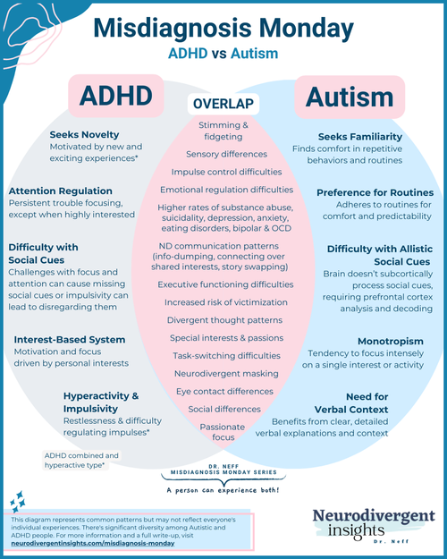
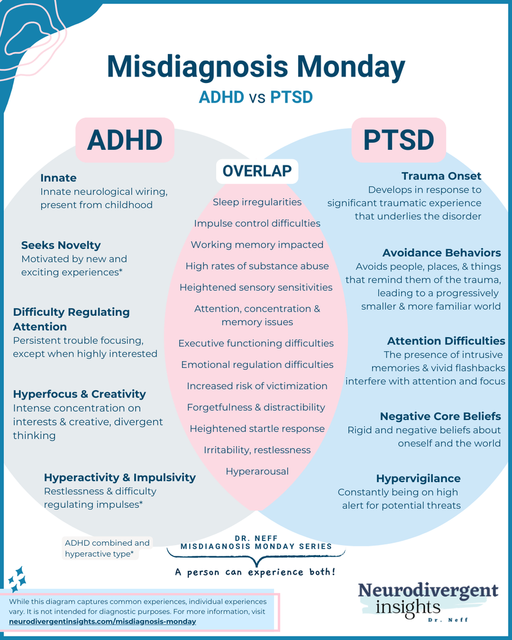

Slide 12
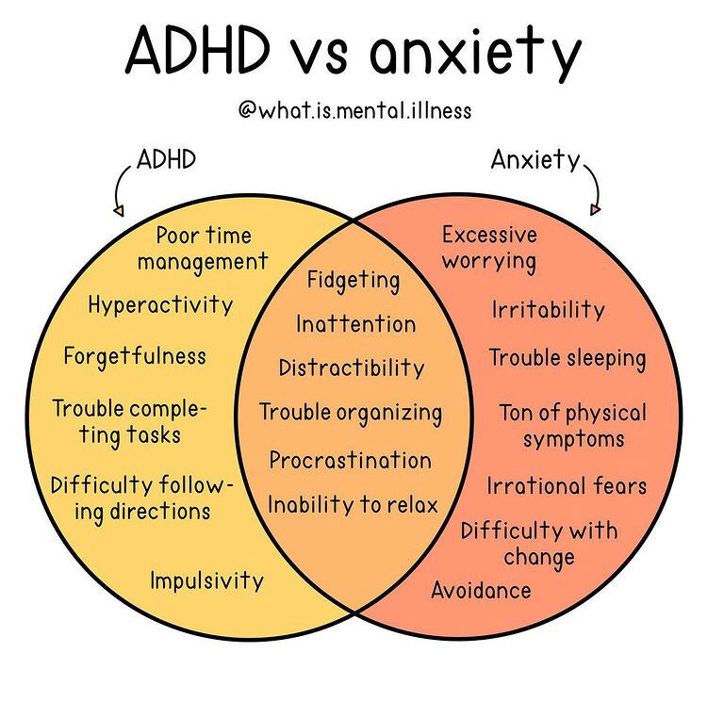
  Cause of Distractibility: In ADHD, distractibility is often due to a lack of focus or interest in tasks, whereas in anxiety, distractibility stems from racing thoughts or excessive worrying.
  Emotional Response: Anxiety is driven by fear, worry, or panic, while ADHD is more related to issues of impulsivity, inattention, and sometimes emotional regulation, but typically without the persistent fear characteristic of anxiety.
Notes:
Students may respond in different ways:
-deny
-apologize
-beg
-trying to do harder
- trying better the next time
- internalizing feelings of not being good enough

Slide 13
Students with ADHD may have a hard time...
•Slowing down
•Monitoring their actions
•Understanding the consequences of their actions
•Waiting their turn
•Prioritizing
Notes:
can lead to labels like:
-irresponsible
-messy
-careless
-

Slide 14
They may just need a couple more days...

Slide 15
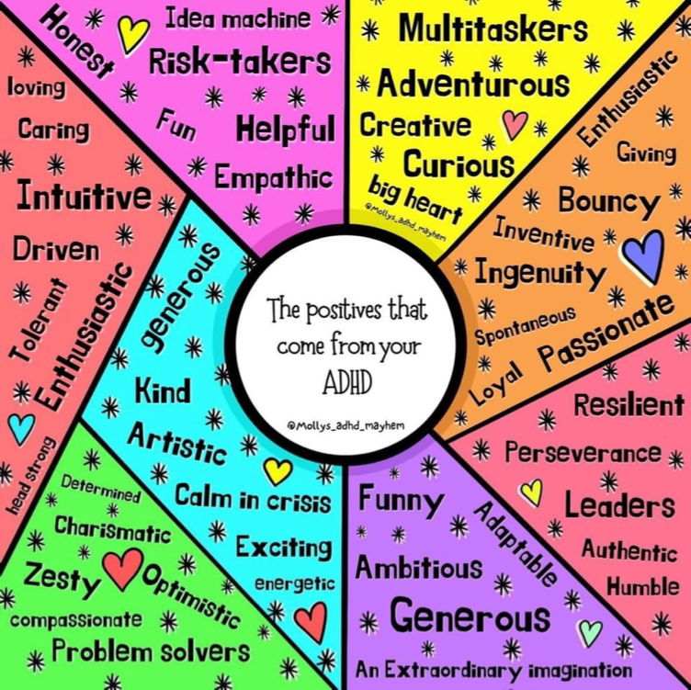
“it helps to think of ADHD as a complex set of contradictory or paradoxical tendencies: a lack of focus combined with an ability to superfocus; a lack of direction combined with highly directed entrepreneurialism; a tendency to procrastinate combined with a knack for getting a week’s worth of work done in two hours; impulsive, wrongheaded decision making combined with inventive, out-of-the-blue problem solving; interpersonal cluelessness combined with uncanny intuition and empathy; the list goes on.”
― Edward M. Hallowell, ADHD 2.0
Notes:
Affrimations from "Small Talk" by the Pinks
"I don't need to fix myself"
"I am multi-passionate"
"It's okay to change direction"
" I also have a lot of skills others don't have."
"I am a person of value no matter what needs I have."
"I deserve to be here."

Slide 16
Scenario
The teacher tells the class, "You have 10 minutes to complete this assignment." However, one student spends most of the time—about 8 minutes—getting supplies or being off-task. When the 10 minutes are up, the student hasn’t finished and becomes upset. The teacher explains that they didn’t complete the assignment because they wasted time.
Later in the day, the students who finished their work in the morning get to participate in a fun activity. The student who didn’t finish must stay behind to complete the assignment instead. This makes the student upset again, as they don’t understand why they aren’t allowed to join the fun activity.

Slide 17
Time Mngmt.
Task Initiation
Organization
Planning
  Skill Needed: Allocating time appropriately to ensure the task is completed within the given timeframe.
  Challenge: The student may not understand how to divide their time effectively or prioritize task completion.
  Skill Needed: Starting the task promptly without procrastination or delay.
  Challenge: The student may struggle to begin the assignment quickly, getting distracted or preoccupied with unrelated activities.
  Skill Needed: Having all materials ready and accessible to begin the task efficiently.
  Challenge: The student may need extra time to locate supplies or may not know how to organize their workspace effectively.
  Skill Needed: Developing a mental or written plan for completing the assignment within the allotted time.
  Challenge: The student might lack the ability to foresee the steps needed to complete the task on time.

Slide 18
Self-Monitoring
Emotional Regulation
Impulse Control
Flexibility
  Skill Needed: Keeping track of their progress and recognizing when they are off-task.
  Challenge: The student may not realize they are spending too much time on non-task-related activities or may not know how to refocus once distracted.
  Skill Needed: Adapting to the situation when things don’t go as planned or when faced with the consequence of missing the fun activity.
  Challenge: The student may have difficulty shifting their mindset to accept the situation or adapt to changes.
  Skill Needed: Adapting to the situation when things don’t go as planned or when faced with the consequence of missing the fun activity.
  Challenge: The student may have difficulty shifting their mindset to accept the situation or adapt to changes.
  Skill Needed: Avoiding distractions and staying focused on the assignment instead of engaging in off-task behaviors.
  Challenge: The student may have trouble resisting distractions, which further delays their progress.

Slide 19
MAY STRUGGLE BECAUSE...
MAY STRUGGLE BECAUSE...
  Developmental Stage
  Lack of Support or Guidance (Clear Instruction)
  Limited Understanding of Expectations

Slide 20
  Crave stimulation, but are easily overstimulated.
  Hate structure, but can’t function without it.
  Can’t focus, but can laser focus on their interests
  Require lots of sleep, but often don’t get any.
CONTRADICTIONS
Notes:
lets watch my favorite couple give a few more examples
speak here before video bc it will play over and as soon as video ends go to next slide.
cant talk even if video stops

Slide 21
CONTRADICTIONS
AND CONSIDERATIONS

Slide 22
Online considerations
A study published in the journal PLOS One, found less than 50% of popular TikTok A.D.H.D. videos shared info that matched diagnostic criteria or treatment guidelines. Even people diagnosed with A.D.H.D. struggled to spot accurate content.
Approximately half of the analyzed TikTok videos about ADHD were misleading. Clinicians should be aware of the widespread dissemination of health misinformation on social media platforms and its potential impact on clinical care.
https://www.nytimes.com/2025/03/19/well/mind/adhd-videos-tiktok-misinfo.html
https://pmc.ncbi.nlm.nih.gov/articles/PMC9659797/

Slide 23
Executive Functioning
The executive function regulates, controls, and manages thoughts and actions.
Executive function affects:
  Planning
  Inhibition
  Attention
  Reasoning
  Cognitive Flexibility
  Monitoring
Notes:
those with adhd are more likely than neurotuypcial peers to multi task.
Unfortunately research shows that mutli tasking is not the time saver we think it is.
For things we that don't require our full attention we have done hundreds of time it's ok like doing laundy
Mistakes are common
Coffee ex- forgot filter

Slide 24
Executive Functioning
Imagine it like this:
The brain is not catching the “signal”- the signal is fading in and out like a poor cellphone signal.
Notes:
Boost the signal and decrease the noise

Slide 25
But......
“they totally pay attention when they play video games.”

Slide 26
Interest Based Nervous System
When something is highly interesting, competitive, novelty, or urgent, it can create a state of undivided attention.
Therefore, they can suddenly hyper-focus and get their work done so they don’t miss recess.
•
•
ADDitude. (2019). ADHD & the Interest-Based Nervous System. [online] Available at: https://www.additudemag.com/adhd-brain-chemistry-video/ [Accessed 20 Oct. 2019].

Slide 27
Interest Based Nervous System
You may “misinterpret spotty, inconsistent focus as a sign of defiance or selfishness.”
It is not.
ADDitude. (2019). ADHD & the Interest-Based Nervous System. [online] Available at: https://www.additudemag.com/adhd-brain-chemistry-video/ [Accessed 20 Oct. 2019].

Slide 28
Help increase focus by making the activity:
Interesting
(even better if it’s specific to their interests, like a sports team or game.)

Slide 29
Help increase focus by making the activity:
Important
(create a sense of urgency; why they need to know and do this now- not how it will help them in the future.)

Slide 30

They just need medication...
Medication doesn’t teach skills.
While medication doesn't teach skills, it can help some people with ADHD access and apply those skills more effectively.
Notes:
effective treatment may include:
medication
psychoeducation
skills training
pmt- parent management training
therapy- cbt, dbt,
coaching
finding support groups

Slide 31
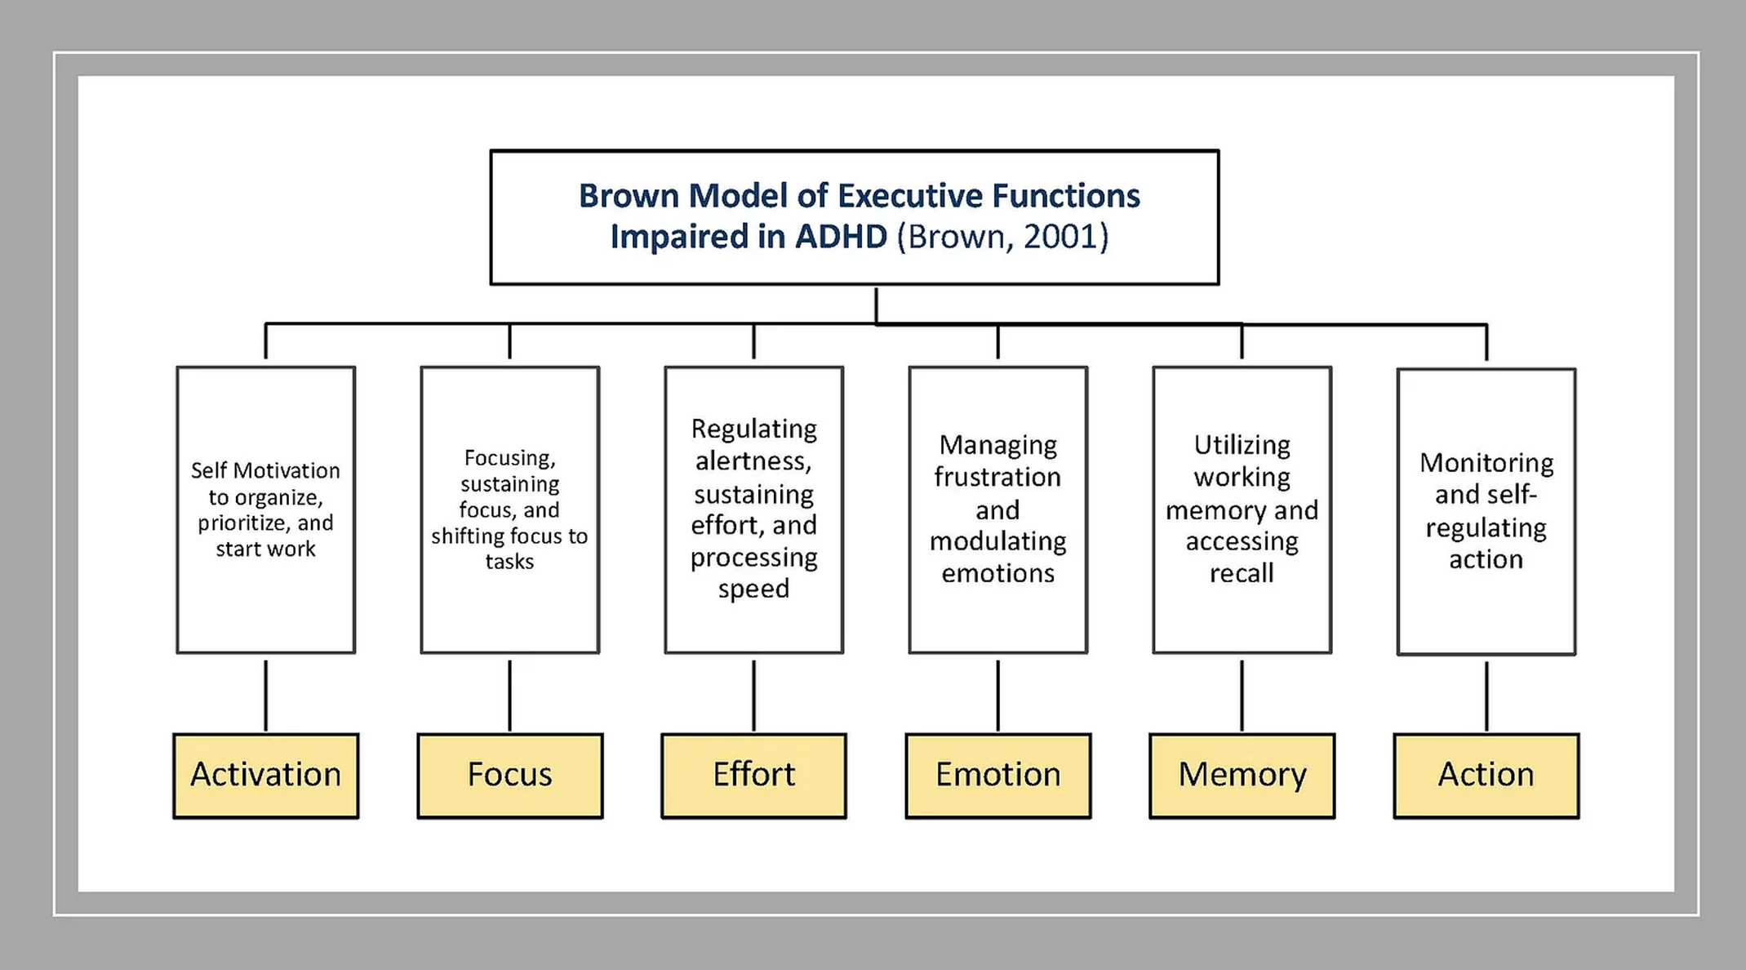

Slide 32
Activation
They may have trouble with:
–Organizing tasks
–Estimating time
–Prioritizing
–Getting started

Slide 33

Strategies for Activation-Small Group
Habit Stacking (from Atomic Habits)
  Add a new habit to something you already do daily.
  Example: “After I hang up my backpack, I’ll turn in my homework.”
  Use sentence starters:
    “After I ___, I will ___.”
    “Before I ___, I will ___.”
  Have students create and share their own examples.
Notes:
Habit Stacking is a simple strategy from James Clear’s book Atomic Habits. It helps students create routines by adding a new habit to something they already do every day.
Explain to students what Habit Stacking is: "Habit stacking means adding a new habit to something you already do—like connecting two puzzle pieces that fit perfectly!"
Next, model for students with an example. For example,"After I hang up my backpack, I'll put my homework in the turn-in tray."
Encourage students to create examples using sentence starters:
“After I ___, I will ___.”
“Before I ___, I will ___.”
Have students come up with their own habit stacking examples and share with a partner or the group.

Slide 34
Strategies for Activation- Individual
Body Doubling
Having a person there with you while you engage in and complete a task. Interestingly, the body double doesn’t even have to be helping you with the task.
:
ADDitude. (n.d.). Getting Stuff Done Easier with a Friend: Body Double. Retrieved May 12, 2025, from https://www.additudemag.com/getting-stuff-done-easier-with-a-friend-body-double/

Slide 35
Focus
They may struggle with:
  Sustaining focus
  Having “spotty focus” like a weak radio station
  Becoming easily distracted by things around them and their own thoughts
  They understand the word but need to read it repeatedly to remember it and the meaning of what they are reading.

Slide 36
Strategies for Focus- Small Group
CLAP, TAP, GRAB
  Model language students can say to themselves (self-talk): “There will be time to think about that later, but for the next few minutes, I am going to focus on_______.”
  Debrief: How did they stay focused during the game? What was the connection between the game and focus? (Why do they think we played this game during our focus lesson?)

Slide 37

Strategies for Focus- Individual
  Cut a file folder into sections.
  Open only the section you want them to see and focus on.

Slide 38

Effort
•They may struggle with:
•Processing speed
•Being alert
•Sustained effort
•Long term projects
•Activities that longer periods of time, like writing projects
•Regulating sleep
•Shutting off their thoughts
•Getting up in the morning

Slide 39
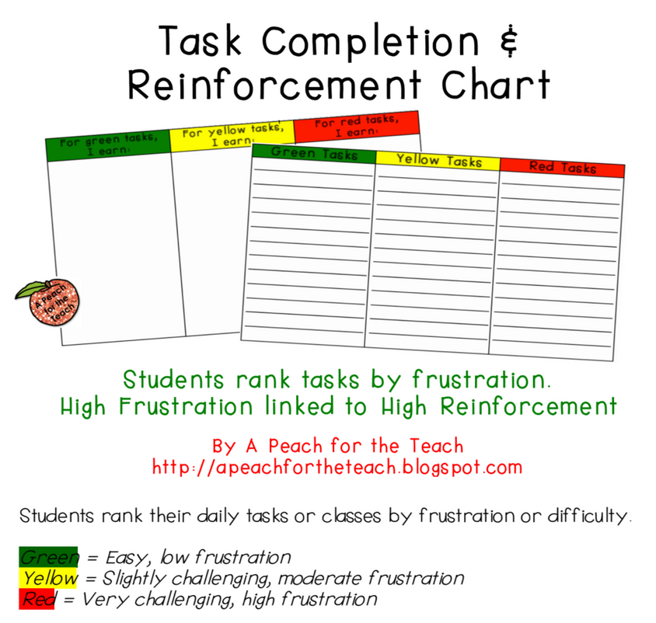
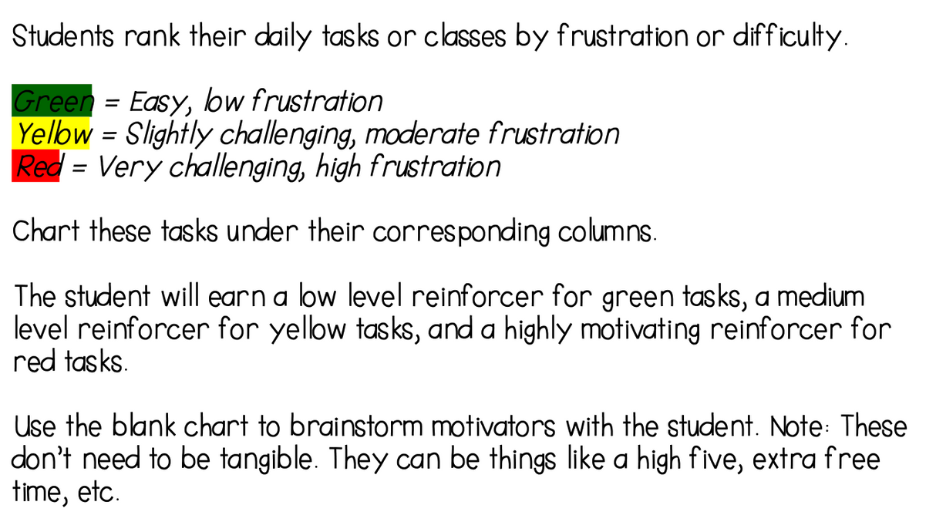
Strategies for Effort

Slide 40
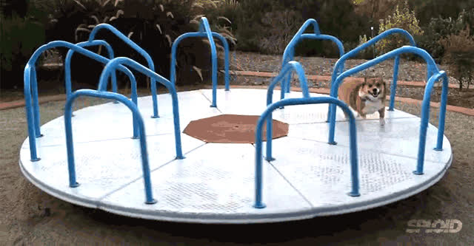
Strategies for Effort
Stamina Chart:
See how long a student can engage in an activity.
Take a break and try again.
Keep a visual chart of how long they were able to attend.
*Tip: Encourage them to try for “1 more minute” and beat their last time.

Slide 41
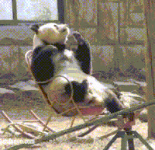
Emotional Regulation
They may struggle with
–Regulating emotions
–Modulating
–Managing frustration
–Fixating on a feeling
–Finding perspective
*Note: the DSM-5 does not recognize emotional management as part of ADHD.

Slide 42

Strategies for Emotions
Dan Siegel- Name It To Tame It
Labeling may diminish emotional reactivity. It reduces the FREQUENCY and INTENSITY.
•Psychologist David Rock states, “when you experience significant internal tension and anxiety, you can reduce stress by up to 50% by simply noticing and naming your state.” Ablett further explains, if we can see the emotion, we do not have to be the emotion.
Notes:
Reduces frequency and intensity. Not giving our emotions power. Having the right vocabulary allows us to see the real issue. It helps us get ourselves off of the autopilot of ingrained behaviors and habitual responses. It lets us ‘name and tame’ the emotions we are experiencing, rather than being overwhelmed by them.5

Slide 43

Strategies for Emotions
Small Group-
Ping Pong Rally
Individual-
Interoception
Both-
Make it part of the routine
Biblio-therapy
Notes:
Reduces frequency and intensity. Not giving our emotions power. Having the right vocabulary allows us to see the real issue. It helps us get ourselves off of the autopilot of ingrained behaviors and habitual responses. It lets us ‘name and tame’ the emotions we are experiencing, rather than being overwhelmed by them.5

Slide 44
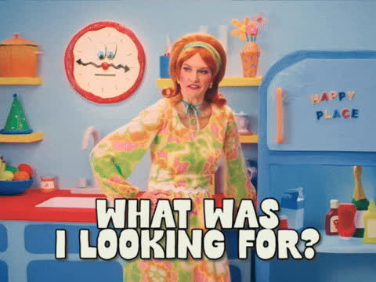
Memory
•They may have great long-term memory (remember things from the past.)
•They may struggle with:
–Short-term memory
–Remembering what they were about to say
–Remembering multi-step directions
–Recall
–Remembering one thing while focusing on something else
Notes:
Reduces frequency and intensity. Not giving our emotions power. Having the right vocabulary allows us to see the real issue. It helps us get ourselves off of the autopilot of ingrained behaviors and habitual responses. It lets us ‘name and tame’ the emotions we are experiencing, rather than being overwhelmed by them.5

Slide 45
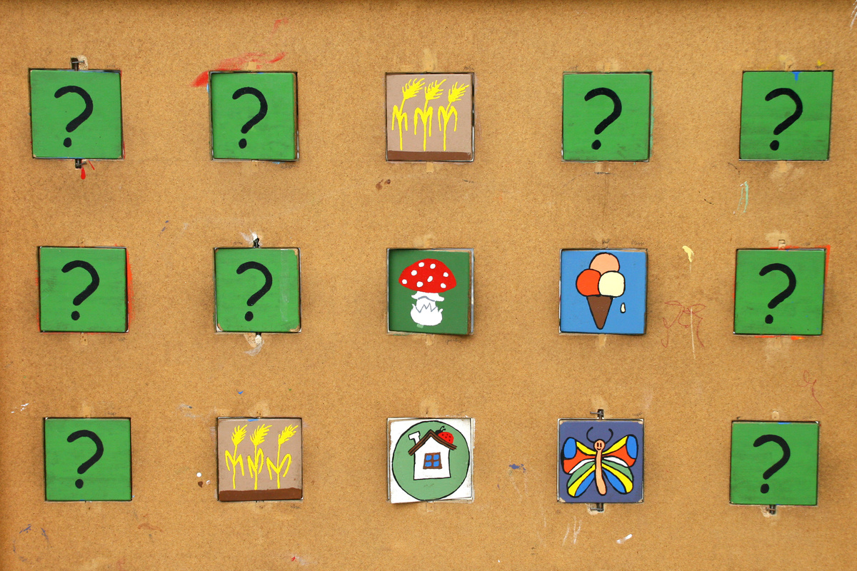
Strategies for Memory- Small Group
Memory Match Game
  Match vocab words with definitions
  Match the emotion word with a picture of the emotion
  Match the teacher's name with their picture
  Match the item with its “home.”
Notes:
High school and MS: Mnemonic Device

Slide 46

Strategies for Memory- Individual
Brain Dump
Provide each student with paper or writing materials—or record their responses on the board. Invite them to recall everything they’ve learned so far and write it down in any format they prefer, such as bullet points, sketches, or short sentences. There’s no right or wrong way to do a brain dump; the goal is simply to capture as much information as possible from memory.

Slide 47
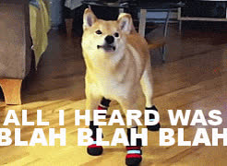
Action
They may struggle with:
–Regulating behavior
–Acting impulsively
–Understanding the context of interactions
–Failing to understand body language and social cues
–Pacing
Notes:
Reduces frequency and intensity. Not giving our emotions power. Having the right vocabulary allows us to see the real issue. It helps us get ourselves off of the autopilot of ingrained behaviors and habitual responses. It lets us ‘name and tame’ the emotions we are experiencing, rather than being overwhelmed by them.5

Slide 48

Strategies for Action-Small Group
Self-Monitoring Activity: My Top 3
  Students identify 2–4 common mistakes or feedback points.
  Choose a keyword or short phrase for each one.
  Use the first letters to create an acronym or silly phrase.
  Use the acronym as a reminder to avoid repeating mistakes.
Notes:
Have students identify 2–4 mistakes they noticed in their work or behavior. They can also reflect on common feedback from teachers or caregivers and write down 2–4 points they frequently hear. Next, ask them to choose a key word or short phrase for each mistake or feedback point. Using the first letter of each keyword, they’ll create an acronym or silly phrase to help them remember these issues. Encourage them to use this acronym as a quick reminder to self-monitor and avoid repeating the same mistakes in the future.

Slide 49

Strategies for Action- Individual
Dry-erase board: Give the student a small dry-erase board.
When they get excited when you are teaching, have them write or draw what they want to say on the board.
*Tip: Teach them to hold up their board and you give them a thumbs up which let’s them know you see what they wanted to say/blurt.
Notes:
Reduces frequency and intensity. Not giving our emotions power. Having the right vocabulary allows us to see the real issue. It helps us get ourselves off of the autopilot of ingrained behaviors and habitual responses. It lets us ‘name and tame’ the emotions we are experiencing, rather than being overwhelmed by them.5

Slide 50
Directions
Student Teacher
•
•Give clear, short, specific directions.
•
•Have the student repeat the directions back to you.
•
•State, pause, repeat.
•Have the student “teach” you and the parent about their reward system or the subject.
OTHER TIPS
OTHER TIPS

Slide 51
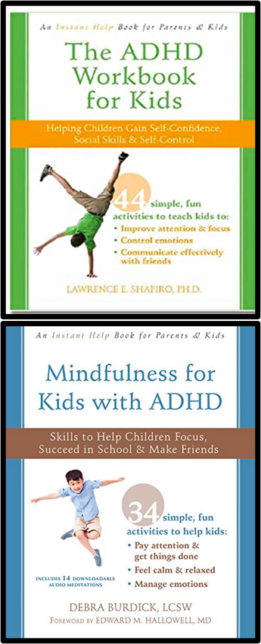
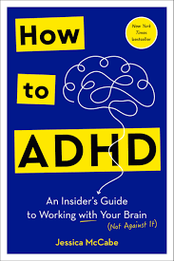


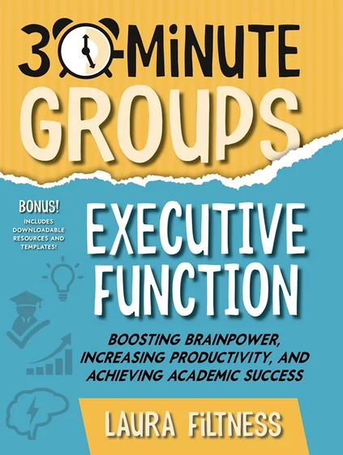
Books
NEW IN 2025
Notes:
Reduces frequency and intensity. Not giving our emotions power. Having the right vocabulary allows us to see the real issue. It helps us get ourselves off of the autopilot of ingrained behaviors and habitual responses. It lets us ‘name and tame’ the emotions we are experiencing, rather than being overwhelmed by them.5

Slide 52
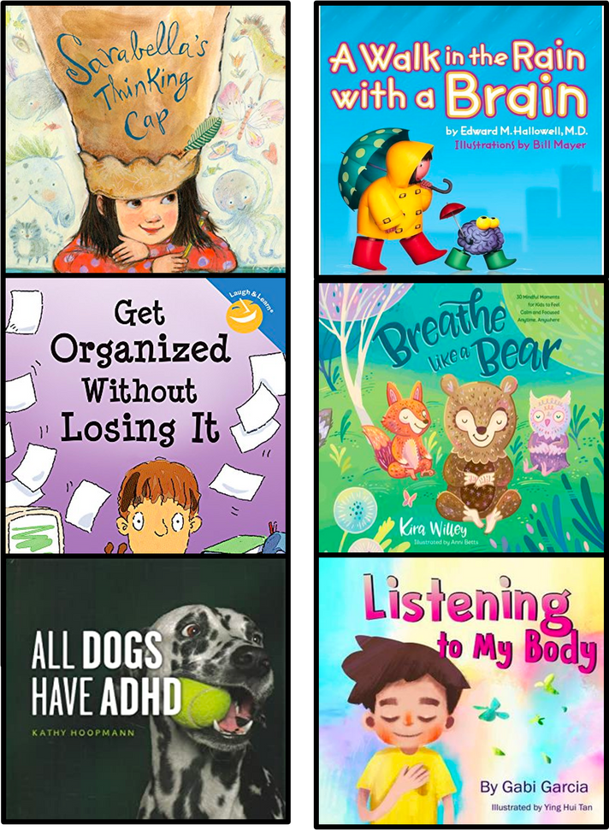

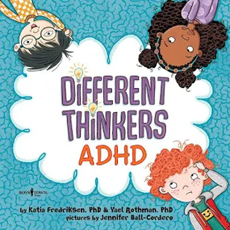





Books
Sept 2025
Notes:
Reduces frequency and intensity. Not giving our emotions power. Having the right vocabulary allows us to see the real issue. It helps us get ourselves off of the autopilot of ingrained behaviors and habitual responses. It lets us ‘name and tame’ the emotions we are experiencing, rather than being overwhelmed by them.5

Slide 53
Resources and References
  •Brown Clinic for Attention and Related Disorders- brownadhdclinic.com
  •ADDitude. (2019). ADHD & the Interest-Based Nervous System. [online] Available at: https://www.additudemag.com/adhd-brain-chemistry-video/ [Accessed 20 Oct. 2019].
  •Knight Barrett, K. (2019). ADHD and the Case for Support Through Collegiate Age: Understanding the Lifecycle of Developmental Delays in Executive Function for ADHD and its Impact on Goal Setting.
  •(Rodrigues, P. and Pandeirada, J. (2019). When visual stimulation of the surrounding environment affects children’s cognitive performance.)
  • ADDitude. (2019). ADHD & the Interest-Based Nervous System. [online] Available at: https://www.additudemag.com/adhd-brain-chemistry-video/ [Accessed 20 Oct. 2019].
  •Quarto, C. (2018). AD/HD and Executive Functions: A New Model & Intervention Strategies for School Counselors.
  “How To ADHD: An Insiders Guide To Working by Jessica McCabe 2024
  “Small talk” by Richard and Roxanne Pink, 2024
Notes:
Reduces frequency and intensity. Not giving our emotions power. Having the right vocabulary allows us to see the real issue. It helps us get ourselves off of the autopilot of ingrained behaviors and habitual responses. It lets us ‘name and tame’ the emotions we are experiencing, rather than being overwhelmed by them.5

Slide 54

I’M WONDERING
I’M WONDERING
What questions do you have?

Slide 55


STAY IN TOUCH
STAY IN TOUCH
Pawsitive School Counselor
pawsitiveschoolcounselor@gmail.com
https://pawsitiveschoolcounselor.com

