Slide 1
Every Student, Every Day
District Collaboration for English Learner Success
Meagan Turnbow, ESL Coordinator
Dr. Larissa Westerfield, Coordinator of Teaching & Learning

Slide 2
RCS: Our Story, Our Schools
51 schools
51,091 students
48% of all students qualify for free/reduced lunch
14 Title I schools but 29 qualify
238 ESL Teachers
7,514 ELs
2,074 T1-4
1,297 Newcomers
822 LTELs
672 Dual served
9,588 Total L, W, T1-4

Slide 3
Why Every Student, Every Day?
Notes:
Why does it matter that we say this or think this? Where did this motto come from? (Our Iceberg is Melting) - flooding with the message; This takes support from the top down.

Slide 4
RCS Vision
Collaborative Culture | Successful Students
Empowered Educators | Proactive Planning

Slide 5
25-26 C&I Focus Areas
Build systems around aligned, high quality instructional materials (HQIM) to ensure all students receive appropriate grade level instruction.
Increase teacher and instructional leader capacity to lead and/or participate in high performing PLC process.
Build and maintain structures that focus on the measured outcomes and success of all students.
Create and refine structures to focus on inclusivity and collaboration (district and school-level).
Refine alignment and commitments between schools and CO.
Notes:
Born out of the focus on Every Student, Every Day – How, as district, are we going to ensure every student is discussed and their needs are met? What are our action steps and evidence of these areas?

Slide 6
Expectations
Intentionality around Collaboration
Subgroup Data Focus
High-Quality Instructional Materials (HQIM)

Slide 7
Why should we collaborate?
“When teachers work together on collaborative teams, they improve their practice in two important ways. First, they sharpen their pedagogy by sharing specific instructional strategies for teaching more effectively. Second, they deepen their content knowledge by identifying the specific standards students must master. In other words, when teachers work together, they become better teachers”
(Many & Sparks-Many, 2015, p. 83).

Slide 8
Intentionality Around Collaboration
Curriculum Leads
Principals
Content Alignment Meetings
Instructional Leadership Team
Instruction Department
Everyone is in a PLC
Notes:
Why did we realize we needed to focus on creating an environment of intentional collaboration?
Discuss how we have incorporated active collaboration points in each of these areas:
Intentionality around collaboration/creating an environment that is conducive to collaboration: coordinators (who is at the table and what we discuss), Curriculum leads (who is involved, PLC model, subgroup data, collaboration around assessments, data, content knowledge, and instructional strategies, purpose, results of survey – collaboration across schools biggest success), content alignment meetings (who is involved, topics discussed, purpose), instruction dept meetings (all voices and all aspects of a student's day heard and discussed in these meetings), principal meetings (subgroup data, discussions between grade bands, discussions within grade bands, In Leading PLCs at Work Districtwide, From Boardroom to Classroom, Dr. Eaker and the other authors discuss how the principal meetings are the room that is filled with the highest paid employees in the district. Use that time to collaborate and act as a PLC. This is an area of growth for us, but we have done special populations trainings and collaboration K-12 and collaboration in grade bands over these topics and with the book study, Yes We Can.)

Slide 9
Curriculum Leads: ​
“It is the process of learning together that helps educators build their capacity to create a powerful PLC” ​
(DuFour et al., 2016, p. 7)

Slide 10
Curriculum Leads
What is the right work that leads to improved student learning/results?​
Collective responsibility for student learning
Notes:
“In order to ensure all students learn at high levels, educators must work collaboratively and take collective responsibility for the success of each student” (DuFour et al., 2016, p. 12).

Slide 11
Curriculum Leads
Every Student, Every Day
Higher levels of learning for ALL our students
Evidence of student learning
Notes:
We have to believe that all students can learn at high levels.
Every PLC discussion and planning decision should run through the filter of: Will this ensure higher levels of learning for our students?
“Educators in a PLC focus on results—evidence of student learning” (DuFour et al., 2016, p. 12)

Slide 12
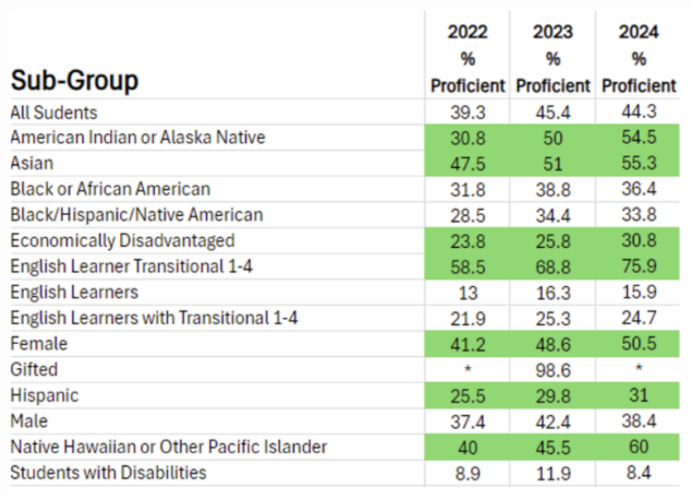

Slide 13
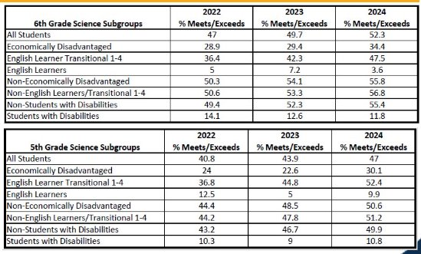

Slide 14
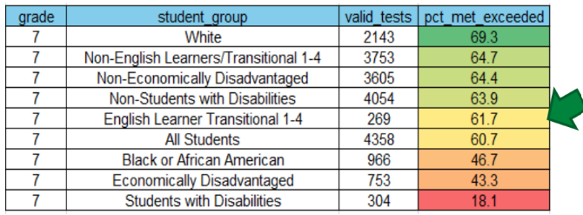

Slide 15
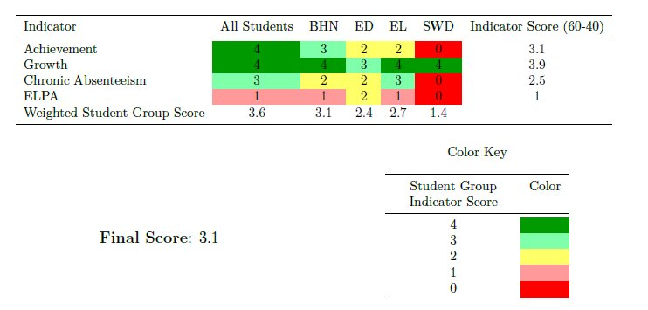

Slide 16

HQIM
Morphology (MS)
Newcomer Curriculum (1-12)
New Curriculum (HS)
3Ls Framework (K-8)
Notes:
Focus on training of pedagogical approaches, instead of content, for high school teachers
Materials for high school ESL students that are more relevant to high school students' interests
3Ls Framework – grade level texts; scaffolds and expectations; inclusion of higher level writing
Language checks

Slide 17
Where are we now?
District Structures
Collaboration
Outcomes

Slide 18
District Structures
Content Alignment meetings
Curriculum Lead meetings
Scheduling meetings to discuss collaboration across departments/areas
Principal meetings
Positions to support Tier 1 teachers
Positions (coaches) to support ESL teachers
IGNITE
School Collaboration Plans
ESL Lead meetings
Department Structure
ESL Liaisons within schools
Translators
Family Nights (ESL College Night)
Collaborative structures within schools
Notes:
Department structure - Right people in the right places for their strengths

Slide 19
Collaboration about ESL
Relationships
Teamwork
Right people at the table
School Board
County Commission
District Leadership
Instructional Coaches
ESL Department Roles
Notes:
Principal meeting – K-12 discussing ways for Special Populations teachers to be included in PLCs & data meetings; "collaboration days," etc.
Instructional coaches – Heat maps; focus collaboration across schools between coaches; ESL coaches included; ESL presentations at coach meetings

Slide 20
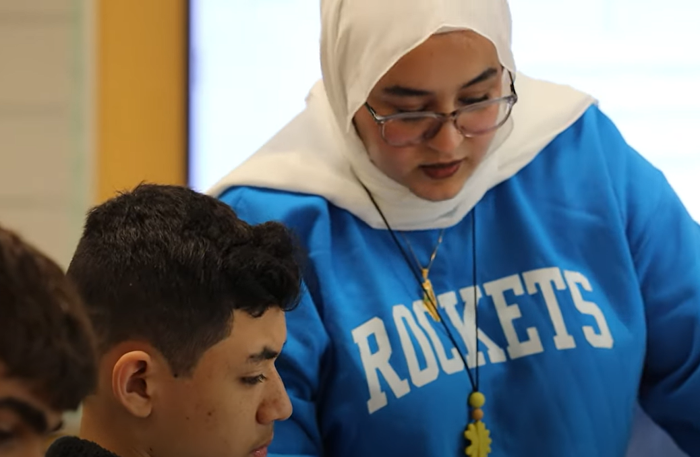
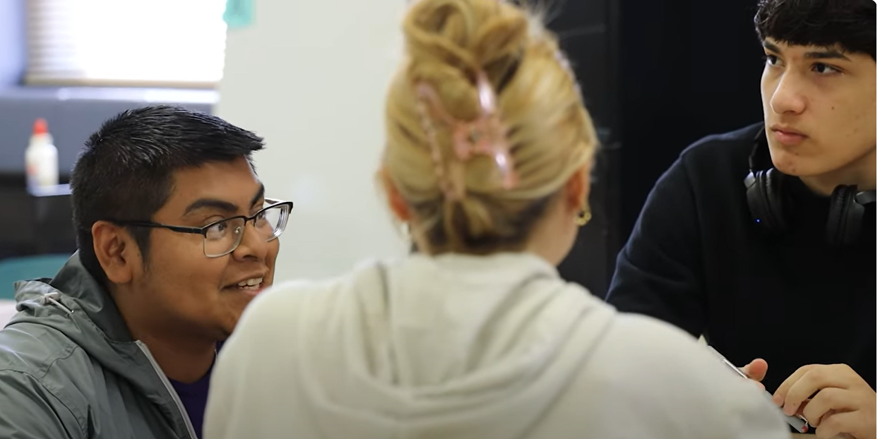
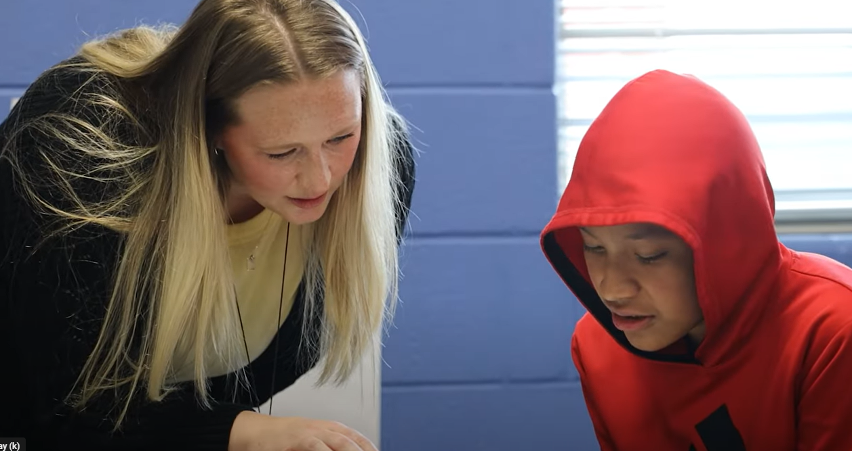
Co-Teaching

Slide 21
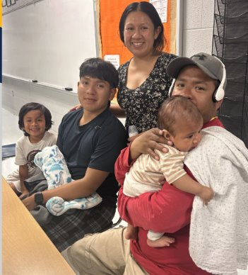
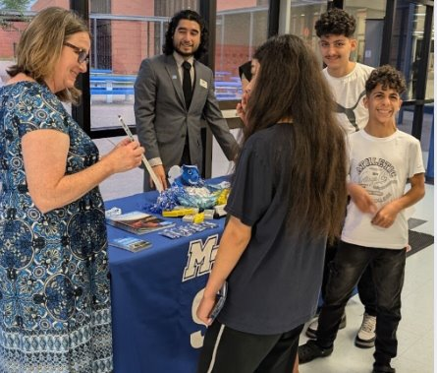
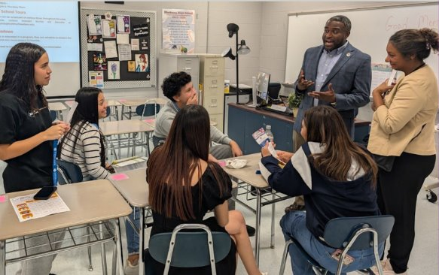
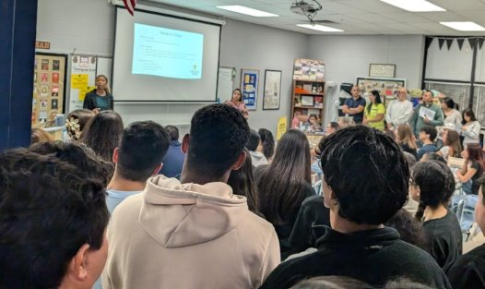
ESL College Night

Slide 22
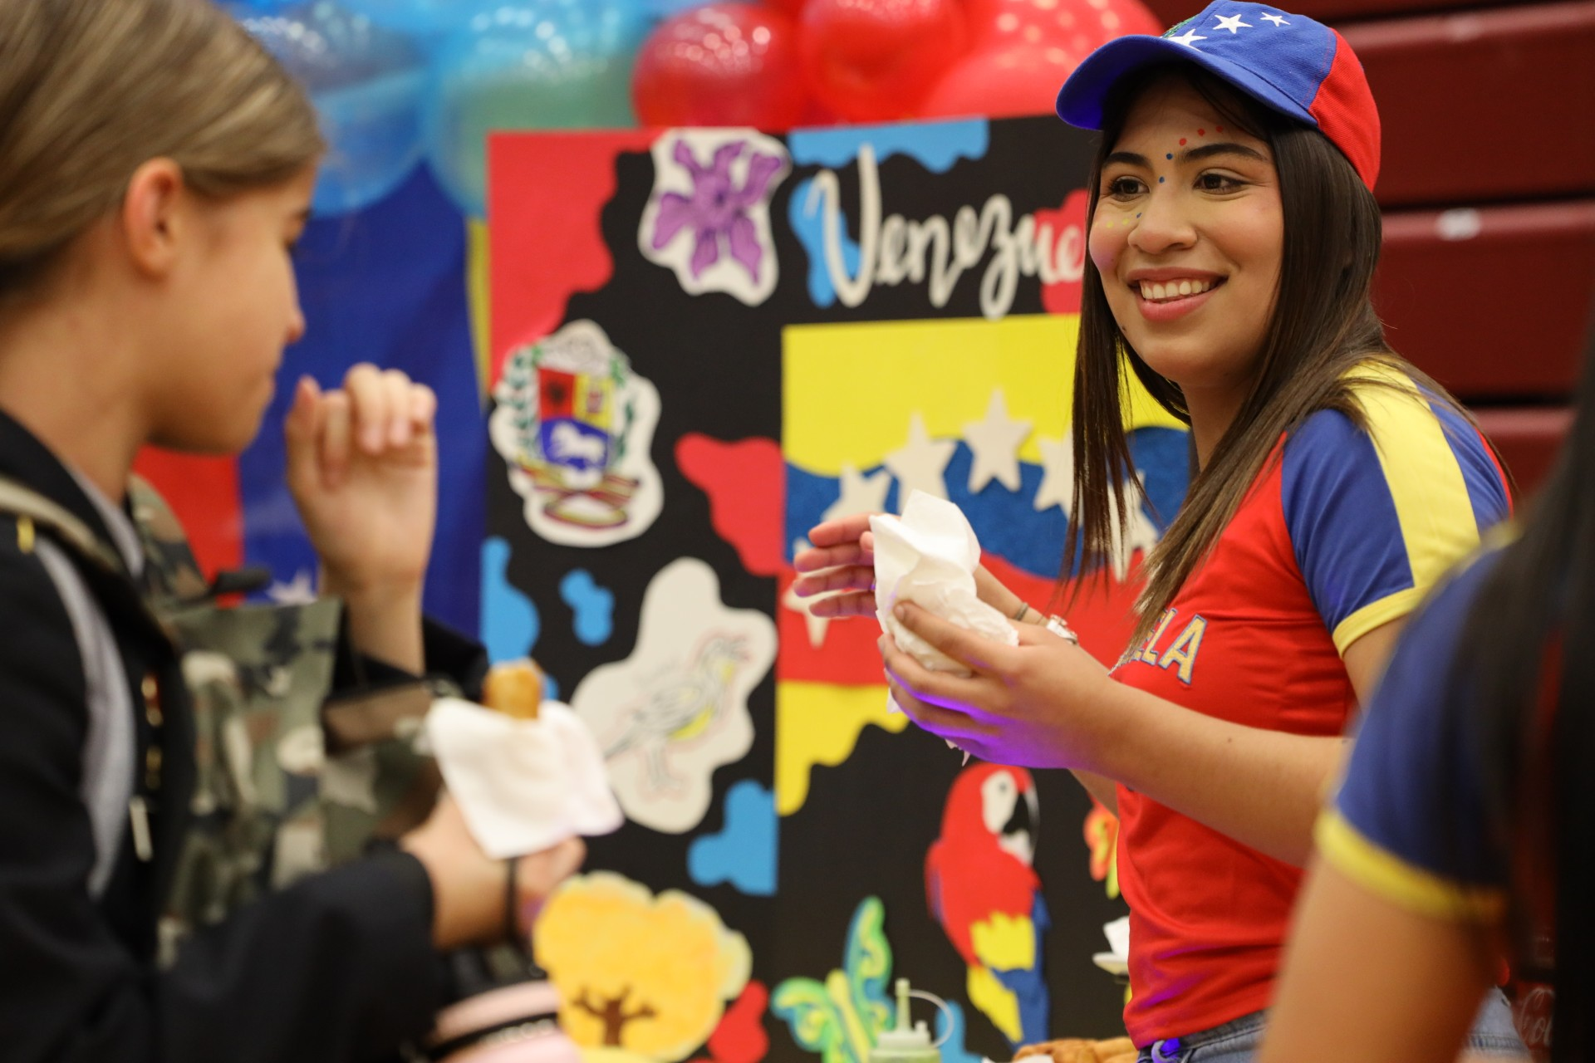
Outcomes
Awareness
Relationship building
Reduced silos
ESL College Night
District Level 5 data
School-Level ESL Parent Classes
Collaboration on District Resources
Notes:
Awareness of how ELs do not necessarily have cognitive disabilities, which has resulted in higher expectations; no longer lumping ESL and SpEd together when discussing students and data
ESL College Night – leading to other people spearheading efforts
Collaboration on district resources – Emily/Corey & Content Specialists

Slide 23
ELPA21 2025 Results
Grade | RCS | State
1 | 13% | 12%
2 | 20% | 17%
3 | 25% | 22%
4 | 30% | 25%
5 | 16% | 14%
6 | 16% | 12%
7 | 13% | 10%
8 | 14% | 9%
9 | 5% | 4%
10 | 6% | 4%
11 | 8% | 6%
12 | 13% | 6%
KG | 5% | 5%
2023 Exits (WIDA ACCESS): 495
2024 Exits (WIDA ACCESS): 648
2025 Exits (ELPA21): 1,107
Middle School tripled exits
Notes:
Middle school exits – added morphology, curriculum fidelity that includes grade level texts and higher expectations, new curriculum for newcomers with foundation skills (HQIM), PLC meeting expectations, inclusion of multiple data points to analyze growth (language checks)

Slide 24
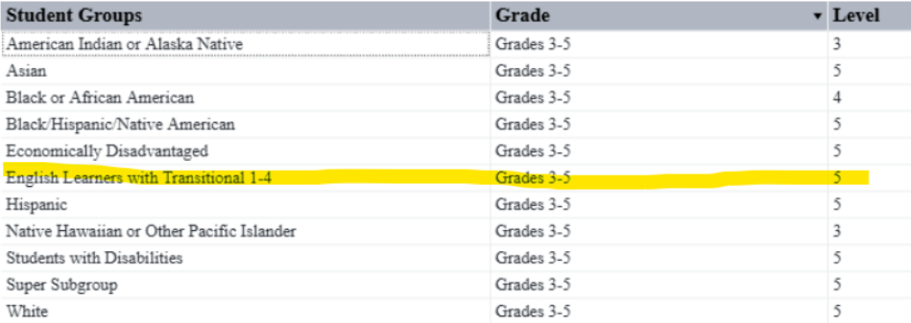
TVAAS Growth Grades 3-5
Notes:
Why did we realize we needed to focus on creating an environment of intentional collaboration?
Discuss how we have incorporated active collaboration points in each of these areas:
Intentionality around collaboration/creating an environment that is conducive to collaboration: coordinators (who is at the table and what we discuss), Curriculum leads (who is involved, PLC model, subgroup data, collaboration around assessments, data, content knowledge, and instructional strategies, purpose), content alignment meetings (who is involved, topics discussed, purpose), instruction dept meetings (all voices and all aspects of a student's day heard and discussed in these meetings), principal meetings (subgroup data, discussions between grade bands, discussions within grade bands)

Slide 25
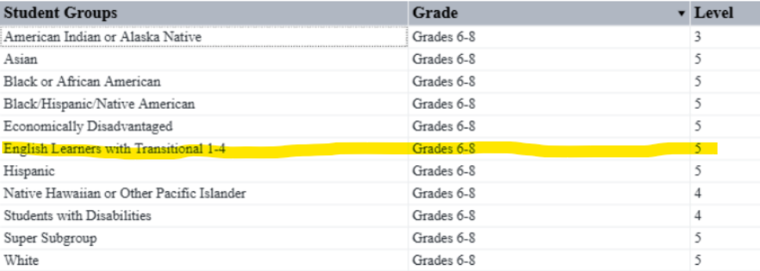
TVAAS Growth 6-8

Slide 26
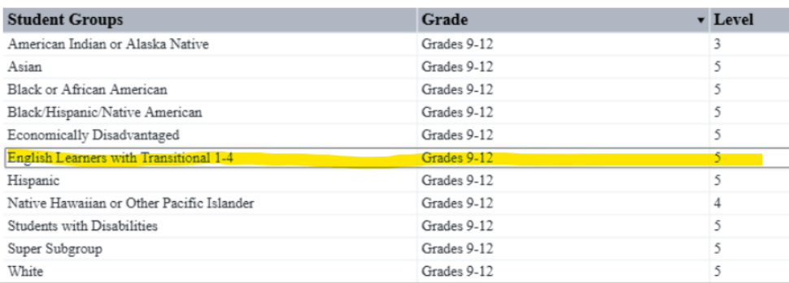
TVAAS Growth 9-12

Slide 27
PLC Questions
Q1
What is it we want our students to know and be able to do?
Q2
How will we know if each student has learned it?
Q3
How will we respond when some students do not learn it?
Q4
How will we extend the learning for students who have demonstrated proficiency?​
Notes:
How will we know if each student has learned it?

Slide 28
What about your district? Where can you grow?
Sphere of influence
Power of data/Being results-oriented
PLC process
Book studies
CTE

Slide 29
Questions?

