Slide 1

ThE ipG: FROM AN ESL PERSPECTIVE AT THE ELEMENTARY, MIDDLE, AND HIGH SCHOOL LEVELS
Presented by: Kristy Altizer (Sullivan County), Sabrina Cox (Rhea County Schools),
April Davis (Claiborne County Schools)

Slide 2
Introduction
What is the purpose of the Core Knowledge Building Tennessee Instructional Practice Guide for K-12?
  To support all educators in identifying areas where high quality instruction can be enriched so all students can access Tier 1, grade-level classroom instruction

Slide 3
Learning objectives
To become familiar with Tennessee's K-12 Core Knowledge Building IPG from an ESL perspective
To identify specific questions and address specific considerations unique to each section of the IPG critical for intellectual preparation at all levels: Elementary, Middle, and High School

Slide 4
culture of learning tASK ​1: Students complete instructional tasks, volunteer responses and/or ask appropriate questions.
Do ELs need the teacher to rephrase or repeat the instructions in shorter steps or more explicitly?
Would ELs benefit from a sentence stem/frame to share their ideas?
Did you model the task first? Did you model to students how to ask clarifying questions?
Were students able to think, pair, share with a partner BEFORE expected to answer or respond?

Slide 5
Think, Pair, Share
What are some ideas you have to support English learners in understanding and following teacher's behavior expectations and directions?

Slide 6
culture of learning
Task ​2:
Continued
Did you explain and model your behavior expectations for students who have never attended schools in the US and for RAELs throughout the year?
Would your ELs benefit from having the directions available both orally and in writing with appropriate visuals?
Did you repeat the directions so the student could process them?

Slide 7
culture of learning
Task ​2: continued
Questions and tasks address the text by attending to its particular qualitative features: its meaning/purpose, and/or language, structure(s), and knowledge demands.
Where in the text can you see that the sentence structure may interfere with ELs comprehension or ability to complete the task?

Slide 8
culture of learning
Task ​2: continued
Did you explain and model your behavior expectations for students who have never attended schools in the US and for RAELs throughout the year?
Would your ELs benefit from having the directions available both orally and in writing with appropriate visuals?
Did you repeat the directions so the student could process them?

Slide 9
culture of learning
Target ​3:
Students execute transitions, routines, and procedures in an orderly and efficient manner.
Were these explicitly taught by teacher modeling or demonstration and with repetition as needed?

Slide 10
culture of learning
Task 4:
Students are engaged in the work of the lesson from start to finish; there is a sense of urgency about how time I used.
Does the assignment match the ELs proficiency levels?
Are appropriate scaffolds implemented to ensure engagement from start to finish?

Slide 11
Think, Pair, Share
How can teachers help ELs feel included in their classroom culture?

Slide 12
culture of learning Task 5:
Students and their teacher demonstrate a joy for learning through positive relationships and strong classroom culture that is responsive to student interests, experiences, and approaches to learning.
Do you encourage ELs to make personal connections from their lives and culture to increase their connection to learning?

Slide 13
Core action one:
High-Quality texts at the center of instruction
Do ALL ELs have HQIM for instruction?
Were ELs provided time to preview the material in advance?

Slide 14
Core action two: effective use of questions & tasks
Task A
Questions and tasks address the text by attending to its particular qualitative features: its meaning/purpose, and/or language, structure(s), and knowledge demands.
Where in the text can you see that the sentence structure may interfere with ELs comprehension or ability to complete the task?

Slide 15
Discussion Time Let’s look deeper: why would this sentence structure be difficult for an el to understand?
"Whatever obstacles I found made me fight all the harder, but it would have been impossible for me to fight it all except that I was sustained by the personal and deep-rooted belief that my fight had a chance" (“Jackie Robinson).

Slide 16
Answer: why would this sentence structure be difficult for an el to understand?
"Whatever obstacles I found made me fight all the harder, but it would have been impossible for me to fight it all except that I was sustained by the personal and deep-rooted belief that my fight had a chance" (“Jackie Robinson).

Slide 17
Core action two:
Task A Continued
Can you annotate these areas to increase their comprehension? Will chunking help them identify where they will need to stop and think?
Chunking example: "Whatever obstacles I found made me fight all the harder, but it would have been impossible for me to fight it all except that I was sustained by the personal and deep-rooted belief that my fight had a chance" (“Jackie Robinson).

Slide 18
Core action two:
Task A Continued
Do you need to build student's background knowledge before completing the task?
Do you have specific questions for your lower proficient ELs?
Have you previewed the questions/ tasks with them in advance to decrease their affective filter and to ensure they understand the instructional language in the question and task?

Slide 19
Core action two:
Task B
Questions and tasks require students to use evidence from the text to demonstrate understanding and to support their ideas about the text. These ideas are expressed through written and/or oral responses.
Have you modeled locating text evidence and explicitly explained what it means to support the evidence?
Would your ELs have better access to the task by pre-highlighting some of the text evidence? Could you highlight 2-3 sentences and have the EL determine the best evidence to decrease language processing overload?

Slide 20
Core action two: tasks B
Continued
Which ELs need the text to be chunked ( a section where the evidence is located) to reduce their language processing overload?
Would your ELs have better access to completing the task by numbering the paragraphs and informing your ELs that each numbered paragraph has text evidence?
Can lower proficient ELs match the evidence to supporting details by allowing them to focus on matching key words or phrases?

Slide 21
Core action two: effective
Task C
Questions and tasks attend to the words (academic vocabulary), phrases, and sentences within the text.
Do you have visuals available for ELs to understand the new, academic vocabulary? Do you have a word bank for essential vocabulary?
What additional specific vocabulary do you think your ELs may need to know to access content vocabulary? How can you frontload this vocabulary?

Slide 22
Core action two: effective
Task C
Continued
Have you planned opportunities for ELs to create meaning of new vocabulary by having them create sentences orally and/or in writing?

Slide 23
Core action two: effective
Task D
Questions and tasks are sequenced to build knowledge by guiding students to delve deeper into the text and graphics.
Are you strategic with your questions & tasks?
Have you planned specific questions that allow lower proficient ELs to answer in words or short sentences?
Do your questions build in complexity and promote deeper thinking?

Slide 24
Core action three: opportunities for student engagement
Task A
The teacher poses questions and tasks that allow opportunities for students to do the majority of the work, and students engage in those opportunities via speaking/listening, reading, and/or writing.
Explicitly explain the target question/language objective and have a student re-explain to ensure understanding.
Provide wait time & prompt ELs as needed to get them over their "freeze".
Implement THINK/pair/share/write

Slide 25
Core action three:
Task B
The teacher expects evidence and precision from students and probes student's answers accordingly, and students provide text evidence to support their ideas and display precision in their oral and written responses.
Reduce student affective filter by starting your response with a statement that reflects positivity (Ex: You have the idea, let's look deeper. What else can you tell me? Let us think about how you can expand your answer by including text evidence and your supporting reason(s)?)

Slide 26
Core action three:
Task B
Continued
Chunking a text into sections for lower proficient ELs ensure they do not get overwhelmed by the amount of written text they are to work through to complete the task.
Provide a sentence stem and/or frame to support students with organizing their thoughts and forming a sentence to participate.

Slide 27
Think, Pair, Share with numbered cards
What would you recommend a teacher do when an EL continually demonstrates productive struggle when completing assignments both independently and with classmates?

Slide 28
Core action three: opportunities for student engagement
Task C
The teacher cultivates reasoning and meaning making by allowing students to productively struggle, and students persevere through difficulty.
Do the students understand the task or purpose for learning? If not, re-explain, model 'thinking aloud', and remind students to refer to your scaffolds and supports such as anchor charts, reference books, etc.
It’s important to be a facilitator for learning at this time.

Slide 29
Core action three:
Task D
The teacher creates conditions for student conversations where students are encouraged to talk and ask questions about each other's thinking, and students engage in those opportunities in order to clarify or improve their understanding.
It is not a race- think time is critical for ELs to understand the directions and to process what they want to say using correct sentence structure
Model using sentence stems/frames
Model to ELs how to clarify their understanding and how to question their classmates thinking

Slide 30
Core action three: opportunities for student engagement
Task E
The teacher deliberately checks for understanding throughout the lesson and adapts the lesson according to student understanding, and students refine their written and/or oral responses (if appropriate).
Does the teacher have a clear understanding of the purpose for learning and does each student understand the purpose for learning?
When planning- identify checking for understanding areas that will be critical for you to stop and ensure ELs are understanding.

Slide 31
Core action three:
Task E Continued
Consider making small adjustments to questions/tasks if ELs appear to struggle and remind students to refer to their texts.
Summarization by students (after a few sentences, a paragraph, page, etc.) teaches all students to monitor their comprehension of learning.

Slide 32
Core action four:
HQIM ACCESS for ALL
How do you ensure ELs can fully access HQIM while fostering ownership of their learning?

Slide 33
Task a:
Supports promote access to the same text and learning task of all students without modifying or changing the ultimate student expectation. Supports attend to identified details, ideas or concepts and language that is critical to understanding this text(s) and task.
*Did you pre-teach vocabulary, provide visuals, provide and explicitly explain exemplars, highlight text (paint a sentence) so students can reread and focus on essential information for learning as needed?

Slide 34
Task B:
Supports address specific student learning needs and are based on recent and relevant learning data and as a result; supports are temporary and leveraged only when necessary.
*Are supports based on individual data?

Slide 35
Task c:
Supports used address the prerequisite skill/standard that students need to access the grade level skill in the lesson.
*Some examples include vowel charts, sound walls, graphic vocabulary cards, multiplication chart, etc.

Slide 36
Task D:
Throughout the lesson, supports maintain student ownership of assignment/task. Then, by the end of the lesson, students can access the task independently.

Slide 37
How to use the ipG at the elementary, middle, and High school levels?
What does this "intellectual preparation" look like?

Slide 38
Grade 5 ELA Example using ipg as a guide
Lesson Intellectual Prep:
Standard: 5.SL.CC.3- Summarize the points a speaker makes and explain how each claim is supported by reasons and evidence.
Learning Targets:
I can identify the points a speaker makes and explain how each claim is supported by evidence.
I can determine the meaning of unfamiliar words from “
This I Believe: Free Minds and Hearts at Work.”

Slide 39
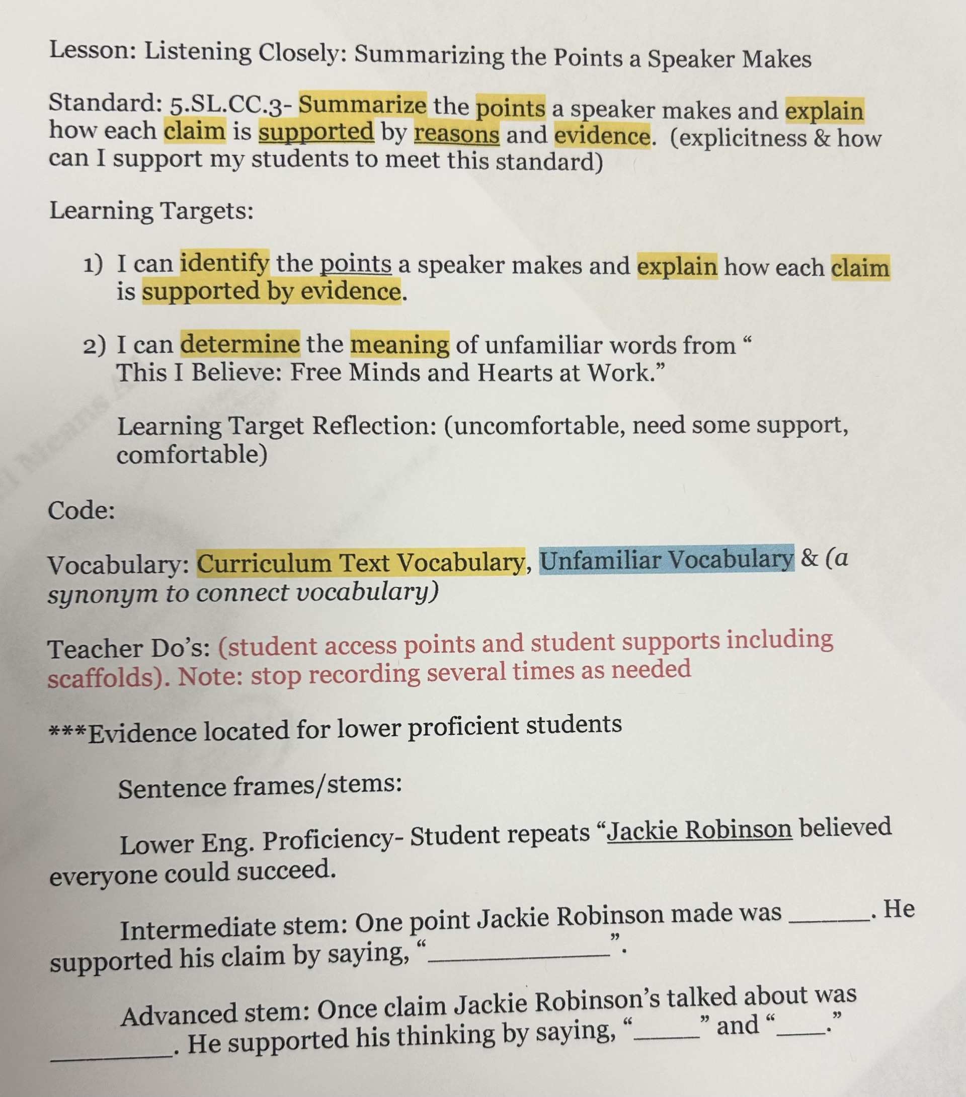
Grade 5 ELA prep example
Teacher Do's

Slide 40
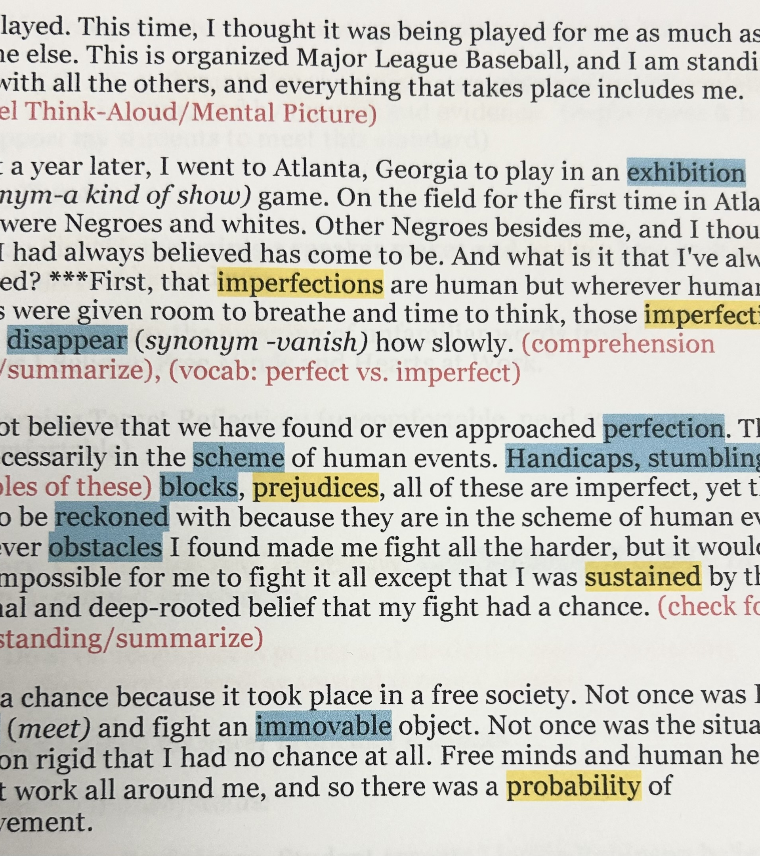
Grade 5 ELA prep example
Teacher Do's

Slide 41
References
Cleveland, R. (2024) CoP1: EL's & the IPG-Setting the Expectation of Learning [Video]
EL CoP 1: ELs & the IPG - Setting the Expectation of Learning
Martin, M. (2008). Jackie robinson: This I believe [Transcript]. NPR. https://www.npr.org/transcripts/89030535
Seidlitz, J., & Perryman, B. (n.d.). 7 Steps to a language-rich, interactive Classroom (2nd ed.). CITA Education.
Tennessee Department of Education. (n.d.). Tennessee instructional practice guide: K-12 knowledge building lessons.Bestforall. https://bestforall-cms.tnedu.gov/sites/default/files/documents/TN%20IPG%20Word%20Doc%20v2%20SY2024%20(3)%20(1).pdf
Seidlitz, J., & Perryman, B. (n.d.). 7 Steps to a Language-Rich, Interactive Classroom (2nd ed.). CITA Education.

Slide 42
Resources
• IPG Intellectual Prep Questions
•Intellectual Prep Standards and Teacher Do’s
•Intellectual Prep Teacher or Student Resource
•Suggested Scaffolds for English Learners (ELs) Aligned with IPG Core Actions
•Link to resources
https://drive.google.com/drive/folders/1dEwpdUvWCA08w8Obc_3LAxrWCo_-XMhN?usp=drive_link

