Slide 1
Advocating for the School Counselor Role:
We Do More Than Just
Your Schedule!
Nicole L. Hurt, Ed. S.
Licensed Professional School Counselor
Middle Tennessee Christian School

Slide 2
OBJECTIVES
Who Am I?
What People THINK We do!
Why Does It Matter?
Educating Students
Partnering with Parents
Admin & Teacher Collaboration
Let’s Learn S’more!
What Now?
Questions?

Slide 3
Middle & High School Teacher
8 years
School Counselor & Asst. Principal
(6-12)
8 years
School Counselor
(6-12)
5 years

Slide 4
Let’s Get
Started!
www.menti.com
JOIN CODE
29 42 22
Scan the QR Code

Slide 5
Why Does it Matter?
School counselors are important to the success of a school & its students and serve as school leaders and advocates. The role is often misunderstood among stakeholders, which can result in being assigned inappropriate tasks. This can interfere with meeting the needs of students.

Slide 6
Titles Matter
From Position to Program
GUIDANCE COUNSELOR
SCHOOL
COUNSELOR
VS.
Focused on vocational guidance
Academic, Social/Emotional, & College/Career
Work in isolation within the school
Collaboration
Task-Oriented/Reactive
Program Focused/ Proactive
Notes:
Reference study done with standards and different titles used.

Slide 7
Educating
Students

Slide 8
MAKE
YOURSELF
VISIBLE!

Slide 9
Beginning of
the Year
Classroom Presentation

Slide 10
MINUTE
MEETINGS

Slide 12
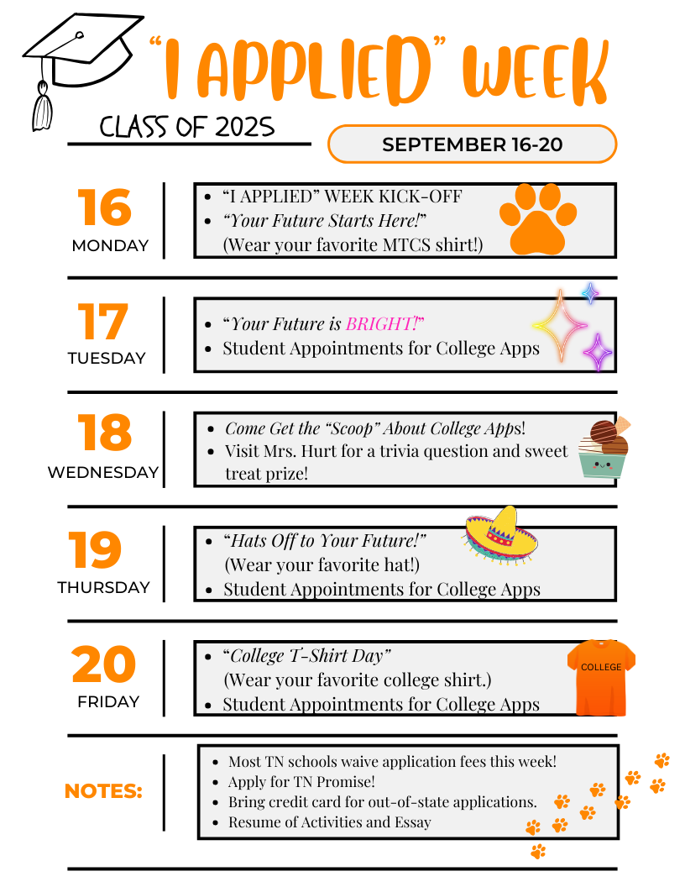
COLLEGE APP WEEK

Slide 13
SCHOOL
COUNSELING
WEEK
February

Slide 16
Partnering with Parents

Slide 17
Open House Presentation

Slide 21
Message
TEACHER

Slide 22
PARENT
S’more
NEWSLETTERS

Slide 23
PARENT
S’more
NEWSLETTERS

Slide 24
Parent Partnership Workshops & Coffee with the Counselor

Slide 25
Admin & Teacher Collaboration

Slide 26
REFERRAL/REQUEST

Slide 28
REMIND
THEM!

Slide 29
Help them see they work WITH you!

Slide 30
Celebrate
them!

Slide 31
Provide Resources!
First Five

Slide 32
How did that parent meeting go?
How are YOU?
What do you need right now?
How is ______ doing since we met?

Slide 33
Awesome Office Meeting
(High School)
Awesomer Office Meeting
(Middle School)

Slide 35
Let’s learn S’MORE
about the School Counselor!

