Slide 1
Strengthening Collaborative Partnerships Between General and Special Education in Middle and High School Settings
Kimberly Hale, PhD, LBA, BCBA
Stacy Williamson

Slide 2
Why Collaboration Matters
Shared responsibility for student success
Supports inclusive education practices
Increases understanding of diverse learning needs
Enhances professional growth for both special and general education teachers

Slide 3
Special education provides the foundation.
What are we building?

Slide 4
Understanding the Expertise of Team Members
Special education teachers as experts in accommodations, modifications, and often student history
General education teachers as subject-matter experts
Administrators as experts in building, resource, and personnel management and navigating school/district policies

Slide 5
How well does your team understand IDEA and their roles and responsibilities?

Slide 6
Building Trust and Respect
Foster a culture of mutual respect and support.
Acknowledge each other’s challenges and contributions.
Commit to ongoing collaboration.
Provide meaningful input.

Slide 7
Effective Communication
Open and Transparent Communication
Collaborative Planning
Use of Technology
Receptive to Feedback

Slide 8
Role Clarity
Clearly communicate the vision.
Define clear roles and responsibilities for each teacher and paraprofessional.
Avoid overlap and confusion about duties.
Ensure both teachers contribute meaningfully to planning, instruction, and assessment.

Slide 9
Utilizing Data for Decision-Making
Use data from assessments, observations, and progress monitoring.
Remember that not everyone has access to the same data or information.
Analyze data together to inform instructional decisions.
Adjust teaching strategies based on student needs.

Slide 10
Examples of Successful Collaboration

Slide 11
It will always be that easy, right?

Slide 12
The Reality
Time constraints
Resource limitations
Differing expectations
School structures
Varied teaching philosophies
High caseloads
Resistance to change
Different curricular demands
Inconsistent use of accommodations and modifications
Limited administrative support

Slide 13
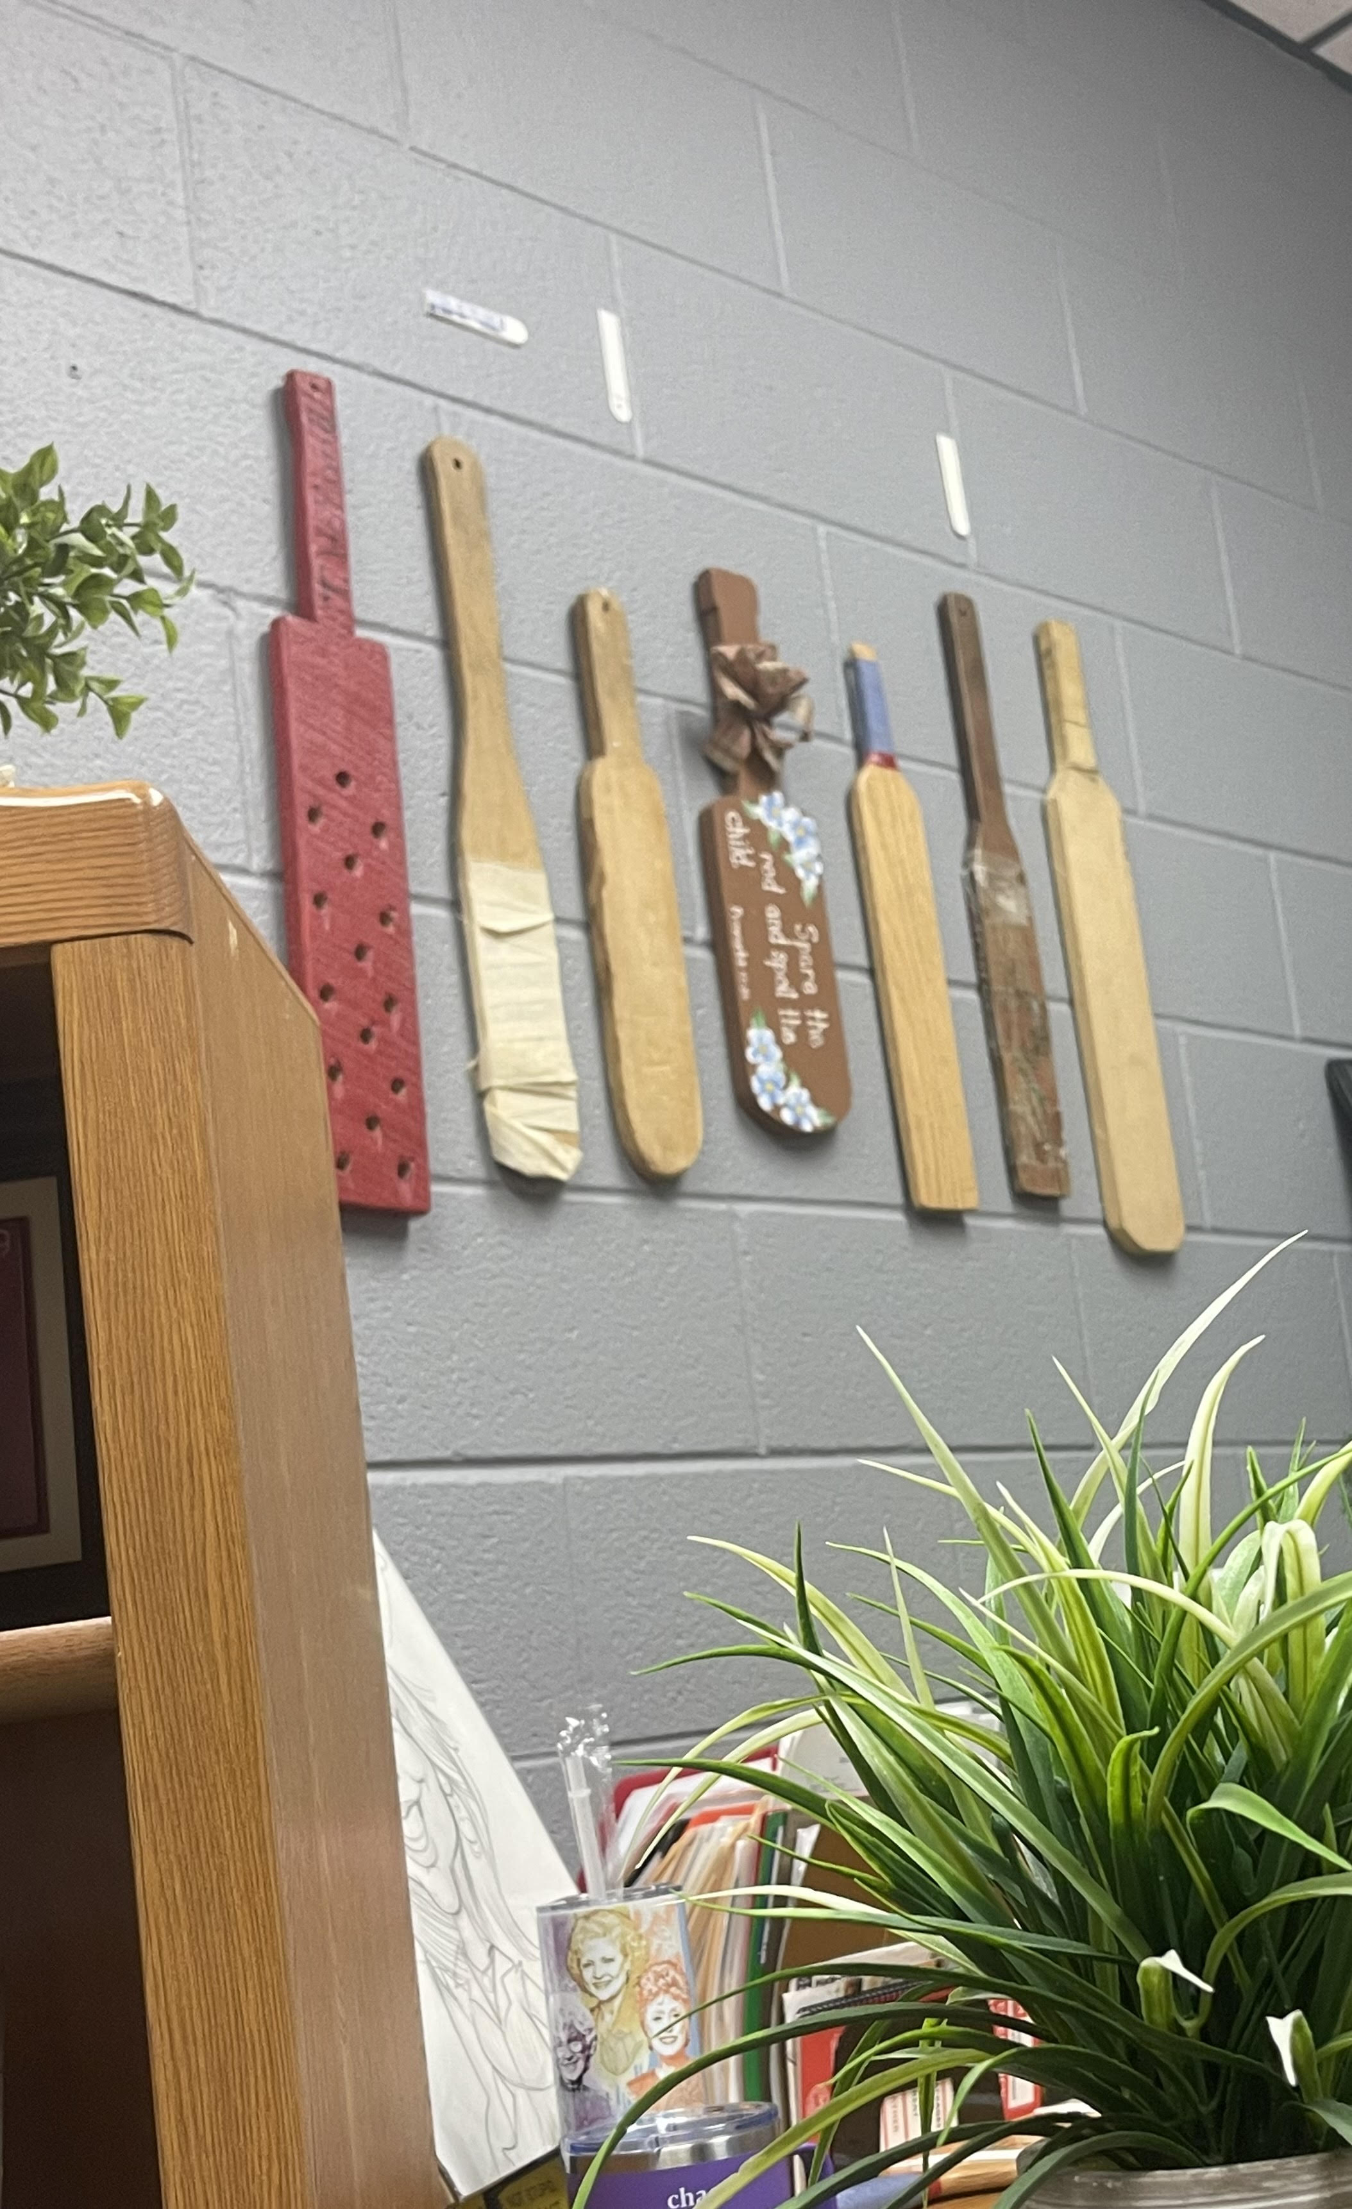
Navigating Reality
Scenarios of a Different Sort

Slide 14
Special educators are master architects, skillfully constructing individualized support systems that empower students and build the foundation of inclusive learning environments.

Slide 15
Questions and Discussion

