Slide 1
It’s not US vs. THEM;
It’s all SPECIAL ED!

Slide 2
Somebody get this kid ____________________!

Slide 3
Somebody get this kid OUT OF MY CLASS!
INCLUSION
VS.
SPECIAL CLASSES

Slide 4
Somebody get this kid SOME HELP!
ACCOMODATIONS
VS.
MODIFICATIONS

Slide 5
INCLUSION
the practice or policy of providing equal access to opportunities and resources for people who might otherwise be excluded or marginalized, such as those who have physical or intellectual disabilities and members of other minority groups.
(Oxford Languages and Google, https://languages.oup.com/google-dictionary-en/)

Slide 6
INCLUSION Teachers become…
“a Jack of all trades is a master of none, but oftentimes
better than a master of one.”
-William Shakespeare

Slide 7
But you don’t have to do it ALONE!
“No man is an island, entire of itself; every man is a piece of the continent, a part of the main. If a clod be washed away by the sea, Europe is the less, …

Slide 8
any man's death diminishes me, because I am involved in mankind, and therefore never send to know for whom the bells tolls; it tolls for thee.”
(John Dunn, No Man Is An Island)

Slide 9
COLLABORATION is the key that unlocks the door to INCLUSION
the action of working with someone to produce or create something.
(Oxford Languages and Google, https://languages.oup.com/google-dictionary-en/)

Slide 10
the action of working with someone…
Administration
General Education Teachers
Special Education Teachers
Related Service providers
RBA’s and BCBA’s
Parents and Students

Slide 11
to produce or create something…
What are we trying to produce?

Slide 12
to produce or create something…
What are we trying to produce?
Strong, independent, successful, confident, life long learners and educators, who actively participate in and positively contribute to society as a whole.

Slide 13
So now that we have Remembered our WHY… Let’s talk about our HOW!

Slide 14
How to Collaborate with Administration…
Time and Support

Slide 15
How to Collaborate with General Education…
Standards and Expectations

Slide 16
How to Collaborate with Special Education…
Accommodations, Modifications, and Strategies

Slide 17
How to Collaborate with Behavior Specialists…
Analysis and Alternatives

Slide 18
How to Collaborate with Related Services…
Expertise, equipment, and understanding

Slide 19
How to Collaborate with Parents…
Empowerment and Encouragement

Slide 20
How to Collaborate with Students…
Ownership

Slide 21
Collaboration Ideas/Strategies…
Multimodal Approach
Shared Experiences
Plan Ahead
Shared Responsibilities
Play to Your Strengths
Do the Unexpected

Slide 22
Examples
Super Bunny
PreK Team
Animal Farm
If You Give a Kid a Cookie Party

Slide 23
SuperBunny

Slide 24
Pre-K Team

Slide 25
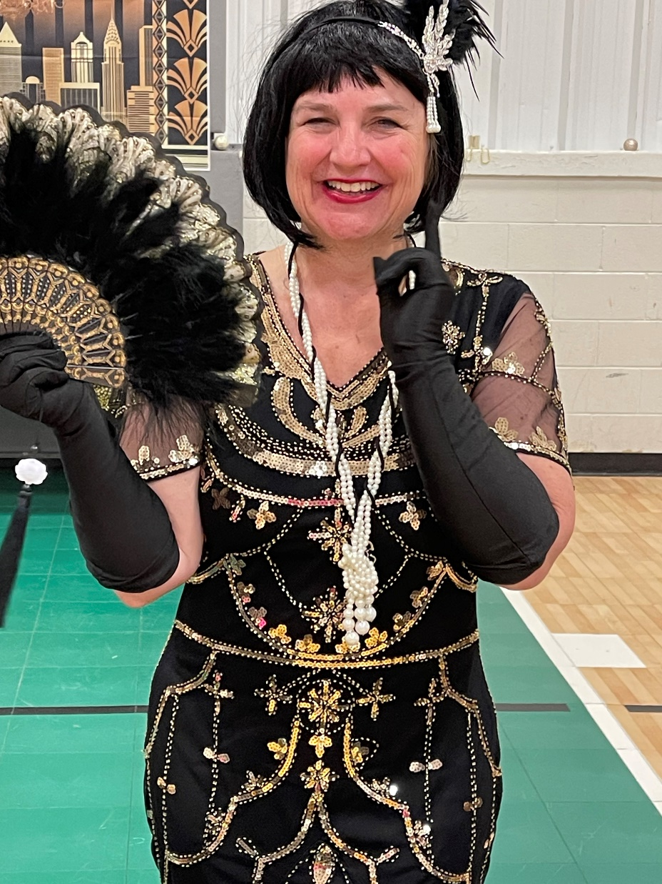
Do the unexpected

Slide 26
You’re Turn…
Scenario #1:
Elementary School Class
How can you collaborate with your school to make Fire Drills more Sensory Friendly?

Slide 27
You’re Turn…
Scenario #2:
Middle School Class
How can you collaborate with your Parents to address pre-teen Hygiene and Social Skills?

Slide 28
You’re Turn…
Scenario #3:
High School Class
How can you collaborate with your students to make current events come to life for them?

Slide 29
Resources for Collaboration
The ARC of TN
Lesson Pix
Teachers Pay Teachers
Tobii Dynovox
Reading First
Harry Wong
YouTube
Disney
PBS Kids
The Great Backyard Bird Count
And many more…

Slide 30
Questions

