Slide 1
Tennessee Voices: Tools and Strategies to Grow Writers

Slide 2
Content Objective Participants will explore strategies and tools for supporting student language proficiencies across the content
Language Objective
Participants will listen to strategies and reflect on implementation ideas

Slide 3
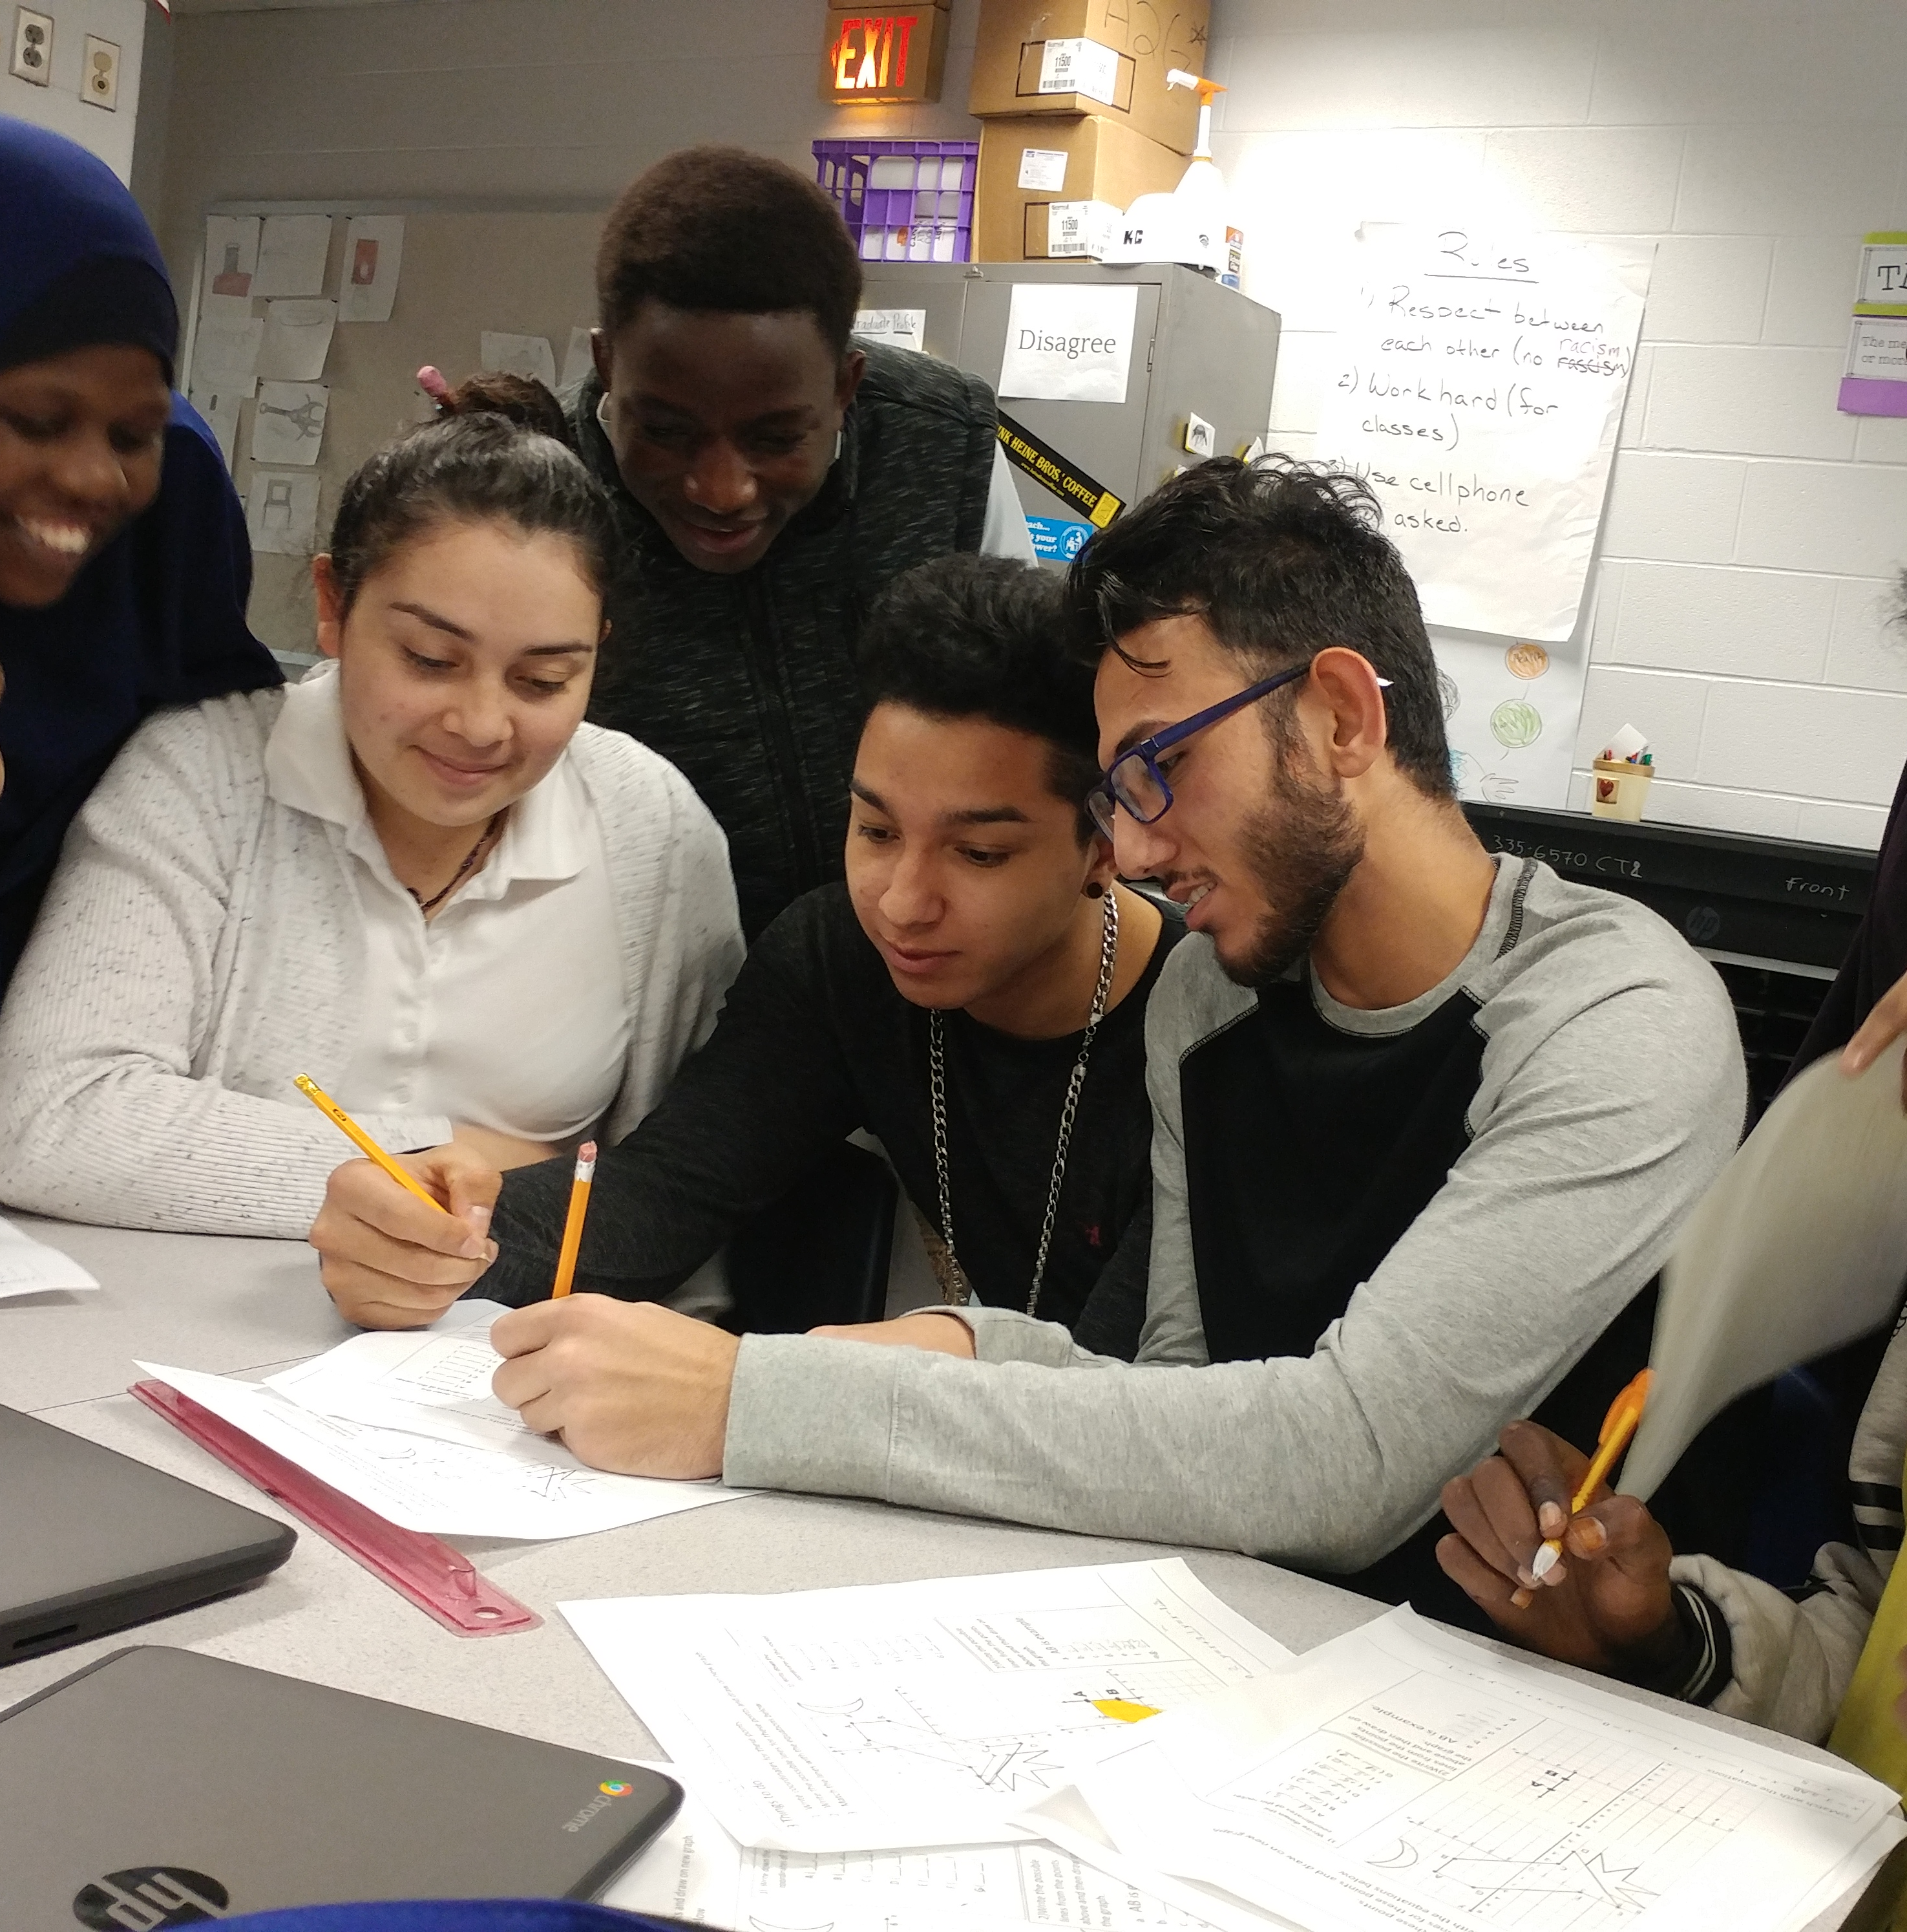
Goals for Educators
Set High Expectations
Encourage Productive Struggle
Create Safe Spaces for Discomfort
Provide Opportunities to Thrive

Slide 4
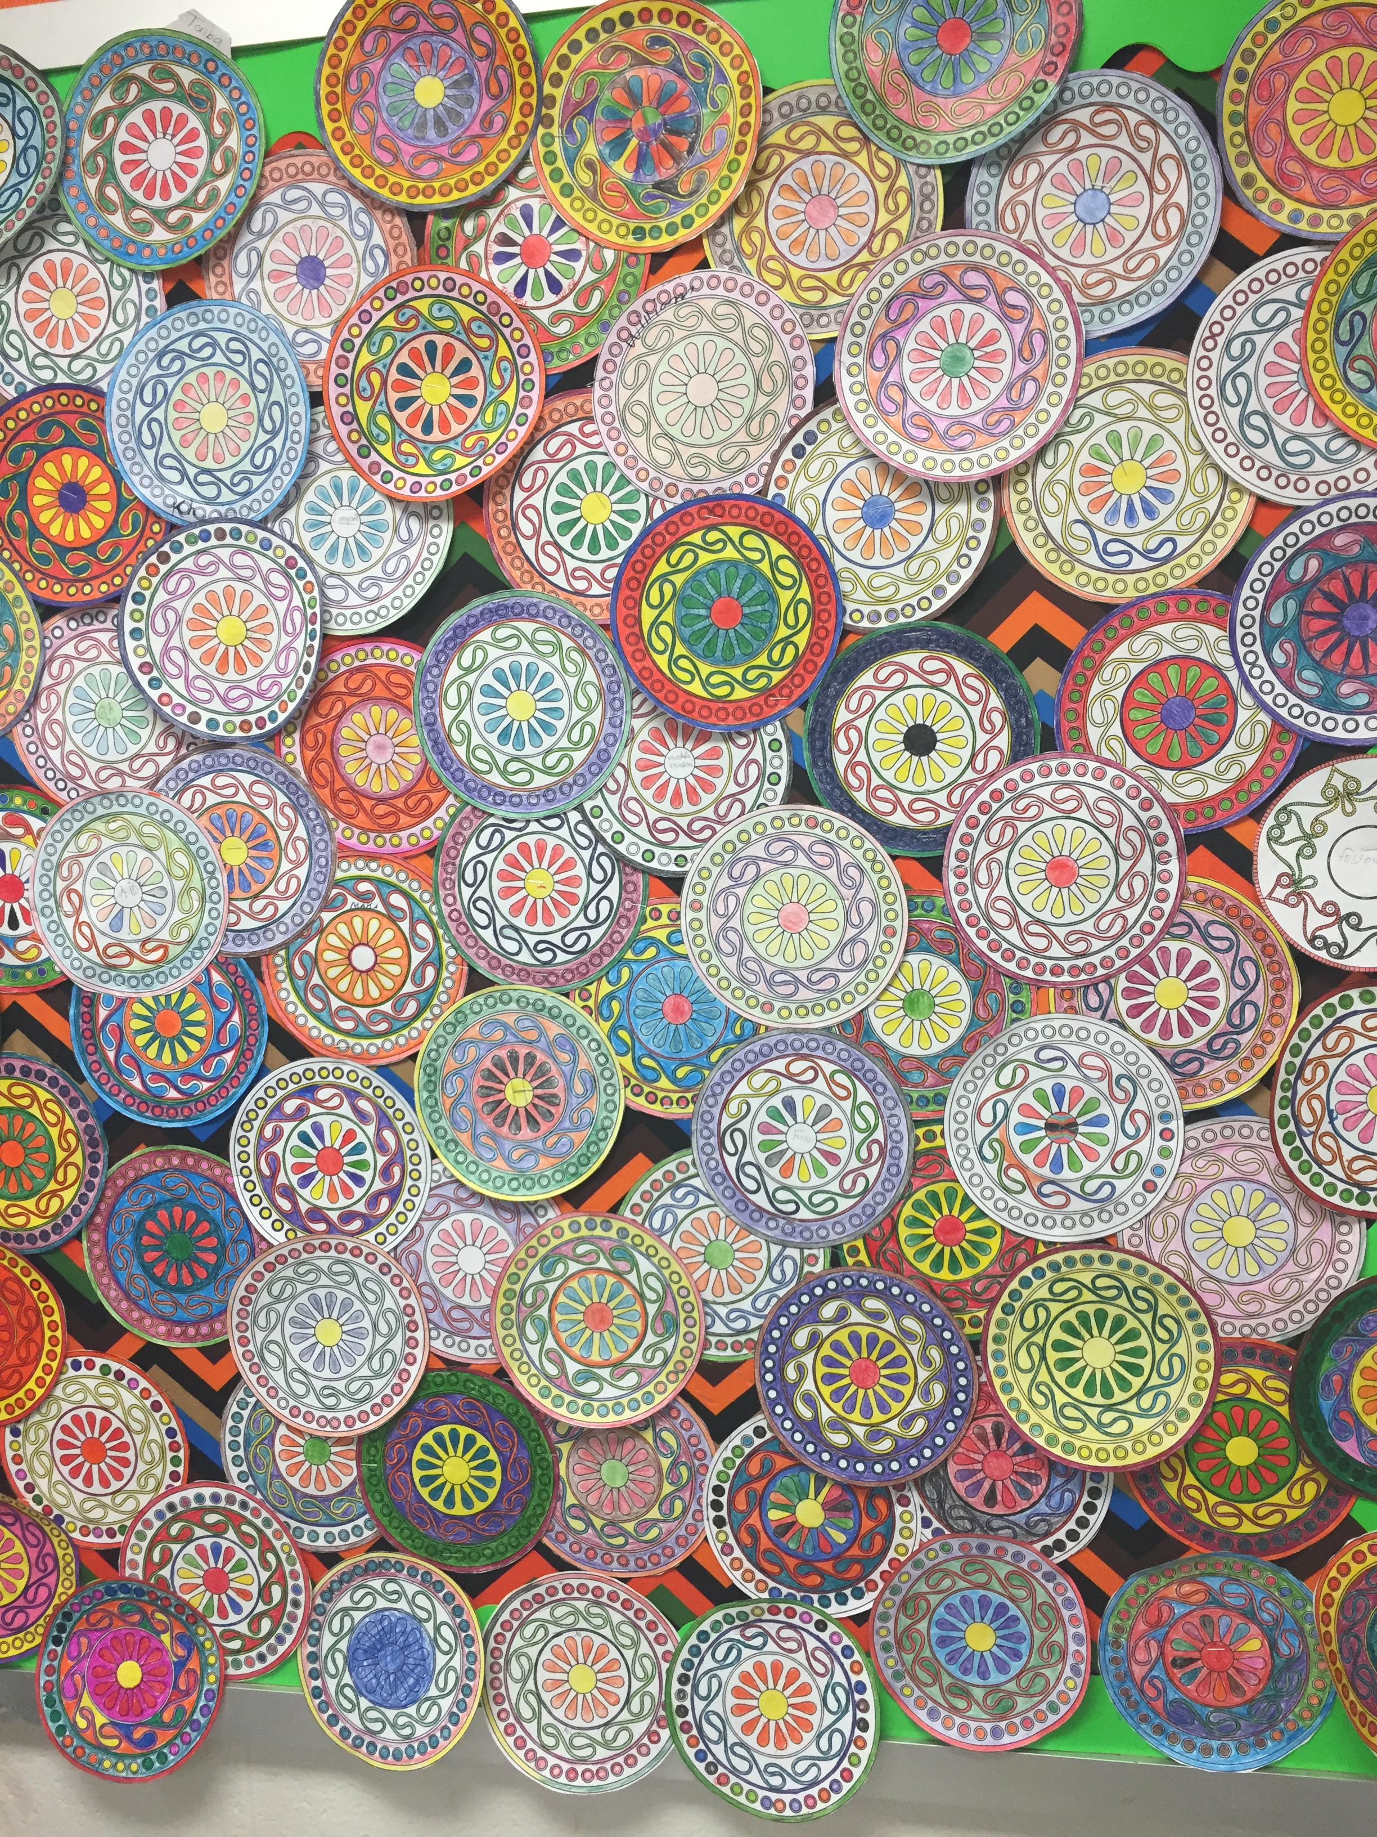
2024-2025 Student Demographics
66 students receive daily accommodations
Scores Range from Emerging, to Proficient
56 students are T1, T2, Waive
Approximately 60% are United States citizen
Suburban area of Chattanooga
Family Engagement and participation is common
Currently 25 languages represented

Slide 5
Planning for Successful Outcomes for Student
Quantitative
Scores on assessments
Proficiency levels
Gaps in knowledge as indicated on assessments
Qualitative
Emotional reactions to assignments
Quality of work submitted across the content

Slide 6
Review and Analysis of Assessment Data Overall
Standardized Assessments
TCAP Scores
Benchmark Scores
ENL Assessment Scores

Slide 7
Formative Proficiency Assessment
Formative, Pre-assessment used to measure current proficiency for ENLs
Summative annual assessment for ENLs to measure progress
Comparing formal assessments to observations in classroom to evaluate potential gaps in knowledge or language barriers to assessments
Summative Proficiency Assessment

Slide 8
Identifying Student 's Needs for Writing Skills
Classroom Performance
Student proficiency and mastery across the content
Evaluate discussion and collaborative skills
Core Curriculum Educator input
Identify Students' areas for concern

Slide 9
Results for Students With Writing Strategies
31% of students in Academic Year 2023-2024, Grades 6-8 Earned Scores to Exit Services
Students in all grades increased in proficiencies across modalities
Students identified as newcomers, and all proficiencies improved
We have real data for designing learning for future students

Slide 10
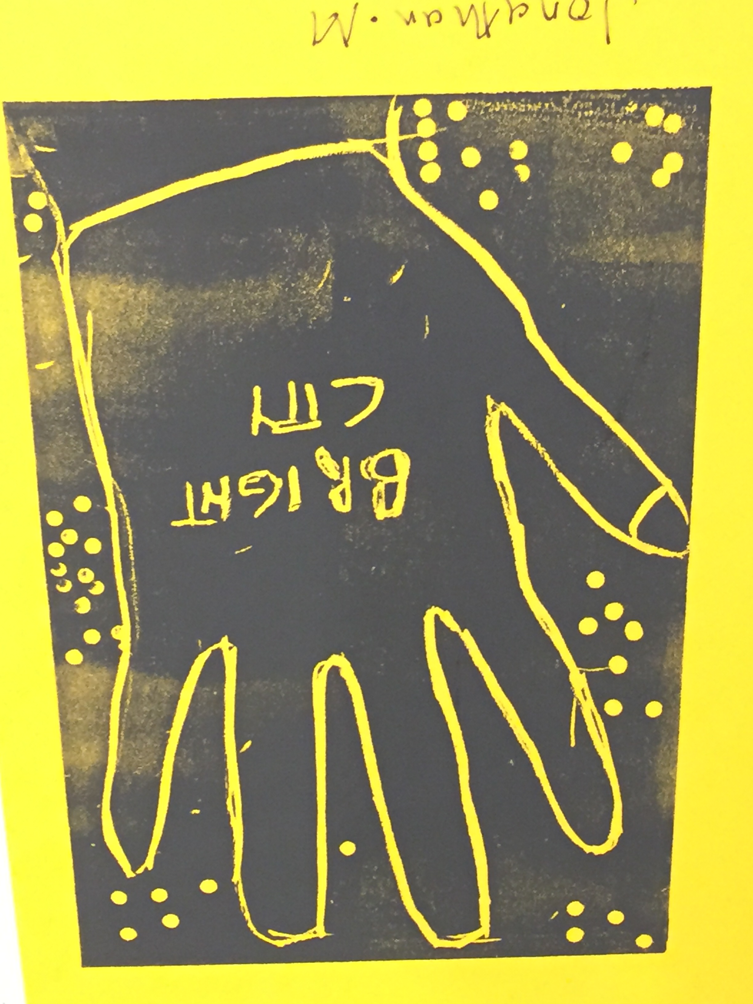
10 Active Strategies to Grow Writers
Story Dice
Art Card Gallery Walks
Chat Stations
Grade-level Texts
Graphic Organizers
Discussion Diamond
Drawing and Describing
Publish Their Stories
Partnerships
Authentic Community Projects

Slide 11
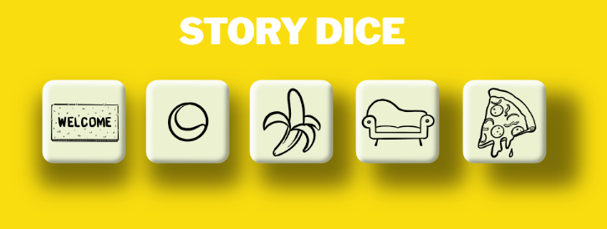
1. Story Dice
https://davebirss.com/storydice/
How it Works:
Story Dice is projected
Students evaluate the symbols
Students write timed response
Students read aloud
This Strategy
Promotes Creativity
Inspires wonderings
Engagement with peers
Supports individual thinking
Supports Group Thinking

Slide 12
Encourages students to tap into their own cultural context to decide what the symbols mean

Slide 13
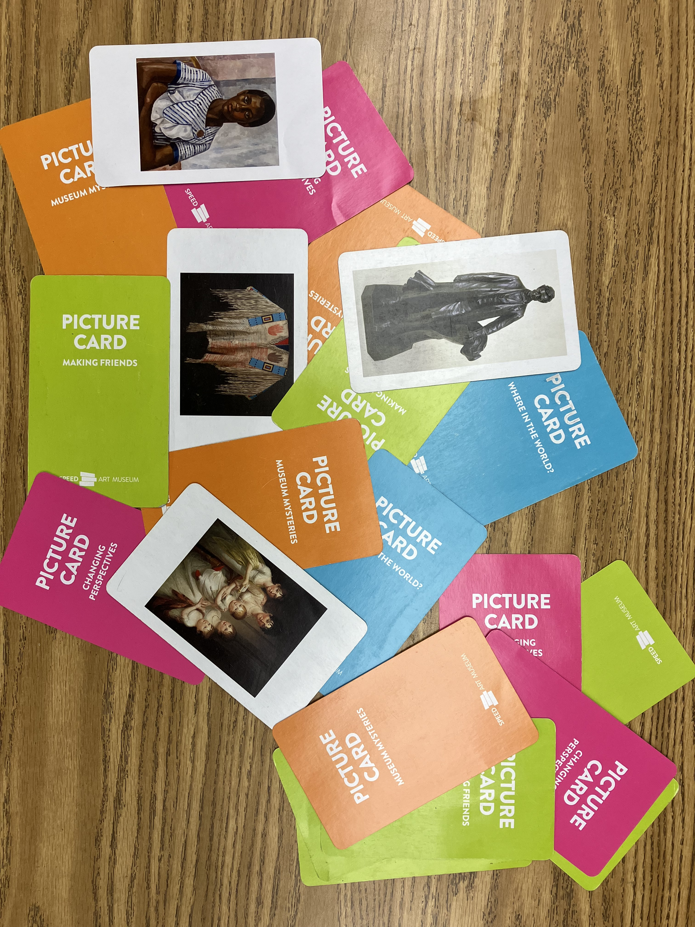
2. Art Card Gallery Walks
How it Works:
Art Cards are selected
Students examine the images
Students write to a prompt
Students read responses

Slide 14
Critiquing Artwork of Others Inspires Writing
This Strategy
Focuses on rich imagery to inspire thinking
Scaffolds writers by interaction with different stimuli - art and artifacts
Connects students to community conversations

Slide 15
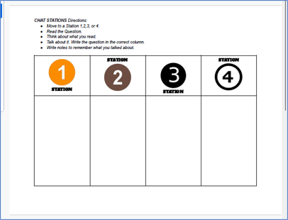
3. Chat Stations
How It Works:
Stations assigned
Content posted with directions
Each station is timed
Students switch until all visited
Students gain content and discuss notes and impressions
Formulate responses with the larger group

Slide 16
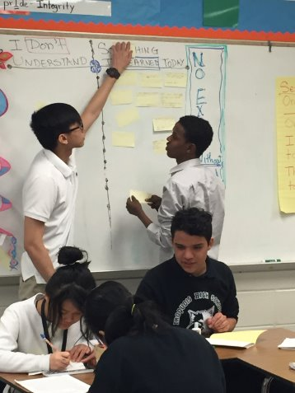
Flexible Method in All Core Content
This Strategy
Planned interaction with peers
Grade-level text
Builds background
Review material
Confirm mastery of materials
Study for assessments

Slide 17
4. Grade-level Texts Provide Entry to Writing
How It Works:
Students assigned grade-level text
Writing Prompts are directly linked to identifying text-evidence

Slide 18
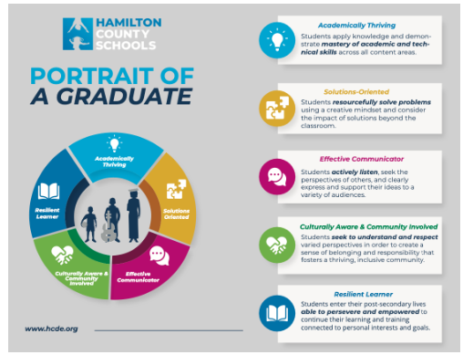
Evaluate and Modify Resources for Use by Various Grade-Levels
This Strategy
Allows differentiation of most resources
Connect students to resources at their learning level
Allows connecting students to current initiatives

Slide 19
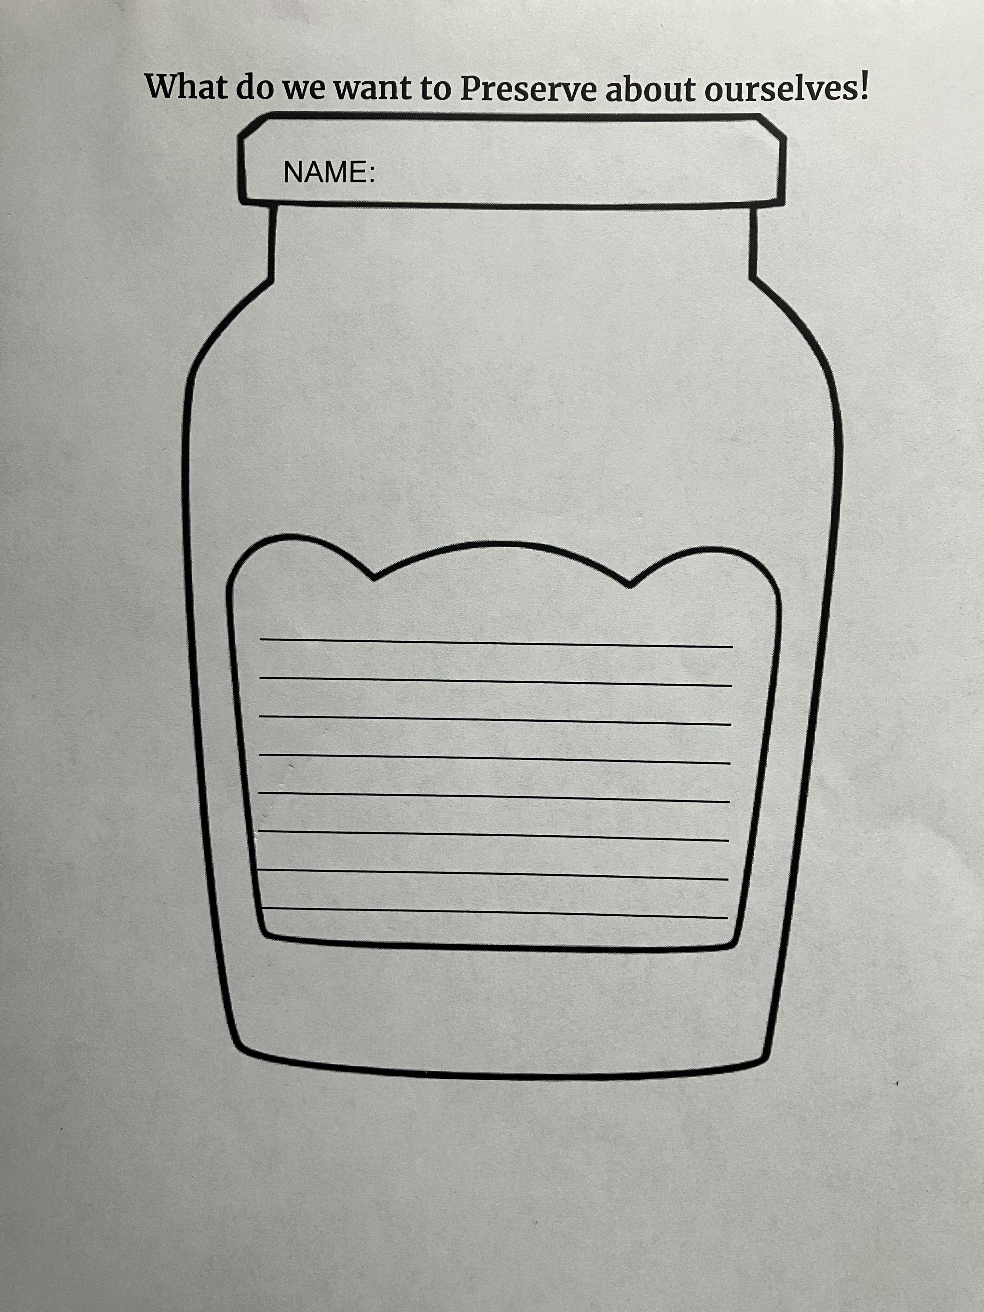
5. Graphic Organizers Guide Robust Writing
How It Works:
Provides a framework
Students may work solo or in group
Work may be displayed

Slide 20
Visually Connect to The Text

Slide 21
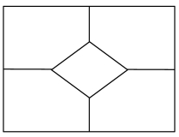
6. Discussion Diamond - Solo and Group Thinking
How It Works:
Students are given a prompt
Students think independently and respond in one of the four spaces
Once solo thinking time ends, work as a group to compare and work toward consensus
Write their agreed-upon response in the Diamond

Slide 22
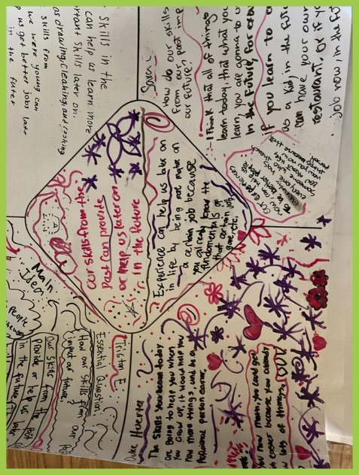
Diamonds Work With All Core Curriculum
This Strategy
Offers Both Solo and Group Writing
Offers Deeper Dive into Texts
Require Robust Questions:
What should we do to help refugees?
How do some people become refugees?

Slide 23
7. Drawing, Describing, Writing
How it Works:
Students review the same image
They respond in small groups to the images
Students write responses
This Strategy
Allows all proficiencies to be success
Flexible - can create chart on whiteboard on printed
Can use with any text

Slide 24
Drawing Engages Student Thinking

Slide 25
8. Publish Student Work
How it Works:
Students assigned a prompt
Students write draft and discuss with a partner
Students construct, write and illustrate their book

Slide 26
Digitally Publish Student Work
This Strategy
Allows all proficiencies to be success
Students wrote their autobiography
They read their work aloud
Forward-facing outcomes

Slide 27
9. Partner With Local & National Organizations
How it Works:
Organizations are invited by Teacher
Authentic Project is Identified
Students Complete a forward-facing project

Slide 28
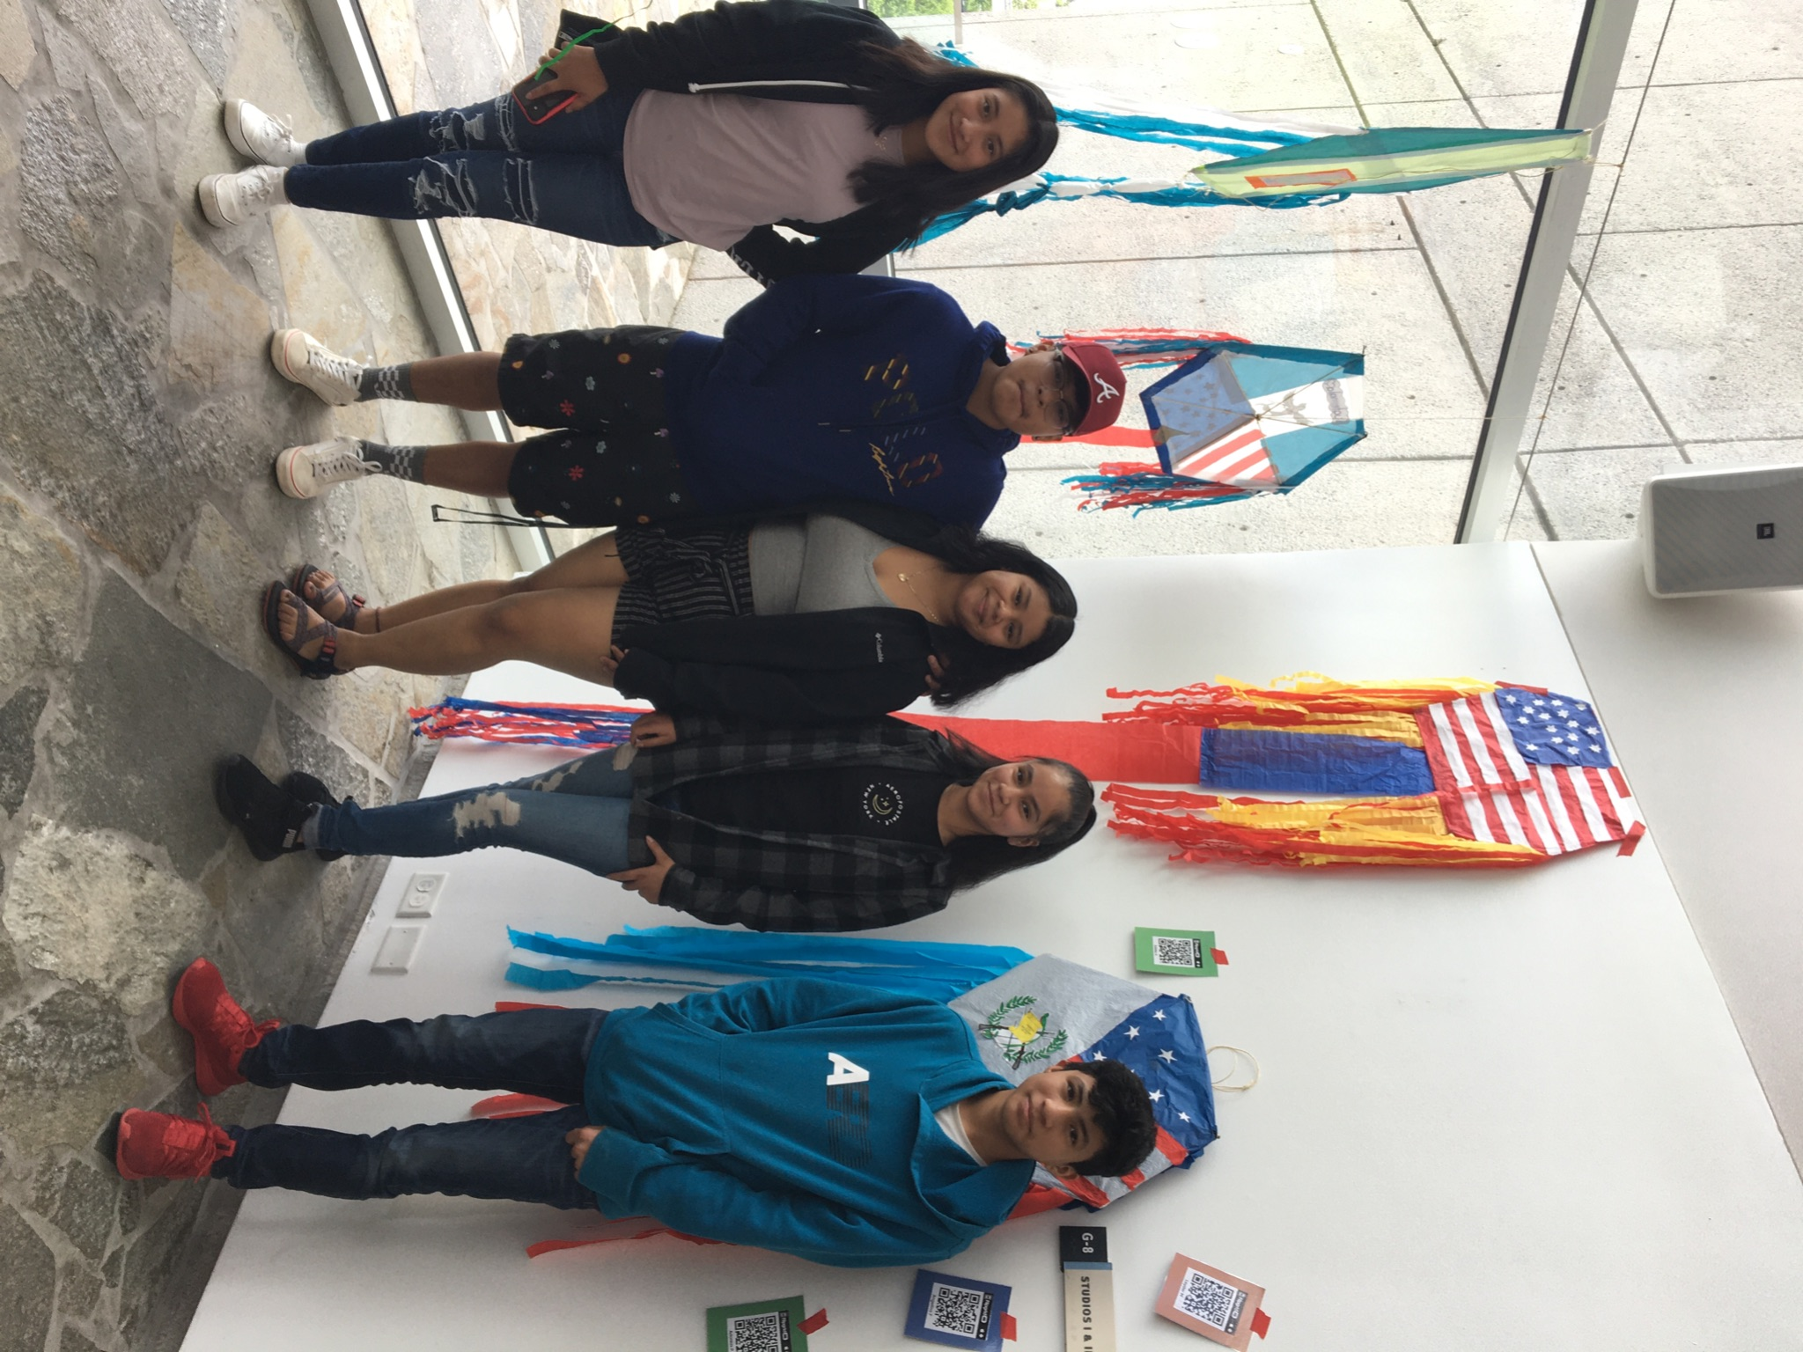
Students Are Recognized As Part of the Larger World
This Strategy
Writing Leads To Other Artifact Creations
Their Work is Celebrated
They Connect to Many Communities Oustse the School

Slide 29
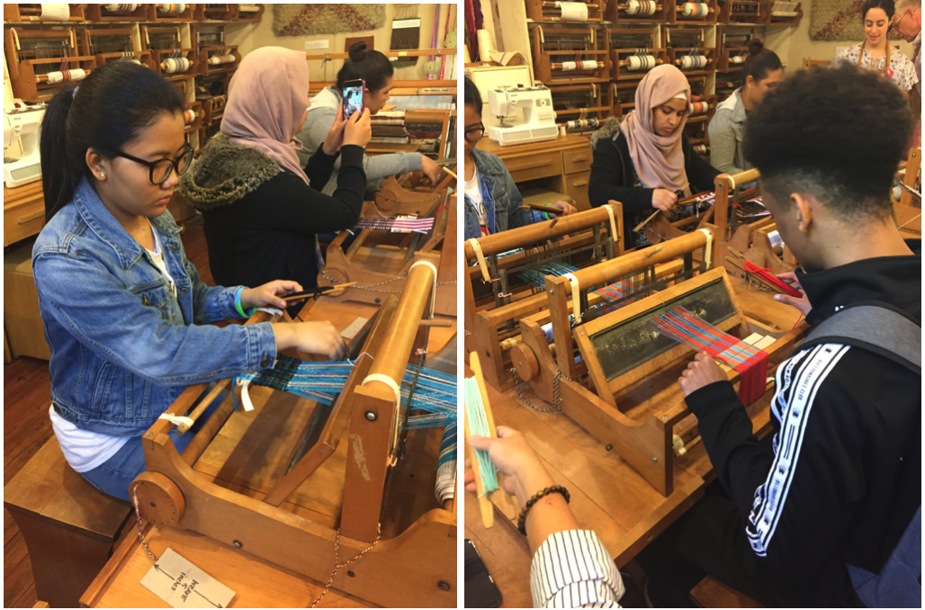
Connects students to past experiences
Connects to cultures
Trust students as experts

Slide 30
10. Community Service Through Writing
How It Works:
Teacher or School Identify a Partner
Collaborate on Specific Project to Benefit People in Their Community
Forward-facing Outcomes

Slide 31
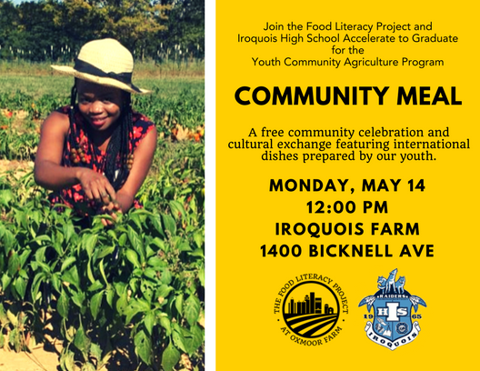
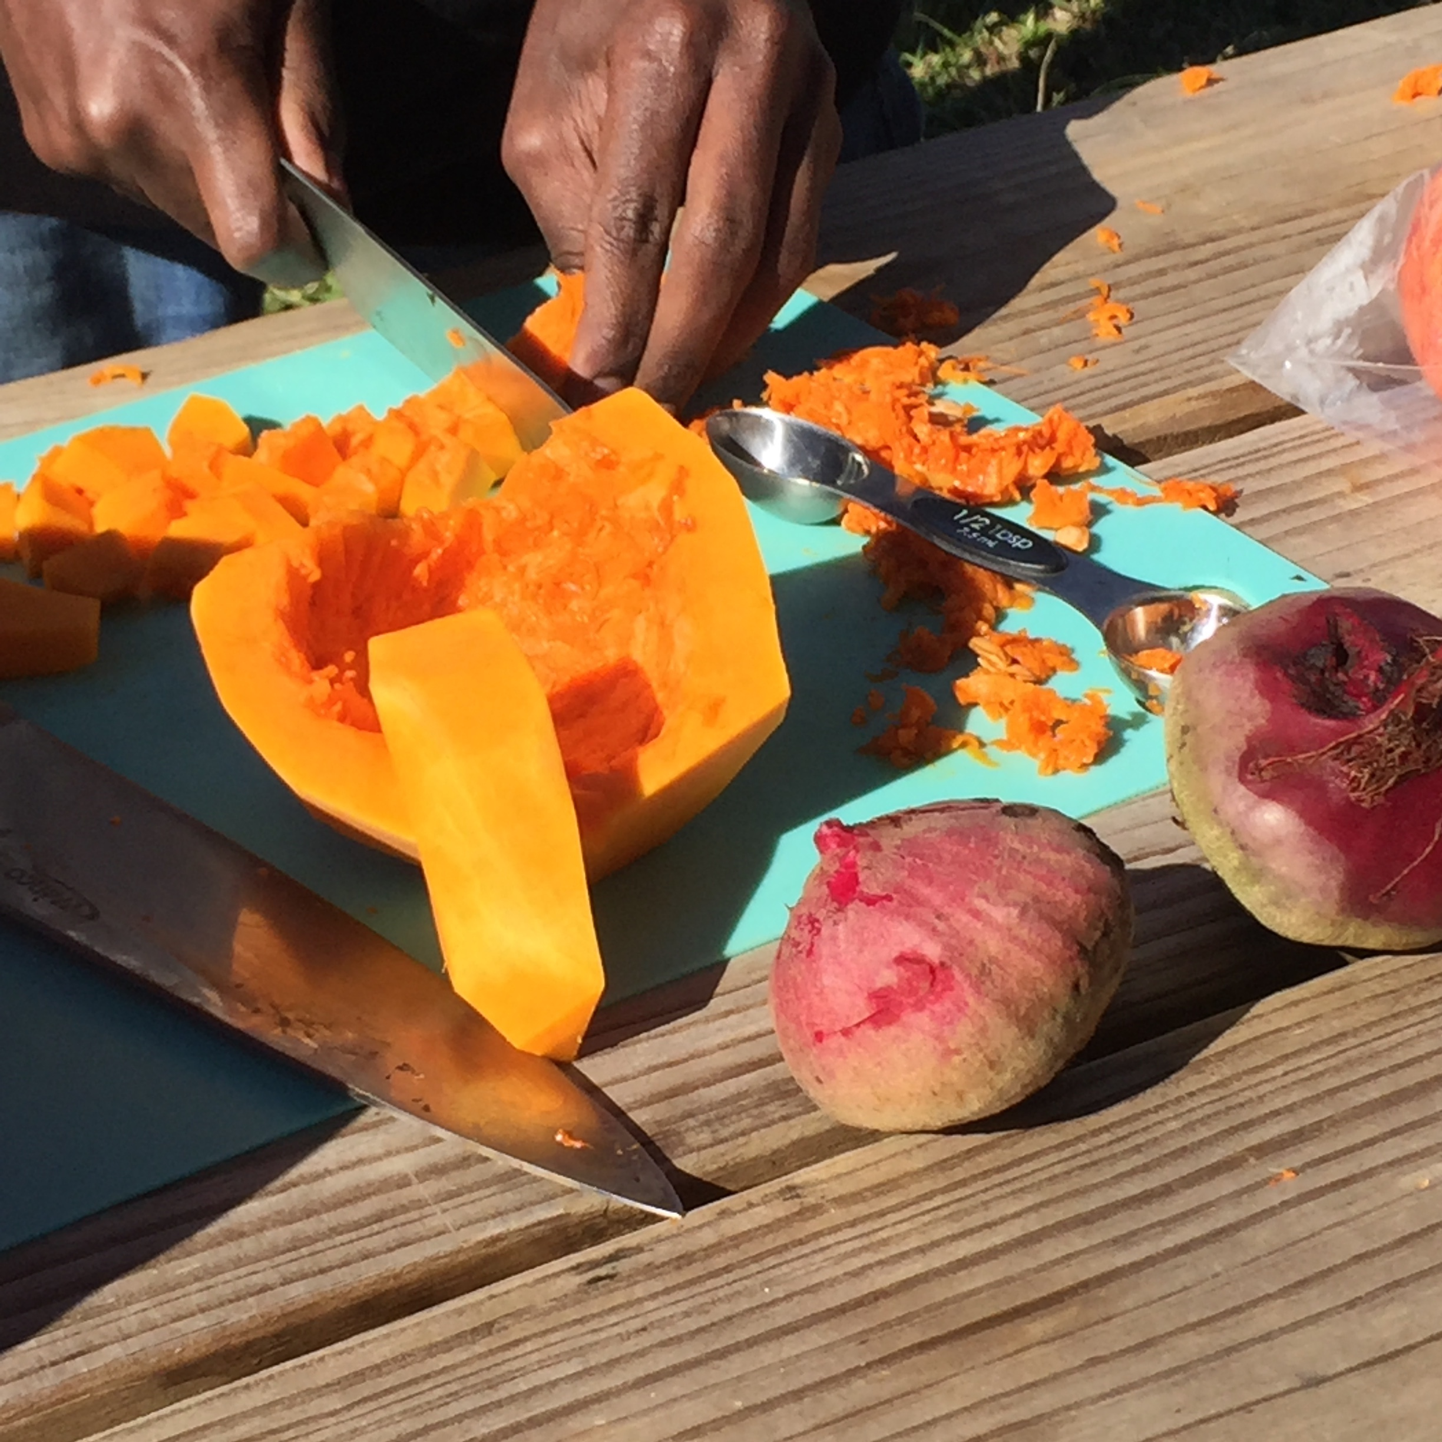
Students See How Life Experiences Benefit Writing

Slide 32
Skills And Dispositions Along With Academic Skills
This Strategy
Connected to Healthy Food and Cooking
Expository Writing
Step by Step Directions in Recipes
Description Langauge

Slide 33
What additional tools, strategies & practices support this work?

Slide 34
Student Buy-In is Critical for Their Success
What motivates the students to do the hard work?
Ask for student input
How are we sharing language development needs and proficiency scores with students?
Provide to both students and families

Slide 35
Give Space for Thinking and Ideating Provide Resources

Slide 36
Students Schedule Appointments
How It Works:
Students schedule with teacher when THEY need to
Teacher offers targeted support
Provides opportunities to identify content and the need to reteach

Slide 37
Take It and Pass It!
How It Works:
Puts students in charge of discussions
Autonomy to decide what to focus the discussions on
Great Check-in before, during and after writing

Slide 38
Wheel of Names
How It Works:
Students all participate
Random selection
Gamifies participating
Students stay engaged and ready to answer

Slide 39
We Can ALL Support Tennessee Voices
“I just write all the time. In my whole life I've never had what I've heard people talk about writer's block. I've never had that. Life is like a song to me. I just hear everything in music, so I have never once thought "Well, I'm never gonna be able to write again." I've got thousands of songs.” ​
Dolly Parton

Slide 40
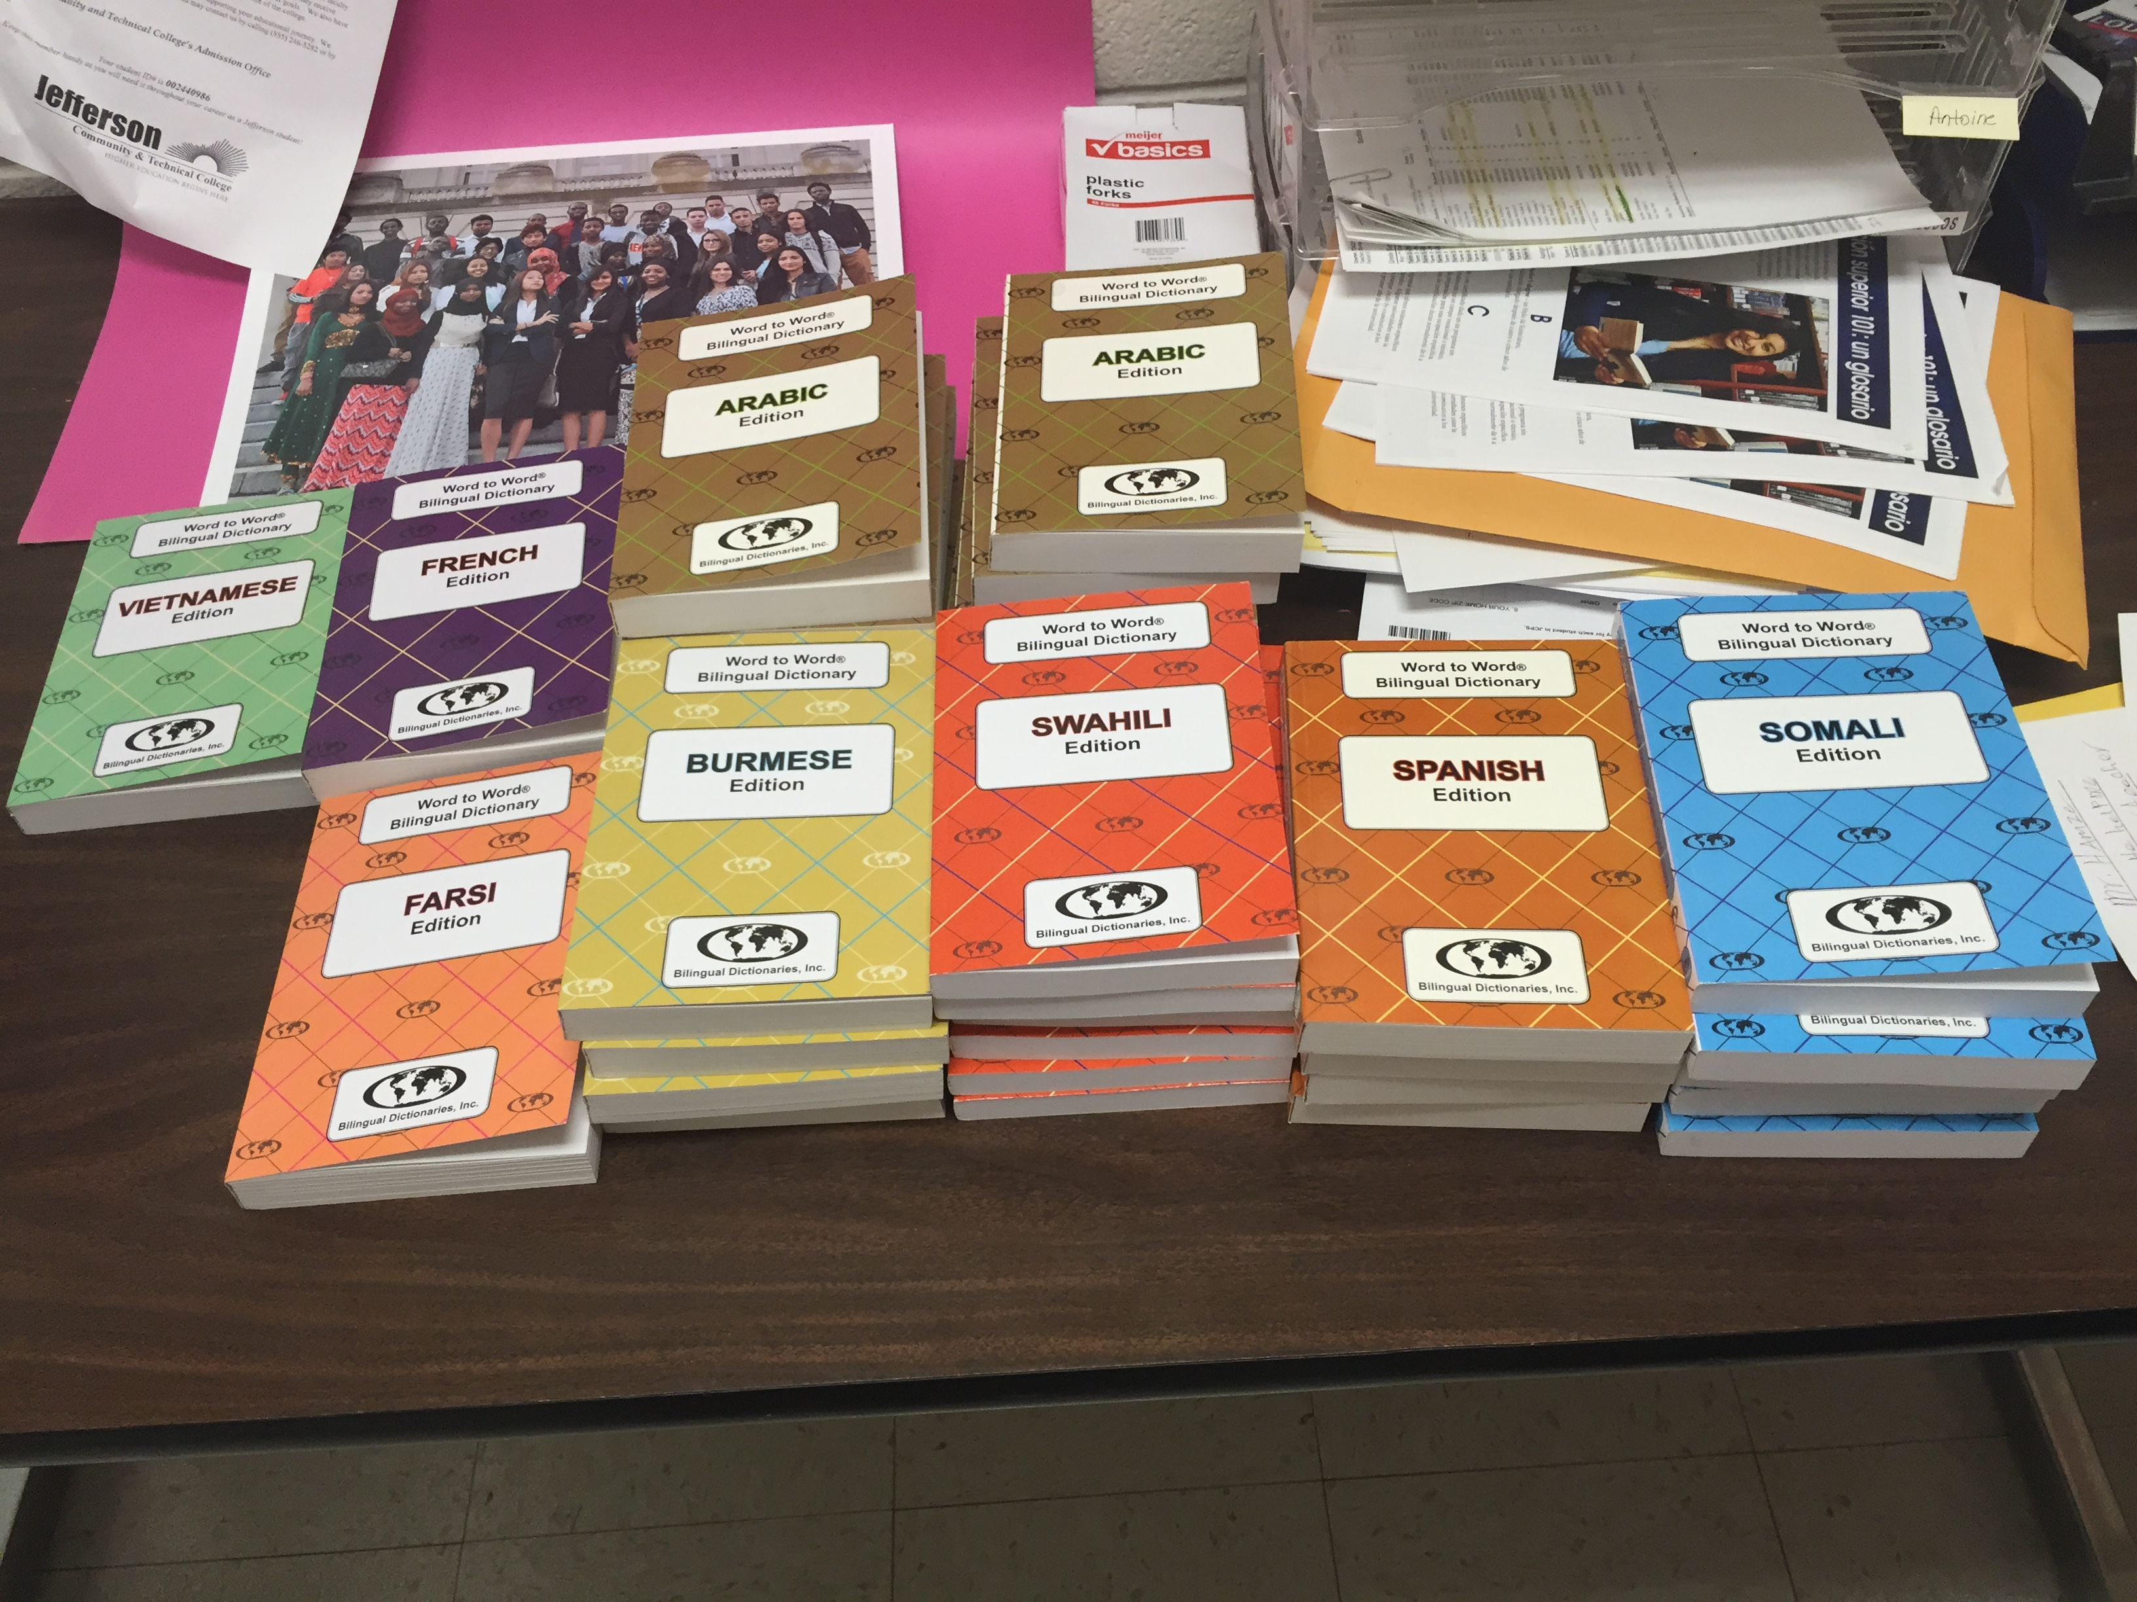
Thank you
Donna M. Neary, Ed.S.
Hamilton County Schools
neary_donna@hcde.org
donnaneary1962@gmail.com

