Slide 1
Best Practices for Secondary English Language Learners
Dr. Rebecca Doxsee
Coordinator of academic access
Hamilton county schools

Slide 2

Four buckets
Culture of Learning
High Expectations
Opportunities for Student Engagement
Checks for Understanding
Notes:
IPG: connections to what you are doing and how this leads to best practice for all

Slide 3
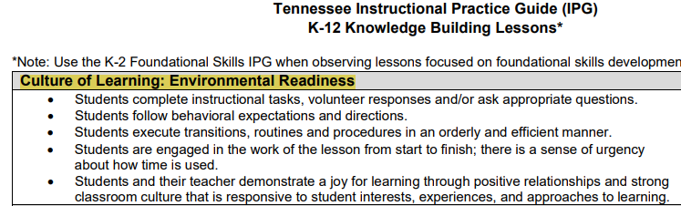
Culture of Learning: Environmental Readiness
Notes:
If the conditions for learning are not met, then it doesn’t matter what strategies you use, text, etc.. This has to be first. Why do you think this is so important? Especially for ELL students?

Slide 4
Expectations and Respect
Is direct, specific, and consistent in communicating and enforcing very high behavioral expectations. Wins students’ respect and creates an environment where learning is key and potential disruptions are unusual.
Classroom management: Expectations and Respect
Notes:
A lot of times teachers think this is most relevant to elementary schools, but I would contest this is more important for our secondary students.

Slide 5
Expectations and Respect: Culture of Learning
On-Task: Students complete instructional tasks, volunteer responses and/or ask appropriate questions.
Positive Behavior: Students follow behavioral expectations and directions.
Procedures & Routines: Students execute transitions, routines, and procedures in an orderly and efficient manner.

Slide 6
Expectations and Respect: Culture of Learning
Urgency: Students are engaged in the work of the lesson from start to finish; there is a sense of urgency about how time is used.
Joy: Students and their teacher demonstrate a joy for learning through positive relationships and strong classroom culture that is responsive to student interest, experiences, and approaches to learning.

Slide 7
Environmental Readiness
Build relationships: Get to know your students on a personal level, showing interest in their culture and background.
Use positive reinforcement: Offer encouragement and praise for their efforts, even small ones.
Provide opportunities for collaboration: Group work can help students support each other and build confidence.

Slide 8
Let’s Share
What is one thing you can do to enhance the culture of learning in your classroom and/or school?

Slide 9
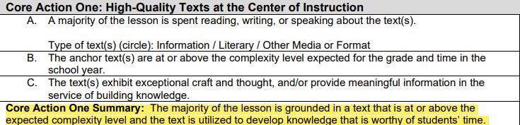
High Expectations

Slide 10
High Expectations
Conveys high expectations and provides multiple opportunities for student mastery. Effectively differentiates throughout the lesson, knows when and how to scaffold instruction, and uses flexible grouping at appropriate times with students.
Delivery of Instruction: Expectations

Slide 11
What the Research Says
Mainstream teachers were more effective when they viewed ELL students as equal members of their class, deserving the same high expectations and support that all other students received (Brisk, 2018).

Slide 12
Let’s Share
What does it mean to have high expectations?

Slide 13
High Expectations
Keep the topic at grade level (only using scaffolds when needed)
Provide access to academic rigor
All students can participate

Slide 14
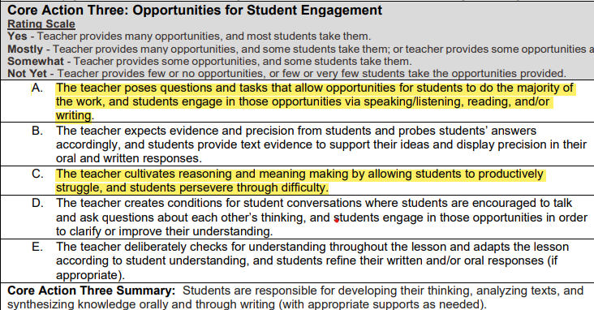
Opportunities for Engagement

Slide 15
Planning for Engagement
What are the big ideas in this lesson?
What can I do to ensure all students get an opportunity to reflect on, respond to, and share responses?

Slide 16
Planning for Engagement
What Discourse Protocol do you plan to use in order to get the students engaged in the work? Where in the lesson would this happen?

Slide 17
Planning for Engagement
How can you make the math "visible" to foster math connections?
What questioning would you use to help bring out the ideas/strategy being used?
What question would you ask to help students to construct an understanding of the strategy?
What question(s) would you ask to illuminate/clarify the students' own thinking about the strategy used?

Slide 18
Strategies for Engagement
Quick-Write
Quick-Draw
Share responses in small groups or pairs
Use a Checks for Understanding tool to gauge the students understanding and ask if they would share out.

Slide 19
Let’s Share
What are some engagement strategies that include all?
What are some questions to use during planning to be intentional about implementing engagement strategies that will make learning visible?

Slide 20
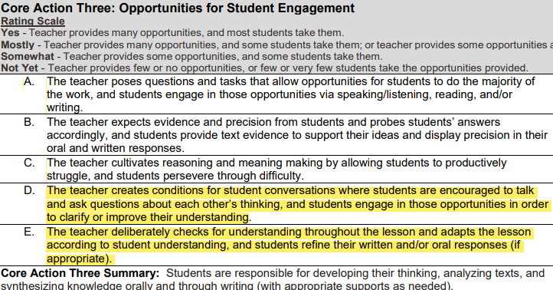
Checks for Understanding

Slide 21
Checks For Understanding
Uses a wide variety of assessment techniques to check for understanding throughout the learning process, provide timely feedback to the student, and immediately identify misconceptions to further adjust instruction. Students provide feedback to each other on the quality of the work.
Monitoring, Assessment & Follow-Up

Slide 22
What the Research Says
Identifies gaps: Teachers can pinpoint areas where students are struggling and address them promptly.
Tailored instruction: Allows for adjustments to teaching methods to better suit student needs.
Increased engagement: Active participation in checking for understanding keeps students focused and motivated.

Slide 23
Checks for Understanding: Why? What?
What?
Why?
What data will support learning?
What data will provide information about learning?
What data will impact learning?
Why right here?
Why right now?
Why this lesson?
Why this activity?

Slide 24
Strategies
Questioning techniques
Active Learning Strategies
Open-ended questions
Closed-ended questions
Wait time
Think-Pair-Share
Exit Tickets
Whiteboards

Slide 25
Checks For Understanding
What are some ways you check for understanding?

Slide 26
Instructional Practices to Support All
Making it actionable
Notes:
Let’s combine all the foundational work into actionable next steps

Slide 27
The Importance of Background Knowledge
“Whether or not readers understand a text depends far more on how much background knowledge and vocabulary they have relating to the topic than on how much they’ve practiced comprehension skills. That’s because writers leave out a lot of information that they assume readers will know. If they put all the information in, their writing would be tedious. But if readers can’t supply the missing information, they will have a hard time making sense of the text.”
Daniel Willingham, University of Virginia
Notes:
Just make a quick reference to the importance of Background knowledge and high expectations

Slide 28
The Importance of Background Knowledge
The Batsmen were merciless against the Bowlers. The Bowlers placed their men in slips and covers. But to no avail. The Batsmen hit one four after another along with an occasional six. Not once did their balls hit their stumps or get caught.

Slide 29
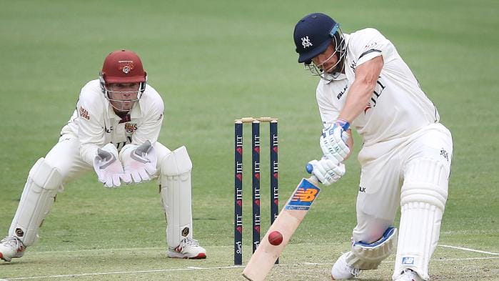
The Importance of Background Knowledge

Slide 30
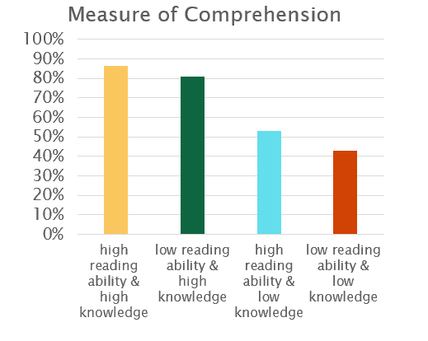
The Baseball Study
To their surprise, Recht and Leslie found that reading ability had little impact on how well kids understood the story. But knowledge of baseball did. In fact, those who were weaker readers did as well as strong readers if they had knowledge of baseball.

Slide 31
So What?
What are ways to incorporate background knowledge prior to a lesson?
Let’s share.
Notes:
In our buckets or IPG, this really fits under high expectations. ALL students will thrive when given the information they need to move forward. I read a sentence for a lower grades class and it used the word Cab. My kids don’t know what a cab is. Taxi, uber, lyft, yet. But cab, no. So a quick pictures and explanation and everyone is on board and understands.

Slide 32
Now What?
Build/activate background knowledge
Pique curiosity
Preview the text
Pictures or videos

Slide 33
Let’s Practice
The barbed wire fence, a stark symbol of division and restriction, snaked across the desolate landscape.
Notes:
Read this sentence. Students will respond to this sentence in a structured paragraph to explain the representation of the fence and it’s role in division and restriction in society and politically.

Slide 34
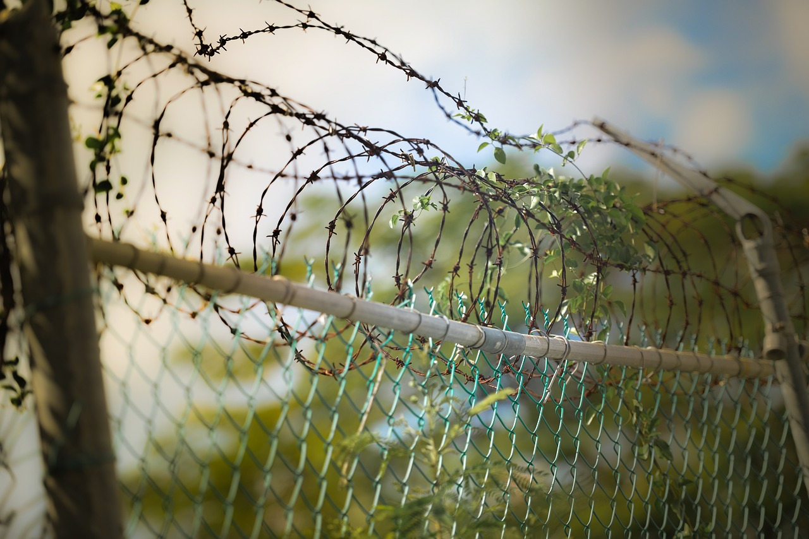
Let’s Practice

Slide 35
Sentence Starters
The barbed wired fence makes me feel…
When I see a barbed wire fence it reminds me of…
The barbed wire fence is a symbol of division because…

Slide 36
Checks for Understanding
Use a Checks for Understanding tool to gauge the students understanding.
A Tool can be…
  A roster with checks and minuses
  The question you are assessing with quick responses to select and sequence
  The various steps in the math problem you are assessing and you highlight trends
Notes:
A tool can be whatever you want it to be. Historically, I have found that teachers don’t like to feel something is being done to them, so this “tool” can be whatever works for you, as long as it is collecting the information you need to assess your students’ mastery.

Slide 37
Let’s Share
Jot down some checks for understanding methods for the exercise we just completed.
  The barbed wire fence, a stark symbol of division and restriction, snaked across the desolate landscape.
Notes:
Turn and talk

Slide 38
Let’s Share Out
Reinforcement: What do you want to keep doing
Refinement: What would you like to change
One Next Step: What is one, very specific, next step. This should be actionable and something that could implement immediately.
Notes:
Share out

Slide 39
Best Practices for All
Incorporate reading, writing, speaking, listening, and writing activities
Create a culture of learning that embraces all learners
Provide access to academic rigor

Slide 40
Four buckets
Culture of Learning
High Expectations
Opportunities for Student Engagement
Checks for Understanding
Notes:
IPG: connections to what you are doing and how this leads to best practice for all

Slide 41
The Baseball Study
“Prior knowledge creates a scaffolding for information,” explains Recht. “For poor readers, the scaffolding allows them to compensate for their generally inefficient recognition of important ideas.”* If those same kids were taking a state test, the SAT or any other standard test of comprehension, and the passage just happened to be about baseball, they would outperform everyone else. But if they encountered a passage on a topic they knew little about, they would fare much worse.

