Slide 2
Ensuring EL Achievement
Dr. Kevin Stacy

Slide 3
Focus on actionable accountability
Provide tools to support actionable conversations
Implement best practice strategies
fostering an environment where
every student can thrive.

Slide 4
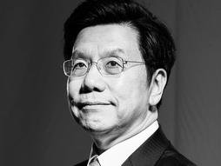

Slide 5
Kai Fu Lee
In 1973,
he was an EL Student
in a High School in Tennessee.

Slide 6
Education:
Bachelor degree from Computer Science from Columbia University
Ph.D. from Carnegie Mellon University,
Honorary Doctorate Degrees from both Carnegie Mellon and the City University of Hong Kong.

Slide 7
Leadership:
Chairman and CEO of Sinovation Ventures and President of Sinovation Venture's Artificial Intelligence Institute.
Prior to founding Sinovation in 2009, Dr. Lee was the President of Google China, and senior executives at Microsoft, SGI, and Apple.

Slide 8
Accomplishments:
Co-chaired the Artificial Intelligence Council for the World Economic Forum Center for the Fourth Industrial Revolution
Highly recognized as “TIME100 AI” Top 25 AI Leaders in the World
100 Most Influential People in the World by TIME Magazine in 2013
https://globalcenters.columbia.edu/content/kai-fu-lee

Slide 9
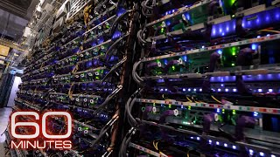

Slide 10
Top Down and Bottom up Approach
English Language Development Services
Accessibility to the
Content

Slide 11
How are they measured?
ELPA Growth Scores
Achievement
and Growth Scores

Slide 12
Year | EL /Transitional | Transitional
2023 | 26.6% | 45.1%
2022 | 8.6% | 37.9%
2021 | 5.1% | 26%

Slide 13
Time Perspective
Accessibility to the Content
English Language Development Services

Slide 14
Top Down Approach
Accessibility to the
Content

Slide 15
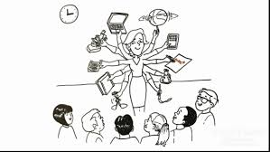
Understanding the Customer

Slide 17
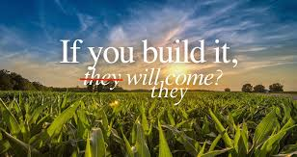

Slide 18
Content Vocabulary Strategies
Language Difference
EL Teacher
Instructional Strategies
Content Teacher
Language Acquisition
Achievement
Content Enriched Language Practice

Slide 19
Question:
You will portray the role of a content teacher. Choose the session that you would like to go to. Why did you choose that session?

Slide 20
Signal : Pencil up when you have your answer
Stem to Use: I chose __________________ because ___________________.
Share: Share your answer with a partner
Accountability: Be ready to share your answer or your partner's answer.

Slide 21
Getting Students to use academic language.
English learner strategies for the class.
ELD Standards for your Content Class

Slide 22
Understanding the Customer

Slide 23
Getting Students to use academic language.

Slide 24
Classroom Accountability

Slide 25
QSSA
Question:
Signal : Pencil up when you have your answer
Stem to Use: I chose __________________ because ___________________.
Share: Share your answer with a partner
Accountability: Be ready to share your answer or your partner's answer.

Slide 26
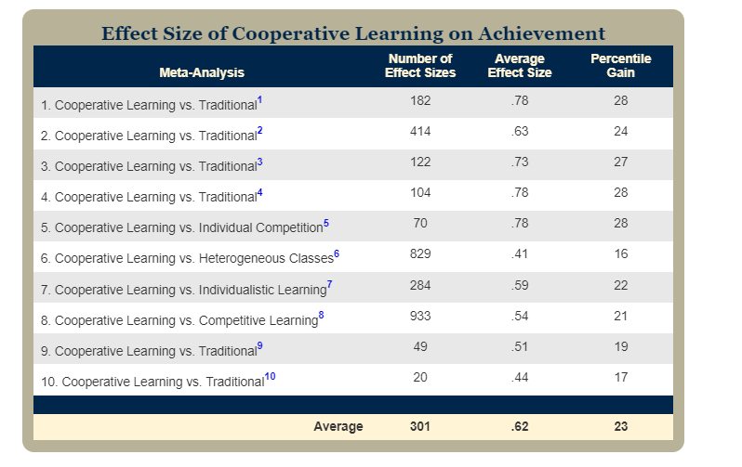
https://www.kaganonline.com/free_articles/dr_spencer_kagan/384/Effect-Size-Reveals-the-Impact-of-Kagan-Structures-and-Cooperative-Learning

Slide 27
Academic Conversations www.JeffZiers.org

Slide 28
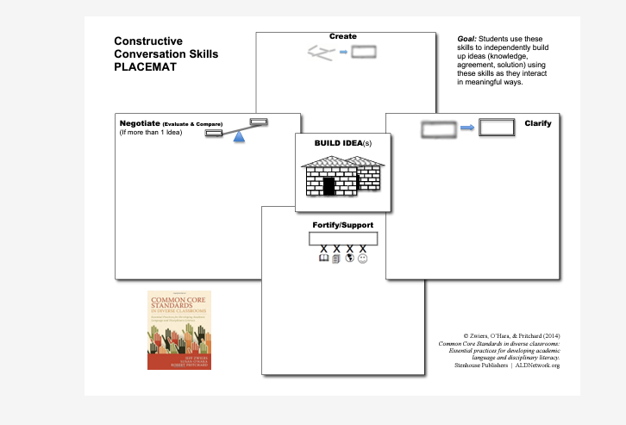

Slide 29
Language Integration

Slide 30
Language Integration
What Language requires explicit instruction for the standard to be expressed?
5.PS3.1: Use models to describe that energy in animals’ food (used for body repair, growth, motion, and to maintain body warmth) was once energy from the sun.

Slide 31
Visual Learning
Purpose: Visual tools to help students organize and structure their thinking.
Example: Use a Flow Map to sequence the steps of a scientific process, such as the energy transfer from the sun to animals. Students can visually see the flow of energy, which helps them understand and describe the process in their own words.

Slide 32
Signal Words​
Purpose: Help students organize their writing and speaking by using transitional phrases.
Example: Introduce signal words like “first,” “then,” “because,” and “as a result” when explaining scientific processes, which aids in constructing logical and sequential explanations.

Slide 33
Sentence Stems​​
Purpose: Provide students with a structure to begin their sentences, supporting them in constructing complete and coherent responses.
Example:
For expressing opinions: "I think that energy transfer is important because..."
For explaining cause and effect: "When the sun’s energy is absorbed by plants, it leads to..."

Slide 34
Juicy Sentence​
Purpose: Focus on complex sentences within the text that are rich in content and language.
Example: Identify a "juicy sentence" from a text about energy transfer (e.g., "The sun's energy is captured by plants and then transferred to animals through food."). Break down the sentence with students to discuss its meaning, structure, and key vocabulary.

Slide 35
QSSSA (Question, Signal, Stem, Share, Assess)​
Purpose: Engage students in structured oral language practice.

Slide 36
Word Banks​
Purpose: Provide students with a list of key vocabulary to use in their writing and discussions.
Example: Create a word bank for the energy transfer topic that includes words like “photosynthesis,” “energy,” “transfer,” “producer,” and “consumer.” This helps students incorporate relevant vocabulary into their explanations and written work.

Slide 38
TRTW (Turn and Talk, Read, Talk, Write)
Purpose: Engage students in a cycle of reading, discussing, and writing, which reinforces comprehension and expression.
Example: After reading a section of a text on energy transfer, have students turn and talk to a partner about what they learned, then write a short summary or answer a question based on their discussion.

Slide 39
Standards
Complex Questioning
Complex Text
Motivation
Domain Enriched
Integrative
Focused (word, sentence, discourse)
Functional
Content
Academic Language
Task
Fluency
Background Knowledge
Student Efficacy
Scaffolding
Proficiency Level Descriptors
SEL Awareness
Social-emotional learning
Culturally-Responsive Teaching
Asset-Based Mindset
Reading, Speaking, Listening and Writing
Thinking /Visual Learning

Slide 40
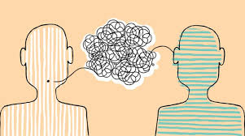
Accountable Conversations

Slide 41
EACH SCHOOL REPORTING 10 Percent of a School Report Card

Slide 42
What is your EL data?
What does your trend data say?
How are you addressing needs?

Slide 43
How are content teachers held accountable to ILPs?
What professional development opportunities are there regarding content language development?

Slide 44
Bottom Up Approach
ELPA Growth Scores

Slide 45
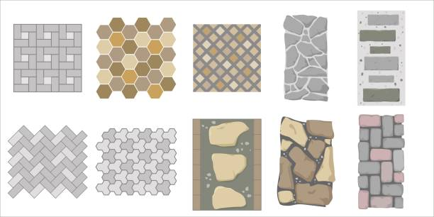
EL Conversation Tool

Slide 46
Meet Your New Planning PAL

Slide 47
Domain Enriched
Integrative
Focused
Functional/Task Based
Standards
Focused Language Standard (ELPA)
Content-Theme embedded
Grade Level Text
Focused Listening
Fluency
Proficiency +1
Word level (Morphology and Phonology)
Sentence level (Syntax)
Discourse (Semantics)
Writing
Standards
Task
Assessment
SEL Awareness
Social-emotional learning strategies
Culturally-Responsive Teaching
Asset-Based Mindset
Focused Academic Conversations
Motivation
Essential Question
Background Knowledge
Student Efficacy
Scaffolding/Visual Learning
Thinking Skills

Slide 48
My take on the Hippocratic Oath

Slide 49
I swear to fulfill, to the best of my ability and judgment, this covenant:
I will respect the hard-won scientific gains of those Educators in whose steps I walk and gladly share such knowledge as is mine with those who are to follow.
I will apply, for the benefit of ALL students, all measures [that] are required, avoiding those twin traps of teaching to the masses and stereotyping students.

Slide 50
I will remember that there is art to Education as well as science, and that warmth, sympathy, and understanding may outweigh a benchmark assessment or a TCAP score
.
I will not be ashamed to say "I know not," nor will I fail to call in my colleagues when the skills of another are needed for a student’s intervention.

Slide 51
I will respect the privacy of my students, for their problems are not disclosed to me that the world may know. Most especially must I tread with care in matters of specific needs and student emotions . If it is given to me to help families, all thanks. But it may also be within my power call professionals in case of abuse; this awesome responsibility must be faced with great humbleness and awareness of my own frailty. Above all, I must not play God.

Slide 52
I will remember that I do not treat a benchmark score, a disability , but a growing student, whose literacy and education may affect the person's family and economic stability. My responsibility includes these related problems, if I am to care adequately for the students.
• I will prevent (ignorance) whenever I can but I will always look for a path to a find a (strategy for best practice)

Slide 53
I will remember that I remain a member of society, with special obligations to all my fellow human beings, those sound of mind and body as well as the rich and poor.
If I do not violate this oath, may I enjoy life and art, respected while I live and remembered with affection thereafter. May I always act so as to preserve the finest traditions of my calling and may I long experience the joy of learning for those who seek my help.

Slide 54
Thank You!
Dr. Kevin Stacy
Kevin.Stacy@CMCSS.net
615-482-8729

