Slide 1
The Phonics Project in Williamson County School ESL Program: Building the /pleɪn/ as we /flaɪ/
Joseph Whinery, Ann Matanakilagi

Slide 2
Outline
Background
Needs of ESL students in phonics instruction
Current program comparisons
Phonics as literacy / Phonics as language
Complications
Future objectives

Slide 3
Background
2018
Talk with ELA curriculum specialist
need for a phonics curriculum within the ESL program
budget not available to purchase a product
advised to use resources available at school
2020-2021
A need for phonics instruction, materials, and teacher training became apparent.
Summer 2021
ESL teacher attended Reading 360 training

Slide 4
Background
2021-2022
Met with ELA specialists (elementary and secondary) to discuss phonics resources.
phonics is not part of T1 instruction past 2nd Grade
agreed to the necessity of direct phonics for all ESL students
PWRS was suggested as the screener.
Teaching CKLA concurrently in Tier 1 ELA and ESL was discouraged.

Slide 5
Background
2021-2022
phonics programs on the WCS RTI vetted resources listed and compared
survey of ESL team for priorities and needs in a phonics program
comparisons and survey results: narrowed to 95% Group and PALS.
PALS chosen

Slide 6
Background
2022-2023
PWRS given to all ELs as first phonics screener
RTI PWRS as a dyslexia screener; not appropriate as ESL phonics screener
WCS ESL Phonics Task Force started
created new screener, based on the PWRS, implemented for screener #2 and #3
All ESL teachers trained on PALS; implemented across the district in ESL program instruction
Phonics Task Force continued investigation into other research-based phonics resources and program; West Virginia

Slide 7
Background
Summer 2023
West Virginia Phonics resources created by Phonics Task Force
2023-2024
Updated screener based on Houghton-Mifflin, PWRS, PALS, West Virginia
West Virginia Phonics (WCS ESL edition) presented to all ESL teachers
Phonics Program Menu given to all teachers
Training on different programs and possible recommendations to all ESL teachers

Slide 8
Background
2023-2024 (1st Q)
West Virginia Phonics passage questioned by non-ESL parent
all West Virginia Phonics discontinued in WCS
permission for Phonics Task Force to review/revise every possible passage
interrupted flow of ESL phonics instruction
back on track around 2nd Q
mid and final screeners administered
end of 2023-2024, curriculum leaders: discontinue all non-WCS phonics resources; use only CKLA and Words Their Way in 2024-2025
training by ELA and RTI specialists (1st Q) 2024

Slide 9
Needs of ESL students in phonics instruction
Based on Literacy Foundations for English Learners: A Comprehensive Guide to Evidence-Based Instruction 1st Edition
by Elsa Cardenas-Hagan Ed.D. CCC/SLP CDT CALT as recommended in Reading 360 training
Systematic and explicit instruction
Provide students with a phoneme awareness task that addresses a new English language sound.
Provide students with a model of the word and multiple opportunities to say the word.
Provide students with an explicit example of vocabulary for each word.
Provide students with strategic use of their native language by thinking about the English word in their native language.

Slide 10
Needs of ESL students in phonics instruction
Based on Literacy Foundations for English Learners: A Comprehensive Guide to Evidence-Based Instruction 1st Edition
by Elsa Cardenas-Hagan Ed.D. CCC/SLP CDT CALT as recommended in Reading 360 training
Alphabet and sound-spelling patterns should be connected to native language(s) as much as possible.
Repetition in instruction and practice.
Syllabication and morphology instruction.

Slide 11
Phonics Programs Comparison | Alphabet (PALS condensed and CKLA writing) | PALS | West Virginia
Systematic and Explicit | yes | yes | yes
Vocabulary | light | light | yes- not necessarily academic words
Phonemic Awareness appropriate to ELs | no | partially- explicit but missing language comparison | partially- explicit but missing language comparison
Sound Spelling Patterns appropriate to ELs | partially- explicit but missing language comparison | partially- explicit but missing language comparison | partially- explicit but missing language comparison
Hear, say, read, and write in each lesson | yes | writing not included | yes
Repetition. Multiple examples | yes | yes | yes
Syllabication | no | no | yes
Morphology | no | no | no

Slide 12
Phonics Programs Comparison | Alphabet (PALS condensed and CKLA writing) | PALS | West Virginia
Systematic and Explicit | yes | yes | yes
Vocabulary | light | light | yes- not necessarily academic words
Phonemic Awareness appropriate to ELs | no | partially- explicit but missing language comparison | partially- explicit but missing language comparison
Sound Spelling Patterns appropriate to ELs | partially- explicit but missing language comparison | partially- explicit but missing language comparison | partially- explicit but missing language comparison
Hear, say, read, and write in each lesson | yes | writing not included | yes
Repetition. Multiple examples | yes | yes | yes
Syllabication | no | no | yes
Morphology | no | no | no

Slide 13
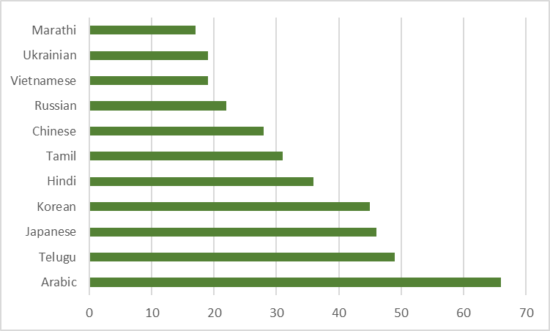
Phonics as Literacy / Phonics as Language

Slide 14
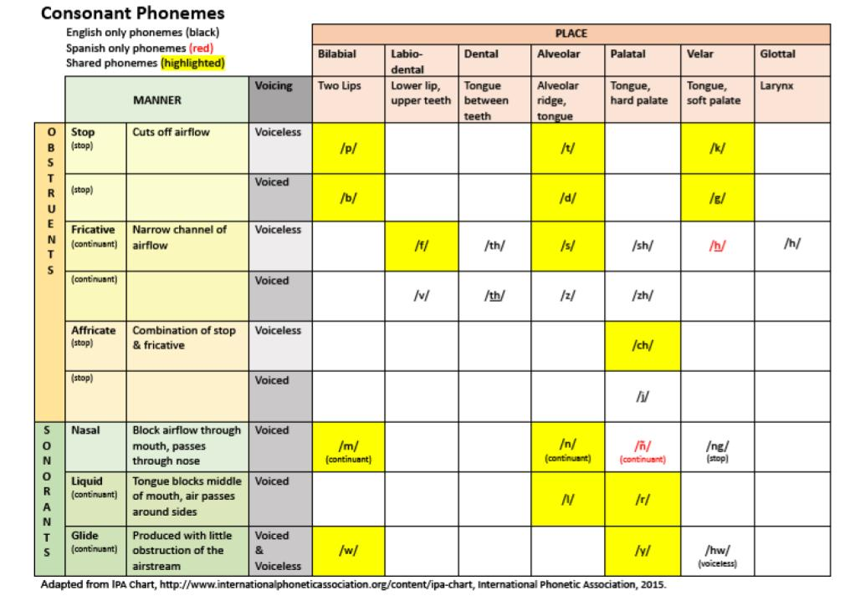
Phonics as Literacy / Phonics as Language
Additional Instructional Suggestions:
Spanish speakers may need additional instruction in:
-endings -ed (pronounced /d/ or /t/ or /ed/), -s (pronounced (/z/, /s/, /iz/ or /is/)
-Silent -e spellings
-R-controlled vowels
-Prefixes that transfer across both languages: re-, bi, tri-, pre-
https://www.cde.state.co.us/early/spanishenglishphonemes

Slide 15
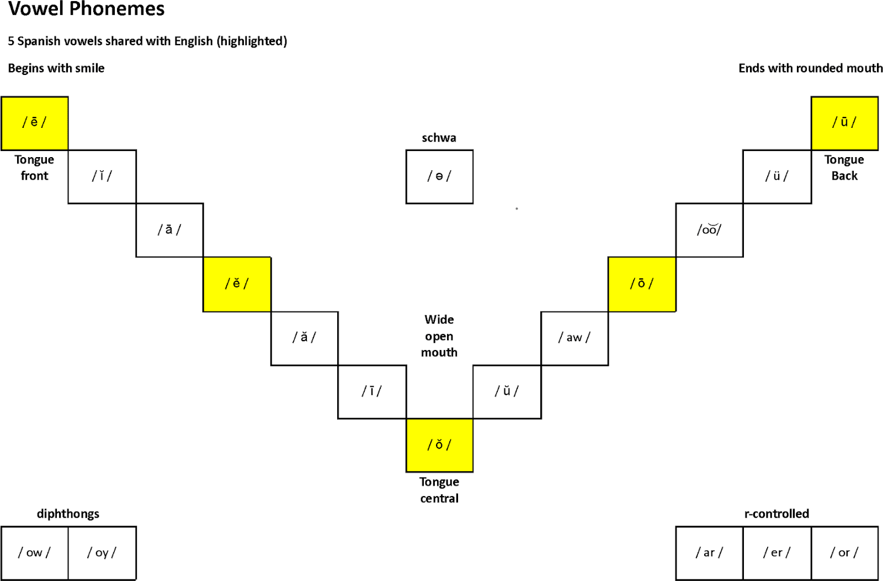
Phonics as Literacy / Phonics as Language
Spanish Speakers may need explicit instruction in:
-Vowel digraphs: ou, ow, eigh, au, aw, oo
https://www.cde.state.co.us/early/spanishenglishphonemes

Slide 16
Phonics as Literacy / Phonics as Language
https://bilinguistics.com/articulation-errors-second-language-learners/

Slide 17
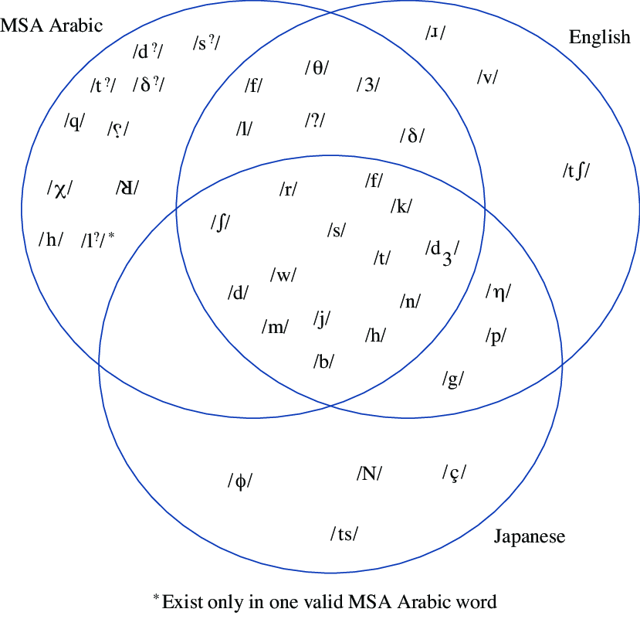
Phonics as Literacy / Phonics as Language
https://www.researchgate.net/figure/Arabic-Japanese-and-English-consonants-3-5-9-11_fig2_270122534

Slide 18
Phonics as Literacy / Phonics as Language
K-3 (weeks 5-7) | SPA | ARA | JPN
/m/ spelled ‘m’ as in mat | Y | Y | Y**
/a/ spelled ‘a’ as in mad | N | Y | N
/t/ spelled ‘t’ as in tag | Y | Y | Y**
/d/ spelled ‘d’ as in dad | N | Y | Y**
/o/ spelled ‘o’ as in mom | Y* | N | Y
/k/ spelled ‘c’ as in cat | Y | Y | Y**
/g/ spelled ‘g’ as in dog | Y | N | Y**
/i/ spelled ‘i’ as in dig | N | Y | N
* papa
** dougu

Slide 19
Phonics as Literacy / Phonics as Language
K-7 (weeks 18-21) | SPA | ARA | JPN
/ch/ spelled ‘ch’ as in chin | Y | N | N
/sh/ spelled ‘sh’ as in shop | N | Y | Y
/th/ (unvoiced) spelled ‘th’ as in thin | N | Y | N
/th/ (voiced) spelled ‘th’ as in them | N | Y | N
/qu/ spelled ‘qu’ as in quit | Y* | Y | N
/ng/ spelled ‘ng’ as in sing | N | N | Y
* Quito, queso // cuatro

Slide 20
Phonics as Literacy / Phonics as Language
https://bilinguistics.com/articulation-errors-second-language-learners/

Slide 21
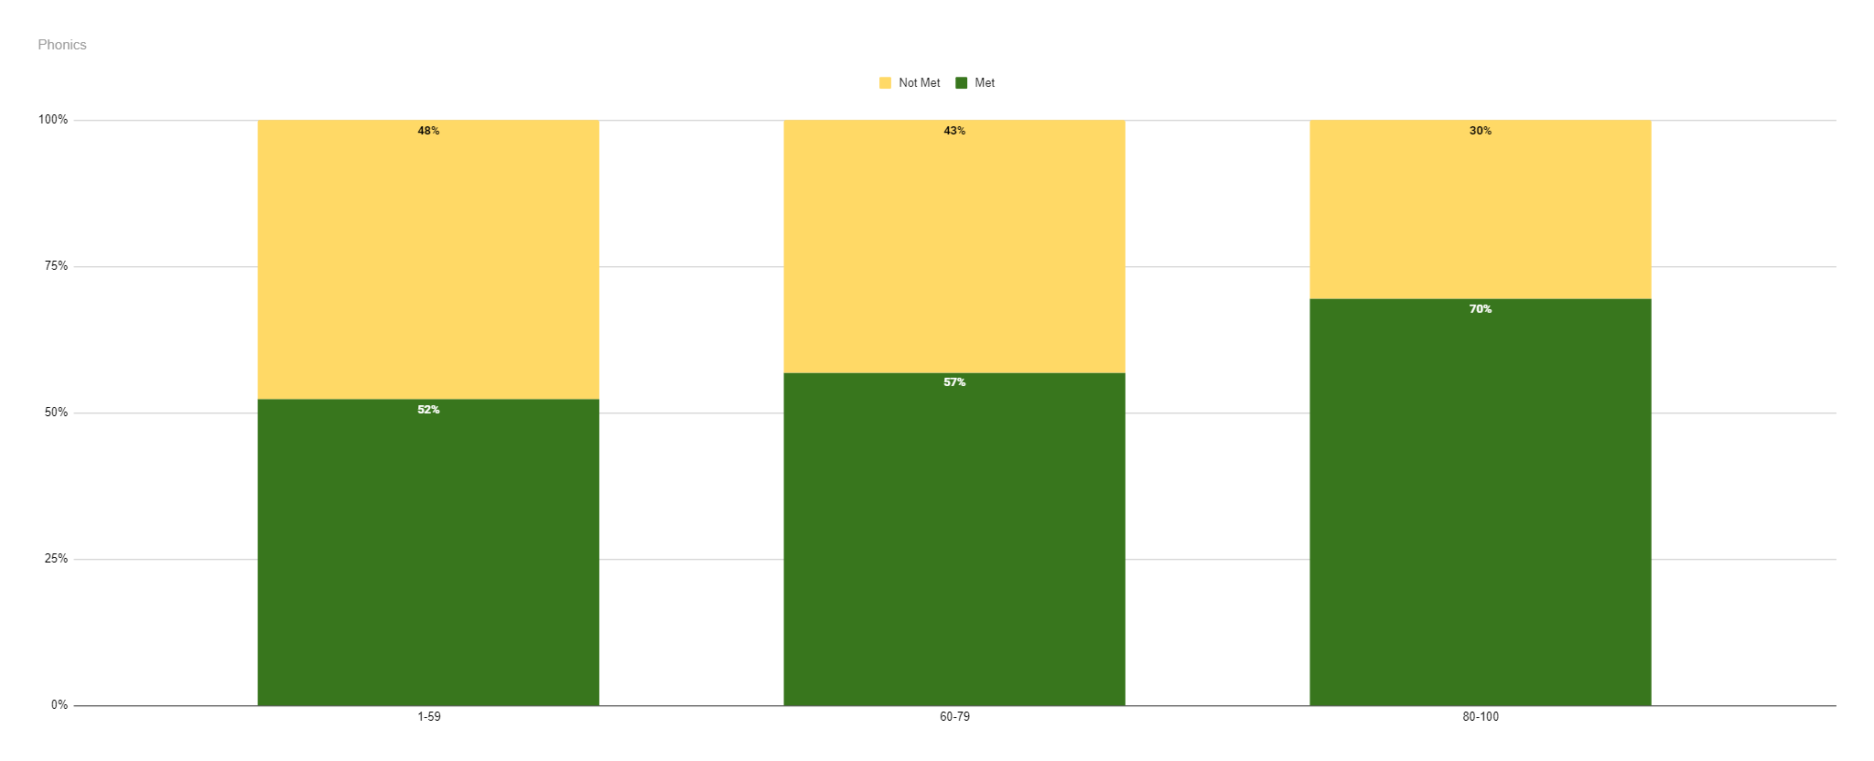
Phonics as Literacy / Phonics as Language

Slide 22
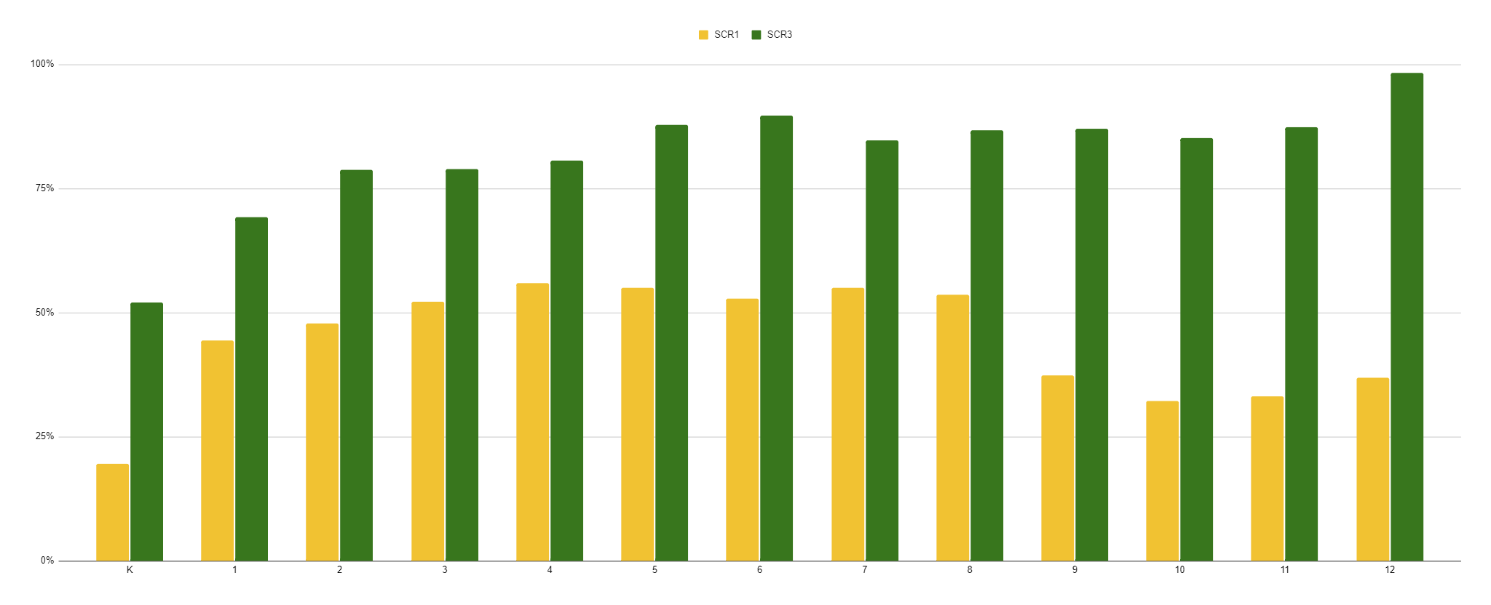
Data: Growth (2022-2023)

Slide 23
Screener
Phonics and Word Reading Survey Administration and Scoring Record
Student: _________________________________ Grade: _________ Date: _________
Directions: Follow the directions for each section. Use the script to direct students.
Use 1 administration and scoring record per screening. Transfer scores from the administration and scoring guide to student summary chart after each screening. Only 1 summary chart per year per student.
Foundational Skills
Directions: For items A-D, do not stop based on students ability or score. Complete all 4 sections.
Say, I’m going to show you some letters. Tell me the name of each letter as you point to it. Remember, tell me the name, not the sound.
Letter naming- Uppercase
D A N S X Z J L H
T Y E C O M R P W
_____/26 K U G B F Q V I
Notes:

Slide 24
Screener
Summary Chart
Instructions: All students will end the year with at least an initial and final screener. Initial screener will be given upon student arrival and final screener will be given at the end of the school year. The mid-screener will be given at the end of second semester.
Student: _____________________ Grade: _________
Date | ____________ | ____________ | ____________
Foundational Skills | Initial | Mid | Final | Notes
Letter Naming: Uppercase | ____/26 | ____/26 | ____/26
Letter Naming: Lowercase | ____/26 | ____/26 | ____/26
Consonant Sounds | ____/21 | ____/21 | ____/21
Vowel Sounds D1. Short Vowels D2. Long Vowels D3. Short Vowel Sound Recognition | D1. ____/5 | ____/5 | ____/5
 | D2. ____/5 | ____/5 | ____/5
 | D3. ____/5 | ____/5 | ____/5

Slide 25
Screener
Foundational Skills
A. Letter Naming: Uppercase
B. Letter Names: Lowercase
C. Consonant Sounds Vowel Sounds
D.1 Short Vowels Vowel Sounds
D2. Long Vowels Vowel Sounds
D3. Short Vowel Sound Recognition
Single Syllable Words
E. Short Vowels in CVC Words
F. Short Vowels and Consonant Blends
G. Digraphs
H. Long Vowel vCe Words
I. Predictable Vowel Teams
J. Vowel Teams with Multiple Sounds
K. Vowel-R
L. Complex Consonants
Multisyllable Words
M. Consonant -le
N. Open-closed
O. Vowel-r
P. Closed-Closed
Q. Silent e
R. Vowel Teams
Total items: 252
Goal: 80%

Slide 26
Phonics Programs Menu
Below are descriptions of the programs and possible recommendations.After giving the screener, teachers can look at the data and choose which resource would be most beneficial to their students. The only ESL team expectation is that teachers are using a systematic and explicit phonics program.
 | Description | Possible Recommendations
PALS Level A Student Materials CR2021.pdfPALS A | includes phonemic awareness moves slowly introduces letter names/sound with a lot or repetition sequential lessons | Kindergarten a lot of repetition needed moves very slowly
PALS B | no phonemic awareness moves more quickly into decoding and sight words introduces letters, vowel teams, inflectional ending, and vowel teams fluency phrases sequential lessons | 1st and 2nd grade Newcomers some repetition needed moves slowly not literate in first language

Slide 27
Phonics Programs Menu
Alphabet A (Condensed PALS Level A & CKLA) | all of PALS level A lessons that introduce a new sound all of the CKLA lessons for handwriting for the new sounds | covers the same topics as PALS level A without the repetition literate newcomers
Alphabet B (Condensed PALS Level B & CKLA) | All of PALS level B lessons that introduce a new sound all of the CKLA lessons for handwriting for the new sounds | covers the same topics as PALS level B without the repetition literate newcomers
West Virginia | can be used sequentially or specific lessons to meet needs 3 different presentation options: powerpoint printable resources condensed or a combination of the 3 | proficient in foundational skills gaps in phonics knowledge

Slide 28
 | A (K) | B (1)
1 | a | a
2 | m | m
3 | t | t
4 | s | s
5 | b | i
6 | c | f
7 | f | d
8 | n | r
9 | d | o
10 | i | g
11 | g | n
12 | o | p
13 | r | h
14 | h | c
 | A (K) | B (1)
15 | p | l
16 | l | e
17 | u | b
18 | j | w
19 | e | y
20 | w | k
21 | z | ck
22 | k | u
23 | v | sh
24 | x | j
25 | qu | ch
26 | sh | v
27 | ch | th
28 | th | ing
 | A (K) | B (1)
29 | ck | ee
30 | ee | ea
31 | ea | ed
32 | er | er
33 | ir | ir
34 | ar | ur
35 | oa | ar
36 | igh | aw
37 |  | ou
38 |  | ow
39 |  | z
40 |  | qu
41 |  | oo
42 |  | ai
 | A (K) | B (1)
43 |  | ay
44 |  | oi
45 |  | oy
46 |  | qu
47 |  | oo
48 |  | ai
49 |  | ay
50 |  | oi
51 |  | oy
52 |  | x
53 |  | oa
54 |  | igh
55 |  | ol
56 |  | or
Level A- Kindergarten Level B- 1st Grade
Level A- 88 lessons
Level B- 70 lessons
PALS: Skills

Slide 29
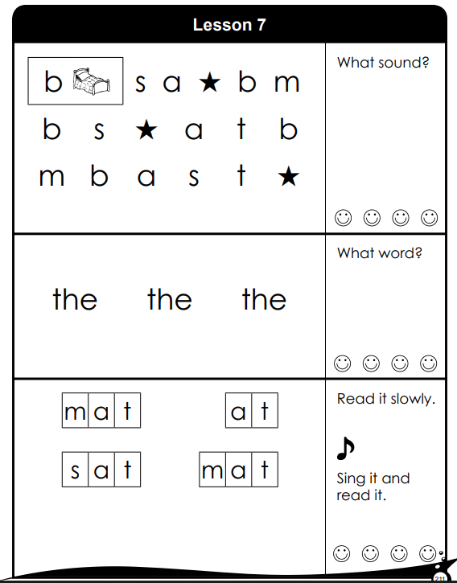
PALS A
https://frg.vkcsites.org/wp-content/uploads/2018/07/KPALS-Excerpt-2018.pdf

Slide 30
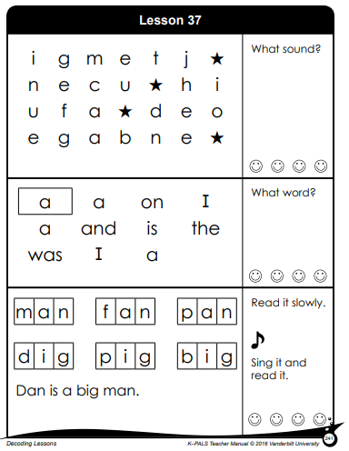
PALS A
https://frg.vkcsites.org/wp-content/uploads/2018/07/KPALS-Excerpt-2018.pdf

Slide 31
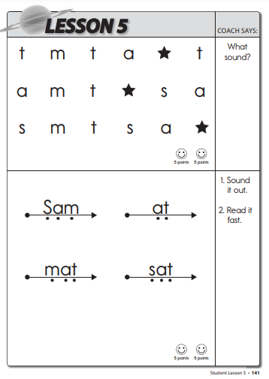
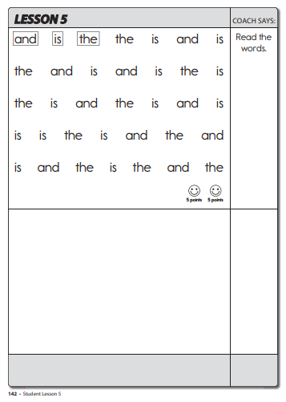
PALS B
https://frg.vkcsites.org/wp-content/uploads/2018/07/PALS-Reading-Grade-1-Excerpt-2018.pdf

Slide 32
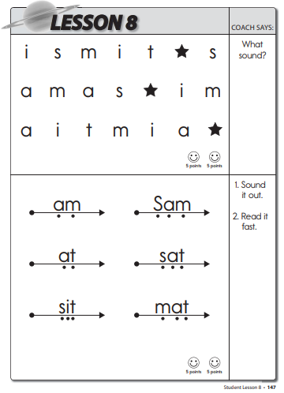
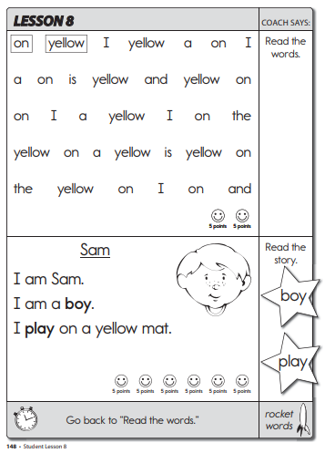
PALS B
https://frg.vkcsites.org/wp-content/uploads/2018/07/PALS-Reading-Grade-1-Excerpt-2018.pdf

Slide 33
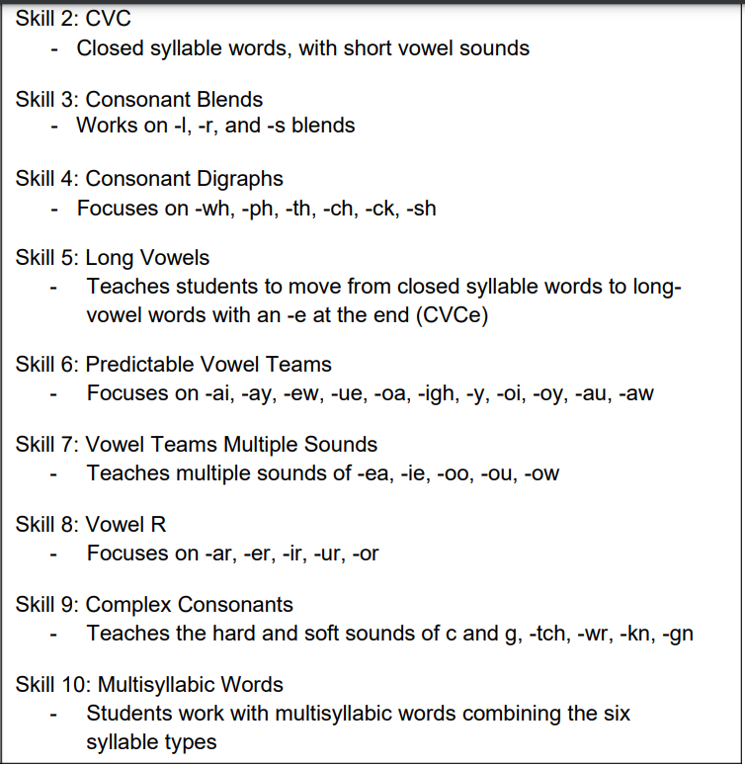
West Virginia Phonics: Skills

Slide 34
West Virginia Phonics: Lesson Plan
Every West Virginia Lesson Plan has:
5 days of lesson plans
3 stories using the target pattern
a list of target words in each story

Slide 35
Warm-up Activities: practices target sounds from previous lessons from other skills or within the same skill.
Phonological Awareness and Articulation of Skill: An activity that practices phonological awareness and describes how to create the sound.
Letter-Sound Correspondence: An activity to practice identifying the target sound with the spelling of the target sound.
Word Reading Blending Routines: An activity to practice reading the target sound.
Word Work: An activity to manipulate the words with the target sound.
Dictation: Practice writing words or phrases with the target sound.
Text Application: A story using words with the target sound.
West Virginia Phonics: Lesson Plan

Slide 36
Considerations
Time Restraints:
Most sections are shorter than suggested time.
less than 5 minutes to read 10 words
Shorten from 5 days to 3 days with less review.
Omit what students do not need.
able to read the target sound but struggle with the spelling, focus on word work and dictation
Materials:
Some teachers don’t have access to technology in their classroom or pull groups in the hallways. Resources need to be usable without the powerpoint portion.
Reduce teacher prep time.
Create master copies of resources and laminate so they can be reused.

Slide 37
Short Vowels a e i o u review | 3 weeks each 18 weeks total
Consonant Blends l r s | 3 weeks each 9 weeks total
Digraphs ch ck sh th wh/ph | 3 weeks each 15 weeks total
CVCe a_e i_e o_e u_e review | 3 weeks each 15 weeks total
Predictable Vowel Teams au/aw ai/ay ew/eu oa oi/oy igh/y | au/aw- 3 weeks ai/ay- 3 weeks ew/eu- 1 week oa- 3 weeks oi/oy-3 weeks igh/y- 3 weeks 16 weeks total
Unpredictable Vowel Teams ea ie oo ou ow | 3 weeks each 15 weeks total
Vowel R ar er, ir, ur or | ar- 3 weeks er, ir, ur- 2 weeks or- 3 weeks 8 weeks total
Complex Consonants hard/soft g hard/soft c tch wr kn/gn | hard/soft g- 3 weeks hard/soft c- 3 weeks tch- 3 weeks wr- 3 weeks kn/gn- 2 weeks 14 weeks total
Multi-Syllable Words Closed Silent E R Open Consonant LE | 3 weeks each 15 weeks total

Slide 38
Digraph- TH
Teacher Instruction | Say: A digraph is when two or more consonants are put together to make 1 sound. /t/ and /h/ together make the /th/ sound. To make this sound, stick the end of your tongue in your teeth and push air out. /Th/ can make 2 different sounds. One /th/ is voiced and you will feel your throat vibrate when you say it. The other /th/ is voiceless and does not cause any vibration. There are no definite rules of when to use each one but, there are generalities. See the right column for generalities. Demonstrate: Show how to pronounce the sound. Optional: Show pictures/video of mouth formation. Use a mirror to have students see their mouth placement. Write: the target sound in lowercase and capital letters on the board. | /TH/ generalities: Voiced: at the end of a silent e word. (We have not covered this rule yet, but they may be familiar with it or you can just show the examples.- bath vs bathe between 2 vowels- weather, mother, brother at the beginning of most high-frequency words- the, this, that, these, those, therefore, them, through Voiceless: at the end of words- myth, Smith, mouth, bath at the beginning of most other words besides high-frequency words

Slide 39
Target Sound-
/TH/

Slide 40
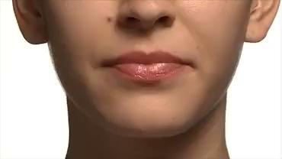
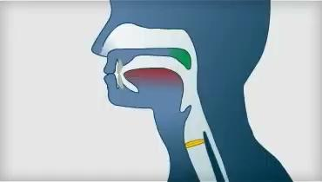

Slide 41
Rules:
/th/ is a digraph. A digraph means 2 or more consonants are put together to make 1 sound.
/th/ can be made as a voiced or voiceless sound. Voiced means that you can feel the vibration in your throat and voiceless means you cannot feel vibration.

Slide 42
Voiced vs Voiceless /TH/
Voiced
at the end of a silent e word.
bath vs bathe
between 2 vowels
weather, mother, brother
At the beginning of most high-frequency words.
the, this, that, these, those, therefore, them
Voiceless:
at the end of words
myth, Smith, mouth, bath
at the beginning of most other words besides high-frequency words
thunder, think, thought

Slide 43
Digraph- TH
Phonemic Awareness | Compare the sound to the student’s native language. Do they use this sound in their other language(s)? Does it come at the beginning, middle, or end of words? Can they think of examples of this? What is the letter or symbol that represents the sound? | /Th/ is not as common in other languages. Arabic: https://arabic.fi/letters/43

Slide 44
‘th’ in other languages

Slide 45
Do you use this sound in the other language(s) you speak?
Does it come at the beginning, middle, or end of words?
Can you think of examples?
What is the letter or symbol that represents the sound?

Slide 46
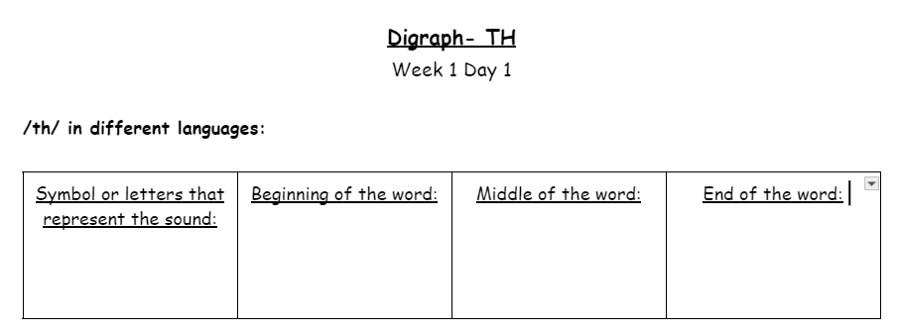

Slide 47
Digraph- TH
Read Words | Practice blending the sounds to read the words. | Day 1: think, think, broth, Beth, cloth, with, then Day 2: bath, both, math, thud, thug, than Day 3: Roth, path, moth, rath, this, that

Slide 48
Blend Words

Slide 49
th
i
n

Slide 50
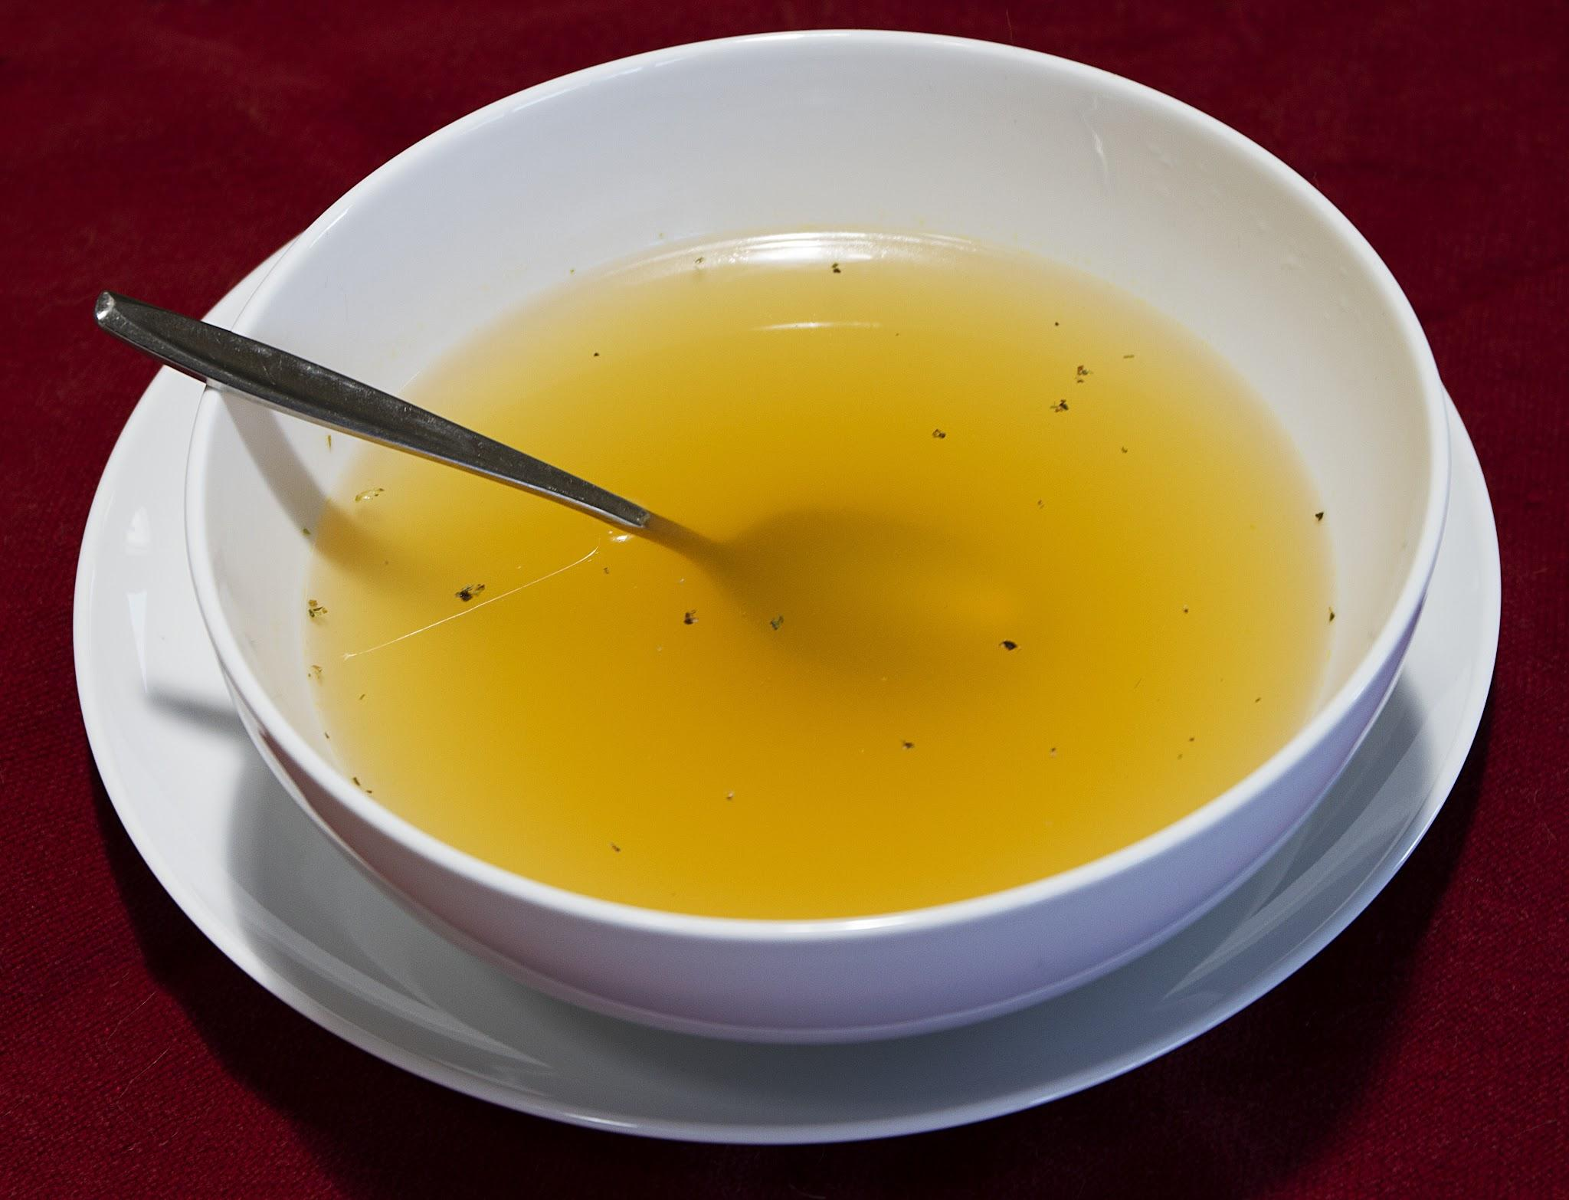
b
r
o
th

Slide 52
Digraph- TH
Word Work | Building words- use words from “Word Reading” above or any other short a cvc words. Chaining- T says initial word and students write it. T then says, change ______ to _________ and students write the new word. This continues for as long as necessary. Dictation: Dictate the words, phrases, or sentences and have students write them. You could also have students brainstorm other words they know that have this target sound. | Chaining: thin, then, them; Beth, bath, both, moth Words: See words from “Word Reading” Phrases: think in math, this cloth, a thin moth Sentences: The bath is hot. This cloth is both wet and big. I think on the path.

Slide 53
Word Work

Slide 54
Build Words: Elkonin Boxes

Slide 55
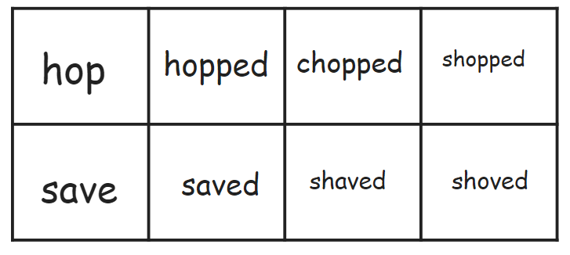
Chaining

Slide 56
____________________________________________________________________________________________________________________________________________________________________________________________________________________________________________________________________________________________________________________________________________________________
Dictation

Slide 57
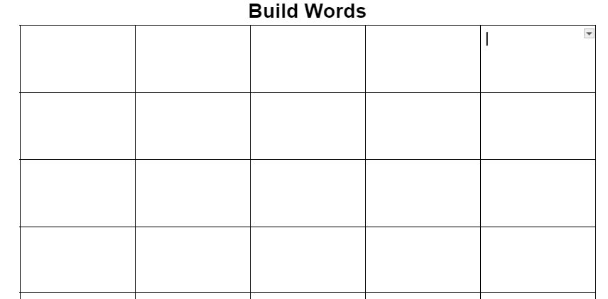
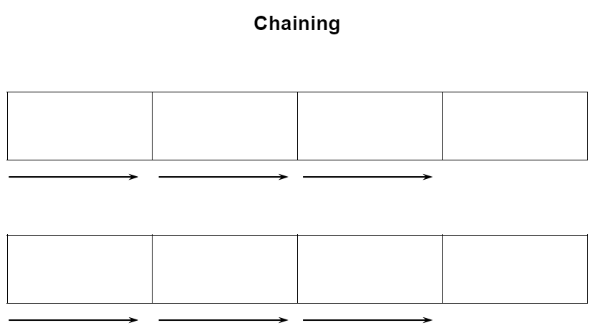
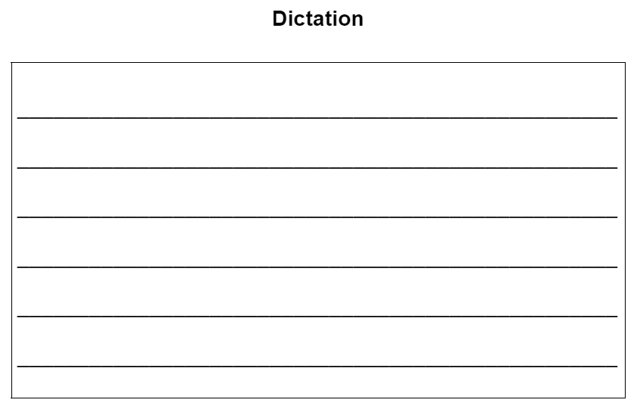

Slide 58
Digraph- TH
High Frequency Words | Read the high-frequency words that align with this skill with automaticity. Decodable: Words that should be decodable based on phonics skills. Irregular: Words that have to be memorized because they don’t follow the rule, or don’t follow a rule the students have already learned. | Decodable: that, them, this, then, with Irregular: they

Slide 59
High Frequency Words

Slide 60
that

Slide 61
then

Slide 63
Digraph- TH
Decodable Text | Practice reading words with the target sound in a text. | Read the decodable text. Answer comprehension questions that correspond. Create a corresponding writing or speaking prompt for students to answer.

Slide 64
Text Application

Slide 65
Seth the Sloth
Seth the Sloth likes to eat. Seth is not thin. Seth likes to eat thin mints. Seth keeps a cloth with him to help with the mess he makes. Seth eats too many thin mints and then gets sick.
Seth’s Mom said, ”You must not eat thin mints again.” Seth will have to drink broth, not eat thin mints. Seth does not like the broth.
Seth’s mom says, “Drink the broth, Seth!” Seth drinks lots and lots of broth. Seth gets thin from all the broth he drinks.

Slide 66
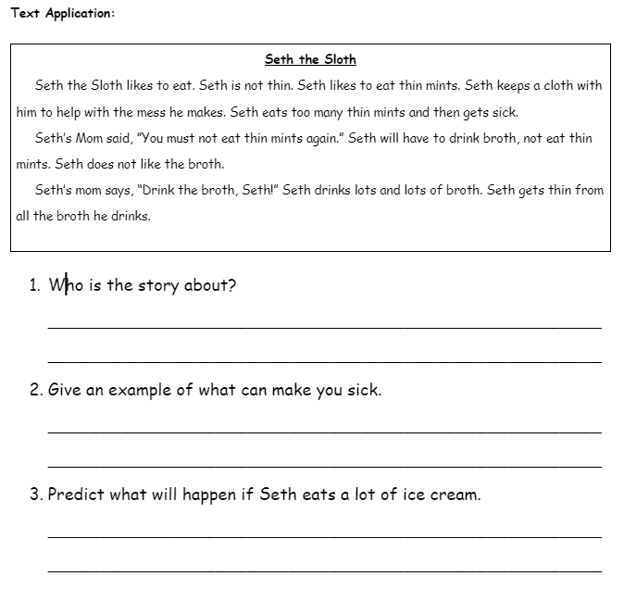

Slide 67
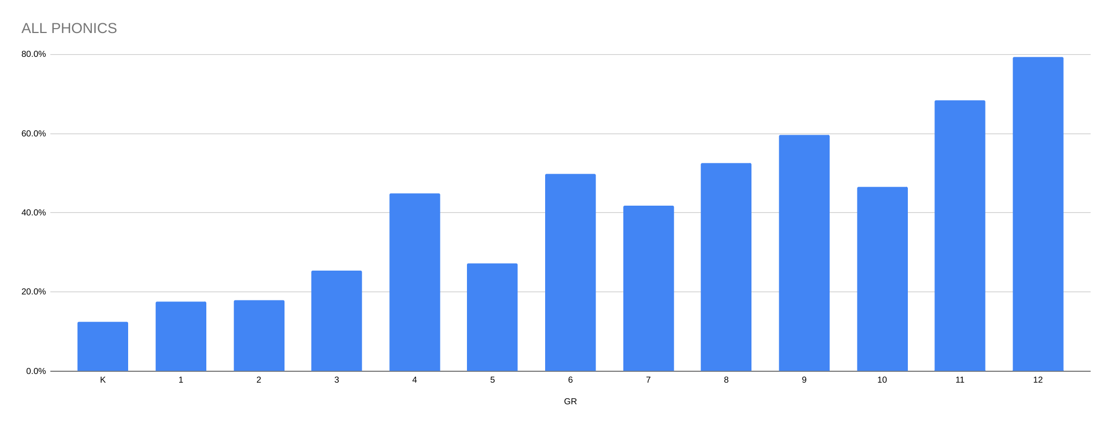
Data: Growth (2023-2024 initial)

Slide 68
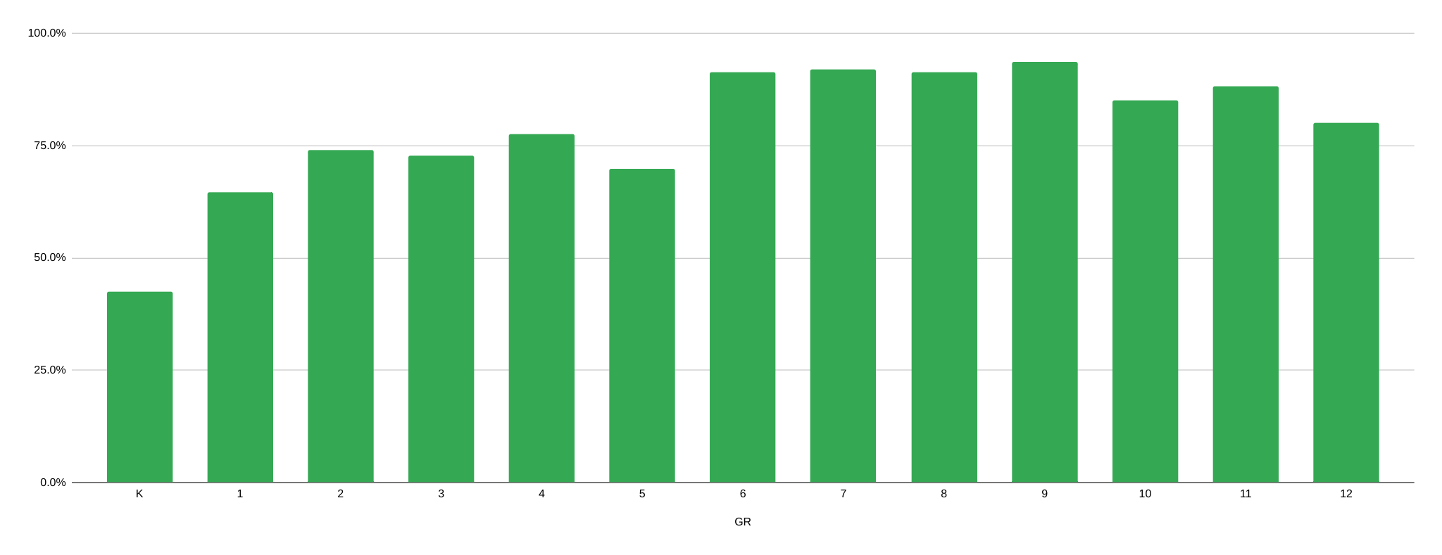
Data: Growth (2023-2024 mid)

Slide 69
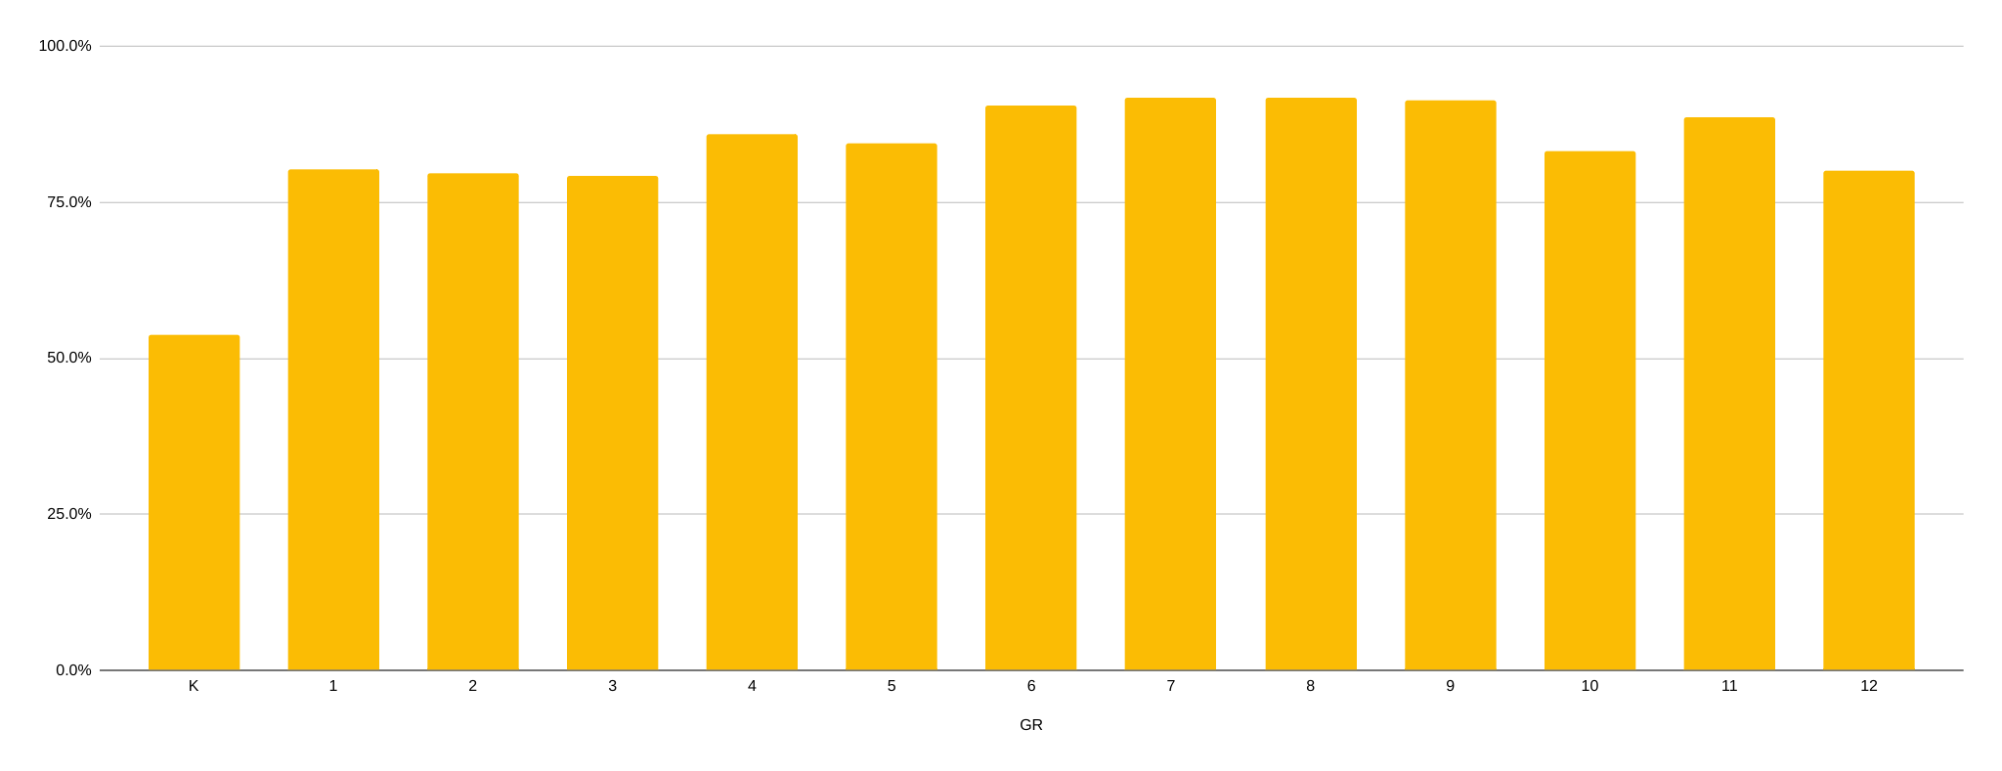
Data: Growth (2023-2024 final)

Slide 70
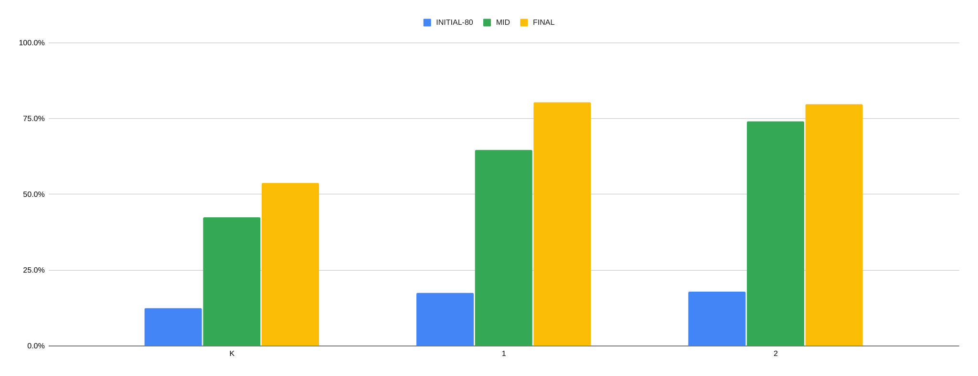
Data: Growth (K-2)

Slide 71
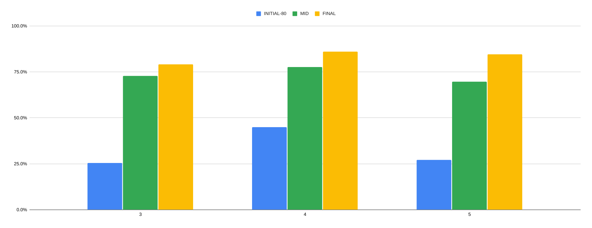
Data: Growth (3-5)

Slide 72
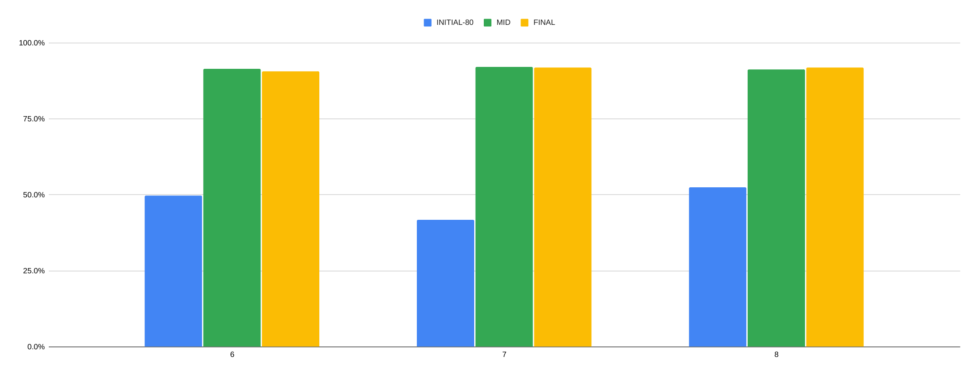
Data: Growth (6-8)

Slide 73
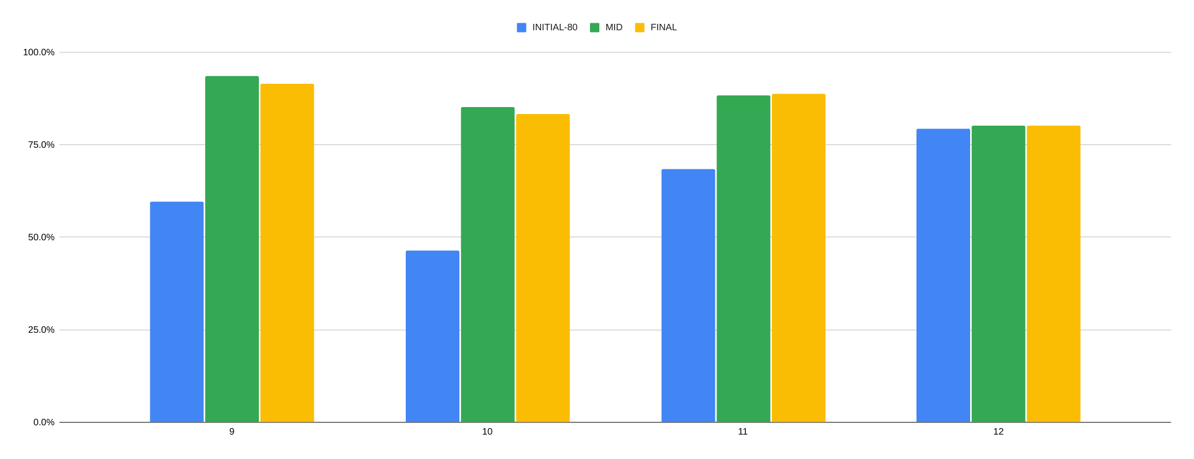
Data: Growth (9-12)

Slide 74
Notes from our teachers!
How were students impacted by the phonics program?
“It gave me some structure and set a pace for clear instruction. My lower students gained a lot.”
“The first time I gave the screener, it was more unnatural for them to make the sounds. At the time of the final screening, they didn't bat an eye when it came time to make the sounds. It helped strengthen students' understanding of consonants, vowels, digraphs, etc. The students learned some academic language related to phonics.”
“I think that my approach to teaching phonics benefited the students because it was taught at a slow pace. By focusing on the sounds of letters and different letter blends, ELs were able to apply their knowledge of phonics into their classroom reading materials.”
“It helped...having a sequential program that built on the previous lessons”
“I think giving them all a foundation was helpful- it was eye opening for me to see skills that they had deficits in- the screener was helpful with this!”
“I have always included phonics in my instruction; however, I appreciated having this additional program and having the same program we will all using. I think doing this allows us to not only have a similar understanding of the building blocks of reading but also gives us a common language.”

Slide 75
Notes from our teachers!
What are things you want to change or keep for next year?
“I want lessons that specifically support some of the skills (long vowels, -le syllables, etc). Some of my students "tapped out" on the screener in the same place because I didn't explicitly teach those skills. I would also love more challenging passages for the upper elementary students to read. I did like having a systematic "path" to follow and that it was low-prep and routine. The kids knew the procedures, learned to work with partners, and transferred their phonics skills to other areas.”
“I want to continue to use a structured phonics program”
“I want to find a better way to teach it to older elementary students”
“I love having a phonics program to lean on that is EASY to follow, and doesn't take much time. Something I would like to change is the age appropriateness of the reading passages with the program for secondary students. The reading passages were a bit "babyish" for older learners.”
“I think every student needs to complete a phonics screener. Then students not meeting the average expectations should receive explicit phonics instruction daily using a prescription curriculum. Students who screen at or above expectations should receive targeted instruction to address specific areas of weakness. For example, a student may only have difficulty with consonant-le words because - maybe they simply haven't been taught/grasped this particular rule. There would be no need to go lesson by lesson through a curriculum.”

Slide 76
Future Objectives if continuing with current programs
Continued yearly increase in students’ phonics comprehension shown by data.
Creation of resource for system-wide use of language profiles comparing most common WCS languages to English and instruction possibilities.
Bilingual alphabet charts
Continue to monitor data collected to determine teacher and student needs.
cvcE lowest across the district.
Does West Virginia meet the needs or do we need to add one more program even more advanced? Rewards?
More syllabication curriculum.
What comes after phonics? Morphology?

Slide 77
Considerations
Before beginning, identify all invested parties and meet.
Who should be the phonics provider?
ESL teacher? RTI provider? Classroom teacher?
What are the priorities of the district for resources/curriculum?
What resources meet those priorities?
What resources that already exist in the district can be used or cannot be used?
What department will pay for the resources?
Norms of implementation and expectations of instruction.
Do these look different based on grade, school, teacher, etc?
What data will be collected, who will analyze it, and when should the team meet again to discuss?

Slide 78
Considerations
Pilot programs in a small representative sample of your whole population before implementing across your district.
Finding a single program that will meet the needs of all learners K-12 is very difficult. Be prepared to adopt several programs or make accommodations for the programs.
Many ESL teachers have never been trained in phonics instruction. Be prepared to educate the teachers and have clear resources available.

