Slide 1
The mission of the Tennessee School Counselor Association is to advance the profession of school counseling in preschool through post-secondary in order to maximize the academic performance, career planning, and personal/social growth of every student.
Updates from the
Tennessee School Counselor Association

Slide 2
TN SCALI Conference Registration
September 22-24, 2024: Embassy Suites and Hotel and Convention Center in Murfreesboro, TN
Registration is now open!
TSCA Member Cost $135
Non-member Cost $170

Slide 3
Not a TSCA Member?
Join now!
Registration is easy
https://tennesseeschoolcounselor.org/join-us
Professional Membership is $25
Student and Retired Memberships are $10

Slide 4
TSCA Store!
TSCA Store is ready to take orders!
Store link on our website:
www.tennessseeschoolcounselor.org

Slide 5
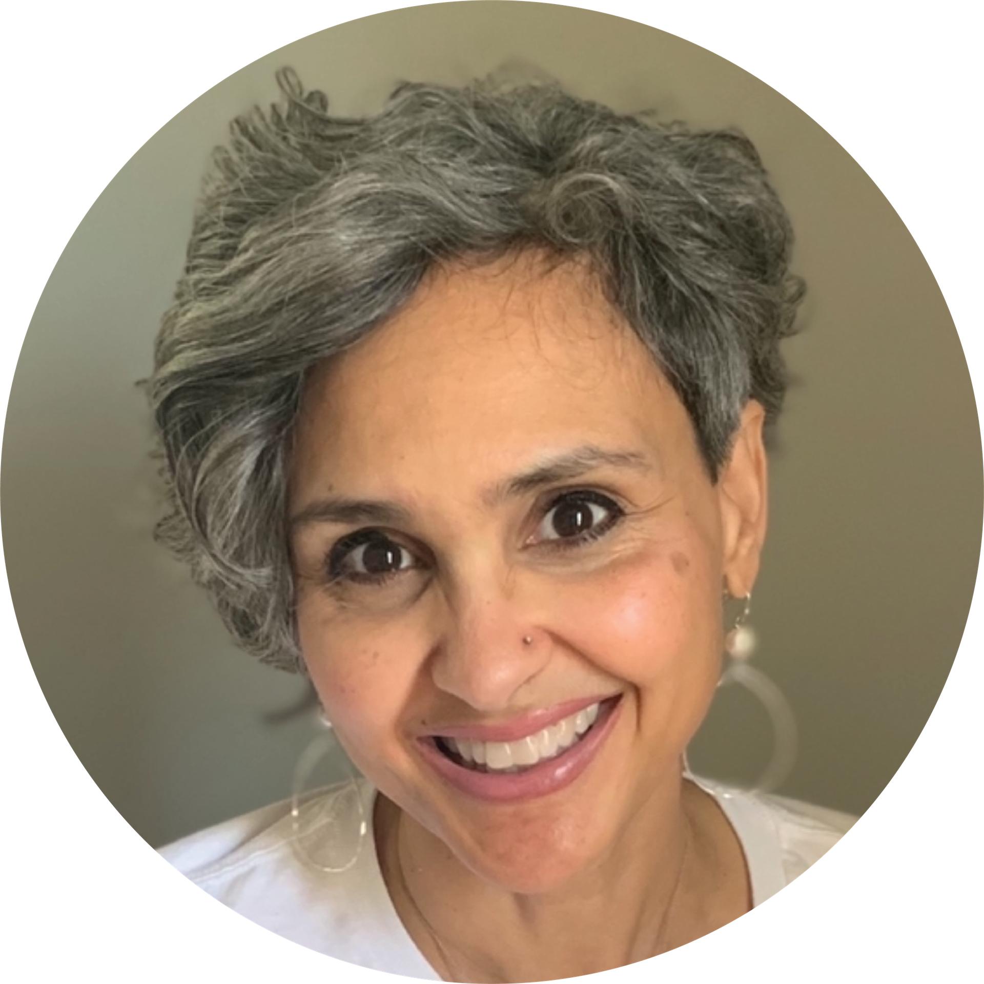
Meet our Tennessee School Counselor
of the Year:
Jacquelyn Patterson!
Jacquelyn is a former elementary and middle school educator and began her career in 1991 and continued to work in this capacity for twenty-six years.
For the past five years has served in this position with Rutherford County Schools. In addition to this role Mrs. Patterson is a Pre-licensed Professional Therapist and is working towards her clinical practice.

Slide 6
Meet our Tennessee School Counselor
of the Year:
Jacquelyn Patterson!
"I want our students to know that they matter. They have value. They have potential. They have a purpose. Likewise, they have a voice, and I am listening. Even when they are not sure how to express what they are feeling, I am here to support them, and they are never alone. It takes courage to ask for help. There is nothing weak about it, and it takes strength and determination to set goals and work towards them. Their mental health is just as important as their physical health. "Mental health is not a destination, but a process..." (Shpancer, 2010). It is an investment in yourself, and they are worth it, and I am honored to get to walk alongside their journey."

