Slide 1
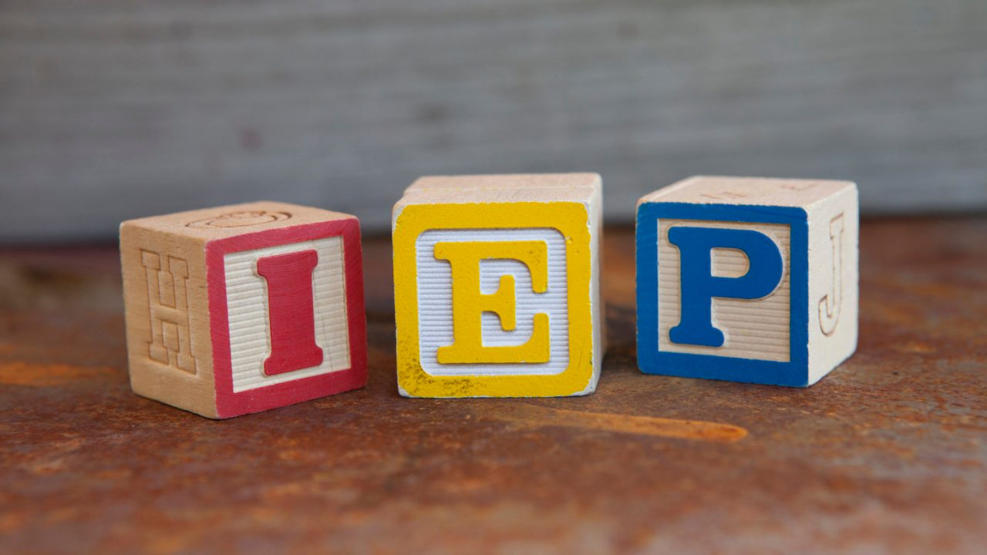
Implicit Bias in the
Presenters:
Dr. Taylor Biondi, RTI:B Coordinator
Christopher Flor, Transition Coordinator
Metropolitan Nashville Public Schools
Notes:
Chris/Taylor

Slide 2
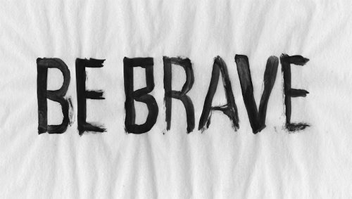
Brave Space Norms
Be vulnerable
Look to your own growth first
Accept non-closure
Take the perspective of others
Assume best intentions
Lean into discomfort/fear
Think critically
Consider impact over intent
Practice mindfulness
Notes:
Taylor

Slide 3
Participants will confidently be able to:
Explain
Explain why implicit bias and disproportionate outcomes are dangerous for students
Identify instances of implicit bias in IEP narratives and PLEPs
Identify
Prepare
Prepare to address implicit biases with their peers and colleagues
Notes:
Taylor
IEP quality - indicator
False positive/false negatives

Slide 4
“The point isn’t to get people to accept that they have biases, but to get them to see that those biases have negative consequences for others.”
–Theresa McHenry (GM HR, Marketing and Consumer Business at Microsoft)
Notes:
Taylor

Slide 5
Word Knowledge
Implicit Bias
Equity Lens
Instructionally Appropriate IEPs
Advising: Melissa Gordon and Joy Guss
MNPS Office of Diversity, Equity, and Inclusion
Notes:
Chris

Slide 6
Word Knowledge
Implicit Bias
Implicit Bias is the tendency to process information based on unconscious associations and feelings, even when these are contrary to one’s conscious or declared beliefs.
While implicit bias impacts everyone, the identities that are MOST harmed by implicit bias are people from marginalized groups, such as individuals with disabilities and Black, Indigenous, and Persons of Color (BIPOC)
Notes:
Chris

Slide 7
How do I know if I have implicit bias?
Do I have a brain?
Do I live in society?
Notes:
Chris

Slide 8
Implicit Bias can show up as...
False Positives
False Negatives
Students are identified as needing support when they don't actually need it
Students are NOT provided support, when they do in fact need it

Slide 9
Implicit Bias can show up as...
False Positives
False Negatives
A student is given more time in the special education setting than what they need
A student has skill deficits that need to be addressed in the IEP, but are not

Slide 10
Word Knowledge
The Equity Lens confirms the importance of recognizing institutional and systemic barriers and discriminatory practices that have limited access and success for many student in the education system.
The Equity Lens emphasizes historically disadvantaged students, such as out of school youth, emerging bilingual students (ELL), and students in communities of color and some rural geographic locations, with a particular focus on racial equity.
Equity Lens
Notes:
Chris

Slide 11
Word Knowledge
The result of creating a culture of equity will focus on the outcomes of academic proficiency, civic awareness, workplace literacy, and personal integrity. The system outcomes will focus on resource allocation, engagement, communications, data collection and analysis and educator hiring, preparation, and development.
-Oregon Education Investment Board
Equity Lens
Notes:
Chris

Slide 12
Word Knowledge
Instructionally Appropriate
IEP’s
An IEP is considered instructionally appropriate when measured against the TDOE IEP Rubric.
When considering implicit bias in writing instructionally appropriate IEP’s, we must consider the intersections of disability, race, class, ethnicity, sexual/gender identity, and other identities.
Applying the TDOE IEP Rubric equitably to all students is necessary to help screen for implicit bias in IEP Writing.
Notes:
Chris

Slide 13
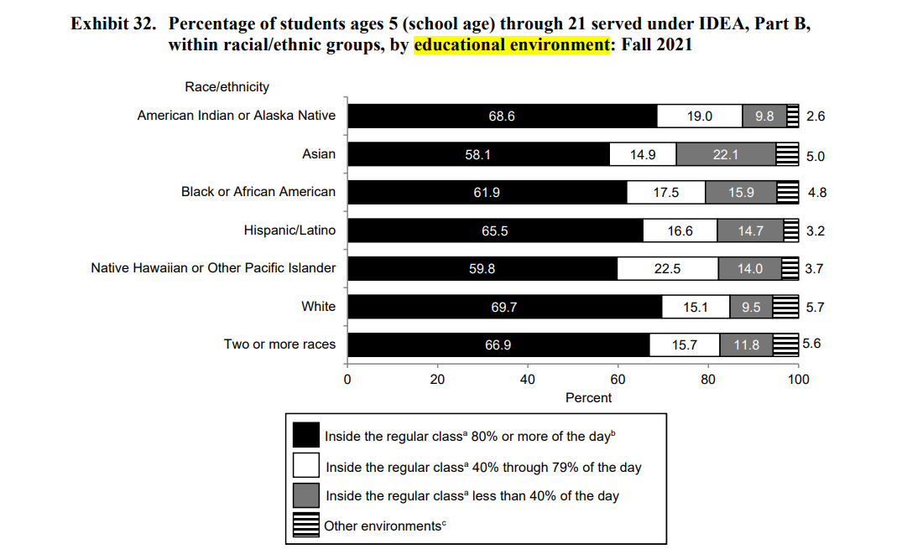
Students of color are more likely to educated in a separate environment than white students
OSEP: 45th Annual Report to Congress
Notes:
Taylor

Slide 14
Special Education Outcomes
Lower high school graduation rates
63.1% of SWD
82.3% overall
Higher unemployment
10.7% of former SWD
5.1% overall
Lower NAEP scores compared to the general population, and several subgroups
Free/reduced lunch
Race/Ethnicity
Gender
“The academic achievement of students with disabilities is abysmally low and unacceptably low… There is no positive trend across time in achievement data for students with disabilities.”
- Douglas Fuchs, Professor of Special Education and Nicholas Hobbs Endowed Chair, Vanderbilt University

Slide 15
Special Education Outcomes
Less likely to enroll in post-secondary education
55% of SWD
62% without disabilities
Less likely to live independently
36% of SWD
44% without disabilities
Less likely to have a checking acct. and other signs of financial independence
60% of SWD
71% without disabilities
Four to five times more likely to be involved in the criminal justice system, including:
Stopped by police, other than for traffic violation
Arrested
Spend a night in jail
On parole/probation

Slide 16
Hope is not lost! Inclusion works!
Time spent engaged in the general education curriculum is strongly and positively correlated with math and reading achievement for students with disabilities.
(Cole, Waldron, & Majd, 2004; Cosier, Causton-Theoharis, & Theoharis, 2013)

Slide 17
Hope is not lost! Inclusion works!
Students with autism in inclusive settings scored significantly higher on academic achievement tests when compared to students with autism in self-contained settings.
(Kurth & Mastergeorge, 2010)

Slide 18
Hope is not lost! Inclusion works!
Students with intellectual disabilities that were fully included in general education classrooms made more progress in literacy skills compared to students served in special schools.
(Dessemontet, Bless, & Morin, 2012)

Slide 19
Hope is not lost!
Inclusion works.
IEP quality matters.
But... some students are more likely than others to access inclusive supports and high-quality IEPs.

Slide 20
A Case Study from Madison, WI
2019-2020 Disproportionality Determination
Determination of Disproportionality by the WI Department Instruction (Every Student Succeeds Act criteria)
Black scholars are overrepresented in special education in the categories of EBD, ID, SLD, and OHI
Black scholars with an IEP are overrepresented in the discipline referral numbers
Black scholars with an IEP are overrepresented in more restrictive (not inclusive) settings
MMSD developed and submitted an improvement plan to DPI in mid-October and this work is a key component of that plan.
Notes:
Chris

Slide 21
A Case Study from Madison, WI
Beginning in the 2020-21 School Year
Began by reviewing randomized sample of high school students IEPs identified as having an emotional/behavioral disability who were identified by family in Infinite Campus as White or Black/Multiracial with Black as one of their races
Through statistical analysis IEPs were reviewed; Analysis team found themes; Currently reviewing middle and elementary school IEPS
Group named themselves: ARIC- Anti-Racist IEP Committee
Notes:
Chris

Slide 22
A Case Study from Madison, WI
Student Strengths in IEPs
 | Black Students | White Students
Academic Strengths | 39% | 70%
Examples: “relative academic strength in reading and writing”, “strong and independent math student”
Athletic Strengths | 37% | 14%
Examples: “very athletic”, “talented athlete”, “physically fit”
Notes:
Chris

Slide 23
A Case Study from Madison, WI
Functional Performance Information
 | Black Students | Average # of codes | White Students | Average # of codes
Negative Behavior | 88% | 8.9 | 86% | 4.5
Physical Aggression | 54% | 2.2 | 24% | 2.6
Verbal Aggression | 54% | 2.5 | 27% | 1.8
Refusal | 56% | 2.3 | 35% | 1.7
Incapable | 34% | 2 | 24% | 2.1
Notes:
Chris

Slide 24
A Case Study from Madison, WI
IEP Program Summary
Disability-Related Needs | 50% of disability-related needs written as true need (vs. deficit language)
Annual IEP Goals | High Quality | Black - 13% | White - 28%
 | No Baseline | Black - 46% | White - 52%
 | Self-Advocacy | Black - 6% | White - 47%
Specially Designed Instruction | SpEd Setting | Black - 435 mins/wk | White - 160 mins/wk
 | Black high school students eligible under EBD spend 2.7x more minutes than their white peers in the special education setting
Notes:
Chris

Slide 25
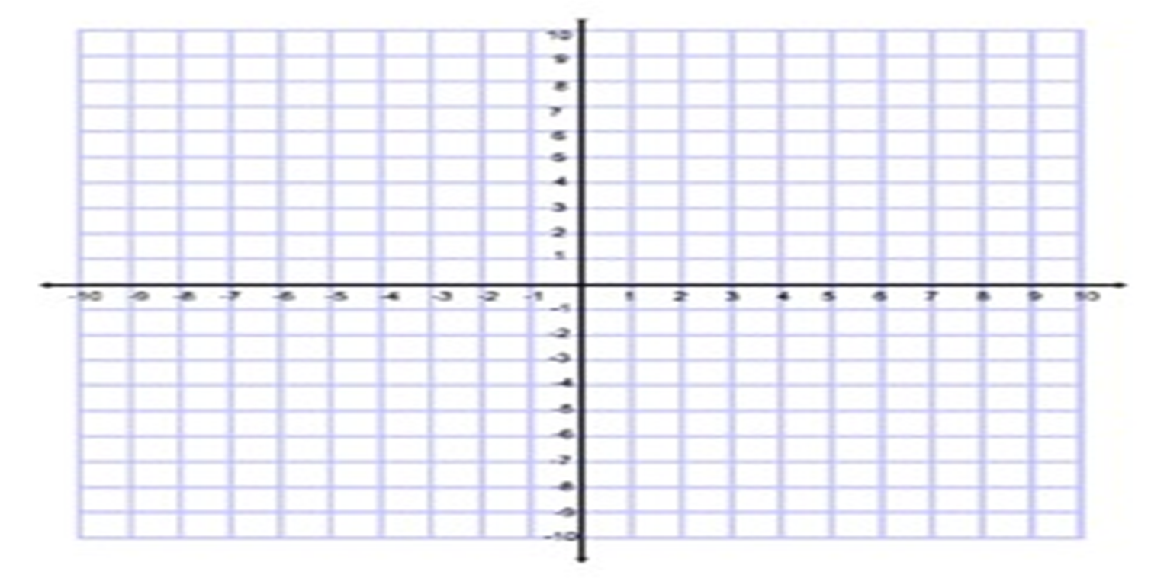
Can we separate the issue of equity from the concept of an 'instructionally appropriate' IEP?
Equitable
NOT
Instructionally
Appropriate
Instructionally
Appropriate
Inequitable
Notes:
Taylor Talking Points: We are going to be quiet for 30 seconds; ::After sensing cognitive dissonance in the room, cue animation::

Slide 26
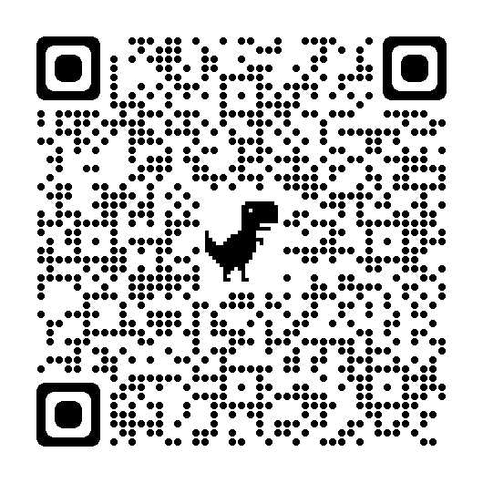
Case Studies
Follow the QR code for some IEP samples.
How do these examples reinforce the data trends that Metropolitan Madison Schools identified from their investigation?
Compare the best intentions we can assume about the teams that drafted these documents with the potential impact on students.
What inequities could be produced as a result?
Notes:
Taylor

Slide 27
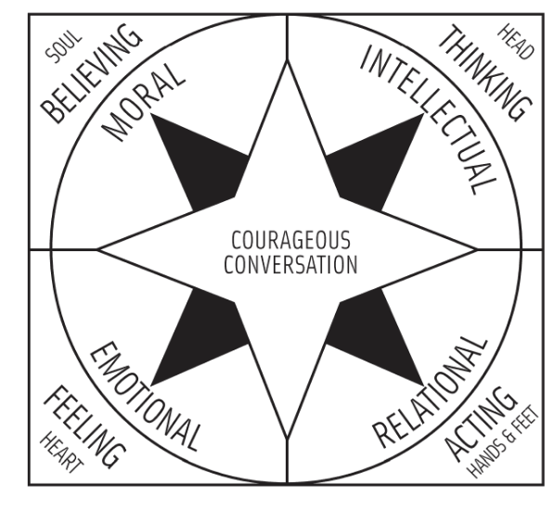
Having "Courageous Conversations" about race
Singleton, G. E. (2014). Courageous conversations about race (2nd ed.). Corwin Press.

Slide 28
INSERT CITATION FOR CC

Slide 29
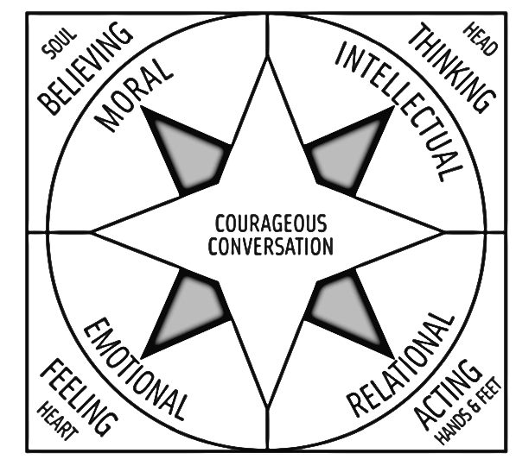
How does bias in your IEP writing expose beliefs you have about disability, race?
Do your actions align with what you say you think?
How does all this information make you feel?
Now what will you do moving forward?
Notes:
`

Slide 30
Action and Reflection
Follow the QR code to the Padlet
Choose 3 questions to respond to and add a comment
Review your peers' responses and "like" or comment
Notes:
Taylor

Slide 31
References
https://iod.unh.edu/sites/default/files/media/InclusiveEd/researchsupport-final.pdf
sites.ed.gov/idea/files/45th-arc-for-idea.pdf
About Us - Courageous Conversation

