Slide 1
Overview
Introduction
Goals
Content
Practical Application
Questions & Feedback

Slide 2
A LiTTLE bit ABOUT ME…

Slide 3
Who’s in the (virtual) room?
Good Morning, Everyone!

Slide 4
From HERE TO THERE: Building bridges for students experiencing homelessness
Dr. Kisha Napper, NCC
Educational Advocate
Special Populations Consultant

Slide 5
Session Goals
Heighten awareness about students experiencing homelessness
Understand the diversity of students’ lived experiences
Identify strategies and resources to support students experiencing homelessness in collaboration with other stakeholders

Slide 6
The basics
Don’t assume anything.
First things first
Maslow to Bloom

Slide 7
Important terminology
McKinney Vento Act (MCV)
Homelessness: MCV vs HUD
Doubled Up
Unaccompanied Youth

Slide 8
Important terminology
Immigrant
Migrant
Refugees
Unhoused, unsheltered, homeless, in transition

Slide 9
Mckinney-vento act
Children or youth who lack:
Fixed-unchanged
Regular-consistent
Adequate-sufficient by law/reasonable

Slide 10
Settings
Doubled up, hotel, motel, campground, trailer, tent, shelter, park, car, public spaces, substandard living, or similar settings
[42 U.S.C. § 11434a(2)]

Slide 11
Doubled Up By necessity
Financial hardship
Job loss/eviction/health
Domestic violence
Natural disaster
Safety issues
And more…

Slide 12
Doubled up by convenience
By Choice
Options
Access

Slide 13
What’s the issue?
Many barriers impede student success.
Distinct from poverty
Lifespan issues
Negative educational outcomes

Slide 14
What’s the issue?
Increased likelihood of homelessness (4.5)
Growing numbers
Vulnerable Subpopulations

Slide 15
Context
More than 1.5 Million children and youth have been identified as experiencing homelessness in public schools (NCHE, 2021).
Tennessee
Locally

Slide 16
Context
Regionally
Rural
Urban
Suburban

Slide 17
Subpopulations
Greater challenges
Household income
Race/ethnicity
Immigration status

Slide 18
subpopulations
Pregnancy status
Education level
Sexual orientation

Slide 19
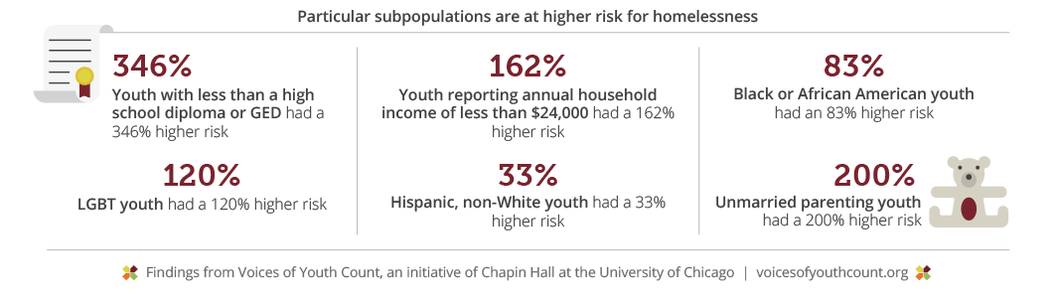

Slide 20
What’s the answer?
Education is powerful.
Education can break the cycle of homelessness.
Education is the key to helping students experiencing homelessness.

Slide 21
What’s in a name?
UNHOUSED
UNSHELTERED
HOMELESS
IN TRANSITION
Experiencing homelessness

Slide 22
Legal responsibility
Identification
Immediate enrollment vs services
Implement procedures to remove barriers for students
School stability
Best interest
Transportation
Support for Academic Success (HS & Beyond)

Slide 23
Questions for your consideration
Do you feel prepared to serve students experiencing homelessness?
What do you need to know more about to support students experiencing homelessness?
What are you doing that’s working?
What’s challenges do you have?

Slide 24
Situations and scenarios

Slide 25

I’m not just a homeless kid

Slide 26
Mental Health & SEL
(with and for students)
Please pay attention.
Communicate honestly.
Strengths-Based Approach

Slide 27
Mental health & SEL
Encourage and support
Future Story
Empower

Slide 28
Specific to Counselors (and others)
Advocate.
Maintain confidentiality.
Need to know
Commit.

Slide 29
Academic considerations
High mobility often causes academic issues.
Attendance and Truancy
Achievement and Intervention
Students can get lost in the shuffle.

Slide 30
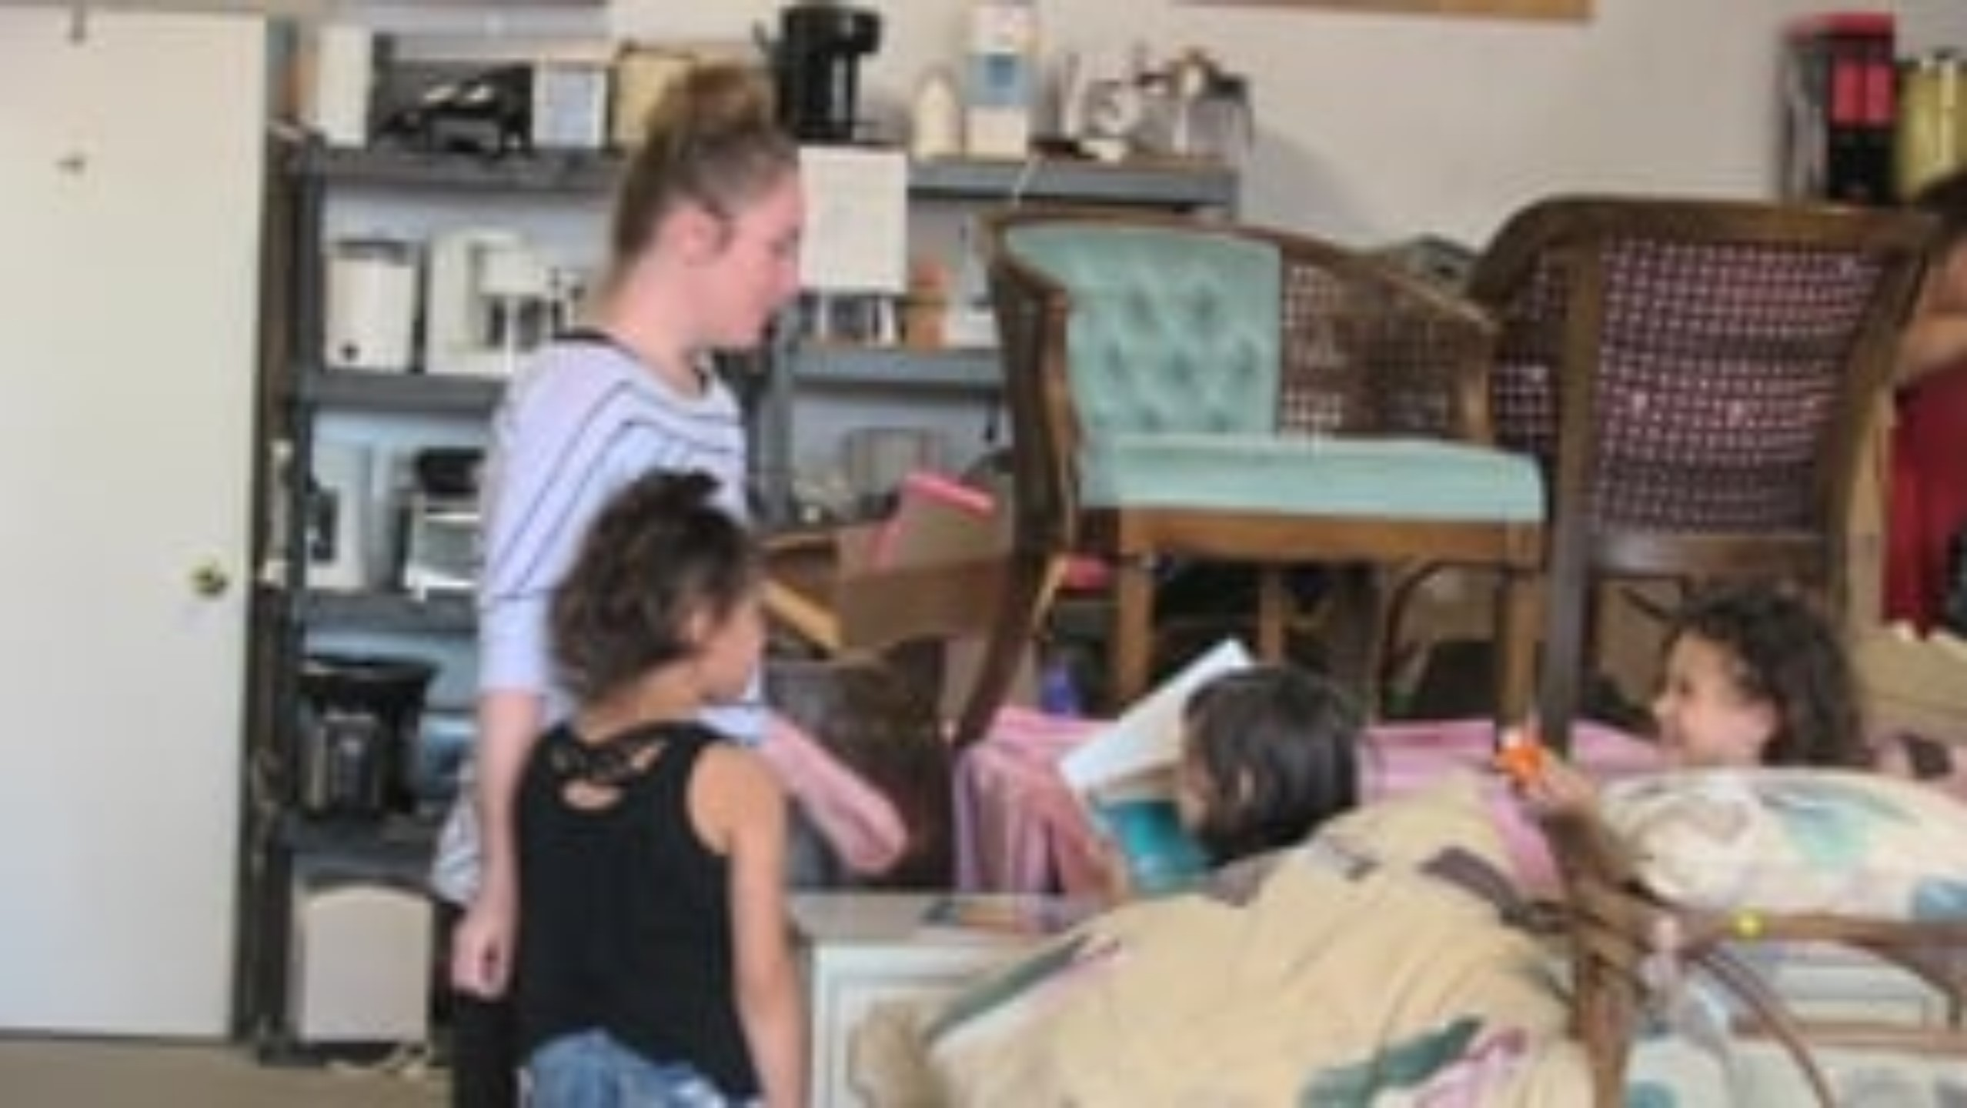
Positively homeless

Slide 31
It is important Understand the barriers associated with students’ living conditions.

Slide 32
Barriers by living situation
Homelessness is varied.
Living situations are different for each family.
Understanding is key.

Slide 34
Situations to consider
Health
Hygiene
Food
Clothing
Responsibilities
Structure
Vital documents
Transportation
Working families
Financial issues
Credit issues

Slide 35
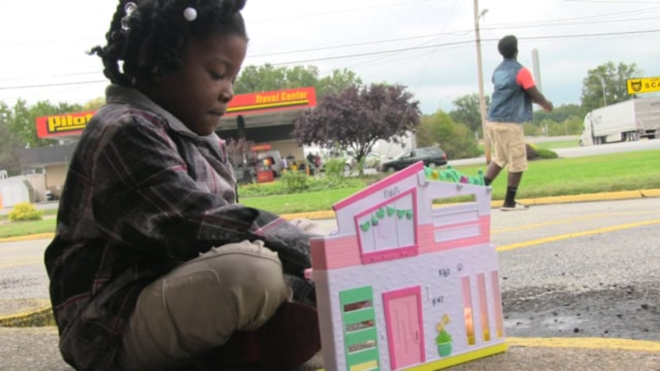
A mom’s biggest fear

Slide 36
How do we build bridges… to success?
MCV Act Requirements
Implementation
Stability and Consistency
Graduation and Beyond

Slide 37
hOw do we build bridges to success?
Collaboration
Fidelity
Equity

Slide 38
Equitable support
No identification
No access
Improve
Remove
Extra

Slide 39
It all starts here.
Identification and access
Support to succeed
Graduation and beyond
Connect to resources
Monitor progress

Slide 40
Academic Monitoring
Quarter: |  |  | School:
Student Name & Grade | Class Failed/Teacher Name | Subject Grade | SPED/RTI | Grade/Credit Recovery | Intervention Time | Teacher Strategies to Address Failing Grades

Slide 41
ABC’s of Helping
Attendance
Academics
Behavior
Coursework
Credit Accrual

Slide 42
Build a Collaborative Team
Village Thinking
Stakeholder Support
Who knew?

Slide 43
Exercise Self-care
Self care isn’t selfish.
Oxygen mask
Compassion fatigue is real!

Slide 44
Who’s on the team?
District Liaison
School Level
School Counselors (MH Support)
Teachers
Administrators
Interventionists
Bus Drivers
Community Stakeholders
Students and Families
SRO’s

Slide 45
The significance of the team…

Slide 46
Every kid is one caring adult away from being a success story.
-Josh Shipp
REMEMBER.

Slide 47
Questions and Insights

Slide 48
policy & practice
National Center for Homeless Education
Schoolhouse Connections
National Association for the Education of Homeless Children and Youth

Slide 49
Dr. kisha napper, ncc
Educational Advocate
Special Populations Consultant
connect@napperconsultingservices.com

Slide 50
