Slide 1
Charting the Course for Unique Learning Needs
Dr. Stephanie Dallmann
Supervisor of Assessments/ESL
Dr. Hannah Hopper
ESL Program Coordinator
Megan Burchfield
Multilingual Learner Accessibility Coach

Slide 2
Hamblen County
District Profile
PK-12 = 10,350 students
18 schools
700 teachers
Multilingual learners = ⅓ student population
40%
47%
15%
21%

Slide 3
Hamblen County
Why are we here today?
Data story + Population growth = Rethinking our journey
One year in—initiation and implementation
Path taken, successes, and lessons learned so far
Next steps to institutionalization

Slide 4
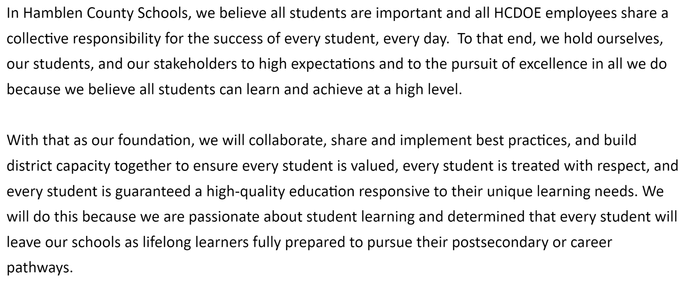
District Vision
Where we strive to be as a district…

Slide 5
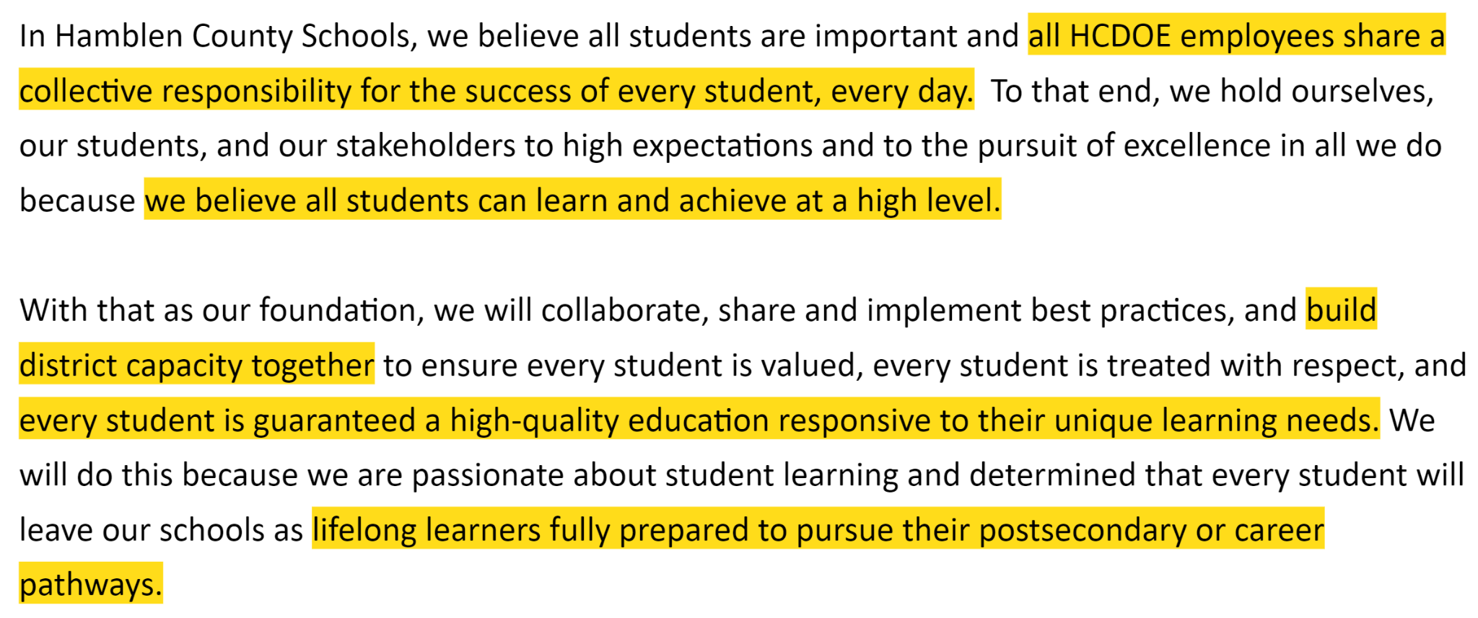
District Vision–Key Statements
Where we strive to be as a district…

Slide 6
District Vision–Leading Statements
Where we strive to be as a district…
Collective responsibility
ALL students can learn and achieve at a high level
Build district capacity together
Guaranteed high-quality education responsive to unique learning needs
Prepared to pursue postsecondary or career pathways

Slide 7
MLL Department Vision
Where we strive to be as a team…
Owning the vision
Living the vision
Empowering others through the vision
Keeping the main thing the main thing
“This is how we operate”

Slide 8
Charting the Course for Unique Learning Needs
Vision as North Star
All students can learn and achieve at a high level
Collective responsibility
Build district capacity together to guarantee high-quality education responsive to unique learning needs
Prepared to pursue postsecondary or career pathways

Slide 9
Charting the Course for Unique Learning Needs
All Students Can Learn and Achieve at a High Level
A mindset shift is needed
Approaching change
How do we approach district level change?

Slide 10
All Students Can Learn and Achieve at a High Level
Mindset
Critical Question:
Do you believe all students can learn and achieve at a high level?

Slide 11
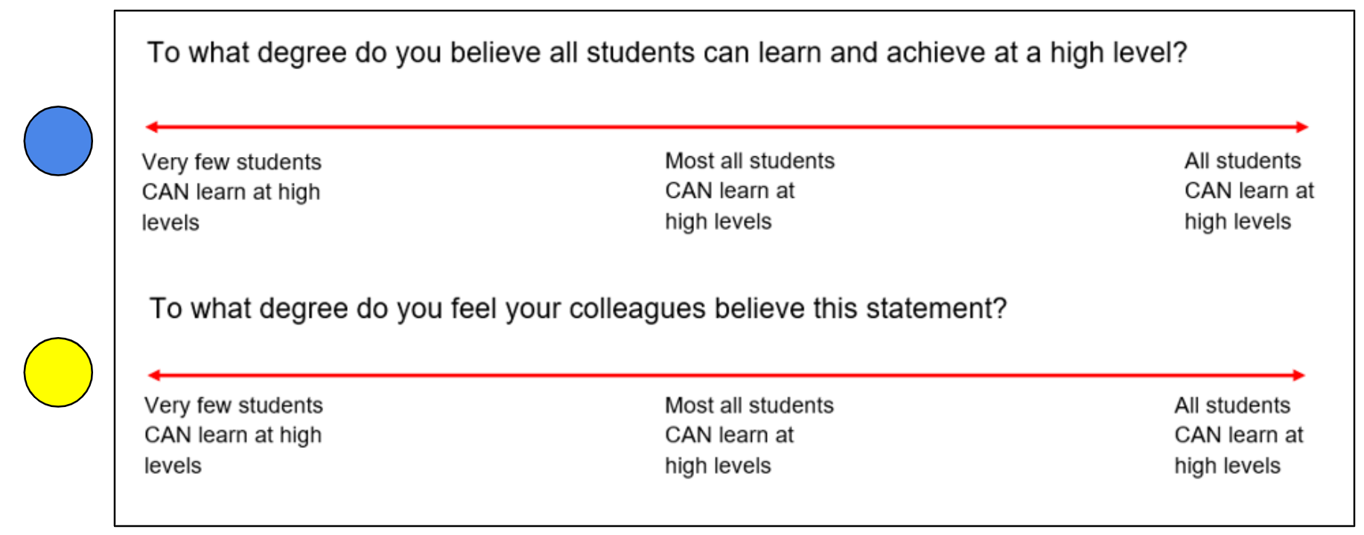
All Students Can Learn and Achieve at a High Level
Mindset
Do you believe all students can learn and achieve at a high level?

Slide 12
All Students Can Learn and Achieve at a High Level
Mindset
What does a “high level” mean here?
Reflection on beliefs and actions

Slide 13
All Students Can Learn and Achieve at a High Level
Mindset
What does a “high level” mean here?
Reflection on beliefs and actions
We should be asking this question:
Is this student going to be expected to function independently when they leave us?

Slide 14
All Students Can Learn and Achieve at a High Level
Mindset
What does a “high level” mean here?
Reflection on beliefs and actions
We should be asking this question:
Is this student going to be expected to function independently when they leave us?
If yes, grade-level expectations for all students
If not, we modify the four PLC questions and make an educational plan that is reflective of the unique learning needs of the student.

Slide 15
All Students Can Learn and Achieve at a High Level
Mindset
You cannot force a mindset change
What is the proper way to approach a mindset that is not aligned to the vision?

Slide 16
All Students Can Learn and Achieve at a High Level
Mindset
You cannot force a mindset change
What is the proper way to approach a mindset that is not aligned to the vision?
Ignore it
Tackle it
Tackle them

Slide 17
All Students Can Learn and Achieve at a High Level
Approaching Change
How do we reach institutionalization?
How do we respond when we hit an implementation gap?
Cultural vs. technical
Change in culture
Change in structure
Skill vs. will
Identifying the challenge
Is there a lack of knowledge/skill?
Is there a lack of understanding around the “why”?

Slide 18
Charting the Course for Unique Learning Needs
Collective Responsibility
Mindset
Goals
Strategies

Slide 19
Collective Responsibility
Mindset
Shift to collective responsibility
“All HCDOE employees share a collective responsibility for the success of every student, every day.”
Planting seeds
How can we plant seeds of change throughout the district?
Highlighting strong instructional practices

Slide 20
Collective Responsibility
Long Range Goal Approach
Where do we want to be at the end of three years?
These goals inform the planning process
Backward Design
Where do we want to be?
What steps will we take to get there?

Slide 21
Collective Responsibility
Entry Points
Year One
Year Two
Year Three
Streamlining processes throughout systems and years

Slide 22
Collective Responsibility
Goals
Data driven
Audaciously attainable goals
Using data to improve, not to prove
Monitoring progress
Kramer, S. V., & Schuhl, S. (2023). Acceleration for all: A how-to guide for overcoming learning gaps. Solution Tree Press.

Slide 23
Collective Responsibility
MLL Goal
Goal: Increase MLL student achievement to 50% by end of SY25-26
MLL group = Hispanic + Pacific Islander
EL student group

Slide 24
Collective Responsibility
High Leverage Strategies
Coalescence around vision
Building capacity
Acceleration
Differentiated supports
Targeted professional learning

Slide 25
Charting the Course for Unique Learning Needs
Build Capacity Together to Respond to ULN
Coalescence around vision
Acceleration
Differentiated supports
Targeted professional learning
Unique Learning Needs Institute

Slide 26
Building Capacity Together to Respond to ULN
Vision and Acceleration
Acceleration is “living the vision”
Systematic process of bringing all student learning to grade level or beyond
Planning for proficiency for all
Applying strategic scaffolds during intellectual preparation
Aligns all systems we have in place

Slide 27
Building Capacity Together to Respond to ULN
Differentiated Supports
Providing individualized supports to schools, principals, and teachers based on what they need to live the vision for acceleration for all
Several offerings of professional learning that is focused on meeting the needs of multilingual learners
Math, Science, Social Studies
Accessibility add-on walkthrough tool to support IPG tool
Scheduling support
Coaching, co-planning, and co-teaching

Slide 28
Building Capacity Together to Respond to ULN
Targeted Professional Development
Unique Learning Needs (ULN) Institute
Data story for these two student groups
Offered twice during the summer
Two pathways
Supporting Instruction for Students with Disabilities
Supporting Instruction for Multilingual Learners
Overlapping sessions, including dually identified students

Slide 29
Building Capacity Together to Respond to ULN
Targeted Professional Development
MLL Cohort
Accelerated path offered to all district teachers and administrators
Focused on building and applying knowledge of linguistic development to content planning and instruction
Introduction to WIDA ELD Framework entry points
Summer 2023: 33 participants completed training

Slide 30
Building Capacity Together to Respond to ULN
Targeted Professional Development
MLL Cohort
Summer 2024: Expanding offerings and blending acceleration with WIDA ELD Framework
One-on-one coaching support and custom professional development throughout the year
Offered as an accelerated pathway to earn ESL add-on licensure through primary partnership with local university

Slide 31
Building Capacity Together to Respond to ULN
Targeted Professional Development
2024 EL Literacy Summit
May 2024: Professional Development
Maximizing embedded professional learning opportunities
Intensive literacy focused training in response to current needs
Strengthening academics through accelerated literacy instruction

Slide 32
Charting the Course for Unique Learning Needs
Prepared to Pursue Postsecondary or Career Pathways
Counseling work
College and Career Readiness

Slide 33
Prepared to Pursue Postsecondary and Career Pathways
Counseling Work to Ensure College and Career Readiness
Data story for CCR and Ready Grad
Partnering with CTE department to align goals to improve opportunities for MLL and SWD
Increase opportunities in scheduling
Targeting MLL cohort participation with CTE teachers
Expanding co-teaching opportunities for ESL teachers through CTE courses (focus on access)

Slide 34
Next Steps
Stay the Course
Measure, monitor, and adjust; repeat
Continue to build upon existing structures
Acceleration through ULN Institute
Expansion of the MLL Cohort
Continued professional learning around ULN throughout the year

