Slide 1

Reach for the Stars
How Writing Can BOOST All Areas of English Language Development
Sunita Watson, Teacher of MLLs

Slide 2

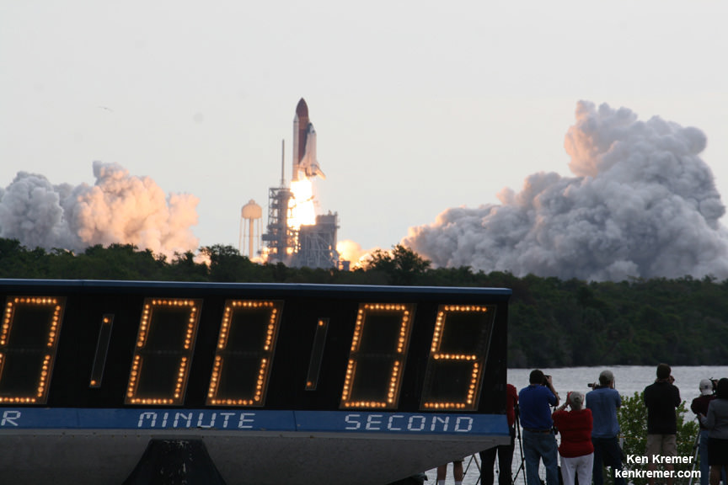
Countdown (session objectives)
In this session, we will:
Examine
Examine our own attitudes about writing
View
View examples of daily and periodic student writing in the multi-lingual classroom (spotlight)
Write
Practice writing
Adjust
Adjust attitudes about writing
This Photo by Unknown Author is licensed under CC BY

Slide 3


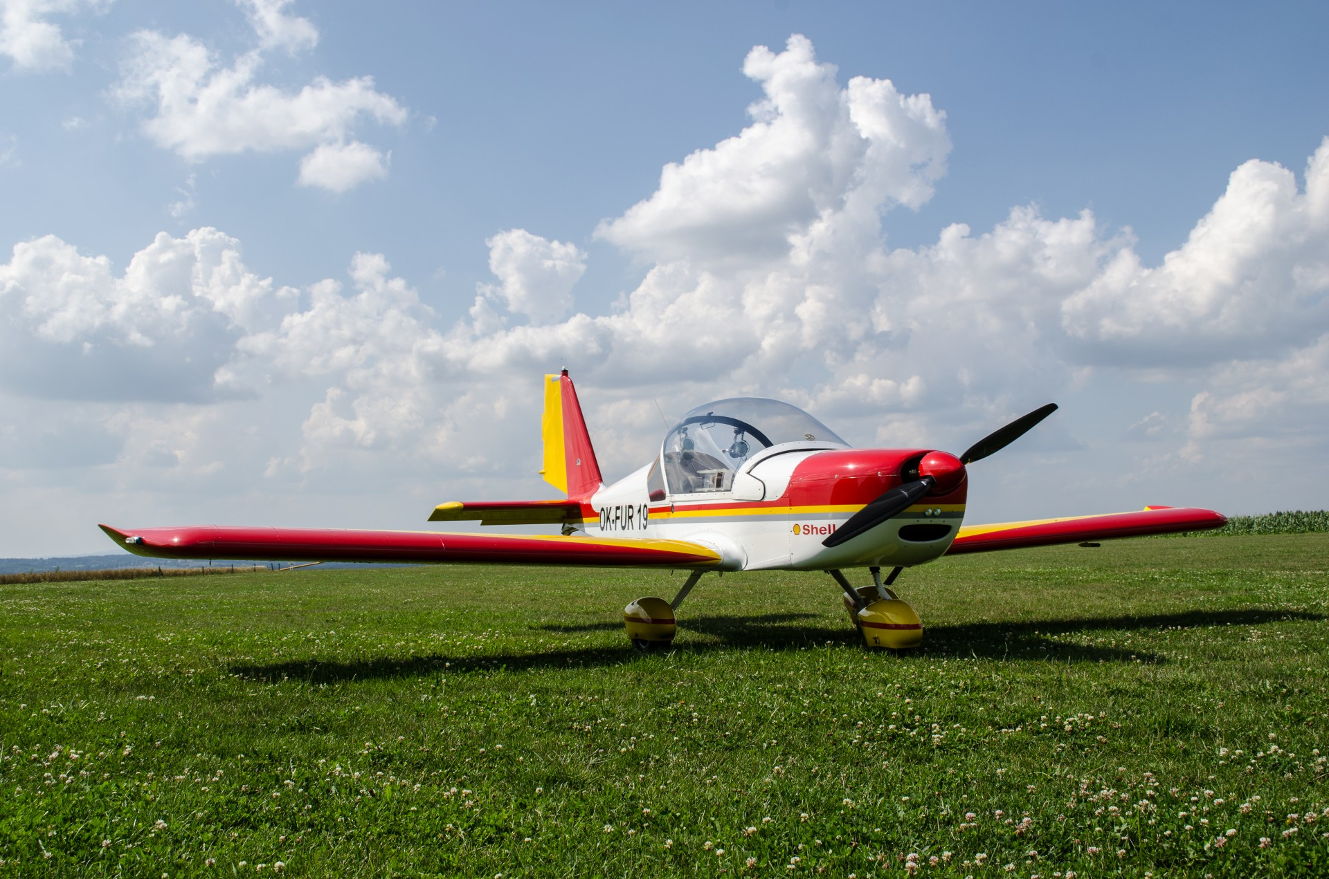
Grounded –parking lot: Writing Attitudes
Directions:
Choose a parking lot that best identifies your current writing attitude.
Write your name on a sticky note and “park it in the lot.”

Slide 4
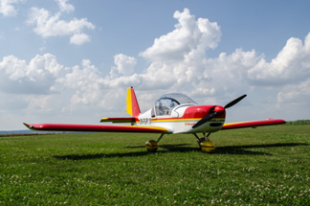
Grounded –parking lot: Writing Attitudes
I love to write, and I love to teach writing!
I like to write, but I don’t really like to teach writing.
I don’t really like to write, but I am OK at teaching writing.
I don’t like to write, and I don’t like to teach writing.
I’m not comfortable about writing, but I’m willing to learn!

Slide 5
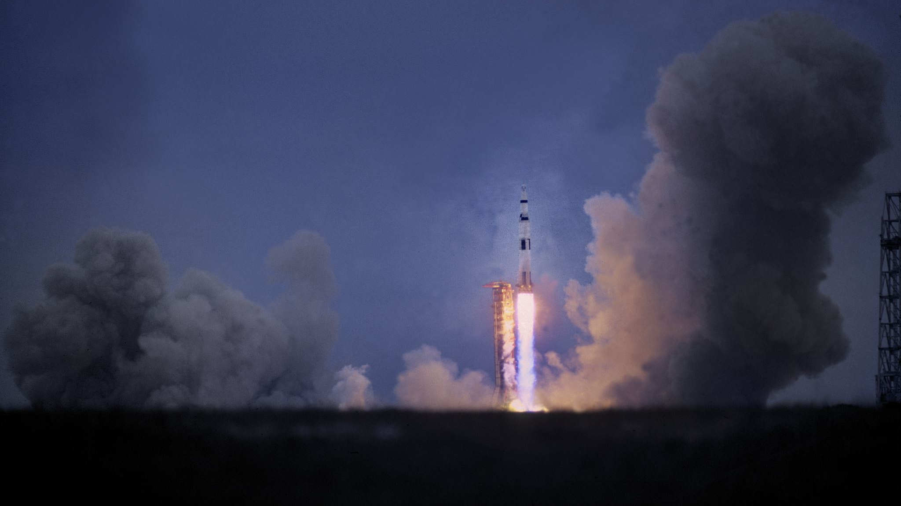

Rocket booster—what drives my thinking

Slide 6

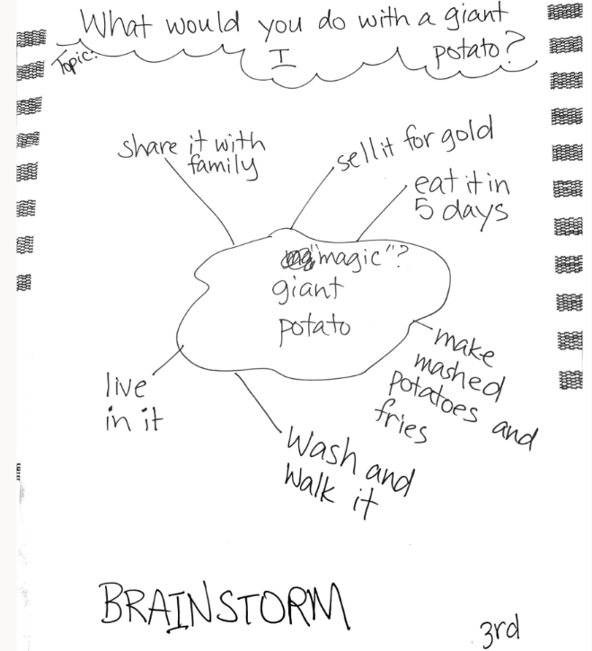
Student Samples:
BRAINSTORMING

Slide 7
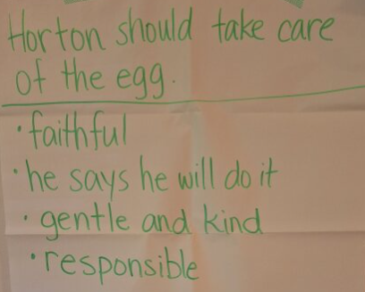
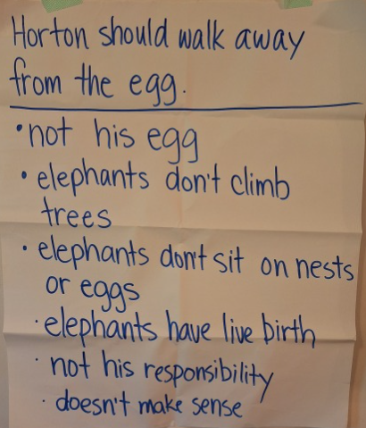

Student Sample: OPINION WRITING

Slide 8
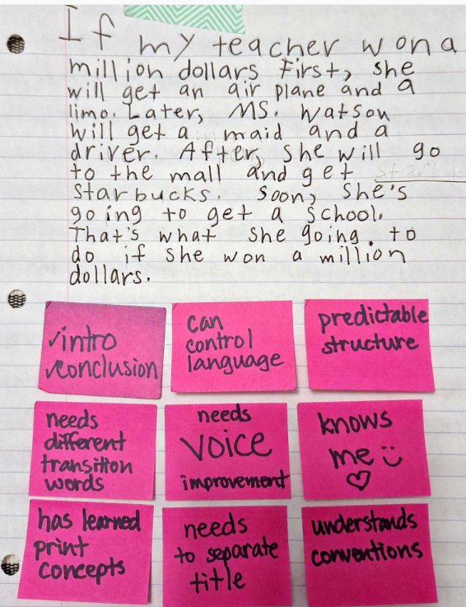

Student Samples:
DAILY JOURNAL
PROMPTS

Slide 9

Student Samples: JOURNAL PROMPTS:
The Polar Bear Rescue Story Phenomenon
January Journal Prompt Choice:
There is a new polar bear at the local zoo with an amazing rescue story.
Write that story.

Slide 10



Student Samples:
The Hungry Games

Slide 11
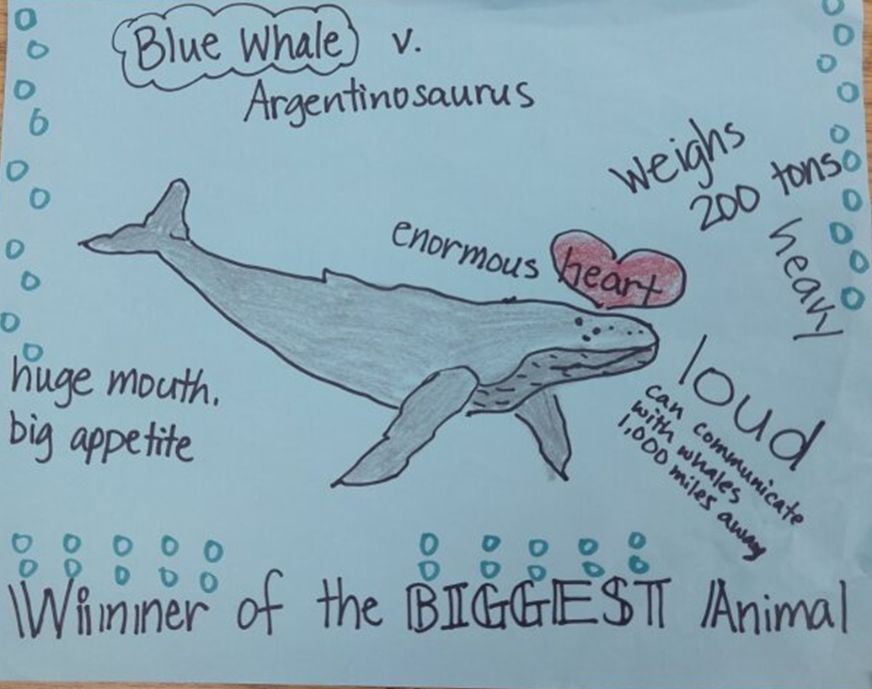

Who is the winner? Make a main idea/key details poster.
Your poster should have:
Title/main idea
At least 5 key details
Location (district)
Picture
Neat
Colored/attractive

Slide 12
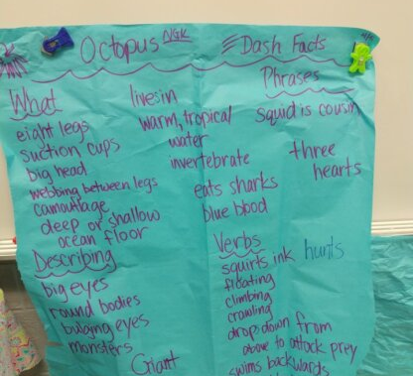

COFFEE HOUSE &
POETRY READING:
DASH FACTS
We need lots of words—words to choose from and to throw away!

Slide 13



Dash Facts
How-to
Watch
Re-watch: stop & chunk
What is the main idea?
What are key details? (grammar)
What are interesting words?
Chart: Teacher writes; students talk

Slide 14
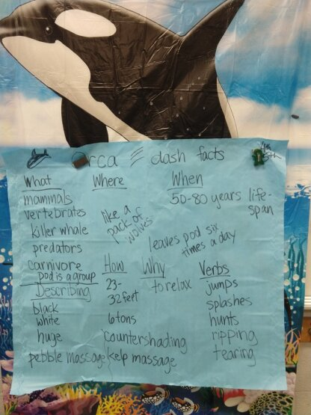

We use poetry templates to write:
A class poem together
Students’ individual poems
Poetry types used:
5Ws Cinquain
Shape Limerick
Haiku Couplet
Diamante
Couplet
We need lots
Of words!!

Slide 15
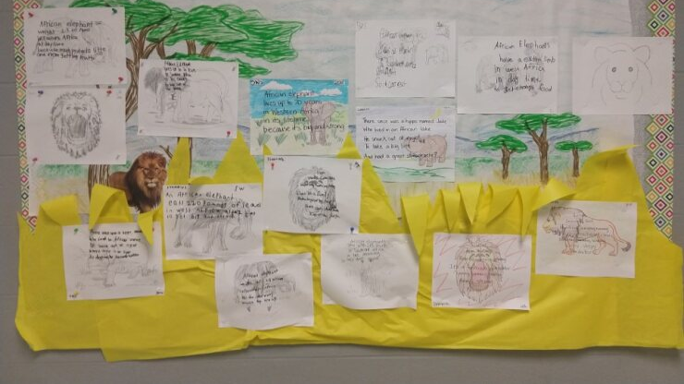

Students succeed and celebrate!

Slide 16

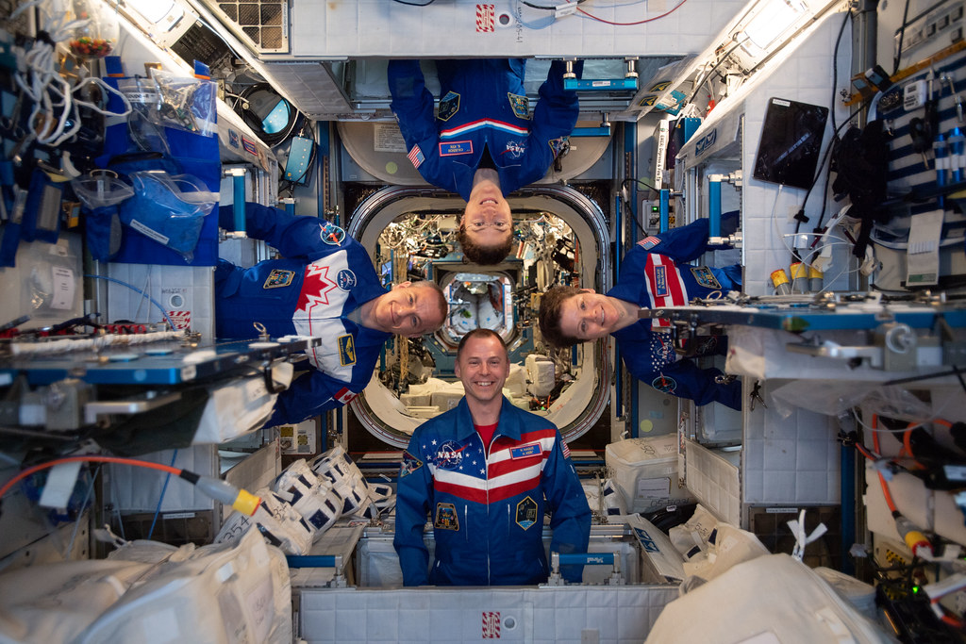
Astronauts in training:
Model &
Instructions
This Photo by Unknown Author is licensed under CC BY-NC-ND

Slide 17
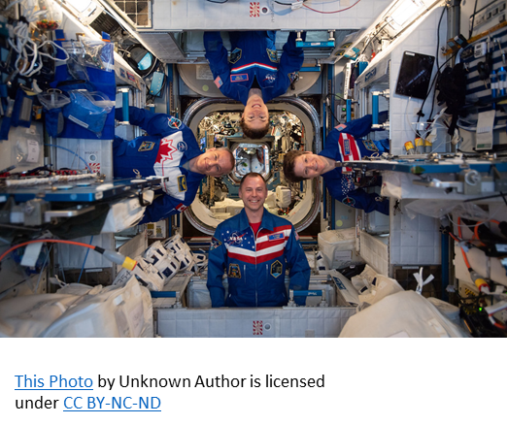
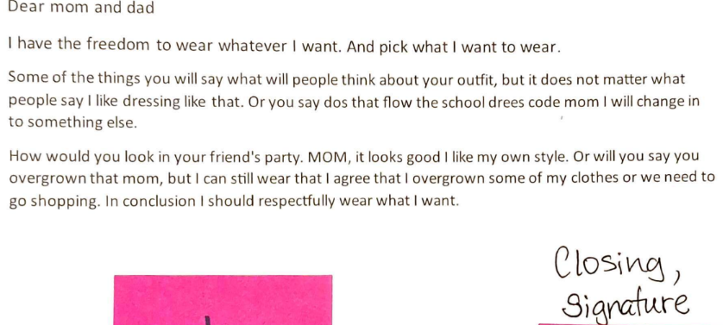
In the SPACE SHUTTLE
Online group

Slide 18
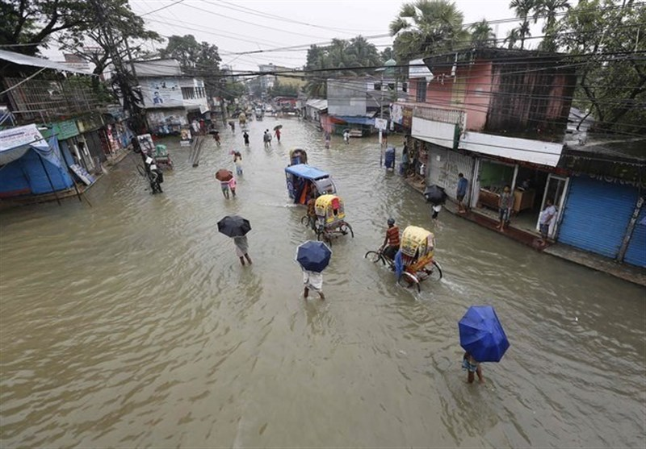



In the Space Shuttle: Quick Writes
What do you notice?
What do you wonder?
Have you experienced flooding like this?
Explain your experience.

Slide 19



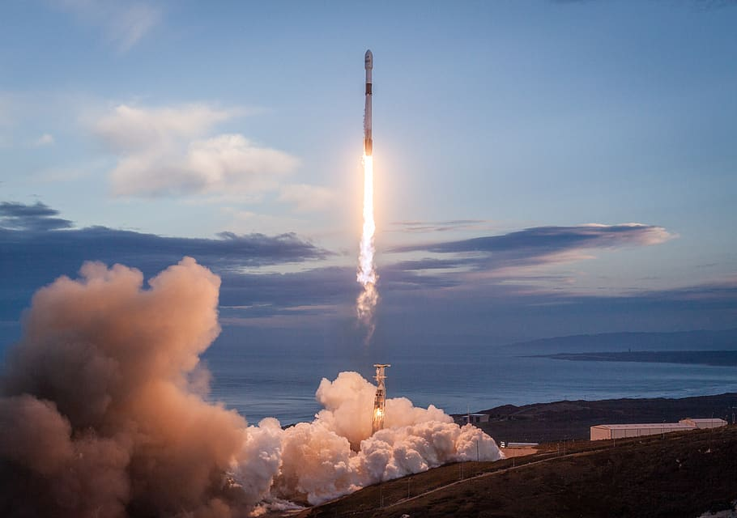
Houston, we are ready for liftoff!
How have your writing attitudes changed?
If there was a change, what was it, and why do you think it changed?
What would you like to do differently?
Share!

Slide 20

Mission Accomplished!
Sunita Watson
watsonsu@rcschools.net
X@Sunita_Watson

Slide 21
Resources Consulted
Gibbons, P. English Learners, Academic Literacy, and Thinking: Learning in the Challenge Zone. Heinemann Educational Books, 2009.
National Geographic Kids: Animal Showdown.
https://kids.nationalgeographic.com/videos/topic/animal-showdown
Sesame Street: The Hungry Games – Catching Fur (Hunger Games Catching Fire Parody)
https://www.youtube.com/watch?v=eT7nD02Im5E

