Slide 1
Supporting Student Socially and Emotionally
Courtney Lee, Ed.S., Special Education Teacher

Slide 2
“We don’t just teach. I don’t care if you’ve been in it 20 years or 5 years, you understand your role is an advocate for your students.”
-Dr. Christine Tennyson
Notes:
One of my favorite parts of being an advocate is teaching our students how to be an advocate for themselves and them being able to control emotions and talk through those rough parts is a HUGE part of the process for self-advocating

Slide 3
SEL
Lessons that are meant to teach skills such as:
  Social
  Emotional
  Attitudes
  Behavior
  Values
Notes:
Alphabet Soup Joke Here

Slide 4
Agenda
Elementary School
Middle School
Useful Accommodations
Notes:
Bulk will be in Elementary School
Just a touch in Middle School, the main strategy that I have seen used successfully
Some Accommodations that will help our students who are struggling socially and/or emotionally within the classroom

Slide 5
Elementary School

Slide 6
Types of Support
Small Group Pull Out – Morning and Afternoon
Core Support in General Education – focusing on specific students that need social emotional support

Slide 7
Morning Small Group
Happens at the very beginning of the day
15 – 30 minutes
Includes:
  Calendar
  Weekly Book/Social Story/Video Clip Activity
  Token Reward

Slide 8
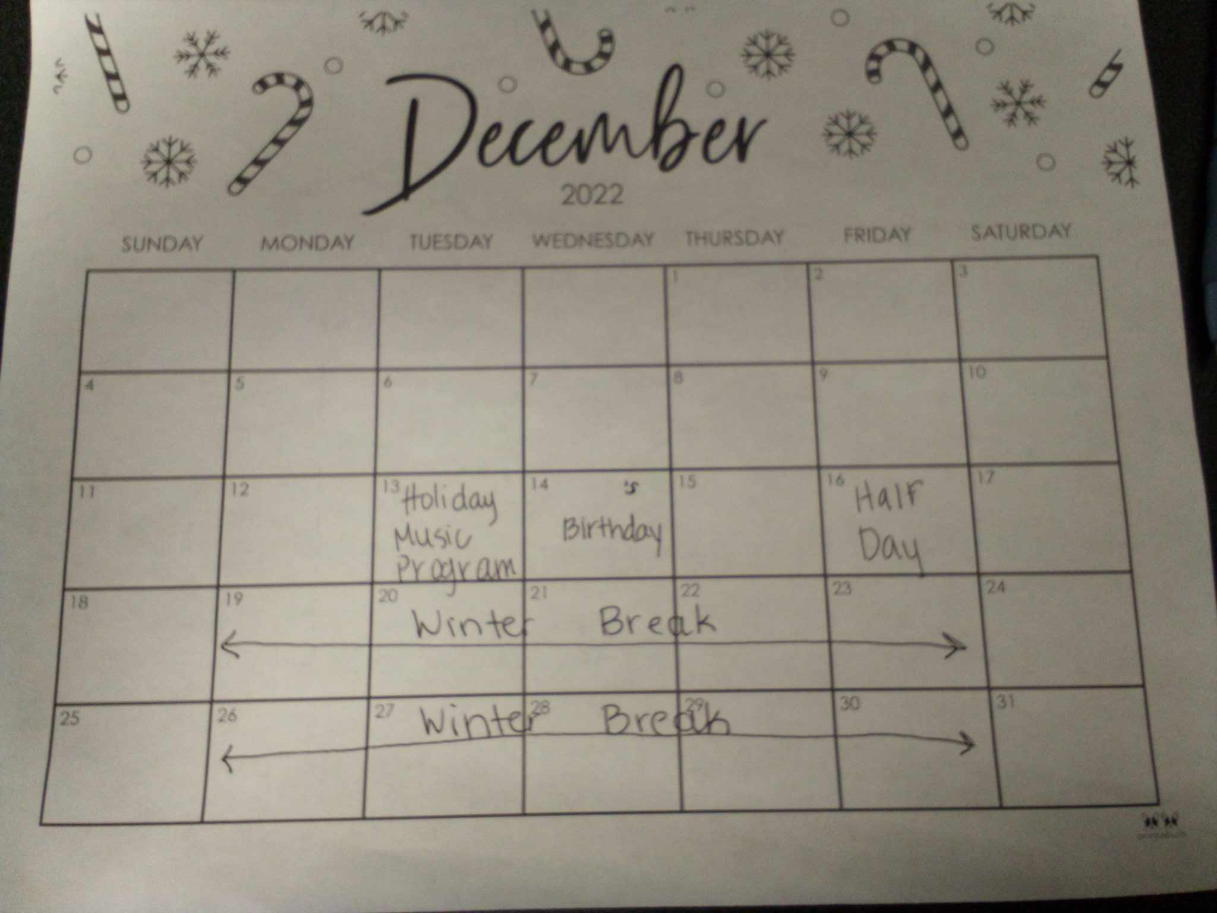
Beginning of the Month Calendar

Slide 9
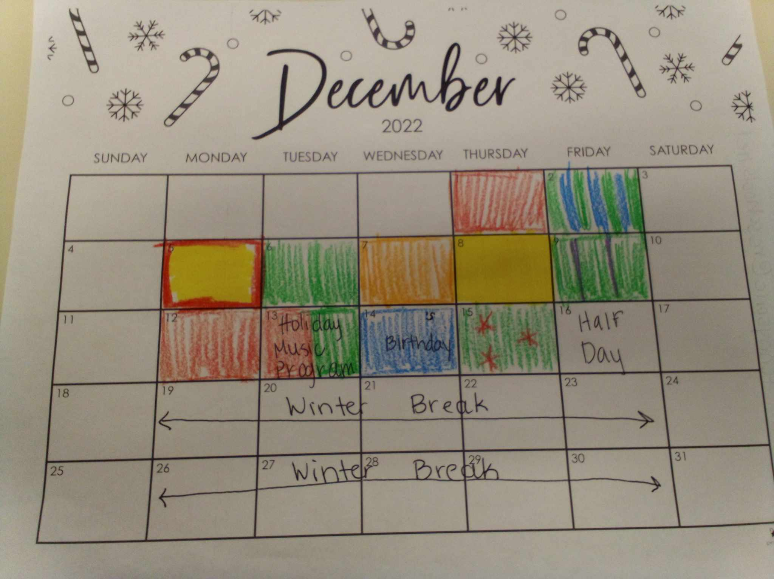
End of the Month Calendar
Notes:
Colors – most students associate some type of color with emotion whether that be a program that they have been taught before, or from seeing a movie where emotions are a particular color
Start with your basic colors, Talk about the feelings associated with each of those colors. If your school uses something that already talks about colors and emotions then stay on track with them.
As you get to know and learn your kids, give them more freedom – when we let students have the freedom to pick their colors, they have more buy in with the group
We all have those students that will keep us on our toes and tell us rainbow
After students color their square for the day, go around the table and have them tell the group what color they are, the feeling associated with it, and why they have that feel, “I’m blue today, because I’m sad, because I miss my mom.” “I’m rainbow, because I’m feeling all mixed up. Pick one color you feel and tell me. Pink, because my mom loves me.” “I’m purple, it’s my favorite color, and I’m happy and purple makes me happy.”
As we are going around the table, this often opens up other smaller more natural teachable moments, such as turn taking and not interrupting others

Slide 10



Notes:
Think about these colors, give me a feeling that you could uniquely associate with one of the colors

Slide 11
December 2023
 |  |  |  |  | 1 | 2
3 | 4 | 5 | 6 | 7 | 8 | 9
10 | 11 | 12 | 13 | 14 | 15 | 16
17 | 18 | 19 | 20 | 21 | 22 | 23
24 31 | 25 | 26 | 27 | 28 | 29 | 30
Notes:
I encourage all of you to take a calendar with you and fill it out for the rest of the month. I fyou recognize how you are felling each morning, what could you change to make the day better?

Slide 12
Weekly Book/Social Story/Video Clip
Day 1 – Watch Clip or Read Book
Day 2 – Talk about the main message in the clip or book
Day 3 – Color Page with sentence starter
Day 4 – Direct Questions about the clip or book
Day 5 – What Feels Right
Notes:
Used the same one all week
Make sure that it is something the students are relating to. You can find clips from shows that are relevant to the students. You can find books that have characters the students enjoy

Slide 13


Slide 14








Token Reward
Notes:
Extrinsic Motivator – sometimes I need one myself, if I finish this part of my IEP, then I can read a chapter in my book.
Taped on my wall, at the end of every group time they were with me, smiley each time if they earned it
Asked Were you responsible, were you respectful, were you ready to learn?
If not spoke very briefly about what was wrong and/or what could have been done differently
If they forgot smiley or wrote it on someone else’s chart, they didn’t get it
Teaches decision making, responsibility, saving, empathy (donating to a friend)
Treasure levels: 5, 10, 15
Buy any day, as long as it was asked for appropriately and not in the middle of lesson

Slide 15
Afternoon Small Group Structure
Start with the question: How was your day?
Pass around a sheet of paper with the date in the middle and let them write one word to describe their day
Play a board game, card game, or social game
Notes:
A lot of times, we will know perfectly well how a particular student’s day went, but we need to make sure to let them have a voice.
If they give you an answer that may not be the most truthful then you can always follow up with a questions like “Did you have anything that frustrated you?” or “Was there something you were upset about today?”
Always participate, and be truthful to an extent.

Slide 16








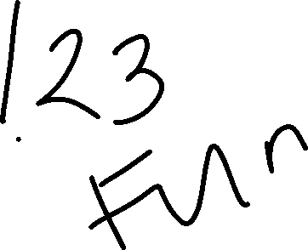
Notes:
I didn’t have many students in my end class, so we always did half a sheet and I always let them write their own in any color and any writing utensil they wanted
In the beginning of the year, I would let the students use the same word and easy words such as “good” as the progressed I would tell the students to find a better word and that they could not use the same as their peers
Hung on the wall all week

Slide 17
Why Games?
Encourage Turn Taking
Losing in a controlled environment
Team Work
Critical Thinking
Following Rules

Slide 18
Core Support
Teaching students to use the calm down corner
Assisting with Occupational Therapy devices that might be present
Recognizing when students are getting frustrated or angry
Assisting with use of calm down techniques at their desks
Removing students from classroom as a last resort
Notes:
When this happens can be different for every student. What part of the curriculum does the student struggle with. Is there a pattern for the time of dayt he student is struggling?
Some students may need something such as a compression vest for times of high emotions, helping the student to recognize when they need, how to properly ask for it, and how to properly use it
When you recognize that a student is frustrated or angry, try to speak to them. I see that you are balling your fist, closing your eyes, laying your head down, etc. Are you frustrated? Are you mad? Can I help you? Help the student to recognize signs that they are getting frustrated so they can them advocate for themselves to use the calm down corner, the OT devices, a simple sensory device at the desk
Ask them if they have recognized other examples of students having a tell they are getting frustrated or upset
Calm down techniques that I have used with success at their desks are – sensory stickers or sensory bottles

Slide 19
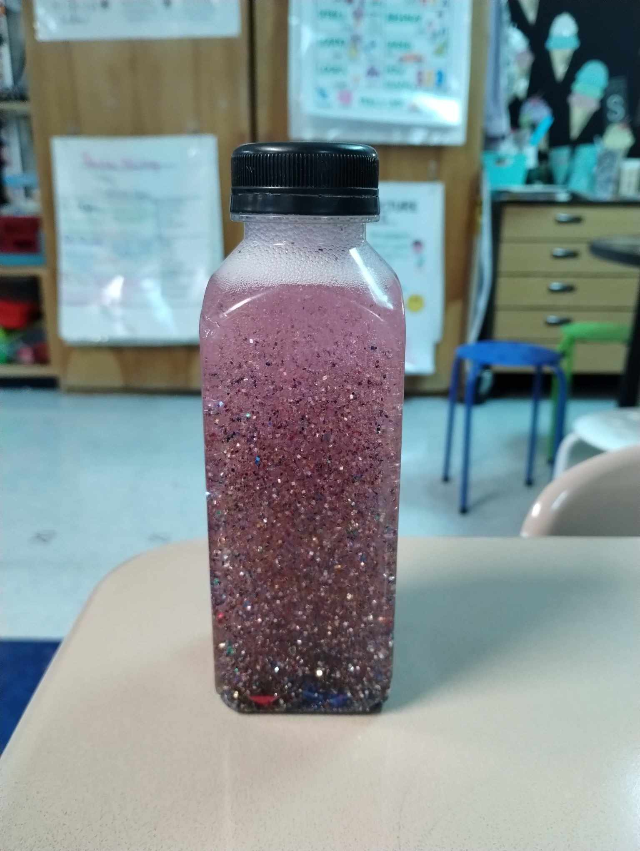
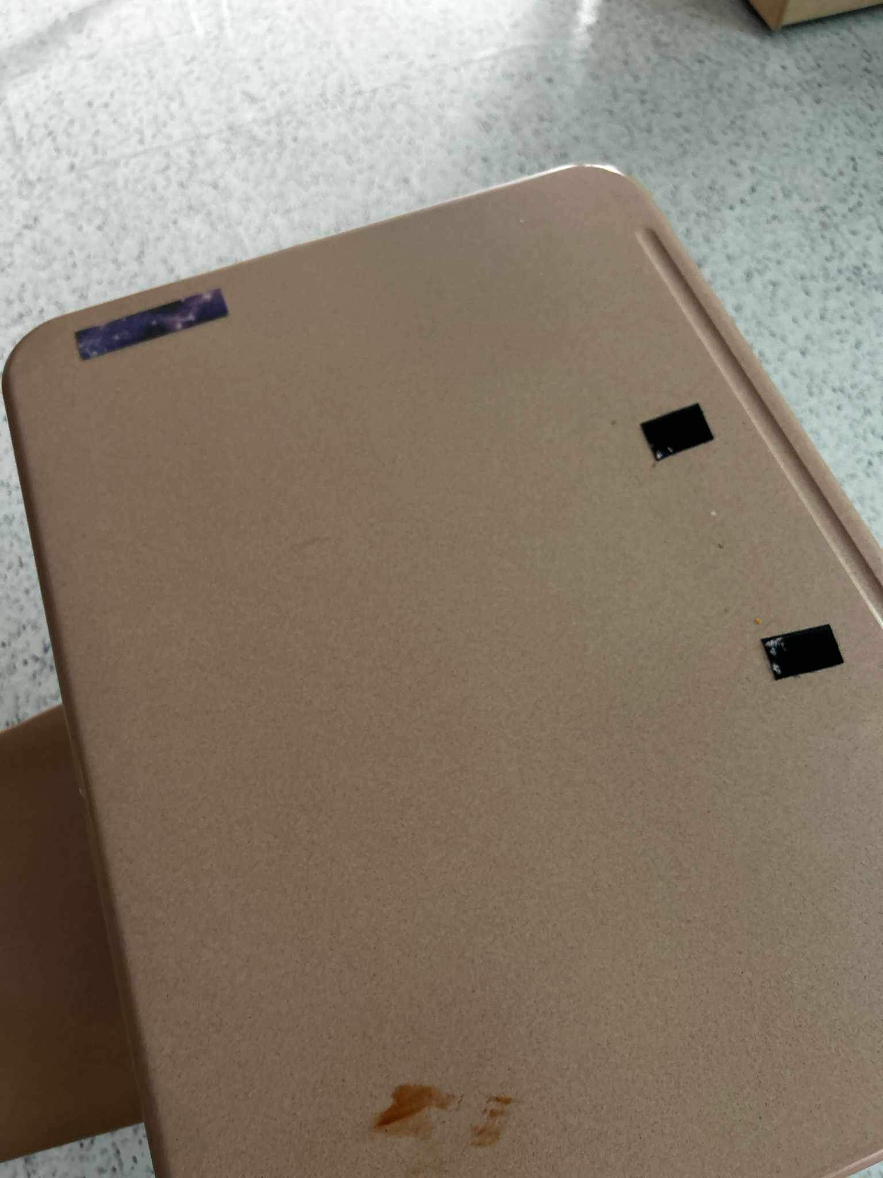
Notes:
Sometimes with my little ones, it take me doing hand over hand with them and touching the strip to remind them it is there to use
Sensory bottles – don’t have to be bought, they can be made, all kinds of things can be added to personalize, tutorials all on line

Slide 20
Middle School
Notes:
7th grade is the hardest year – and arguably my favorite age to work with. So much attitude yet so much potential

Slide 21
Types of Support
One to one
  Check In
  Check Out
Core Support

Slide 22
Check-In
At the beginning of the day during arrival – 5 minutes
  A goal for the day
  Homework
  Perceived difficulties
  Review of previous day

Slide 23
Check-Out
At the end of the day during dismissal – 5 minutes
  Review goal for the day
  Ask what to complete for homework
  Good experience
  Bad experience

Slide 24
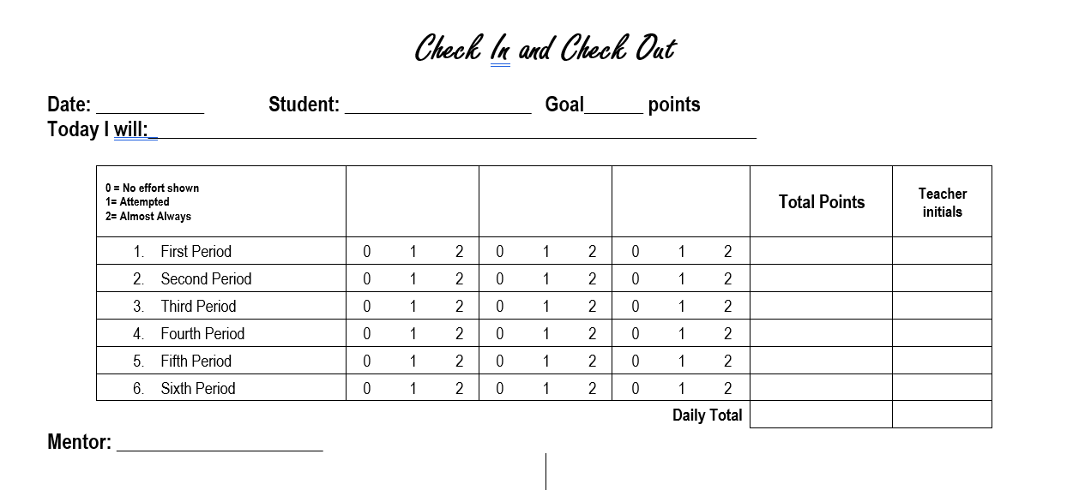
Notes:
Paper or digital
Edit it to be particular to the student, made the columns to reflect IEP goals
Can be used to help foster responsibility

Slide 25
Core Support
Recognizing when students are getting frustrated or angry
Prompting
Notes:
Very similar to Elementary school, but a few tweaks for age appropriateness
Help the entire class – try not to single students out

Slide 26
Useful Accommodations

Slide 27
Examples
Sensory Tools
Breaks
Chunking Assignments
Notes:
With any accommodation, the key is to, as a team come up with an operational definition for the particular student – and then to edit that definition as the need arises

Slide 28
Sensory Tools
Strips
Bottles
Seats
Bands
Fidget Toys
Notes:
Do your students automatically know how to use these?
Do you have to teach them they are a tool NOT a toy?
Typically fidget toys stay in a designated area

Slide 29
Breaks
Within the classroom
With a partner teacher
Simple Walk
Notes:
Different for ES and MS

Slide 30
Chunking Assignments
Folding paper
Odds/evens
Cutting assignment apart

